Slide 1
Essential Question:
What caused World War II?
What were the major events during World War II from 1939 to 1942?
Warm Up Question:
Notes:
46a - examine the impact of the war on science, art, and social thinking by identifying the cultural significance of Sigmund Freud, Albert Einstein and Picasso
46b - determine the causes & results of the Russian Revolution from the rise of the Bolsheviks under Lenin to Stalin's first 5 Year Plan
46c - characterize the social, economic, and political climate of the post-World War I world that led to favorable conditions for totalitarian regimes
46d - describe the rise of fascism in Europe and Asia by comparing the policies of Benito Mussolini in Italy, Adolf Hitler in Germany, and Hirohito in Japan
46e - analyze the rise of nationalism as seen in the ideas of Sun Yat Sen, Mustafa Kemal Attaturk, and Mohandas Ghandi
46f - describe the nature of totalitarianism and the police state that existed in Russia, Germany, and Italy and how they differ from authoritarian governments
46g - explain the aggression and conflict leading to World War II in Europe and Asia including the Italian invasion of Ethiopia, the Spanish Civil War, the rape of Nanjing in China, and the German annexation of the Sudetenland
47a - describe the major conflicts and outcomes including Pearl Harbor, El-Alamein, Stalingrad, D-Day, Guadalcanal, the Philippines, Hiroshima and Nagasaki, and the end of the war in Europe and Asia
47b - identify Nazi ideology, policies, and consequences which led to the Holocaust
47c - explain the military and diplomatic negotiations between the leaders of Great Britain (Churchill), the Soviet Union (Stalin), and the U.S. (Roosevelt/Truman) from Teheran to Yalta and Potsdam and the impact on Eastern European nations

Slide 2
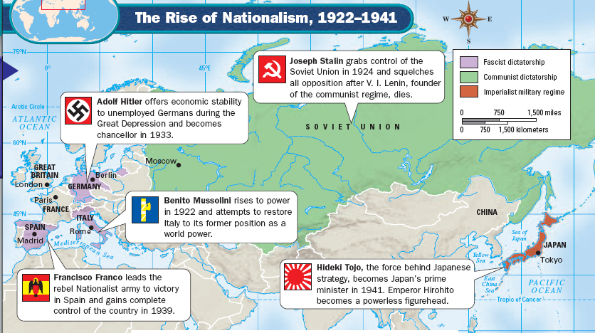
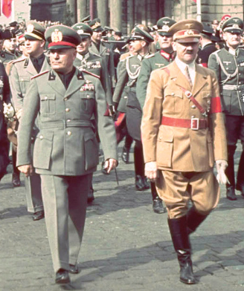
In the 1930s, events throughout the world led to conditions that started World War II
High unemployment, desperation, & feelings of betrayal led to the rise of totalitarian dictators
Fascist dictators Mussolini & Hitler threatened to conquer new territories for Italy & Germany

Slide 3
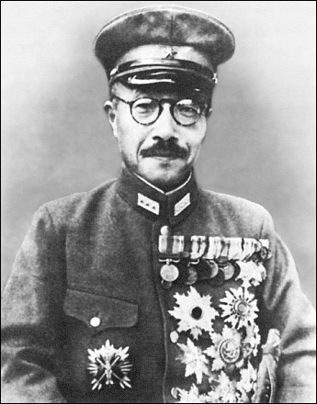
In the 1930s, events throughout the world led to conditions that started World War II
Extreme nationalism & a need for raw materials led to a desire to expand in Japan under Hideki Tojo

Slide 4
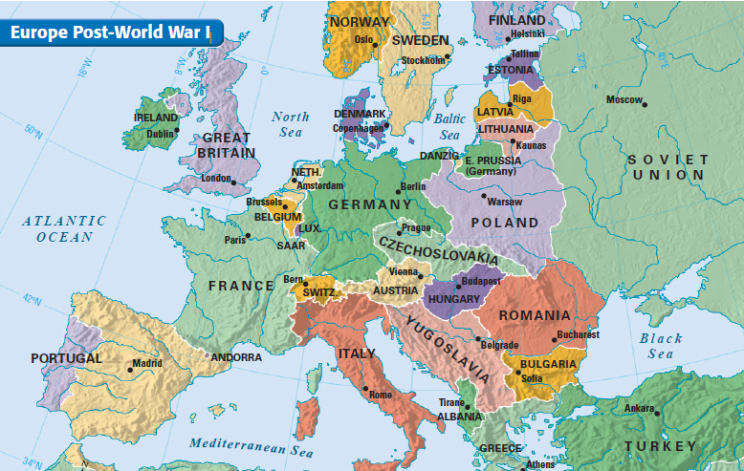
By the 1930s, the world was moving towards another war but few nations were in a position to prevent war
Britain & France were the leaders of the League of Nations but both wanted to avoid another war
The USA was focused on the depression & wanted to avoid foreign affairs

Slide 5
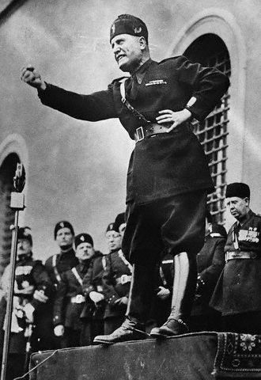
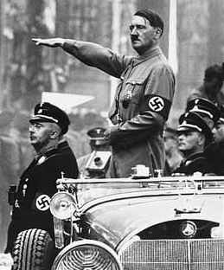
Japan, Italy, & Germany aggressively expanded in Africa, Asia, & Europe
In 1936, Germany, Italy, & Japan formed an alliance called the Axis Coalition

Slide 6
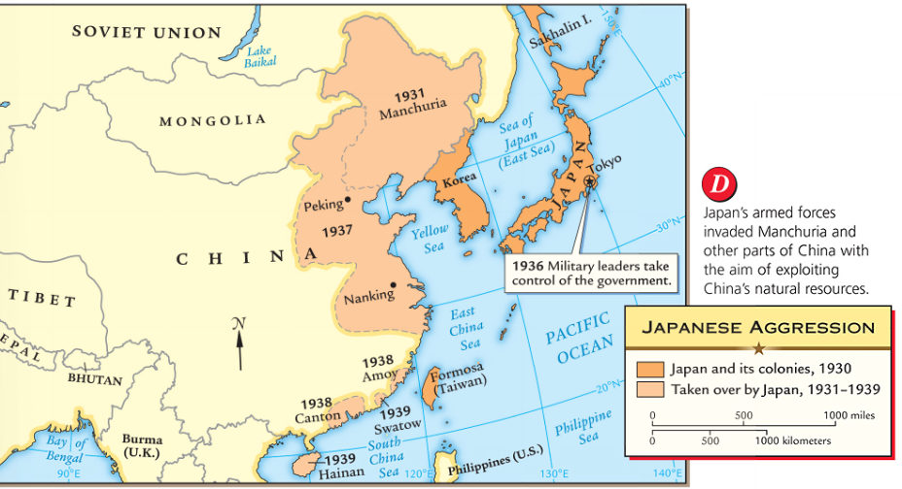
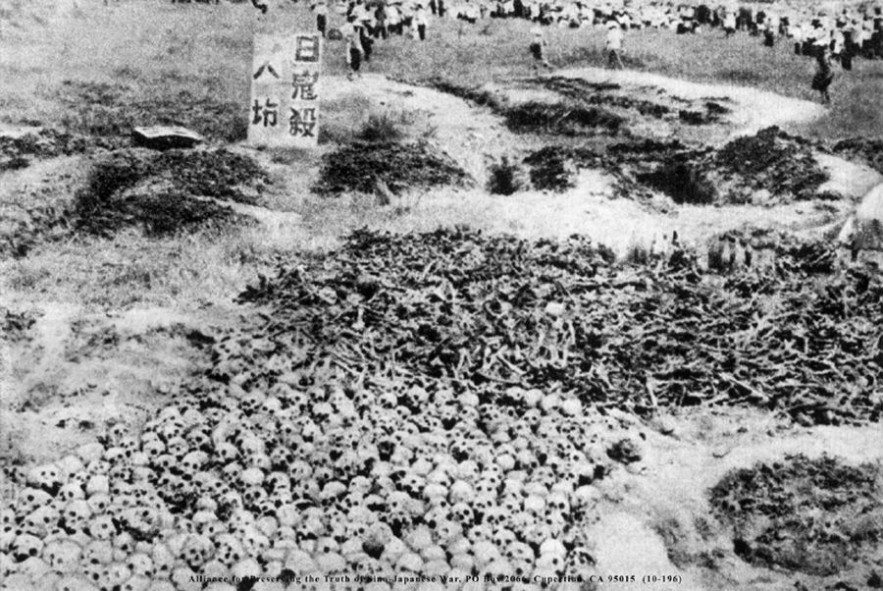
In 1931, Japan invaded Manchuria in order to seize its iron & coal mines
In 1937, Japan conquered northern China & killed 300,000 unarmed soldiers & civilians during the “Rape of Nanjing”
Notes:
46g - explain the aggression and conflict leading to World War II in Europe and Asia including the Italian invasion of Ethiopia, the Spanish Civil War, the rape of Nanjing in China, and the German annexation of the Sudetenland

Slide 7
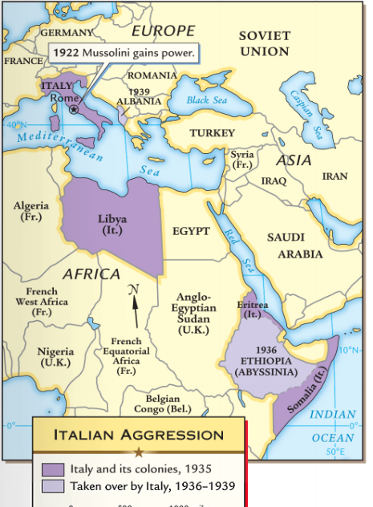
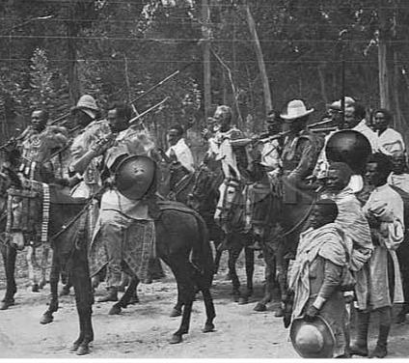
In 1935, Mussolini began his campaign to create an Italian Empire by invading Ethiopia
The Italian army easily defeated the Ethiopians
Ethiopian soldiers defending their country from the Italian military

Slide 8
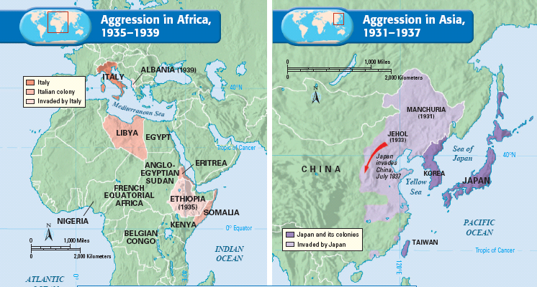
Critical Thinking Decision #1: How should the League of Nations respond?
The Decision:
A
The League of Nations condemned Japanese & Italian aggression but did nothing to stop the attacks in an effort to maintain peace in the world

Slide 9
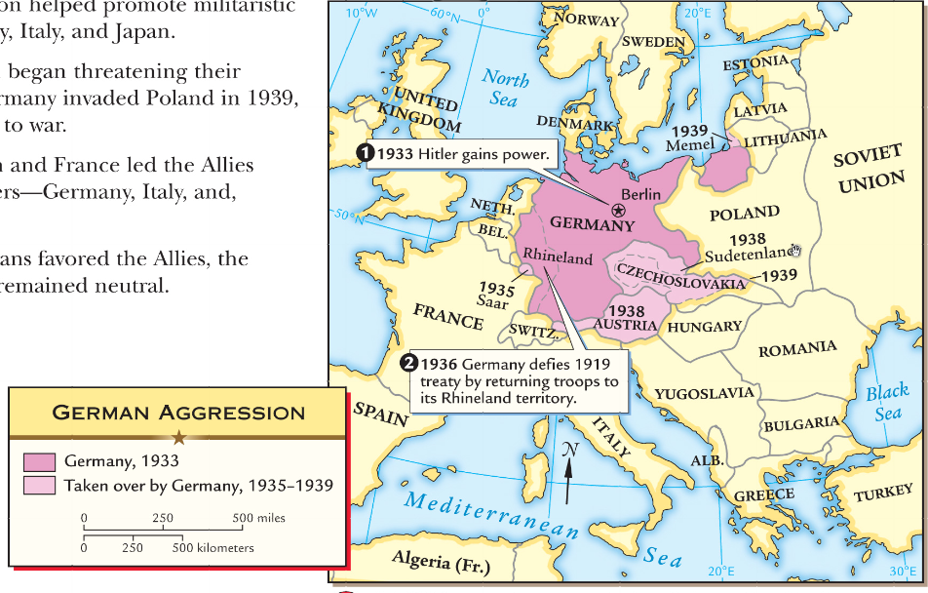
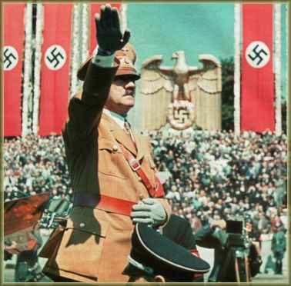
The failure of the League of Nations to stop Italy or Japan, encouraged Hitler to expand Germany too
In 1935, Hitler defied the terms of the Treaty of Versailles & expanded the size of the German military
In 1936, Hitler moved his army to the Rhineland
Both times, the League of Nations refused to stop Hitler in order to keep peace in Europe

Slide 10
The failure of the League of Nations to stop Italy or Japan, encouraged Hitler to expand Germany too
In 1938, Hitler annexed Austria
Next, Hitler demanded that the western border of Czechoslovakia, an area known as the Sudetenland, be given to Germany

Slide 11
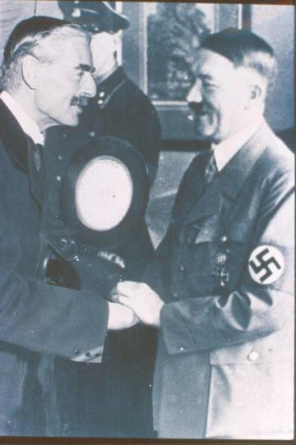
Critical Thinking Decision #2: How should the League of Nations respond?
Germany was allowed to keep the Sudetenland if Hitler promised to stop expanding
The Decision:
B
In 1938, leaders from England & France met with Hitler & Mussolini at the Munich Conference in order work out an agreement to avoid war

Slide 12
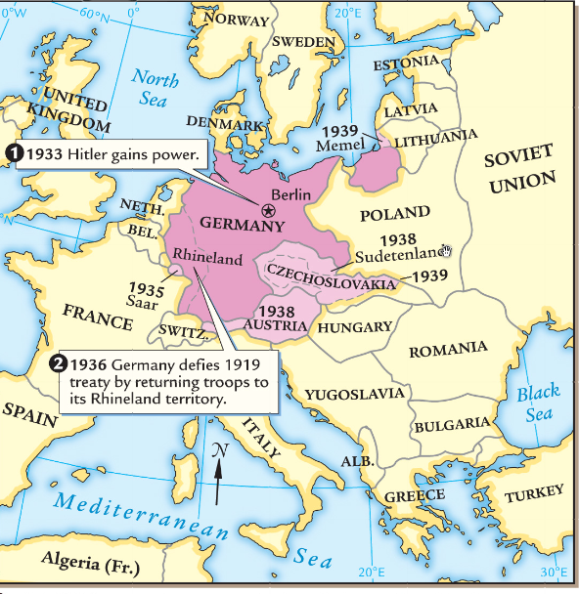
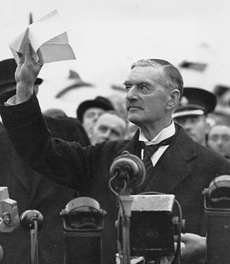
Britain & France used appeasement with Hitler: they gave in to his demands in order to avoid war
Six months after the Munich Conference, Hitler broke his promise & annexed all of Czechoslovakia
After the Munich Pact, British Prime Minister declared he had gained “peace for our time”

Slide 13
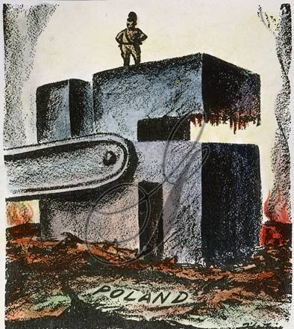
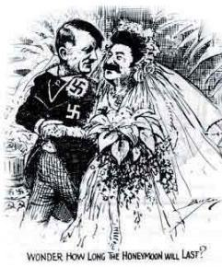
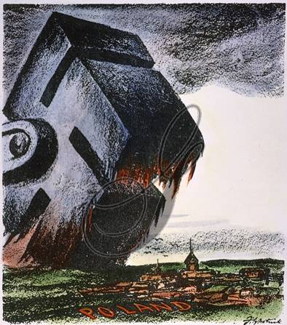
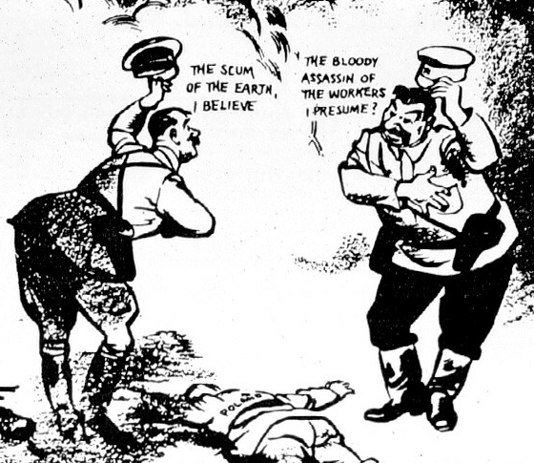
In 1939, Hitler demanded that western Poland be returned to Germany but he did not want to provoke a war with the Soviet Union
Stalin & Hitler agreed to the Nazi-Soviet Nonaggression Pact, promising never to attack each other
Secretly, Germany & the USSR agreed to divide Poland
On September 1, 1939, Hitler ordered the German military to attack Poland

Slide 14
Critical Thinking Decision #3: How should Britain & France respond?
The Decision:
D
On September 3, 1939, Britain & France declared war on Germany…World War II had begun

Slide 15
Essential Question:
What were the major events during World War II from 1939 to 1942?
CPWH Agenda for Unit 12.3:
Clicker Review Questions
Finish “WWII: 1939-1942” notes
Today’s HW: 32.1
Unit 12 Test: Wed, April 13

Slide 16
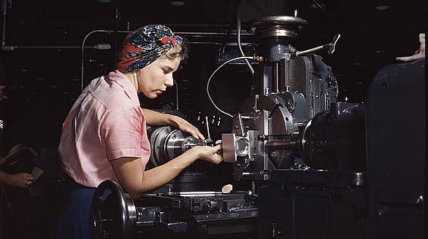
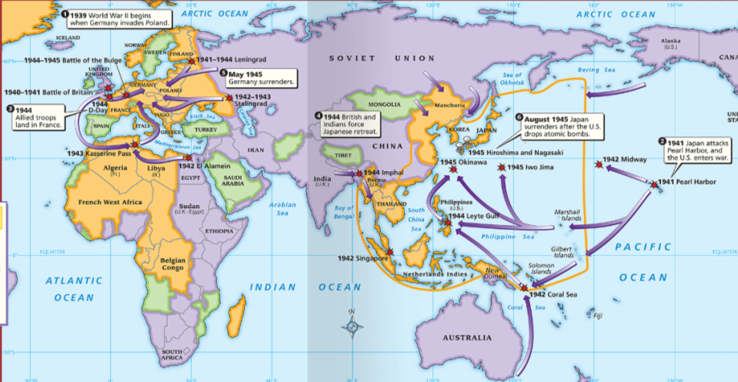
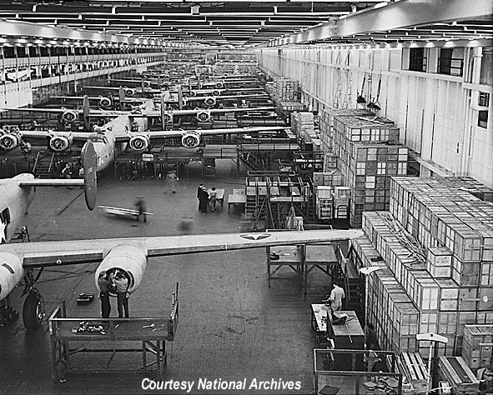
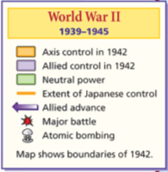
World War II was a two “theater” war with fighting taking place in Europe & in the Pacific
The Allies & Axis Powers converted to total war for the second time in 20 years

Slide 17
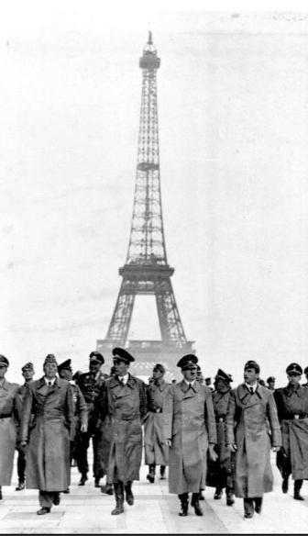
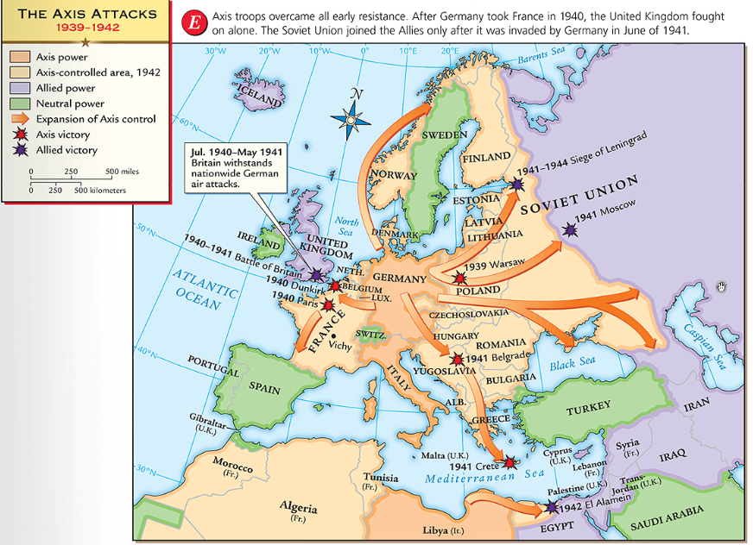
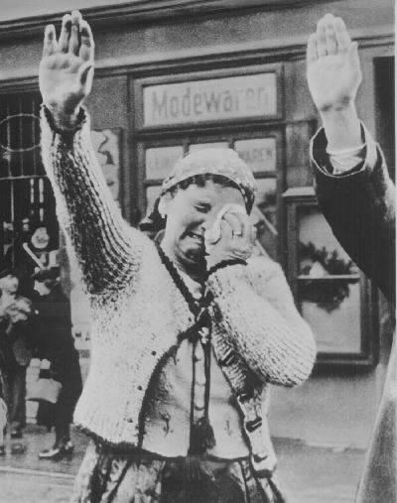
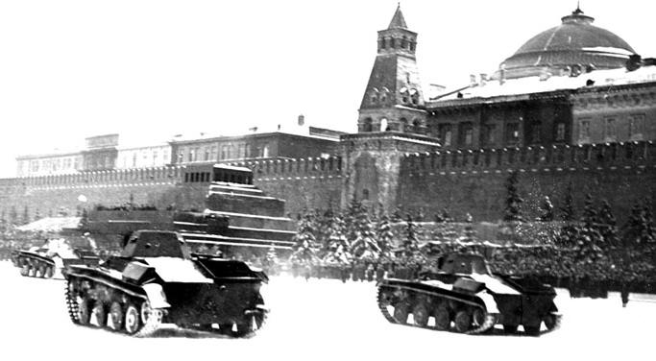
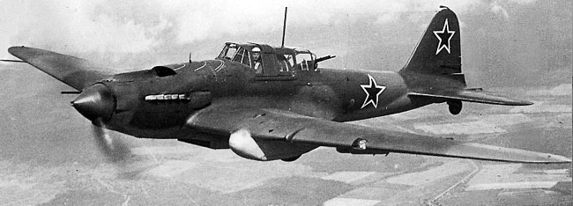
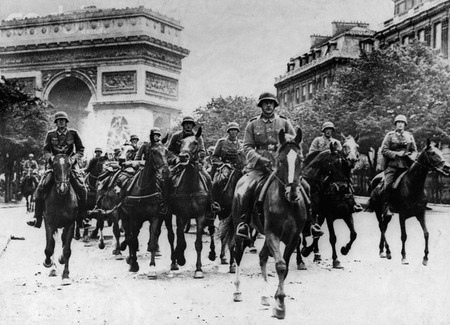
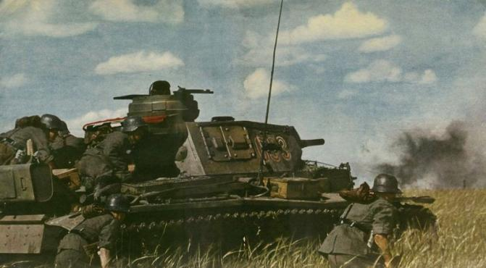
When World War II began, Germany used a “lightning war” strategy called blitzkrieg that relied on fast, strong attacks using air raids, artillery, & tanks
By 1940, Germany conquered Poland, Denmark, Norway, Netherlands, Belgium, & France

Slide 18
When France fell to the Nazis, Britain was the only nation at war with Germany
In 1940, Germany began a massive bombing campaign using its air force called the Battle of Britain

Slide 19
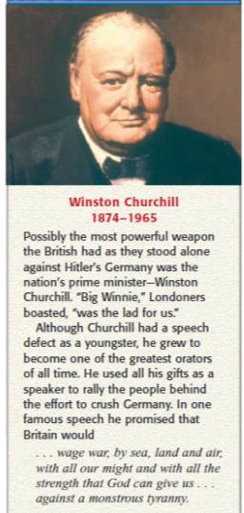
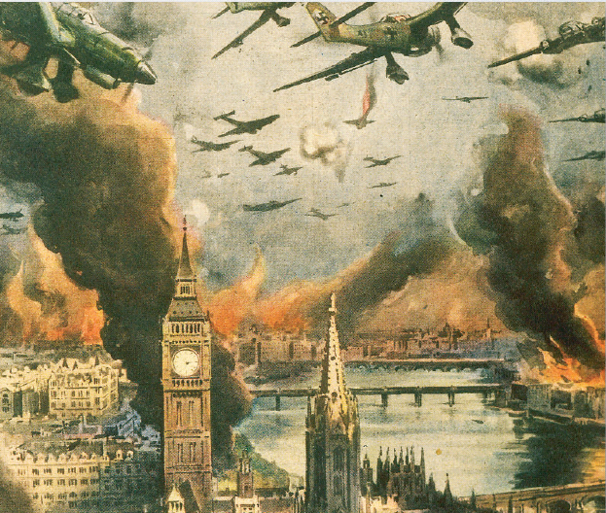
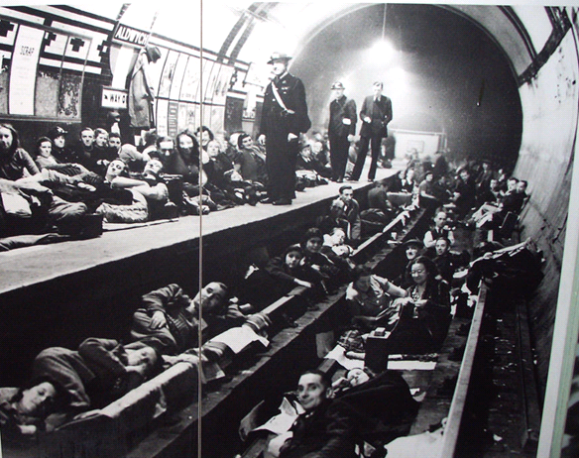
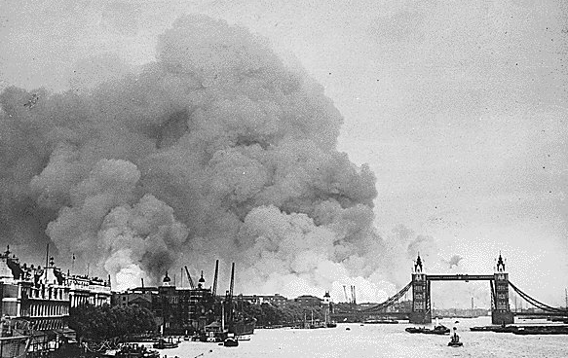
The British air force fought German planes aided by radar & the ability to crack German codes
Prime Minister Winston Churchill vowed that the British would “never surrender”
After 8 months, Hitler called of the attacks & focused on Eastern Europe

Slide 20
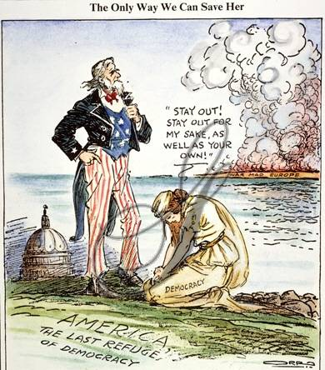
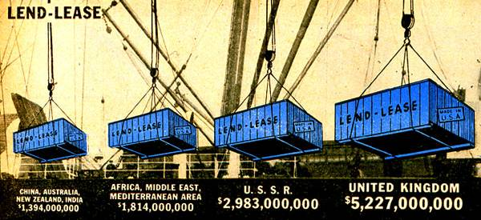
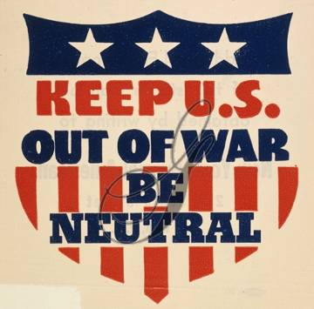
The United States vowed to remain neutral when World War II began
After the fall of France & attack on Britain, the U.S. began selling war supplies to the Allied Powers

Slide 21
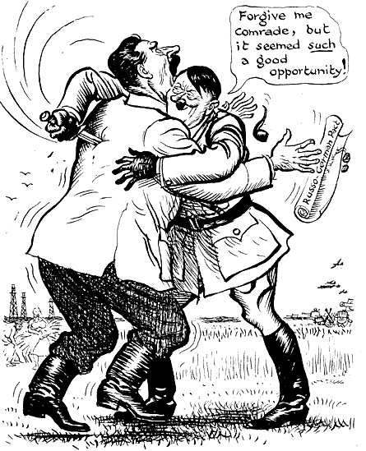
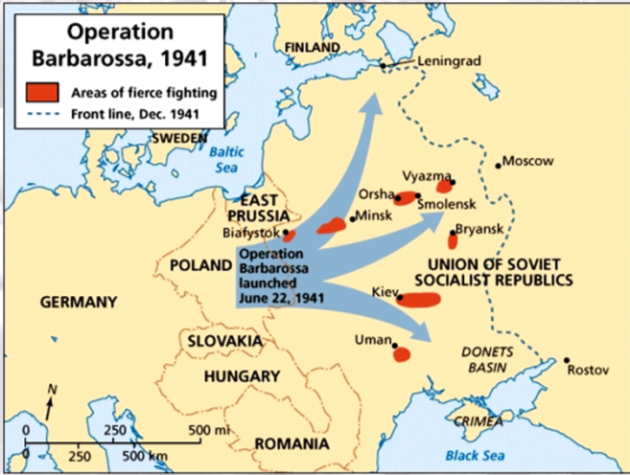
In 1940, Italian & German troops moved to take control of North Africa
Meanwhile, Hitler took control of the Balkans
In 1941, Hitler broke the Nazi-Soviet Pact & invaded the Soviet Union

Slide 22
By 1942, the Axis Powers controlled most of Europe & North Africa but were unable to defeat Britain & the USSR

Slide 23
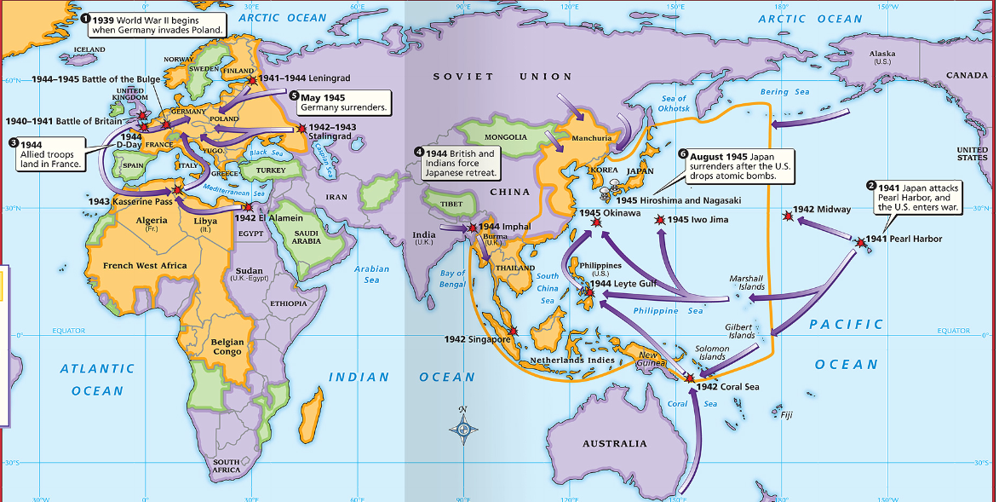
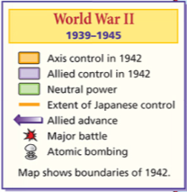
Meanwhile, the Japanese were expanding in throughout the Pacific

Slide 24
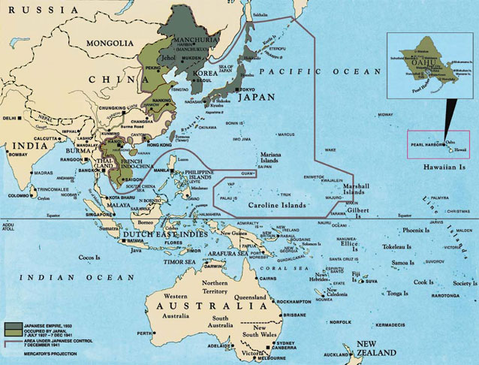
Critical Thinking Decision #4: How should the United States respond?
From 1939 to 1941, Japan conquered European colonies in Asia including French Indochina
The Decision:
C
Japan threatened to take the U.S. colonies of Guam & the Philippines

Slide 25
In 1941, the United States cut off sales of iron & oil with the Japanese
Japan interpreted the embargo as interfering with their right to expand

Slide 26
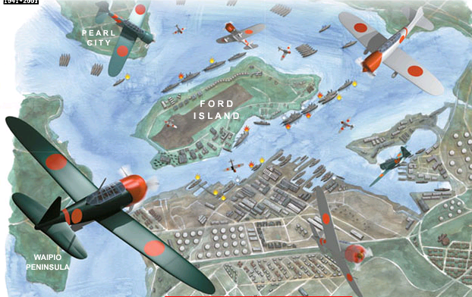
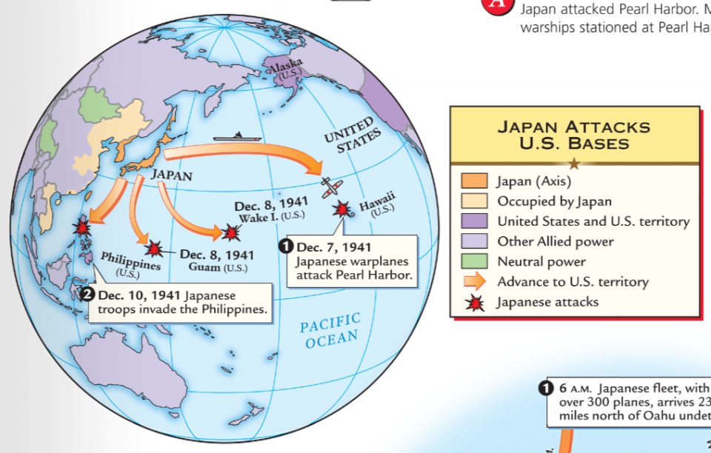
On December 7, 1941 Japan attacked the U.S. naval base at Pearl Harbor in Hawaii
The surprise attack crippled the U.S. navy & killed 2,300 Americans
After the attack, the USA declared war on the Axis Powers & entered WWII

Slide 27
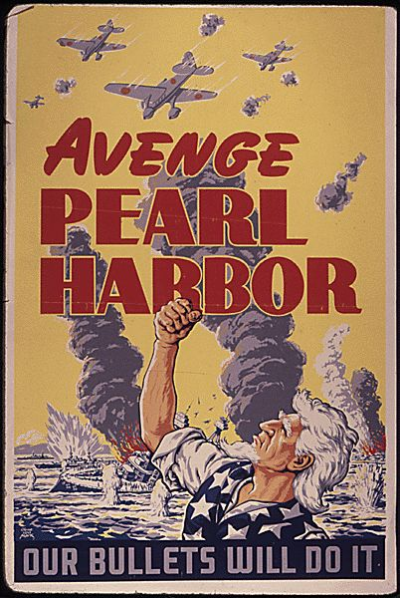
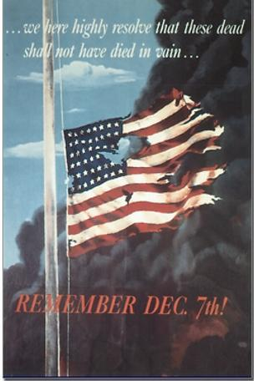

Slide 28
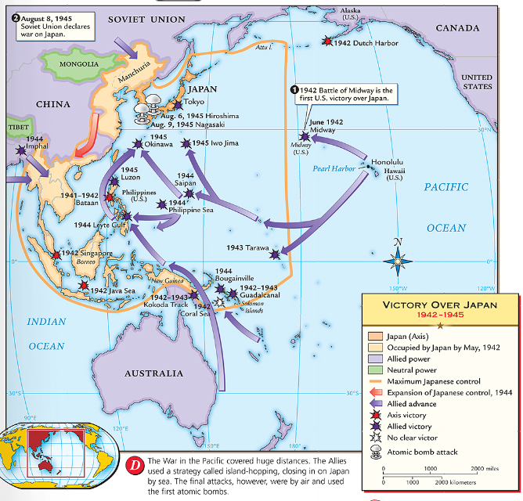
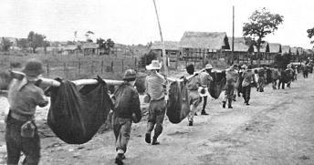
After Pearl Harbor, the Japanese took the Philippines & threatened to take India and Australia
By 1942, Japan controlled a large empire in the Pacific, “Asia for the Asiatics”

Slide 29
From 1939 to 1942, the Axis Powers (Germany, Italy, Japan) dominated Europe, North Africa, & Asia
But, 1942 was a turning point year for the Allies who were able to win the war by 1945

