Slide 1
Art and Patronage
Italians willing to spend a lot of money on art.
~Art communicated social, political, and spiritual values.
~Italian banking & international trade interests had money.
Public art in Florence organized/supported by guilds.
Therefore, the consumption of art was used as a form of competition for social & political status!

Slide 2
Renaissance Art
A comparison with Medieval Art

Slide 3
Before the Renaissance

Slide 4
The artwork . . .
Focused on religious subjects
Lacked perspective--paintings appear flat.
There is little use of light and shadow.
The artwork is not natural. Figures appear "placed" in the picture. Large = important

Slide 6
The artwork . . . .
Children are painted to resemble small adults.
Colors are more subdued than in later periods.
In the earlier paintings there is heavy use of gold.
Religious symbols used--haloes, Biblical figures, saints, etc.

Slide 8
During the Renaissance

Slide 9
The artwork…
There is use of perspective, light and shadow, proportion,

Slide 11
The artwork…
Figures--drawn from nature and based on observation of real world (objective).
Colors are rich, warm, and glowing.

Slide 12
Continued…
Anatomically correct physiology, and emotion.
Use of classical topics/stories depicted in paintings – story of Judith and Holofernes

Slide 13
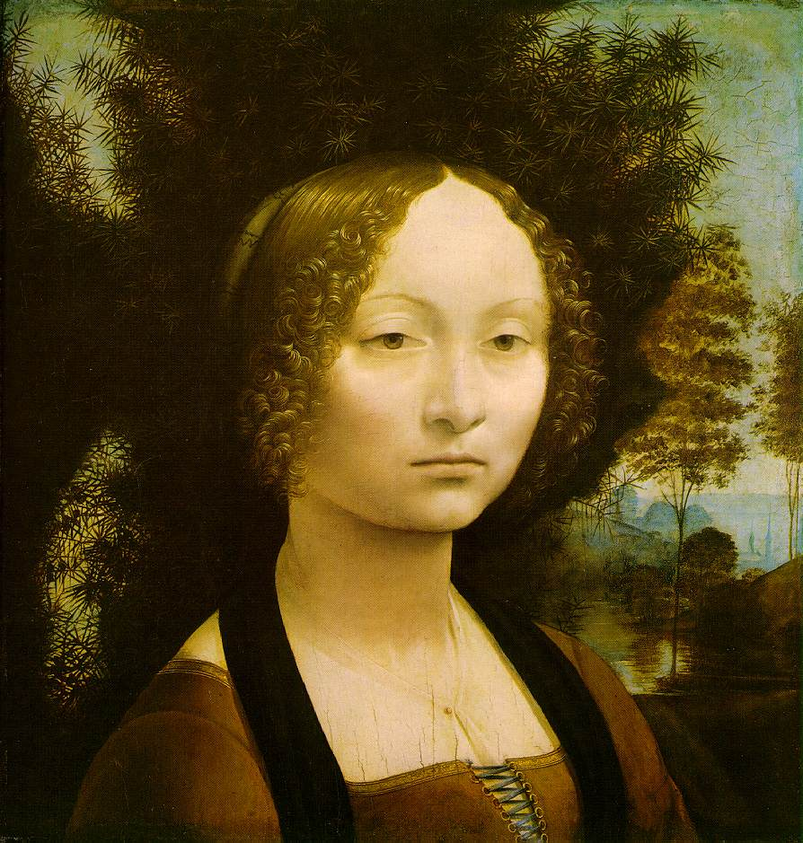
More . . .
Artists became known for individual style and imagination.
This is a DaVinci—
note the similarity in the mouth in this work to the another famous picture by DaVinci
Ginevra de' Benci

Slide 15
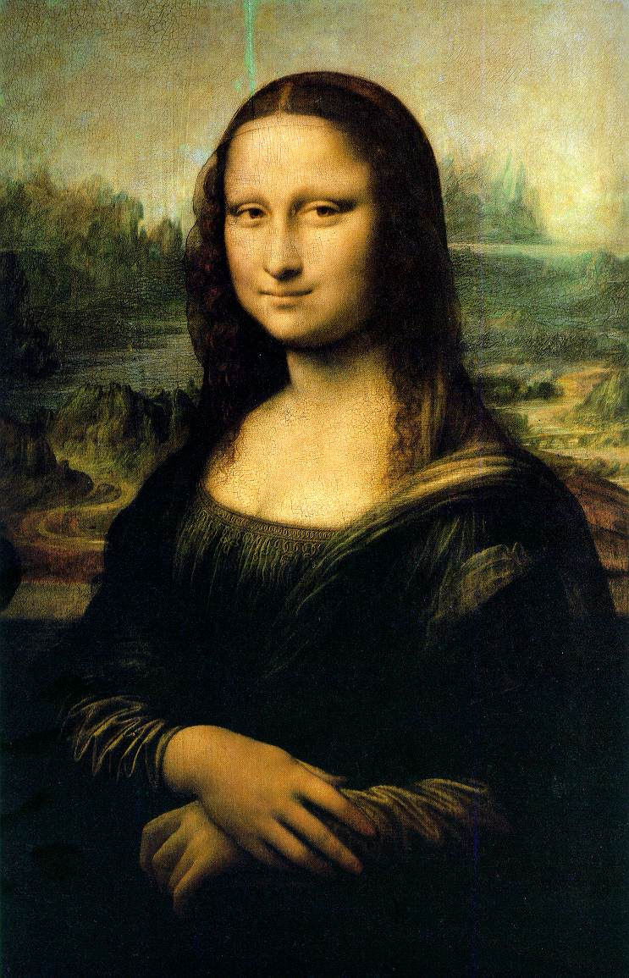
…The Mona Lisa

Slide 16
Characteristics of Renaissance Art

Slide 17
Realism & Expression
Expulsion from the Garden
Masaccio
1427
First nudes since classical times.

Slide 18
2. Perspective
First use of linear perspective!
The Trinity
Masaccio
1427

Slide 19
3. Classicism
Greco-Roman influence.
Secularism.
Humanism.
Individualism → free standing figures.
Symmetry/Balance
The “Classical Pose” Medici “Venus”

Slide 20
4. Emphasis on Individualism
Batista Sforza & Federico de Montefeltre: The Duke & Dutchess of Urbino
Piero della Francesca, 1465-1466.

Slide 22
5. Geometrical Arrangement of Figures
The Dreyfus Madonna with the Pomegranate
Leonardo da Vinci
1469
The figure as architecture!

Slide 24
Early Renaissance
The First Three
Hall-of-Famers

Slide 25
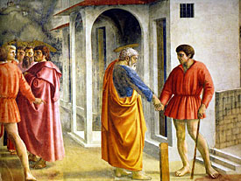
Masaccio 1401-1428
Founder of early Renaissance Painting
Painted human figure as a real human being
(3D)
Used perspective
Consistent source of light (accurate shadows)

Slide 28
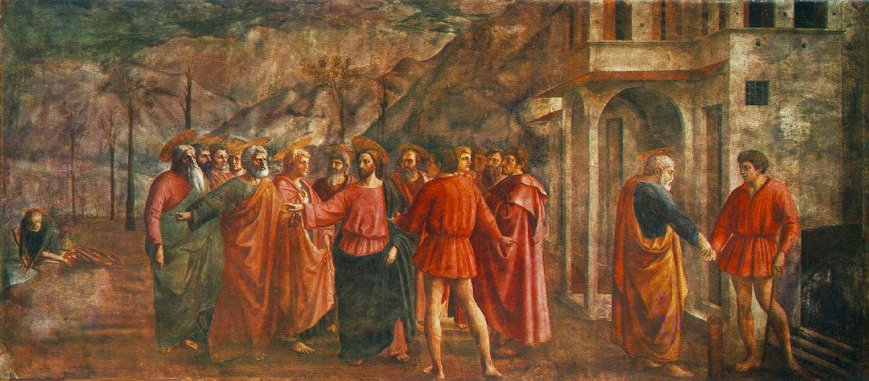
The Tribute Money

Slide 29
#2 Donatello 1386-1466
The sculptor’s Masaccio
David (1430-32)
First free standing, life-size nude since Classical period
Contrapposto
Sense of Underlying skeletal structure

Slide 30
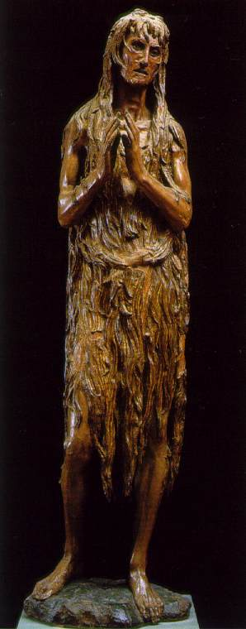
The Penitent Magdalen ~Donatello --real --gaunt
“Speak, speak or the plague take you!”

Slide 31
#3 Boticelli
1482
Rebirth of Classical mythology
Fully Pagan
THE BIRTH OF VENUS

Slide 33
The Italian Renaissance
Leonardo
Michelangelo
Raphael
Titian

Slide 34
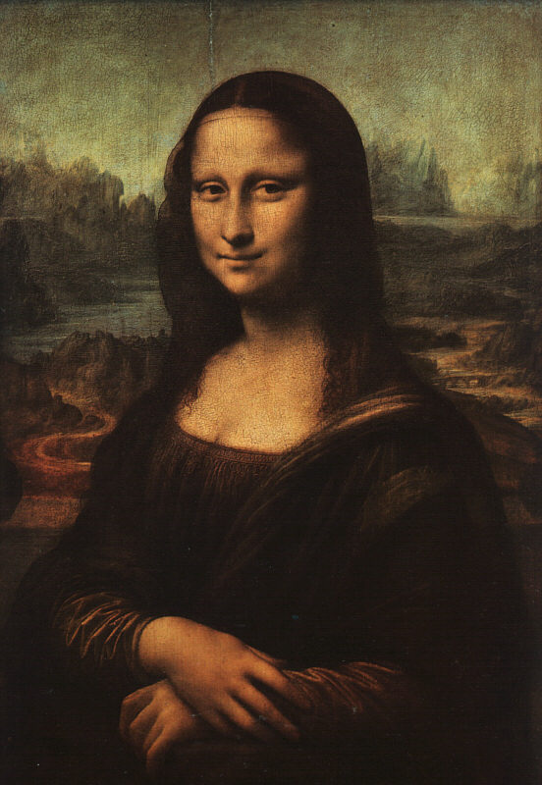
Da Vinci Mona Lisa (1503-06) Perspective, Anatomy, Composition

Slide 35
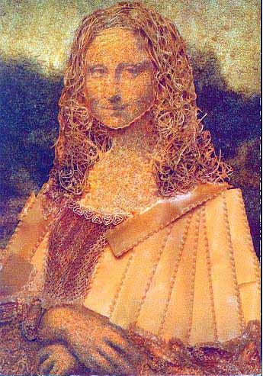
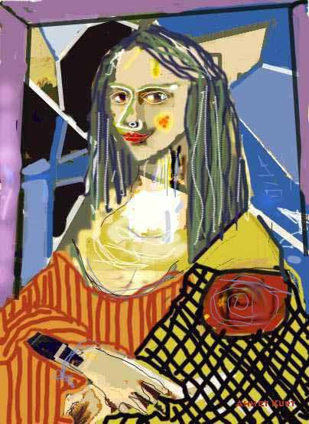
Cultural icon

Slide 36
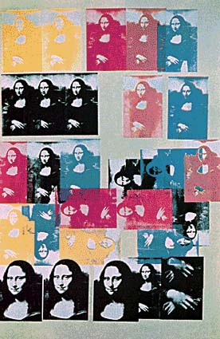
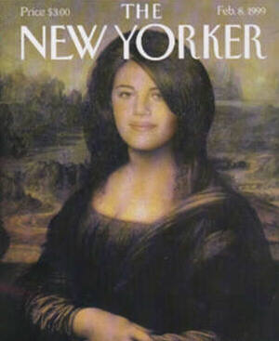

Slide 37
Michelangelo
David
Michelangelo Buonarotti
1504
Marble

Slide 38
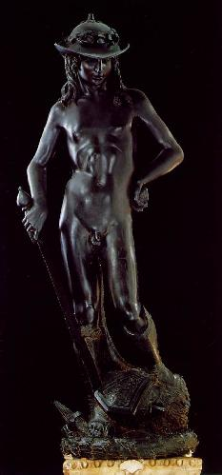
Contrapposto
(counterpoise)
To model the human form in a non-symmetrical, relaxed stance that appears realistic

Slide 39
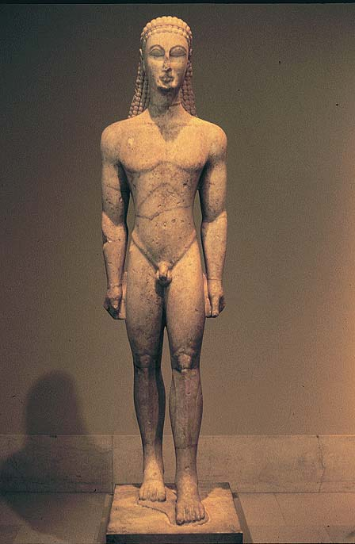
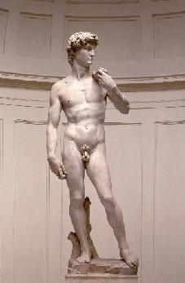
Compare:

Slide 40
Humanism (even within Biblical stories): Love of the Human Form

Slide 41
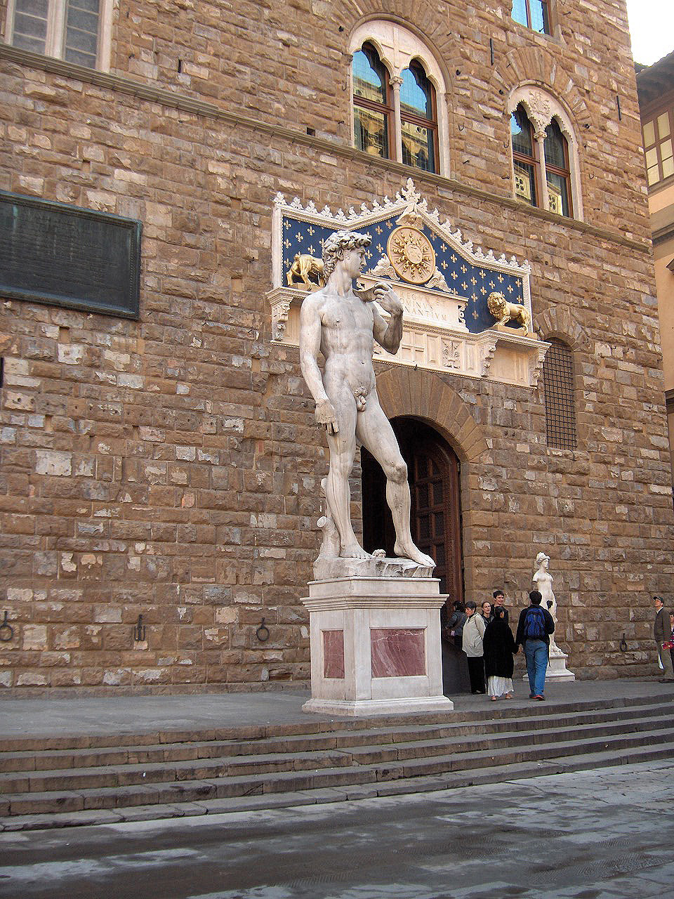

Slide 42
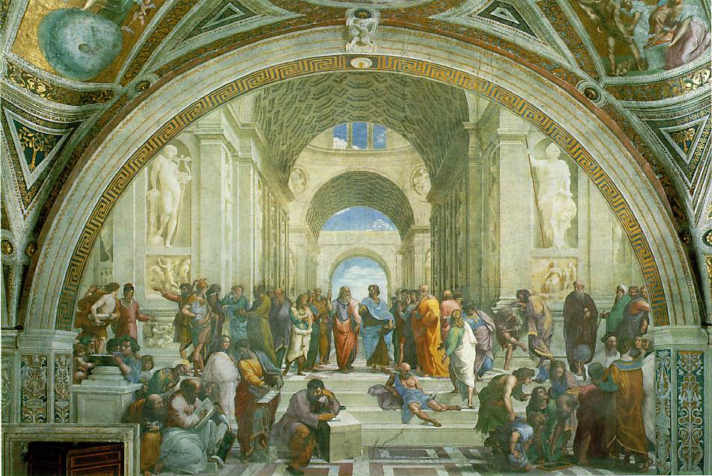
Raphael School of Athens 1510

Slide 43
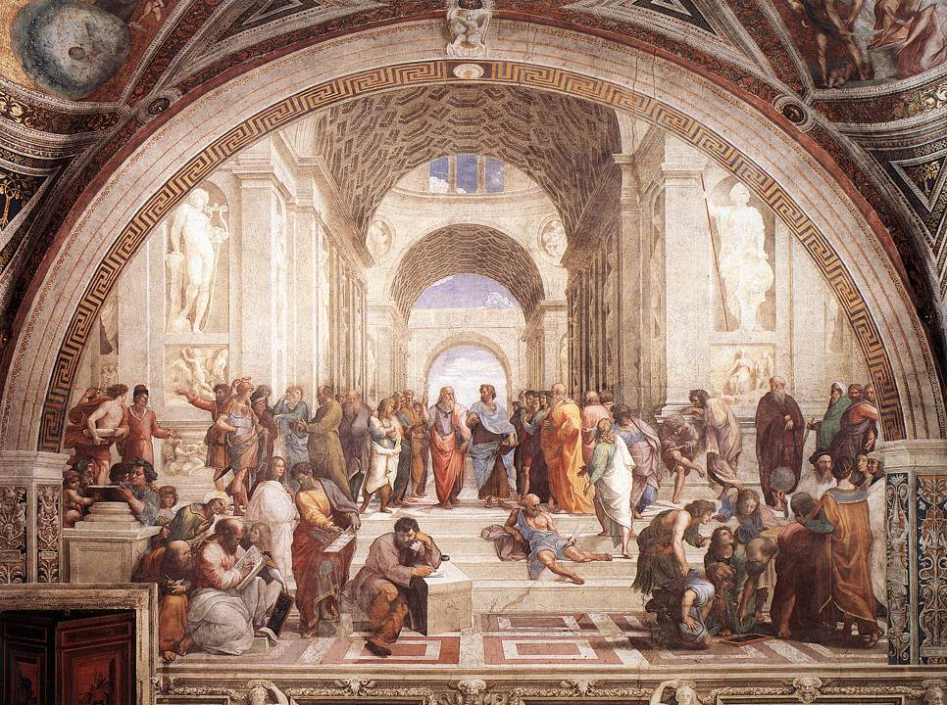
Da Vinci
Raphael
Michelangelo

Slide 44
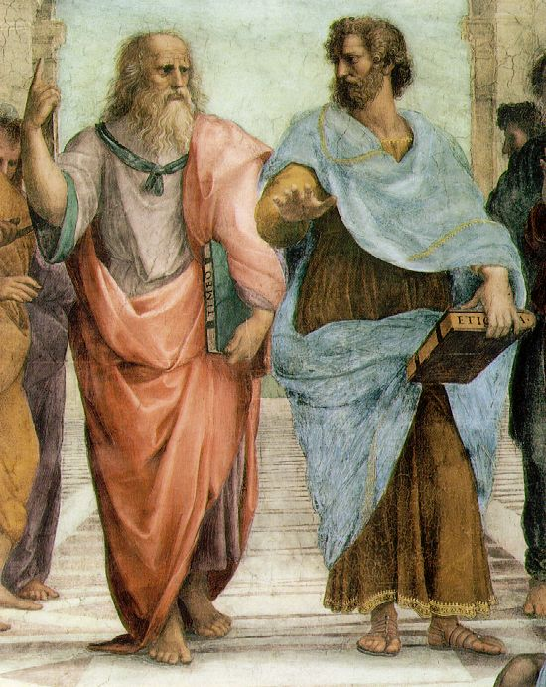
Plato: looks to the heavens [or the IDEAL realm].
Aristotle: looks to this earth [the here and now].

Slide 46
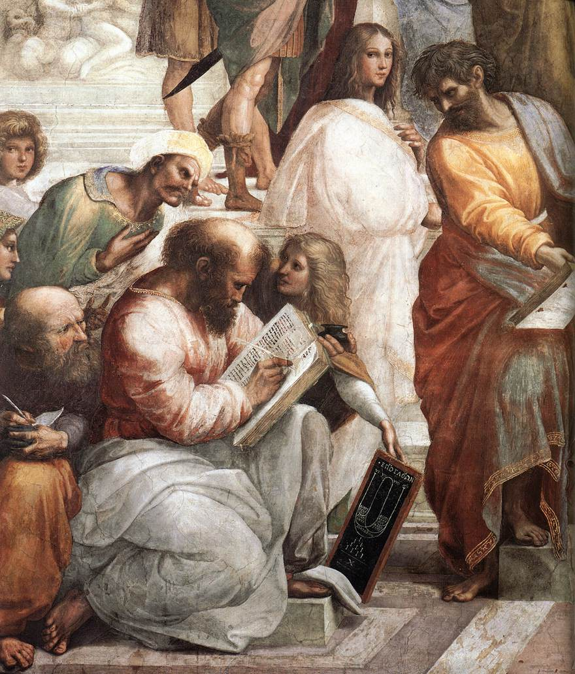
Pythagoras

Slide 47
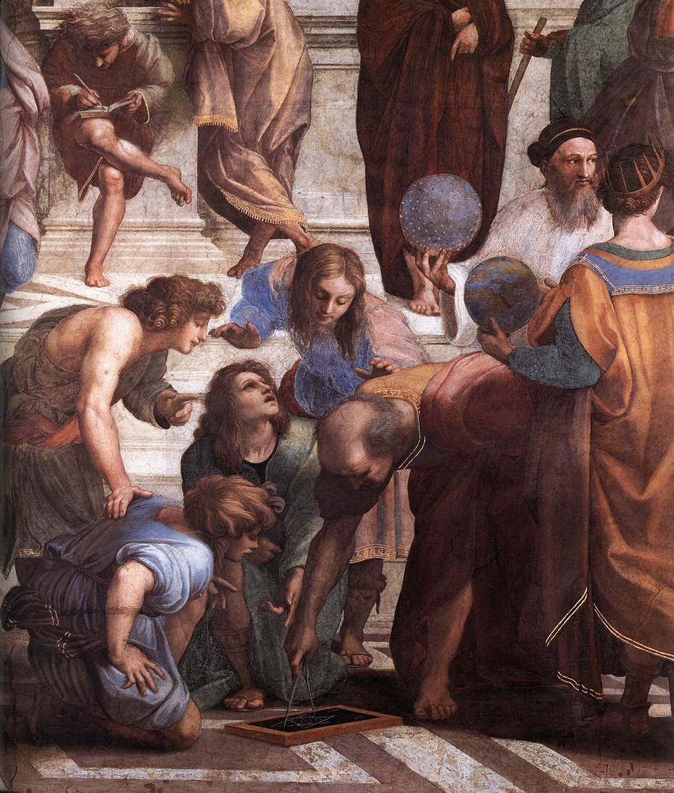
Zoroaster
Ptolemy
Euclid

Slide 48
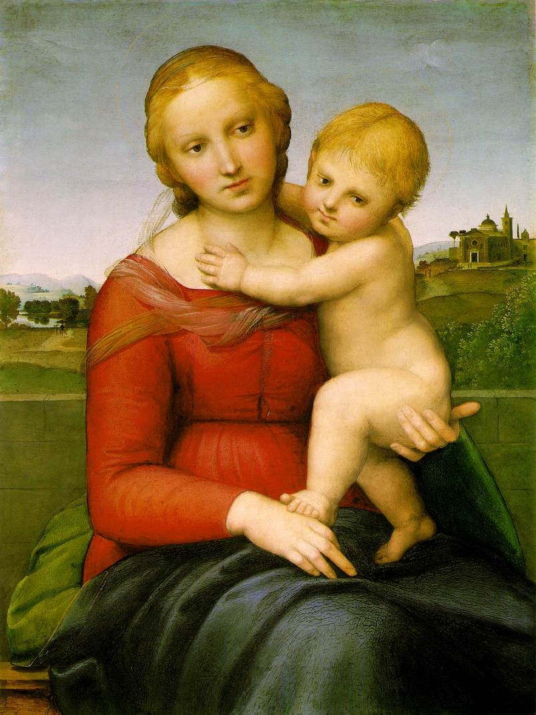
Raphael
painted natural looking settings…
…of people who looked real.
His paintings were full of motion, gestures, and animation.

Slide 50
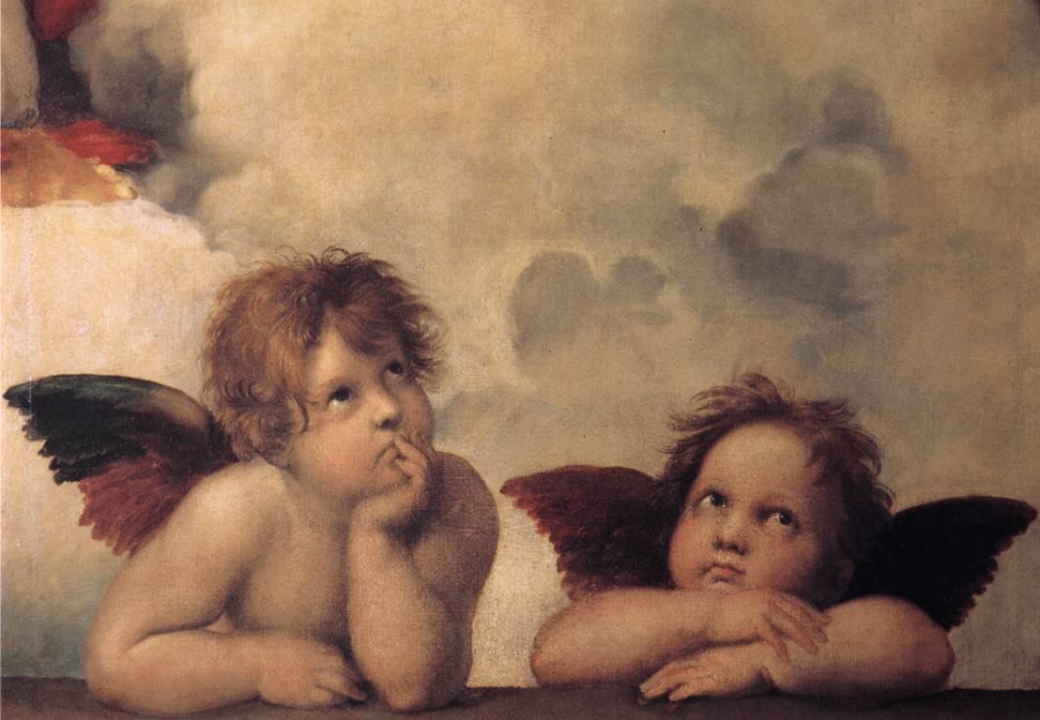
Raphael’s “Angels”

Slide 51
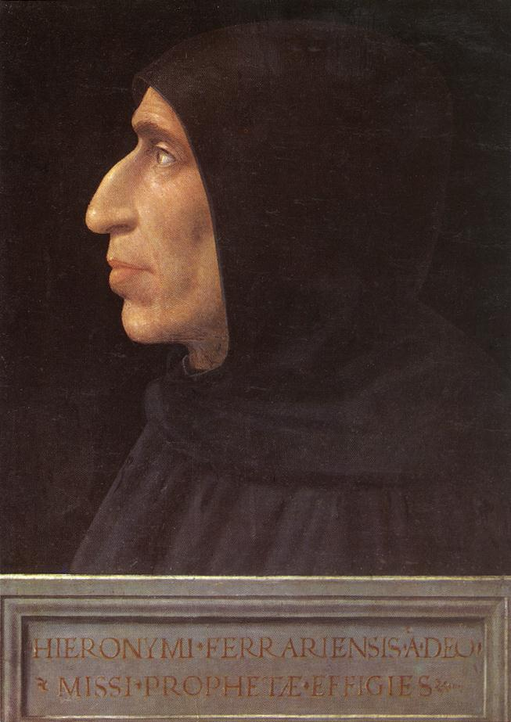
A Portrait of Savonarola
By Fra Bartolomeo, 1498.
Dominican friar who decried money and power.
Anti-humanist → he saw humanism as too secular, hedonistic, and corrupting.
The “Bonfire of the Vanities,” 1497.
Burned books, artwork, jewelry, and other luxury goods in public.
Even Botticelli put some of his paintings on the fire!!

Slide 53
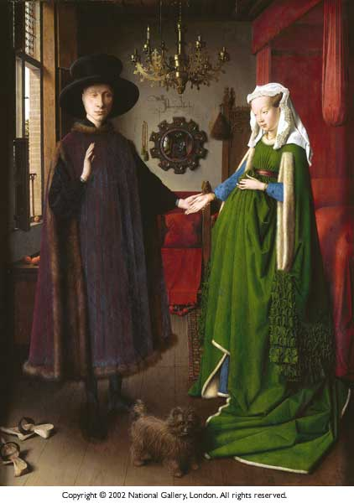

Slide 54
Sources:
National Gallery
Web Museum of Paris, France

