Slide 1
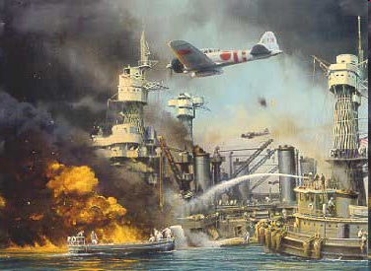
Modern War Powers: From WWII through the War on Terrorism
Artemus Ward
Dept. of Political Science
Northern Illinois University
Bill of Rights Institute
Indianapolis, IN
September 23, 2010

Slide 2
Introduction
WWII provided the Supreme Court with a number of cases which further clarified the powers of the elected branches in times of war.
Specifically, the Court upheld actions curtailing civil rights and liberties of American citizens.
After the WWII, the conflicts in Korea and Vietnam provided the impetus for congress to assert its prerogatives during war time.
The War on Terrorism has provided the Court with further opportunities to define war powers. The Court not only took up the task but also ruled against the elected branches.

Slide 3
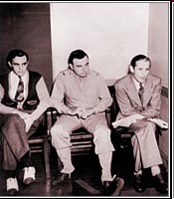
Ex parte Quirin (1942)
In June 1942, 8 German soldiers in uniform landed in the U.S. via submarine in order to carry out attacks on U.S. war industries and facilities.
Though all were born in Germany, they had spent considerable time in the U.S. prior to the war and two were U.S. citizens.
After landing they took off their uniforms and proceeded with the plan. But two men turned themselves in to the FBI and soon the others were taken into custody.
President Roosevelt convened a secret military tribunal which sentenced the eight men to death. The President later commuted the death sentences of Dasch and Burger to life in prison, as they had both confessed and assisted in capturing the others. Though all of the men confessed and gave full statements, the remaining six were executed by electrocution. Dash and Burger were released from prison in 1948 and deported to Germany.
Dasch spent the remaining years of his life trying to return to the U.S. One time, a visa application was sent to J. Edgar Hoover by the State Department on Dasch's behalf. Hoover stated that the idea of giving Dasch a visa was "outrageous" and promptly denied it. Dasch died - still in Germany - in 1992.
Two alleged Nazi saboteurs, Herbert Haupt (L) and John Dasch (R), at their trial by military commission at the Department of Justice in 1942.

Slide 4
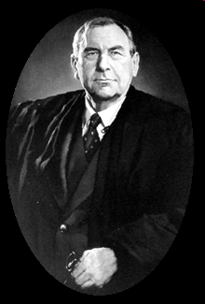
Chief Justice Harlan Fiske Stone delivered the opinion for a unanimous Court
The Court upheld the military tribunals as a proper exercise of both the President’s and Congress’ war powers: “By [the President’s] Order creating the present Commission he has undertaken to exercise the authority conferred upon him by Congress, and also such authority as the Constitution itself gives the Commander in Chief, to direct the performance of those functions which my constitutionally be performed by the military arm of the nation in times of war. It is unnecessary for present purposes to determine to what extent the President as Commander in Chief has constitutional power to create military commissions without the support of Congressional legislation. For here Congress has authorized trial of offenses against the law of war before such commissions.”
The decision established the principle that during war time persons could be designated “enemy combatants,” detained, and tried by military commissions.
“The law of war draws a distinction between the armed forces and the peaceful populations of belligerent nations and also between those who are lawful and unlawful combatants. Lawful combatants are subject to capture and detention as prisoners of war by opposing military forces. Unlawful combatants are likewise subject to capture and detention, but in addition they are subject to trial and punishment by military tribunals for acts which render their belligerency unlawful. The spy who secretly and without uniform passes the military lines of a belligerent in time of war, seeking to gather military information and communicate it to the enemy, or an enemy combatant who without uniform comes secretly through the lines for the purpose of waging war by destruction of life or property, are familiar examples of belligerents who are generally deemed not to be entitled to the status of prisoners of war, but to be offenders against the law of war subject to trial and punishment by military tribunals.”

Slide 5
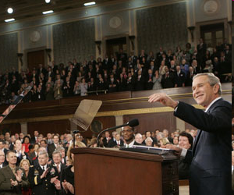
Quirin as Precedent for the War on Terrorism
While the Bush Administration relied on Quirin during the War on Terrorism, there are some differences. For example, Congress had officially declared war during WWII while Congress had merely passed a broadly-worded, joint resolution one week after Sep. 11, 2001: “the President is authorized to use all necessary and appropriate force against those nations, organizations, or persons he determines planned, authorized, committed, or aided the terrorist attacks that occurred on September 11, 2001, or harbored such organizations or persons, in order to prevent any future acts of international terrorism against the United States by such nations, organizations or persons.”
Does this give the President the authority to detain enemy combatants and try them by military commission?

Slide 6
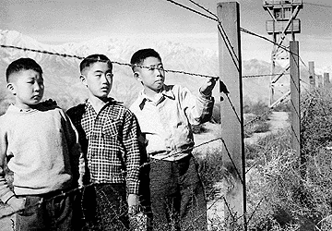
Korematsu v. United States (1945)
During World War II, just after Pearl Harbor, Presidential Executive Order 9066 and congressional statutes gave the military authority to exclude citizens of Japanese ancestry from areas deemed critical to national defense and potentially vulnerable to espionage.
The federal government targeted anyone of Japanese descent living within 60 miles of the west coast of the United States. 140,000 Japanese Americans living in California, Oregon and Washington were first subject to a curfew and later rounded up and interned at what were called Assembly Centers, but were essentially jails.
In Hirabayashi v. United States (1943) the Supreme Court ruled unanimously that the curfew order was constitutional. But the next case overshadowed Hirabayashi.
Fred Korematsu was born in San Francisco, tried to join the military but was denied for health reasons, and instead worked as a welder in the defense industry.
He was engaged to an Italian-American woman and decided to undergo plastic surgery to convince authorities that he was of Spanish-Hawaiian origin.
Korematsu remained in San Leandro, California and violated Civilian Exclusion Order No. 34 of the U.S. Army.

Slide 7
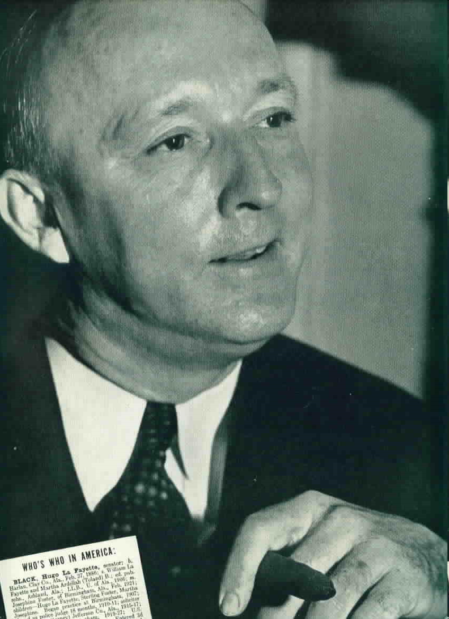
Justice Hugo Black for the 6-3 Majority
The Court sided with the government and held that the need to protect against espionage outweighed Korematsu's rights.
Justice Black argued that compulsory exclusion, though constitutionally suspect due to its racial classification, is justified during circumstances of "emergency and peril.“
“Korematsu was not excluded from the Military Area because of hostility to him or his race. He was excluded because we are at war with the Japanese Empire, because the properly constituted military authorities feared an invasion of our West Coast and felt constrained to take proper security measures, because they decided that the military urgency of the situation demanded that all citizens of Japanese ancestry be segregated from the West Coast temporarily, and, finally, because Congress, reposing its confidence in this time of war in our military leaders — as inevitably it must — determined that they should have the power to do just this.”

Slide 8
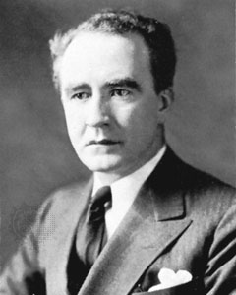
Justice Frank Murphy Dissenting
“This exclusion goes over ‘the very brink of constitutional power’ and falls into the ugly abyss of racism.”
“The judicial test of whether the Government, on a plea of military necessity, can validly deprive and individual of any of his constitutional rights is whether the deprivation is reasonably related to a public danger that is so ‘immediate, imminent, and impending’ as not to admit delay and not to permit the intervention of ordinary constitutional processes to alleviate the danger.”
“I dissent from the legalization of racism. Racial discrimination in any form and in any degree has no justifiable part whatever in our democratic way of life. All residents of this nation are kin in some way by blood or culture to a foreign land. Yet they are primarily and necessarily a part of the new and distinct civilization of the United States. They must accordingly be treated at all times as the heirs of the American experiment and as entitled to all the rights and freedoms guaranteed by the Constitution.”

Slide 9
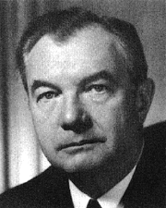
Justice Robert Jackson Dissenting
“While an unconstitutional order will only last as long as the conflict, a judicial construction of the due process clause that will this order is a far more subtle blow to liberty than the order itself.”
“The Court for all time has validated the principle of a racial discrimination in criminal procedure and of transplanting American citizens. The principle then lies about like a loaded weapon ready for the hand of any authority that can bring forward a plausible claim of an urgent need.”

Slide 10
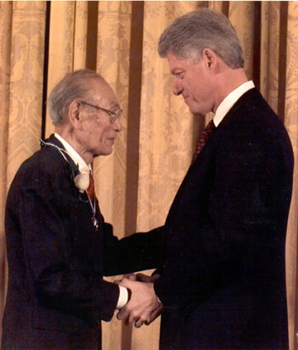
Korematsu Aftermath
Handed down the same day at Korematsu, the Court held in Ex parte Endo (1945) that while exclusion was constitutional, citizens deemed “loyal” must be set free. This decision helped lead to the re-opening of the West Coast for resettlement by Japanese-Americans.
The 1948 Japanese-Americans Claims Act allowed camp detainees to receive compensation for their losses. The government received $131 million in claims, and paid $38 million to settle them.
In 1988, President Reagan signed the Civil Liberties Act, which gave $20,000 in reparations to each of the 75,000 surviving camp detainees, as well as an apology for their losses of liberty and property.
In 1998, President Clinton awarded Fred Korematsu the Presidential Medal of Freedom.

Slide 11
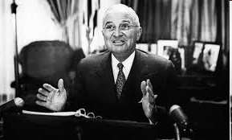
The Steel Seizure Case Youngstown Sheet & Tube Co. v. Sawyer (1952)
In 1947 Congress passed the Taft-Hartley Act. President Harry Truman vetoed it but Congress overrode his veto. Among other things, the Act rejected the idea that labor disputes could be resolved by government seizure. It did allow the president to obtain an injunction for an 80 day cooling off period as a way to postpone any strike that seriously threatened the public interest.
During the Korean War, the United Steelworks Union decided to strike. Truman did not invoke Taft-Hartley and instead, hours before the strike was to begin, he issued an executive order seizing the nation’s steel mills in order to keep them operational. He addressed the nation:
“Our national security and our chances for peace depend on our defense production. Our defense production depends on steel … I have no doubt that if our defense program fails, the danger of war, the possibility of hostile attack, grows that much greater. I would not be faithful to my responsibilities as President if I did not use every effort to keep this from happening.”

Slide 12
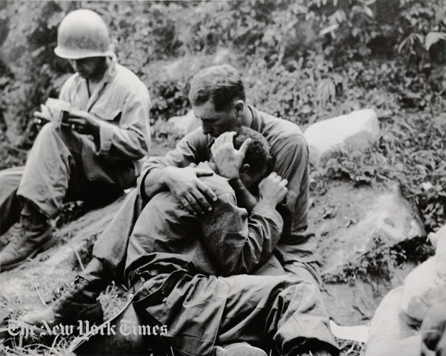
A grief stricken American infantry man whose buddy has been killed in action is comforted by another soldier, Haktong-Ni area, Korea, 1950.

Slide 13
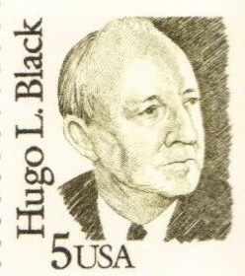
Justice Hugo Black for the Majority
The Court ruled 6-3 that Truman’s seizure was unconstitutional.
"The order cannot properly be sustained as an exercise of the President's military power as Commander in Chief of the Armed Forces. The Government attempts to do so by citing a number of cases upholding broad powers in military commanders engaged in day-to-day fighting in a theater of war. Such cases need not concern us here. Even though 'theater of war' be an expanding concept, we cannot with faithfulness to our constitutional system hold that the Commander in Chief of the Armed Forces has the ultimate power as such to take possession of private property in order to keep labor disputes from stopping production. This is a job for the Nation's lawmakers, not for its military authorities."

Slide 14
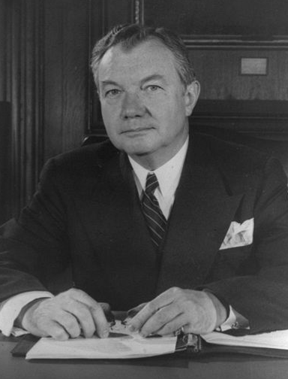
Justice Robert Jackson Concurring
Jackson's opinion took a more flexible approach to the issue, eschewing any fixed boundaries between Congress' and the President's power.
Specifically, Jackson divided presidential war powers into three categories, ranked in descending order of legitimacy:
The President acts with the express or implied authority from Congress;
Congress is silent;
The President defies the express or implied will of Congress.
Jackson reasoned that the seizure fell within the third category as Taft-Hartley expressly rejected presidential seizure as a remedy for labor strikes.
Jackson’s opinion has become the standard for judging presidential war powers.

Slide 15
War Powers Resolution (1973)
As the U.S. became embroiled in military conflicts in Korea and Vietnam War, members of Congress became concerned that legislation was needed to regulate presidential military action in circumstances when congress had not officially declared war.
Passed over President Richard Nixon’s veto, the law requires:
the president to submit a report within 48 hours “in any case in which United States Armed Forces are introduced … into hostilities or into situations where imminent involvement in hostilities is clearly indicated by the circumstances;”
And “terminate any use of United States Armed Forces with respect to which a report was submitted (or required to be submitted)” within 60 days unless he deems an additional 30 days necessary;
“unless the Congress…has declared war or has enacted a specific authorization for such use of United States Armed Forces;”
And at any point “forces shall be removed by the President if the Congress so directs by concurrent resolution.”
Is the War Powers Resolution (WPR) constitutional?
While the Supreme Court has never ruled on its constitutionality, every president has taken the position that it is unconstitutional. And when president’s regularly submit reports to congress concerning military actions they say that they are doing so “consistent with” as opposed to “pursuant to” the WPR.

Slide 16
War on Terrorism
Sep 11, 2001 – The Bush Administration states that the nation has been attacked by Al Qaeda via commercial airlines.
Sep 18, 2001 – Congress passes the “Authorization for the Use of Military Force” (AUMF) authorizing the president to “use all necessary and appropriate force against those nations, organizations, or persons he determines planned, authorized, committed, or aided the terrorist attacks.”
Oct 7, 2001 – U.S. military invades Afghanistan.
Nov 13, 2001 – President Bush issues an executive order providing for the detention and military trial of non-citizen enemy combatants. Hundreds of people are held at the U.S. detention camp at Guantanamo Bay, Cuba and they begin legal proceedings in U.S. courts seeking release.
Oct 16, 2002 – Congress passed the “Iraq War Resolution.”
March 20, 2003 – U.S. military invades Iraq.

Slide 17
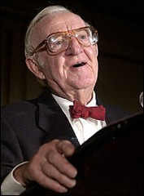
Rasul v. Bush (2004)
Can non-citizen detainees challenge their detentions in U.S. courts?
The Supreme Court found that the degree of control exercised by the United States over the Guantanamo Bay base was sufficient to trigger the application of habeas corpus rights. Justice John Paul Stevens, using a list of precedents stretching back to mid-17th Century English Common Law cases, found that the right to habeas corpus can be exercised in "all ... dominions under the sovereign's control."
He said that because the United States exercised "complete jurisdiction and control" over the base, the fact that ultimate sovereignty remained with Cuba was irrelevant.
Further, Stevens wrote that the right to habeas corpus is not dependent on citizenship status and applies to all persons under the control of the United States.
The detainees were therefore free to bring suit challenging their detention as unconstitutional.

Slide 18
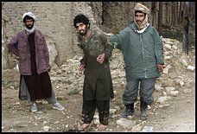
Hamdi v. Rumsfeld (2004)
In the fall of 2001, Yaser Hamdi, an American citizen, was arrested by the United States military in Afghanistan. He was accused of fighting for the Taliban against the U.S., declared an "enemy combatant," and transferred to a military prison in Virginia. Frank Dunham, Jr., a defense attorney in Virginia, filed a petition for a writ of certiorari in federal district court there, first on his own and then for Hamdi's father, in an attempt to have Hamdi's detention declared unconstitutional. He argued that the government had violated Hamdi's Fifth Amendment right to Due Process by holding him indefinitely and not giving him access to an attorney or a trial. The government countered that the Executive Branch had the right, during wartime, to declare people who fight against the United States "enemy combatants" and thus restrict their access to the court system.
Can U.S. citizens be deemed enemy combatants? Yes.
Can U.S. citizen-enemy combatants be denied due process? No.

Slide 19
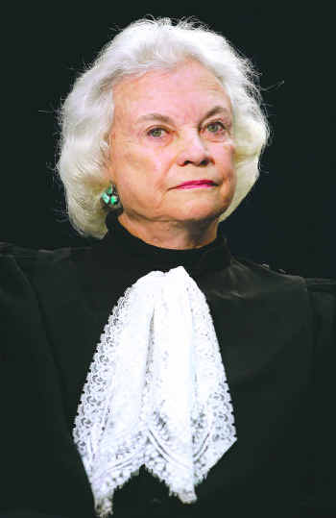
Justice Sandra Day O’Connor Delivered the Majority Opinion
Justice Sandra Day O'Connor wrote for five justices that Congress authorized the president to declare and detain enemy combatants when they passed the Authorization for the Use of Military Force one week after the terrorist attacks of Sep. 11, 2001.
However, she also held for eight justices that Fifth Amendment due process guarantees give a citizen held in the United States as an enemy combatant the right to contest that detention before a neutral decisionmaker (though that can be a military tribunal or something less, the presumption is with the government, and hearsay is allowable).
“We have long since made clear that a state of war is not a blank check for the President when it comes to the rights of the Nation’s citizens.”

Slide 20
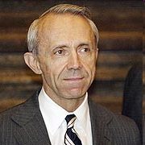
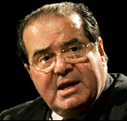
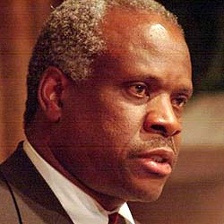
The Hamdi Dissenters
Justices Souter and Ginsburg, concurring and dissenting in part, said that Congress had not given the president such authority by the broadly worded AUMF.
Justices Scalia and Stevens said in their dissent that absent a formal suspension of the writ of habeas corpus, citizens must be tried for treason.
Justice Thomas said in his dissent that the AUMF is explicit approval for the president to do whatever he wants with citizen enemy combatants.
As they had during the Civil War and WWII, the justices again declined to answer the question of whether the president can unilaterally suspend habeas corpus and declare citizens enemy combatants.
In Jul. 2004 the Bush Administration set up Combatant Status Review Tribunals (CSRT) to comply with the Court’s decision in Hamdi.
In Sep. 2004, the Bush Administration cut a deal with Hamdi. He would not be criminally prosecuted and was sent home to his family in Saudi Arabia on a Defense Dept. jet. However, he had to renounce his U.S. citizenship, pledge never to sue the U.S., and agree never to set foot in Afghanistan, Iraq, Israel, Pakistan, Syria, the West Bank and Gaza Strip, and the United States.

Slide 21
Detainee Treatment Act (2005)
On December 30, 2005 Congress passed and the President signed into law the Detainee Treatment Act (DTA) which provided for the treatment of enemy combatants but also stripped the federal courts of jurisdiction to hear habeas corpus petitions from non-citizens detained at Guantanamo Bay, Cuba.

Slide 22
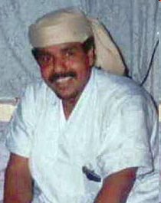
Hamdan v. Rumsfeld (2006)
In 2004 Salim Hamdan, a Yemen citizen, was captured by militia in Afghanistan and turned over to U.S. forces. He was sent to Guantanamo Bay, Cuba and charged with conspiracy to commit offenses triable by a military commission. Specifically, the government alleged that between 1996 and 2001 Hamdan willfully and knowingly joined an enterprise of persons who shared a common criminal purpose of attacking civilians and civilian objects. There was no allegation that Hamdan had any command responsibilities, exercised any leadership, or participated in the planning of any activity. His role in the conspiracy, according to the government, included acting as Osama bin Laden’s personal driver, arranging and providing transportation for Al Qaeda members, and receiving weapons training at Al Qaeda-sponsored camps.
As the military commission was set to begin, Hamdan filed for a writ of habeas corpus in U.S. district court arguing that the commission lacked the authority to try him because conspiracy is not a triable offense under the Geneva Convention and that the commission’s procedures violate military and international law, including the principle that a defendant must be permitted to see the evidence against him.
The U.S. District Court ruled in Hamdan’s favor but a 3-judge panel of the Court of Appeals for the D.C. Circuit unanimously reversed with Judge (and future U.S. Chief Justice) John Roberts in the majority.

Slide 23
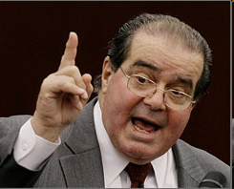
Scalia’s Crystal Ball
In a March 2006 speech in Switzerland (prior to oral argument and three months before the Court handed down the Hamdan decision), Scalia said: “Give me a break. I had a son on that battlefield, and they were shooting at my son, and I’m not about to give this man who was captured in a war a full jury trial. I mean, it’s crazy.”
Some called for Scalia’s recusal in the case but he participated.

Slide 24
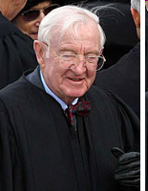
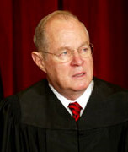
Justice John Paul Stevens for the Majority
The Court ruled 5-3 that the neither the AUMF nor the DTA expanded the President’s authority to convene military commissions.
Therefore, the President must comply with the requirements of the Uniform Code of Military Justice and the Geneva Convention, which generally provide for proceedings consistent with courts-martial:
“We conclude that the military commission convened to try Hamdan lacks power to proceed because its structure and procedures violate both the UCMJ and the Geneva Conventions. Four of us also conclude that the offense with which Hamdan has been charged is not an ‘offense that by…the law of war may be tried by military commissions.”
In a separate concurring opinion, Justice Anthony Kennedy hinted that congress could change the law to allow military commissions with lesser standards than courts-martial.

Slide 25
Military Commissions Act (2006)
Congress responded to Hamdan by passing the Military Commissions Act (MCA), which essentially amended the DTA to include those provisions suggested by Justice Kennedy’s concurrence:
Military tribunals do not have to follow general courts-martial procedures but must follow other specific procedures outlined in the Act;
Geneva Convention-rights are not applicable;
Habeas petitions cannot be brought in U.S. courts except in limited circumstances and only after military commission decisions.

Slide 26
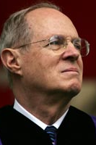
Boumediene v. Bush (2008)
Justice Anthony Kennedy wrote the 5-4 majority opinion that the Military Commissions Act of 2006 unconstitutionally limited detainee's access to judicial review and that detainees have the right to challenge their detention in conventional civilian courts under Article I, Section 9 of the Constitution.
Furthermore, Kennedy wrote that If Congress intends to suspend the right, an adequate substitute must offer the prisoner a meaningful opportunity to demonstrate he is held pursuant to an erroneous application or interpretation of relevant law, and the reviewing decision-making must have some ability to correct errors, to assess the sufficiency of the government's evidence, and to consider relevant exculpating evidence.
In dissent, Justice Scalia argued that "the procedures prescribed by Congress in the Detainee Treatment Act provide the essential protections that habeas corpus guarantees; there has thus been no suspension of the writ, and no basis exists for judicial intervention beyond what the Act allows."

Slide 27
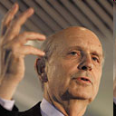
Aftermath: Breyer Comments
After a September 8, 2008 speech at the University of Arizona Rogers College of Law, Breyer was asked about recent Supreme Court rulings that rebuked the Bush Administration's assertions of executive power. Breyer said that in the series of Guantanamo rulings, the executive branch had lost three times and Congress twice. "We said bin Laden's driver was right," Breyer said, referring to the 2006 Hamdan v. Rumsfeld decision.
Breyer also noted that President George W. Bush, in responding to his latest Supreme Court defeat in a detainee case, said, "I don't have to like it, but I'll follow it."
The audience rose to its feet in applause when Breyer said, "I thank you, President Bush, for those words. In them is the history of the United States of America."

Slide 28
Military Commissions Act (2009)
On October 28, 2009, President Obama signed into law the Military Commissions Act of 2009, which amended the Military Commissions Act of 2006 and provided new rules for the handling of commission trials and commission defendants' rights.
A new 281 page set of procedures for conducting military commissions in accordance with the Military Commissions Act of 2009 was released on May 4, 2010 but there has been internal disagreement within the Obama administration on how to proceed.

Slide 29
Conclusion
In its WWII-era cases the Supreme Court seemed to give broad latitude to the elected branches in the area of war powers.
Yet the Steel Seizure Case and the War Powers Resolution suggests that Congress is willing to assert its authority against the President’s power as Commander in Chief.
In a series of cases during the War on Terrorism the Court repeatedly, yet narrowly, rebuked both the Bush Administration and the Republican Congress in their attempts to handle detainees.
The Court’s latest decisions in this area suggest that the justices are not only willing to decide war powers cases but also to rule against the elected branches during a time of war.

