Slide 1
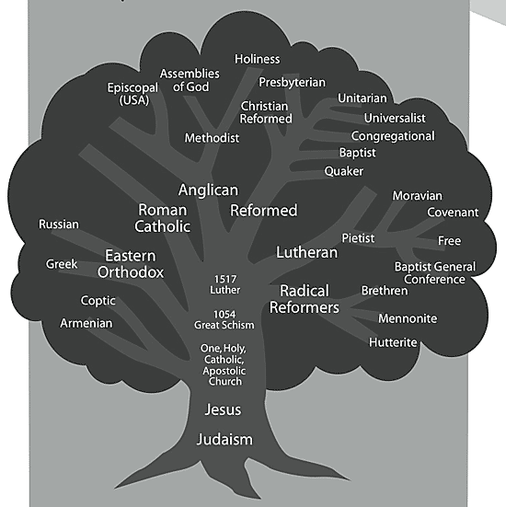
Essential Question:
What caused the Protestant Reformation?
Warm-Up Q:
Look at this image: What is the main idea of the Protestant Reformation?

Slide 2
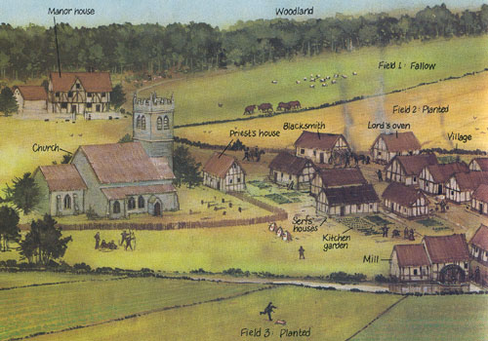
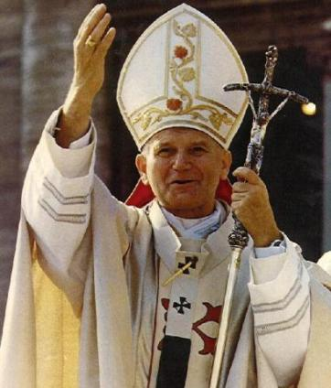
During the Middle Ages, the Catholic Church was the dominant religion in Western Europe
Without a common government in Europe, the Catholic Pope became an important political leader
On the manor, priests were powerful because the controlled peoples’ access to heaven by delivering the sacraments & absolving sins
Notes:
Medieval Christians’ everyday lives were harsh. Still, they could all follow the same path to salvation—everlasting life in heaven. Priests and other clergy administered the sacraments, or important religious ceremonies. These rites paved the way for achieving salvation. For example, through the sacrament of baptism, people became part of the Christian community. At the local level, the village church was a unifying force in the lives of most people. It served as a religious and social center. People worshiped together at the church. They also met with other villagers. Religious holidays, especially Christmas and Easter, were occasions for festive celebrations.

Slide 3
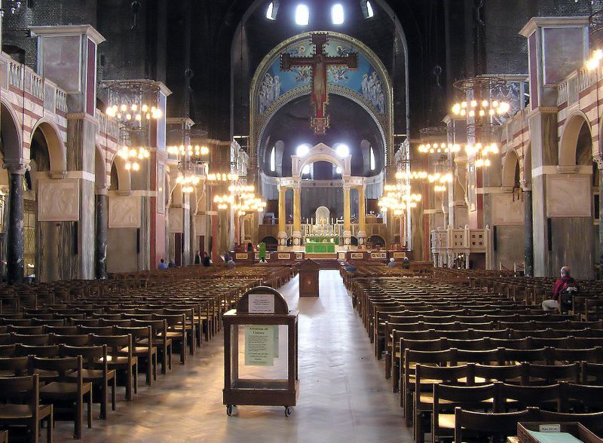
The Catholic Church taught that people could gain access to heaven (called salvation) by having faith in God & doing good works for others
Notes:
Basis of beliefs are the 7 Holy Sacraments:
Baptism, Communion, Confession, Confirmation, Marriage, Ordination of Priests, Last Rites for the Dying
By participating in each sacrament, gain more of God’s grace

Slide 4
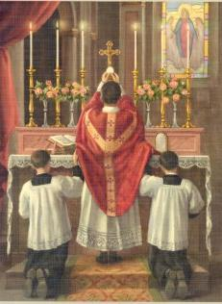
Practices of the Catholic Church
The church taught that Christians could gain more of God’s grace through a series of spiritual rituals called the Holy Sacraments
Sacraments included Baptism, Confirmation, Communion, Confession, Marriage, Ordination of Priests, Last Rites for the Dying
Notes:
Basis of beliefs are the 7 Holy Sacraments:
Baptism, Communion, Confession, Confirmation, Marriage, Ordination of Priests, Last Rites for the Dying
By participating in each sacrament, gain more of God’s grace

Slide 5
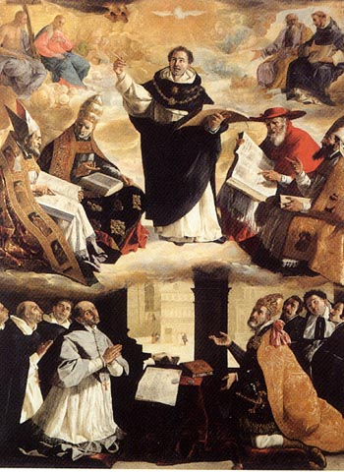
But, the church was also growing corrupt
Clergy members took vows of chastity to abstain from sex…but some church leaders fathered children
Priests were required to go through rigorous training in a monastery…but some church positions were sold to the highest bidder called simony
Sometimes, feudal lords would use their influence to have friends or children named as priests, called lay investiture
As a result, some clergy members were poorly educated

Slide 6
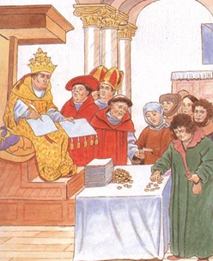
One of the most corrupt church practices was the selling of indulgences
Indulges began as a way for people to repent for their sins through good works
But rather than requiring good deeds, church leaders began selling indulgence certificates as a way of raising money
These practices went unquestioned during the Middle Ages

Slide 7
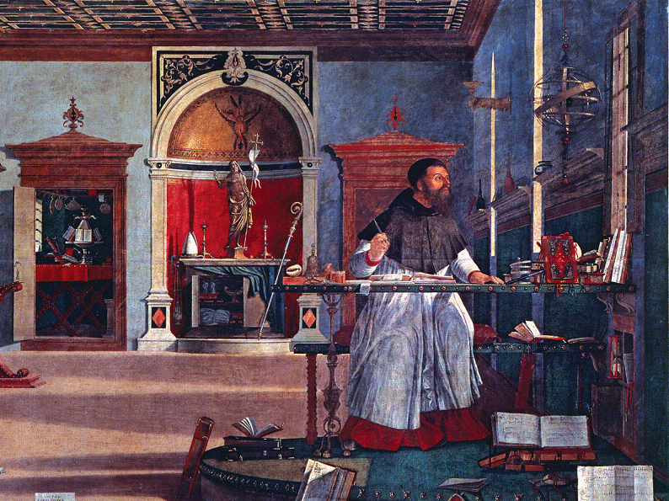
By the time of the Renaissance, some Christians began criticizing church corruptions & questioned Catholic teachings
Christian humanists believed that they could help reform the Catholic Church

Slide 8
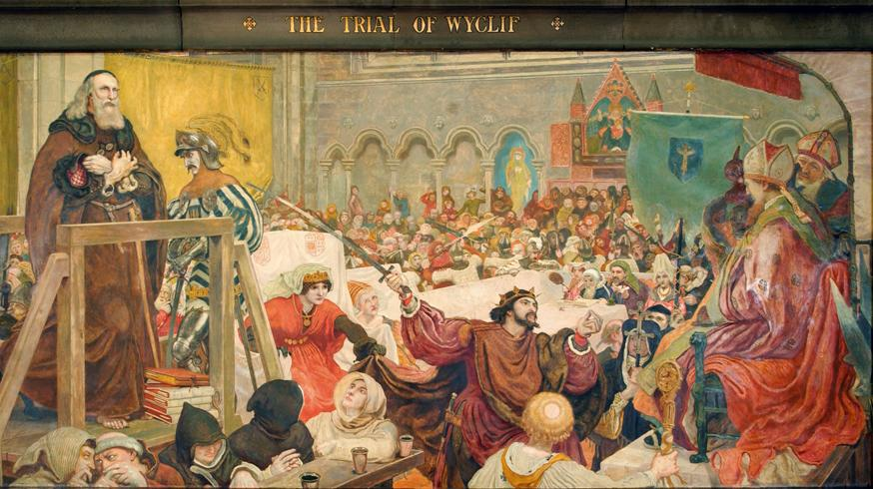
In the 1300s, Reformers like John Wycliffe & priest Jan Hus attacked corruptions like indulges, said that the Bible (not the Pope) was the ultimate authority on Christianity, & wanted church teachings in the vernacular (local language) not Latin

Slide 9
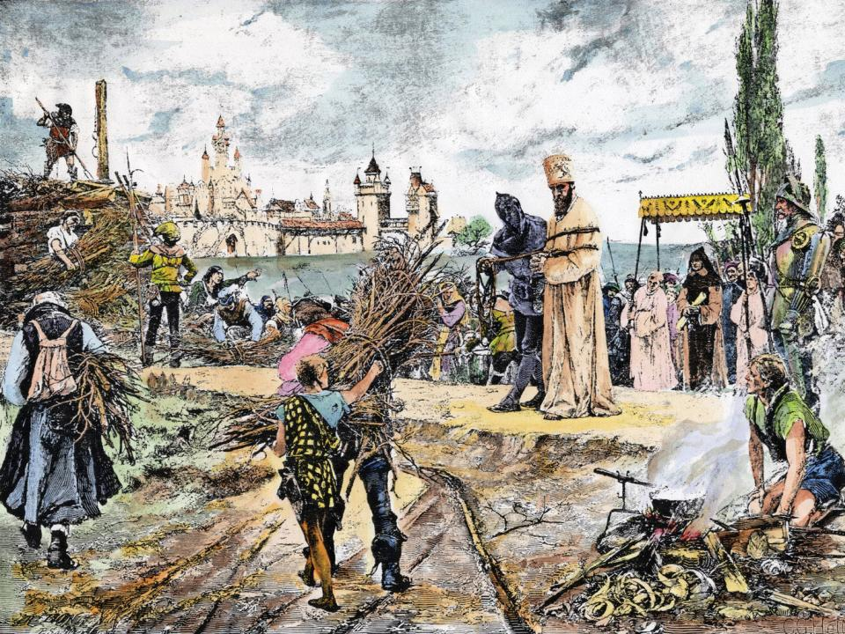
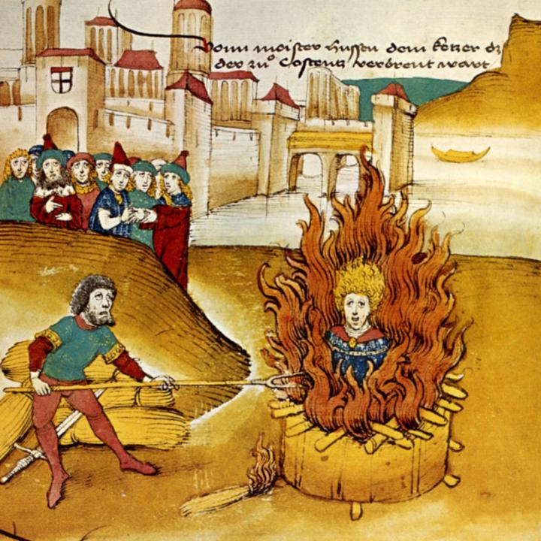
Title
Catholic leaders responded to these criticisms by executing Wycliffe & Hus
Text

Slide 10
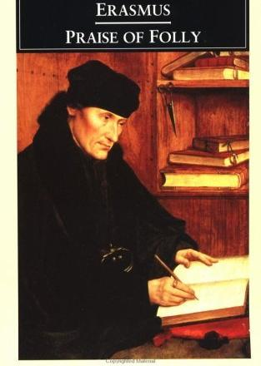
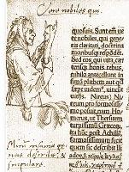
In 1509, Christian humanist Erasmus published Praise of Folly which called for an end of corruptions

Slide 11
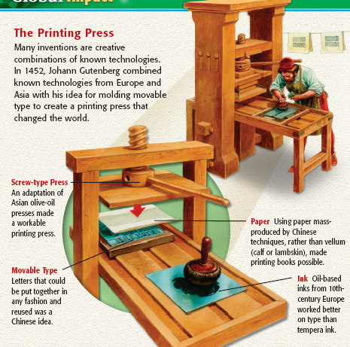
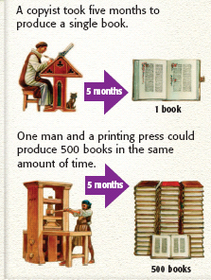
As a result of Johann Gutenberg’s invention of the moveable-type printing press in 1453, Erasmus’ book spread throughout Europe & increased calls for church reform

Slide 12
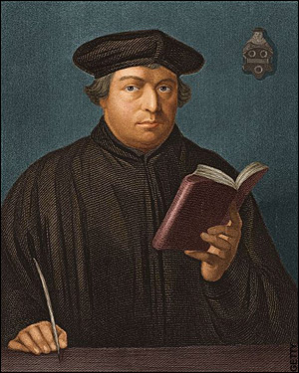
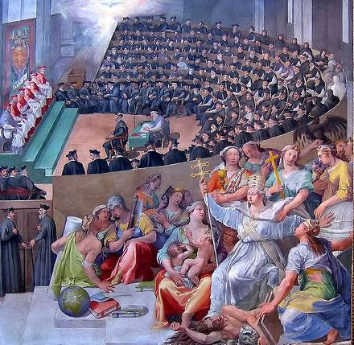
The Protestant Reformation
By the early 1500s, the Catholic Church was in turmoil over the controversy of corruption & its unwillingness to adopt reforms
In Germany, a Catholic monk named Martin Luther became involved in a serious dispute with the Catholic Church

Slide 13
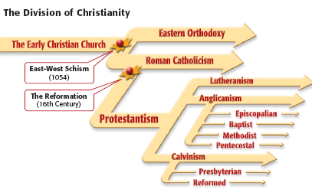
Martin Luther’s break from the Catholic Church began the Protestant Reformation & inspired a series of new Christian denominations
Protestant Reformation
Protest Reform
During the Protestant Reformation, reformers protested church corruptions & practices in hopes of reforming Christianity

Slide 14
The Protestant Reformation

Slide 15
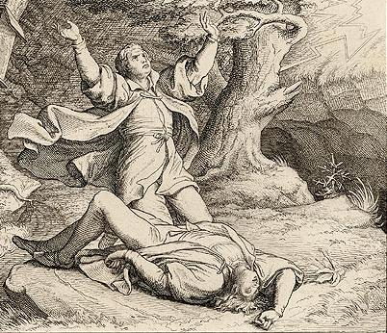
Martin Luther
As a young boy in Germany, Luther was going to become a lawyer, but after he nearly died in a thunderstorm he vowed to become a Catholic priest

Slide 16
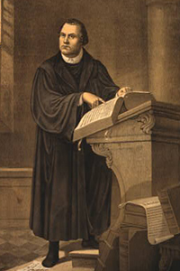
Martin Luther
After studying the Bible as a monk, Martin Luther became a priest & scholar
During his studies of the Bible, Luther became convinced that salvation could not be achieved by good works & sacraments
Instead, Luther was inspired by St. Paul’s Epistle to the Romans: “A person can be made good by having faith in God’s mercy”

Slide 17
Martin Luther
Martin Luther believed that salvation was gained though having faith in God; He called this idea Justification by Faith
Martin Luther was also deeply troubled by the church’s selling of indulgences, which he saw as false salvation

Slide 18
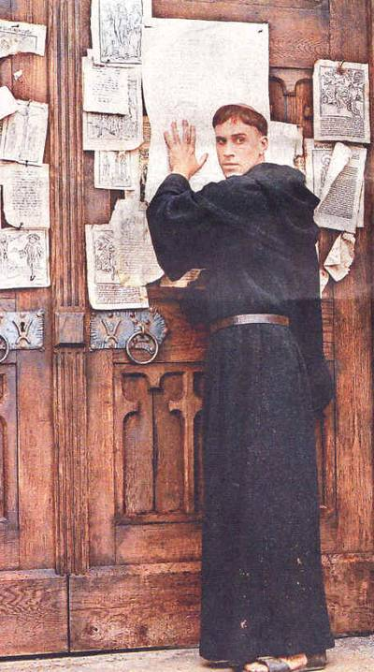
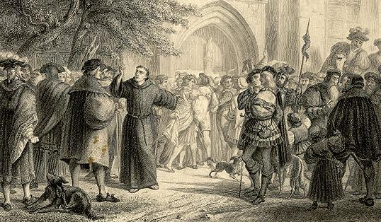
In 1517, Martin Luther wrote a list of arguments against church practices called the “Ninety-Five Theses”
He posted the Ninety-Five Theses on the church door in the town of Wittenberg & welcomed debate of his ideas

Slide 19
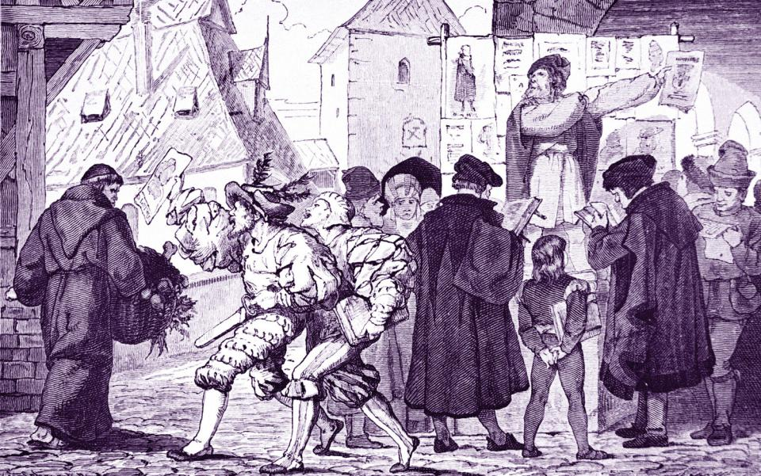
The “Ninety-Five Theses” spread quickly through Europe causing an incredible controversy
Many people, especially in Northern Europe, were excited about his ideas
But the Catholic Church condemned Luther & rejected his ideas

Slide 20
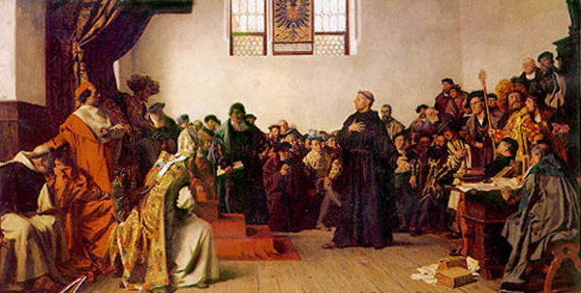
In 1521, Luther was called before the Diet of Worms, a meeting of church & political leaders
The Church demanded that Luther take back his teachings
Luther refused, argued that the Bible was the only source of religious authority, & encouraged Christians to study the Bible for themselves
At the Diet of Worms, Martin Luther was excommunicated from the Catholic Church

Slide 21
Martin Luther’s stand against the Catholic Church led to the formation of a new Christian denomination known as Lutheranism
Lutheranism was the first of a series of “Protestant” Christian faiths that broke from the Catholic Church

Slide 22
Essential Question:
What were the main beliefs of the Protestant faiths: Lutheranism, Calvinism, & Anglicanism?
Pop Quiz!!
☺

Slide 23
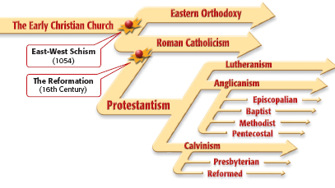
Protestant Faiths
What were the main beliefs & practices of the first Protestant faiths: Lutheranism, Calvinism, & Anglicanism?
As a class, read the placards on Lutheranism, Calvinism, & Anglicanism
Complete the chart as you read
Be prepared to discuss your answers

Slide 24
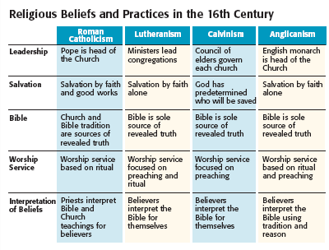
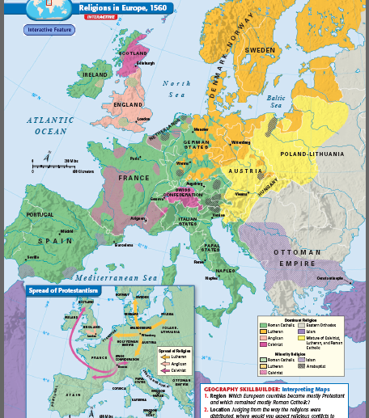
Protestant Reformation

