Slide 1
The Mongols
AP World History Notes
Chapter 12

Slide 2
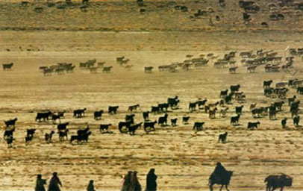
Review of Pastoralists (Pastoralism vs. Agriculture)
Relied on raising livestock instead of growing food
Used every part of the animal: milk, blood, wool, hides, and meat
Animals also used for transportation & the military
Less productive economy overall
Smaller populations
Lived in small encampments with related kinfolk
Organized by: families, clans, and/or tribes

Slide 3
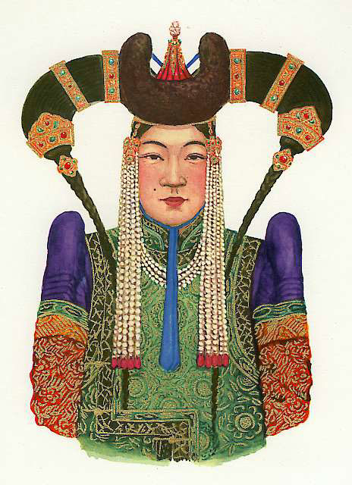
Review of Pastoralists (Pastoralism vs. Agriculture)
Pastoralists offered women a higher status in society
Fewer restrictions
Greater role in public life
Involved in productive labor
Mongol women:
Could initiate divorce
Could remarry if widowed
Served as political advisors
Active in the military
Prominent Mongol Woman

Slide 4
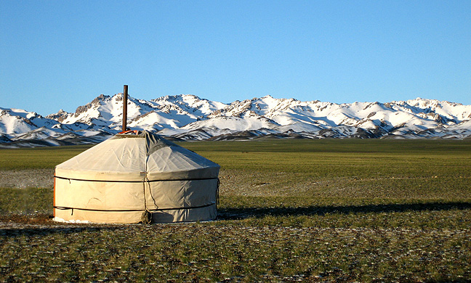
Review of Pastoralists (Pastoralism vs. Agriculture)
Pastoralists = nomadic
Traveled in systematic patterns based on seasonal changes and environmental conditions
Not homeless → took their homes and belongings with them
Mongolian Yurt

Slide 5
Pastoralists: Economic Interactions
Often traded with their agricultural neighbors
Wanted food, manufactured products, and luxury items
This desire for goods sometimes caused the creation of larger tribal confederations or nomadic states that could more effectively deal with larger civilizations

Slide 6
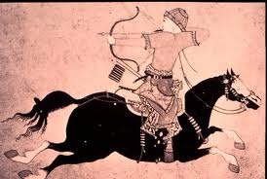
Pastoralists: Military Interactions
Nomadic states had military advantages
Horseback riding and hunting skills
Entire male population and many females trained in these skills
Used their militaries to extract wealth from larger civilizations → through raiding, trading, and extortion

Slide 7
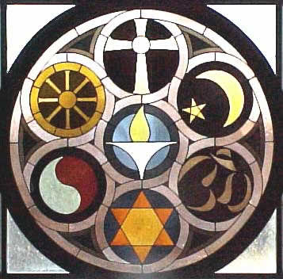
Pastoralists: Cultural Interactions
Many pastoralists became familiar with and experimented with foreign:
Religions and philosophies
Clothing and hair styles
Languages
Political and social ideas

Slide 8
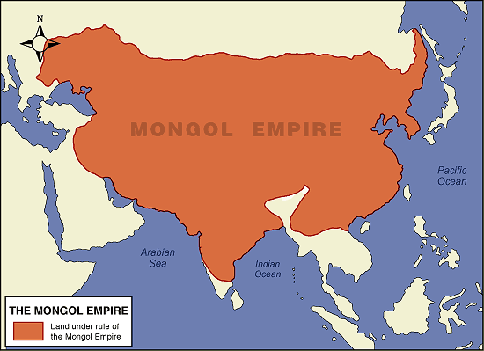
The Mongol Empire
Largest land-based empire in world history
Stretched from the Pacific coast of Asia to Eastern Europe
Brought the major civilizations of Eurasia (Europe, China, and the Islamic world) into more direct contact than ever before

Slide 9
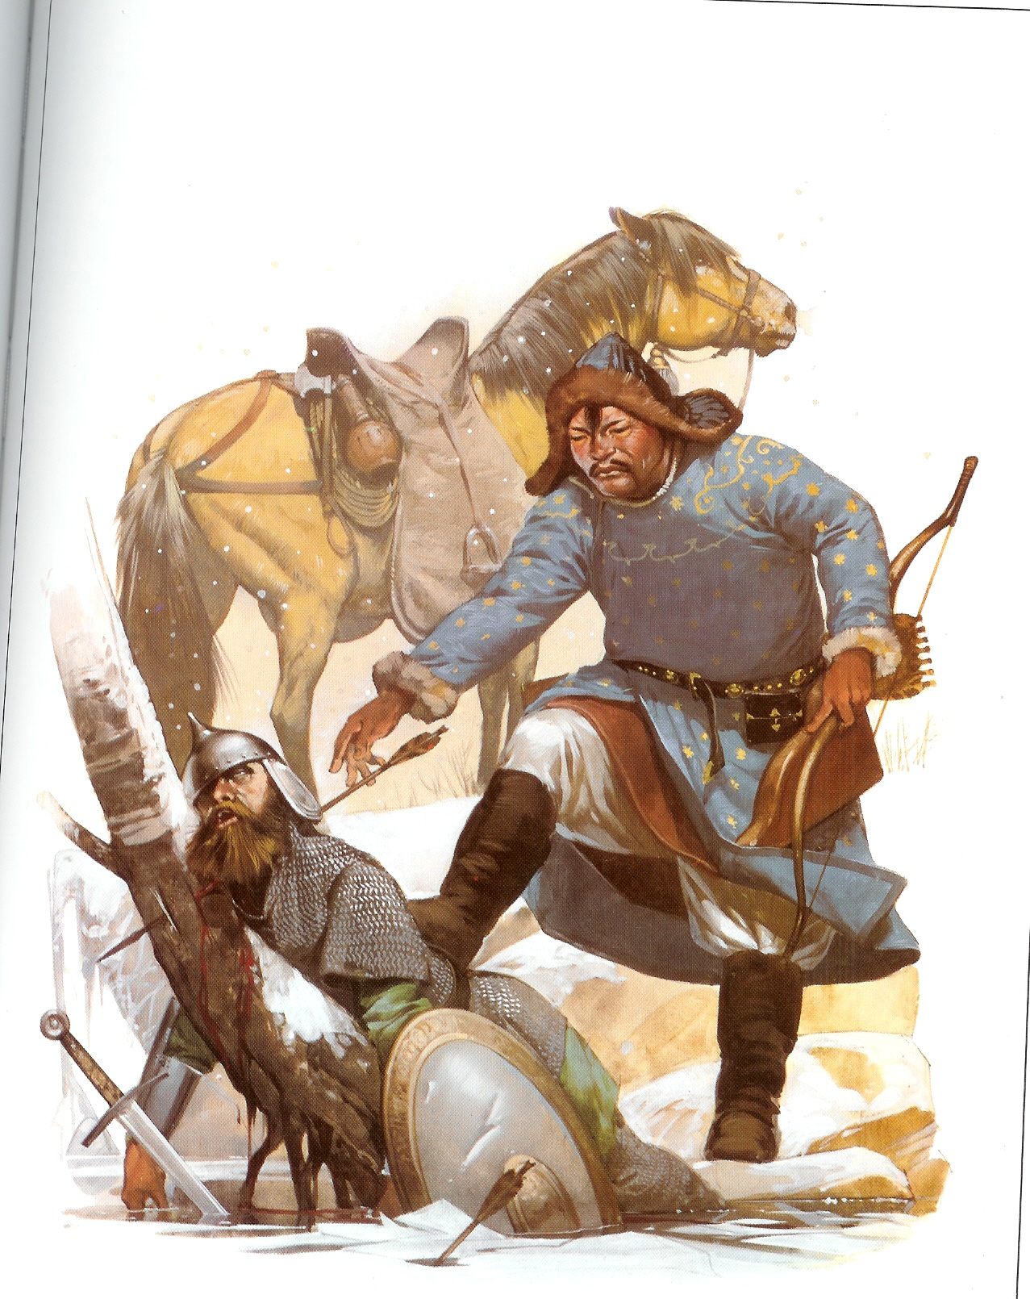
The Mongol Empire
One major contribution = facilitated worldwide networks of exchange and communication
No real cultural impact
Did not spread any major religion
Did not spread their language or culture
What did they offer? Status of defeated, conquered, and subordinate

Slide 10
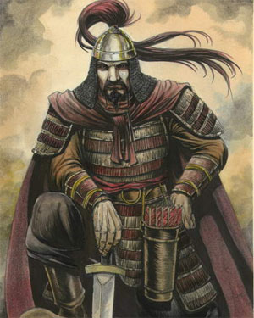
Temujin (1162-1227)
United and led the Mongols
How did he rise to power?
Capitalized on shifting tribal alliances and betrayals
Mounting string of military victories
Enemies were indecisive
Used his reputation as a leader generous to friends and ruthless to enemies
Incorporated warriors from defeated tribes into his own forces

Slide 11
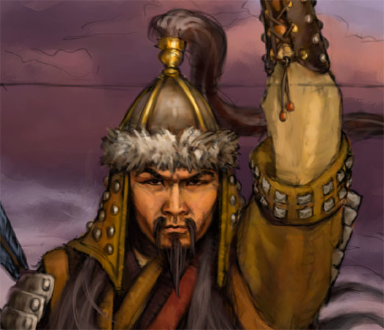
Temujin
1206 = a Mongol tribal assembly recognized Temujin as Genghis Khan
Means “universal” or “supreme” ruler

Slide 12
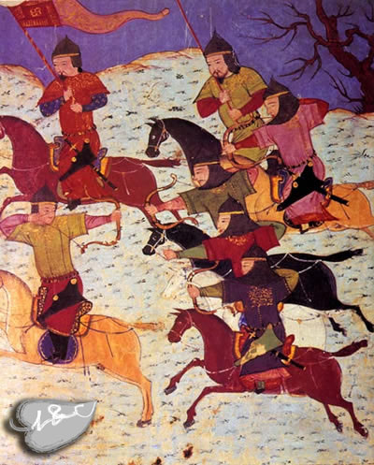
Mongol Expansion
Two major reasons for Mongol expansion under Genghis Khan:
The newly united Mongols needed a common task or else they would fragment and fall apart
He needed external resources with which to reward his followers
1st goal = China

Slide 13
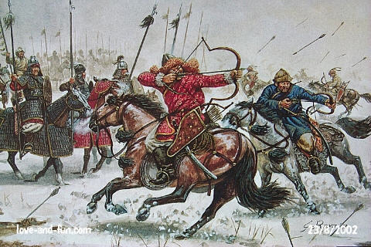
Mongol Expansion
1209 = marks the beginning of Mongol conquests
Conquests continued for about 50 years under Genghis Khan and his grandsons = Ogodei, Mongke, and Kublai
Final empire contained: China, Korea, Central Asia, Russia, much of the Islamic Middle East, and parts of Eastern Europe

Slide 14
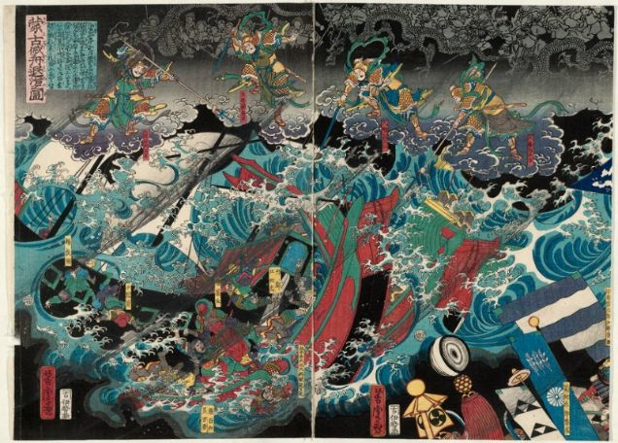
Mongol Expansion
Mongol expansion put in check by a few setbacks, which marked the limits of the empire:
1242 = Withdrawal from Eastern Europe
1260 = Defeat by Egyptian forces in Palestine
1274 & 1281 = Two failed invasions of Japan
Difficulty of moving through the tropical jungles of Southeast Asia
Painting of the Defeat of the Mongol Invasion Fleet

Slide 15
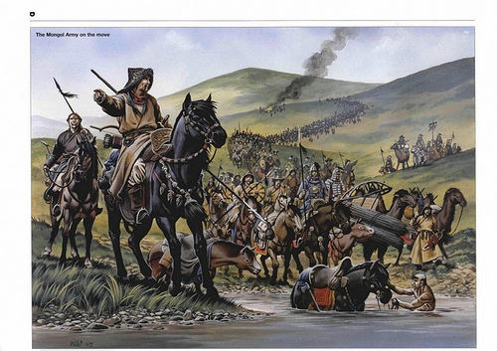
The Mongol Military
Genghis Khan reorganized the entire social structure of the Mongols into military units
Of 10, 100, 1,000, and 10,000 warriors
Allowed for effective control and command
Conquered tribes = broken up and dispersed throughout these units

Slide 16
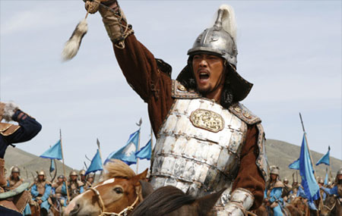
The Mongol Military
Displayed incredible discipline and loyalty
People that deserted their unit in battle = put to death
Unit leaders fought alongside their men
ALL Mongols benefited from the wealth that flowed into the Mongol Empire from conquered civilizations

Slide 17
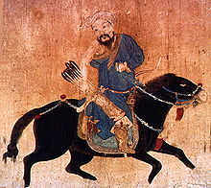
The Mongol Military
Conquered people were incorporated into the military
Nomads = put into the cavalry
Settled peoples = infantry and artillery forces
Other conquered people served as laborers → built roads and bridges, carried supplies, etc.
Artisans and craftsmen = typically spared from massacre, enslaved, and put to work

Slide 18
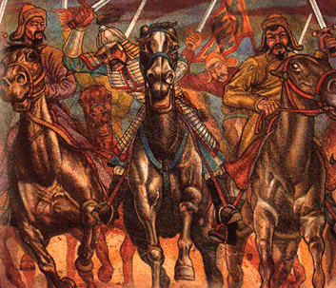
The Mongol Military
Brutal and ruthless military tactics
All who resisted Mongol rule = slaughtered along with their wives, children, and dependents
Cities destroyed
Their brutality worked as psychological warfare also → many of those that heard about the Mongols were afraid and voluntarily surrendered

Slide 19
Mongol Efficiency
Mobilized human and material resources
Detailed census taking
Knew how many people they controlled and what resources were available to them
Allowed them to effectively tax the people
Set up an effective system of relay stations
Provided for rapid communication
Fostered trade
Centralized government
Various government offices
Scribes translated laws into the various languages people spoke throughout the empire

Slide 20
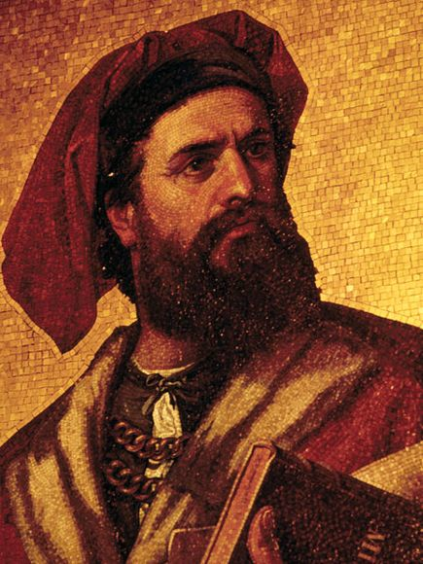
Marco Polo
Merchant from Venice, Italy
Traveled throughout the Mongol Empire for almost 3 decades
Utilized Mongolian relay stations and road networks
Kept a diary of everything he encountered and experienced
Primary way in which Europeans learned about the east

Slide 21
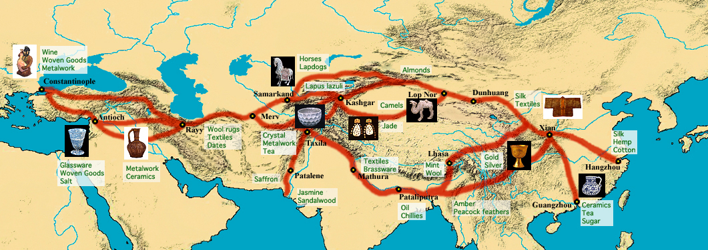
Mongolian Economic Policies
Wanted to foster trade
Allowed merchants free use of their relay stations
Often offered merchants 10% more than their asking price

Slide 22
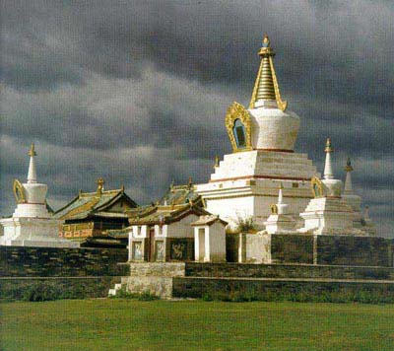
Mongolian Administrative Policies
Mongols held the highest decision-making posts
Chinese and Muslim officials held many advisory and lower-level positions
Ancient Mongol capital = Karakorum

Slide 23
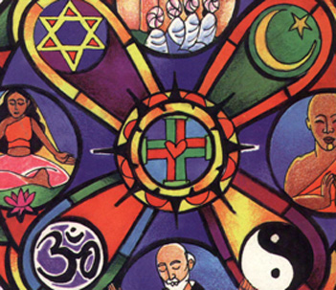
Mongolian Religious Policies
Total religious toleration → as long as religion wasn’t the cause of political opposition
Major religions throughout the Mongol Empire = Buddhism, Christianity, Islam, and Daoism

