Slide 1
The Mongol Empire as a Eurasian Network
AP World History Notes
Chapter 12

Slide 2
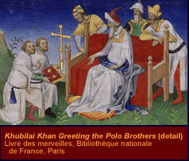
Toward a World Economy
Mongols did not make or trade anything themselves
But they did promote international commerce by maintaining secure trade networks
Done so that they could tax goods and extract wealth from larger civilizations
Result = brought the two ends of the Eurasian world (Europe and China) into closer contact than ever before
Result = start of a truly international economy

Slide 3
Diplomacy on a Eurasian Scale
In addition to facilitating long-distance trade, the Mongols also prompted diplomatic relationships throughout Eurasia
Closest relationship = between the courts of China and Persia
Regularly exchanged ambassadors
Shared intelligence information
Fostered trade between their regions
Sent skilled workers back and forth

Slide 4
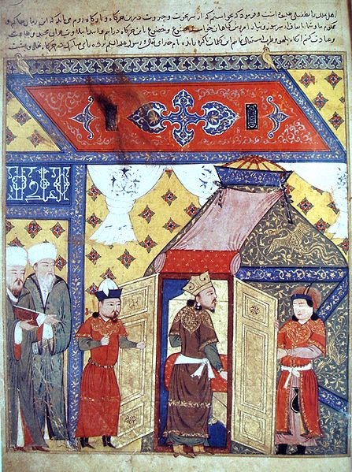
Cultural Exchange in the Mongol Realm
Substantial exchange of peoples and cultures
Missionaries and traders traveled throughout the empire
Mongols forcibly transferred skilled craftsmen and educated people to distant parts of the empire
Policy of religious tolerance spread religions
Result = exchange of ideas and techniques
Persian depiction of Ghazan’s conversion to Islam

Slide 5
Cultural Exchange in the Mongol Realm
Region | Major Contributions
China | Daoism, acupuncture, painting, printing, gunpowder weapons, compass navigation, medical techniques
Persia / the Middle East | Islam, astronomy, lemons, carrots
Byzantium | Christianity

Slide 6
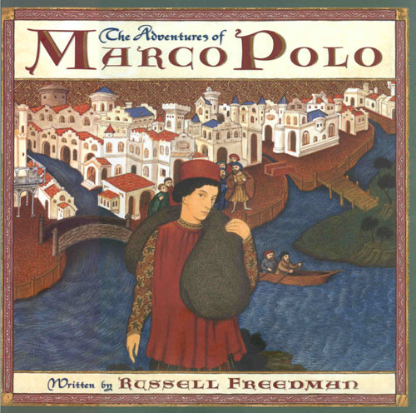
Cultural Exchange in the Mongol Realm
Europeans benefited the most from this exchange
Had been more cut off from the rest of the world
Had been less technologically developed
Were able to benefit without the devastating consequences of Mongol conquest

Slide 7
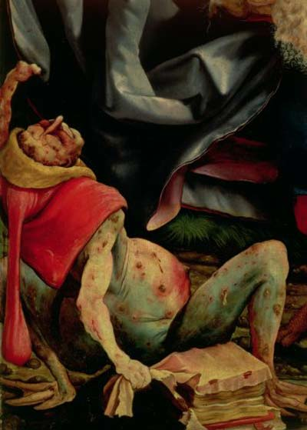
The Plague
Originated in Central Asia
Spread across trade routes of the Mongol Empire
Carried by rodents and transmitted to humans by fleas
1331 = erupted in northern China
1347 = had reached the Middle East and Western Europe
1348 – 1350 = ½ of Europe’s population died
Result = sharp decline in the Eurasian population for over a century

Slide 8
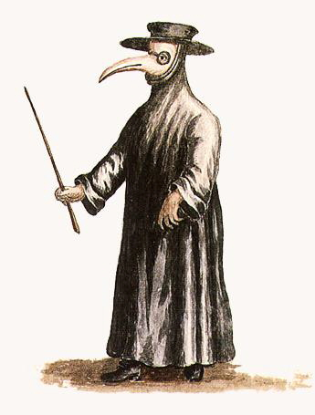
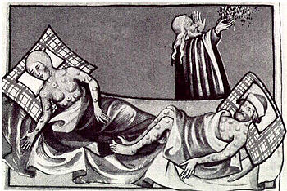
The Plague

Slide 9
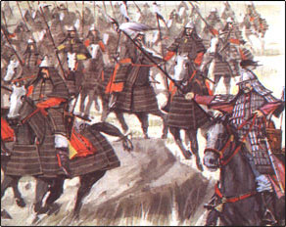
The Plague: Results
Primary reason for the demise of the Mongol Empire
Population contracted
Cities declined
Volume of trade diminished all across the world
By 1350 = Mongol Empire was in disarray
Within a century → Mongols lost control of the Chinese, Persian, and Russian civilizations

Slide 10
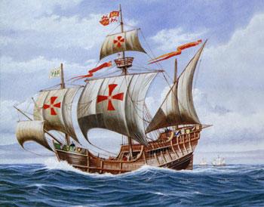
The Plague: Results
Europeans turned to the sea in their continuing efforts to reach Asia
WHY?
Disruption of Mongol-based land routes
Desire to avoid Muslim intermediaries (and their heavy taxes)

