Slide 1
Essential Question:
What were the key events in the 20th century that shaped the history of the Middle East?
Warm Up Questions:

Slide 2
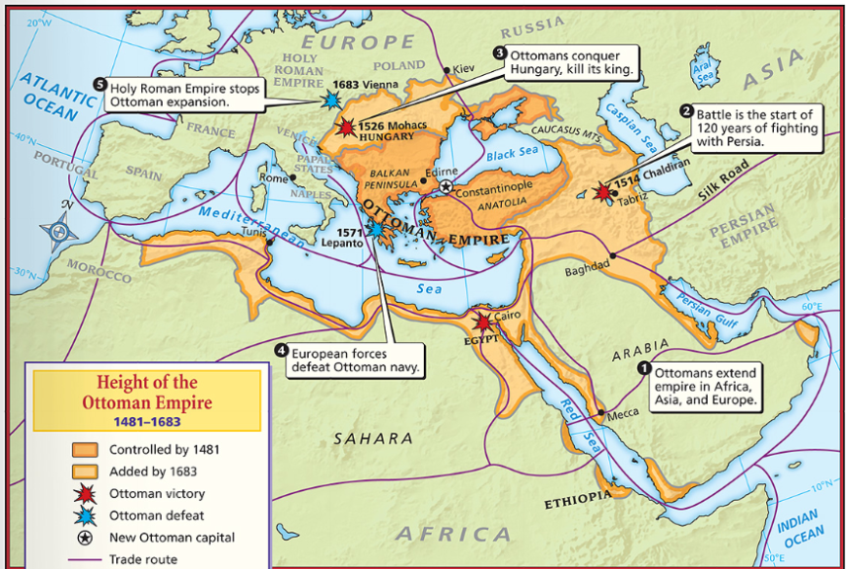
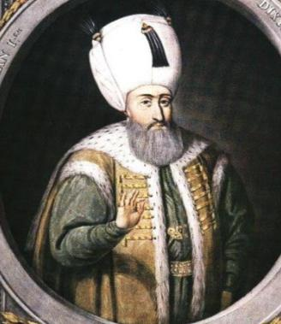
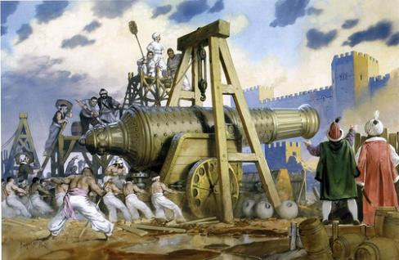
From 1300 through the 1600s, the Ottoman Empire was the most powerful empire in Southwest Asia & North Africa
From 1700s to 1922, the Ottoman Empire grew weak due to poor leadership
Suleyman the Lawgiver
Janissaries & “gunpowder” empire

Slide 3
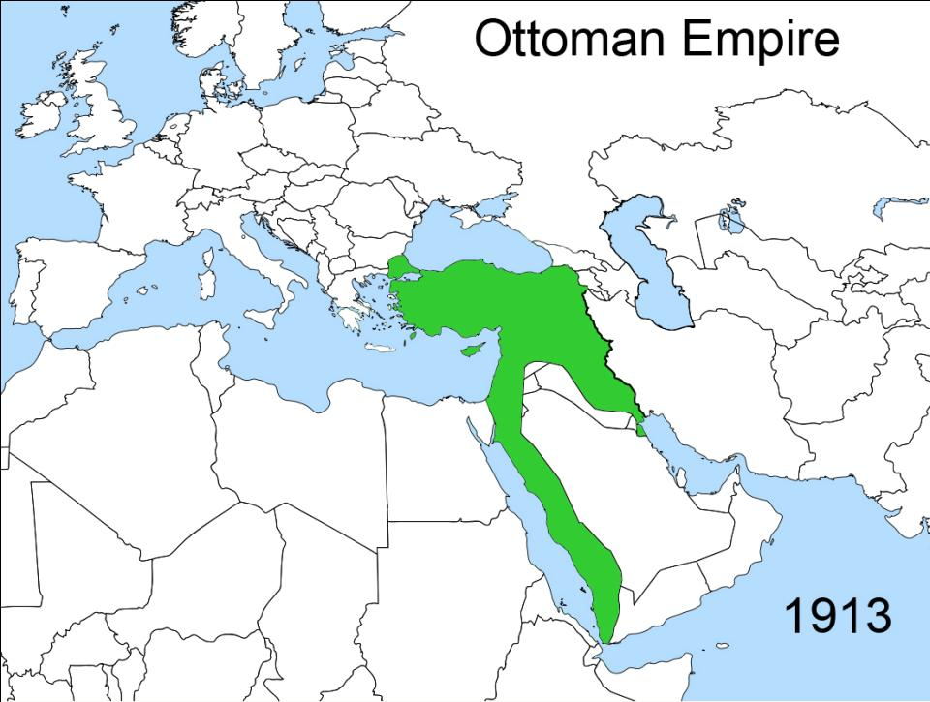
By the outbreak of World War I, the Ottoman Empire was the “sick man of Europe”

Slide 4
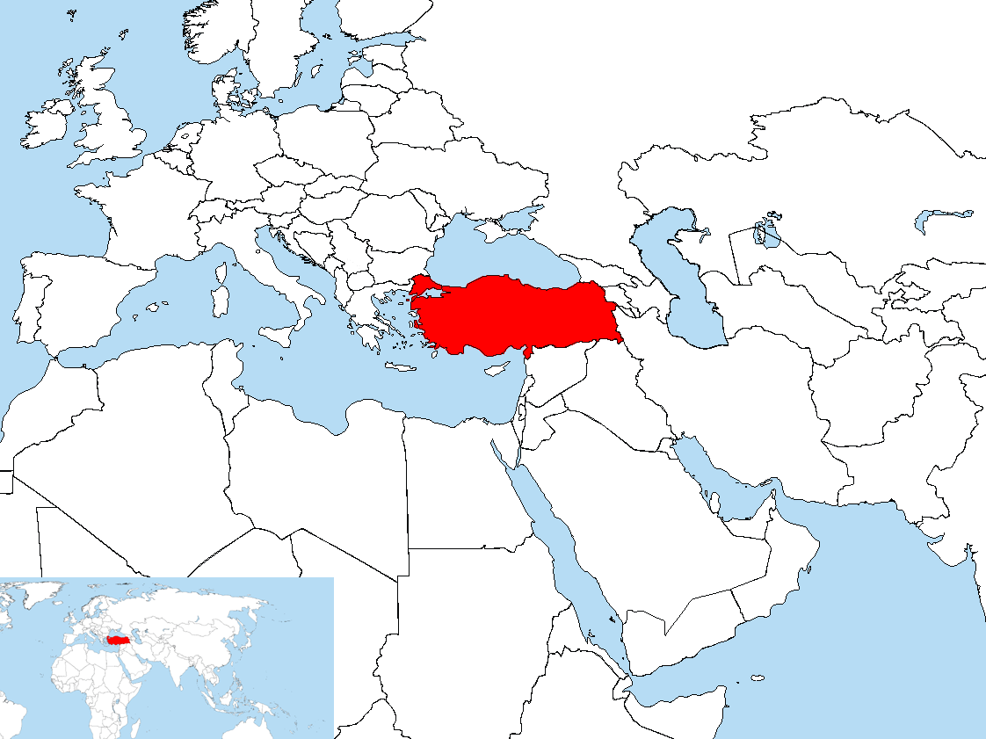
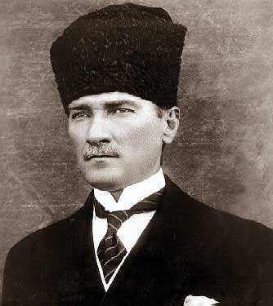
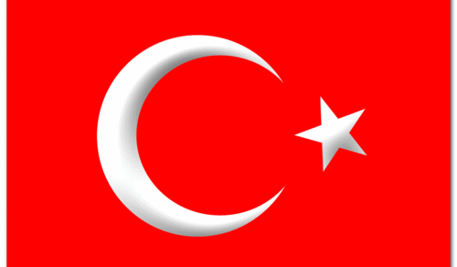
When the Central Powers lost World War I in 1919, the Ottoman Empire broke apart & was forced to give up all territories except Turkey
In 1922, Nationalist leader Mustafa Kemal overthrew the last Ottoman sultan & created the Republic of Turkey

Slide 5
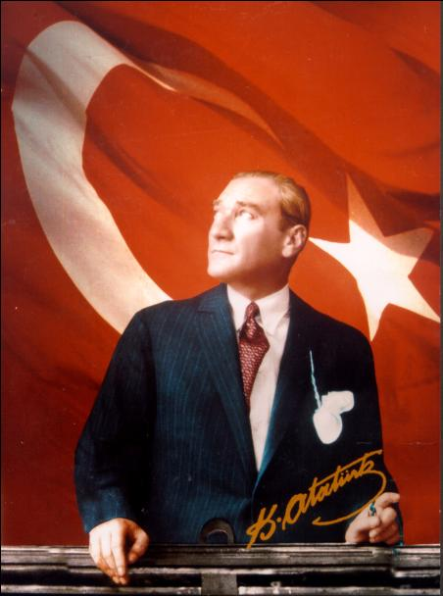
Kemal was elected Turkey’s first president in 1923 & became known as “Ataturk” (Father of the Turks)
As President, Kemal transformed Turkey into a modern nation
Kemal separated the laws of Islam from the laws of the nation & introduced a European-style legal code
He granted women the right to vote & run for public office
He encouraged industry & a capitalist economy

Slide 6
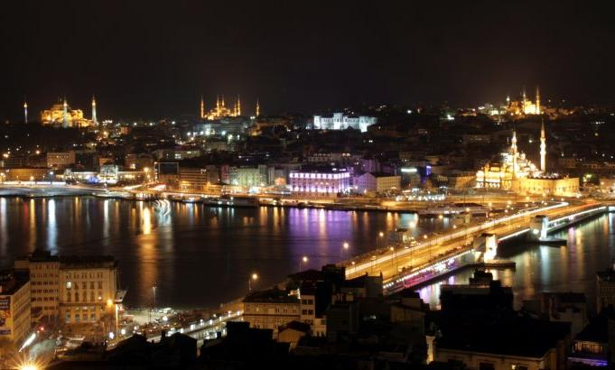
Today, Turkey is a wealthy nation with a model democracy that protects freedom among a largely secular Islamic population

Slide 7
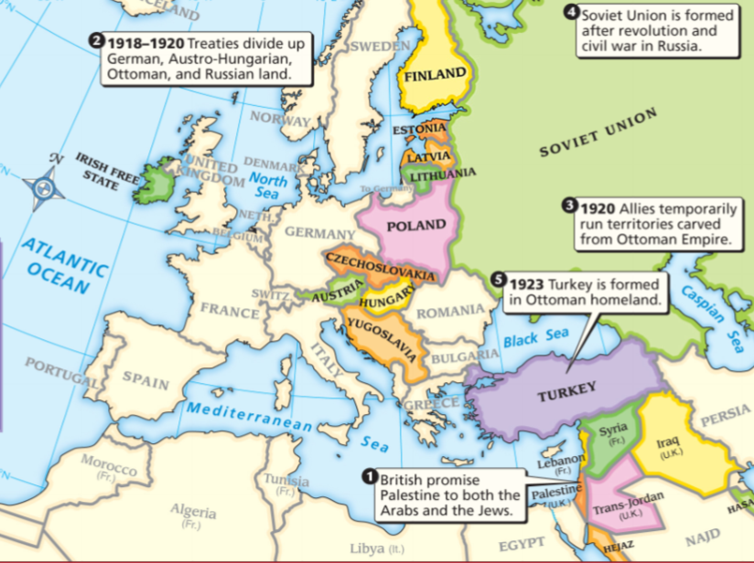
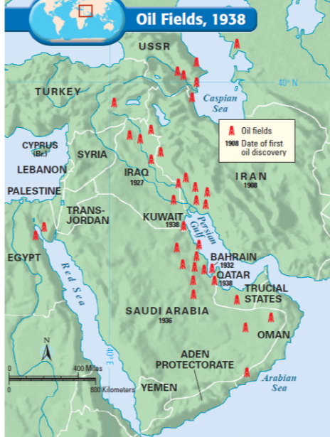
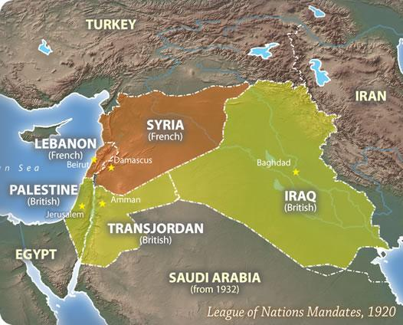
When WWI ended, the Middle East was divided into mandates that were controlled by Britain and France
Britain & France offered self-rule to Arabs in the mandates...
Increasing demand for oil in the 1920s & 30s brought European & American oil companies which dominated the local governments of Iran, Iraq, Kuwait & Saudi Arabia
…but the European powers held real control over the region’s oil fields
Notes:
While nationalism steadily emerged as a major force in Southwest Asia, the region’s economy was also taking a new direction. The rising demand for petroleum products in industrialized countries brought new oil explorations to Southwest Asia. During the 1920s and 1930s, European and American companies discovered enormous oil deposits in Iran, Iraq, Saudi Arabia, and Kuwait. Foreign businesses invested huge sums of money to develop these oil fields. For example, the Anglo-Persian Oil Company, a British company, started developing the oil fields of Iran. Geologists later learned that the land around the Persian Gulf has nearly two-thirds of the world’s known supply of oil. This important resource led to rapid and dramatic economic changes and development. Because oil brought huge profits, Western nations tried to dominate this region. Meanwhile, these same Western nations were about to face a more immediate crisis as power-hungry leaders seized control in Italy and Germany.

Slide 8
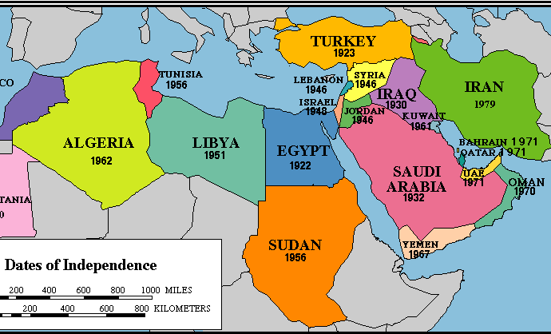
The domination of the Middle East by Western powers & the success of Kemal in Turkey increased Arab nationalism & calls for independence
In the 1930s, Iraq & Saudi Arabia formed nations
The end of WWII in 1945 inspired a new wave of Arab nationalism as Syria, Lebanon & Jordan became nations
By the 1970s, all of the territories in the Middle East were independent of European control

Slide 9
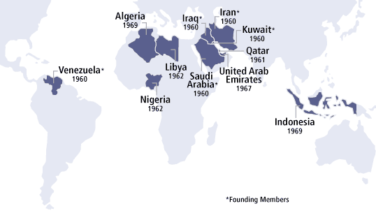
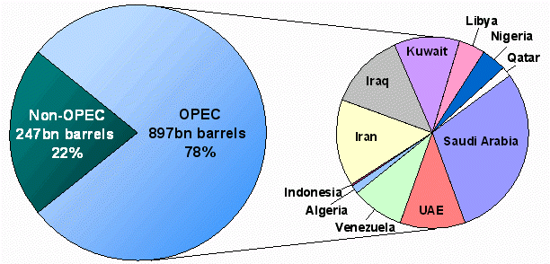
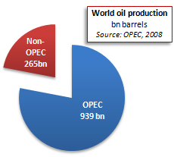
In 1960, the oil-producing nations of the world formed the Organization of Petroleum Exporting Countries (OPEC) to regulate the supply & price of oil
OPEC gave Middle Eastern nations greater control over the oil in the region

Slide 10
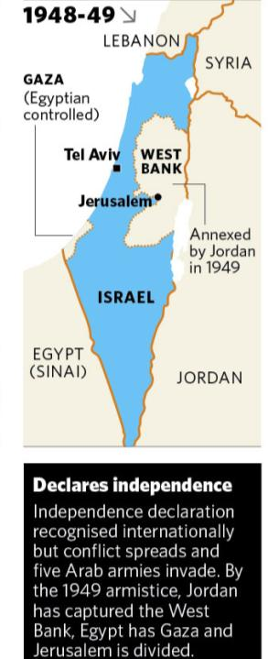
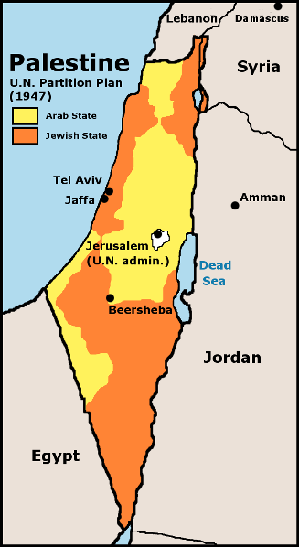
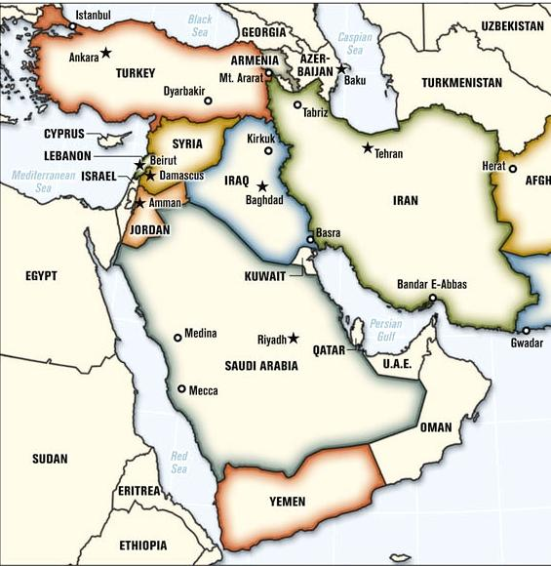
The creation of Israel changed the history of the Middle East
After WWII, the United Nations partitioned the British mandate Palestine into a Palestinian state & a Jewish state called Israel
When Israel declares itself an independent nation in 1948, the first Arab-Israeli War began as Egypt, Iraq, Jordan, Lebanon, Saudi Arabia, Syria invaded Israel
Israel defended itself & seized additional territories along the West Bank & border with Egypt

Slide 11
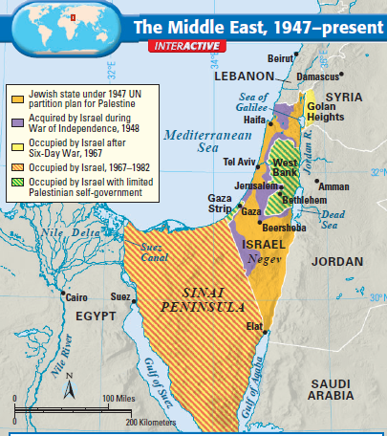
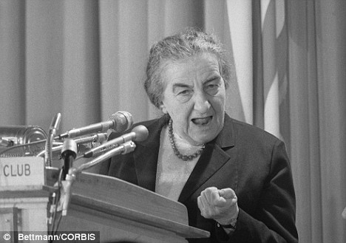
Fighting broke out again in 1967 as Israel quickly defeated Egypt, Jordan, Syria, Iran
After this Six Day War, Israel gained control of Jerusalem, the Golan Heights, West Bank, & Sinai Peninsula
In 1973, Arabs attacked again, but Israel defended itself under the leadership of Prime Minister Golda Meir
Israel saw these territories as a buffer zone from future attacks

Slide 12
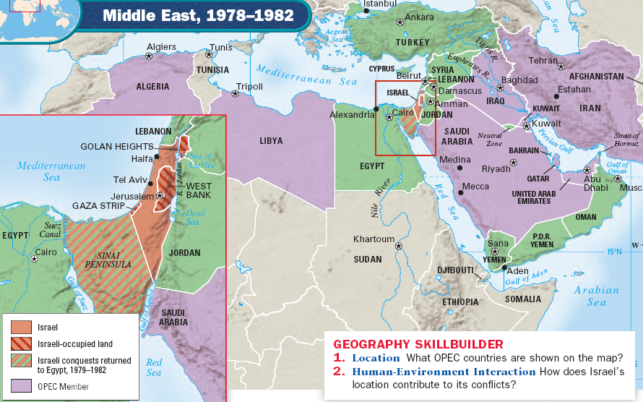
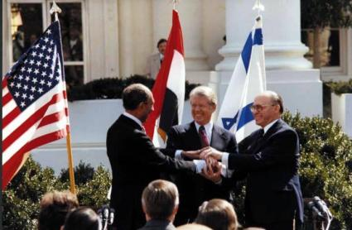
In 1977, a major breakthrough took place when Egypt agreed to recognize Israel’s right to exist in exchange for a return of the Sinai Peninsula by Israel

Slide 13
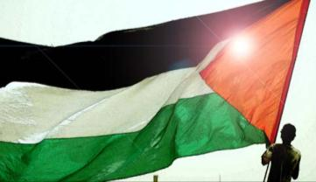
As Israel & Arabs fought, Palestinians struggled for recognition
Palestinian Muslims were granted a partition by the United Nations , but Israel seized some of areas in the Strip Gaza & the West Bank
In 1964, the Palestinian Liberation Organization (PLO) was formed to demand a Palestinian state
Since its formation, the PLO has carried out numerous attacks on Israel & receives aid from many Muslim nations in the Middle East

Slide 14
Israeli-Palestinian tensions have intensified in recent years due to suicide bombings in Jewish civilian territories
Peace talks have stalled as Israel refuses to negotiate until Palestinian attacks stop
Recently, both side have discussed creating a new Palestinian state that would exist peacefully next to Israel

Slide 15
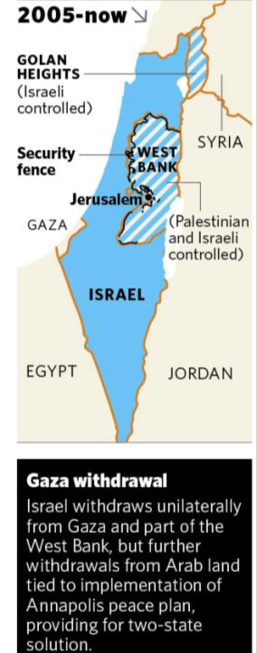
The Current Situation in the Middle East
Video on building a wall to divide Israel and the West Bank from 2002 (7:23)
Video on the current state of conflict between Israel and the Palestinians from December 2010 (stop at 2:13)
Notes:
http://abcnews.go.com/ThisWeek/video/peace-mideast-part-12376028

Slide 16
Essential Question:
What were the key events in the 20th century that shaped the history of the Middle East?
CPWH Agenda for Unit 14.4:
Clicker Review Questions
“Global Terrorism” notes
Today’s HW: 36.1 & 36.2
CPWH Final Exam: May 23-24
County Post-Test: May 25-27

Slide 17
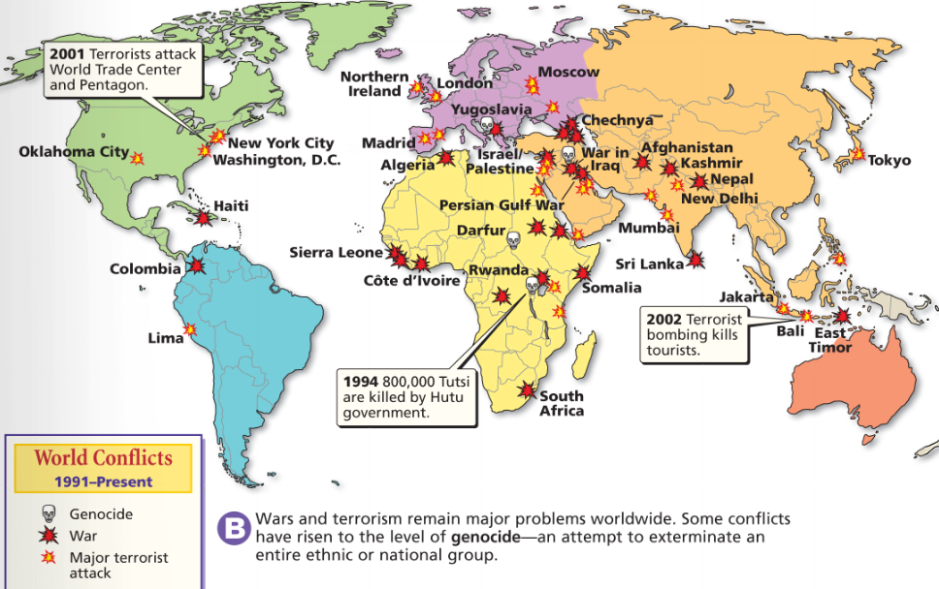
One important trend of the past 50 years has been the increase in international terrorism
Terrorism is when people or groups use violence & fear to bring change to a government or society
Terrorism is not new; Since the 1960s more than 14,000 attacks have occurred worldwide

Slide 18
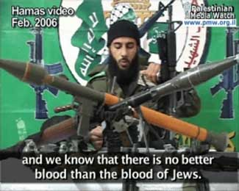
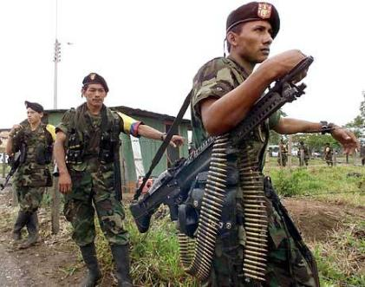
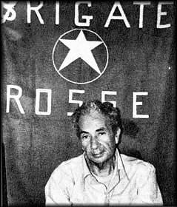
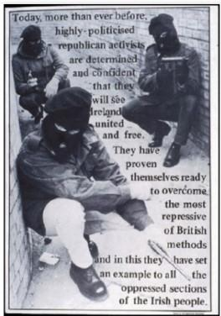
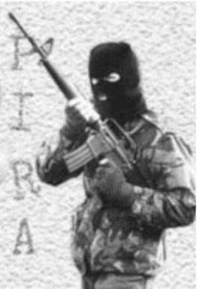
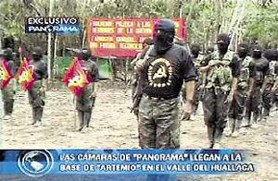
Terrorism occurs for different reasons by a variety of groups
In Peru, Shining Path led a revolution inspired by Mao’s Cultural Revolution
In the Middle East, Palestinian groups like Hamas & Hezbollah target attacks on Israel
Revolutionary Armed Forces of Colombia (FARC) has tried to create a Cuba-style communist gov’t in Colombia
In Northern Ireland, the Irish Republican Army (IRA) used terrorism against Britain to gain independence
In Italy, the Red Brigade was a communist group that used attacks & assassinations to get Italy to leave NATO
Notes:
Hamas and Hezbollah

Slide 20
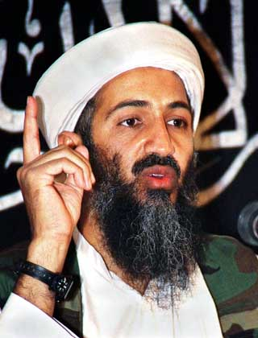
The most deadly terrorist organization in recent history is al-Qaeda
Al-Qaeda was formed by Osama bin Laden as a radical terrorist organization to create a new Islamic empire
Al-Qaeda has attacked the USA & other Western nations that bin Laden believes are trying to destroy Islam

Slide 21
In 1998, two U.S. embassies in Africa were bombed
In 1993, al-Qaeda detonated a bomb in the basement of the World Trade Center in New York
In 2000, the USS Cole was attacked in Yemen

Slide 22
On September 11, 2001, hijacked planes destroyed the World Trade Center & hit the Pentagon in Washington D.C.
After 9/11, President George W Bush declared a “war on terrorism” & sent troops to destroy al-Qaeda in Afghanistan

Slide 23
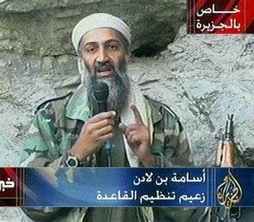
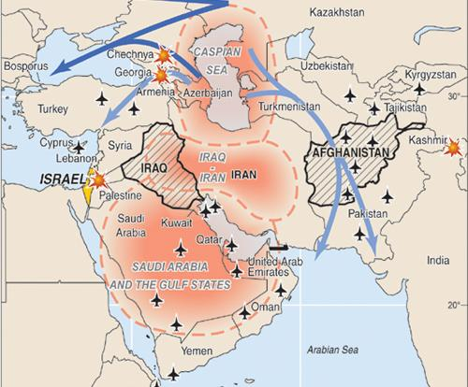
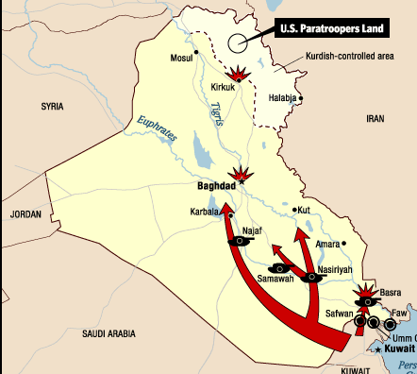
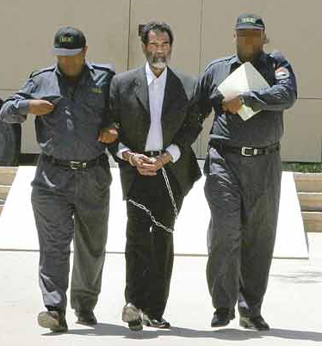
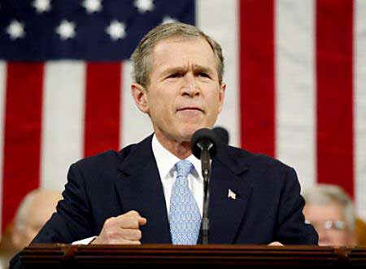
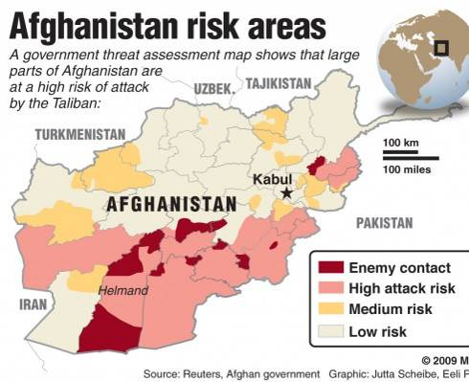
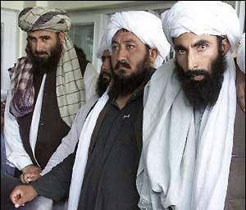
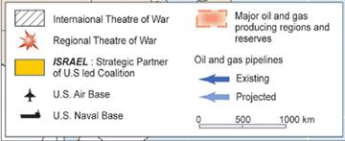
The American Response to September 11, 2001
al Qaeda terrorists
Iran, Iraq, & North Korea form an “Axis of Evil”
Taliban government

Slide 24
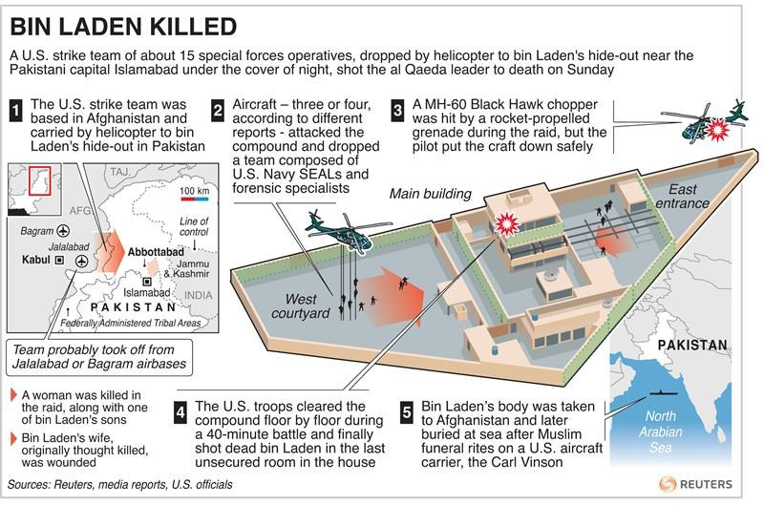
Target: Bin Laden Video (7.25)
“We Got Him” Video (7.05)

Slide 25
Essential Question:
What were the key events in the 20th century that shaped the history of the Middle East?
CPWH Agenda for Unit 14.4:
Clicker Review Questions
“The Middle East in the 20th Century & Today” notes
Today’s HW: 36.3
CPWH Final Exam: May 23-24
County Post-Test: May 25-27

Slide 26
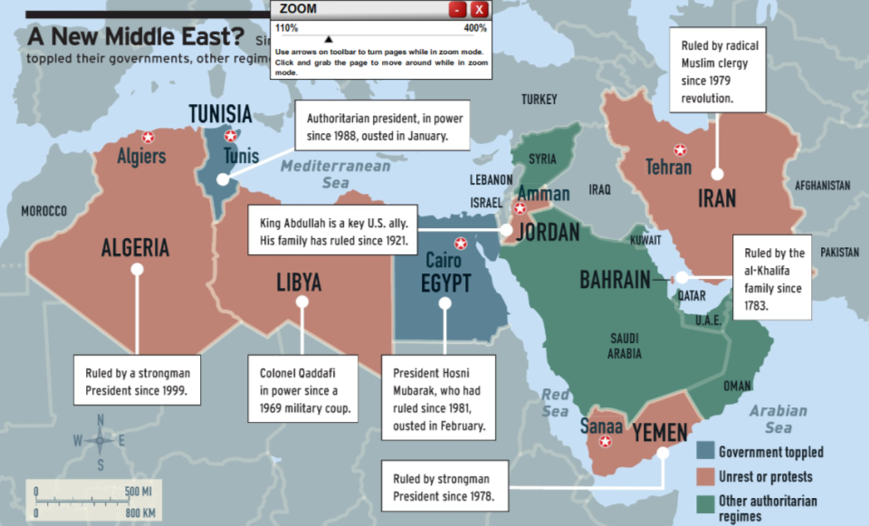
In 2010-2011, numerous revolutions erupted in North Africa & the Middle East in which citizens are demanding the overthrow of authoritarian governments in favor of democracy

Slide 27
Overview video (2.39)
Arab Spring Timeline

Slide 28
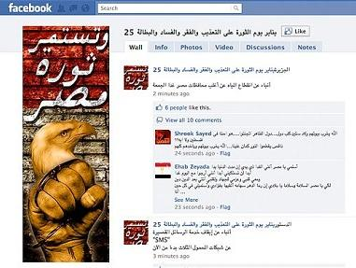
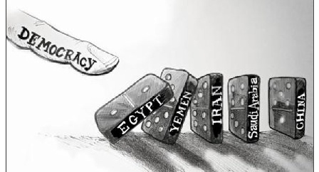
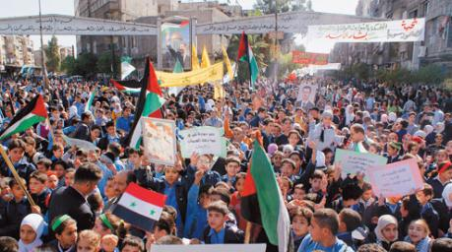
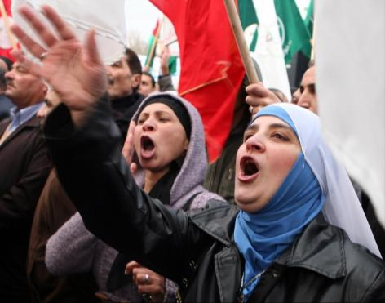
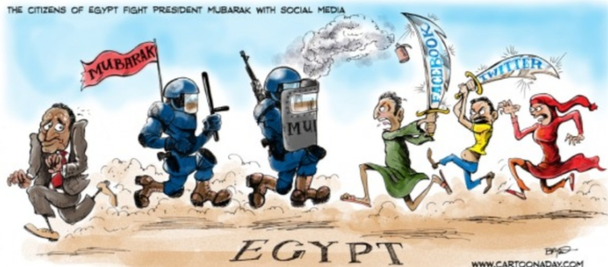
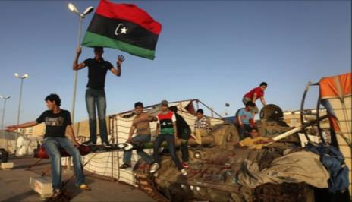
What’s Happening in the Arab World?
What options do citizens have when they want democracy?

Slide 29
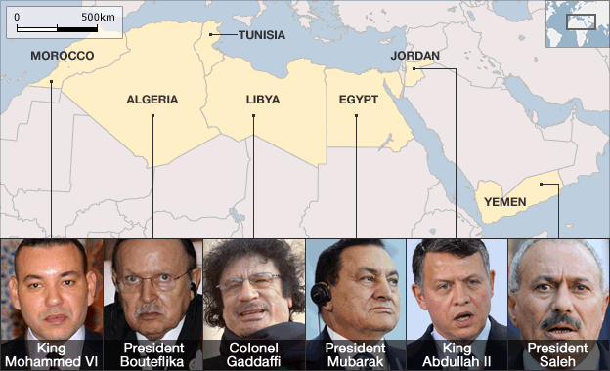
What’s Happening in the Arab World?
What options do leaders have when protests occur?

Slide 30
Arab Spring Videos: Tunisia, Egypt, Libya
Uprising: Radical Jihad or Democratic Protest?

