Slide 1
Essential Question:
What was the impact of the Islamic Empire under the Abbasids & Umayyads?
Warm-Up Question:
?

Slide 2
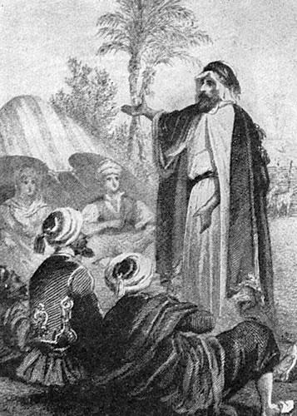
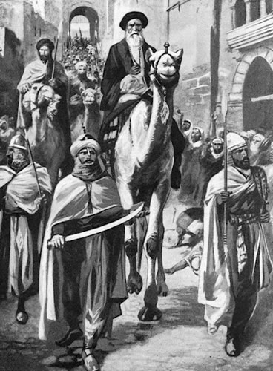
Overview of Islam
Around 600 AD, a new monotheistic religion began called Islam:
Islam was founded by the prophet Muhammad in the Arabian city of Mecca
After the Hegira to Medina, Muhammad gained converts & returned to Mecca

Slide 3
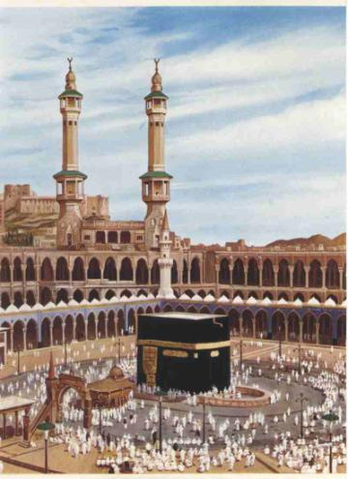
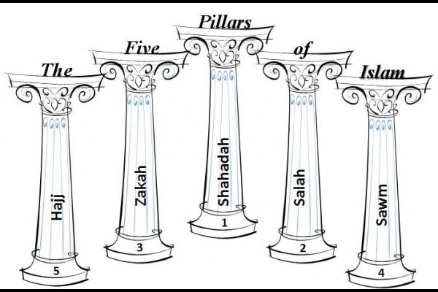
Overview of Islam
Muslims believe in the Five Pillars of Islam:
Faith: belief in one god, Allah & the prophet Muhammad
Prayer: 5 times per day towards Mecca
Alms: 2.5% to charity
Fasting: During the month of Ramadan
Hajj: Pilgrimage to Mecca

Slide 4
Class Discussion: Who will take over after Muhammad dies?

Slide 5
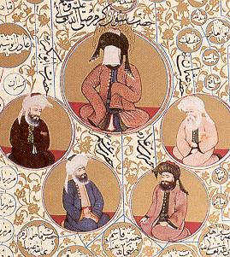
Islam After Muhammad
When Muhammad died in 632, the Muslim community elected a new leader called a caliph (“successor”)
The first 4 caliphs all knew Muhammad & promised to stay true to the Qur'an & Muhammad’s message
Muhammad & the Rightly Guided Caliphs

Slide 6
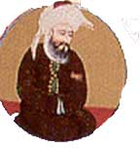
The Rightly Guided Caliphs
The first caliph was Muhammad’s friend & father-in-law, Abu Bakr:
His goal was to keep Muslims united under his gov’t (“caliphate”)
His used jihad to control & expand the Muslim empire

Slide 7
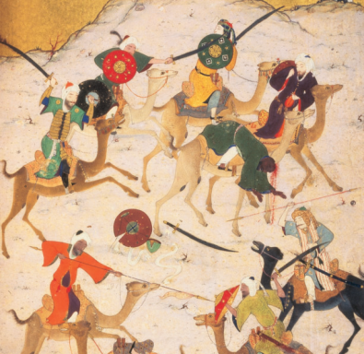
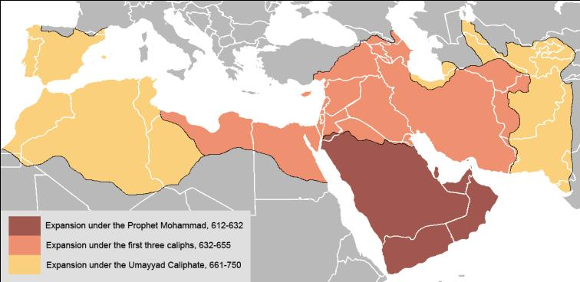
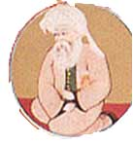
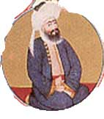
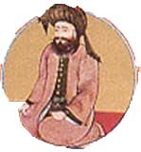
The Rightly Guided Caliphs
The empire expanded under the next caliphs

Slide 8
During the Rightly Guided Caliphates, the Islamic Empire expanded “Dar-al-Islam” (the areas where Islam is practiced)
The caliphs used the Shari'ah (laws of Islam) to govern the empire
The caliphate never forced non-Muslims to convert, especially “People of the Book” & allowed religious tolerance as long as taxes were paid to the empire

Slide 9
The Umayyad Empire
After Ali’s death in 661 led to a civil war for control of the empire:
The clan that came to power started the Umayyad Empire
But the rise of the Umayyads led to a division in Islam

Slide 10
The Sunni-Shi’a Split
Before the Umayyads, caliphs were elected members of Muhammad’s family
Shi’a Muslims rejected the Umayyads
The Shi’a believe that caliph must come directly from Muhammad’s bloodline
Sunni Muslims accepted the rule of the Umayyads
The Sunni believe caliphs should follow Muhammad’s example, but don’t have to be relatives

Slide 11
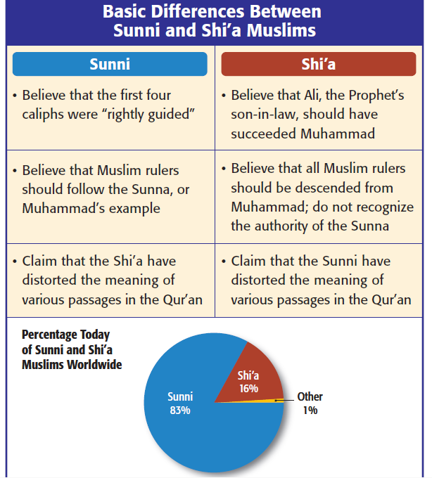

Slide 12
The Umayyad Empire
The Umayyads expanded the empire which brought wealth & new Islamic converts

Slide 13
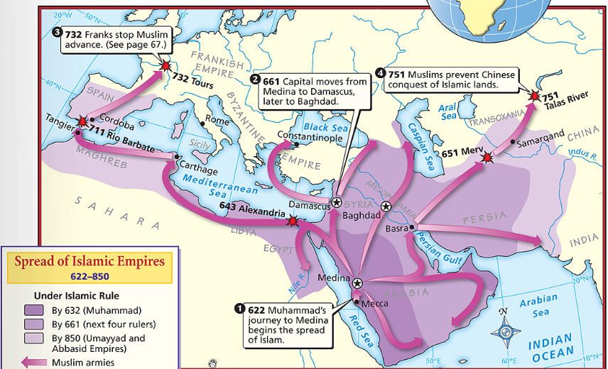
In 750, the Umayyad Empire was overthrown by the Abbasids
Under the Abbasids, the Islamic Empire grew to its greatest extent

Slide 14
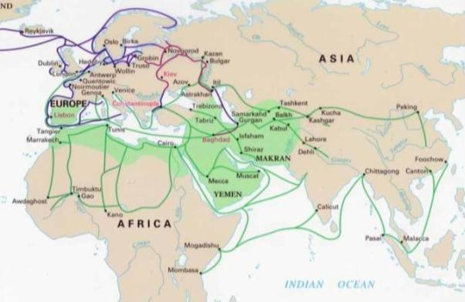
The Abbasid Empire
The Abbasid Empire (750 to 1258):
The Abbasid caliphate built a strong gov’t bureaucracy to rule their empire
Muslim merchants expanded wealth by trading across Africa, Indian Ocean, and Mediterranean Sea

Slide 15
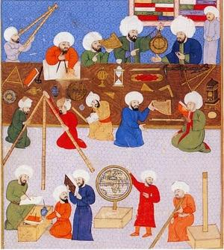
The Abbasid Empire
Wealth from trade led to a golden age, a time of great Muslim achievements in science, math, medicine, & architecture

Slide 16
Closure Activity
Complete the Monotheism Chart on your notes

