Slide 1
The Industrial Revolution

Slide 2
1. Factors of Success in Great Britain
Exploration and Colonization
Had many colonies that produced many raw goods
Colonies were also markets to sell manufactured goods
Sea Power
Had the largest naval and merchant fleet in the world

Slide 3
c. Political Stability
Had peace and stability within the mother country
d. Government Support
Government passed laws that favored business
e. Growth of private investment
Private sector funded experiments for creating new technology

Slide 4
2. Agricultural Factors
Jethro Tull
Invented the seed drill machine
Had positive and negative effects on agriculture

Slide 5
b. Positive
Farmers improved livestock breeding methods to raise healthier animals
Better varieties of food crops were developed
Improvements increased Britain’s food supply
Increased Britain’s population

Slide 6
c. Negative
Enclosure movement
Wealthy landowners bought more farms that had been shared by the rich and poor
They will combine the fields and fence them in
Allows for more efficient farming methods
Drawbacks
It forced countless farmers off the land
Forced people to move to the cities to look for work

Slide 7
3. Factors of Production
Land
All of a nation’s natural resources
Water was the most important resource for Great Britain

Slide 8
b. Labor
Great Britain had a growing population
Displaced farmers would make up a large portion of new factory workers

Slide 9
c. Capital
Funds that were necessary for the Industrial Revolution
“human capital”
People with abilities and skills necessary for the Industrial Revolution

Slide 10
4. A Revolution in Textiles
The Cottage System
Prior to the Industrial Revolution
System where weaving was done in the home

Slide 11
b. Changes in Textiles
Eli Whitney
Solved problem of pulling seeds from cotton blossoms
Invented the cotton gin

Slide 13
ii. James Hargreaves
Revolutionized the spinning process
Invented the Spinning Jenny

Slide 14
iii. Richard Arkwright
Solved problems of Spinning Jenny
Invented the spinning frame

Slide 15
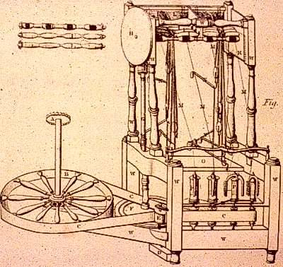

Slide 16
iv. Edmund Cartwright
Patented the power loom to meet the demand for better weaving machines

Slide 18
v. Factories
Will be built to house these large machines

Slide 19
5. The Steam Effect
James Watt
Improved the steam engine
His machine was faster and more efficient at driving the machines

Slide 20
b. Richard Trevithick
Used a steam engine to power the first locomotive in 1802

Slide 21
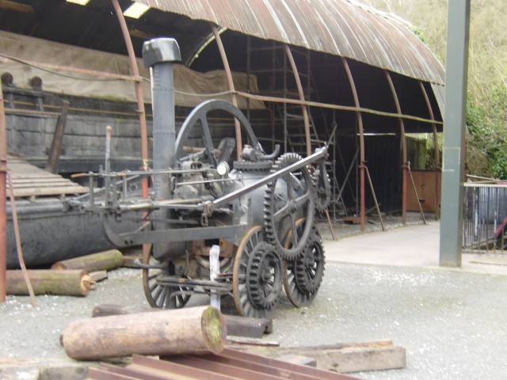

Slide 22
c. Robert Fulton
Used steam to power ships
Began shipping business that would run between Albany and NYC
1st profitable use of steam navigation

Slide 23
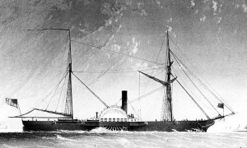

Slide 24
d. Effects of Steam
Would be used in textile industry
Steam will fuel the coal industry
Areas of farm land will become centers for coal mines and factories

Slide 25
6. Factories
Working Conditions
Children began working in factories
Some as young as 6
Paid very little
Asked to d the more dangerous jobs because they were small and could fit in tight places

Slide 26
ii. The work day was long
12hrs or more a day
iii. Poor ventilation, sanitation, and inadequate food
iv. Most workers were men

Slide 27
b. Labor Unions
Formed because of working conditions
Represented workers interests
Would urge employers to change or threatened a strike

Slide 28
c. Mass Production
A system of manufacturing large numbers of identical items
Interchangeable parts
Identical machine made parts
Assembly line
Process where product moves from worker to worker and each performs a step in the manufacturing process

Slide 29
7. Capitalism and Competition
Laissez-faire
Adam Smith
Wrote “The Wealth of Nations”
Advocate of Laissez-faire
Means, government should not interfere with business
Believed everyone benefited from the lack of government interference
This is called a market economy
Allows business to compete with one another

Slide 30
b. Thomas Malthus
Concerned with population growth
Believed that population would always grow faster than the food supply

Slide 31
8. New Roles for Business Leaders
Entrepreneur
Someone who starts a business
Emergence will take some political power away from the wealthy landowner

Slide 32
b. Famous Entrepreneurs from America
Andrew Carnegie
Led in the steel industry
Huge philanthropist

Slide 33
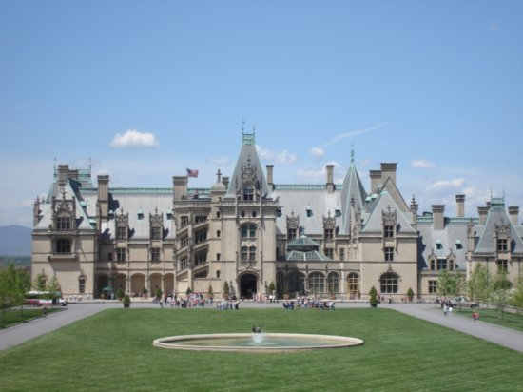

Slide 34
ii. Cornelius Vanderbilt
Built up the railroad industry
Grandson built the Biltmore

Slide 35
iii. John D. Rockefeller
Built up the oil industry

Slide 36
9. Competing Economic Views
Robert Owen
Socialism
Believed that government or society, not individuals, should own property and control industry

Slide 37
b. Karl Marx
Wrote “Das Kapital”
Believed workers would sink into poverty as capitalism grew
Working class will or would take control and govern themselves
Argued that capitalism would collapse

Slide 38
http://www.youtube.com/watch?v=kfuUoINOU5I

