Slide 1
The French Revolution

Slide 2
1. Causes of the Revolution
Inequalities in Society
Old Order structure (Ancient Regime)
It is a social or political structure that created inequalities in French society

Slide 3
ii. 3 Estates (classes)
First Estate (1 % of the population)
Made up of the Roman Catholic clergy
Privileges
Only the Church could try priests and bishops accused of a crime
Neither the Church or clergy had to pay taxes

Slide 4
2. Second Estate (less than 2% of the population)
Made up of the nobility
Held high positions within the government

Slide 5
3. Third Estate (everyone else)
Three levels within this group
Bourgeoisie
City dwelling merchants, factory owners and professionals
Artisans and city workers
Skilled labor
Peasants or Sans Culottes
Unskilled labor
Pay rent to a land lord
Gave a tenth of what they earned or made to the church

Slide 6
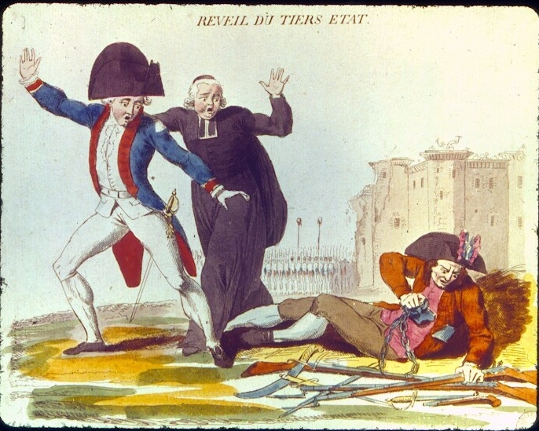

Slide 7
Enlightenment
John Locke
Jean-Jacque Rousseau
Baron de Montesquieu

Slide 8
Financial Crisis
France was deeply in debt
King and court continued to spend more than they had
King tries to tax the Second Estate; they refused to pay
Drought and harsh winter limited the food supply

Slide 9
One of the first events of the revolution was a meeting that the nobility asked Louis XVI to call, the Estates General. This took place in August 1788

Slide 10
2. First Events of the Revolution
Estates General
Called in August 1788 to approve new taxes on the Third Estates
Each estate received 1 vote
The Third Estate thought that each member should get 1 vote
King Louis XVI ordered the old rules would be followed, but did not enforce it
The Third Estate will create the National Assembly on June 17, 1789

Slide 11
Louis XVI
Marie-Antoinette

Slide 12
b. The Tennis Court Oath
King Louis XVI locks out the Third Estate after they created the National Assembly
Members of the Third Estate decide to meet at an indoor tennis court nearby and pledged the Tennis Court Oath
They promise not to leave the tennis court until they had created a new constitution for France

Slide 13
c. Storming of the Bastille
July 14, 1789
King Louis XVI ordered troops to Paris and Versailles
Sparked fear that the king would use violence to end their marriage
July 14, a Parisian mob went to the Bastille looking for gun powder
Will storm the Bastille after trying to negotiate with the commander
Became a powerful symbol of the French Revolution

Slide 14
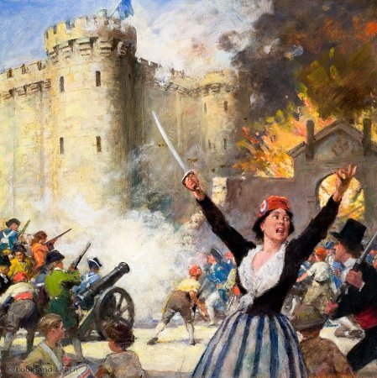

Slide 15
The Assembly had eliminated all the feudal dues and services that peasants owed. They also removed First Estate’s privileges. They seized Church lands and sold them to pay off the debt. The clergy were turned into public employees and downgraded the monarch to commoners.

Slide 16
3. Creating a New Nation
Declarations of the Rights of Man
Laid out the basic principles of the French Revolution
“Liberte, Egalite, Fraternite” means Liberty, Equality, and Fraternity (brotherhood) became the motto of the Revolution
Inspired by the English Bill of Rights, American Declaration of Independence and the writings of the Enlightenment philosophers

Slide 17
iii. Stated that all men are equal and remain equal before the law
iv. Gave freedom of speech, press and religion

Slide 18
b. Other Reforms
Granted broad voting rights, however only men who paid taxes and were at least 25 years old could vote
Kept the monarchy but severely limited the king’s power
The National Assembly will be replaced by the National Convention

Slide 19
c. The National Convention
Abolished the monarchy and declared France a republic
Controlled by Radicals

Slide 20
4. A Radical Government
Leaders
Jean-Paul Marat
Strong advocate of violence
Had his own revolutionary newspaper
One of the more radical leaders of the revolution

Slide 21
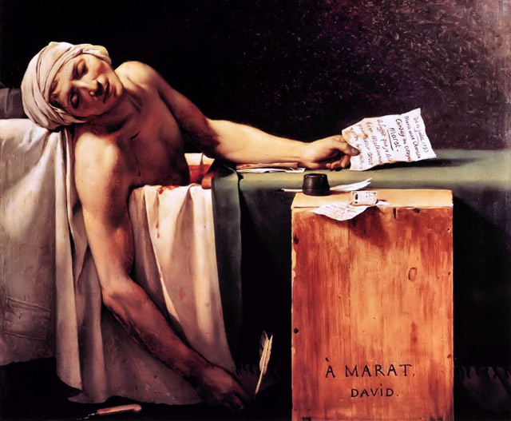

Slide 22
ii. George-Jacques Danton
A violent agitator
Popular with the public
One of the more radical leaders of the revolution

Slide 23
iii. Maximillien Robespierre
Leader of the National Convention during the most bloodthirsty time
Would become increasingly more radical

Slide 24
b. Execution of a King
Radicals wanted to execute the king to prevent the monarchy from returning to power
National Convention will place both Louis XVI and his wife Marie-Antoinette on trail
Jan. 23, 1793- Louis is executed via the guillotine
Marie-Antoinette will suffer the same fate

Slide 25
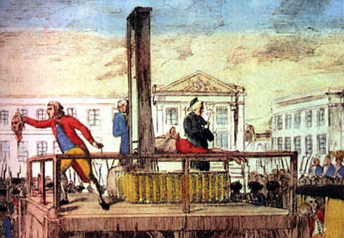

Slide 26
c. Committee of Public Safety
Established by the National Convention
Managed the country’s defense
Created a draft
Requirements
All able bodied unmarried men age 18-45

Slide 27
d. Revolutionary Tribunal
Purpose was to root out and eliminate those who threatened the revolution from within

Slide 28
e. Other actions by the Convention
Shut down churches
Robespierre created a new religion
Worshiped the revolution
Months were renamed
Created the metric system

Slide 29
5. Reign of Terror
The Terror
Revolutionary leaders feared a counter-revolution
National Convention’s response to this fear was to accuse, try and execute anyone who opposed them

Slide 30
The accused had few rights and often were not allowed a defense
Executions (by guillotine) drew crowds and became a daily activity
10 month Reign of Terror finally ended when Robespierre and his followers were arrested and executed

Slide 31
iii. France will create a new constitution and have a new governing board called the Directory

Slide 32
b. The Directory
Weak and corrupt
Shared similar characteristics of the Old Order, such as: high prices, bankruptcy and unhappiness among the people

Slide 33
Napoleon

Slide 34
1. Napoleon’s Rise to Power
Early years
Born in 1769, on the island of Corsica
Sent to military school in northern France at the age of 9
Graduated early at the age of 16

Slide 35
b. Military career
Became a lieutenant in the artillery
Would move up through numerous victories
Will be rewarded with increased responsibility over French troops
His success made him a national hero

Slide 36
c. Napoleon takes power
Wanted to take power away from the Directory
In 1799, Napoleon’s supporters took control of the weak French government in a coup d’ etat
A consulate will run France in name only
Elected Napoleon as First Consul
Napoleon will rule like a dictator

Slide 37
d. Why would people welcome a dictator?
He promised to restore order and stability
He pledge to uphold some key revolutionary reforms

Slide 38
e. Emperor Napoleon
Wanted to make his power permanent
Submitted a plebiscite
It asked all voters if they wanted an empire
Napoleon will crown himself, not the pope, emperor in 1804

Slide 39
2. Napoleonic Wars
France vs. Great Britain
Admiral Nelson
Commanded the British navy
Prevented Napoleon from conquering all of Europe

Slide 40
c. Battle of Trafalgar
Napoleon’s only defeat
Naval battle

Slide 41
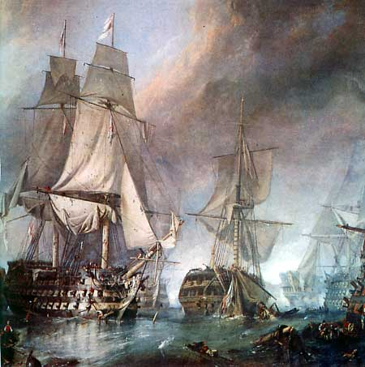

Slide 42
d. Continental System
A plan to weaken Great Britain
French and allied ships were not allowed to trade with Britain
Goal
To cut down Britain’s ability to fund other nation’s effort to stop him

Slide 43
iv. Britain responded by requiring all ships to get British permission before trading with the French Empire
v. Neither nation was able to enforce these laws

Slide 44
3. Napoleon’s policies
Reforms
Reform of the Church and State Relations
The Concordat
An agreement with the pope
Acknowledge that most French citizens were Catholic, but it didn’t require that they be Catholic or attend service
France still had law of religious toleration

Slide 45
ii. Economic Reform
Bank of France
Established to regulate the economy
Established a more efficient tax collection system

Slide 46
iii. Established Lycees (high schools)
iv. Established a system of promotion by merit not birthright
v. Paid compensation for children of all classes to attend school
b. Napoleonic Code
Uniform set of laws
Limited liberty and promoted order over individual rights

Slide 47
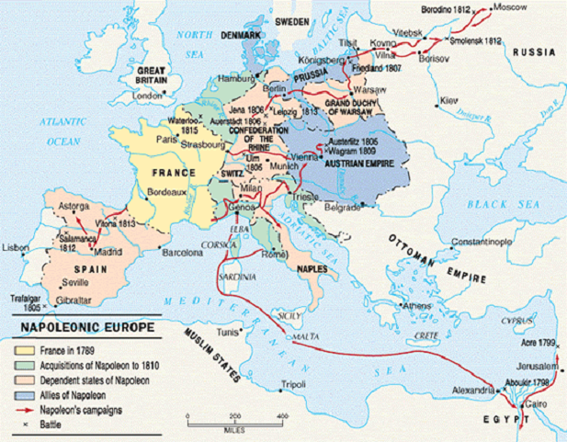

Slide 48
4. Disaster and Defeat
Russia
Concern over Russia’s military power
Tsar Alexander I was decreasing the country’s support for the Continental System

Slide 49
iii. The Russian Campaign of 1812
French troops, commanded by Napoleon, invaded Russia
Russians will burn the fields in front of the French, this leaves them with nothing to use

Slide 50
iv. Napoleon will be defeated by the Russian winter
v. Defeat gives enemies a renewed hope

Slide 51
b. Battle of Nations
Russia, Prussia, Austria and England vs. France
Napoleon suffered an overwhelming defeat
Napoleon surrendered Spring 1814
He is exiled to island of Elba, off the coast of Italy

Slide 52
5. The Last Campaign
The Hundred Days
One year after his exile, Napoleon will return to France and head to Paris
March 20, 1815
Marks the beginning of the Hundred Days
A period where Napoleon briefly returns to his former glory

Slide 53
iii. The Battle of Waterloo
Napoleon’s final stand
The English were led by the Duke of Wellington
Napoleon will be defeated
iv. Napoleon is exiled to island of St. Helena
v. Napoleon dies in exile in 1821 at the age of 51

Slide 54
6. The Congress of Vienna
Meetings
September 1814- June 1815
Leaders throughout Europe met to discuss how to keep peace in Europe

Slide 55
b. The Big Four
Prince Clemons von Metternich of Austria
Wanted to return Europe back to the Old Order system
He is viewed as a reactionary, someone who opposes change

Slide 56
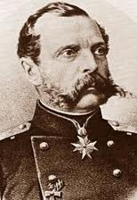
ii. Tsar Alexander I
iii. Lord Robert Castlereigh of England

Slide 57
iv. Prince Maurice de Talleyrand of France

Slide 58
c. Decisions from the meetings
Will change boundaries across Europe to strengthen the nations
France had to give up all of its conquered territory
France forced to pay an indemnity

Slide 59
7. Revolution’s Legacy
Congress of Vienna permanently changed European boundaries
Standards for government, law, taxes, education, promotion by merit and ability
French debt
Enlightenment ideals inspired political movements

Slide 60
