Slide 1
Essential Question:
What led to the end of the Cold War?
Warm Up Question:

Slide 2
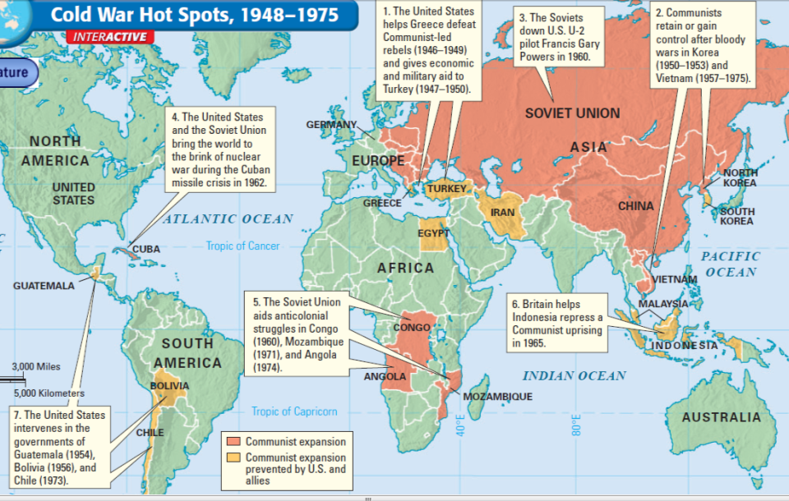
The USA & Soviet Union engaged in the Cold War from 1945 to 1991
In the 1940s, 50s, & 60s the USA fought to contain communism throughout the world
In the 1970s, U.S. détente policy ended as the USSR invaded Afghanistan

Slide 3
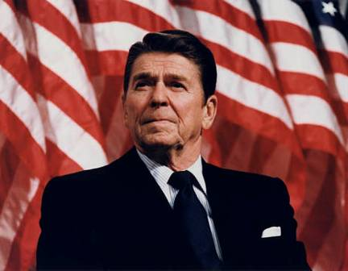
In the 1980s, two new leaders changed the direction of the Cold War: U.S. President Ronald Reagan & Soviet leader Mikhail Gorbachev
Reagan took a strong stand against communism & the Soviet Union
Reagan’s goal was to win the Cold War & restore America’s position as a dominant super power
Reagan referred to the Soviet Union as an “evil empire”
He spent $2 trillion to increase the size of the American military
He sent over 500 ICMBs to Western Europe to protect NATO allies

Slide 4
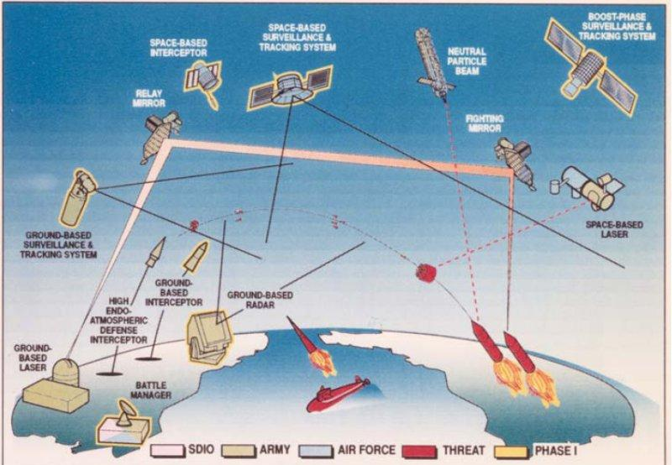
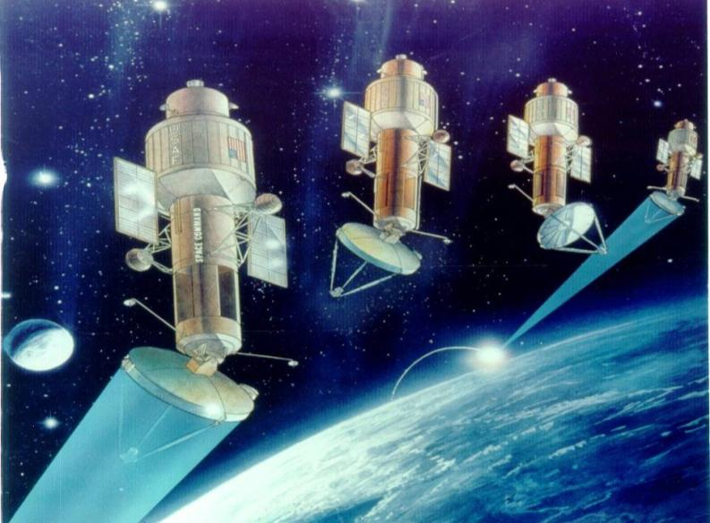
Reagan’s most ambitious program was the Strategic Defense Initiative (SDI), called Star Wars, to protect the U.S. from Soviet nuclear attacks

Slide 5
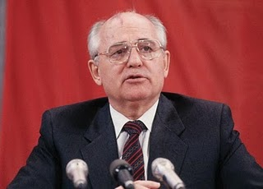
In the 1980s, two new leaders changed the direction of the Cold War: U.S. President Ronald Reagan & Soviet leader Mikhail Gorbachev
Soviet socialism did not offer incentives for hard work; By the 1980s, the USSR had low industrial & agricultural production
Mikhail Gorbachev came to power in 1982 at a time when the USSR was facing serious problems
The USSR spent 50% of its budget on the military, was fighting an expensive war in Afghanistan, & maintained troops and tanks in Eastern Europe
Soviet leaders faced the impossible task of competing with SDI & taking the arms race into space
The Soviet government restricted freedom of speech & did not allow democratic elections so no alternative opinions were offered
Notes:
Low production in industry and agriculture due to lack of incentives? They pretend to pay us and we pretend to work.
Heavy spending on the Soviet military (50%); War in Afghanistan, troops in Eastern Europe
Reality of having to compete with SDI & extend the arms race into space
Communist control forbade criticisms & eliminated new ideas

Slide 6
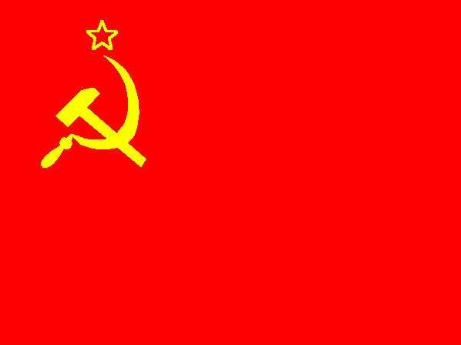
Soviet Problem Solving Group Activity:
Assume the role of Gorbachev & assess the USSR’s problems
Brainstorm three reforms the USSR could adopt to solve these problems
Keep in mind: You want to save Soviet communism, not destroy it
Notes:
Low production in industry and agriculture due to lack of incentives? They pretend to pay us and we pretend to work.
Heavy spending on the Soviet military (50%); War in Afghanistan, troops in Eastern Europe
Reality of having to compete with SDI & extend the arms race into space
Communist control forbade criticisms & eliminated new ideas

Slide 7
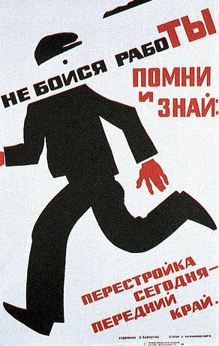
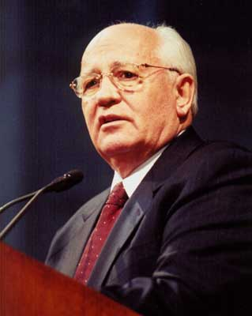
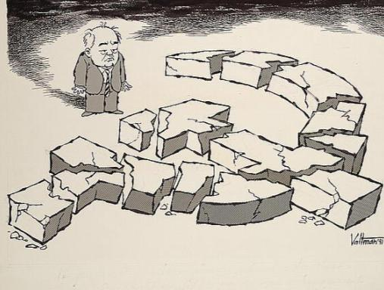
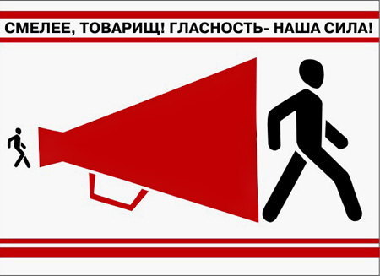
Gorbachev began three major reforms to save the communist system in the Soviet Union
Gorbachev introduced glasnost (“openness”) to encourage freedom of speech & to allow expression of new ideas
Perestroika relaxed some gov’t controls over farms and factories to make production more efficient & it allowed citizens to open small businesses
Democratization allowed citizens to vote for Communist politicians (but Communists only)
'Be Bold, Comrade! Openness: Our Strength!'
“Don't Be Afraid of Work.”

Slide 8
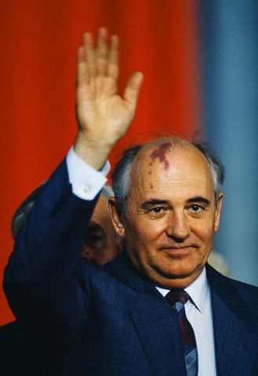
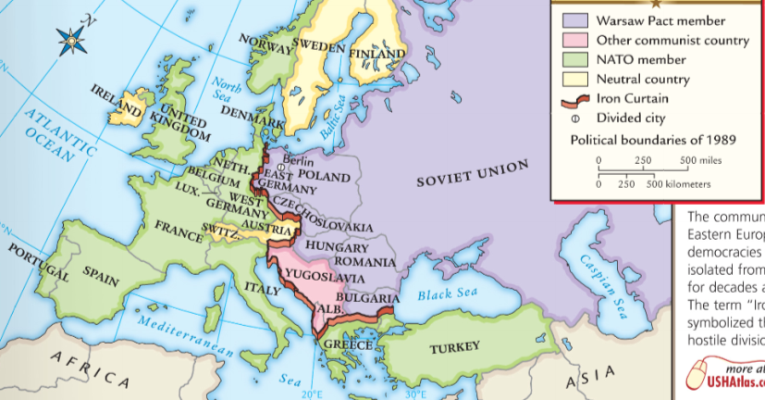
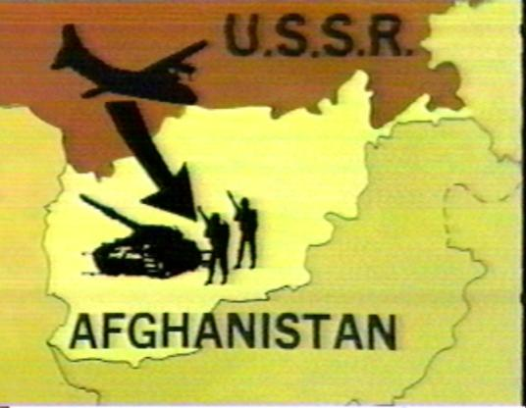
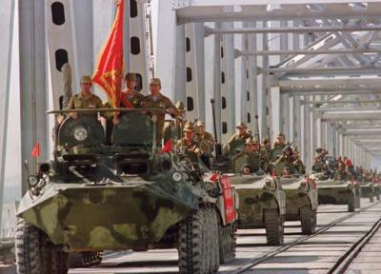
In addition to his economic reforms, Gorbachev changed Soviet foreign policy
Reagan’s SDI plan forced Gorbachev to admit that the USSR could not keep up with the arms race
Gorbachev withdrew Soviet tank divisions from the communist nations in Eastern Europe
In 1989, Gorbachev ended the 9 year war in Afghanistan

Slide 9
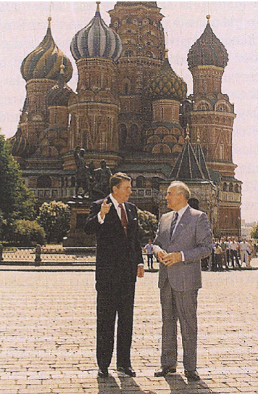
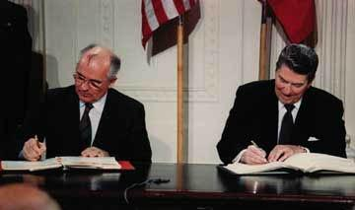
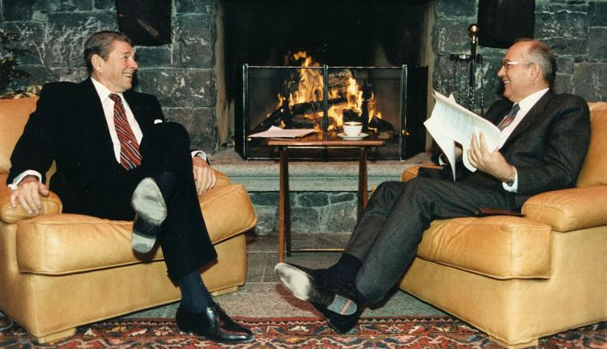
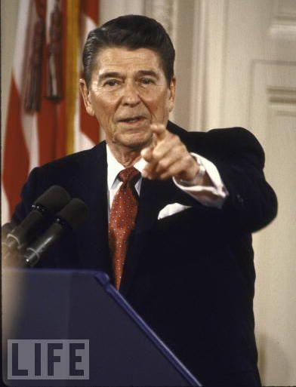
Reagan was able to work with Gorbachev to reduce Cold War tensions
In 1987, Reagan & Gorbachev agreed to end all medium-range ICBMs

Slide 10
Rather than saving the communist system in the USSR & Eastern Europe, Gorbachev’s reforms helped bring an end to communism

Slide 11
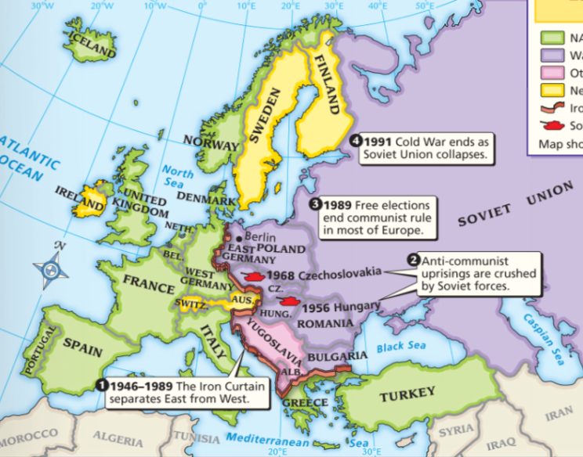
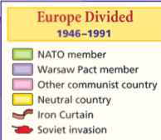
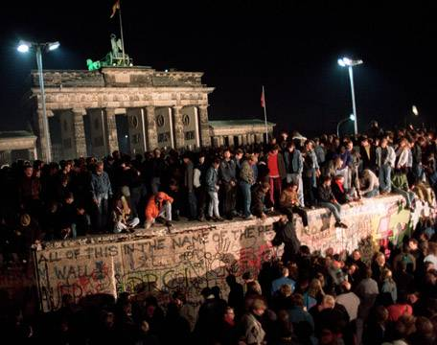
In 1989, a surge of democratic revolution swept through the Eastern European communist satellites
Eastern European nations broke from Soviet control & created democracies
Gorbachev did not use the Soviet military to stop these revolutions
In November 1989, the Berlin Wall came down

Slide 12
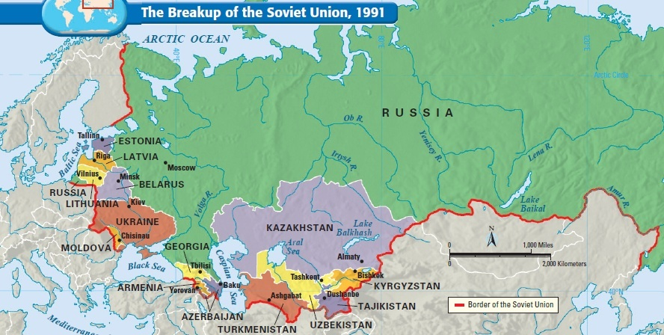
Ethnic nationalism & desire for democracy led to the break-up of the Soviet Union from 1990 to 1991
In 1990, the Soviet states of Estonia, Latvia, Lithuania declared independence from the Soviet Union
In 1991, the Soviet Union broke apart & 15 new nations were formed
The break-up of the Soviet Union in 1991 marked the end of the Cold War

Slide 13
Cold War Political Cartoon Analysis
Cartoon analysis:
Working with a partner, examine each of the following four Cold War political cartoons
For each cartoon, identify what the artist’s message is
Find at least one fact from your notes that supports the main idea of the political cartoon

Slide 14
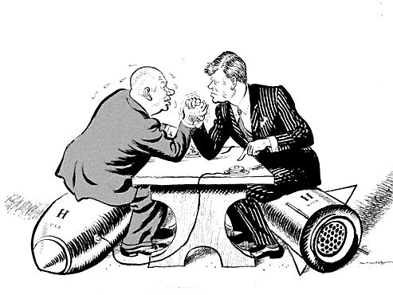

Slide 15
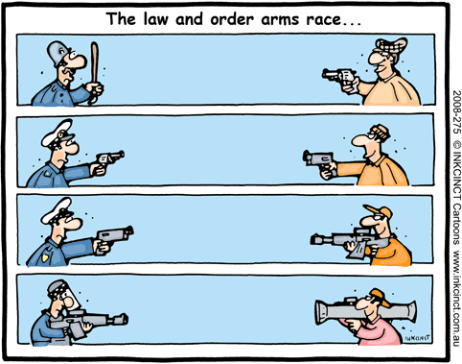

Slide 16
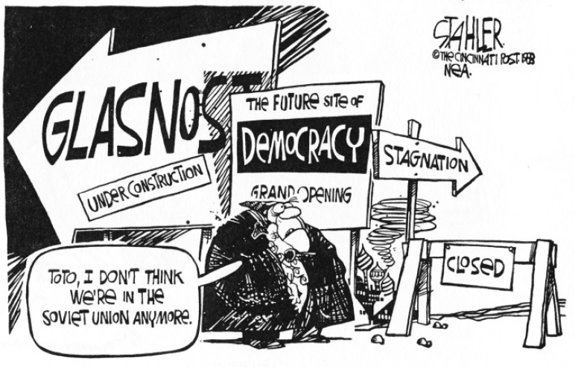

Slide 17
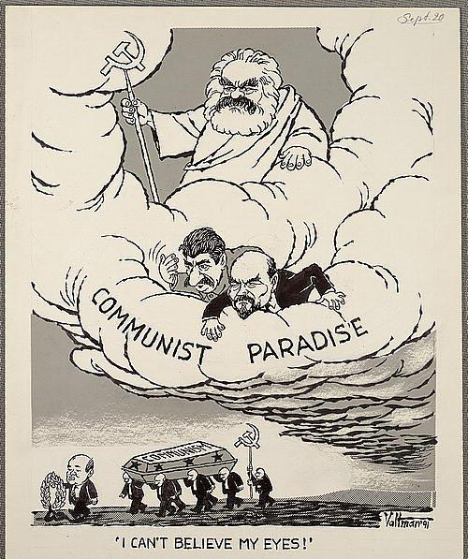

Slide 18
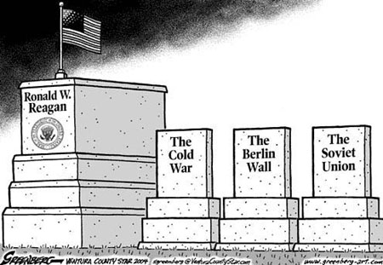
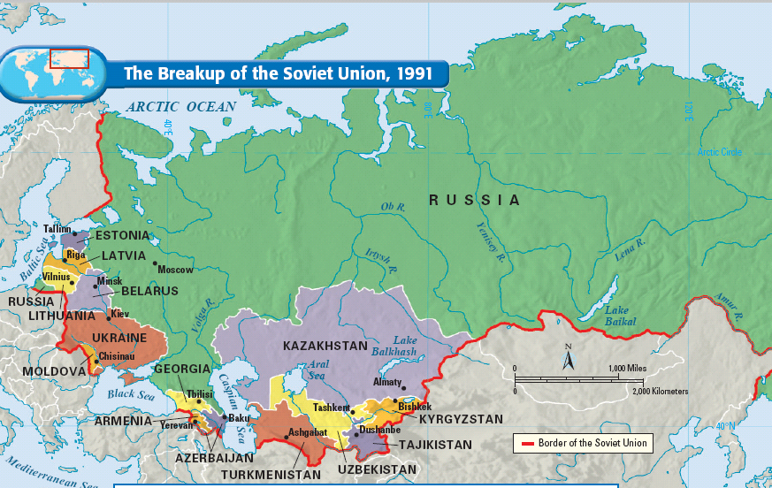
Notes:
For 40 years, Communist Party leaders in Eastern Europe had ruled confidently. Each year their countries fell further behind the West; yet, they remained secure in the knowledge that the Soviet Union, backed by the Red Army, would always send in the tanks when the forces for change became too great. But they had not bargained on a liberal Soviet leader like Mikhail Gorbachev.
As Gorbachev moved toward reform within the Soviet Union and détente with the West, he pushed the conservative regimes of Eastern Europe outside his protective umbrella. By the end of 1989, the Berlin Wall had been smashed. All across Eastern Europe, citizens took to the streets, overthrowing 40 years of Communist rule. Like a series of falling dominos, Communist parties in Poland, East Germany, Hungary, Czechoslovakia, Romania, and Bulgaria fell from power.
Gorbachev, who had wanted to reform communism, may not have anticipated the swift swing toward democracy in Eastern Europe. Nor had he fully foreseen the impact that democracy in Eastern Europe would have on the Soviet Union. By 1990, leaders of several Soviet republics began to demand independence or greater autonomy within the Soviet Union.
Gorbachev had to balance the growing demand for radical political change within the Soviet Union with the demand by Communist hardliners. The hardliners demanded that he contain the new democratic currents and turn back the clock. Faced with dangerous political opposition from the right and the left and with economic failure throughout the Soviet Union, Gorbachev tried to satisfy everyone and, in the process, satisfied no one.
In 1990, following the example of Eastern Europe, the three Baltic states of Lithuania, Latvia, and Estonia announced their independence, and other Soviet republics demanded greater sovereignty. Nine of the 15 Soviet republics agreed to sign a new union treaty, granting far greater freedom and autonomy to individual republics. But in August 1991, before the treaty could be signed, conservative Communists tried to oust Gorbachev in a coup d'etat. Boris Yeltsin, the President of the Russian Republic, and his supporters defeated the coup, undermining support for the Communist Party. Gorbachev fell from power. The Soviet Union ended its existence in December 1991, when Russia and most other republics formed the Commonwealth of Independent States.

Slide 19
