Slide 1
Essential Question:
  What were the causes & effects
  of the Crusades?
Warm-Up Question:
  What is feudalism?
  What is the manorial system?

Slide 2
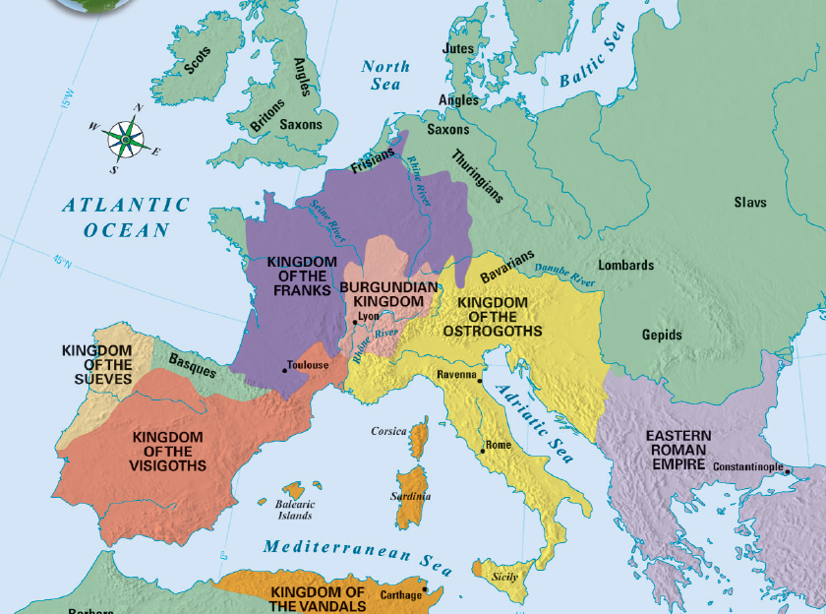
Western Europe in the Middle Ages
After the fall of Rome, Western Europe had constant warfare
Medieval kingdoms lacked trade, common language, & cultural diffusion
Notes:
• Disruption of Trade Merchants faced invasions from both land and sea. Their businesses collapsed. The breakdown of trade destroyed Europe’s
cities as economic centers. Money became scarce.
• Downfall of Cities With the fall of the Roman Empire, cities were
abandoned as centers of administration.
• Population Shifts As Roman centers of trade and government collapsed, nobles retreated to the rural areas. Roman cities were left without strong leadership. Other city dwellers also fled to the countryside, where they grew their own food. The population of western Europe became mostly rural.
The Decline of Learning The Germanic invaders who stormed Rome could not read or write. Among Romans themselves, the level of learning sank sharply as more and more families left for rural areas. Few people except priests and other church officials were literate. Knowledge of Greek, long important in Roman culture, was almost lost. Few people could read Greek works of literature, science, and philosophy. The Germanic tribes, though, had a rich oral tradition of
songs and legends. But they had no written language.
Loss of a Common Language As German-speaking peoples mixed with the Roman population, Latin changed. While it was still an official language, it was no longer understood. Different dialects developed as new words and phrases became part of everyday speech. By the 800s, French, Spanish, and other Roman-based languages had evolved from Latin. The development of various languages mirrored the continued breakup of a once-unified empire.

Slide 3
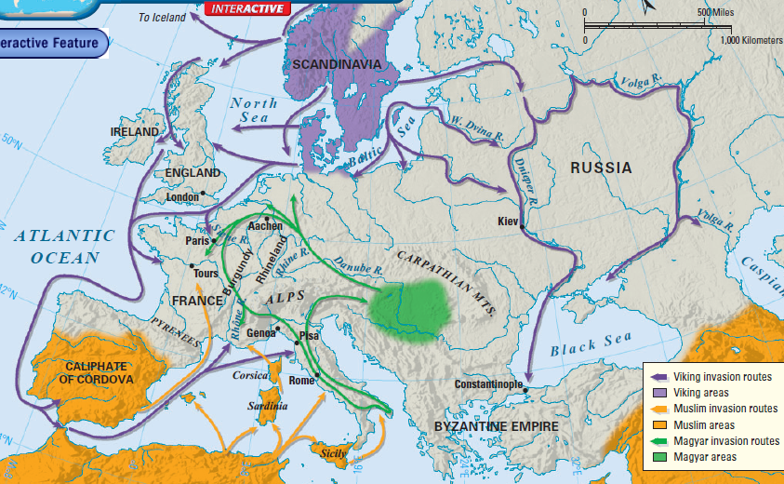
Western Europe in the Middle Ages
Because the Middle Ages were so dangerous, people used a variety of strategies to survive

Slide 4
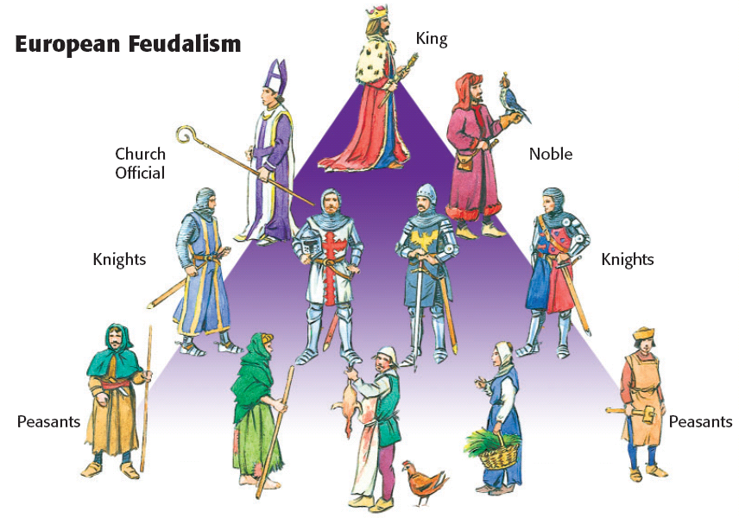
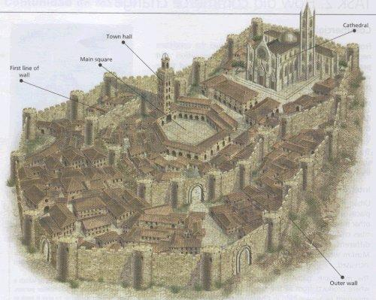
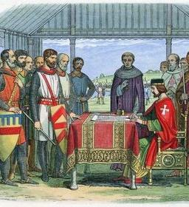
Western Europe in the Middle Ages
Feudalism offered protection when land-owning lords gave fiefs to knights who swore to protect the manor
Castles were built to protect the lord & his peasants

Slide 5
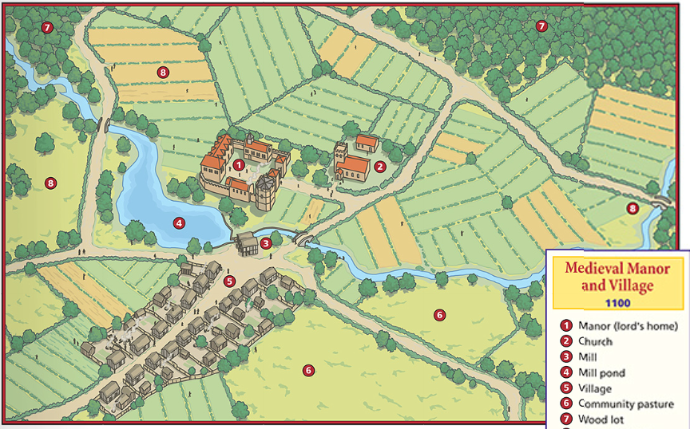
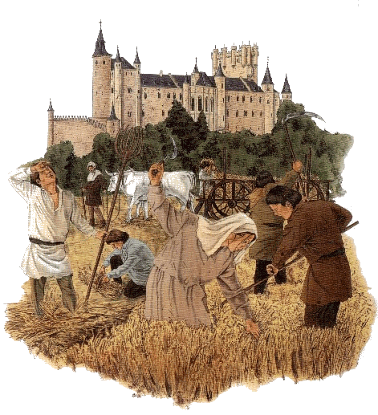
Western Europe in the Middle Ages
Medieval Europeans lived on self-sufficient manors; The manorial system allowed peasants to farm the lord’s land in exchange for part of the food harvested

Slide 6
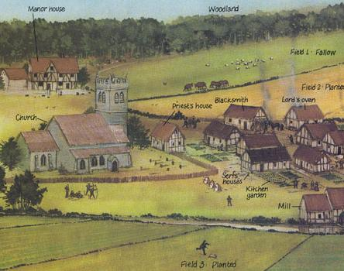
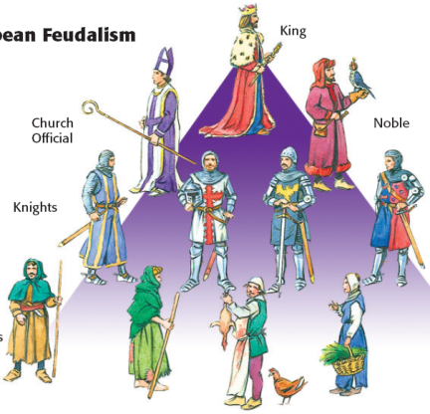
Besides feudalism & the manorial system, what else was important in the Middle Ages?

Slide 7
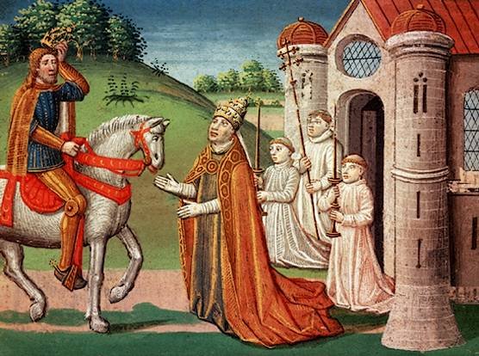
The Role of the Medieval Church
Feudalism & the manor system divided people, but the shared belief in Christianity unified medieval people
Notes:
The Structure of the Church Like the system of feudalism, the Church had its own organization. Power was based on status. Church structure consisted of different ranks of clergy, or religious officials. The pope in Rome headed the Church. All clergy, including bishops and priests, fell under his authority. Bishops supervised priests, the lowest ranking members of the clergy. Bishops also settled disputes over Church teachings and practices. For most people, local priests served as the main contact with the Church.
Religion as a Unifying Force Feudalism and the manor system created divisions among people. But the shared beliefs in the teachings of the Church bonded people together. The church was a stable force during an era of constant warfare and political turmoil. It provided Christians with a sense of security and of belonging to a religious community. In the Middle Ages, religion occupied center stage. Medieval Christians’ everyday lives were harsh. Still, they could all follow the same path to salvation—everlasting life in heaven. Priests and other clergy administered the sacraments, or important religious ceremonies. These rites paved the way for achieving salvation. For example, through the sacrament of baptism, people became part of the Christian community. At the local level, the village church was a unifying force in the lives of most people. It served as a religious and social center. People worshiped together at the church. They also met with other villagers. Religious holidays, especially Christmas and Easter, were occasions for festive celebrations.
The Law of the Church The Church’s authority was both religious and political. It provided a unifying set of spiritual beliefs and rituals. The Church also created a system of justice to guide people’s conduct. All medieval Christians, kings and peasants alike, were subject to canon law, or Church law, in matters such as marriage and religious practices. The Church also established courts to try people accused of violating canon law. Two of the harshest punishments that offenders faced were excommunication and interdict. Popes used the threat of excommunication, or banishment from the Church, to wield power over political rulers. For example, a disobedient king’s quarrel with a pope might result in excommunication. This meant the king would be denied salvation. Excommunication also freed all the king’s vassals from their duties to him. If an excommunicated king continued to disobey the pope, the pope, in turn, could use an even more frightening weapon, the interdict. Under an interdict, many sacraments and religious services could not be performed in the king’s lands. As Christians, the king’s subjects believed that without such sacraments they might be doomed to hell. In the 11th century, excommunication and the possible threat of an interdict would force a German emperor to submit to the pope’s commands.

Slide 8
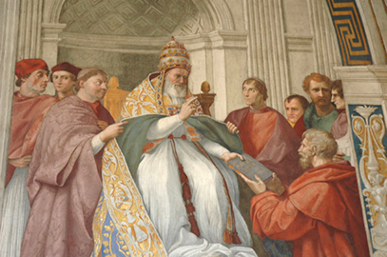
The Role of the Medieval Church
Roman Catholicism was the dominant religion in Western Europe during the Middle Ages:
  Without a common
  government to hold
  everyone together,
  the Catholic Church
  filled an important
  role in peoples’ lives
  The Catholic Pope
  became the strongest
  political leader in Western Europe

Slide 9
The Role of the Medieval Church
The Catholic Church conducted spiritual rituals (called sacraments) & created a system of rules called Canon Law that all Christians had to follow
Kings or lords who violated Canon Law could face interdiction (ban on religious services in a king’s lands)
Christians who violated Canon Law could be excommunicated
(banished from the church)
Notes:
The Structure of the Church Like the system of feudalism, the Church had its own organization. Power was based on status. Church structure consisted of different ranks of clergy, or religious officials. The pope in Rome headed the Church. All clergy, including bishops and priests, fell under his authority. Bishops supervised priests, the lowest ranking members of the clergy. Bishops also settled disputes over Church teachings and practices. For most people, local priests served as the main contact with the Church.
Religion as a Unifying Force Feudalism and the manor system created divisions among people. But the shared beliefs in the teachings of the Church bonded people together. The church was a stable force during an era of constant warfare and political turmoil. It provided Christians with a sense of security and of belonging to a religious community. In the Middle Ages, religion occupied center stage. Medieval Christians’ everyday lives were harsh. Still, they could all follow the same path to salvation—everlasting life in heaven. Priests and other clergy administered the sacraments, or important religious ceremonies. These rites paved the way for achieving salvation. For example, through the sacrament of baptism, people became part of the Christian community. At the local level, the village church was a unifying force in the lives of most people. It served as a religious and social center. People worshiped together at the church. They also met with other villagers. Religious holidays, especially Christmas and Easter, were occasions for festive celebrations.
The Law of the Church The Church’s authority was both religious and political. It provided a unifying set of spiritual beliefs and rituals. The Church also created a system of justice to guide people’s conduct. All medieval Christians, kings and peasants alike, were subject to canon law, or Church law, in matters such as marriage and religious practices. The Church also established courts to try people accused of violating canon law. Two of the harshest punishments that offenders faced were excommunication and interdict. Popes used the threat of excommunication, or banishment from the Church, to wield power over political rulers. For example, a disobedient king’s quarrel with a pope might result in excommunication. This meant the king would be denied salvation. Excommunication also freed all the king’s vassals from their duties to him. If an excommunicated king continued to disobey the pope, the pope, in turn, could use an even more frightening weapon, the interdict. Under an interdict, many sacraments and religious services could not be performed in the king’s lands. As Christians, the king’s subjects believed that without such sacraments they might be doomed to hell. In the 11th century, excommunication and the possible threat of an interdict would force a German emperor to submit to the pope’s commands.

Slide 10
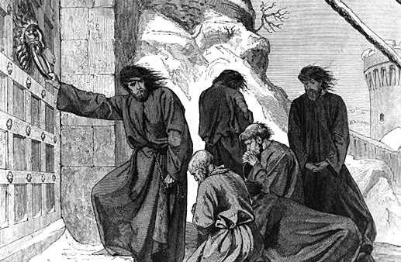
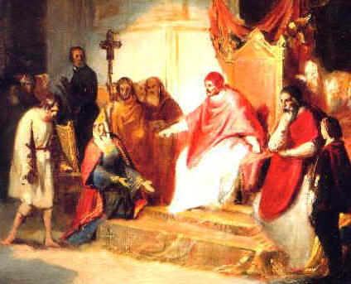
After a disagreement with king Henry IV,
Pope Gregory VII issued an interdict; Henry was so upset he begged for 3 days for the Pope to forgive him

Slide 11
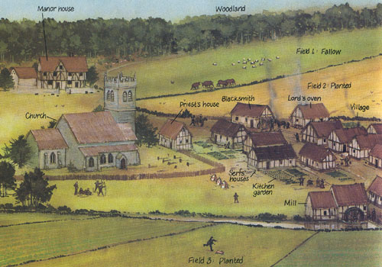
The Role of the Medieval Church
Each territory in medieval Europe had a church which provided order on the manor
Priests controlled peoples’ access to heaven by delivering the sacraments & absolving sins
Peasants’ lives were hard, but the hope of a salvation in heaven kept them loyal & obedient the Church
Christians paid a tax to the church called a tithe
Local priests were the main contact most people had with the Catholic Church
Notes:
Medieval Christians’ everyday lives were harsh. Still, they could all follow the same path to salvation—everlasting life in heaven. Priests and other clergy administered the sacraments, or important religious ceremonies. These rites paved the way for achieving salvation. For example, through the sacrament of baptism, people became part of the Christian community. At the local level, the village church was a unifying force in the lives of most people. It served as a religious and social center. People worshiped together at the church. They also met with other villagers. Religious holidays, especially Christmas and Easter, were occasions for festive celebrations.

Slide 12
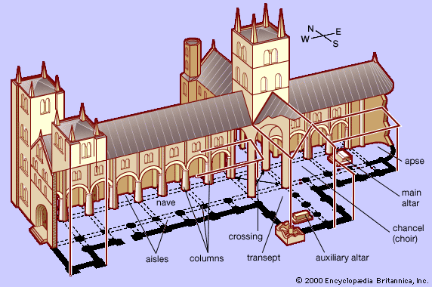
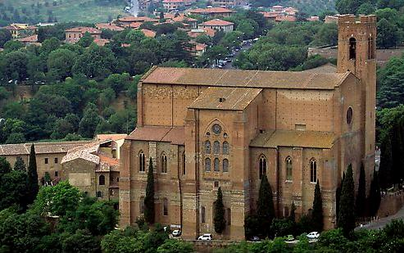
The Role of the Medieval Church
Medieval Christianity was so important
that small churches were built on manors, but large cathedrals were built in cities
Early medieval cathedrals were built with Romanesque architecture

Slide 13
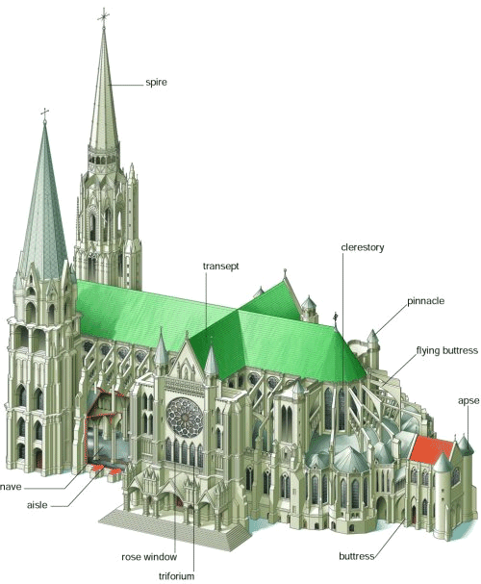
But in the late medieval period,
Gothic architecture was introduced
Tall spires & pointed arches directed the eye towards heaven
Flying buttresses allowed for fewer columns & more open space inside

Slide 14
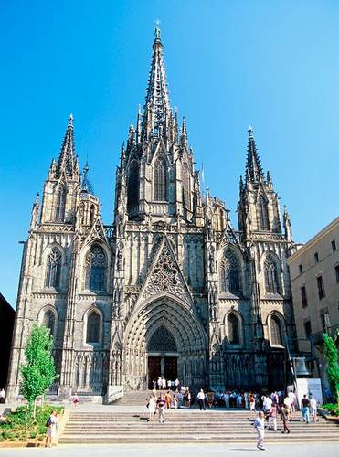

Slide 15
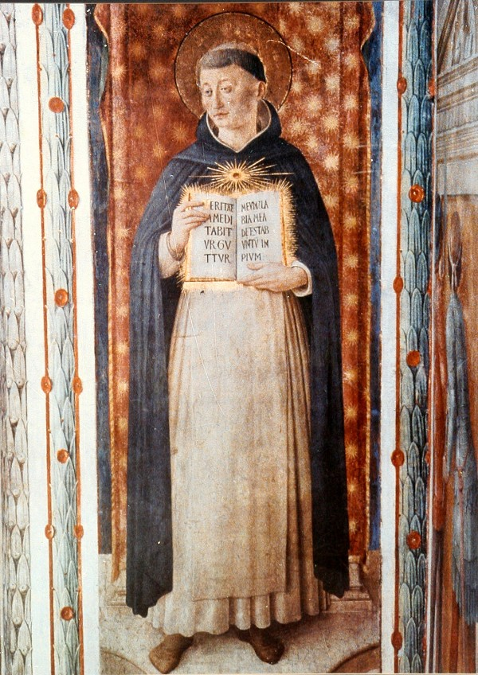
Two Christian Thinkers
St. Augustine
  Wrote City of God
  No earthly city can last forever
  Only the City of God in Heaven is eternal
  Because our understanding is limited, we must put our faith in God
St. Thomas Aquinas
  Summa Theologica –provided a summary of Christian beliefs
  Showed how the writings of Greek philosophers were compatible with Christian teachings
  We should trust reason as well as faith
  Believed in “natural” or “universal laws”
  Beginning of civil disobedience

Slide 16
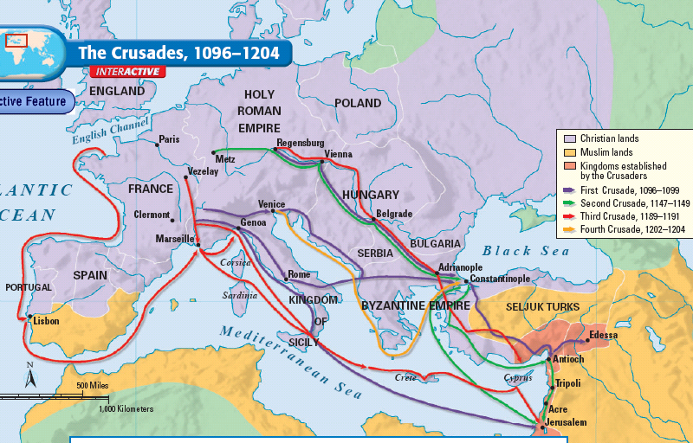
Why did Christians go to Jerusalem during the Middle Ages?

Slide 17
The Crusades
Pope Urban II issued a call to Christians for a Crusade (a holy war) to regain control of the Holy Land
In 1095, the Islamic Empire invaded & took the holy city of Jerusalem
Over the next 300 years, Christians fought Muslim armies in 9 different Crusades

Slide 18
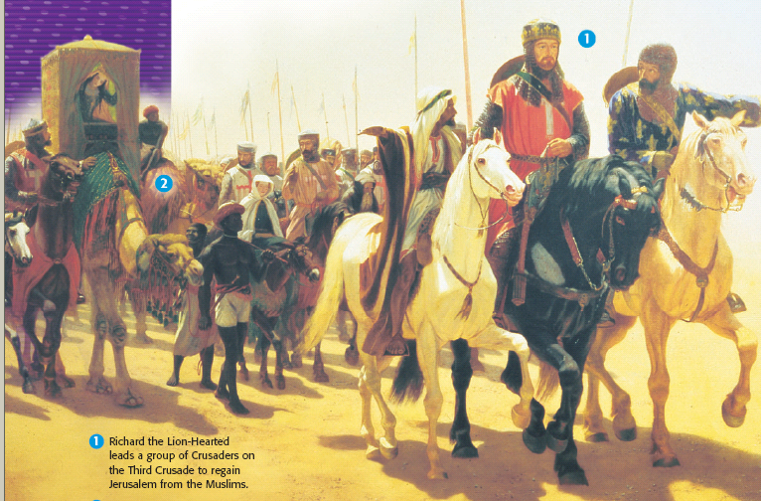
Why did Christians go on the Crusades?
  Merchants wanted access to trade routes
The Pope wanted to unite Roman Catholic & Eastern Orthodox Christians & regain holy lands from Muslims
Knights wanted to support the Church; Many hoped to gain land & wealth
Notes:
Others who participated in the Crusades were younger sons who, unlike eldest sons, did not stand to inherit their father’s property. They were looking for land and a position in society, or for adventure. In the later Crusades, merchants profited by making cash loans to finance the journey. They also leased their ships for a hefty fee to transport armies over the Mediterranean Sea. In addition, the merchants of Pisa, Genoa, and Venice hoped to win control of key trade routes to India, Southeast Asia, and China from Muslim traders.

Slide 19
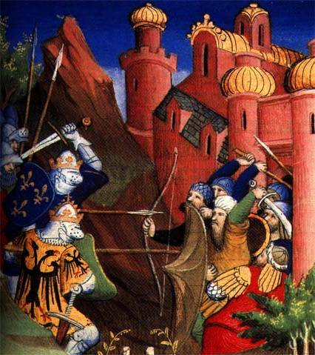
The Crusades
Christian soldiers took back Jerusalem during the First Crusade
But, Muslims took back Jerusalem & kept it during the Second & Third Crusades
More Crusades were fought, but Christians never regained the Holy Lands

Slide 20
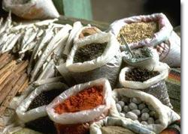
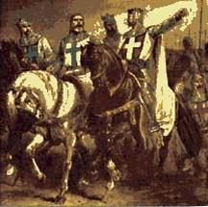
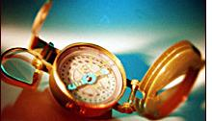

Effects of the Crusades
The Crusades brought cultural diffusion & introduced new ideas into Western Europe
Increased desires for luxury goods like silk, cotton, sugar, & spices
Introduced technologies like compass, astrolabe, ship designs, & gunpowder
Introduced ideas like Arabic numbers, chemistry, algebra, telescope

Slide 21
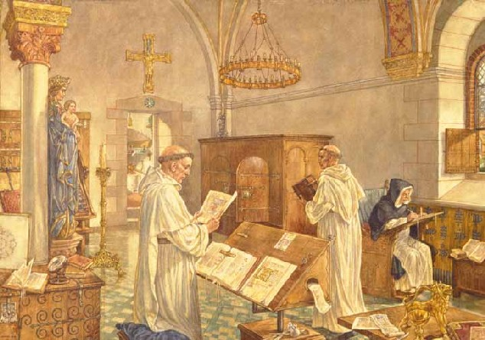
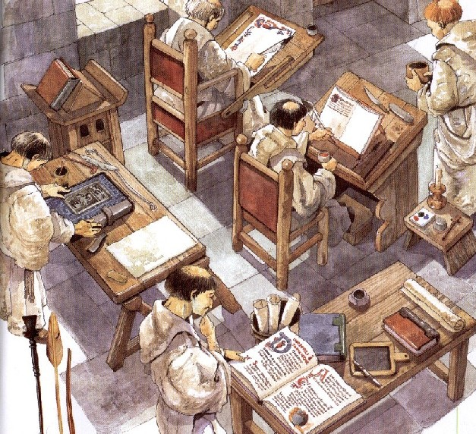
During the Middle Ages, only priests could read & write
Greek ideas
After the Crusades, learning increased & more people were educated
Ideas about the Bible
Roman ideas
Chinese ideas
Islamic ideas

Slide 22
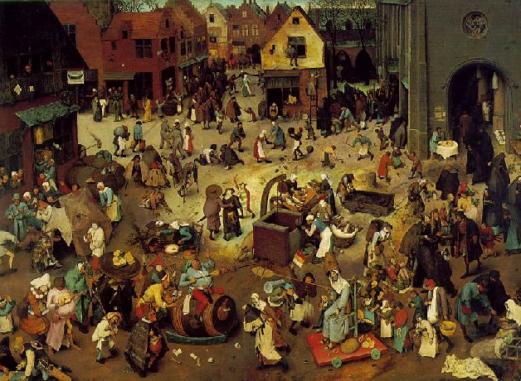
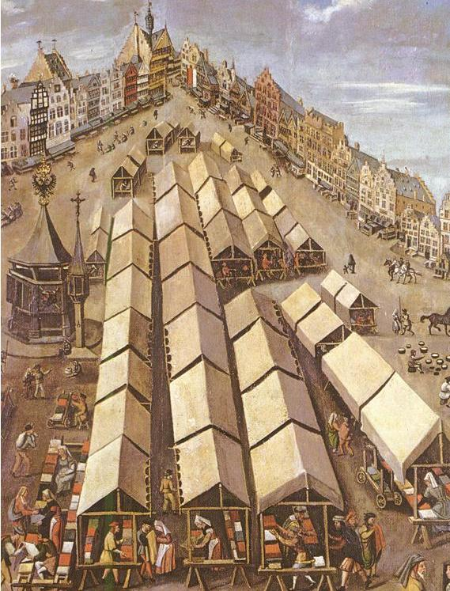
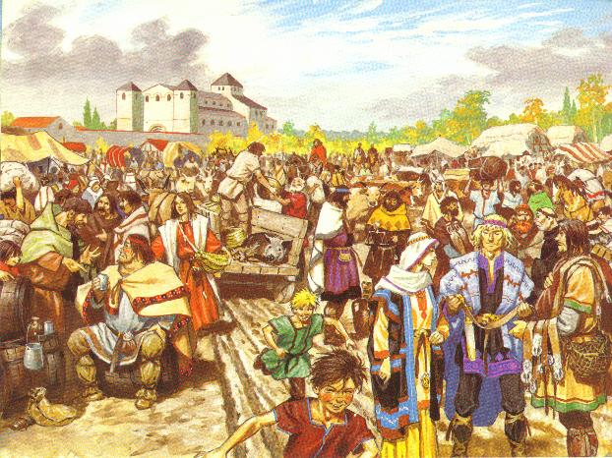
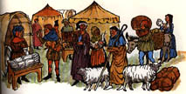
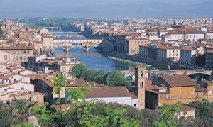
High Middle Ages—Crusades
After the Crusades, people wanted more luxury goods & began to trade
Trade led to the growth of cities
Medieval fairs brought iron & salt to the feudal manors; this was a very rare thing

Slide 23

The Black Death
1347 - 1351

Slide 24
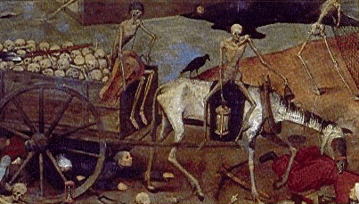
Bring out your dead!

Slide 25
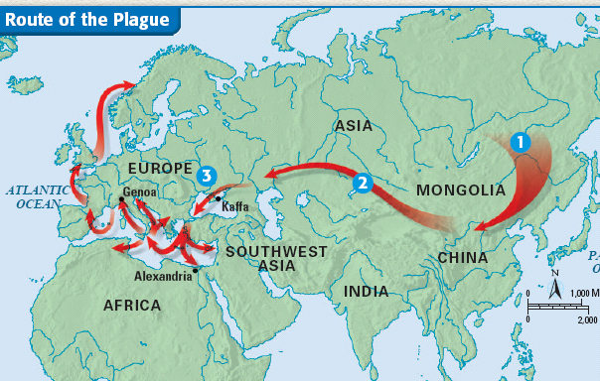
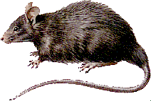
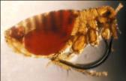
One reason for the decline of the manorial system was the plague, known as the Black Death
In 1347, a trade ship arrived in Italy carrying plague-infested rats
The plague swept quickly throughout Europe along trade routes

Slide 26
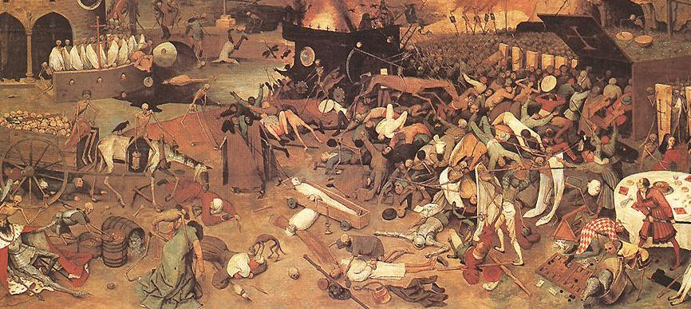
The Black Death

Slide 27
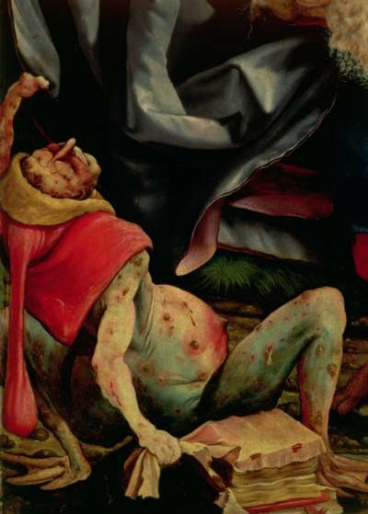
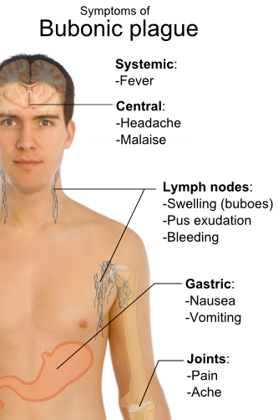

Slide 28
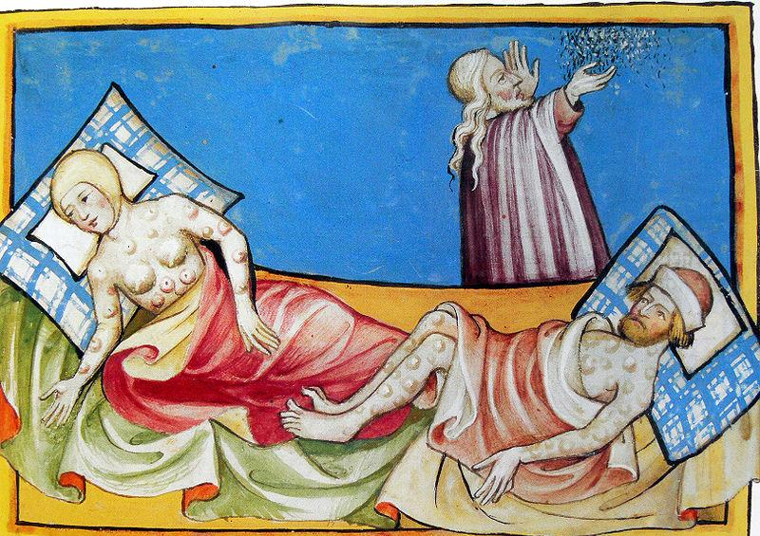
Attempted “cures” for the plague
Bathing in urine
Isolation
Leaches
Prayer
Placing dead animals in the home
Pomanders

Slide 29
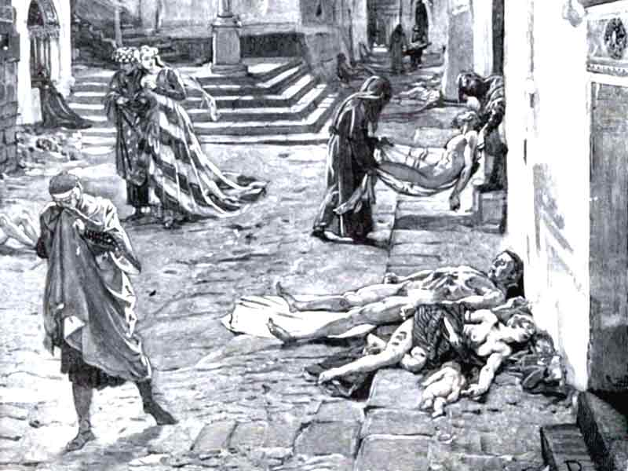
The plague killed 25 million people in 5 years
The plague caused a labor shortage; those that survived could demand higher wages & more rights
Notes:
29

Slide 30
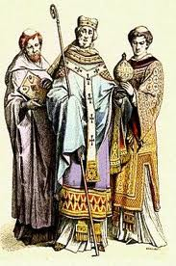
Conclusions
The role of religion in the Middle Ages:
  The Roman Catholic Church played an
  important role in the lives
  of Europeans both before
  & after the Middle Ages
  The Crusades failed to
  secure Jerusalem from
  the Islamic Empire, but
  these holy wars increased
  cultural diffusion &
  helped bring an end to the Middle Ages

