Slide 1
Essential Question:
  What led to the Cold War between the United States & Soviet Union?
Warm Up Questio:

Slide 2
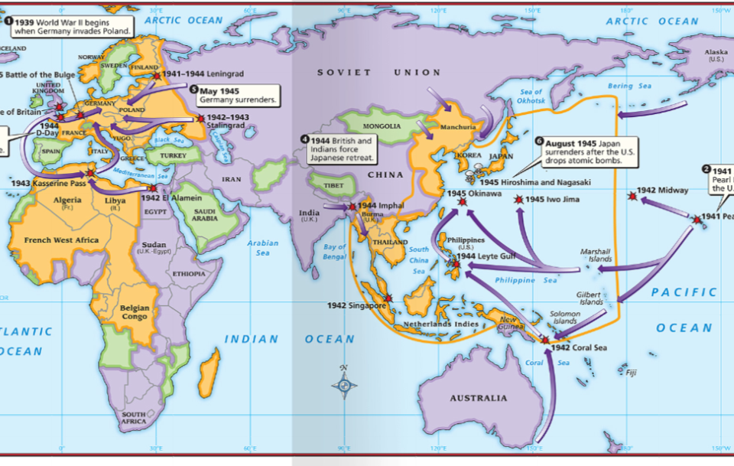
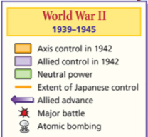
The end of World War II led to important changes in the world:

Slide 3
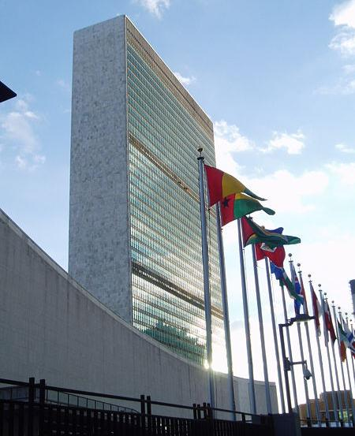
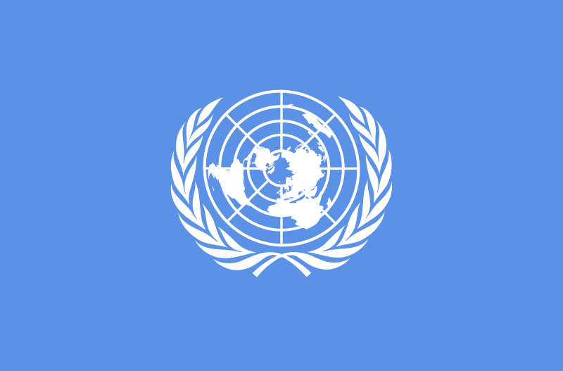
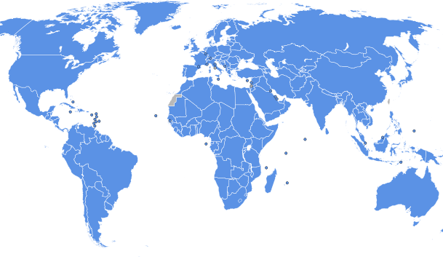
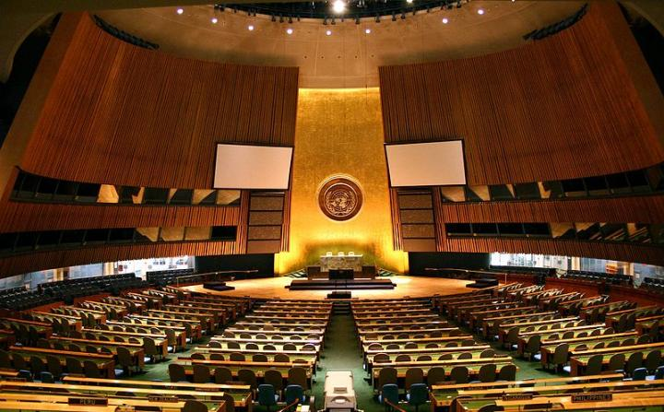
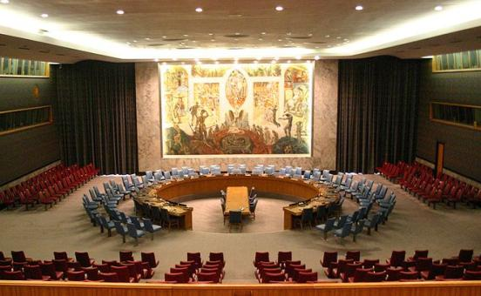
The United Nations was created which replaced the League of Nations
U.N. Peacekeeping Interventions, 1945-2009
United Nations Headquarters is in New York City
Executive Council
General Assembly
Member Nations

Slide 4
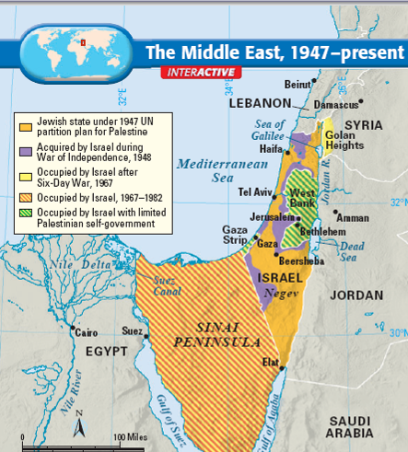
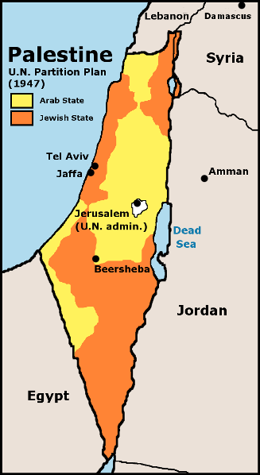
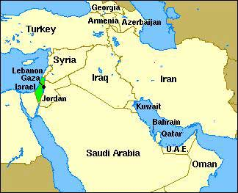
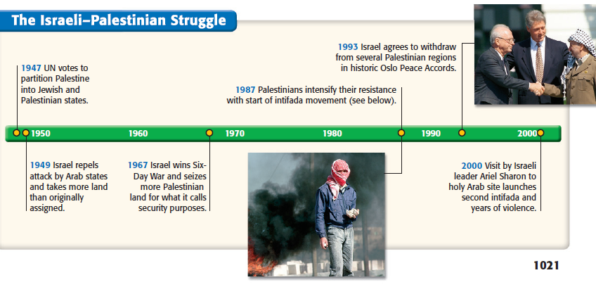
The UN created a Jewish nation called Israel which set off a series of wars with Arabs in the Middle East

Slide 5
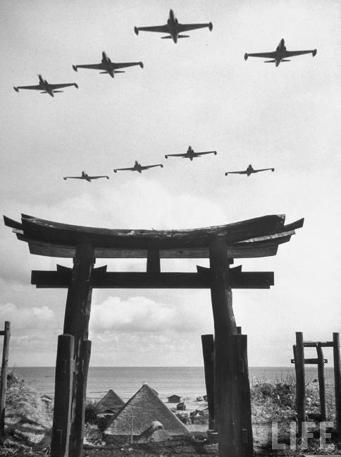
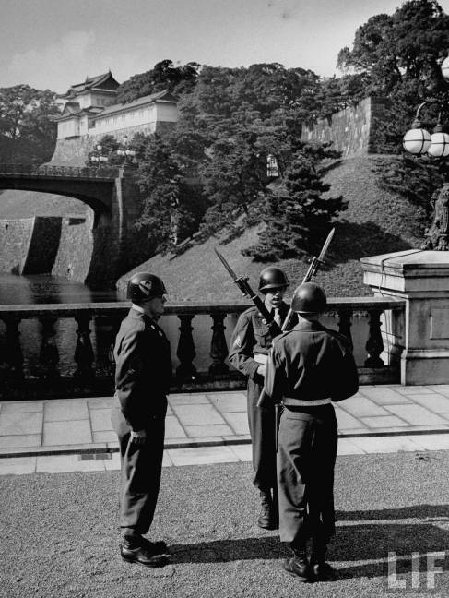
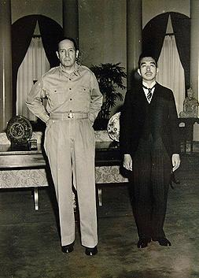
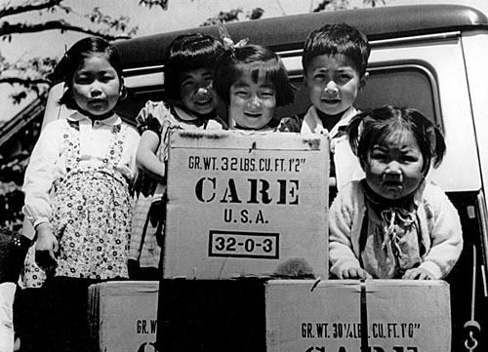
The United States occupied & helped rebuild Japan

Slide 6
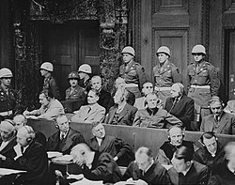
Justice after the War

Slide 7
The Nuremberg trials were a series of military tribunals held by the Alliedforces under international law and the laws of war after World War II. The trials were most notable for the prosecution of prominent members of the political, military, judicial and economic leadership of Nazi Germany, who planned, carried out, or otherwise participated in the Holocaust and other war crimes.

Slide 8
The categorization of the crimes and the constitution of the court would be used afterwards by the United Nations for the development of a specific international jurisprudence in matters of war crime, crimes against humanity, war of aggression, as well as for the creation of the International Criminal Court. The Nuremberg indictment also mentions genocide for the first time in international law (Count three, war crimes : "the extermination of racial and national groups, against the civilian populations of certain occupied territories in order to destroy particular races and classes of people and national, racial, or religious groups, particularly Jews, Poles, and Gypsies and others.")^{[5]}

Slide 9
Japanese Justice
Soon after the war, the Allied powers indicted Japanese leaders. Of these, 984 were initially condemned to death, 920 were actually executed, 475 received life sentences, 2,944 received some prison terms, 1,018 were acquitted. The charges were all tried by the International Military Tribunal for the Far East, also known as "the Tokyo Trials". Other courts were formed in many different places in Asia and the Pacific.

Slide 10
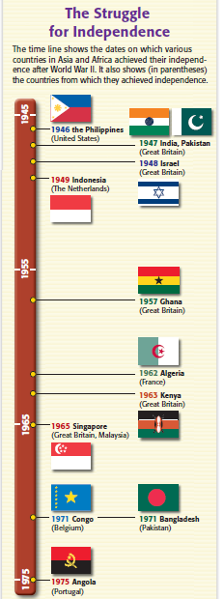
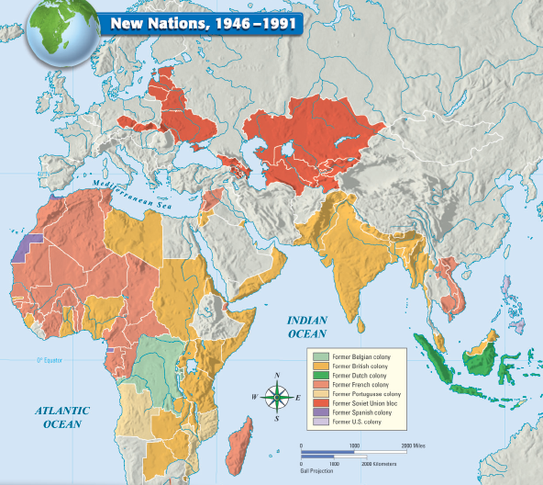
The end of the war inspired independence throughout Africa & Asia, called decolonization

Slide 11
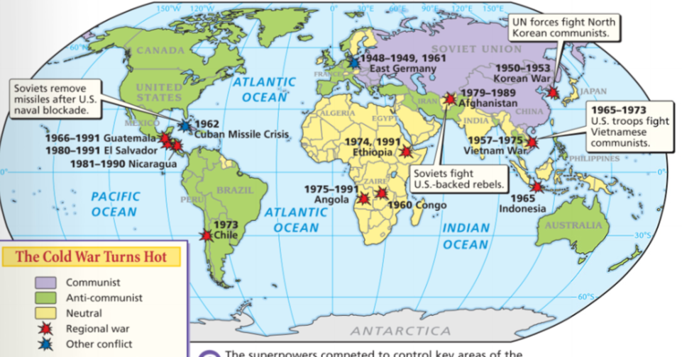
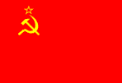
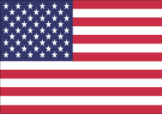
The United States
& Soviet Union were superpowers & rivals who dominated world politics
One of the most important changes after World War II was the beginning of the Cold War
From 1945 to 1991,
the United States &
Soviet Union entered an era of distrust & hostility known as the Cold War
What were the major ideologies of the USA & USSR?
Notes:
The most important change in U.S. foreign policy after WWII was the beginning of the Cold War
The Cold War was an era of distrust & hostility between the USA & USSR from 1945-1991
It was an era of competing ideologies: The USA promoted democracy & capitalism while the USSR tried to spread communism

Slide 12
Examining Cold War Ideologies
The Cold War was a conflict of ideology between the USA & Soviet Union
  Step 1: Match each of the 8 cards with their appropriate definition
  Step 2: Sort the cards by determining which 4 describe the USA & which
  4 cards describe the USSR
  Step 3: Match each of the 8 images with the correct definition

Slide 13
Capitalism | Socialism
Private ownership of industry, freedom of competition, gov’t keeps hands off (laissez-faire) Leads to different economic classes (rich and poor) | Gov’t owns industries and farms; The goal of the gov’t is to bring equality to people The goal is to have a classless society with no rich or poor
Democracy | Totalitarianism
Government of the people People elect their leaders | Government led by a dictator Total control over many aspects of peoples’ lives

Slide 14
Freedom | Equality
Valuing freedoms of speech, press, and business | Valuing basic needs (food, homes, education, jobs) for all people
Individualism | Collectivism
Emphasizes the need for people to do things on their own Competition is a good thing; The best individuals have more power, status, money | Emphasizes the need for people to work together to benefit everyone Everyone works the same amount and every gains the same benefits

Slide 15
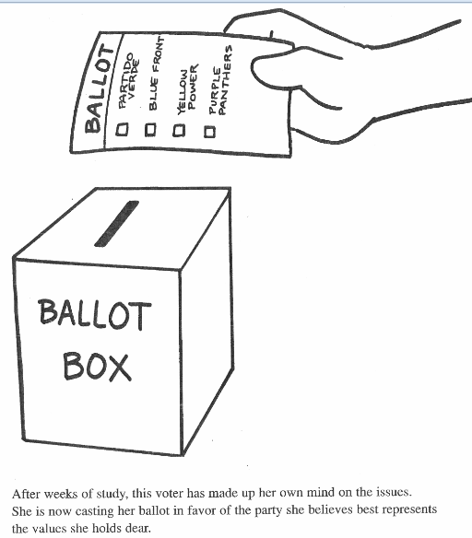
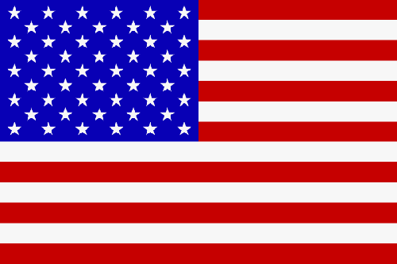
A
DEMOCRACY

Slide 16
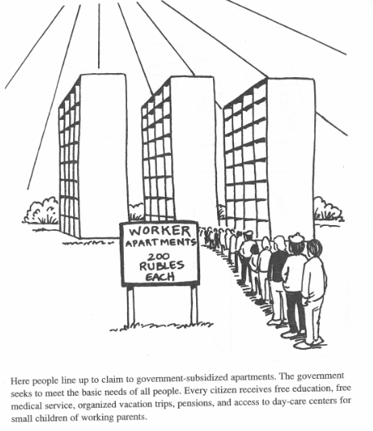

B
EQUALITY

Slide 17

C
CAPITALISM

Slide 18
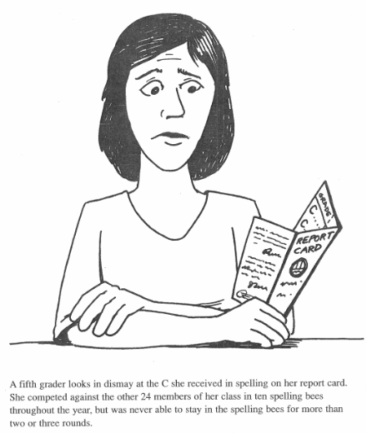
D
INDIVIDUALISM

Slide 19
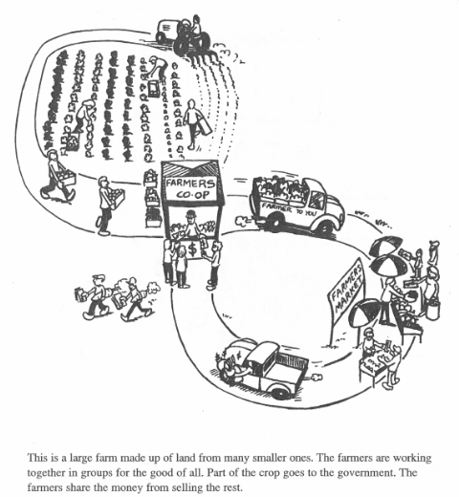
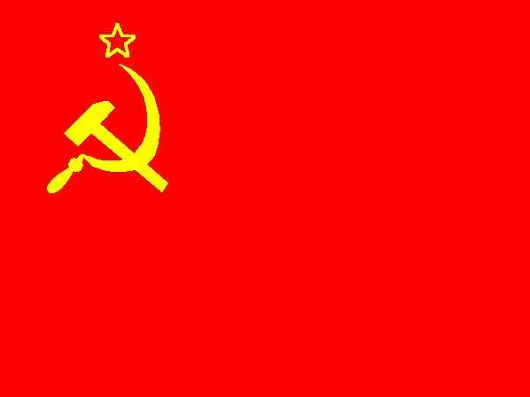
E
COLLECTIVISM

Slide 20
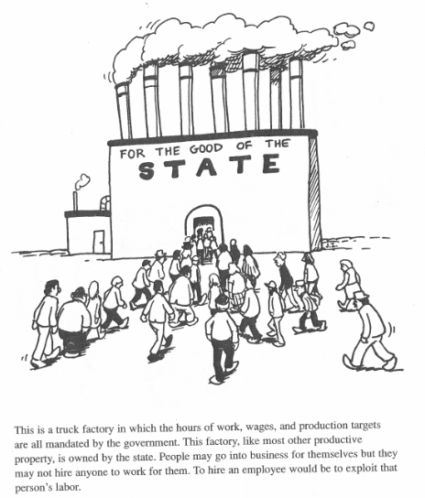

F
SOCIALISM

Slide 21
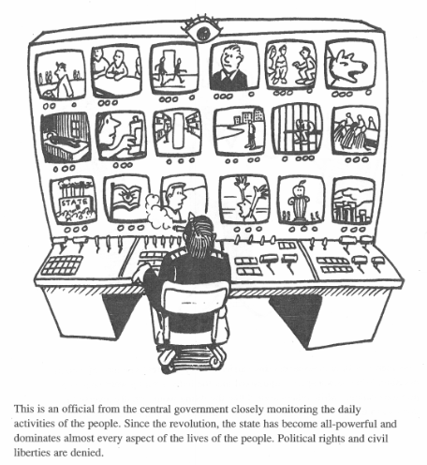
G
TOTALITARIANISM

Slide 22
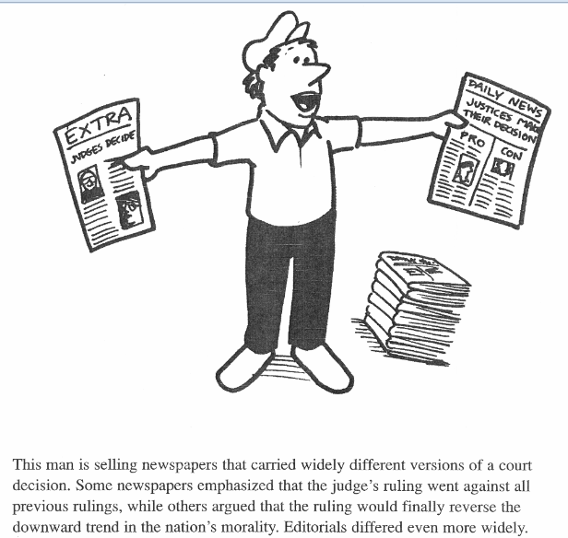
H
FREEDOM

Slide 23
Essential Question:
  What were the major events between the USA & USSR during
  the early years of the Cold War?
CPWH Agenda for Unit 13.1:
  Clicker questions
  “Cold War” notes
  Today’s HW: 33.1
  Unit 13 Test: Tuesday, May 3

Slide 24
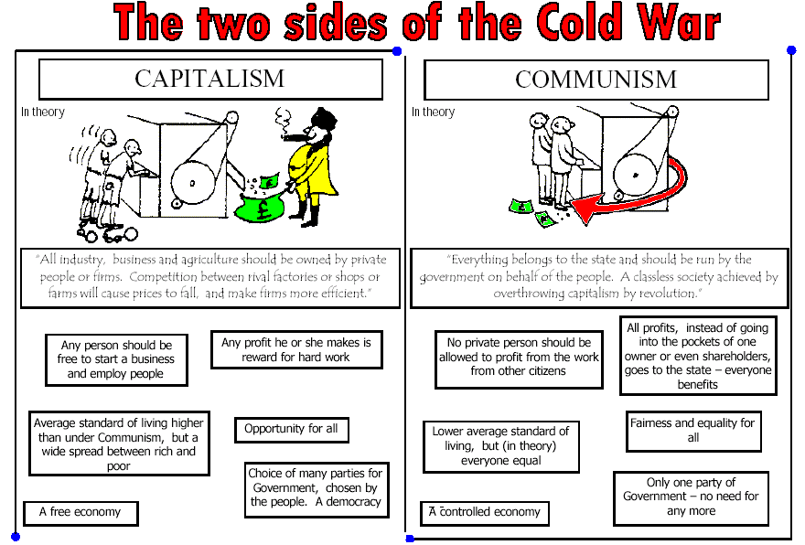
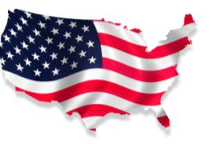

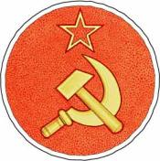


Slide 25
The United States
& Soviet Union were superpowers & rivals who dominated world politics
One of the most important changes after World War II was the beginning of the Cold War
This was an era of competing ideologies: the USA promoted democracy & capitalism while the USSR tried to spread communism
During the Cold War,
the United States &
Soviet Union entered an era of distrust & hostility from 1945 to 1991
The different ideologies between USA & USSR and their desires to spread these ideas led to an era of distrust, hostility, proxy battles, & near nuclear war

Slide 26
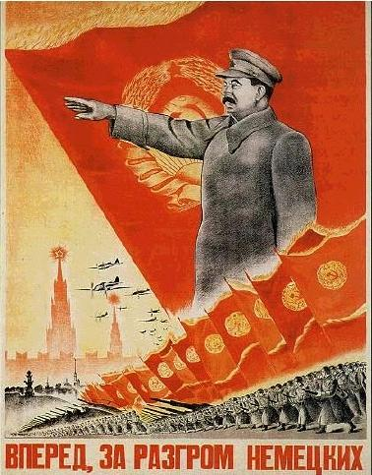
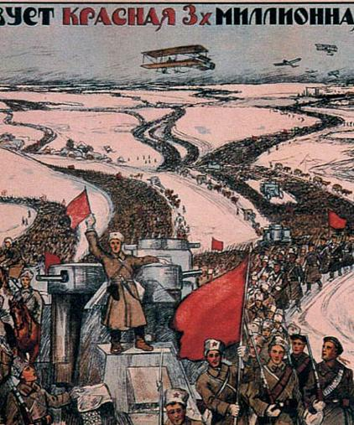
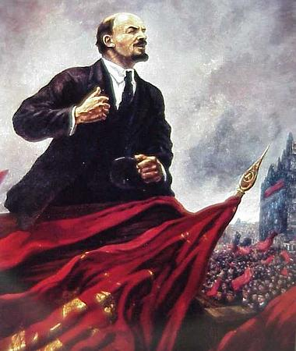
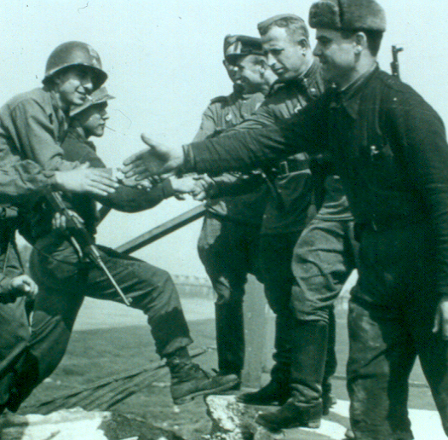
What Caused the Cold War?
In 1917, Lenin led
the Bolsheviks in the Russian Revolution
& created the world’s first communist gov’t
Distrust began when the USA sent troops to fight the “Red Army” during the Russian Civil War
After Lenin’s death in 1924, Joseph Stalin became dictator of the Soviet Union
During WWII, the
USA & USSR worked together to defeat the Axis Powers, but…

Slide 27
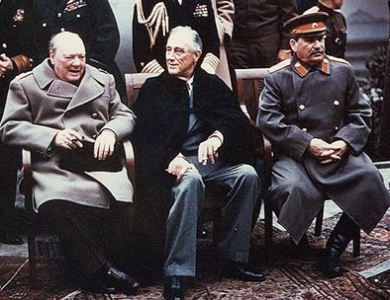
…World War II increased tensions between the
USA and USSR
Stalin never trusted
the Britain or the USA during World War II
The Manhattan Project gave the USA a monopoly on nuclear weapon technology

Slide 28
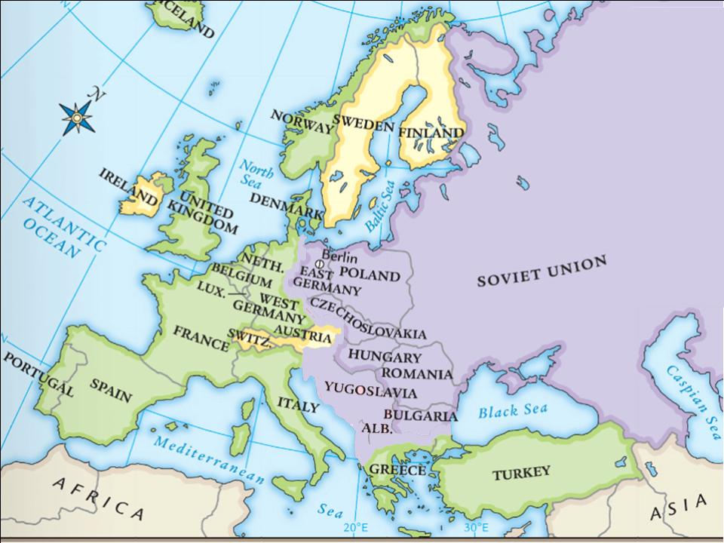
At the Yalta Conference, Stalin agreed to allow self-determination in Eastern Europe
But, Stalin wanted a “buffer zone” between
the USSR & the democratic nations in Western Europe
Stalin used his military to install communist gov’ts in Eastern European nations
Notes:
never did;

Slide 29
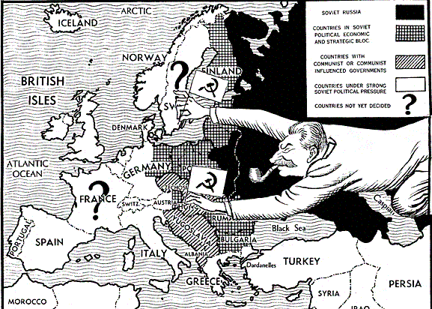
As a result, Eastern European nations
turned communist & became Soviet satellites:
nations that were influenced by the USSR
In the years after World War II, the USA began to view Stalin as a new Hitler—a dangerous dictator who wanted to take over the world

Slide 30
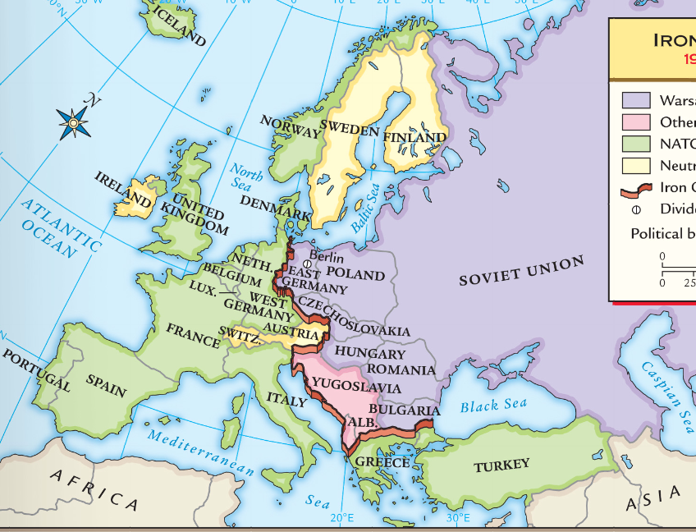

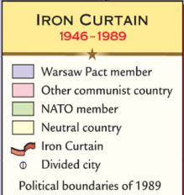
By 1946, Europe was divided by an “iron curtain” that separated democratic/capitalist Western Europe from communist/totalitarian Eastern Europe
Communism & Totalitarianism
Capitalism & Democracy

Slide 31
The U.S. created a foreign policy called containment to stop Soviet influence & the spread of communism
When the USSR began to pressure Greece & Turkey to turn communist, the U.S. created the
Truman Doctrine, promising economic & military help to any nation threatened by communism
T =
The Truman Doctrine
worked & neither Greece nor Turkey fell to communism

Slide 32
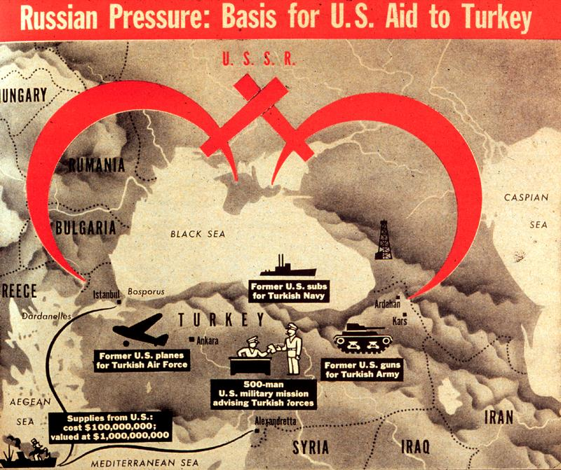
Notes:
Congress appropriated $400 million in aid to Greece & Turkey

Slide 33

European nations had difficulty recovering after WWII which led to fears of communism in Europe
The U.S. created the Marshall Plan which offered $13 billion to help rebuild post-war Europe
M =
By 1952, Western Europe recovered & Communism never took root

Slide 34
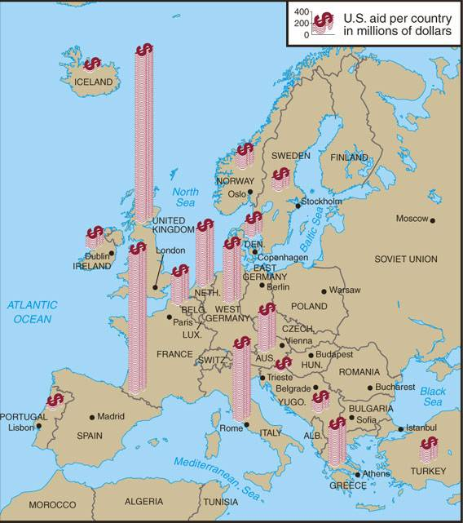
Marshall Plan to Aid Europe 1948-1952

Slide 35
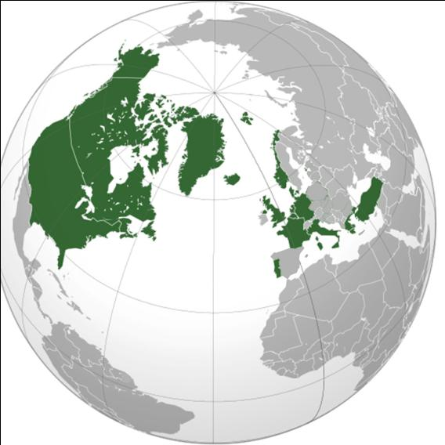
In 1948, the USSR used military force to turn Czechoslovakia to communism; This led to fears that Stalin would use similar tactics in Western Europe
In 1949, the United States formed the
North Atlantic Treaty Organization (NATO): a military alliance among democratic countries in Europe & North America

Slide 36
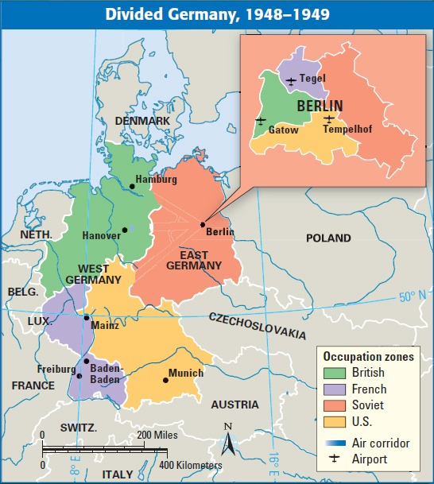
At the end of WWII, Germany was divided into
zones occupied by the USA, Britain, France,
& the USSR
Berlin, the German capital, was also divided but was located in the Soviet zone
In 1948, Stalin tried to turn all of Berlin communist & ordered the Berlin Blockade
which shut down all ground transportation to West Berlin

Slide 37
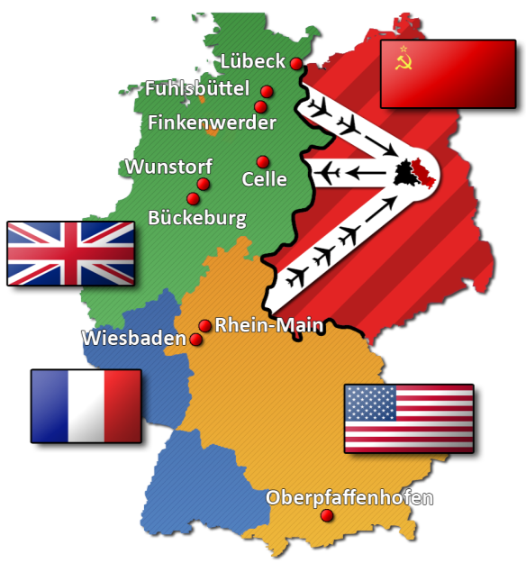
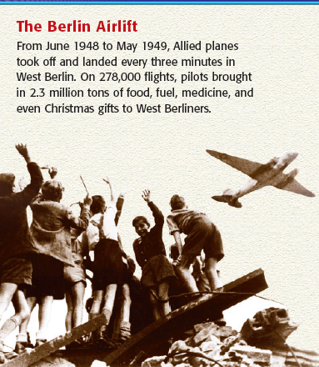
In response, the U.S. began the Berlin Airlift
For 11 months, U.S. & British planes supplies landed in Berlin to bring food, fuel, & supplies
Stalin admitted defeat & lifted the blockade in 1949
The United States successfully kept West Berlin from turning communist

Slide 38

From 1945 to 1949, the United States successfully contained communism in Europe
But over the next 40 years, the Cold War intensified as communism spread to Asia, Africa, and Latin America
The Cold War intensified as new nuclear weapons were introduced; espionage (spying ) increased;
& wars broke out in Korea, Vietnam, & Afghanistan

