Slide 1
Dr. Seuss Goes to War
The World War II Editorial Cartoons of Theodore Seuss Geisel
Richard H. Minear

Slide 2
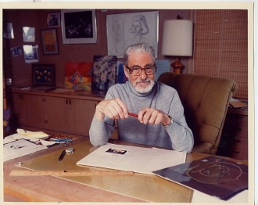
Biography of Dr. Seuss
Theodore Seuss Giesel
  Ted
Born: March 2, 1904
  German American Family

Slide 3
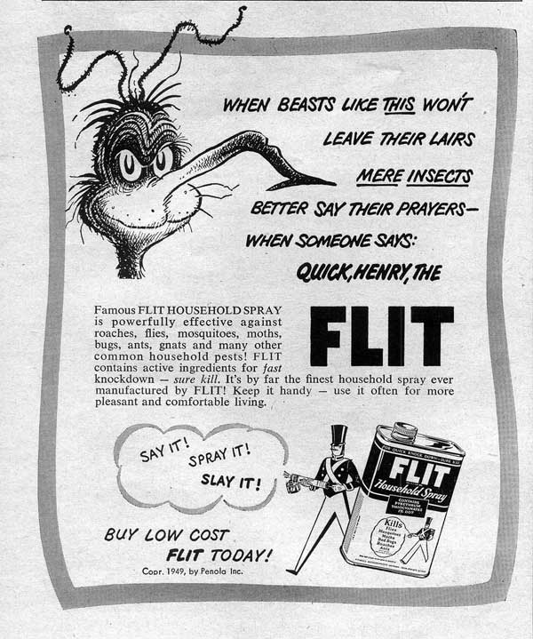
Biography of dr. Seuss
1925: Dartmouth College
  Cartoons in campus humor magazine
Use of alias on published work
Oxford University
Work on advertising campaigns
Move to NY
  Begins to publish books

Slide 4
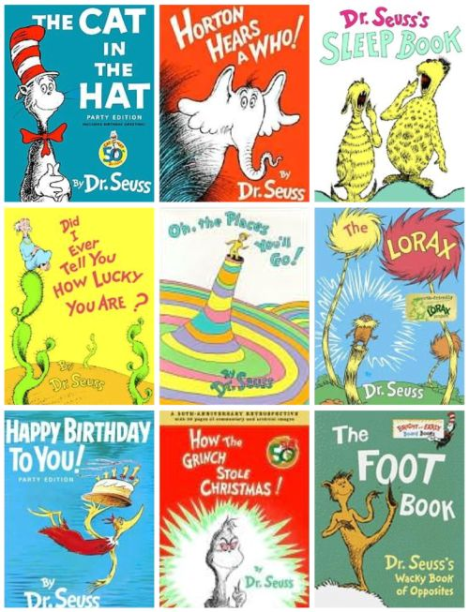
Biography of Dr. Seuss
Published over 40 children’s books
Famous titles:
  Green Eggs and Ham
  The Cat in the Hat
  Horton Hears a Who
  How the Grinch Stole Christmas
  One Fish, Two Fish, Red Fish, Blue Fish

Slide 5
The Work of Dr. Seuss
www.seussville.com

Slide 6
Biography of Dr. Seuss
Becomes interested in politics and American policies of isolationism during WWII
Also concerned about social issues (racial prejudice, anti-Semitism, etc,)
Produces editorial cartoons on political and social issues

Slide 7
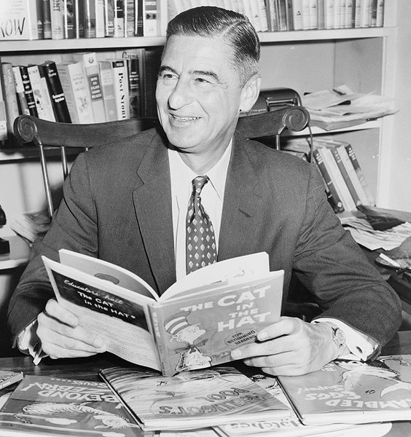
Biography of Dr. Seuss
Personal Life
  Married twice
  No Children
Died 1991
Honors and Legacy
  Awards (Pulitzer Prize, etc.)
  Read Across America Day
  Inspiration for Television, Film, Broadway

Slide 8
Dr. Seuss’ WWII Editorial Cartoons
Format of Lesson:
Small group interaction to analyze one of Dr. Seuss’ editorial cartoons
Complete analysis sheet
Share with the rest of class

Slide 10
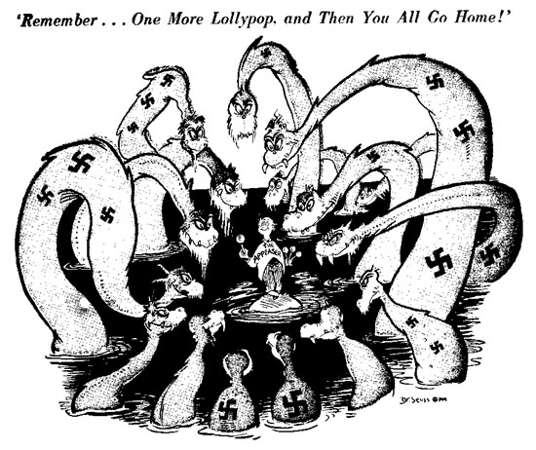
Model for How to Analyze Cartoons

Slide 11
Model for How to Analyze Cartoons
Level 1:
Visuals:
  Little man standing on an island surrounded by beasts
  Lollipops
  Swastikas
  Faces on beasts are mean, sly, toothy
Words:
  “Remember…One More Lollypop, and Then You All Go Home!”
  “The Appeaser” is used to identify the small man

Slide 12
Model of How to Analyze Cartoons
Level 2
Visuals:
  Swastikas are symbols to help identify Nazi Germany
  The lollypops are symbolic of childlike innocence
  Both signify the fact that the Allies are naïve and seemingly unaware of the danger that comes with appeasing Hitler
Words:
  “One more lollypp and you all go home” and “appeaser” are significant because they reflect the thinking at Munich. The Allies let Hitler have his way.
  Naïve, unrealistic, foolish,

Slide 13
Model of How to Analyze Cartoons
Level 3
The “appeaser” is giving lollipops to the beasts. He is giving them a treat. They swarm around him with sly grins and toothy faces, but he still thinks he can control them.
The “appeaser” clarifies the childlike innocence of the man as he deals with the beast.
The cartoon sends the message that appeasing Hitler is just going to cause more problems. He will never have enough.
Isolationists would disapprove of the cartoon. Those supporting U.S. involvement in WWII would support the cartoon.

Slide 14
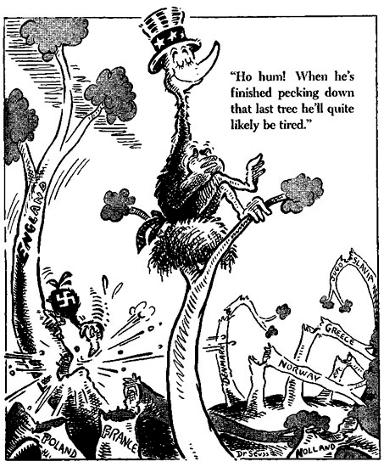

Slide 15
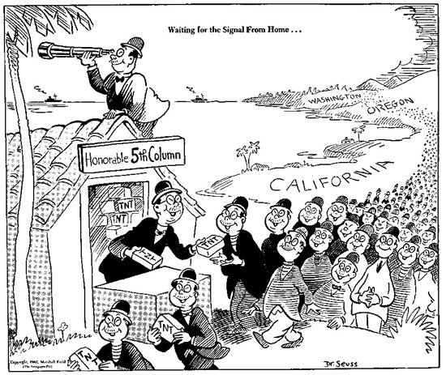

Slide 16
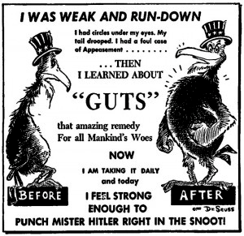

Slide 17
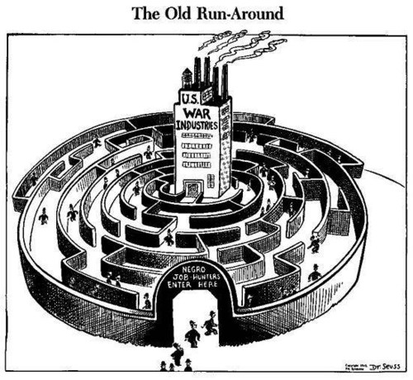

Slide 18
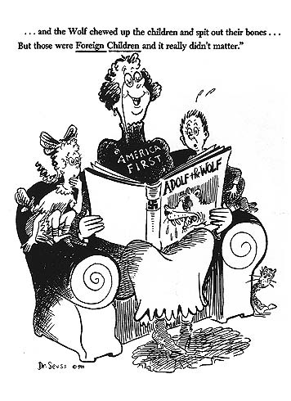

Slide 19
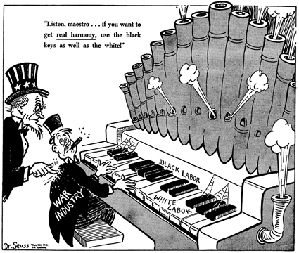

Slide 20
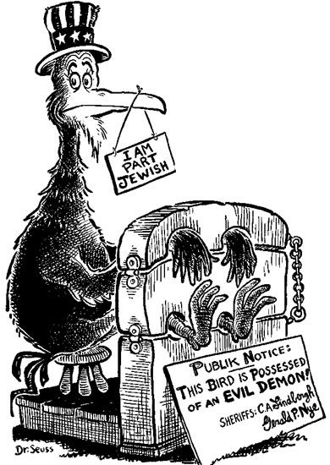

Slide 21
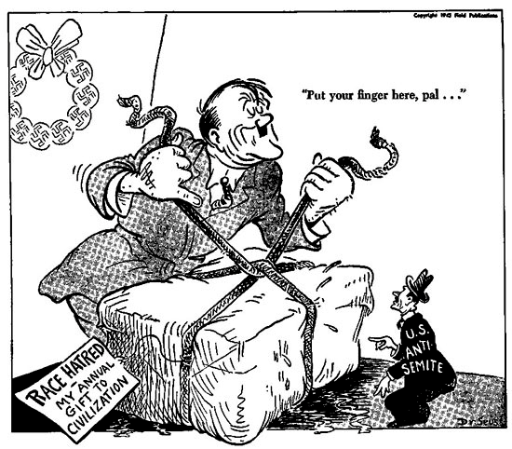

Slide 22
