Slide 1
Scientific Revolution & the Enlightenment
Chap 19, section 1 & 2

Slide 2
The Scientific Revolution marked the beginning of a dramatic shift in how people viewed the world. The medieval and early modern European outlook had been dominated by religion. As a result of this revolution, many came to see the world predominantly in secular and scientific ways. In the short term, the Scientific Revolution set the stage for the Enlightenment; its long-term repercussions can still be felt today.

Slide 3
What was the scientific revolution
A revolution in human understanding and knowledge about the physical universe
17th century
Began with Kepler, Galileo’s astronomic discoveries
Ended with Newton’s major works

Slide 4
Science before the Revolution
“Science” before the revolution by thinkers who were more philosophers
No experimental method or observation
Alchemy, astrology
Science is a habit of mind, It involves using reason, observation, testing, and systematic thought to uncover truths about the world and about people, animals, and things in the world.

Slide 5
Factors leading to change
Knowledge from the Arab world
Knowledge of new peoples and animals from explorations, contact with non-western cultures
Rise of universities and Renaissance ideals
Rise of Rationalism and Empiricism

Slide 6
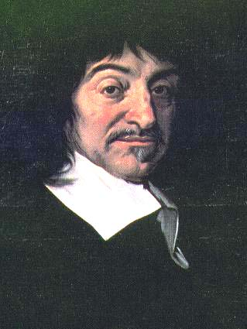
Rationalism & Empricism
Reason, not tradition, is the source of all knowledge, René Descartes (1596–1650)
French philosopher and mathematician
Cogito ergo sum (“I think, therefore, I am”)
Deductive reasoning
Francis Bacon (English), the way to gain knowledge is through observation and experimentation

Slide 7
Scientific Method
Identify a problem
Form a hypothesis
Perform experiments to test the hypothesis
Record the results
Analyze the results to prove the hypothesis true or false

Slide 8
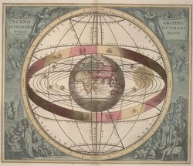
Roots of modern science
Aristotle, 4th century BC, earth at center of universe
Ptolemy, 2nd century astronomer/mathematician, geocentric theory

Slide 9
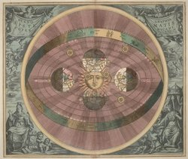
Copernicus (1473–1543)
Polish, 1500s, recognizes heliocentric theory, complete model of the solar system
On the Revolutions of the Heavenly Spheres, 1543

Slide 10
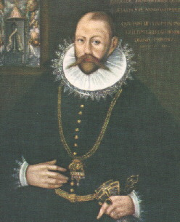
Tycho Brahe (1546–1601)
Danish astronomer court of King Frederick II, who sponsored two observatories
Amassed accurate astronomical data
Discovers supenovas
Argued that the Moon and Sun revolve around the Earth while other planets revolve around the Sun

Slide 11
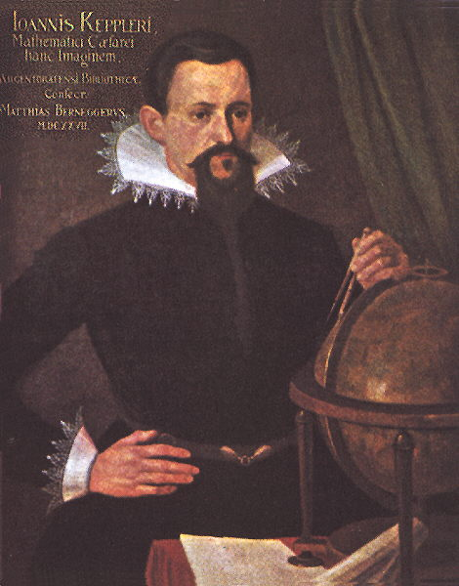
Johannes Kepler (1571–1630)
German astronomer and mathematician, student of Tycho
Didn’t agree with Tycho’s interpretation of data
Disagreed with Copernicus, claiming that other bodies moved in elliptical motion, as opposed to circular motions
Theorized three laws of planetary motion using Tycho’s data

Slide 12
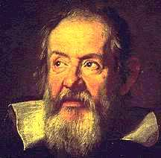
Galileo Galilei (1564–1642)
Italian mathematician, astronomer
“Father of Science”
Telescopes and astronomical discoveries
Discovers Saturn, moon craters, Milky Way

Slide 13
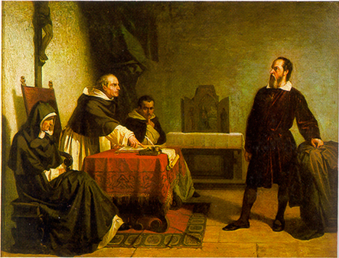
Conflicts with Church
The church condemned heliocentric conceptions of the universe
The Roman Inquisition
Galileo’s trial 1633
Galileo recants, put under house arrest

Slide 14
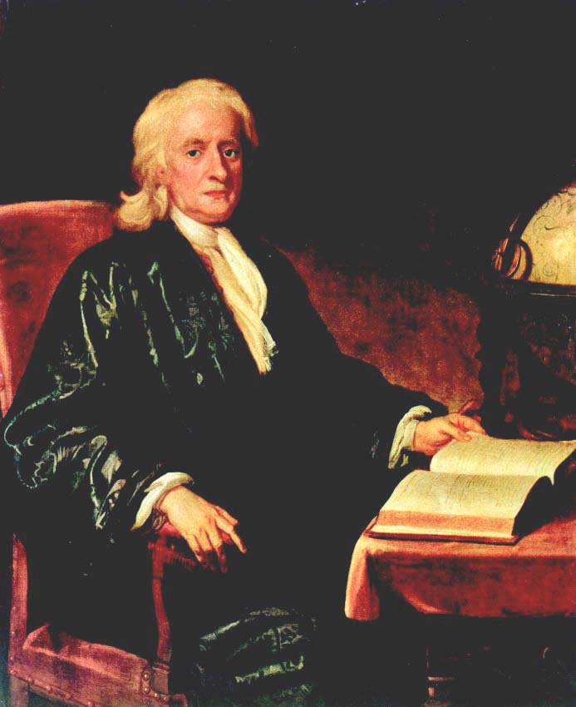
Sir Isaac Newton (1642–1727)
English astronomer, physicist, and mathematician
Synthesized the works of Copernicus, Kepler and Galileo
The Principia-new view of the world
Gravity & the apple
Controversy calculus

Slide 15
Biology
Ancient knowledge of Galen
Andreas Vesalius, Flemish doctor, Univ. of Padua, dissection, 1543
William Harvey, 1600s,English, blood and circulatory system
Antony van Leeuwenhock, Dutch 1600s, microscope, micro organisms
Robert Hooke, English, create terms cell

Slide 16
Chemistry
Robert Boyle, father of modern chemistry, matter as cluster of tiny particles, Boyle’s Law: how temperature, volume, and pressure affect gases
Antoine-Laurent Lavoisier, French 1700s, name oxygen, metric system of measurement, first periodic table

Slide 17
Science, Art & Society
Artists use human anatomy knowledge
Mathematics affect architecture
Beginnings of modern science, new view of univrse as a well-ordered system
Lead to philosophers and scholars seeking new understanding of society
Reexamine old ideas on government, religion, education, and economics

Slide 18
The Enlightenment
The era known historically as the Enlightenment marks the intellectual beginning of the modern world. Ideas originating in this era would gradually spread around the world creating challenges to existing traditions and ways of governing. Many governments today have Enlightenment principles as the basis of their constitutions and forms of government. In addition, the expansion of suffrage to women, blacks, and people of all classes is a legacy of the Enlightenment.

Slide 19
Age of Reason
1600s reason can be used to solve all problems
Ideas spread through inexpensive pamphlets, magazines, books
1700s Paris the center of intellectual activity
Salons: gatherings for aristocrats to discuss new theories and ideas
Philosophes: French Enlightenment thinkers who attended the salons

Slide 20
New Views on Government
Thomas Hobbes, English, 1651 Leviathan
Applied rational analysis to the study of government
Attacked the concept of divine right, yet supported a strong monarchy, the monster “leviathan”
Believed that humans were basically driven by passions and needed to be kept in check by a powerful ruler
People live lives that are “solitary,poor, nasty, brutish, and short” in the state of nature

Slide 21
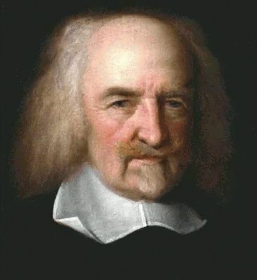
People need governments to impose order
Form a social contract-give up some freedoms to government for guarantees of peace, safety, and order

Slide 22
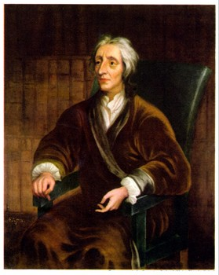
John Locke (1632-1704)
English
People are naturally happy, tolerant, and reasonable
All born with the natural rights of life, liberty, and property
Purpose of government is to protect these rights
If they don’t, can over throw

Slide 23
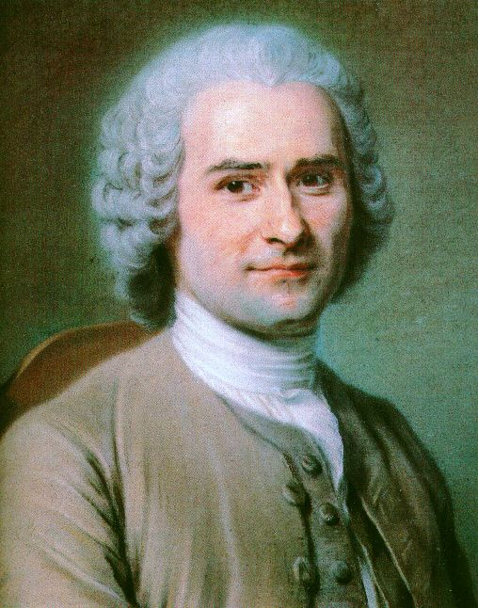
Jean-Jacques Rousseau (1712–1778)
The Social Contract, “Man is born free, but everywhere is in chains.”
Equality key
French

Slide 24
Baron de Montesquieu (1689–1755)
French nobleman
1748 treatise The Spirit of the Laws. Years before writing the treatise, Montesquieu had visited several European countries, carefully observing the workings of each nation’s government. In The Spirit of the Laws, he laid out a comparative study of types of governments, then put forward his own theory of government.

Slide 25
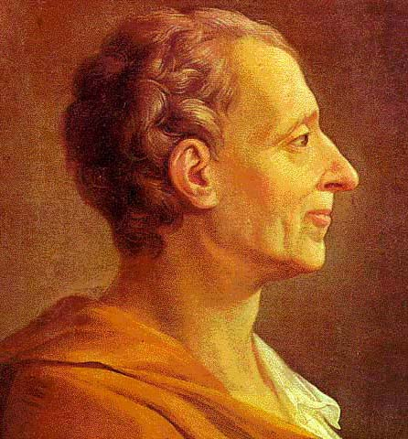
Separation of Powers
Executive, Legislative, Judicial
Best form of government is constitutional monarchy

Slide 26
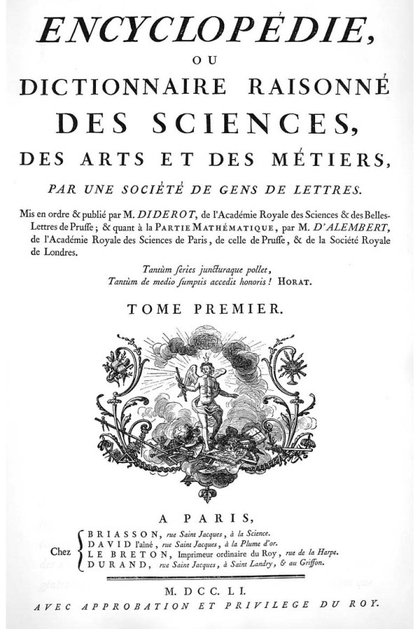
New Views on Society
Religious toleration, women’s rights, and economic systems lead to philosophers
1700s Denis Diderot, French, 28 volumes, criticizes the gov’t, the Church and legal systems
Takes 27 years, spreads ideas across Europe and North America

Slide 27
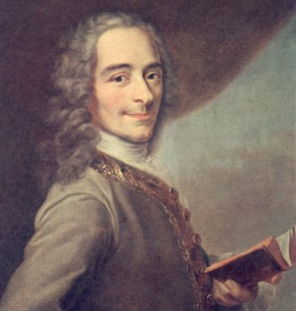
Voltaire (1694–1778)
Most famous philosophe
Wrote plays, essays, poetry, philosophy, and books
Attacked the “relics” of the medieval social order
Championed social, political, and religious tolerance

Slide 28
Above all, Voltaire attacked intolerance in society, politics, and religion. A famous quote usually attributed to Voltaire states, “I disapprove of what you say, but I will defend to the death your right to say it.”
Imprisoned twice, exiled to England for a time
Candide, a young man goes searching around the world for enlightenment and wisdom

Slide 29
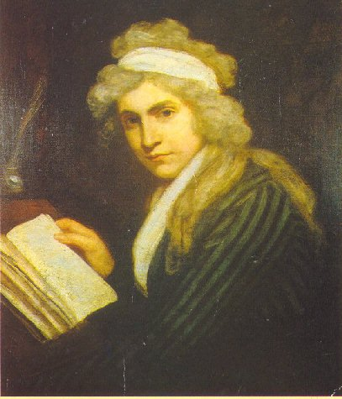
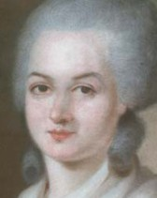
Role of Women
Mary Wollstonecraft, English, 1792, A Vindication of the Rights of Woman
Olympe de Gouges, FrenchDeclaration of the Rights of Woman and the Female Citizen (1791)

Slide 30
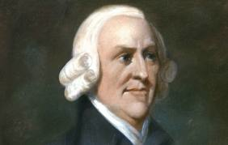
Economics
Adam Smith, Scottish, 1776, The Wealth of Nations
Business activities should take place in a free market
Laissez-faire economics, an economic system that worked without government regulation

Slide 31
Ideas Spread
Monarchs interested in ideas develop government according to ideals- enlightened despots
Challenge long held ideals Church & govenrment, human reason can solve any problem-how to make society more just
Reformers become revolutionaries

Slide 32
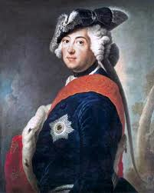
Prussia
Frederick II, 1740-1786
Number of reforms-education, abolish torture, religious toleration (not Jews), reduce censorship

Slide 33
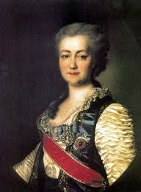
Russia
Catherine II, 1762
Correspond with Voltaire and Diderot
Reforms considered too liberal for elites

Slide 34
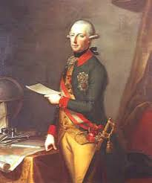
Austria
Joseph II, son of Maria Theresa
Reign 1780-1790, ambitious reform
Abolish torture, death penalty, free food and medicine for poor, abolish serfdom, laborers paid
Religious tolerance for Protestants and Jews (he Catholic)

Slide 35
Key Ideas
The ability to reason is what makes humans unique
Reason can be used to solve problems and improve peoples lives
Reason can free people from ignorance, superstition, and unfair government
The natural world is governed by laws that can be discovered through reason
Like the natural world, human behavior is governed by natural laws
Governments should reflect natural laws and encourage education and debate

