Slide 1
Reforms, Revolutions and War
Reforms in the British Empire

Slide 2
1. Social and Political Reforms
Reform Act of 1832
Prior to the act, there was little representation in Parliament for the working and middle classes
Those in politics were usually men of great wealth because the positions within the House of Commons were not paid positions
By 1830s liberals were challenging the old aristocratic and conservative order

Slide 3
iv. The Reform Act of 1832 gave:
Representation in Parliament for industrial cities
Middle-class men could vote
Increased the number of eligible voters by 50%
Required that only men with a certain amount of property could vote
This prevented working class men from voting

Slide 4
v. British law however, continued to exclude women from voting

Slide 5
b. Sadler and the Factory Act
Michael Sadler
Member of Parliament
Investigated the treatment of children in Britain’s textile factories
He showed the harmful conditions of children in factories
Physical mistreatment
Long hours
Low wages

Slide 6
ii. Factory Act of 1833
Limited the working hours of children in the textile factories
Made it illegal for teenagers to work more than 12 hours a day
Required that children between the ages of 9-13 had to receive two hours of schooling a day

Slide 7
c. Other reforms
In 1833, Parliament abolished slavery in Great Britain and all of the British Empire
Slavery Abolition Act
Did not free slaves immediately
Slaves over the age of six remained partly free
Also stated that the British government would compensate slave owners depending on how many slaves they freed

Slide 8
iii. Parliament also passed laws on public health and crime in order to improve living conditions in industrial cities

Slide 9
d. Chartism
Chartist
A group of people who worked for universal manhood suffrage: voting rights for men
Name came from the People’s Charter

Slide 10
ii. People’s Charter
Document sent to Parliament in 1839
Demanded voting rights for all men
Vote by secret ballot
Meant people could not be intimidated to vote in a certain way
Annual elections
Pay for representatives in Parliament
Working people could become members
Parliament rejected the Charter

Slide 11
iii. By the end of the 1800s many of the reforms in the Charter had been passed by Parliament

Slide 12
2. Victoria Era Voting Reforms
Queen Victoria
Became ruler in 1837
Her reign lasted until 1901
Longest in British history
This is known as the Victorian Era

Slide 13
b. Disraeli and Gladstone
Two influential prime ministers (1868-1885)
Benjamin Disraeli
Member of the Conservative party
Wanted to preserve the best traditions of the past

Slide 14
3. Put forth a bill that would extend voting rights to more working men
Passed in 1837
1 in 3 men could now vote
4. Another law created the secret ballot

Slide 15
iii. William Gladstone
Member of the Liberal party
His party adopted a more progressive approach to solving society’s problems
In 1885 he pushed for a reform bill that extended voting rights further

Slide 16
c. Women’s Voting Rights
Some members in Parliament were pushing for women’s suffrage
Suffrage is the right to vote
Women were still not seen as equals in society
They could not own property
Were not considered legal guardians of their children
Interestingly enough Queen Victoria was against women being able to vote

Slide 17
vi. Disraeli argued in favor for women’s voting rights in 1866
He said that if a women could be queen or own land, she should be able to vote
Put forth a reform bill with women’s suffrage added to it in 1867, but it did not pass
vii. Suffragist tried for over 40 years to get the vote

Slide 18
viii. Millicent Garrett Fawcett
Used a gradual approach
Lobbied members of Parliament, signed petitions and worked on educating the public
Largely unsuccessful

Slide 19
ix. Emmeline Pankhurst
Founder of the Women’s Social and Political Union (WSPU)
Believed you had to be louder than everyone else to be heard
Used violent means to gain attention to the cause

Slide 20
x. In 1918, Parliament granted the vote to women over the age of 30
xi. In 1928, women gained the right to vote on the same basis as men

Slide 21
3. Changes in the British Empire
Ireland
Act of Union
Incorporated Ireland into the United Kingdom in 1801
Hate British landlords
Landlords owned much of Ireland’s land
Had the power to evict Irish farmers
British policies to help their industry hurt Ireland’s agriculture

Slide 22
iii. Potato Famine
Left many hungry and also left many without the means to pay their rent, so they were evicted from the land
Many starved and many more emigrated to the United States

Slide 23
iv. 1860’s
Many started pushing for independence and staged violent protests
Others struggled for home rule
Ireland would govern itself within the United Kingdom
Ireland did not receive limited self-government until 1920

Slide 24
b. Canada
People in Canada were ruled by the British
Some spoke French and other English
1837, Canada experienced many rebellions
1838, Lord Dunham was sent to Canada to serve as governor –general to Canada
1867, the British Parliament united several Canadian colonies and granted them the power to govern themselves
Canada became a self-governing colony

Slide 25
e. Australia and New Zealand
Australia
Since the late 1700s Australia had been used as a place for criminals
By mid 1800s British colonist, attracted to copper and gold deposits, began settling in the colony
1901, Britain granted self-rule to the Commonwealth of Australia
It established its own Parliament but still remained part of the British empire

Slide 26
ii. New Zealand
British made an agreement with the local Maori people for land in exchange for self-rule
New Zealand became a dominion of Great Britain
1893, New Zealand became the first country to give women the vote

Slide 27
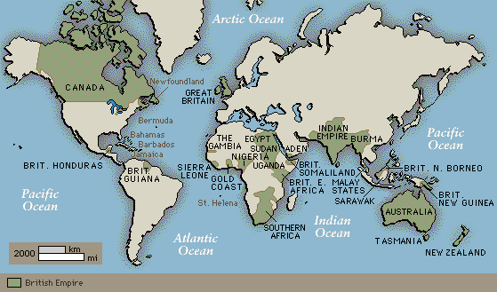

Slide 28
Revolution and Change in France

Slide 29
1. The Revolution of 1830
A King Abdicates
Charles X
Inherited the throne after his brother Louis XVIII died
Tried to rule as an absolute monarch
A revolt occurred when he suspended the power of the legislature
This led to the Rebellion of 1830
Within days the citizens controlled Paris
Charles X abdicated his throne and fled to England

Slide 30
b. The Reign of Louis Philippe
Moderate liberal leaders formed a constitutional monarchy and chose Louis Philippe to be the new king
He was popular with the middle class
He would be referred to as the “citizen king”

Slide 31
iv. He would increase the number of voters by extending the vote to the more wealthy citizens
v. He limited the freedom of the press
vi. Rule would become extremely repressive

Slide 32
2. Birth of a Republic
The Revolution of 1848
Sparked when the French government banned a banquet planned by reformers
Louis Philippe abdicated his throne
French citizens formed a republic, headed by a president

Slide 33
iv. Louis Napoleon was elected president
v. The era that followed was known as the Second Republic

Slide 34
vi. Effects of the Revolution
All adult French men had the right to vote and never lost it
Created support for a republican government
Fueled a new women’s rights movement
Inspired other revolutions across Europe

Slide 35
b. Napoleon III and the Second Empire
French constitution allowed the president to serve only 4 years
Napoleon wanted to stay in office
1851, sent troops to Paris to arrest members of the National Assembly who opposed him
Called for a national vote to see if he had the power to create a new Constitution
The following year he was elected emperor Napoleon III

Slide 36
vi. Second Empire is what followed
vii. Reforms
Increased voting rights
Built many railroads
Increased trade
Improved communications

Slide 37
c. The Third Republic
1870, Napoleon went to war against Prussia
He was captured in battle and surrendered to the Prussians
This act led the assembly to dispose him and proclaim the Third Republic

Slide 38
iv. Important Reforms of the Third Republic
Made primary education available to children between the ages of 6 and 13
Trade unions were legalized
Reduction in working hours
Also required employers to give their workers one day off per week

Slide 39
3. The Dreyfus Affair
Controversial court case
Revealed the extent of anti-Semitism, or prejudice toward Jews in France

Slide 40
c. Alfred Dreyfus
A captain in the French army who was a Jew
Falsely accused and convicted of betraying French military secrets to Germany
Military officers allowed Dreyfus to take the blame knowing he was innocent

Slide 41
iv. He was found guilty, striped of rank and had his sword broken
v. Later suggested that another soldier did the spying but he was not found guilty
vi. A few years later officers came forward with the real story
vii. 1906, Dreyfus was cleared

Slide 42
d. The Dreyfus affair divided society

Slide 43
e. Emile Zola
Wrote a letter that accused the French government of anti-Semitism and led the French courts to reopen the Dreyfus’ case
Letter set off anti-Semitic riots in more than 50 towns
Would be brought to trial for libel and was found guilty

Slide 44
f. Theodor Herzl
Hungarian-born Jewish journalist covered the trial
Shocked by what he saw
Came to believe that the root of the problem was that Jews in Europe did not have a nation of their own

Slide 45
iv. Published The Jewish State, which outlined plans for an independent Jewish country developed with the support of the international community
v. Sparked Zionism
A Jewish nationalist movement to re-create a Jewish state in its original homeland

Slide 46
Independence of Latin America

Slide 47
1. Early Struggles for Latin America
Haiti Becomes Independent
Saint Dominque
1st to break its ties to Europe
Located on the western half of Hispaniola
Sugar exports made it one of France’s richest possessions
Built upon slave labor

Slide 48
ii. The Declaration of the Rights of Man and Citizen had given right to vote to all men, including Mulattoes
iii. French settlers tried to resist the law

Slide 49
iv. Toussaint L’Ouverture
Former slave
Led mulattoes and slaves in a bloody revolt against the French settlers
Actions made him a national hero in Hispaniola

Slide 50
4. Emperor Napoleon sent a general to take back control of the colony
5. 1802, Toussaint agreed to an armistice
6. French broke the agreement and sent him to prison in France where he died in 1803

Slide 51
v. 1804, the revolutionaries of Saint Dominque delcared their independence and named their new nation Haiti

Slide 52
b. Colonies of Spain and Portugal
Spain in the 1800s controlled most of Latin America
Portugal controlled Brazil

Slide 53
iii. There were growing tensions in Latin America between two groups
Creoles: people of European descent who were born in the colonies
Were excluded from the highest level government or church positions
Peninsulares: colonist who were born in Spain
Together they made up the highest social classes
Similar distinction was made in Brazil as well

Slide 54
iv. Creoles began to resent peninsulares as their wealth increased
v. In 1807, Napoleon invaded Spain and Portugal
Spanish king was imprisoned
Portuguese king fled to Brazil
This invasion seriously weakened the power of Spain and Portugal in Latin America

Slide 55
2. Independence of Mexico
Father Hidalgo
A Creole priest
Made the first public call for Mexican independence
History of challenging authority
He met with people who wanted to take power from the peninsulares

Slide 56
v. September 16, 1810
Hidalgo called the member to the church to the church yard
He delivered a speech calling on the peasants to fight for their independence
vi. He wanted people to revolt against the peninsulares not Spain
vii. He claimed to be loyal to Spanish king
viii. He was captured and executed
ix. Would later be known as the Father of Mexican Independence

Slide 57
b. Morelos Continues the Revolution
Jose Maria Morelos
Became leader of the revolutionary movement
Organized a Mexican congress with representatives from many places in Mexico
Wanted Mexico to be an independent republic with guaranteed freedoms
He was captured, found guilt of treason and executed

Slide 58
c. A Creole King for Mexico
Augustin de Iturbide
A Creole royalist
Military officer
In 1820 asked by the Spanish authorities to lead a final battle against the revolutionaries
That same year a liberal revolution was underway in Spain

Slide 59
5. Iturbide believed this revolution might take away some of his power, so he switch sides
6. Made a three part proposal
Mexico would gain its independence but would be ruled by a monarch
Creoles and peninsulares would have equal rights
The Roman Catholic Church would be the official church of Mexico
7. This caused creoles and peninsulares, royalist and revolutionaries to join together and fight for their independence from Spain

Slide 60
ii. 1821, Mexico declared its independence from Spain
iii. That same year they named Augustin emperor of Mexico

Slide 61
3. Revolutionary leaders in South America
Simon Bolivar
Known simply as “the Liberator”
Born into a wealthy Creole family in Venezuela
Admirer of Napoleon
1811, Venezuela declared independence from Spain

Slide 62
v. He led a series of military campaigns for the 10 years against Spain
vi. 1821, his troops defeated the Spanish
vii. He wanted to form one large, unified country called the Federation of the Andes
Never became a reality
viii. He did set up the state of Gran Colombia, which included what are now Venezuela, Colombia, Panama and Ecuador

Slide 63
b. Jose de San Martin
Was a soldier who fought against Napoleon in Spain
Born in Argentina
Returned home when he heard that his country was rising up against Spanish rule

Slide 64
iv. Would lead not only the independence movement in Argentina but in most of South America
v. Declared independence in Argentina in 1816
vi. Next he went on to win independence in Chile
vii. Met Bolivar in Gran Colombia
viii. Result of the meeting
San Martin resigned his position
Left Bolivar in power
San Martin returned to Europe and stayed there until his death in 1850

Slide 65
c. Pedro I
Road to independence in Brazil was different
John VI fled to Brazil when Napoleon invaded in 1807
Having the monarchy there changed Brazil’s status
Rio de Janeiro was made the capital of the entire Portuguese empire

Slide 66
v. Brazil was allowed to trade directly with the rest of the world instead of just Portugal
vi. John VI returned to Portugal after a revolution in 1820
vii. His son Pedro was left to rule
viii. Brazilian-born colonist began to protest their colonial status
ix. Transition to independence occurred more smoothly in Brazil than anywhere else in Latin America

Slide 67
x. September 1822, Prince Pedro simple declared Brazil independent
xi. He was crowned Emperor Pedro I of Brazil soon after

Slide 68
Expansion and War in the United States

Slide 69
1. Growth of the United States
Louisiana Purchase
1803, the United States completed the purchase from France
Gave huge amounts of territory in Central North America

Slide 70
b. A Young Nation
The United States had only just recently won independence from Great Britain
Britain was still harassing the Americans
They seized American sailors and forced them to fight in their war against Napoleon
Helped Native Americans fight the Americans in the Northwest
As a result the United States and Great Britain went to war in 1812

Slide 71
iv. Results of the war
No land had changed hands
Many felt that America had proved their country to be an independent nation
v. President James Monroe
By the 1820s the United States was growing in national pride and beginning to build a world reputation
Monroe issued what is now known as the Monroe Doctrine
It states: that the Americas were off limits to further European colonization

Slide 72
c. Texas and Mexico
In 1820 an American named Moses Austin got permission from Spain to found small settlement in Texas
However when Mexico got its independence from Spain strict laws were imposed on the settlers in Texas
Eventually these settlers fought for and achieved independence for the Republic of Texas

Slide 73
iv. 1845, Texas is admitted into the United States
Mexico is still claimed that Texas belong to them
This and other disputes led to the Mexican-American War
Result of the war, the United States gained large territory that is now the southwestern United States

Slide 74
d. The Move West
Westward expansion had been going on for half a century by 1850
Rapid expansion led some to believe that they had a God-given right to settle land all the way to the Pacific Ocean
The term manifest destiny is used to describe this belief

Slide 75
iii. Reason for heading west
Gold was discovered in California in 1848
National law promised 160 acres of free land to anyone who made the trip west

Slide 76
e. Effects on Native Americans
Settlers were moving onto land that had been inhabited by Native Americans
Led to frequent conflict between Native Americans and settlers

Slide 77
iii. Indian Removal Act
Passed 1830
Called for the relocation of 5 Indian nations to Indian Territory
Under the control of the United States army, Indians from the Cherokee, Choctaw, Chickasaw, Seminole and Creek nations were forced from their homes and moved into Indian Territory

Slide 78
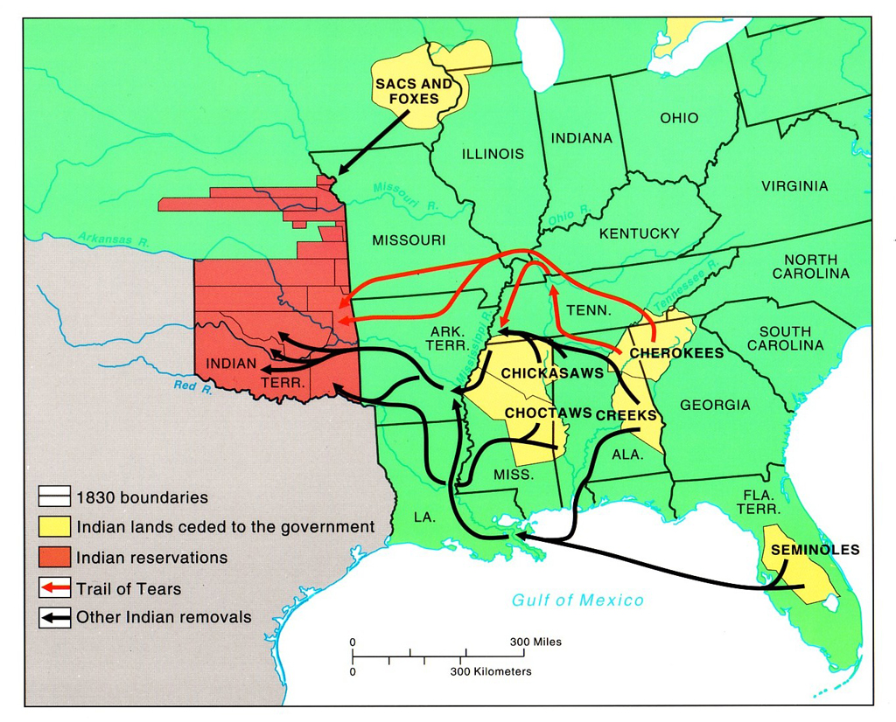

Slide 79
iv. March for the Cherokee was so deadly it became known as the Trail of Tears
Estimated that ¼ of the Cherokees who made the trip died
v. As settlers moved further west, new law moved Native Americans into designated areas, called reservations

Slide 80
2. The Civil War
Slavery
Became a problem as the United States expanded west
Slave labor had been used since the colonies were formed
Many believed that the use of slave labor was wrong
Some fought for abolition (the end of slavery)

Slide 81
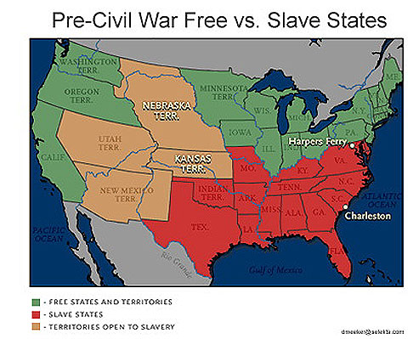

Slide 82
b. The Road to War
As new states were added, Americans had to decide whether the new states would allow slaves or not
South worried that if more states entered that were not slave states that it would shift the balance in Congress and outlaw slavery altogether

Slide 83
iii. The Kansas-Nebraska Act
Created two new territories in the West
Decision on slavery was left to the residence
This set off a bitter debate

Slide 84
iv. The election of Abraham Lincoln as president caused South Carolina to secede or separate from the Union
This process is known as succession

Slide 85
v. Other states soon followed South Carolina
They would form the Confederate States of America
They elected Jefferson Davis as their president
They would also draft their own constitution

Slide 86
c. War Begins
Lincoln did not believe that the Constitution gave the states the right to secede
In 1861, he gave orders to bring supplies to an American fort in South Carolina
At Fort Sumter, the first shots of the Civil War were fired
The Civil War lasted for 4 years
More than 500,000 died from battle or disease
This is more than any American war before or since

Slide 87
d. The Emancipation Proclamation
In January 1863, Lincoln proclaimed all slaves in some areas of the Confederate states free
Did not apply to areas already conquered by the Union
Helped North in several ways
Many slaves fled North, which hurt the Southern economy
Gave renewed purpose to the Union soldiers
Caused European powers to withdraw support of the Confederacy

Slide 88
e. The Union Prevails
Battle of Gettysburg
Fought in 1863, in Pennsylvania
Turning point of the war
Union soldiers defeated the Confederate troops
Lincoln would later deliver a famous speech at the cemetery dedicated for the soldiers killed there

Slide 90
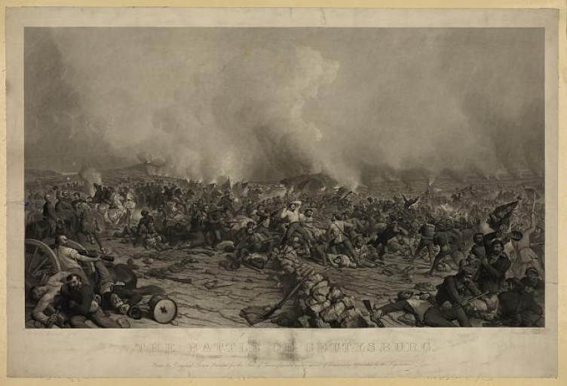

Slide 91
iii. Confederate General Robert E. Lee surrendered to Ulysses S. Grant at Appomattox, Virginia in 1685
This ended the Civil War

Slide 92
f. Effects of the Civil War
The South lay in ruins after the war
Many wonder how the federal government would treat the former Confederate states
This led to the era known as Reconstruction

Slide 95
iv. The government passed several important acts during this period
The Civil Rights Act
Protected some rights of formerly enslaved people
14th Amendment
Granted citizenship to all freed African Americans
15th Amendment
Stated that voting rights could not be denied based on race

Slide 96
v. Reconstruction did not fully achieve the goal of equal rights for former slaves however
vi. Some Southern states passed discriminatory laws
In reality many freed African Americans were still prevented from making a decent living after the war
vii. The amendments passed during Reconstruction did provide a foundation for later civil rights movements in the United States during the 1900s

