Slide 1
The Protestant Reformation (1450-1565)

Slide 2
Key Concepts
End of Religious Unity and in the West
Attack on the medieval church—its institutions, doctrine, practices and personnel
Not the first attempt at reform, but very unique
Word “Protestant” is first used for dissenting German princes who met at the Diet of Speyer in 1529

Slide 3
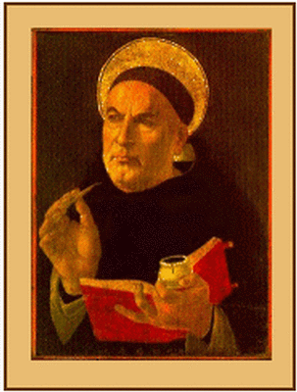
I. The Church’s Problems
Charges of greed
Worldly political power challenged
Weariness of dependence on the Church and the constraints it enforced
Growing human confidence vs. “original sin”
Catholic church becomes defensive in the face of criticism

Slide 4
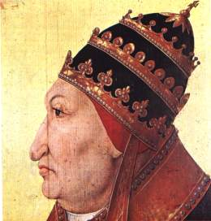
I. The Church’s Problems (cont)
The corruption of the Renaissance Papacy
--Rodrigo Borgia
European population was increasingly anti-clerical post plague
Absenteeism of church leaders
The controversy over the sale of indulgences

Slide 5
II. Convergence of Unique Circumstances

Slide 6
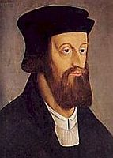
A. Cultural
Better educated, urban populace was more critical of the Church than rural peasantry
Renaissance monarchs were growing impatient with the power of the Church
Society was more humanistic and secular,Growing individualism
--John Wyclif

Slide 7
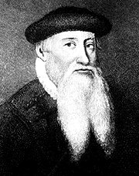
B. Technological: Printing Press
Invention of movable type was invented in 1450 by Johann Gutenberg
Manufacture of paper becomes easier and cheaper
Helped spread ideas before Catholics could squash them
Intensified intellectual criticism of the Church

Slide 8
C. Political

Slide 9
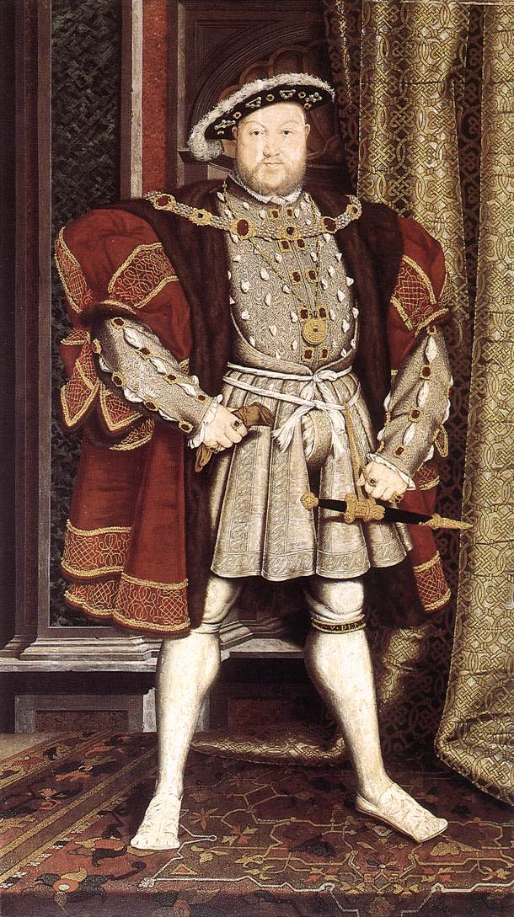
(1) England
Notion of the Renaissance Prince
Recent War of the Roses created a sense of political instability for the Tudor dynasty
--Henry VIII
The significance of a male heir to the Tudors

Slide 10
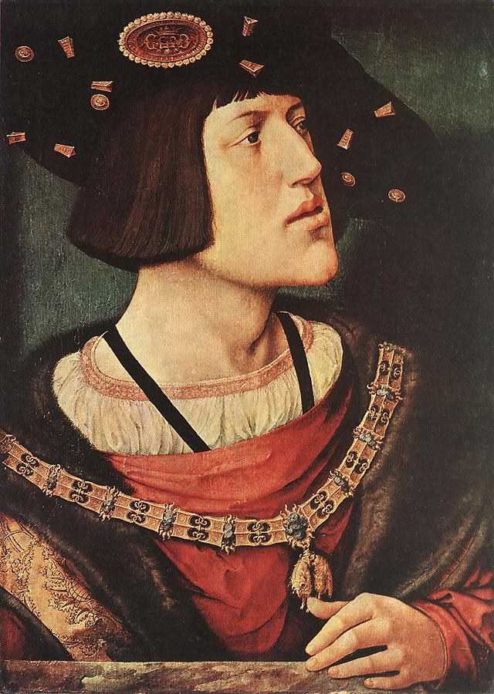
(2) The Holy Roman Empire
Decentralized politics
Pope successfully challenged the monarch here
New HRE, Charles V, is young, politically insecure and attempting to govern a huge realm during the critical years of Luther’s protest
Charles V faced outside attacks from France and the Turks

Slide 11
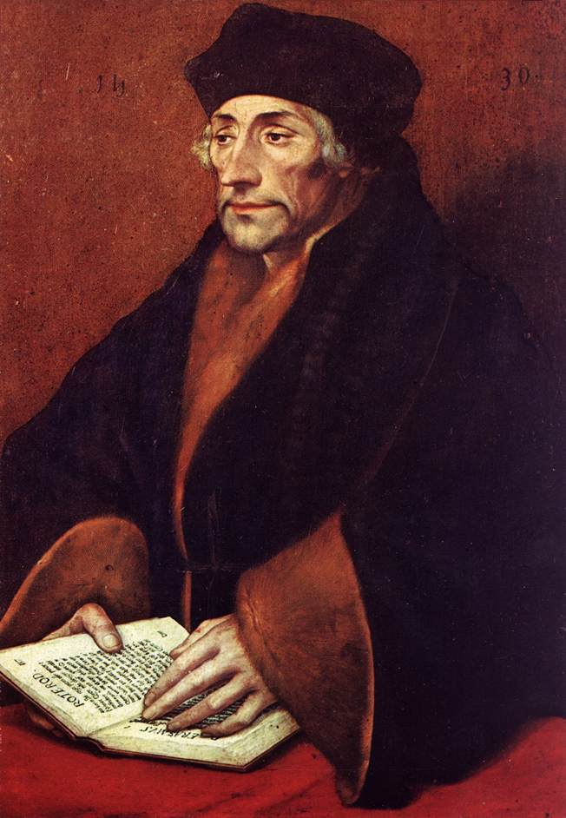
D. Spiritual
Growing piety, mysticism and religious zeal among European masses
Dutch Christian humanist Erasmus inadvertently undermines the Church from within
--In Praise of Folly (1510)
Call for a translation of the New Testament into Greek
Call for a return to the simplicity of the early Church
Millenarian “fever”

Slide 12
III. The Emergence of Protestantism in Europe

Slide 13
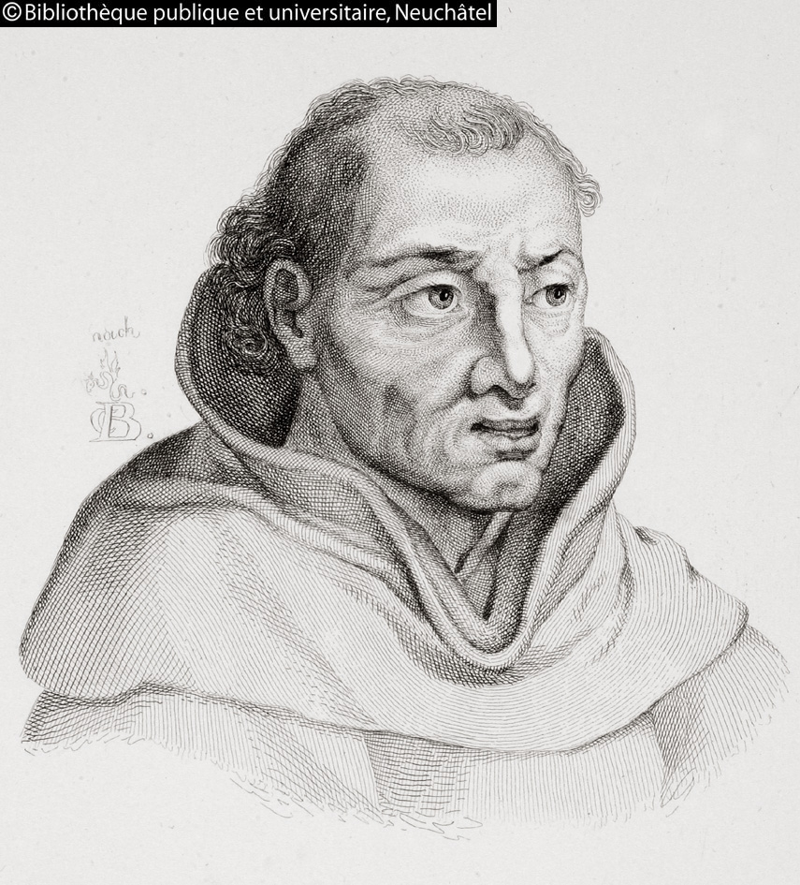
A. Germany (Northern)
Luther troubled by the sale of indulgences
Dominican friar Tetzel was selling indulgences in Wittenberg in 1517
Luther posts his 95 theses on the door of the castle church in Wittenberg on October 31, 1517

Slide 14
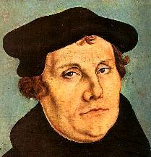
A. Germany (Northern)
Pope pays little attention to the Luther at first-Edict of Worms
Luther attacks the Pope and his bull of excommunication
Luther goes into hiding in 1521
The Protestant Reformation further divided Germany

Slide 15
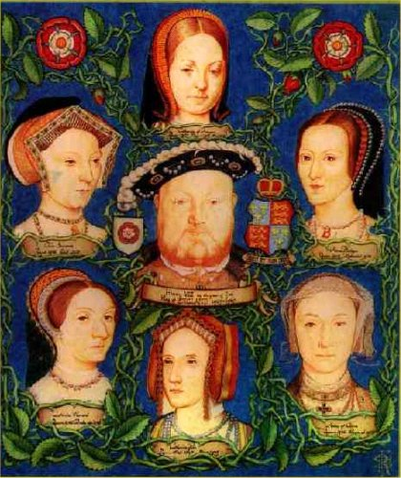
B. England
Henry VIII’s marriage to Catherine of Aragon
Henry creates the Church of England and establishes his own supremacy over it
A “political reformation” only at first
The six wives of Henry VIII

Slide 16
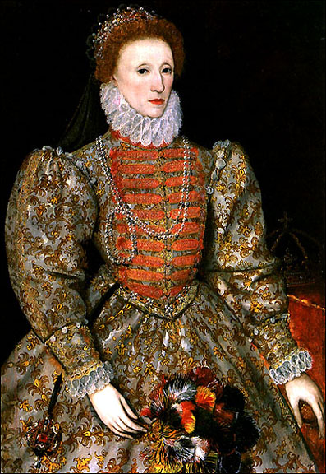
B. England (cont)
The brief reign of Edward VI
The rule of “Bloody” Mary
Return of the exiles to England from Geneva
-- “Puritans”
Queen Elizabeth I
The attack of the Spanish Armada in 1588
-- “The Protestant Wind”

Slide 17
C. Switzerland

Slide 18
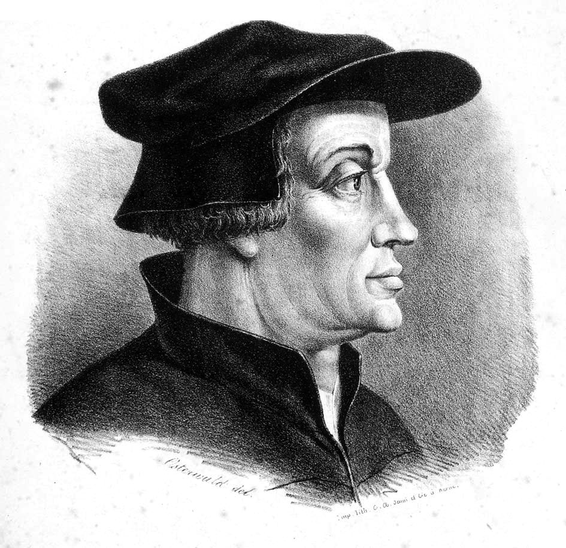
(1) Zurich
Very urban, cosmopolitan setting
Reformer Ulrich Zwingli and his Old Testament persona
“Memorialist” view of the Mass
Zwingli also opposed purgatory, clerical celibacy, intercession of the saints, and salvation by works
The death of Zwingli

Slide 19
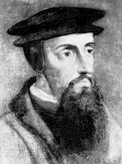
(2) Geneva (French-speaking)
John Calvin, Geneva, 1541-1564
Geneva became the model Protestant training center
Stress on order and rigorous adherence to God’s law, strict
A “Quasi-theocracy”
Self-discipline and the “Protestant Work Ethic”

Slide 20
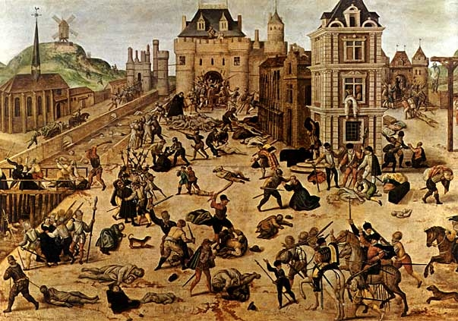
D. France
King Francis I was initially sympathetic to Luther as long as his ideas stayed in Germany
Protestantism made illegal in France in 1534
Persecution of the Huguenots, St. Bartholomew’s Day Massacre
King Henry of Navarre and the Edict of Nantes (1598)

Slide 21
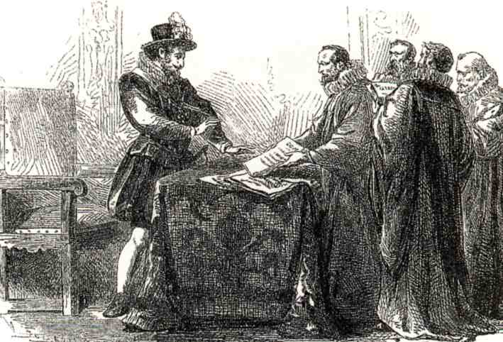
E. Other Parts of Western Europe
No Protestant inroads into Spain or Italy
Protestantism succeeded only where it was urban and supported initially by the nobility
After 1540, no new Protestant territories outside of the Netherlands
Most powerful European nations were Catholic
Protestants were feuding with each other

Slide 22
IV. Reformation Ideas

Slide 23
A. Martin Luther (1483-1546)

Slide 24
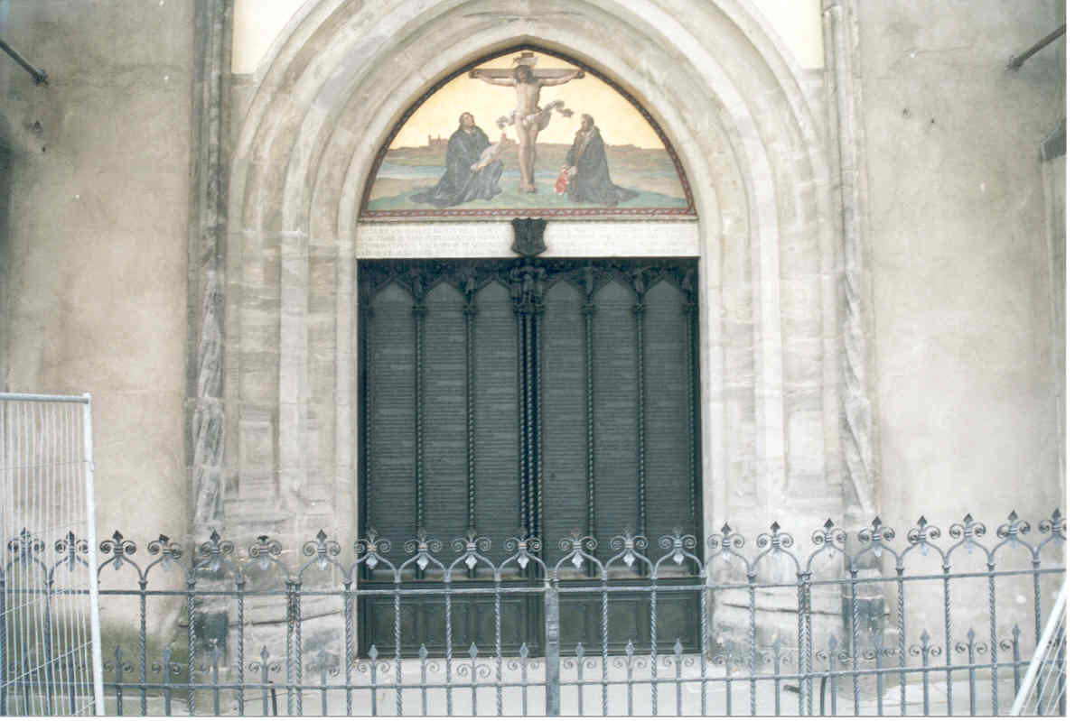
Luther’s Teachings
“Sola Fidei” (Salvation by Faith Alone)
“Sola Scriptura” (Authority of the Scriptures Alone)
--Luther’s German Translation of the New Testament
The Priesthood of All Believers

Slide 25
B. John Calvin (1509-1564)

Slide 26
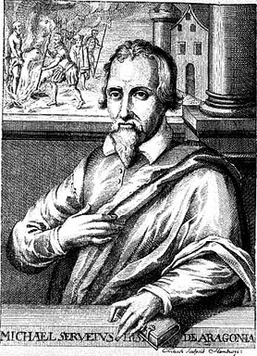
Teaching
Predestination, some are ‘elect’ or chosen for salvation
The right of rebellion
--English Civil War
More of a stress on works than Luther
Divine calling to all sorts of vocations
Government serves the Church
Just war position

Slide 27
V. The Counter-Reformation: The Catholic Response

Slide 28
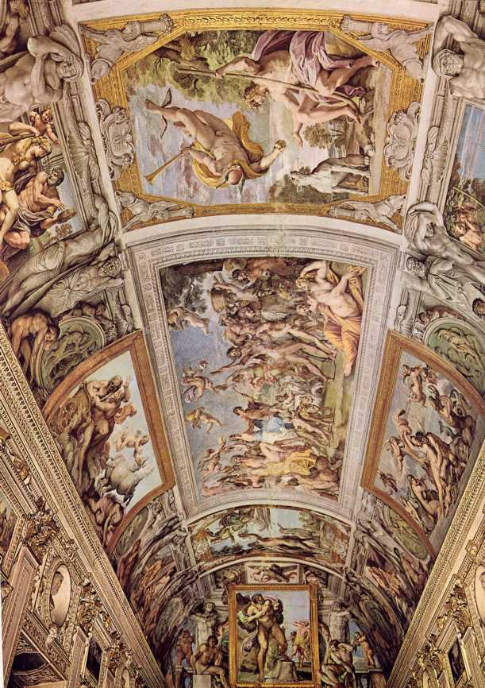
Ingredients
Reformation shaped the form and rapidity of the Catholic response
Council of Trent (1545-1563) addresses the abuses
The Society of Jesus (“Jesuits”)—1534
--Ignatius Loyola
--Charles Borromeo-Milan
--Francis of Sales-Savoy
--Teresa of Avila-Carmelites
The Inquisition
Renewed religious emotionalism-art

Slide 29
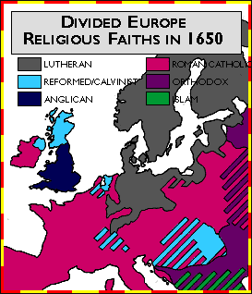
VI. Results of the Reformation
Germany was politically weakened and fragmented
Christian Church was splintered in the West
100 Years of Religious Warfare
Right of Rebellion introduced by both Jesuits and Calvinists
Pope’s power increased
Furthered societal individualism and secularism
Growing doubt and religious skepticism

Slide 30
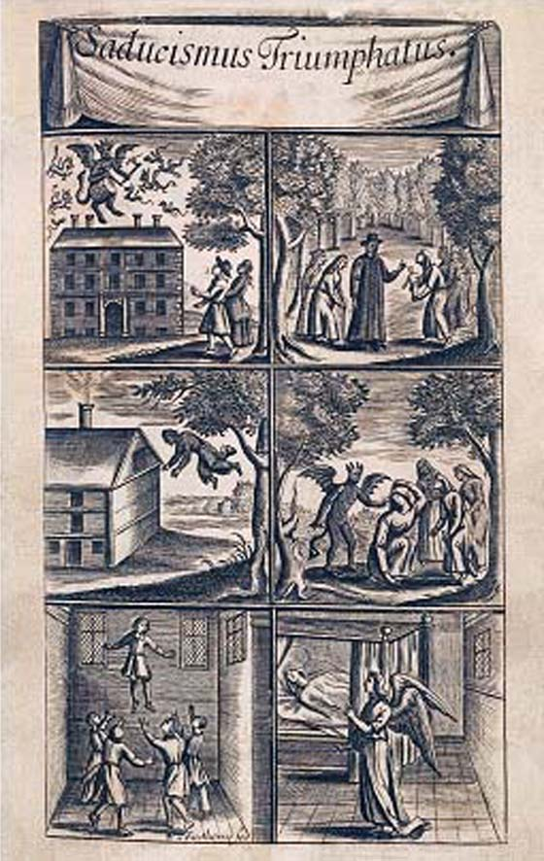
VI. Results of Reformation (cont)
Political stability valued over religious truth
Calvinism boosted the commercial revolution
Witch craze swept Europe in the 1600’s
--Between 1561-1670, 3000 people in Germany, 9000 people in Switzerland and 1000 people in England were executed as witches

