Slide 1
Essential Questions:
Why were the Tang & Song Dynasties considered the “golden age” of China?
What was the impact of the Mongol Empire?

Slide 2
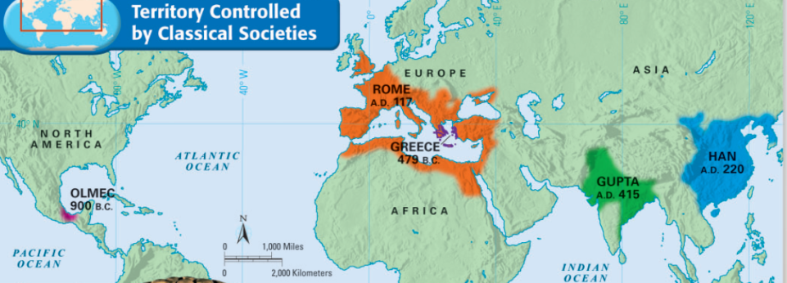
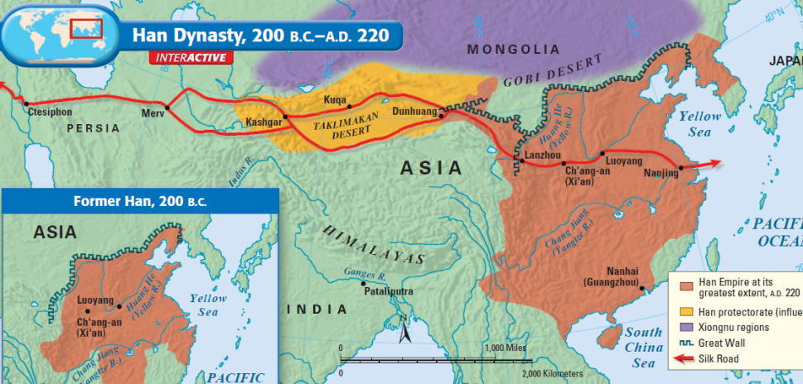
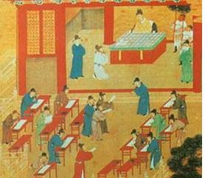
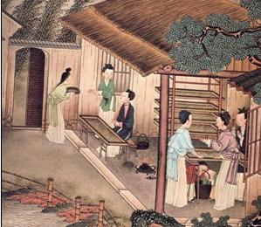
Classical China
During the Classical Era, the emperors of Han China created large empire & developed numerous innovations
The Silk Road trade route brought Chinese luxury goods to Europe & Asia and increased cultural diffusion
Civil service exams for gov’t employees based on Confucian teachings
Silk-making technology that attracted trade from outside China

Slide 3
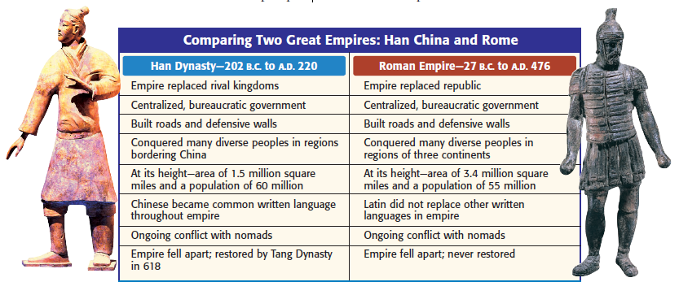
Post-Classical China
Like the Roman Empire, Classical China under the Han Dynasty entered an era of decline & eventually fell

Slide 4
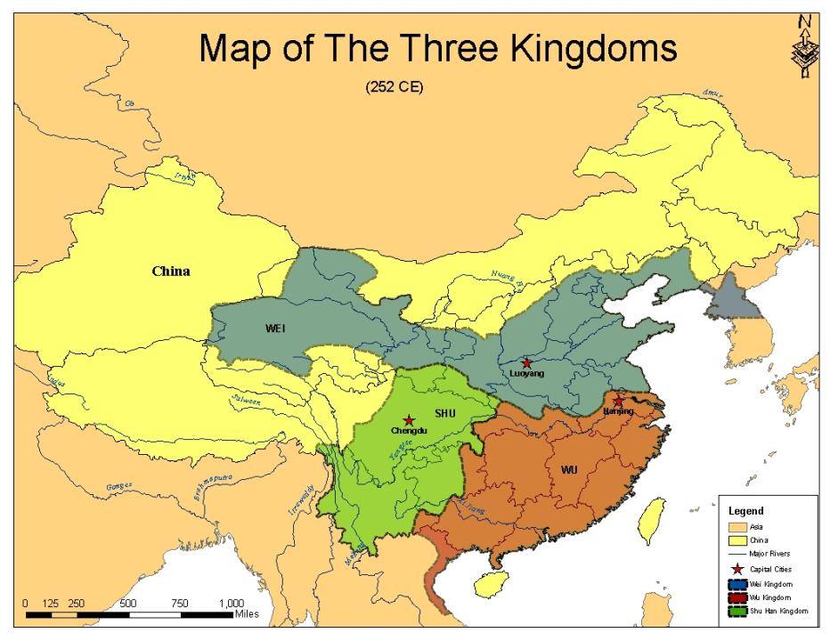
After the Han Dynasty collapsed in 220 A.D., no emperor was strong enough to unify China
Over the next 350 years, more than 30 local dynasties rose & fell

Slide 5
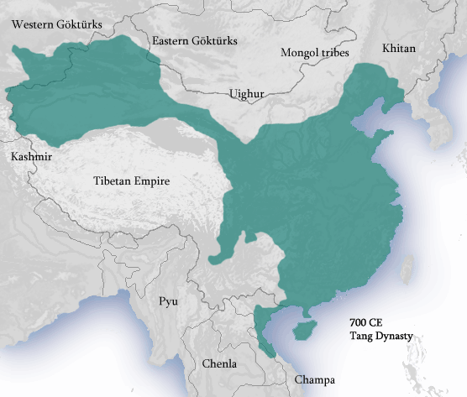
In 589, China was unified again & a strong central government was restored...
…the restoration of the examination system allowed intelligent bureaucrats to help manage the empire
During the Tang & Song Dynasties, China experienced an extended “golden age” & became the richest, most powerful, & most advanced country in the world

Slide 6
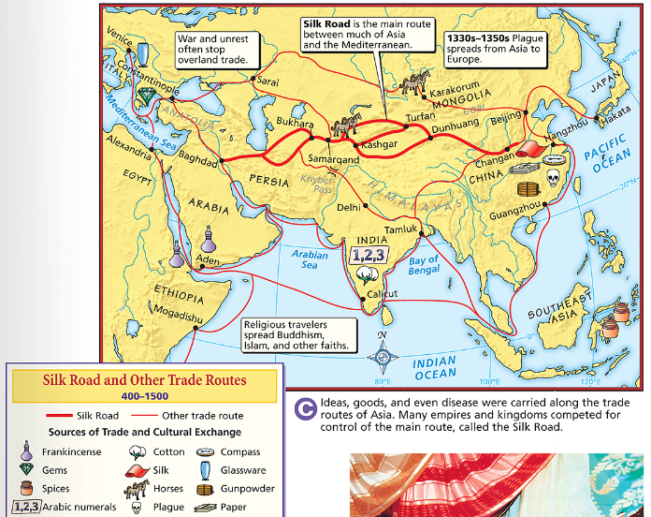
The Golden Age of Post-Classical China
Emperors did their best to try to protect the routes along the Silk Road
Chinese merchants relied on ocean routes as well to trade with India & Arabia
Text
Increased trade led to the spread of Chinese culture (centralized gov’t, Confucianism, & writing) to Korea, Japan, & Southeast Asia
For the 1st time in China’s history, emperors encouraged foreign trade
Notes:
centralized government, Confucianism, Buddhism, and writing

Slide 7
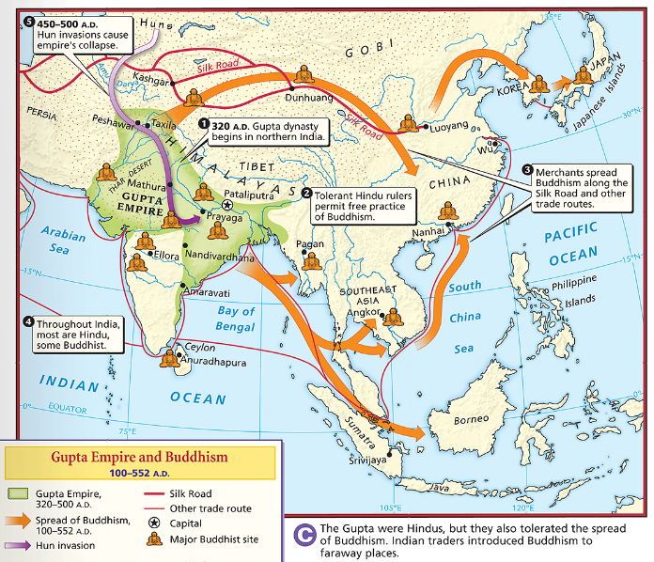
Increased trade helped spread Buddhism throughout China

Slide 8
Chinese Innovations
The Tang & Song dynasties were eras of major technological advancement:
The technologies helped make China the most advanced country in the world
Much of China’s technology spread to other people across trade routes
Class Activity:
Working with a partner, guess what each of the following 10 Chinese innovations are

Slide 9
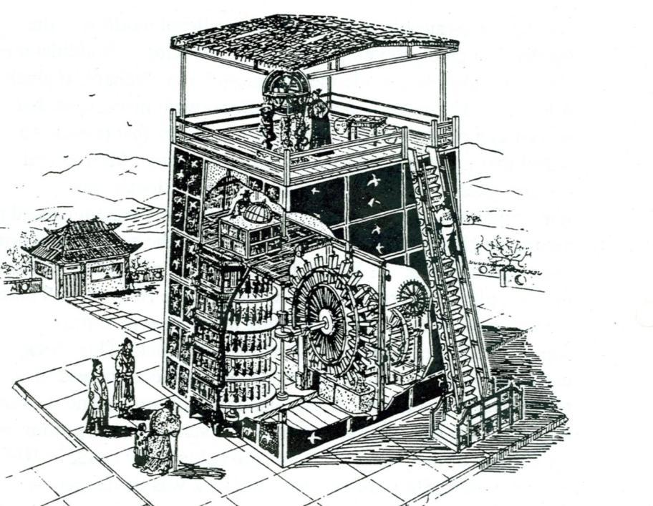
1. Mechanical Clock

Slide 10
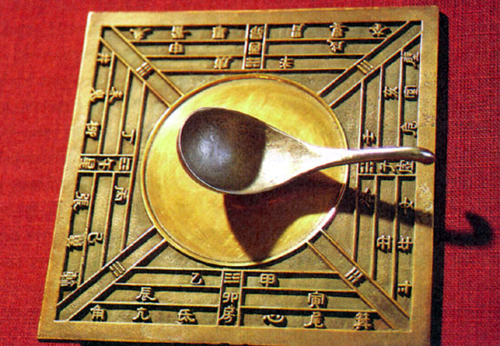
2. Magnetic compass

Slide 11
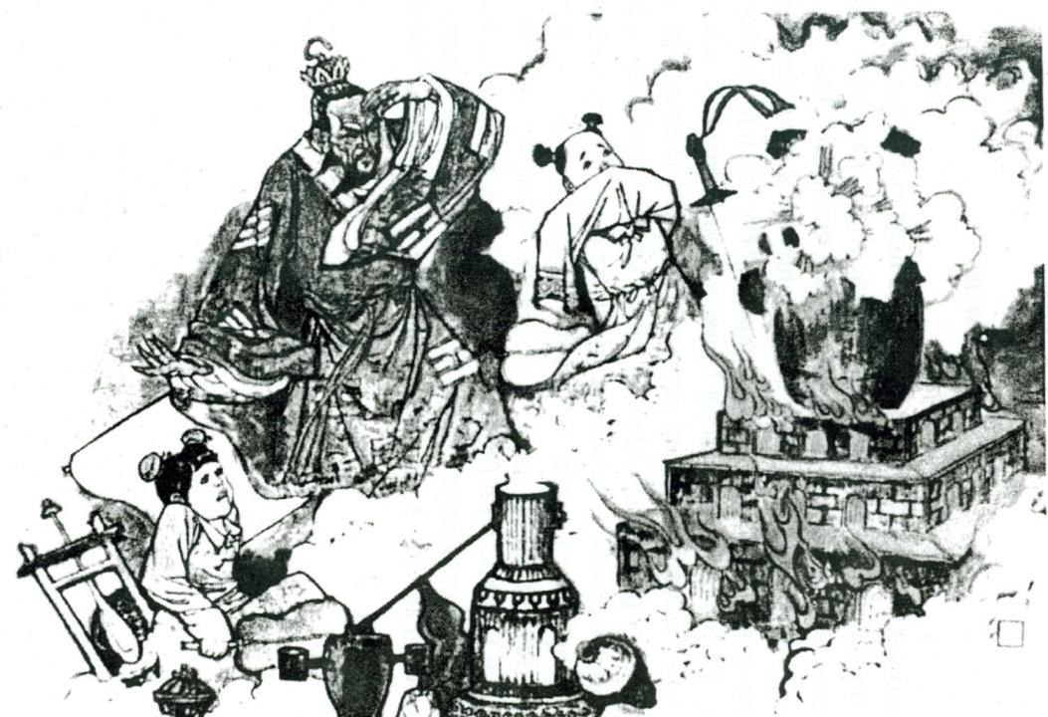
3. Gunpowder

Slide 12
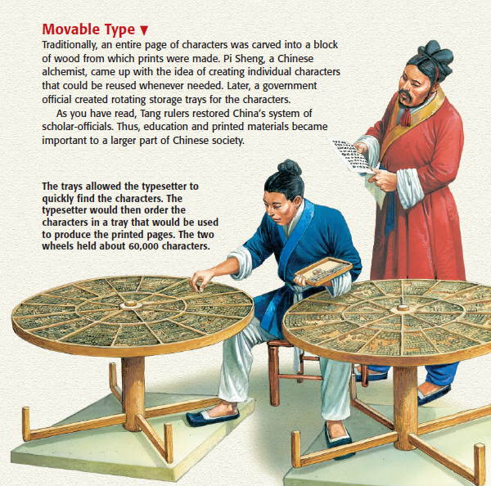
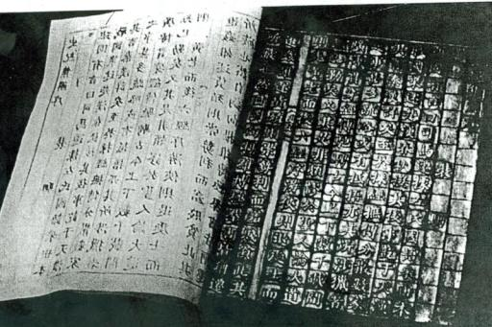
4. Printing Press

Slide 13
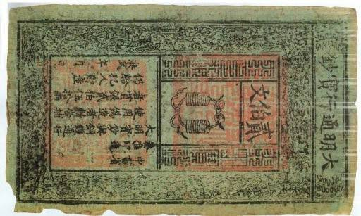
5. Paper money

Slide 14
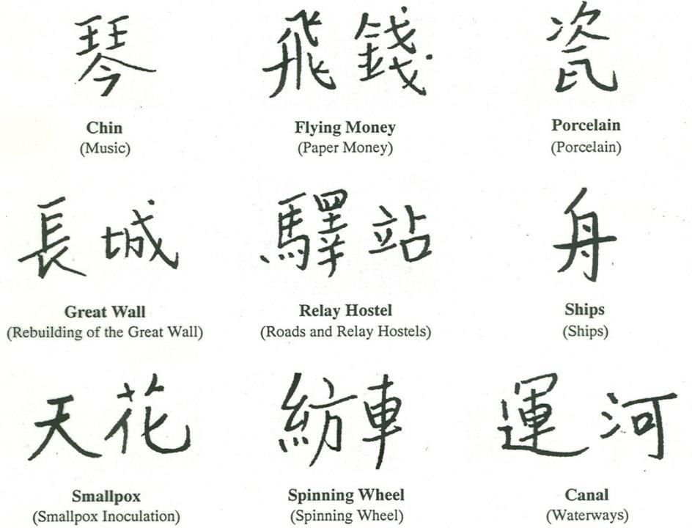
6. Chinese writing

Slide 15
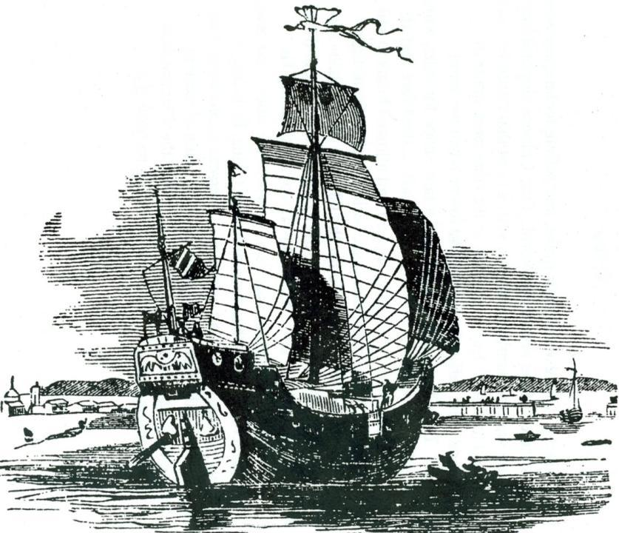
7. Ship building

Slide 16
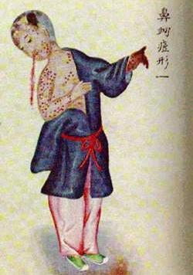
8. Vaccination

Slide 17
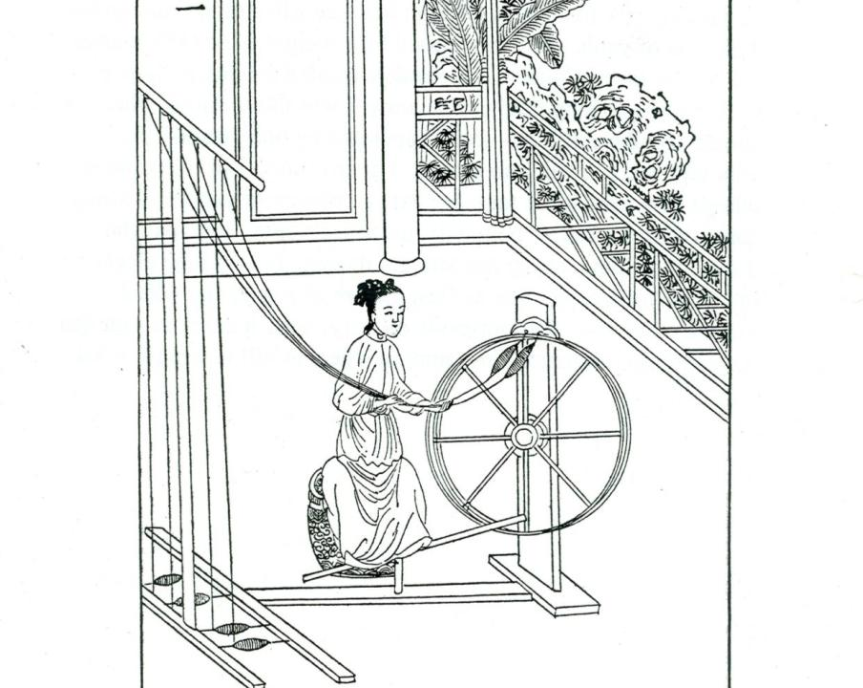
9. Silk weaving

Slide 18
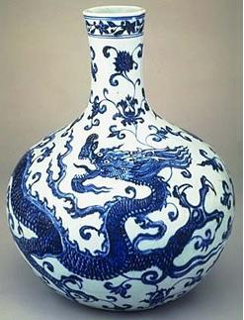
10. Porcelain

Slide 19
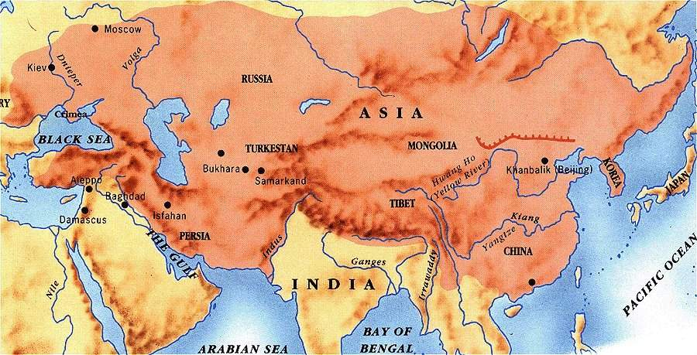
The End of the Golden Age
Despite the wealth & culture during under the Tang & Song Dynasties, the Chinese were briefly overthrown by the Mongols
From 1279 to 1368, foreign nomads called the Mongols ruled China
Notes:
1279-1368, less that 100 years.

Slide 20
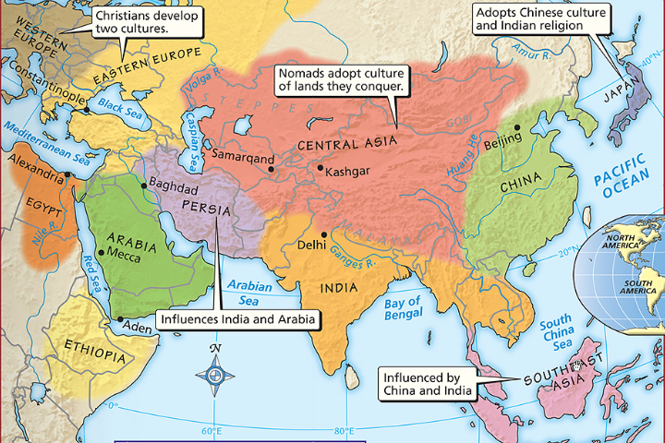
Who were the Mongols?
The Mongols were among the numerous nomadic tribes who lived in Central Asia

Slide 21
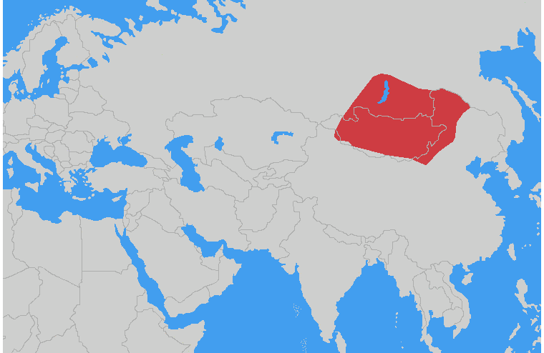
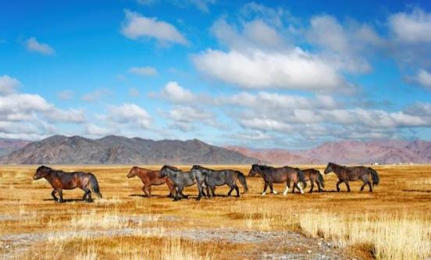
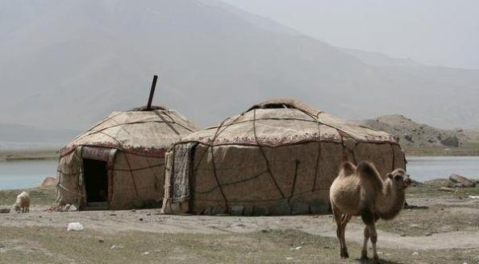
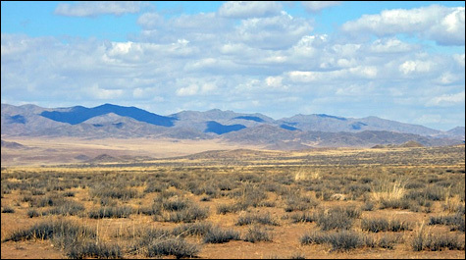
Who were the Mongols?
The Mongols lived in the harsh climate of the Eurasian steppe, an area with little rain & extreme temperatures
Mongol life centered on herding animals, especially horses
Mongols lived as nomadic clans, constantly searching for better pasture lands

Slide 22
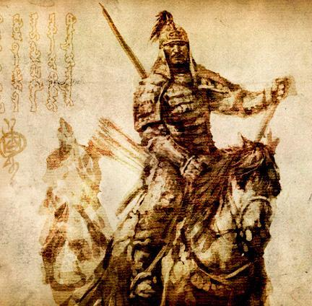
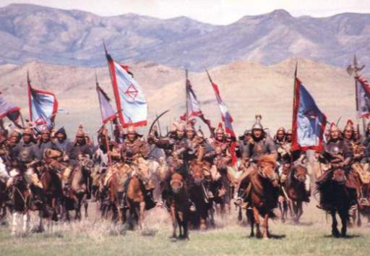
Who were the Mongols?
As a result of their lifestyle, the Mongols were tough warriors who occasionally raided nearby settlements
Genghis Khan built a powerful Mongol army & began a 21-year conquest of Eurasia
From 1200 to 1206, a clan leader named Genghis Khan unified the Mongols

Slide 23
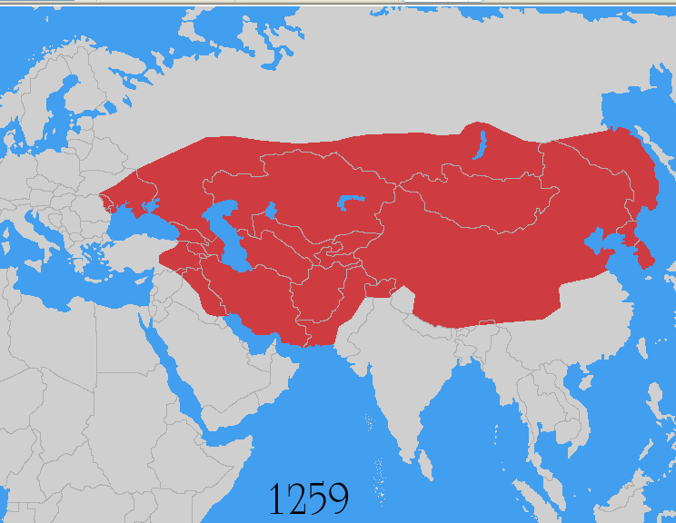
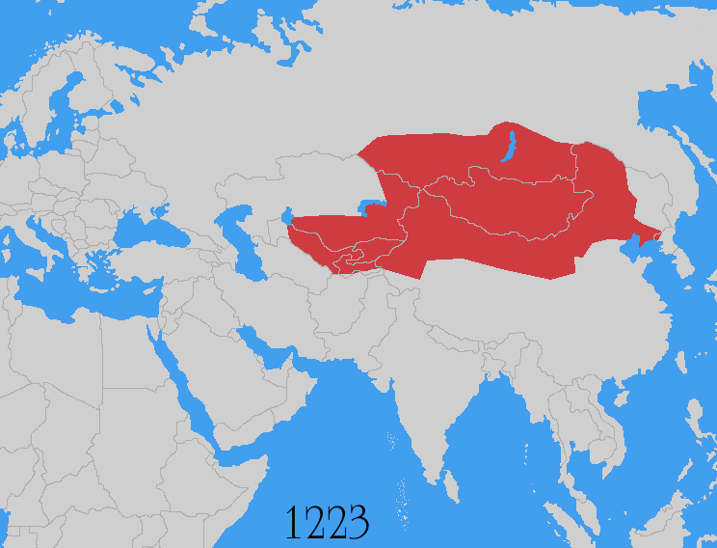
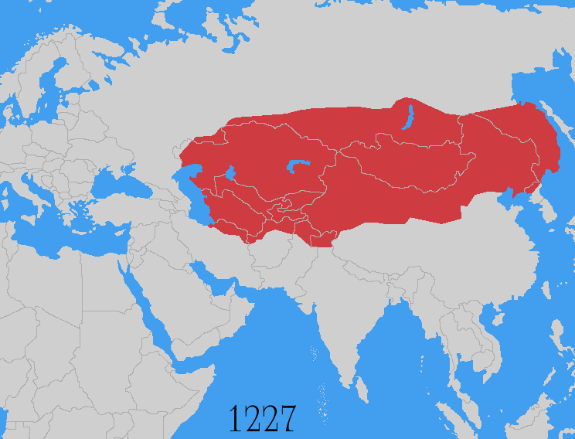
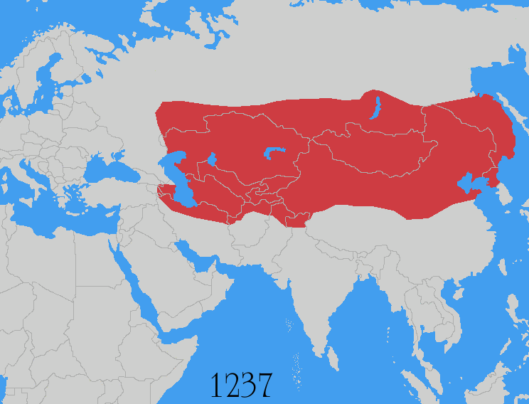
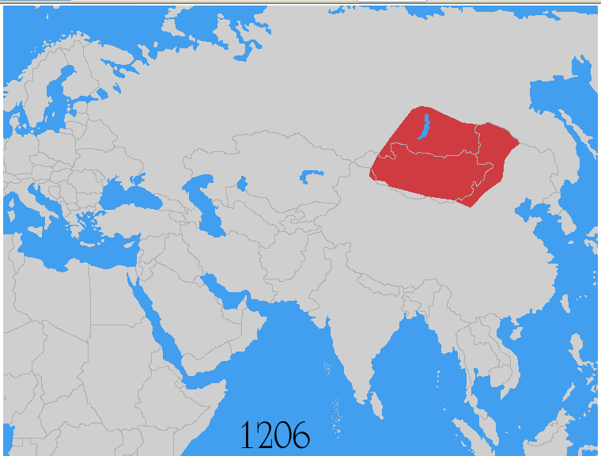
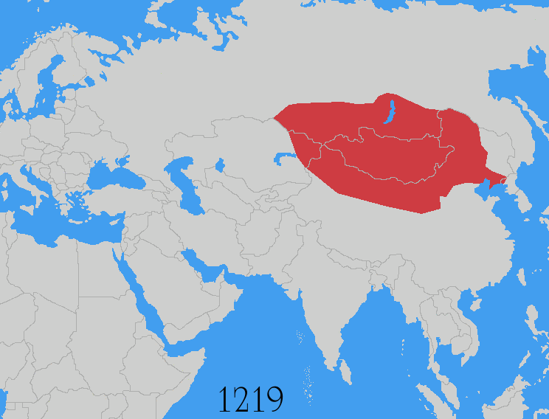
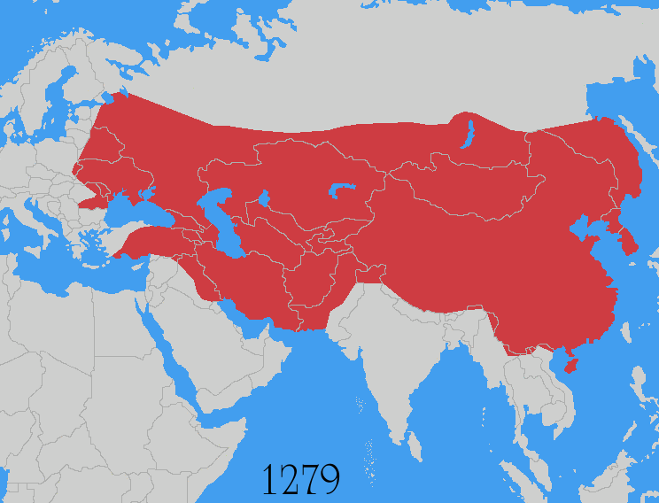

Slide 24
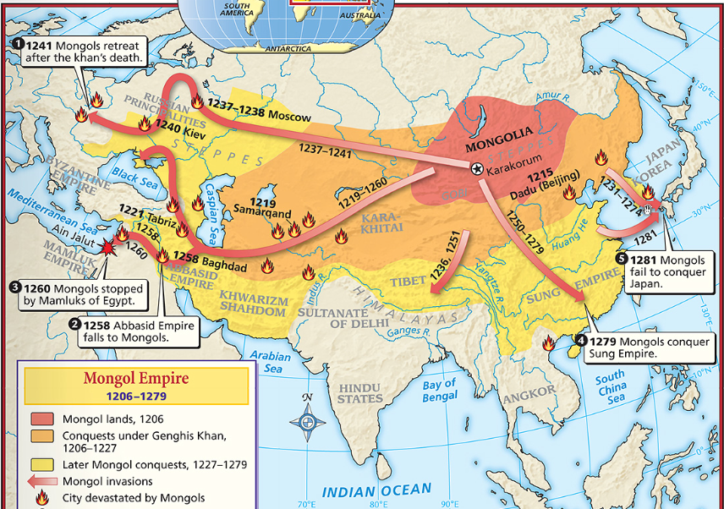
Under Genghis & later khans, the Mongols conquered…
Russia
Korea
Central Asia
China
the Islamic Empire

Slide 25
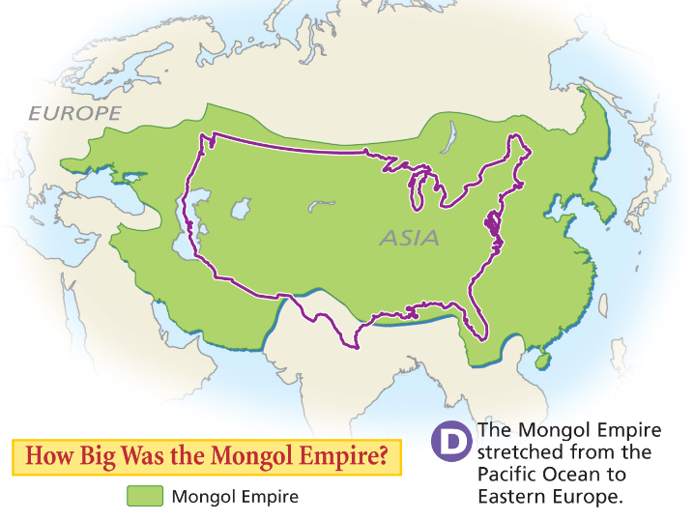

Slide 26
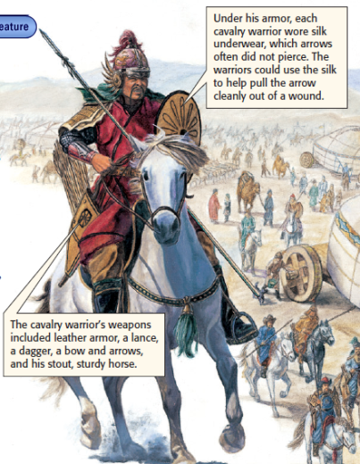
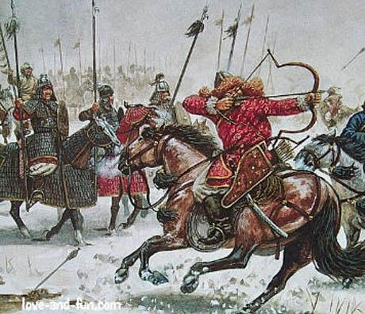
How did the Mongols create this massive empire?
Mongol soldiers were excellent horsemen; Used the horse saddle to shoot arrows while riding
Notes:
Several characteristics lay behind Genghis Khan’s stunning success as a conqueror. First, he was a brilliant organizer. He assembled his Mongol warriors into a mighty fighting force (see below). Following the model of the Chinese military, Genghis grouped his warriors in armies of 10,000. These in turn were organized into 1,000-man brigades, 100-man companies, and 10-man squads. He put his most battle-proven and loyal men in command of these units. Second, Genghis was a gifted strategist. He used various tricks to confuse his enemy. Sometimes, a small Mongol cavalry unit would attack, then pretend to gallop away in flight. The enemy usually gave chase. Then the rest of the Mongol army would appear suddenly and slaughter the surprised enemy forces.
Finally, Genghis Khan used cruelty as a weapon. He believed in terrifying his
enemies into surrender. If a city refused to open its gates to him, he might kill
the entire population when he finally captured the place. The terror the Mongols
inspired spread ahead of their armies, which led many towns to surrender without
a fight. As one Arab historian wrote, “In the countries that have not yet been
overrun by them, everyone spends the night afraid that they may appear
there too.”

Slide 27
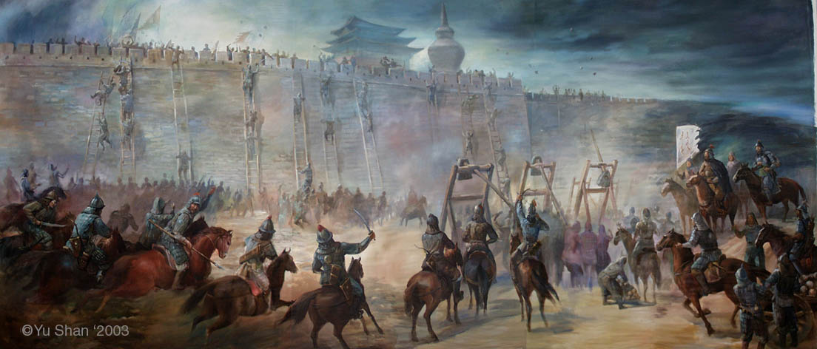
How did the Mongols create this massive empire?
If an enemy refused to surrender, Genghis would order the death of the entire population
As the Mongol reputation spread, many towns surrendered to Genghis without a fight
Genghis was a brilliant military organizer & strategist, but his greatest tactic was terror & fear
Notes:
Several characteristics lay behind Genghis Khan’s stunning success as a conqueror. First, he was a brilliant organizer. He assembled his Mongol warriors into a mighty fighting force (see below). Following the model of the Chinese military, Genghis grouped his warriors in armies of 10,000. These in turn were organized into 1,000-man brigades, 100-man companies, and 10-man squads. He put his most battle-proven and loyal men in command of these units. Second, Genghis was a gifted strategist. He used various tricks to confuse his enemy. Sometimes, a small Mongol cavalry unit would attack, then pretend to gallop away in flight. The enemy usually gave chase. Then the rest of the Mongol army would appear suddenly and slaughter the surprised enemy forces.
Finally, Genghis Khan used cruelty as a weapon. He believed in terrifying his
enemies into surrender. If a city refused to open its gates to him, he might kill
the entire population when he finally captured the place. The terror the Mongols
inspired spread ahead of their armies, which led many towns to surrender without
a fight. As one Arab historian wrote, “In the countries that have not yet been
overrun by them, everyone spends the night afraid that they may appear
there too.”

Slide 28
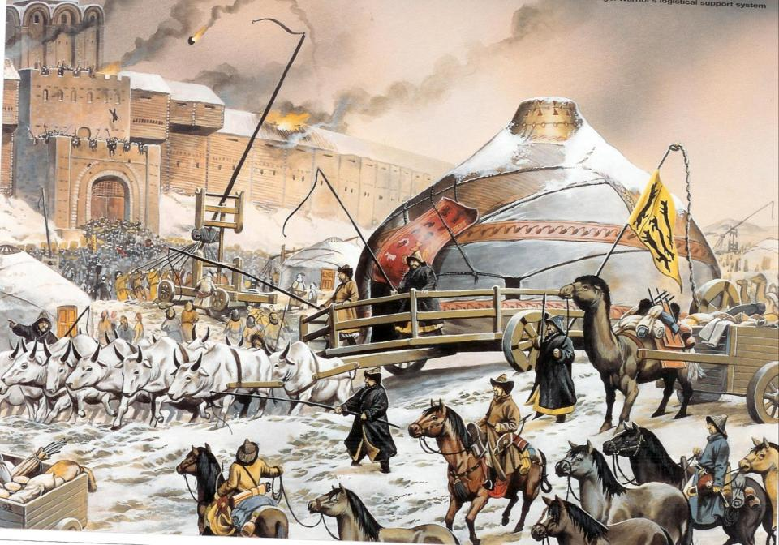
“In the countries that have not yet been overrun by them, everyone spends the night afraid that they may appear there too.” (Arab historian)

Slide 29
The Impact of the Mongol Empire
The Mongols were merciless in battle, but tolerant as rulers
Mongol khans (rulers) often adopted parts of the culture of the people they conquered
In the East, Mongols embraced Chinese culture
In the West, Mongols converted to Islam
Notes:
While ferocious in war,
the Mongols were quite tolerant in peace. They rarely imposed their beliefs or way
of life on those they conquered. Over time, some Mongol rulers even adopted
aspects of the culture of the people they ruled. The Ilkhans and the Golden Horde,
for example, became Muslims. Growing cultural differences among the khanates
contributed to the eventual splitting up of the empire.

Slide 30
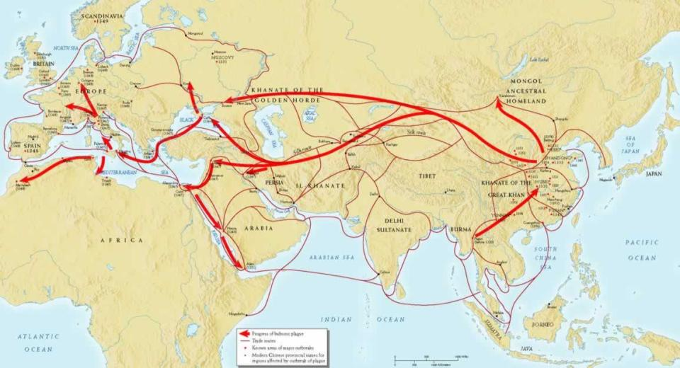
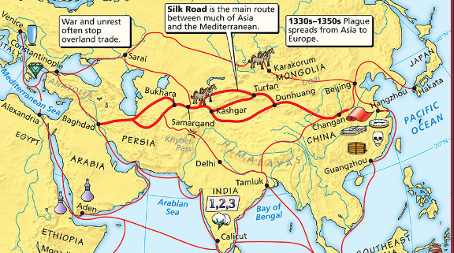
The Impact of the Mongol Empire
Chinese technologies like gunpowder & the magnetic compass reached Europe
But diseases like the plague (Black Death) reached Europe too
Mongol khans brought stability & order to Eurasia
The era from the mid-1200s to the mid-1300s is called the Pax Mongolica (“Mongol Peace”)
During the Pax Mongolica, the Mongols guaranteed safe passage across the Silk Road
As a result, trade & cultural diffusion increased between Europe & Asia
Notes:
From the mid-1200s to the mid-1300s, the Mongols imposed stability and law and order across much of Eurasia. This period is sometimes called the Pax Mongolica, or Mongol Peace. The Mongols guaranteed safe passage for trade caravans, travelers, and missionaries from one end of the empire to another Trade between Europe and Asia had never been more active. Ideas and inventions
traveled along with the trade goods. Many Chinese innovations, such as gunpowder,
reached Europe during this period.
Other things spread along with the goods and the ideas. Some historians speculate
that the epidemic of bubonic plague that devastated Europe during the 1300s was
first spread by the Mongols. (See Chapter 14.) The disease might have traveled
along trade routes or have been passed to others by infected Mongol troops.
For a brief period of history, the nomadic Mongols were the lords of city-based
civilizations across Asia, including China. As you will read in Section 3, China
continued to thrive under Mongol rule.

Slide 31
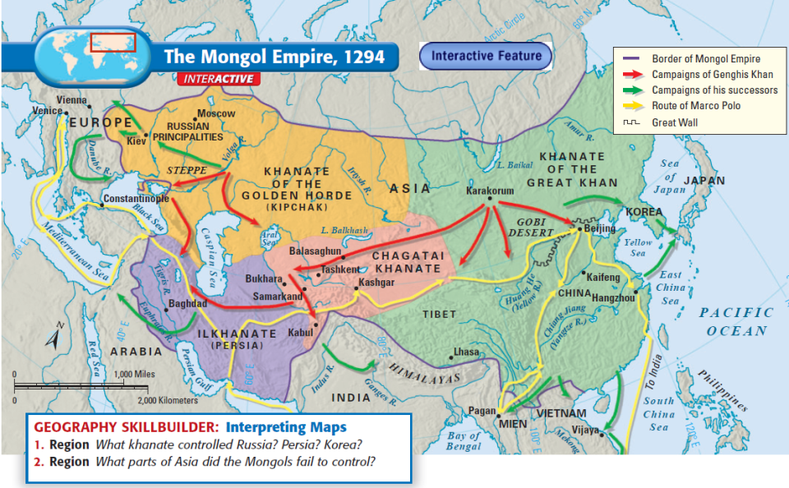
After the death of Genghis Khan, the Mongol Empire was divided into 4 major khanates each ruled by a son or grandson of Genghis
The Mongol destruction of Kiev increased the importance of Moscow in Russia
The khanate in Persia helped control the Silk Road
The Mongols were the first non-Muslims to rule over the Islamic Empire

Slide 32
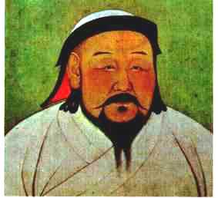
After the death of Genghis Khan, the Mongol Empire was divided into 4 major khanates each ruled by a son or grandson of Genghis
But the most significant khanate was the Mongol rule over China
In 1279, Genghis’ grandson Kublai Khan became the first foreign leader to rule China

Slide 33
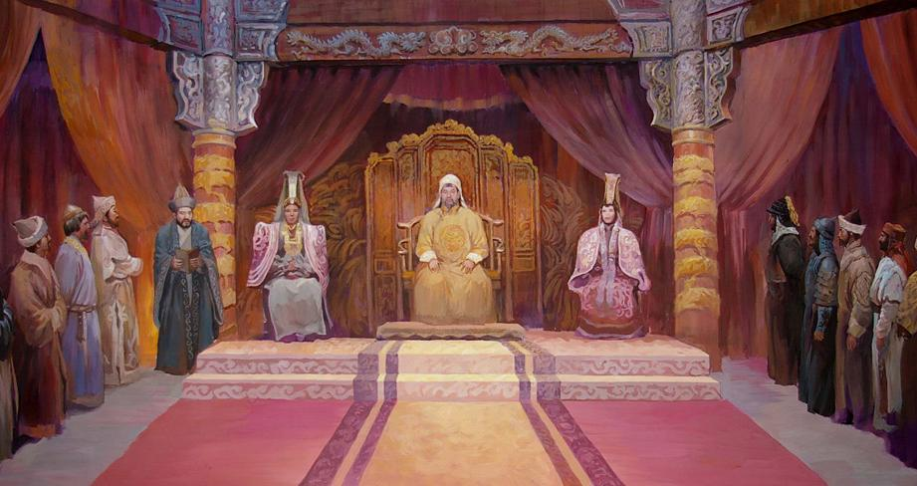
Kublai Khan
Kublai Khan began a new era in China called the Yuan Dynasty
Kublai enjoyed Chinese culture so much that he moved the Mongolian capital to China
But, he excluded the Chinese from serving in high gov’t offices & relied on foreigners to serve in his government

Slide 34
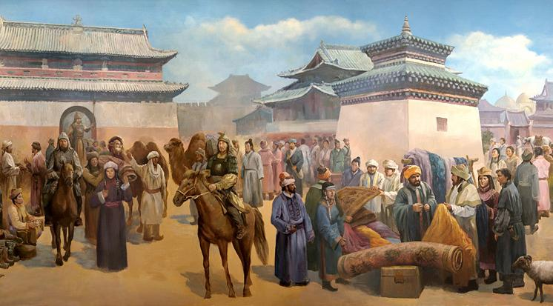
Kublai proved to be a good emperor for China
Under Kublai, foreign trade with China increased due to the Pax Mongolica
He built roads & extended the Grand Canal to help improve transportation in China

Slide 35
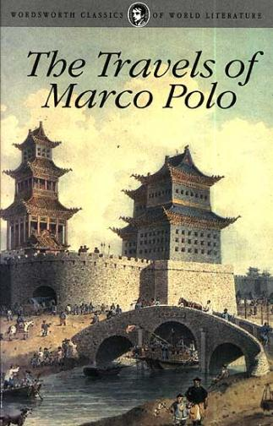
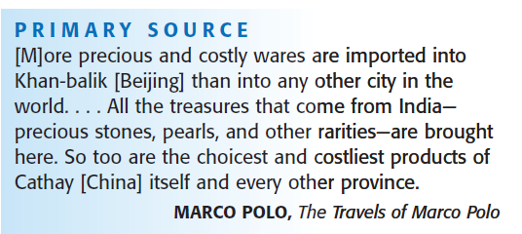
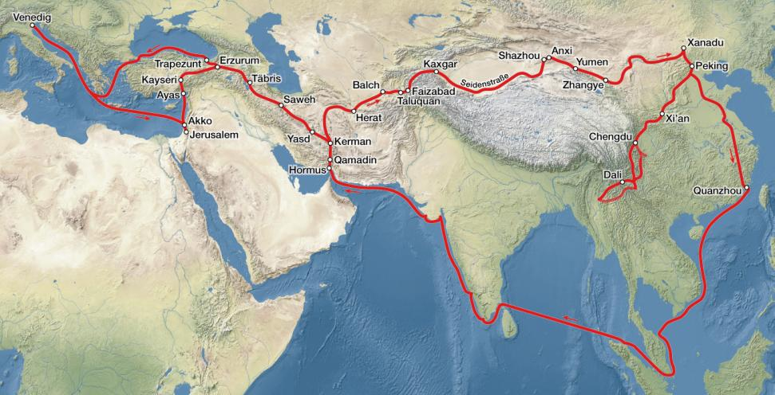
Marco Polo
In 1275, a European merchant named Marco Polo visited Kublai Khan’s court
Kublai was so impressed with Marco Polo that he employed him in the Yuan gov’t for 17 years
When Marco Polo returned to Italy in 1792, his stories of China increased European demand for Asian trade

Slide 36
By the time of Kublai’s death in 1294, the entire Mongol Empire was growing weak
In 1480, under Ivan III Russia gained independence from Mongol rule & started the Romanov Dynasty
In 1370, the Mongols lost control of Central Asia
In 1368, the Chinese overthrew the Mongols & started the Ming Dynasty
In 1330, the Mongols lost control of Persia

Slide 37
The End of the Golden Age
Despite the wealth & culture during under the Tang & Song Dynasties, the Chinese were briefly overthrown by the Mongols
From 1279 to 1368, foreign nomads called the Mongols ruled China
Notes:
1279-1368, less that 100 years.

Slide 38
In 1368, the Chinese overthrew the Mongols & established the Ming Dynasty
The Ming emperors encourage overseas trade…

Slide 39
…and began a series of explorations led by Zheng He to demonstrate Chinese superiority
Notes:
http://www.pbs.org/wgbh/nova/sultan/media/expl_01q.html

Slide 40
Read the excerpt from Zheng He and the Treasure Fleet Expeditions
Zheng He had better ships & traveled farther than any European explorers would for 100 years
With a fleet of over 100 ships, Zheng He led 7 different expeditions
Zheng He explored areas along the Indian Ocean & Africa, expand trade, & collected tribute from foreigners

Slide 41
Chinese Isolation
After the 7th treasure fleet voyage in 1433, Chinese leaders unexpectedly ended the expeditions & retreated into isolationism
Scholar-officials complained that Zheng He’s voyages used valuable resources that were needed to defend China
China’s official trade policy was to keep the influence of outsiders to a minimum
China’s geography & gov’t policies kept it relatively isolated for the next 300 years until European merchants in the 1800s demanded access to Chinese trade

