Slide 1
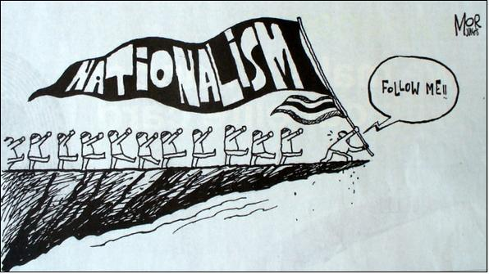

Slide 2
Nationalism-Intro
Nationalism is so hard to explain because it cannot be fit into just one box.
It is similar to patriotism, but whilst patriotism could be defined as the love of one’s country, nationalism focuses more on what shape that country should take.
Because of this, it not only encompasses cultural and emotional aspects, but has political and historical implications also.
Nationalism could be described as the support of a nation, but every nationalist movement has different aims and origins, whether they be desires for autonomy, political representation, or self-preservation.
Even nationalists cannot agree on exactly what constitutes nationalism, as beyond this shared desire for the success of the nation, they have very little in common.

Slide 3
NATIONALISM PRO’s
positive side
nationalism is said to be an expression of identity.
National identity is based on history, culture and often language.
Nationalism can be seen as the defense of this identity; the defense of the right of a nation to remain or become a recognized entity.
It can be classed as standing against the forces of oppression and tyranny.

Slide 4
NATIONALISM CON’s
Negative Side
The negative results of nationalism, however, cannot be denied.
It can cause division in societies when one nationality classes itself as superior to another.
This also generates racism, and can often lead to violent and bloody conflicts.
On the personal level, individuals may be persecuted because other individuals or groups believe their nationality to be inferior, or that it poses a threat.

Slide 5
Nationalism is often said to be a reactionary rather than a progressive ideology.
This is because it is usually the result of some great societal change, which causes individuals and groups to desire a return to previous times.
It has often been caused by industrialization and modernization.

Slide 7
THE UNIFICATION OF ITALY
Early in the 1800’s, Italy was seen as a “geographic expression”
Italians looked back to the glorious days of the Roman Empire and to the days when Italian city-states were at the centre of the Renaissance.
Nationalists yearned for a unified Italy and a return to past glories
Italian nationalism roots dates back to the French Revolution. (Liberty, Equality, and Fraternity)
Napoleon Bonaparte had combined all the small states into larger kingdoms.

Slide 8
ITALIAN UNIFICATION BACKGROUND
After the Congress of Vienna most of Italy was under foreign rule.
Italy struggled throughout the 1830’s and 1840’s.
In 1831, Giuseppe Mazzini founded a secret society called Young Italy to work towards unification.
Mazzini wanted Italy to be a republic
Count Camillo Cavour was a nationalist who favored a unified Italy led by the Kingdom of Sardinia.
The entire movement for Italian unity was called IL Risorgimento.
Attempts to rid Italy of foreign rule failed in 1848, however Sardinia emerged as a leader in the struggle for unification and in 1849 Victor Emmanuel II became king of Sardinia and was a huge supporter of IL Risorgimento.

Slide 9
UNIFICATION COMPLETED
In southern Italy the unification movement was growing under Giuseppe Garibaldi who belonged to Young Italy.
Garibaldi wanted nothing less than a complete unified Italy with a republican form of government.
In 1860 the unofficial approval and formation of the “Red Shirts” army attacked the kingdom of Two Sicilies to drive out the Bourbon rulers.

Slide 10
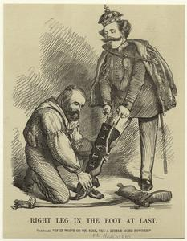
HEADED UP THE BOOT!
Garibaldi and his Red Shirts landed on the island of Sicily and conquered it an a brief and decisive campaign.
The sailed to the mainland, and very victorious there. The Bourbon forces fled before the Red Shirts entered Naples.
Next Garibaldi turned his attention to Rome and the Papal States, which were under French protection, this is where Cavour stepped in.

Slide 11
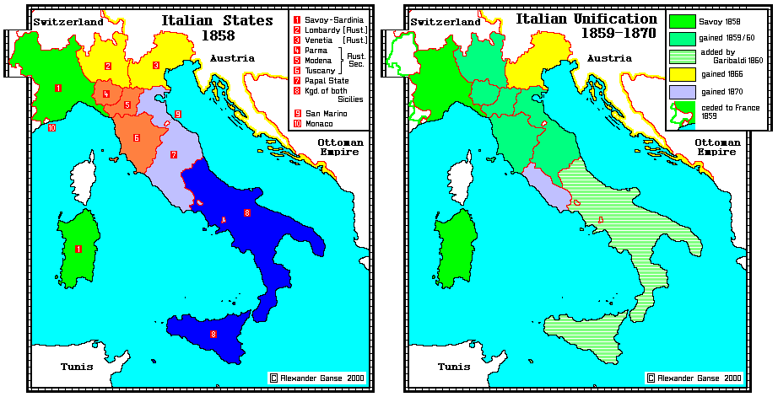

Slide 12
PROBLEMS OF A UNIFIED ITALY
Pope Pius was angry at losing control of Rome and the Papal States.
He withdrew into the Vatican and urged Italian Catholics not to cooperate with their new government.
This put pressure on the people who wanted to be loyal both to Italy and the Catholic Church.
It also created antagonism between people living in the North and South.
Southern Italians resent the fact that Sardinians dominated the government.
Economic differences were also a cause to tension
South was rural and poor
North was beginning to industrialize.

Slide 13
Garibaldi and his republics disliked the government of the new nation.
Although Italy had a constitution that limited the power of the king and elected parliament, only a few men had the right to vote.
Of 20 million people, only about 600,000 had the right to vote (fewer than 1 in every 30)
SECTION 1 REVIEW (PG. 124)
Questions 2 - 6

Slide 14
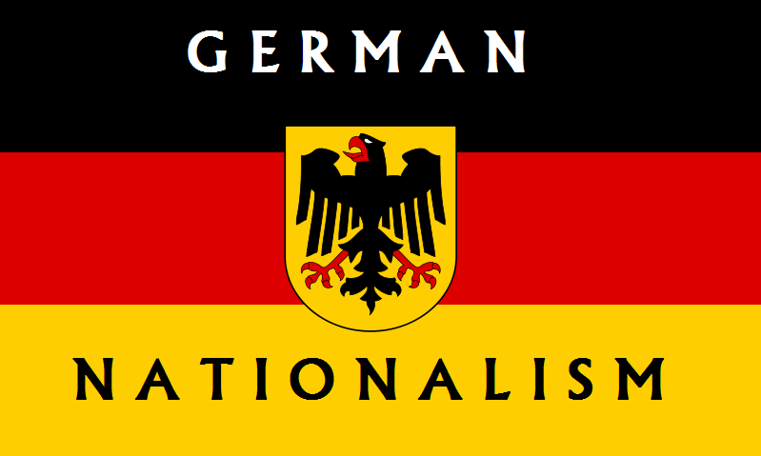
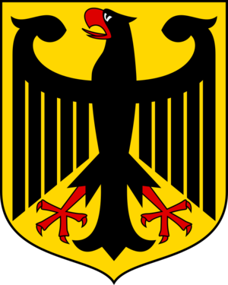

Slide 15
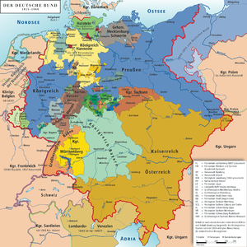
GERMANY BACKGROUND
Like the Italians, Germany was divided into many separate states in 1815.
The German Confederation, created at the congress of Vienna, included 39 loosely grouped independent nations.
Attempts by nationalist in 1848 to unify Germany failed.

Slide 16
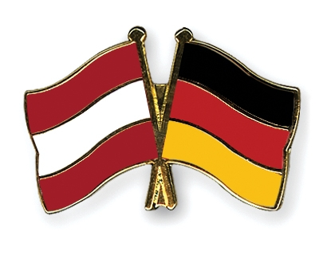
FOREIGN OBSTACLES TO UNITY
The presence of Austria in the German Confederation was the most serious obstacle to German unity.
Austria opposed a unified Germany as it feared it would lose influence on the bordering states.
Austria feared competition if a powerful German nation arose in Central Europe.
France and Russia also feared this, due to the geographic location.

Slide 17
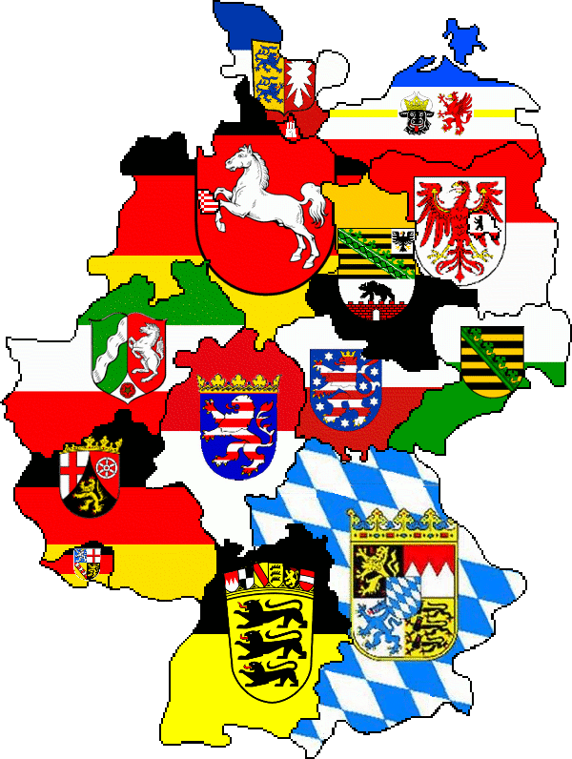
INNER OBSTACLES TO UNITY
Many German smaller states also opposed unification.
The feared a Prussian control of a united Germany.
Catholic states in the south were concerned by a dominate protestant Prussia.
Smaller German states wanted to protect their own customs and traditions, which would be lost if they were absorbed into a larger nation.

Slide 18
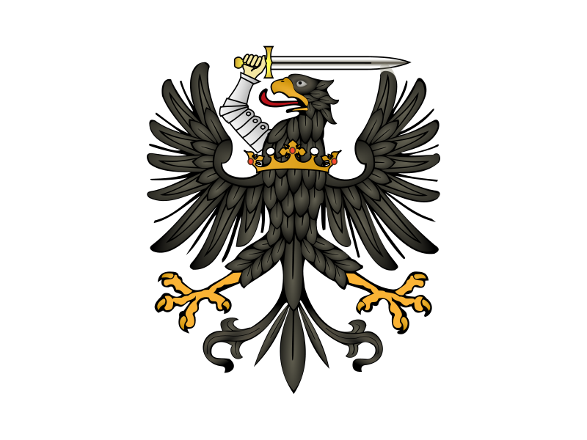
PRUSSIAN LEADERSHIP
In 1850’s, Prussia emerged as a leader in the effort to unify Germany.
Since 1700’s Prussia had a strong powerful state with a large disciplined army.
The Industrial Revolution added greatly to Prussian economic state. (Coal deposits)
During the 1850’s coal fueled the prosperous Prussian iron and steel industry.
This allowed the government to construct and efficient system of railroads , this allowed them to work closely with the military

Slide 19
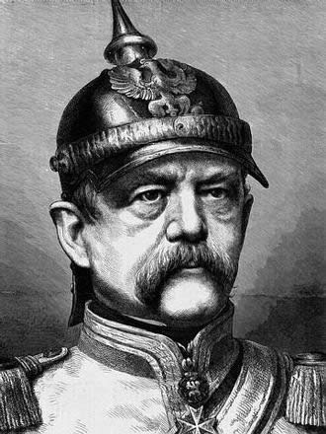
Prussia was neither liberal or democratic.
In fact it was an authoritarian state
Prussia rigorously supported militarism, and was continuously ready for war.
King William I, who came to the throne in 1861, made sure Prussia would remain both authoritarian and militaristic.
To help the situation, he appointed Count Otto von Bismarck as the prime minister and minister of foreign affairs.

Slide 20
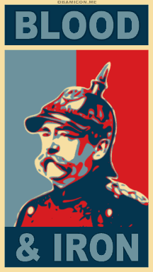
BLOOD & IRON
Bismarck was a former military officer, he believed firmly in royal power.
Although he served in the government, he had no respect for a representative government .
Bismarck and William I shared a common goal of unifying Germany under Prussian control and be the most powerful nation in Europe
Bismarck believed these goals would not be achieved by “speeches and majority decisions… but with blood and iron”
By blood and iron, Bismarck meant warfare and the military

Slide 21
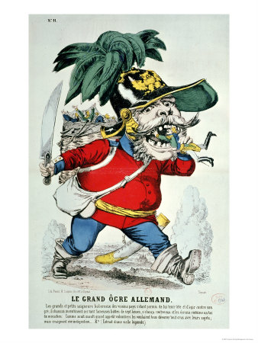
Bismarck claimed that the government did not need the parliaments approval on matters.
According to the constitution , Bismarck could not do or say this, but he ignored it and collected taxes to pay for military expenses anyways.
He followed a policy of “Realpolitik”, a German word meaning realism.
He took whatever political action necessary, whether it was legal or ethical.
He freely applied the policy of Realpolitik in the process of creating a unified Germany.

Slide 22
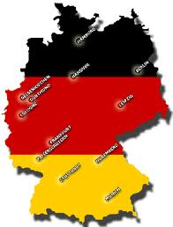
RESULTS SHOW!
January 18, 1871 at Versailles, William I was proclaimed Kaiser or Emperor of Germany.
The new German empire included all members of the North and South states as well as Alsace and Lorraine.
German unification was complete, but the Germans had creating a lasting enemy in France.

Slide 23
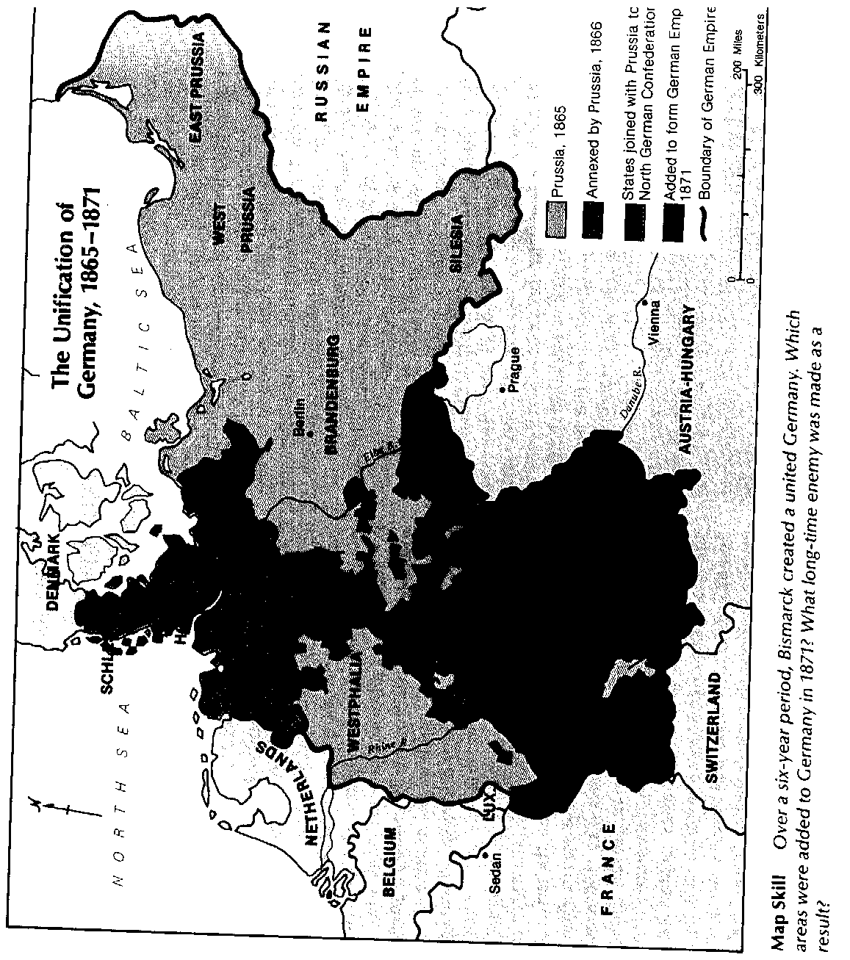

Slide 24
SECTION II REVIEW
PAGE 127
QUESTIONS
2-8

Slide 25
SECTION III CONSULIDATING THE GERMAN EMPIRE
How Bismarck influenced the German Empire
What policies William II introduced.

Slide 26
THE NEW GERMAN EMPIRE STIKES BACK
The new German empire was called the Second Reich
It established a federation, a union of 25 states, each governed by its own king, prince, archduke, or duke
Each ruler appointed representatives to the upper house of parliament called Bundesrat.
The lower house, called the Reichstag was elected male citizens over the age of 25.
The constitution appeared to create a representative government, but the appearance was deceiving.

Slide 27
THINGS AREN’T ALWAYS AS THEY SEEM
The Bundesrat could veto any decision made by the Reichstag.
The emperor and his chancellor controlled enough votes in the Bundesrat to determine its decisions.
Thus political power rested firmly in the hands of the emperor and the chancellor.

Slide 28
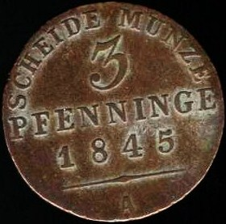
PRUSSIAN INFLUENCE
From the start Prussia dominated the Second Reich.
William I was the king of Prussia as well as emperor, and he appointed Bismarck as his chancellor.
The Prussian tradition of compulsory military service was extended throughout the empire, with Prussian officials in charge of the army.
During the early years, Bismarck created a smooth running empire.
The legal system of each state was made uniform.
The coining of money came under control of one imperial bank (Reichsbank)
The mail, railroad, and telegraph were all coordinated through the empire
Bismarck earned the title “Iron Chancellor”

Slide 29
CONFLICT OVER RELGION
Conflict soon developed between the strong central government and Catholics.
Bismarck considered the Catholic Church a treat to government power.
Catholics were a large minority in Germany, and their political party (Center Party) was the second strongest in Reichstag.
In 1872, Bismarck all out attacked the Catholic Church, calling the attack “Kulturkampf” meaning struggle for civilization.
Government passed laws expelling Jesuit order, members of the clergy were forbidden to criticize the government and all Catholic schools were closed.

Slide 30
FEAR THE WRATH OF GOD!
Bismarck soon realized that Kulturkampf was a failure
Rather than weakening the Catholic Church it united Catholics and strengthened the Center Party.
Bismarck showed his political flexibility, and most anti-Catholic laws were repealed.
Bismarck needed the support of the Center Party because he faced a serious challenge from the socialists.

Slide 31
“GIVE ME GIVE ME NEVER GETS” POLITICAL AND SOCIAL REFORMS
German liberals were initially been unhappy with the Second Reich
They wanted a more democratic government with a truly representative parliament.
Gradually many German liberals came to support Bismarck
The reason was economic prosperity.
Once Germany was unified it went through a period of rapid industrialization and economic growth that benefited the middle class and the industrial capitalists.
Many liberals supported Bismarck in return for economic well being.

Slide 32
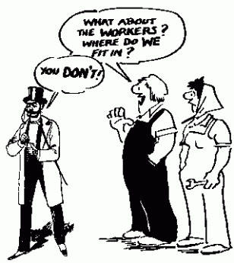
OH NO!... NOT SOCIALISM
Bismarck hated a feared socialism.
He wanted to destroy it in Germany.
He gave the police the right to break up socialism meetings and imprison their leaders.
However, like the Catholics this only strengthened the socialists.
He changed his tactics and introduced reforms to win over workers’ support for the government.
In the 1880’s, they introduced accident, health, and old age insurance.
The German worker won a basic social security program form one of Europe’s most conservative regimes.
The Social Democrats continue to win election to the Reichstag

Slide 33
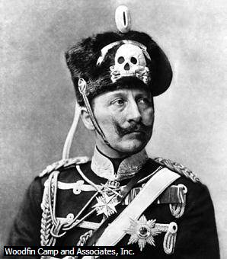
THE EMPEROR’S NEW GROOVE
In 1888, William II (grandson of William I) inherited the German throne.
He believed in the divine right of his family to govern Germany.
He shared with Bismarck a belief that a strong Germany rested on a powerful monarchy as well as a powerful army.
At first, he kept Bismarck as his chief minister, then being a self-centered man resented Bismarck’s domination
He was determined to be his own chief minister and in 1890 he forced Bismarck to resign after 28 years of service.

Slide 34
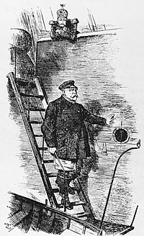
BON VOYAGE!
William II sought to win the support of all Germans, including the working class.
He allowed anti-socialist laws to lapse and extended the social insurance programs.
The Social Democratic country won widespread support and became the single largest party in the Reichstag.
William II’s personal, and often erratic leadership in set a new course for foreign policy.
The ambitious ruler proposed to win Germany “ a place in the sun” amongst the great world powers such as Britain, France, and Russia.
He wanted Germany to be a major commercial, colonial, and military power.
He also competed for colonies in Asia, Africa and the Pacific.

Slide 35
STEEL THE ARMY AND NAVY
Between 1892 and 1913, William II almost doubled the size of the army.
He also devoted much attention to building a large navy that would rival the British.
Both the army and Navy benefited form increased German steel production. By 1900 only the US produced more steel.

Slide 36
A NATIONAL SPIRIT
During the 1800’s Germans developed a strong sense of national pride caused by military victories and economic progress.
By the turn of the century Germany was the leading industrial nation in Europe.
They were also proud of their cultural heritage. They took special pride in their people such as Beethoven and Wagner.
The German educational system was considered by many to be the best in Europe in the 1900’s.
In many ways Prussia still dominated German national life.
Prussian respect and admiration for the military is one example of this dominance.
As Germany became a major world power, the spirit of militarism increased.

Slide 37
SECTION III REVIEW
PAGE 131
QUESTIONS
1-5

Slide 38
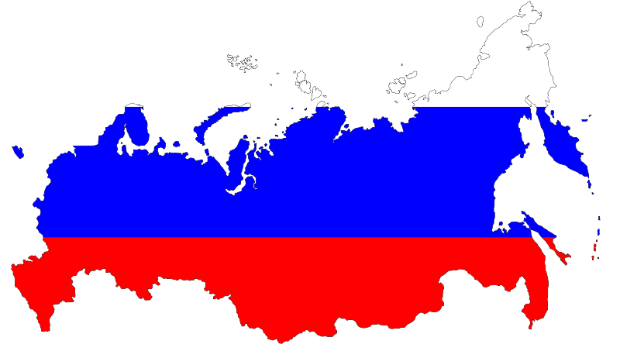
REPRESSION AND REFORM IN RUSSIA
HOW PEOPLE LIVED UNDER THE RUSSIAN AUTOCRACY
WHAT REFORMERS DEMANDED OF THE CZARS

Slide 39
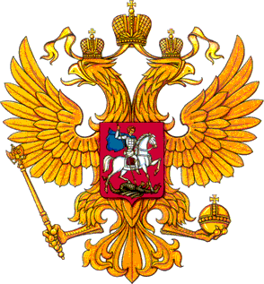
RUSSIA IN THE EARLY 1800’S
The agricultural economy of the Russian Empire was based on serfdom, as it had been for hundreds of years.
Serfdom had been abolished in most of Europe by the 1800’s, but in Russia 40 million serfs lived as if they did in the Middle Ages.
Serfs could be sold along with the land or used as domestic servants.
The system of serfdom was inefficient.
At the same time many landowners were poor managers.
The Russian Empire was an autocracy (a gov’t which has a ruler without unlimited power).
It was difficult for the czar to extend autocracy over the vast empire ands laws were often enforced with highly repressive measure.

Slide 40
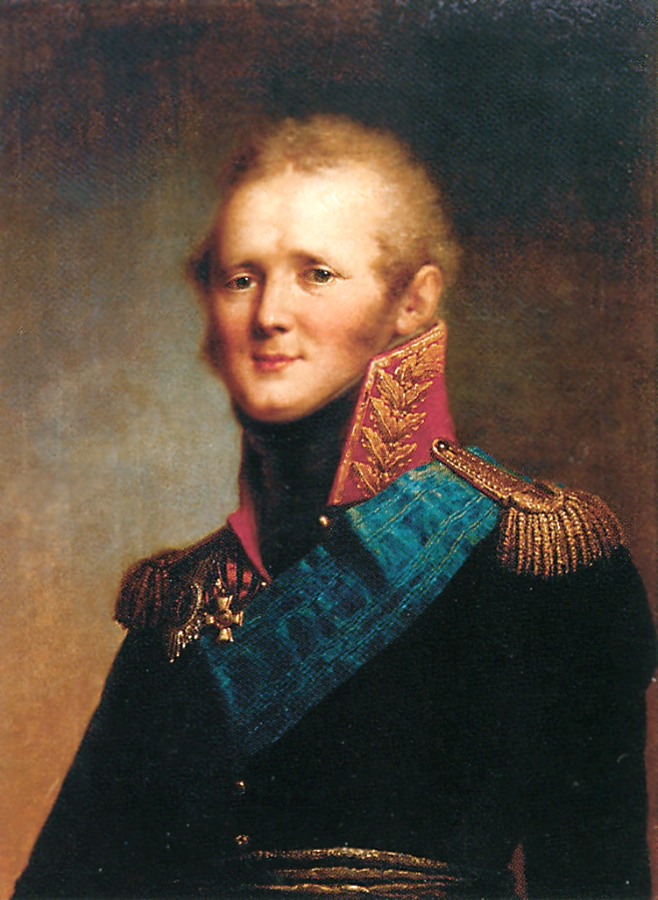
TIME TO PUMP YOU UP … AUTOCRAZY
Alexander I who was influenced by Enlightenment thinkers, became czar in 1801.
Once he realized that Enlightenment idea weakened his power, he abandoned his ideas.
Congress of Vienna in 1815, Alexander was a strong defender of the traditional order.
The war against Napoleon had a lasting effect on Russians.
Many who fought in western Europe were impressed with what they saw there.
Upon their return, they set up societies to discuss and spread ideas of reform.
When Alexander I died in 1825, a group of army officials set up and uprising called the Decembrists Revolt.
The Decembrists demanded a constitutional monarchy.

Slide 41
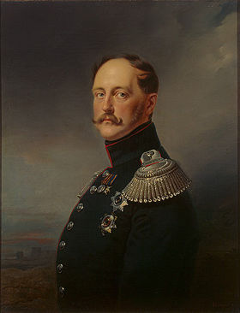
AUTOCRACY PARANOIA
Nicholas I (took over after Alexander I) was determined to strengthened the autocracy during his reign.
Did everything he could to stamp out opposition to the government.
Gave secrete police unlimited power over the Russian lifestyle.
People suspected of treason could be arrested, imprisoned or deported without trial.
Police censored newspapers and other written material.
He targeted universities as he was afraid that students would adopt dangerous foreign ideas.
The outbreaks of the revolutions in other parts of Europe confirmed the czar’s conviction that strict control was necessary in Russia.

Slide 42
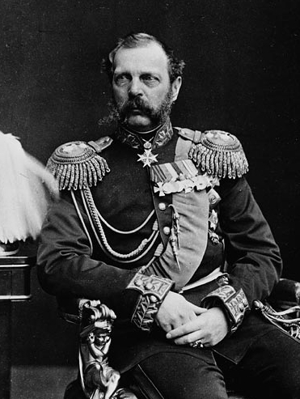
A PERIOD OF REFORM
Despite Nicholas’ I efforts to prevent change, demands for reform grew.
Some disliked the years of repressive rule while others saw serfdom was highly inefficient.
When Russia finally began to industrialize, factories opened and their were no workers to fill them as many were serfs.
The numbers of serf revolts had also increased.
When Russia was defeated in the Crimean War, many blamed it on the weakness of serfdom and the autocratic political system.
Nicholas I died in the midst of the War and he was replaced by his son Alexander II.
The new son like his father believed in autocracy, but thought some reforms were needed to prevent revolution

Slide 43
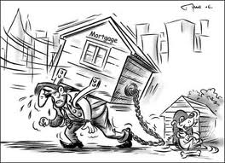
ALL FOR FREEDOM … SAY MIRS!
In 1861, Alexander II issued the Emancipation Edict freeing the serfs.
The czar said “its better to abolish serfdom from above than to wait until it is abolished from below”
They were given their freedom but no land as many had hoped.
Instead the government paid landowners handsomely for their land, then parceled them into village communities called mirs.
The peasants who lived in the mirs paid the government for the land for 49 years
This put them heavily in debt and seldom had enough money to run the farmland effectively.
This hurt Russian agriculture.

Slide 44
YOU SAY YOU WANT A REVOLUTION!
The czar introduced other reforms:
Relaxed censorship and restrictions on universities.
Jury system was introduced.
Regulations for governing soldiers were made less harsh.
Government created local elected assemblies called zemstvos.
Many zemstvos established schools and improved health care.
The reforms of Alexander II encouraged revolutionary activities in Russia
In 1870’s thousands of educated people left the cities, and went to the countryside to convince peasants to support revolutionary goals. But these populists, had very little success
The most radical populist formed a group called People’s Will, who goal was to assonate the czar, which they did in 1881.

Slide 45
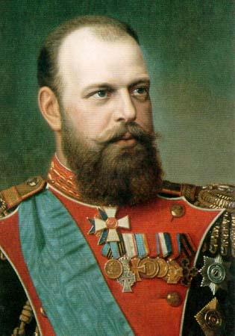
A RETURN TO REPRESSION! AGAIN?
Alexander III, who succeeded his father, moved quickly to crush revolutionaries and end reform.
He reduced the power of the zemstvos, restored strict censorship, and directed the police to seek out critics of the government.
Because of the vast size of the Russian Empire, it contained many ethnic minorities including Ukrainians, Finns, Poles, and Jews, who all opposed Russian rule.
Alexander wanted to strengthen autocracy once again through a process called Russification
This was an attempt to force all people in the empire to use the Russian language and adopt the Russian Orthodox Religion.

Slide 46
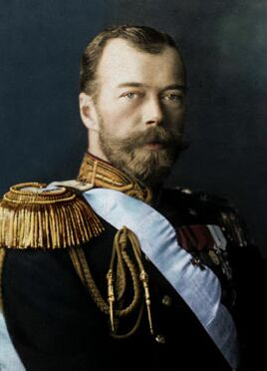
WHEN WILL WE EVER LEARN
In 1894, Nicholas II succeeded his father and continued his fathers repressive ways
Nicholas faced new unrest as Russia finally began to industrialize.
By 1900 Russia was the fourth largest iron producer in the world, and workers reached almost 2 million.
Russian labors (like in other countries) worked long hours for little pay.

Slide 47
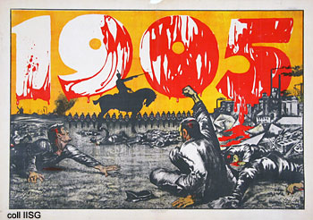
THE REVOLUTION OF 1905
In addition to the labor unrest, the government faced opposition from landless peasants, national minorities, and middle class liberals, who demanded a constitutional government.
Assassination of government officials by the revolutionaries had become very common.
In 1904, war broke out between Russia and Japan over influence in Manchuria and Korea.
Nicholas hoped that a victory would easy discontent at home. But when defeated, the humiliating defeat further increased tensions.
On January 22nd, 1905, Nicholas was presented a petition for better working conditions, greater personal liberties, and an elected national assembly.
He saw this a threat to his power and ordered soldiers to fire into the crowd of people.
About 1,000 workers were killed which came to be known as Bloody Sunday.

Slide 48
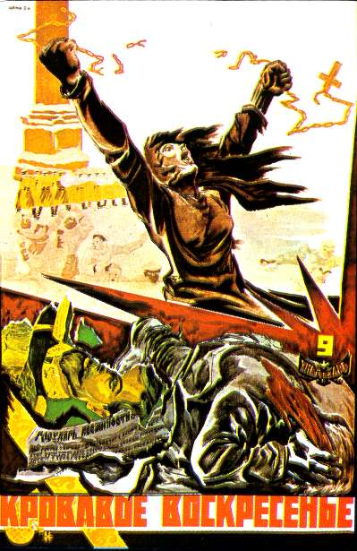
FEEL THE WRATH OF SUNDAY
After Bloody Sunday, the discontent that had been building for years exploded. Russia was quickly engulfed in revolution.
By 1905, the claimer for more freedom and a democratic government was so loud that the czar gave in.
He promised freedom of person, assembly and union, and approved the creation of a national assembly called the Duma, hoping this would end the violence.
It did for a short period, but Nicholas really never gave the Duma a chance and in 1906 he dismissed it when they would not cooperate with him.
The czar emerged from the revolution with his power largely in tact.
New Dumas were elected, but they were dominated by supporters of autocracy.
Nevertheless, between 1906 and 1911, the government introduced some reform, such as setting up a program to help peasants buy there own land.
The problems left unsolved by the Revolution of 1905 remained as seeds for a future revolution.

Slide 49
SECTION IV REVIEW
QUESTIONS
1 – 6
PAGE 135

Slide 50
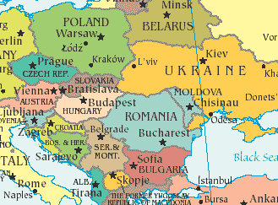
NATIONALISM IN EASTERN EUROPE

Slide 51
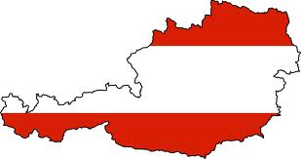
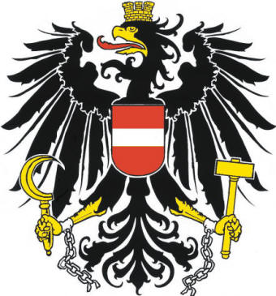
THE AUSTRIAN EMPIRE
The Austrian Empire includes more than 12 different nationalities.
The Germans of Austria and the Magyars of Hungary made up the two largest groups, but neither had a majority.
Other nationalities included Poles, Czechs, Croatians, Slovaks, and Romanians.
The national group had a strong sense of pride in their own languages and customs. And most resented domination by the Austrians.

Slide 52
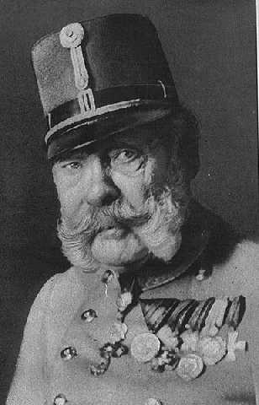
FROM THE CRADLE TO THE GRAVE
Francis Joseph became emperor of Austria in 1848 at the age of 18, and lasted until 1916. (68 years)
He constantly sought ways to keep his empire together.
In 1859, Austria lost Lombardy to Italy.
In 1866, as a result of the rapid defeat by Prussia, Austria lost its influence among the German states.
Although Francis continued to oppose nationalism, he realized that Austrians had to strengthen the empire at home.
He decided to compromise with the Magyars.

Slide 53
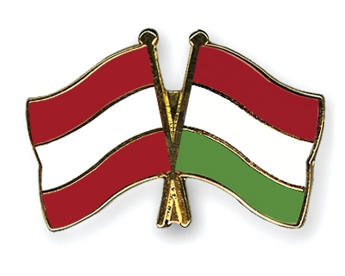
I CHALLENGE YOU TO A DUAL… MONARCHY
The Magyars had long demanded an autocratic gov’t.
The Magyars fought hard during the Prussian war to fight for autocracy and wanted Hungry to be recognized as a separate kingdom with its own territory and constitution under the Hungarian leader Francis Deak.
In 1867, Francis Joseph agreed to the dual monarchy, and old Austria was divided into two parts: The empire of Austria and the Kingdom of Hungary.
The Dual Monarchy of Austria-Hungary was united by a single ruler, the Hapsburg Emperor, who would be the emperor of Austria and the king of Hungary.
They shared ministries of war, finance, and foreign affairs
However, each had its own constitution and its own parliament

Slide 54
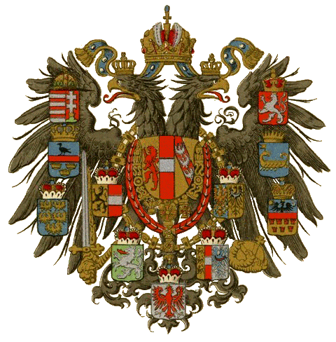
HEY AUSTRIA – YOU HUNGARY?
The dual monarchy satisfied the Magyars, but other nationalities in Austria-Hungary remained dissatisfied
Austrians were a minority in Austria and the Magyars were a minority in Hungary.
The Austrian gov’t made minor concessions to other ethnic groups, however the Magyars tried to force everyone in Hungary to give up their own ethic identity.
The unrest among the nationalities in Austria-Hungary continued to threaten the unity of the empire and the peace in Europe.

Slide 55
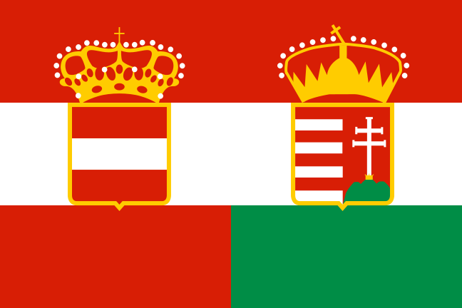
LIFE IN AUSTRIA-HUNGARY
In both Austria and Hungary, a small noble class dominated the political, economic and social life.
Nobles owned huge estates, while peasants only had small plots.
Democracy made little headway in Austria-Hungary, government remained in the hands of wealthy nobles
In Hungary voting was limited to 6 present of the population, this prevented any effective challenge to the Magyar ruling class.
The economy of Austria-Hungary remained mainly agricultural during the 1800’s.
Late in the 1800’s Austria began to industrialize slowly, and Hungary followed behind.

Slide 56
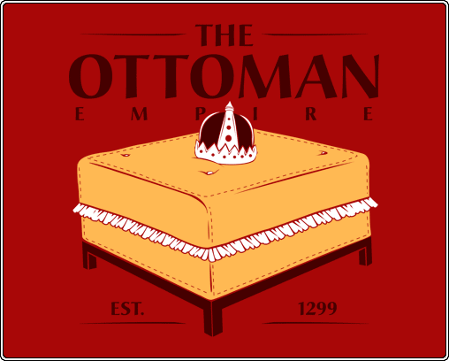
OH NO, NOT THE OTTOMAN’S
In the 1500’s the Ottoman empire extended across Asia Minor into the Middle East and Egypt, but since that time it has steadily declined.
Ottoman empire contained many nationalities who sought freedom from Ottoman rule.
Gradually parts of the empire broke away.
In 1844, Czar Nicholas I called the Ottoman empire “the sick man of Europe”.
Throughout the 1800’s, many diplomats expected it to collapse as one national group after another fought for independence.
However, Britain and France worked hard so that this wouldn’t happen.
They considered the Ottoman Empire a block against expansion of Russia or Austria-Hungary into the Balkan region.
For this reason, France and Britain entered the Crimean War on the side of the Ottoman Empire, as they wanted prevent Russia from gaining control of Constantinople.

Slide 57
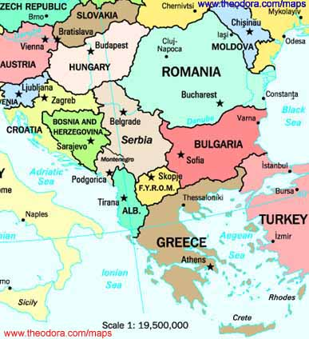
LETS RACE TO THE BALKINS
Although Russia was defeated in the Crimean War, the Ottoman Empire continued to decline.
The race was on for the Balkan states, Russia defeated the Turks as they helped aid the Slavs. They won the right to occupy a large independent Bulgarian state.
Other European powers, feared the increased Russian influence in the Balkans pressured the Russians to attend an international congress at Berlin in 1878.
The Congress reorganized the Balkans and made a much smaller Bulgarian state.
Serbia, Romania, and Montenegro gained complete independence.
Britain receive Cypress
Austria-Hungary got Bosnia and Herzegovina.

Slide 58
A NEW INTERNATIONAL ORDER
The results of the Congress of Berlin reflected the new international order that had developed in Europe by the late 1800’s.
The emergence of new nations such as Germany and Italy and the decline of old empires upset the balance of power worked out in the Congress of Vienna in 1815.
First half of the 1800’s Austrian Empire was dominant, and by the end of the 1800’s Germany under Bismarck took the lead.
The international order was further affected by the industrial revolution, which had fueled economic growth in all parts or Europe, especially Britain and Germany.
Development of technology led to new military weapons, which increased the capacity for war in Europe.

Slide 59
SECTION V REVIEW
QUESTIONS
2 – 6
PAGE 138

