Slide 1
Nationalism in Europe
Italian Unification

Slide 2
1. Stirrings of Nationalism
After the Congress of Vienna
Klemens von Metternich
Wanted to maintain the old Europe with its relationships
Admitted that the old Europe was nearing its end
Old order had been damaged beyond repair

Slide 3
ii. Nationalism
Growing force in Europe during the 1800s
Came in some part from the decisions of the Congress of Vienna
Congress had created political boundaries that ignored national groups
Placed these groups under large empires
Examples:
Austrian Empire: home to Croats, Czechs, Germans, Hungarians, Italians, Poles, Serbs, Slovaks, and Slovenes

Slide 4
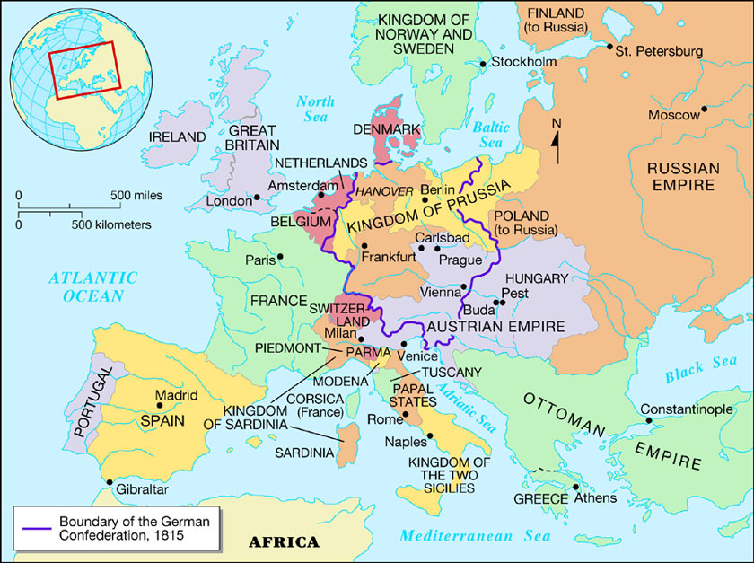

Slide 5
iii. Italy was split into three groups
North- under Austrian rule
Others under the Hapsburgs
The rest left to France
iv. Italian nationalism grew in opposition to these conditions

Slide 6
b. Mazzini and Young Italy
Italians in Austria formed secret societies to work for political change

Slide 7
ii. Giuseppe Mazzini
Launched a nationalist group called Young Italy in 1831
Fought for the unification of the separate Italian states
He was exiled for his views, but smuggled in pamphlets into Italy
Felt the lines need to be redrawn that were set by the Congress of Vienna

Slide 8
2. The Path Toward Unity
Uprisings and Revolutions
In 1848, revolutions spread through Europe, including Italy
1849, Revolutionaries seized Rome and set up a republic that Mazzini and two other governed
French troops would help the pope regain control of Rome

Slide 9
iii. Sardinia
Only place where a successful revolt occurred
Leaders there forced the rulers of Sardinia to grant a new constitution
Sardinia would remain independent

Slide 10
b. Cavour and Sardinia
Camillo de Cavour
One of the most important leaders of the Italian unification movement
Believed a nationalist movement was strong enough to unite Italy

Slide 11
3. Founded a nationalist newspaper called “Il Risorgiment” means “rebirth” or “resurgence”
4. 1852, became prime minister of the independent kingdom of Sardinia
5. Believed a thriving economy was important if the nation of Italy was to be born
He worked to build the Sardinian economy

Slide 12
ii. France
Cavour supported France in a war against Russia
He also gave France the provinces of Nice and Savoy
France agreed to support Sardinia in a war against Austria
iii. By 1860, the northern Italian states were liberated from the control of the Austrian Empire

Slide 13
3. Garibaldi and the Red Shirts
Giuseppe Garibaldi
Many have called him the “sword” of Italy
Joined Mazzini’s Young Italy movement in 1833
Forced to flee Italy twice because of his nationalist activities
Learned the techniques of guerilla warfare while living in South America

Slide 14
v. Returned to Italy for good in 1854
vi. 1860, was asked by Cavour to lead part of the Sardinian army in the war against Austria

Slide 15
b. The Red Shirts
Redshirts is the name given to Garibaldi’s followers
Garibaldi and the Red Shirts gained the island of Sicily using their guerilla warfare tactics in July 1860
September 1860, they, with the help from Sardinian army, helped conquer Naples
Now controlled southern Italy

Slide 16
c. Unification
Garibaldi favored a republic
However he offered the Kingdom of the Two Sicilies to King Victor Emmanuel of Sardinia

Slide 17
iii. 1861, all the territories in Italy agreed on unification
Excluding Venetia and the Papal states
iv. 1866, Prussia and Austria go to war and Italy sides with Prussia
Prussia will give Venetia to Italy after Austria’s defeat

Slide 18
v. 1870, War between France and Prussia, cause French troops to withdraw from Rome
Italian troops enter Rome later that year and completed the unification of Italy under King Victor Emmanuel

Slide 19
4. Challenges After Unification
Social and Economic Problems
Still had regional differences even though Italy was politically united
Southern, Italians resent being ruled by Rome, which became the new capital of Italy in 1871
Catholic Church did not recognize Italy as a legitimate nation
Pope prohibited Catholics from voting

Slide 20
iv. Widespread poverty
v. Unemployment and rising taxes led to riots in towns
vi. Poverty led millions to emigrate to the United States

Slide 21
b. Reforms
Voting reform was a major priority
In the beginning only the wealthiest men could vote
By the late 1800s most adult male taxpayers could vote
Industrial reforms
Limited working hours
Prohibited child labor
Encouraged building of transportation and water systems to improve cities and encourage industry

Slide 22
c. New Foreign Policy
1882, formed a military alliance with Austria-Hungary and Germany
The three nations agreed to defend each other against a possible attack
Known as the Triple Alliance

Slide 23
German Unification

Slide 24
1. Steps Toward Unification
Revolution in Prussia
Revolution swept through Europe in 1848
German liberals in the state of Prussia also took the opportunity to revolt
Differed on whether they wanted a republic or a constitutional monarchy
Agreed that German unity would promote individual rights and liberal reforms

Slide 25
iii. Frederick Wilhelm IV
Prussian king
Promised a constitution and other reforms
He would later go back on all that he promised
Banned publications and organizations that supported democracy and the constitution was never written

Slide 26
b. Economic and Cultural Unity
Early step toward unity
There was an economic alliance between some of the German states

Slide 27
iii. Zollverein
Created in 1834
Name means customs union
Allowed for the removal of tariffs (taxes) on products traded between the German states
Inspired business people to support unification and encouraged the growth of railroads connecting the German states
By 1844, it included almost all the German states

Slide 28
2. Bismarck’s Plan for Germany
Otto von Bismarck
A conservative politician
Became prominent in Prussian politics in 1847 when he gave a strongly conservative speech at the National Assembly
1862, King Wilhelm I of Prussia chose him to be Prussia’s prime minister

Slide 29
b. Bismarck’s Philosophy
He supported the king
Believed it was Prussia’s destiny to lead the German people toward unification
His philosophy toward government was more practical than it was idealistic
Realpolitik
A practice he developed, where policies were based on the interest of Prussia

Slide 30
c. “Blood and Iron”
Bismarck pushed to increase the power of the Prussian army
Believed Prussian unity would only be won by “blood and iron”
He dismissed the assembly when they would not approve funds to expand the army and collected taxes anyway
Built army into a war machine

Slide 31
d. Bismarck’s First War
He used a disagreement between two states called Schleswig and Holstein, to start a war with Denmark
1864, he formed a military alliance with Austria
He believed both of these two states should be controlled by the German Confederation
Denmark gave the territory to Austria and Germany after a brief fight
This left some territory in the hands of Austria as well

Slide 32
3. Unification and Empire
The Austro-Prussian War
Bismarck made an alliance with the Italian prime minister and promised the territory of Venetia to Italy if they helped him in a war against Austria
He persuaded France to stay neutral
He provoked Austria by sending Prussian troops into the Austrian territory of Holstein
Austria declared war on Prussia

Slide 33
v. Wilhelm I blamed Austria for starting the war
Address appealed to the people’s sense of nationalism
vi. War unfolded how Wilhelm and Bismarck planned
vii. Prussians defeated the Austrians in 7 weeks

Slide 34
viii. The treaty that ended the war dissolved the German Confederation and forced Austria to surrender the state of Holstein
Only 3 states remained outside of Prussian control
ix. Bismarck and Wilhelm used the victory to rally other German states around Prussia
x. Austro-Prussian War was the first step toward unification

Slide 35
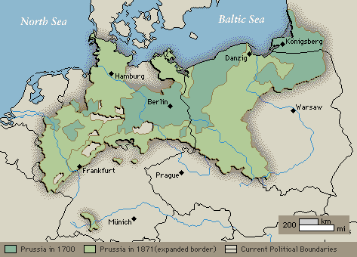

Slide 36
b. Franco-Prussian War
1870, a conflict arose over a dispute with France over the territory of Alsace and Lorraine
These provinces had been a part of the Holy Roman Empire, which included Prussia
This caused the Southern German states to support Prussia and the Northern states in a war against France

Slide 37
iii. 1871, Bismarck secured a Prussian victory against France in the Franco-Prussian War
iv. Peace treaty declared the unification of Germany

Slide 38
c. Creating the German Empire
Peace treaty of the Franco-Prussian war had far reaching consequences
Victory established a unified Germany
Wilhelm I was proclaimed the first Kaiser (emperor) of the German Empire
Bismarck was appointed first chancellor
Significantly changed the balance of power in Europe

Slide 39
4. The Empire’s Growth and Change
A new Government
Germany’s 25 states wanted to retain some power
Government took federalist form
Power was shared between the state and national governments
Wilhelm I led the government
According to law all men age 25 or older could vote
Government will place many restrictions on voters

Slide 40
b. The Government and the Church
Bismarck saw the Roman Catholic Church as a threat to his government
Believed government should control aspect of culture, i.e. education, not the church
Passed laws limiting the influence of the Catholic Church in Germany
This struggle was known as Kulturkampf

Slide 41
c. Economic Growth
Experienced a time of economic growth after unification
France had to pay reparations (money) for damages to Germany during the war
Used some of the money to build railroads t link the German states
Other helped build up businesses
Empire will catch up with other industrial countries of Europe

Slide 42
d. The Path to Social Reform
German socialist protested against harsh factory conditions and called for state control of all industries
Bismarck tried to destroy socialism
He combated socialism with his own reforms
Had reforms that provided benefits for health, accidents, old age and disability

Slide 43
e. Bismarck and Wilhelm
Bismarck did not want to expand Germany’s borders any further after unification
He did believed France was still a threat
Entered into a number of alliances to counteract the threat
1888, Wilhelm I’s grandson, Wilhelm II, became Kaiser
He will fire Bismarck after a disagreement

Slide 44
Unrest in Russia

Slide 45
1. Government and Society
Government
Russian monarchs ruled with absolute power
Czars believed in autocracy
Government by one ruler with unlimited power
Society
Society was mainly agricultural
Russia did not industrialize much

Slide 46
iii. Much of the country consisted of peasants
Serfs
Agricultural workers who were considered part of the land on which they worked
Were controlled by lords
Technically not slaves
Were not allowed to leave the property on which they were born and they did not own the land on which they worked
Had to make regular payments of both goods and labor to their lords

Slide 47
iv. Some government officials wanted to improve conditions for the serfs but were unable to do so

Slide 48
2. Reform and Repression
The Decembrist Revolt
Some revolutionaries formed secret societies to fight the czar’s rule
Saw an opportunity when czar Alexander I died in 1825
Decembrist rebelled against the government
Included some military officers
Led a group of 3000 soldiers and assembled in front of the Winter Palace
Refused to declare their allegiance to czar Nicholas I

Slide 49
iv. Nicholas responded by crushing the rebellion
Captured many of the Decembrist and sent them to Siberia
5 were executed

Slide 50
b. Reforms of Alexander II
Came to power in 1855 near the end of the Crimean War
Lost in that war showed how far behind Russia was compared to the rest of Europe

Slide 51
iii. Russia did not have modern technology and industry needed to build up a military that could compete with that of Europe’s powers

Slide 52
iv. Reforms
1861, Alexander II freed the Russian serf’s and gave them the right to own land as part of a commune
Believed that the terrible conditions serfs lived in would only cause rebellion
Hoped that by giving them land it would help to build a market economy in Russia
Set up a new judicial system
Allowed some local self-government
Reorganized the navy and army

Slide 53
v. Despite the reforms, revolutionary movements continued to strengthen
vi. 1881, a revolutionary group called the People’s Will assassinated czar Alexander II

Slide 54
c. Unrest Under Alexander III
Alexander III became czar after his father died
He was a reactionary and ended all the reforms his father had made
He went after individuals and groups suspected of plotting against his government

Slide 55
iv. Unrest was building in Russia
Mobs started attacking Jews, killing them and destroying their property
These attacks were known as pogroms
Came in several waves
First wave started shortly after Alexander II was assassinated
Some wrongly blamed the Jews for the assassination

Slide 56
d. Industrialization under Nicholas II
Crowned czar in 1894
He ruled like an autocrat
Early part of his reign, industry developed rapidly
During 1890s Russia built the Trans-Siberian Railroad
It would link western Russia with Siberia
Expansion would lead to conflict and war

Slide 57
3. War and Revolution
War with Japan
In the early 1900s Japan was building an empire in the East and saw Russia as a threat
Russo-Japanese War
Started in 1904
It ended with a Russian defeat
Shocked many Russians and added to calls for change

Slide 58
b. Marxist Ideas
Marxists
Russians who followed the communist theories of Karl Marx
Marxists ideas gained popularity in Russia in the late 1800s
Followers wanted to create a socialist republic
A society in which there would be no private property and the state would collectively own and distribute goods

Slide 59
iii. Vladimir Lenin
A Marxist
Published a work in 1902, that called for the overthrow of the czar

Slide 60
c. Revolution of 1905
January 22, 1905
An Orthodox priest named Father Gapon planned to bring a petition to the czar at the winter palace
Petition had a number of demands
Troops fired on Gapon and the protesters as they neared the Winter Palace
This became known as Bloody Sunday

Slide 61
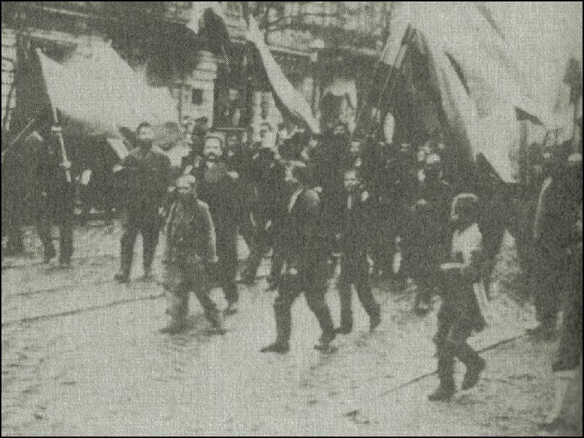

Slide 62
ii. Bloody Sunday inspired many sectors of society to rise up against the czar
Rebellions brook out in cities and the countryside
Workers strike
University students protest
Peasants revolted against their landlords

Slide 63
iii. At first the czar supported autocracy
iv. Then he promised reform but never followed through on his promises
v. October 1905, 2 million workers protested in the streets

Slide 64
d. The October Manifesto
Nicholas II issued the October Manifesto
It was an official promise for reform and a more democratic government
Promised a Russian Constitution
Guaranteed individual liberties to all Russians
Freedom of speech
Freedom of assembly

Slide 65
ii. Stated that voters would elect representatives to the Duma
iii. The czar would rule Russia but would not pass any laws without the approval of the Duma
iv. Nicholas II hoped the Manifesto would end the revolution
He didn’t want to give up the absolute power he had always known though

Slide 66
v. 1906, the first Duma meeting occurred
Nicholas II ended it when they made too many demands
vi. Nicholas did go on to make other reforms after 1905
However revolution would still come later

