Slide 1
Essential Question:
How did Napoleon come to power in France?
What were the important reforms & consequences of his reign?
Warm-Up Question:

Slide 2
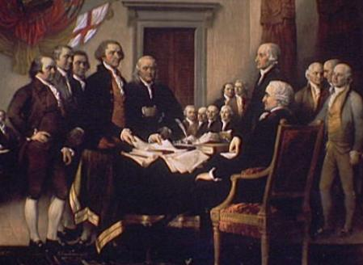
From 1789 to 1804, France experienced revolutionary changes that transformed France from an absolute monarchy to a republic to an empire
The success of the American Revolution & Enlightenment ideas such as individual liberty & consent of the governed led people to question rule by absolute monarchs

Slide 3
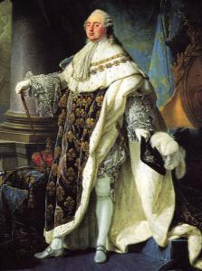
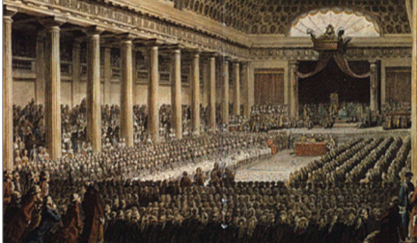
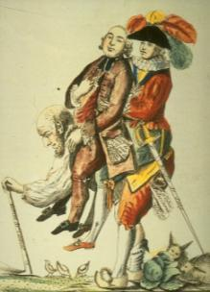
From 1789 to 1804, France experienced revolutionary changes that transformed France from an absolute monarchy to a republic to an empire
Peasants & bourgeoisie of the Third Estate believed Louis XVI’s tax system was unfair
At the Estates-General, Louis XVI raised taxes to solve the financial crisis & the Third Estate rebelled

Slide 4
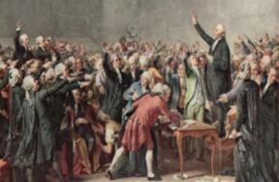
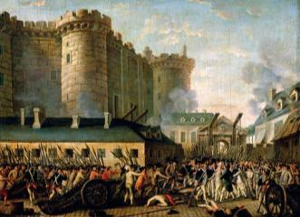
From 1789 to 1804, France experienced revolutionary changes that transformed France from an absolute monarchy to a republic to an empire
The Third Estate formed the National Assembly & demanded the king agree to a limited monarchy
Starvation, frustration, & fear led the peasants to storm the Bastille in 1789

Slide 5
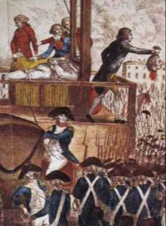
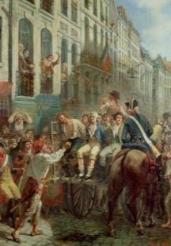
From 1789 to 1804, France experienced revolutionary changes that transformed France from an absolute monarchy to a republic to an empire
When the king refused to work with the parliament, the National Convention was formed & Louis XVI was executed
The leaders of the new republic turned radical & began a Reign of Terror

Slide 6
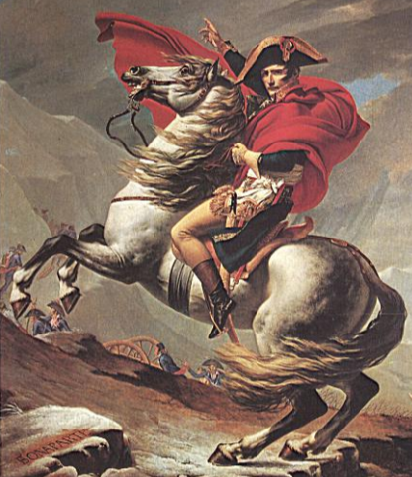
From 1789 to 1804, France experienced revolutionary changes that transformed France from an absolute monarchy to a republic to an empire
By the late 1790s, France was in chaos, the republic failed to solve problems, & foreign nations were at war with France
Who was Napoleon & what was his impact on Europe?
Napoleon Bonaparte seized power in 1799 & created a European empire

Slide 7
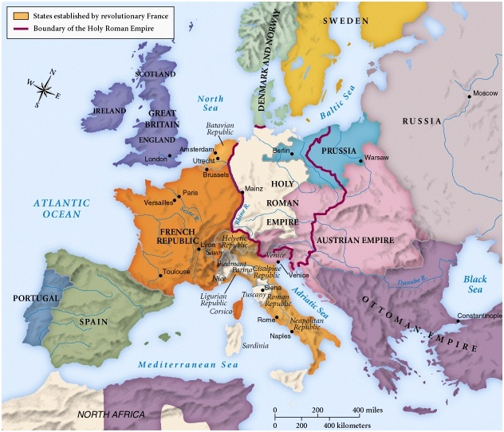
When Louis XVI was executed during the French Revolution, many European nations attacked France to keep revolutionary ideas from spreading

Slide 8
A military officer named Napoleon Bonaparte successfully defended France & became a military hero
But, the French republic lost the confidence of the citizens

Slide 9
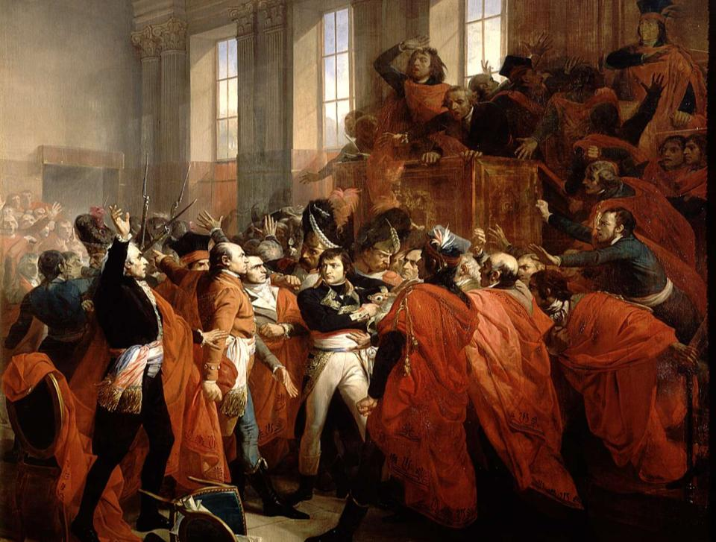
In 1799, Napoleon staged a coup d’etat (overthrow) of the French republic & assumed power as dictator
In 1800, the French people voted in favor of a new Constitution that made Napoleon consul of France

Slide 10
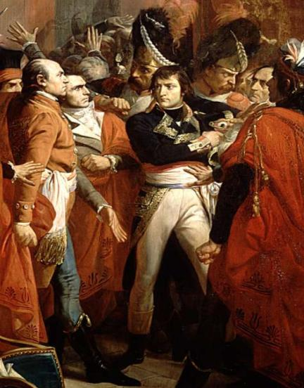
Quick Class Discussion: How to Fix France’s Problems?
Now that Napoleon is in control of France, what are his top priorities?
Brainstorm France’s three biggest problems by 1799
How can Napoleon solve these problems?
Which of these reforms should Napoleon introduce first? Why?

Slide 11
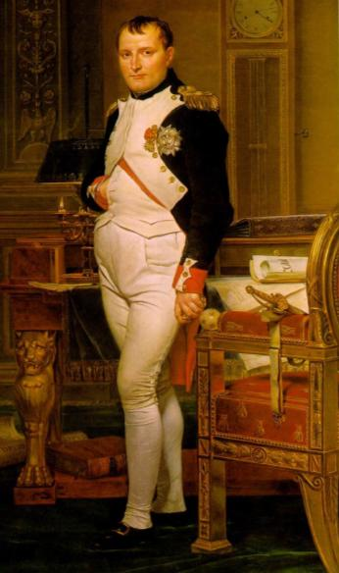
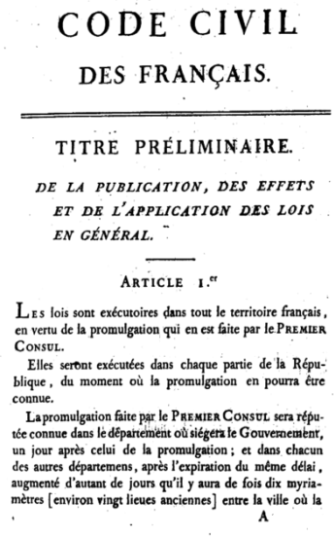
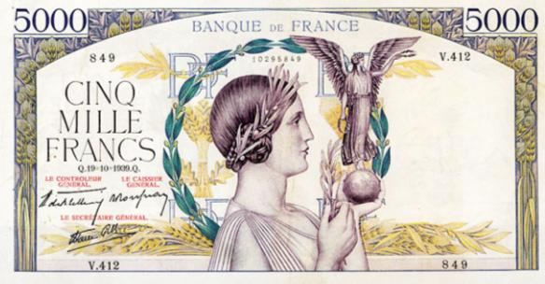
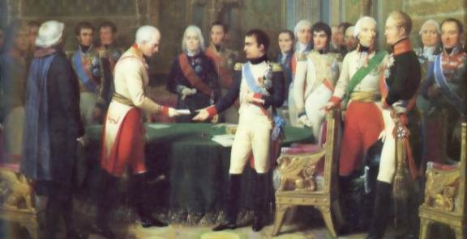
Napoleon made a series of reforms to improve the government, economy, & lives for French citizens
To fix the French economy, he introduced a fair tax system & a Bank of France to regulate the money supply
He created a merit based system for gov’t bureaucrats
He created public schools for students of all backgrounds
He issued a comprehensive set of laws called the Napoleonic Code that provided order, freedom of religion, & eliminated privileges by estates

Slide 12
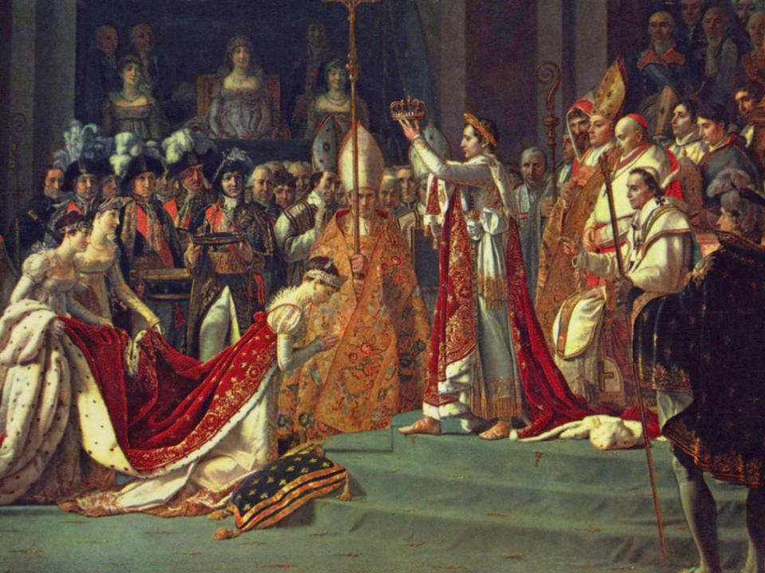
In 1804, Napoleon ordered an election & the French people voted Napoleon emperor for life

Slide 13
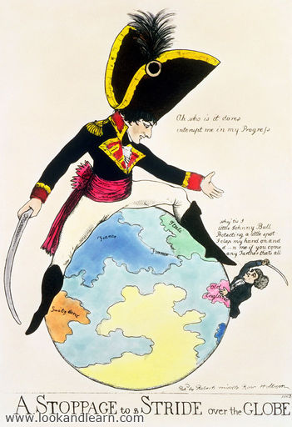
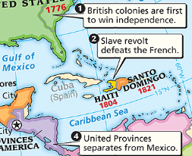
Napoleon wanted control of a global empire in North America & Europe
But, the revolution in Haiti convinced Napoleon to abandon North America

Slide 14
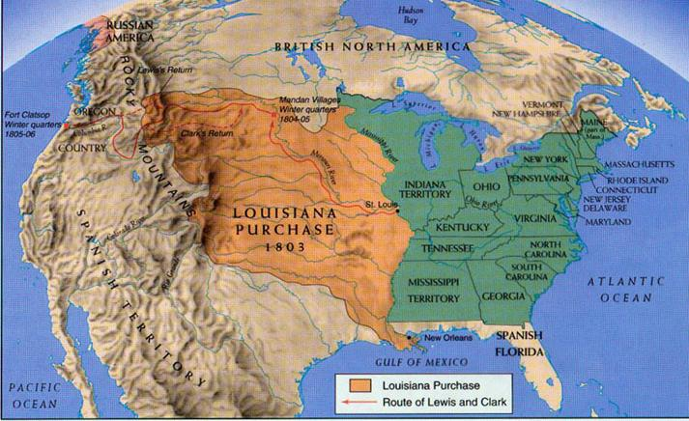
In 1803, Napoleon sold territory in Louisiana to the United States for $15 million; The Louisiana Purchase doubled the size of the USA

Slide 15
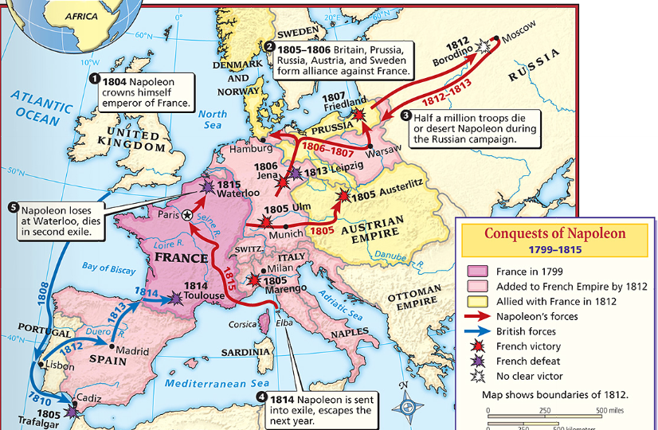
From 1807 to 1812, Napoleon ruled over the largest European empire since the Romans
During the Napoleonic Wars, Napoleon showed his military genius by defeating Austria & Prussia and conquering Spain, Italy, & central Europe

Slide 16
During his rule over Europe, Napoleon made a number of devastating decisions
The one nation Napoleon could not defeat was England
He ordered a blockade, called the Continental System, to cut off all trade with England
The Continental System was a failure & hurt the French economy more than England’s economy

Slide 17
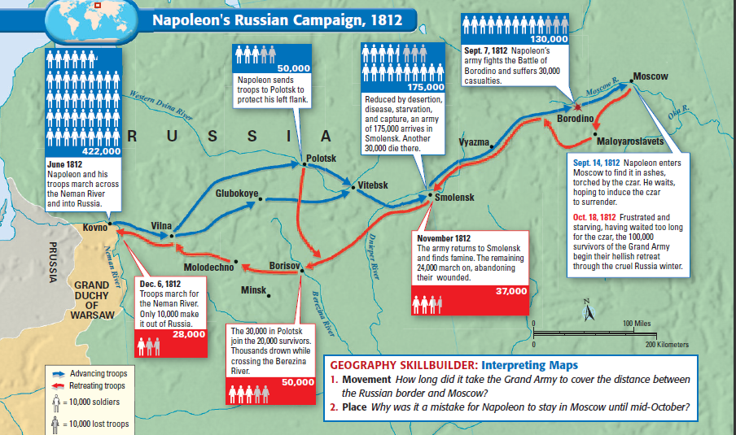
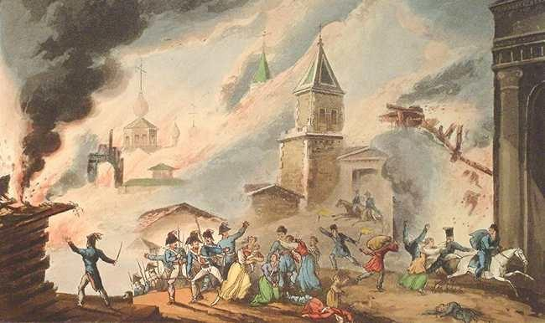
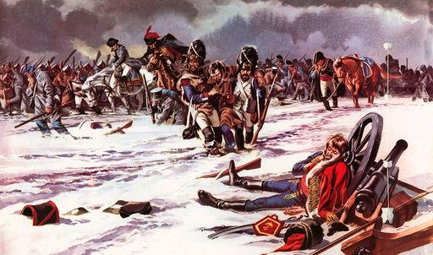
Napoleon’s insistence that nations obey French laws led to a rise in nationalism & uprisings against France
In 1812, Napoleon made his greatest mistake & invaded Russia
The harsh winter & Russia’s scorched-earth policy devastated the French army & forced Napoleon to retreat

Slide 18
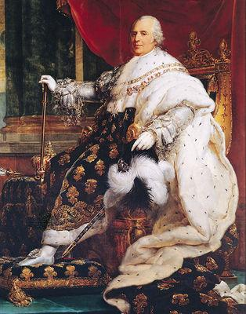
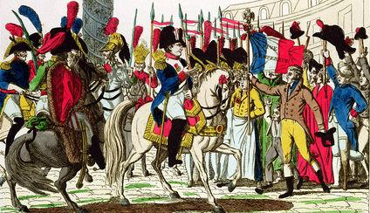
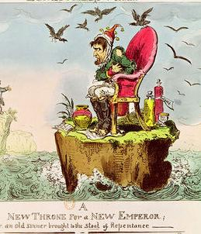
In 1814, the weakened French army was defeated; Napoleon surrendered, was forced to give up his throne, & was exiled to the island of Elba
The French monarchy was restored, but new King Louis XVIII was unpopular; In 1815, Napoleon escaped & triumphantly regained the throne

Slide 19
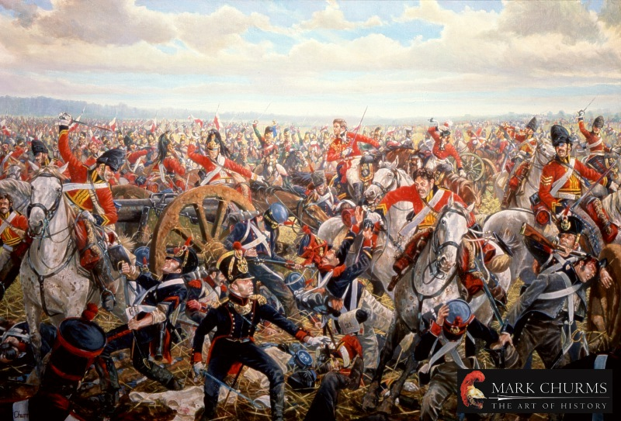
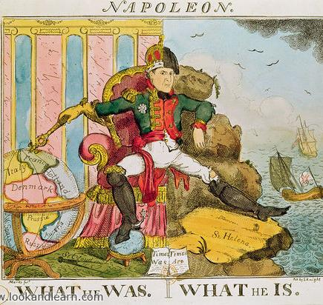
Only 100 days after Napoleon’s return, he built a new army but was defeated by a European coalition at the Battle of Waterloo in 1815
After his defeat, Napoleon was exiled to the remote island of St. Helena in the South Atlantic where he died after 6 years

Slide 20
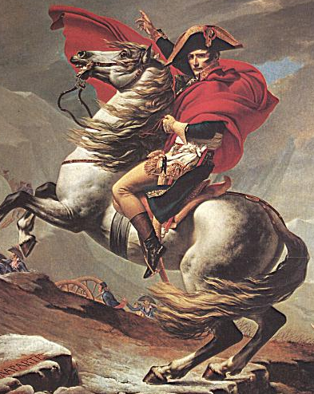
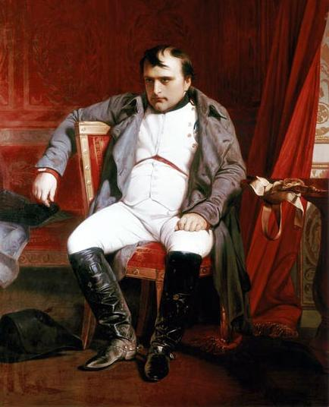
What was Napoleon’s impact?
He created reforms that ended the financial crisis & unequal class system and made public schools & a law code
His rise as emperor ended the Enlightened ideas of democracy that led to the French Revolution
The fall of empire led to a conflict between rule by strong monarchs & democratic governments
His massive empire brought glory to the French people

Slide 21
Who was the read Napoleon Bonaparte?
Was Napoleon:
A great French hero who saved France from destruction & started effective new programs ...OR…
A power-hungry dictator who used France’s problems as opportunity to take over & eliminate the personal freedoms created during the French Revolution?
Create a poster that takes a stand:
Your poster should have a visual & a list of achievements or complaints

Slide 22
Essential Question:
What was the impact of the decisions made at the Congress of Vienna?
Warm-Up Question:
?

Slide 23
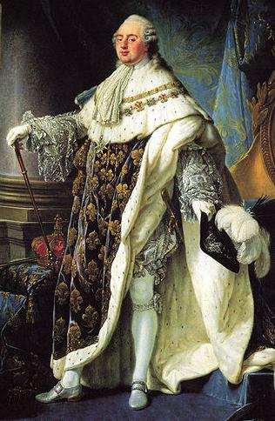
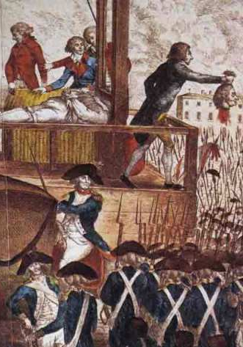
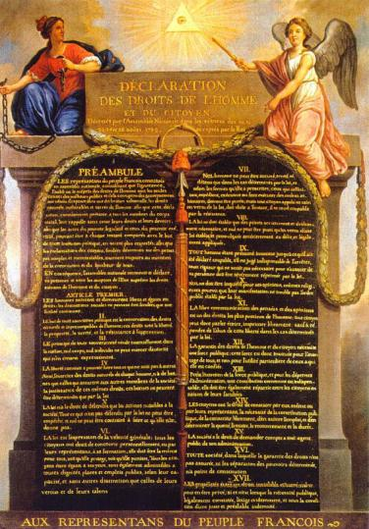
The era after the fall of Napoleon was a conflict among conservative, liberal, & radical forces
Conservatives were usually wealthy land owners & nobles; They typically supported traditional monarchies
Liberals were usually from the middle class; They supported Enlightenment ideas like limited monarchies & voting rights for educated landowners
Radicals were usually from the lower classes; They supported extending democracy to all citizens

Slide 24
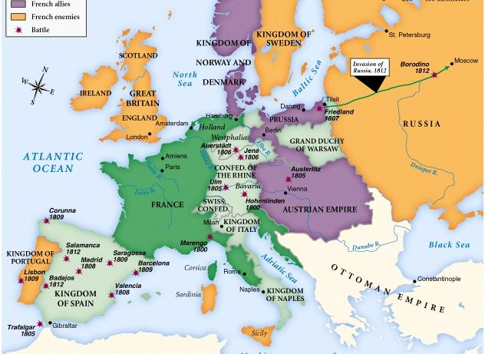
Europe in 1812 (at the height of Napoleon)
…and Norway & Denmark
…and Prussia
In 1812, Napoleon was the emperor of France
…and Warsaw
…and Spain
…and the Rhine
…and Switzerland
…and had defeated Austria
…and he had conquered Italy

Slide 25
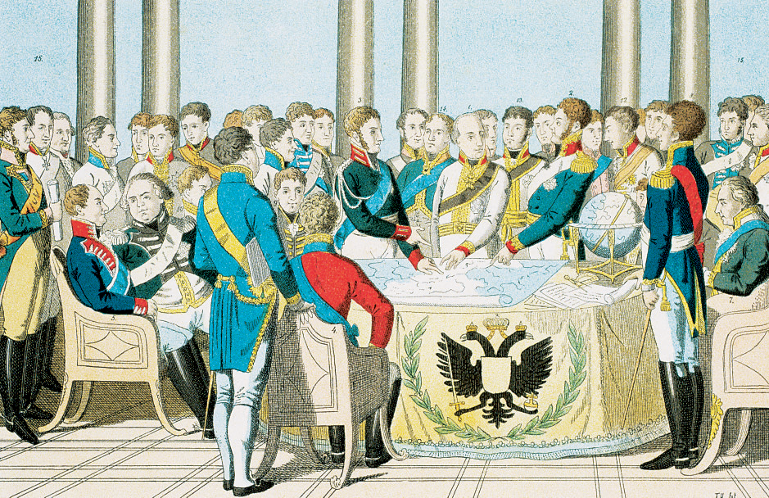
When Napoleon was defeated in 1815, European leaders met at the Congress of Vienna to restore peace & bring stability back to Europe
Class Activity:
Divide into conservative, liberal, radical groups and read the background information provided
As a team, discuss solutions to each of the situations presented & be prepared to discuss

Slide 26
Congress of Vienna was attended by conservatives from Austria, Prussia, Russia, Britain, France and was led by Austrian minister Klemons von Metternich
Metternich & other delegates disliked democracy, feared the ideas of the French Revolution, & wanted to restore Europe to the way it was before Napoleon

Slide 27
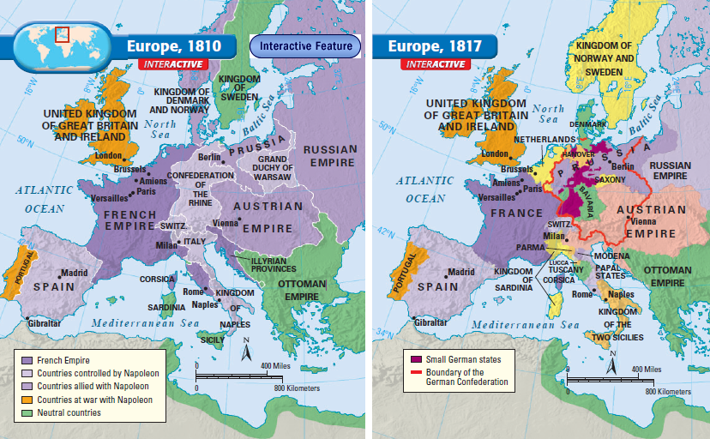
One goal was to prevent future French aggression
This was accomplished taking from France all lands it gained under Napoleon & making the nations around France stronger
The Kingdom of the Netherlands was created
39 states joined to form the German Confederation
Switzerland became a nation
A “buffer zone” was created between France & the major European powers
Sardinia merged with Genoa

Slide 28
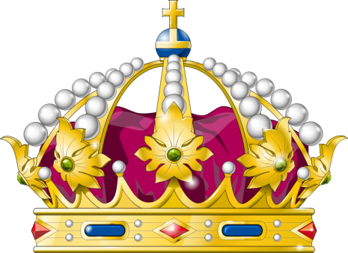
One goal was to restore monarchs to power in Europe
This was done by restoring kings in France, Portugal, Spain, & many Italian & German states

Slide 29
One goal was to maintain a balance of power in Europe
This was done by forming the Concert of Europe, an alliance among Russia, Austria, Prussia, & Britain to maintain peace & stop future revolutions
The decisions made at the Congress of Vienna helped maintain peace in Europe for almost 40 years

Slide 30
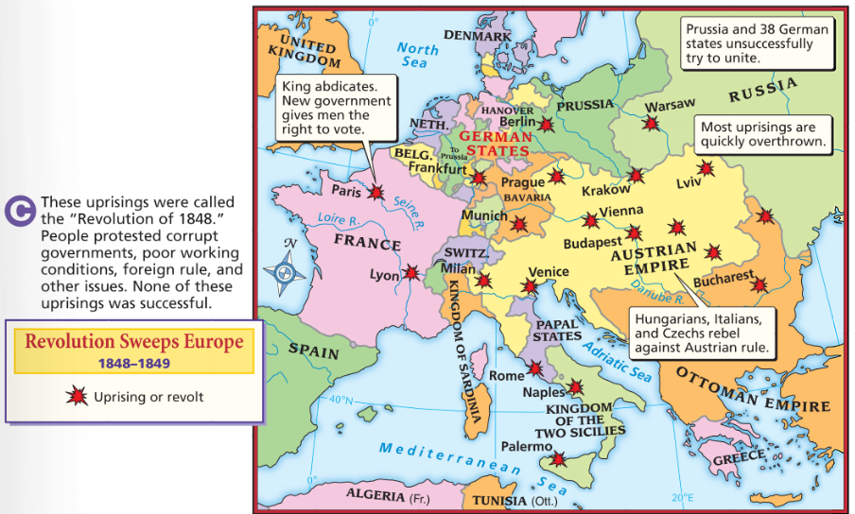
But the decisions of the Congress of Vienna did not make liberals or radicals happy
The restoration of kings led to an increase in demand for democracy in Europe
In 1848, a surge of nationalism swept through Europe which sparked revolutions for democracy & the formation of new nations

