Slide 1
Essential Question:
Who was Muhammad & how did Islam unite the Arab people?
Warm-Up Question:
Read the “Big Picture” section of the Unit 3 Organizer & create a list of questions that you have about the things we will cover this unit

Slide 2
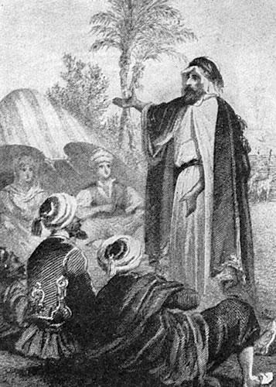
Overview of Islam
Around 600 AD, a new monotheistic religion began called Islam:
The faith was founded by the prophet Muhammad
His followers, called Muslims, spread Islam throughout the Middle East, Africa, Asia, & Europe

Slide 3
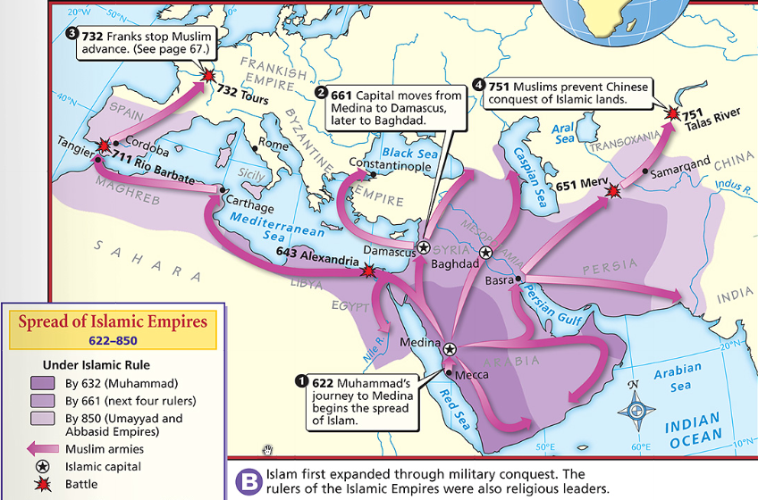
By 750 AD, Muslim leaders built an empire
The Islamic Empire connected diverse people through religion & trade
Muslim scholars focused on learning & developed numerous cultural achievements that are still used today

Slide 4
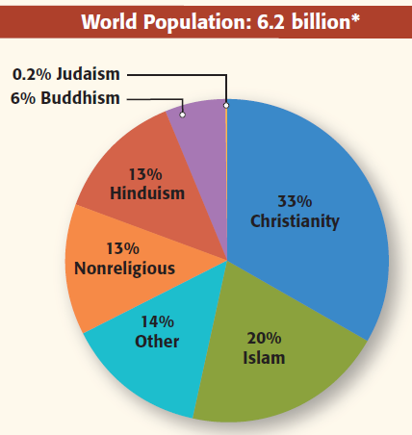
Overview of Islam
Today, Islam is the world’s fastest growing religion with more than 1 billion followers throughout the world

Slide 5
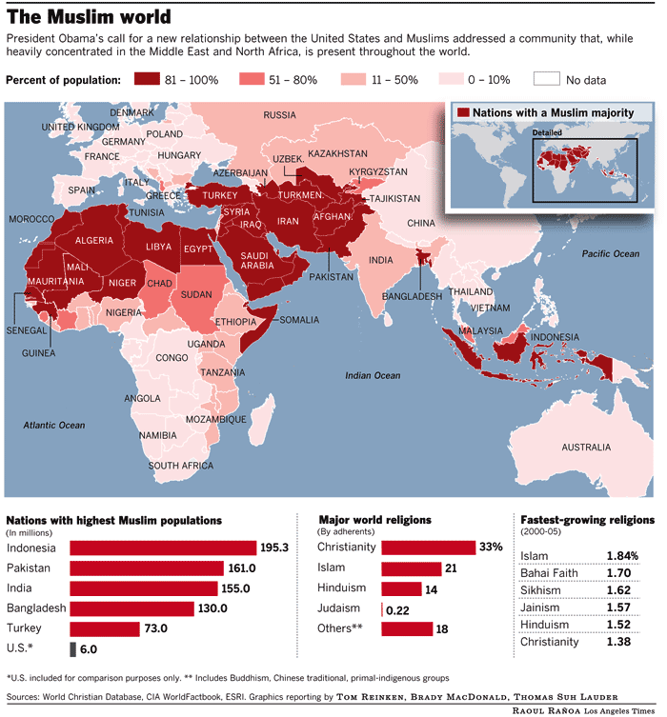

Slide 6
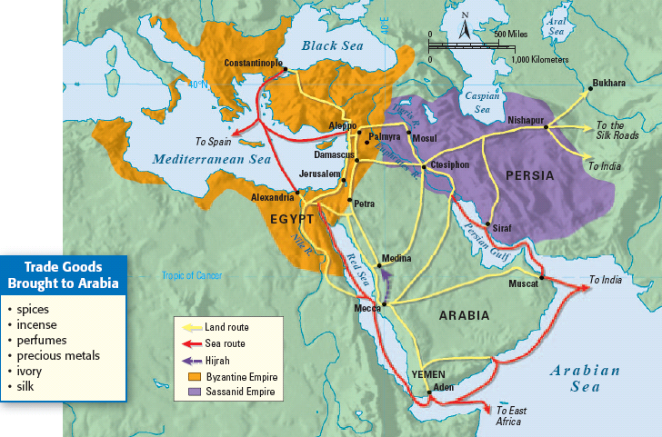
What was Arabia like before Muhammad?

Slide 7
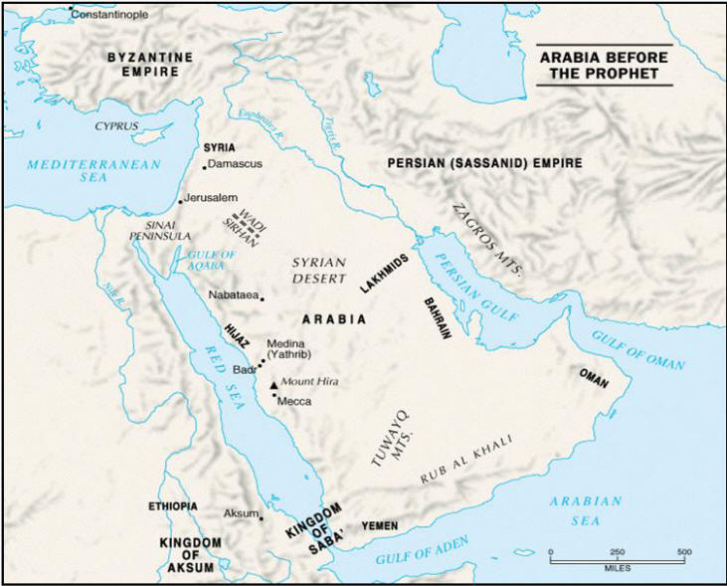
Arabia, the Birthplace of Islam
The Arabian Peninsula is a desert region with little fertile soil or farming
Most Arabs lived in desert tribes which were centered around families & were ruled by clans
Arabia was not united under a single gov’t, but Arabs did have a common language (Arabic)
Most Arabs were polytheistic

Slide 8
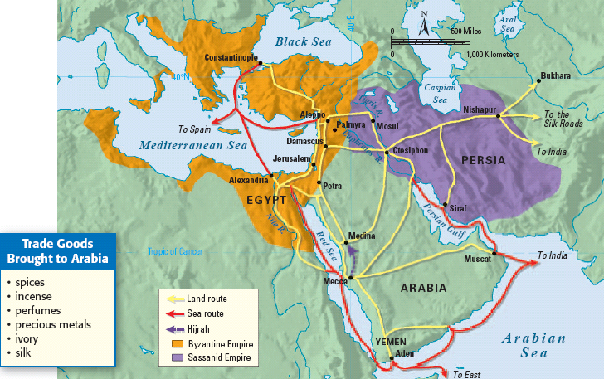
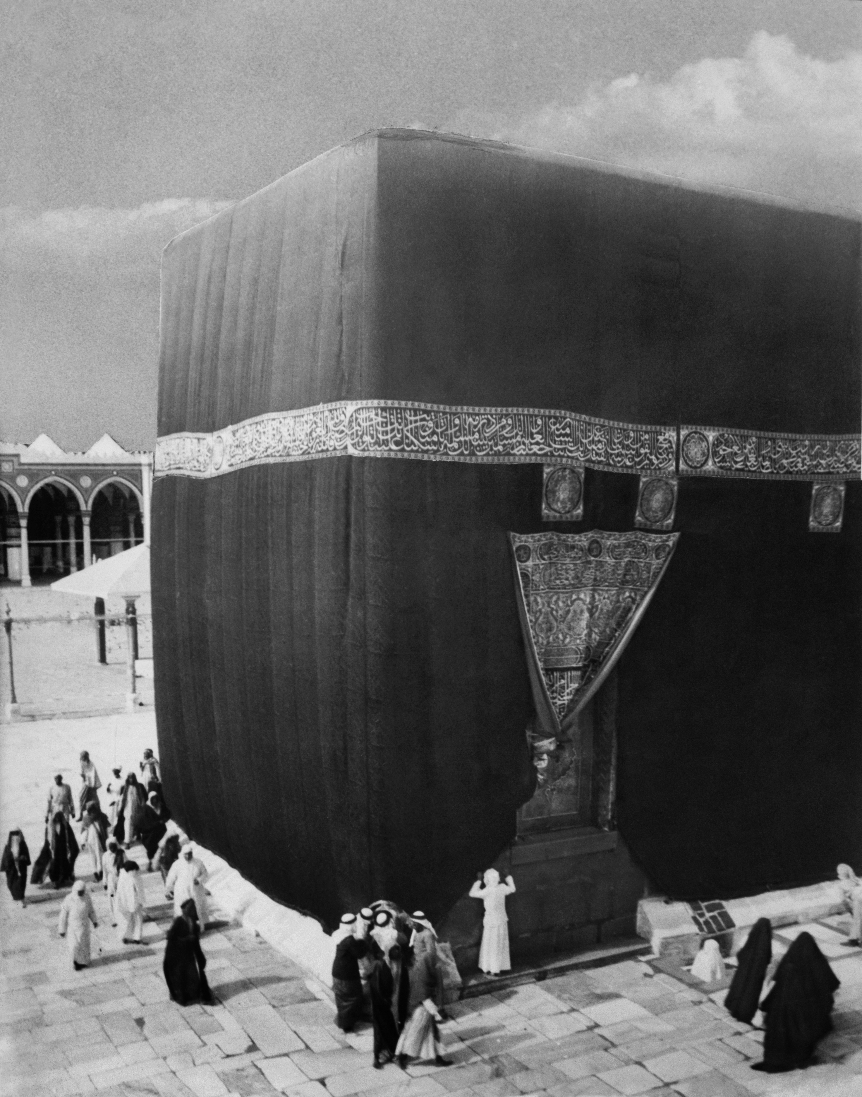
Arabia, the Birthplace of Islam
But, Arabia was the intersection of 3 continents (Africa, Asia, & Europe) so it was an important region for trade & had lots of cultural diffusion
One of the wealthiest trade cities in Arabia was Mecca
Mecca was also a religious city; The Ka’aba was a cube that held statues of hundreds of gods
Arabs made pilgrimages to Mecca to visit the Ka’aba

Slide 9
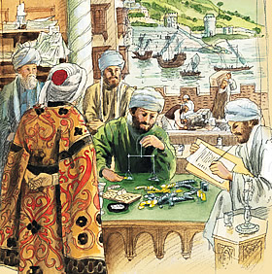
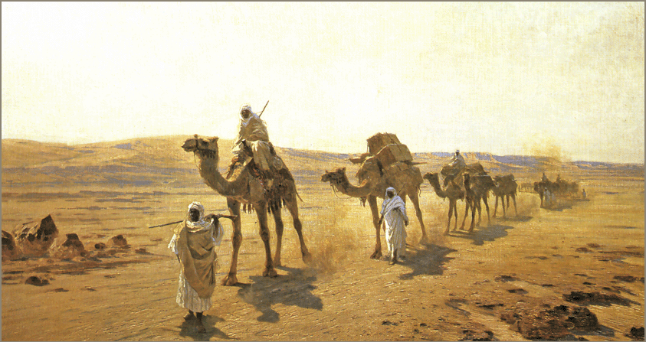
Who was Muhammad?

Slide 10
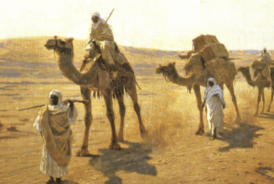
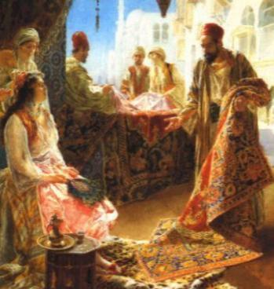
The Early Life of Muhammad
Muhammad’s early life:
He was born in Mecca in 570 into a poor clan, was orphaned at a young age, & was raised by his grandparents
As an adult, Muhammad became an honest & successful merchant
He married a wealthy widow & started a family

Slide 11
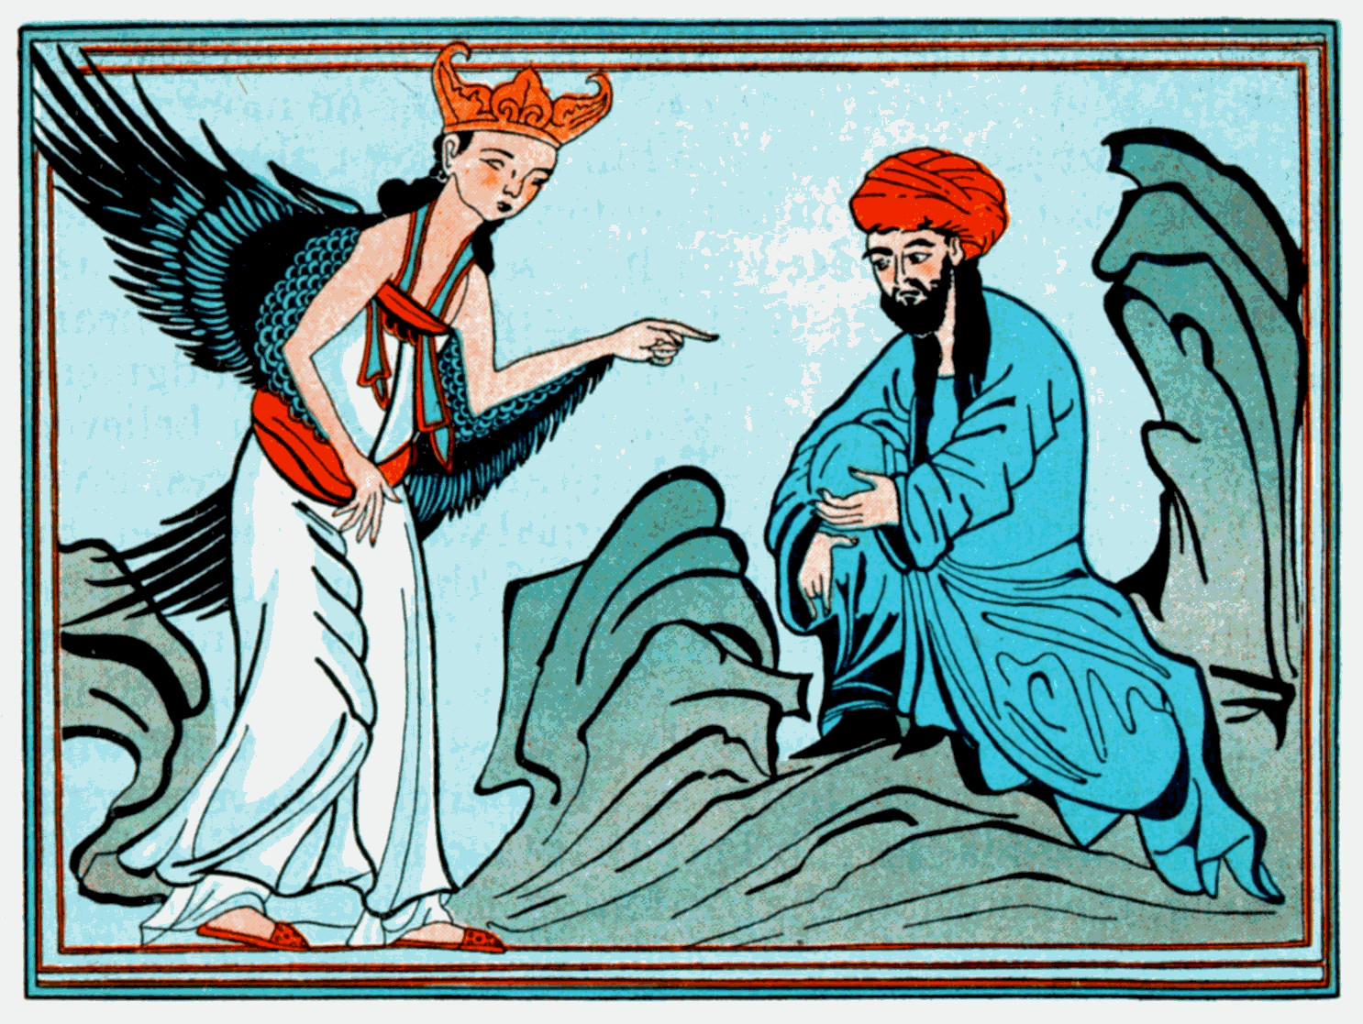
What happened to Muhammad in 610?

Slide 12
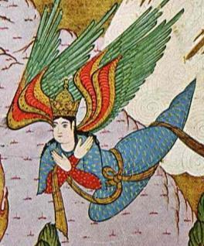
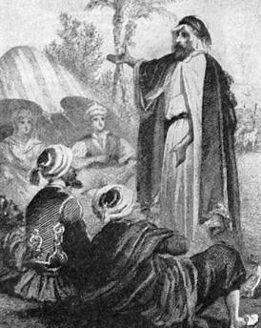
Mohammad & Islam
Muhammad created Islam:
Muhammad’s work brought him into contact with Jewish & Christian merchants
In 610, Muhammad was told by the angel Gabriel that he was a prophet sent to Earth by God
He began preaching a new monotheistic faith called Islam (“surrender to God”)
Notes:
After much soul-searching, Muhammad came to believe that the Lord who spoke to him through Gabriel was Allah. Muhammad became convinced that he was the last of the prophets. He began to teach that Allah was the one and only God and that all other gods must be abandoned. People who agreed to this basic principle of Islam were called Muslims. In Arabic, Islam (ihs•LAHM) means “submission to the will of Allah.” Muslim (MOOZ•lim) means “one who has submitted.” Muhammad’s wife, Khadijah, and several close friends and relatives were his first followers.

Slide 13
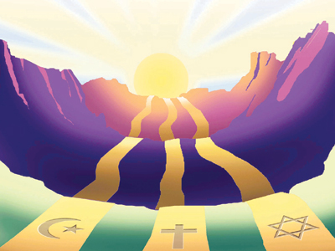
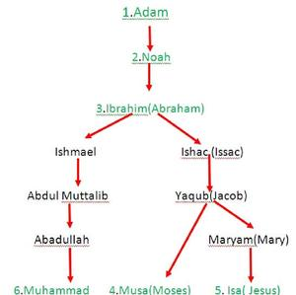
What is the basic concept of Islam?

Slide 14
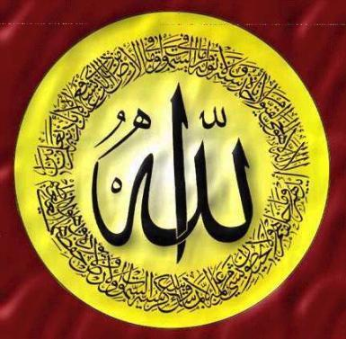
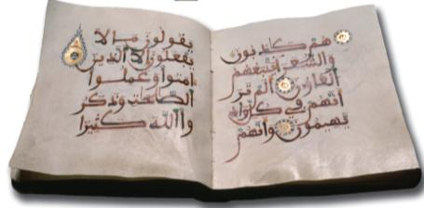
Islam
Basic beliefs of Islam:
Followers of Islam are called Muslims who believe in one God, called Allah
Allah is the same God worshiped by Jews & Christians
Muslims believe Muhammad was the last of God’s prophets
The teachings of Mohammed were written down in the Qur'an (Koran), the holy book of Islam

Slide 15
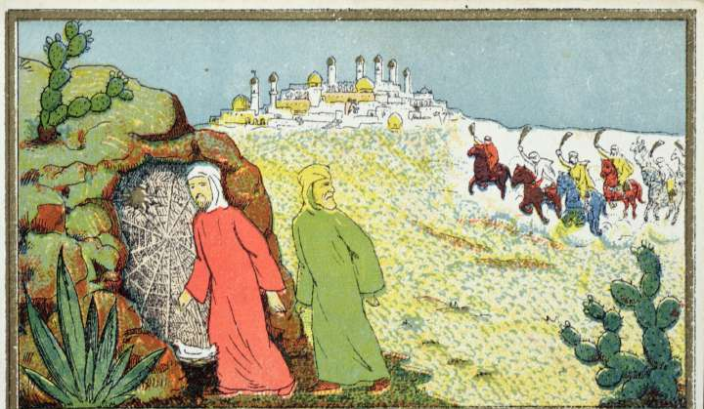
How did some people respond to Muhammad’s new religion?

Slide 16
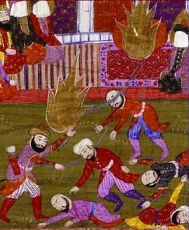
The Hijrah
Reactions to Islam:
By 613, Muhammad began preaching his new ideas in Mecca
Some people were attracted to Islam
But, many people feared Muhammad’s growing popularity & that Mecca would lose its status as a holy city

Slide 17
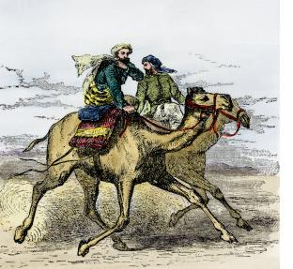
How did Muhammad react to violence by non-Muslims in Mecca?

Slide 18
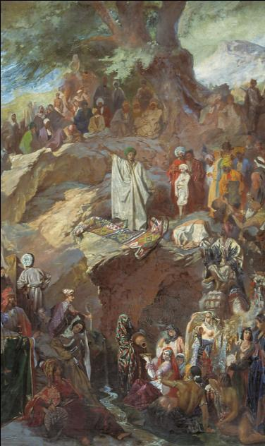
Islam Grows in Medina
After years of attacks, Muhammad & his followers fled to Medina
This migration was known as the Hijrah
In Medina, Muhammad gained new converts who put Islam above their families & clans
He taught respect for Christians & Jews (“People of the Book”)

Slide 19
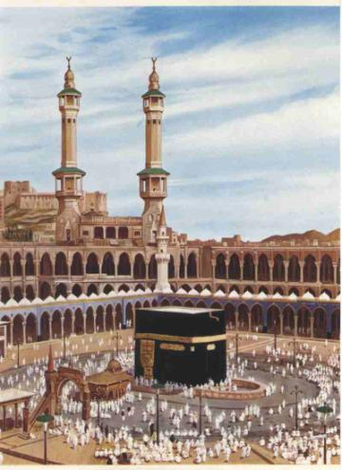
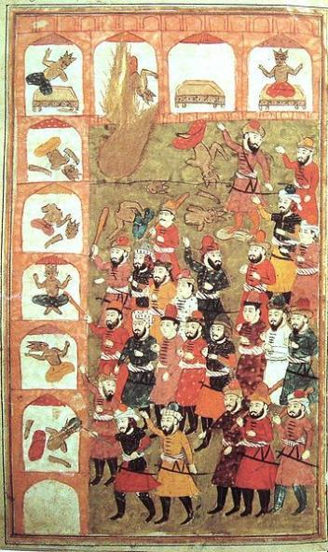
What did Muhammad do after he gained converts & returned to Mecca?

Slide 20
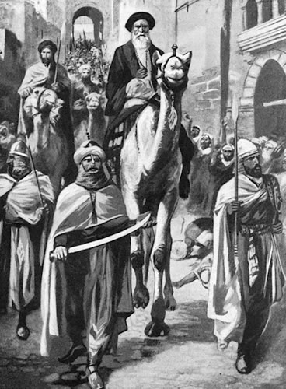
Islam
In 630, Muhammad returned to Mecca with 10,000 troops & conquered the city
He destroyed the god statues in the Ka’aba, leaving only the statue for Allah
This time, the people in Mecca converted to Islam
In 632, Muhammad died

Slide 21
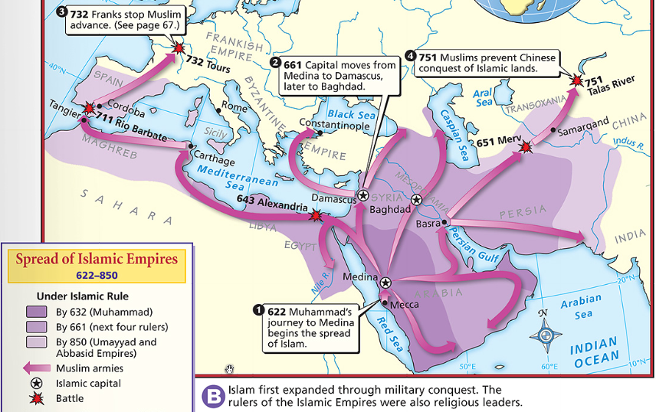
What happened to Islam after Muhammad’s death?

Slide 22
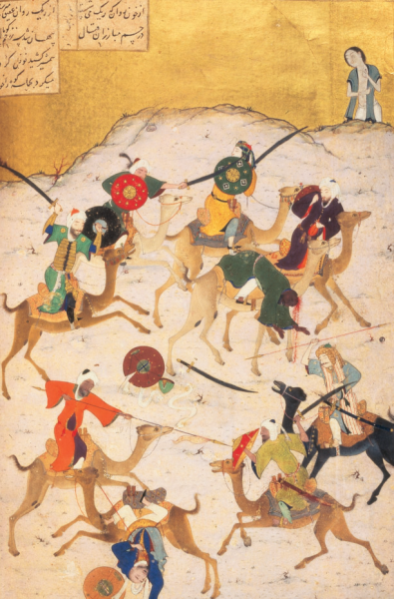
The Islamic Empire
After Muhammad, Islamic leaders created an empire:
The Islamic Empire had well-trained troops that conquered nearby regions
The massive empire led to great wealth for Muslims & new opportunities to spread Islam

Slide 23
Closure Activity
Compare the roles of Moses, Jesus, & Muhammad in the development of the 3 major monotheistic religions
Match the terms from the word bank with the appropriate prophet
Moses
Jesus
Muhammad

