Slide 1
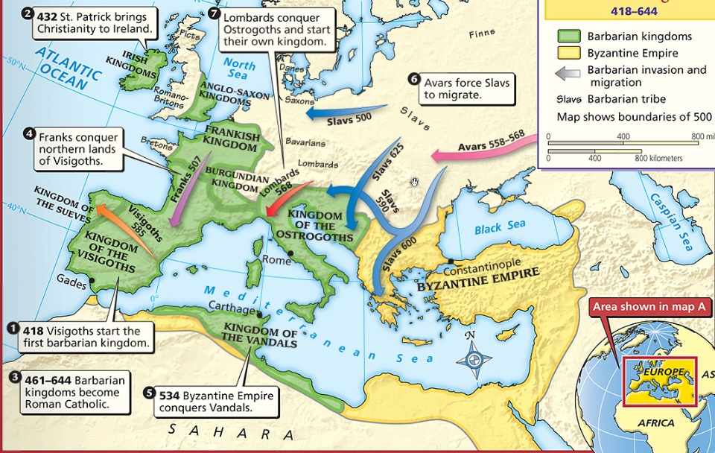
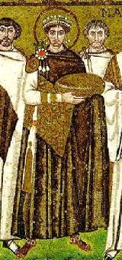
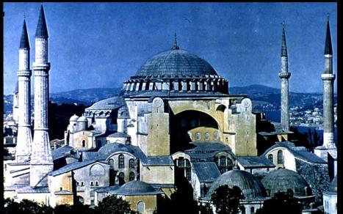
Warm Up: What happened to Europe after the fall of the Roman Empire?
In the East, the Byzantine Empire became a center for trade & Greco-Roman culture

Slide 2
The Middle Ages
In the West, Europe grew weak & fell into the Middle Ages from 500 to 1300
Also known as the “Dark Ages” or “Medieval” era

Slide 3
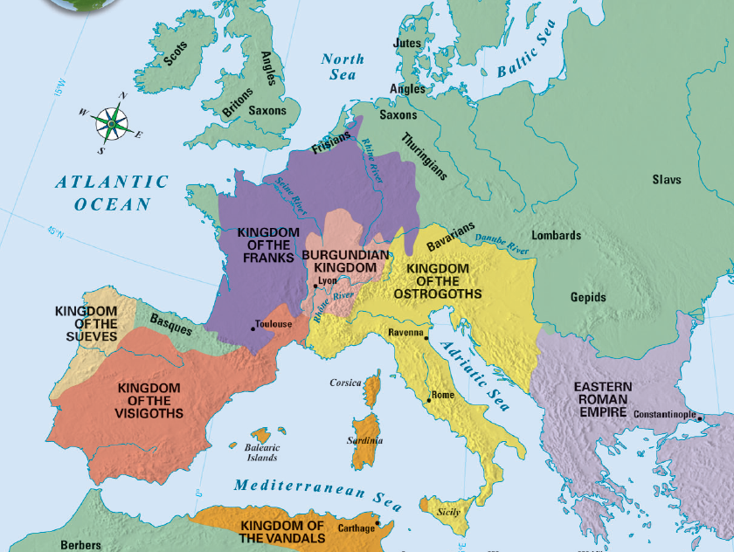
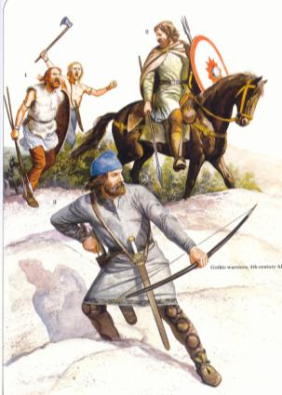
Europe After the Fall of Rome
When barbarian kingdoms conquered Rome, Europe was plagued by constant warfare
Warfare disrupted trade, destroyed Europe’s cities, & forced people to rural areas
Learning declined; Few people could read or write
Greco-Roman culture was forgotten
Europe lost a common language; Latin mixed with local languages to form Spanish, French, Italian
Notes:
• Disruption of Trade Merchants faced invasions from both land and sea. Their businesses collapsed. The breakdown of trade destroyed Europe’s
cities as economic centers. Money became scarce.
• Downfall of Cities With the fall of the Roman Empire, cities were
abandoned as centers of administration.
• Population Shifts As Roman centers of trade and government collapsed, nobles retreated to the rural areas. Roman cities were left without strong leadership. Other city dwellers also fled to the countryside, where they grew their own food. The population of western Europe became mostly rural.
The Decline of Learning The Germanic invaders who stormed Rome could not read or write. Among Romans themselves, the level of learning sank sharply as more and more families left for rural areas. Few people except priests and other church officials were literate. Knowledge of Greek, long important in Roman culture, was almost lost. Few people could read Greek works of literature, science, and philosophy. The Germanic tribes, though, had a rich oral tradition of
songs and legends. But they had no written language.
Loss of a Common Language As German-speaking peoples mixed with the Roman population, Latin changed. While it was still an official language, it was no longer understood. Different dialects developed as new words and phrases became part of everyday speech. By the 800s, French, Spanish, and other Roman-based languages had evolved from Latin. The development of various languages mirrored the continued breakup of a once-unified empire.

Slide 4
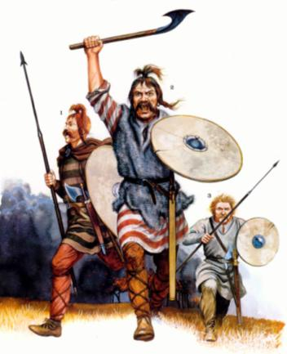
Germanic Tribes in the Middle Ages
Without the unity of the Roman Empire, Europe became divided into a series of Germanic kingdoms
Germanic people lived in small communities led by chiefs & his loyal warriors
Family ties & loyalty were more important than citizenship
Notes:
The Concept of Government Changes Along with shifting boundaries, the entire concept of government changed. Loyalty to public government and written law had unified Roman society. Family ties and personal loyalty, rather than citizenship in a public state, held Germanic society together. Unlike Romans, Germanic peoples lived in small communities that were governed by unwritten rules and traditions. Every Germanic chief led a band of warriors who had pledged their loyalty to him. In peacetime, these followers lived in their lord’s hall. He gave them food, weapons, and treasure. In battle, warriors fought to the death at their lord’s side. They considered it a disgrace to outlive him. But Germanic warriors felt no obligation to obey a king they did not even know. Nor would they obey an official sent to collect taxes or administer justice in the name of an emperor they had never met. The Germanic stress on personal ties made it impossible to establish orderly government for large territories.

Slide 5
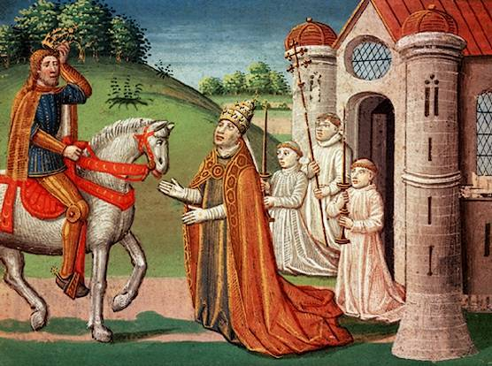
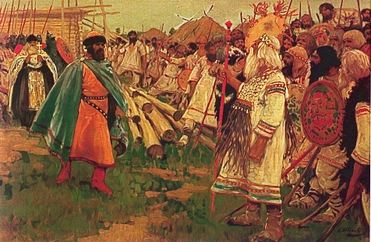
The Spread of Christianity
During the early Middle Ages, the Germanic kingdoms were slowly converted to Christianity
The Catholic Pope became involved in secular (non-religious) issues like road repair, aiding the poor, & helping Christian kings expand their power

Slide 6
The Spread of Christianity
The Franks were the largest & most powerful of the Germanic kingdoms in the early Middle Ages
Frankish kings allied with the Catholic Church & expanded their power
In 771, Charlemagne (“Charles the Great”) became king of the Franks

Slide 7
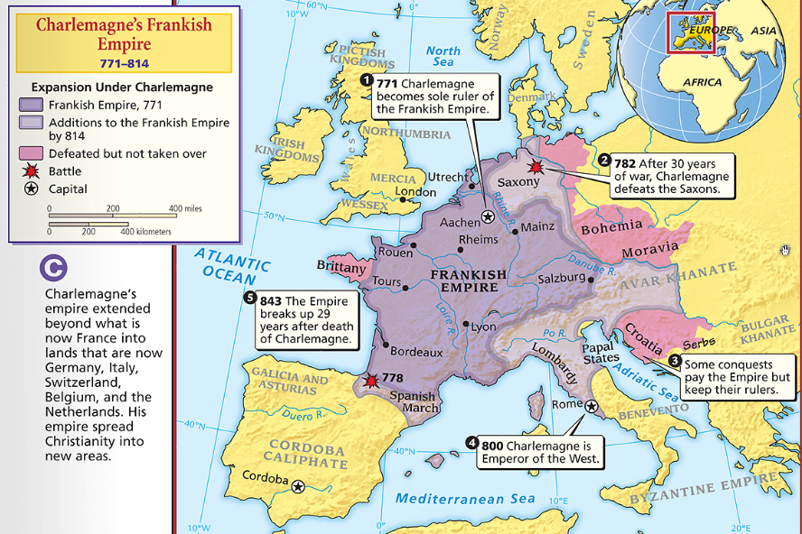
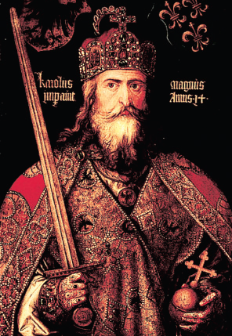
Charlemagne & the Frankish Empire
Charlemagne was the greatest Medieval king because he did something no other king was able to do…create an organized empire – The Holy Roman Empire (First Reich)
He spread Christianity – Missi Dominici
He created schools to train future priests
Charlemagne expanded the Frankish empire
He valued learning & built schools in his empire

Slide 8
Charlemagne & The Holy Roman Empire
After Charlemagne’s death in 814, his Frankish Empire was divided & lost power…
…This was the last opportunity to provide unity in medieval Europe

Slide 9
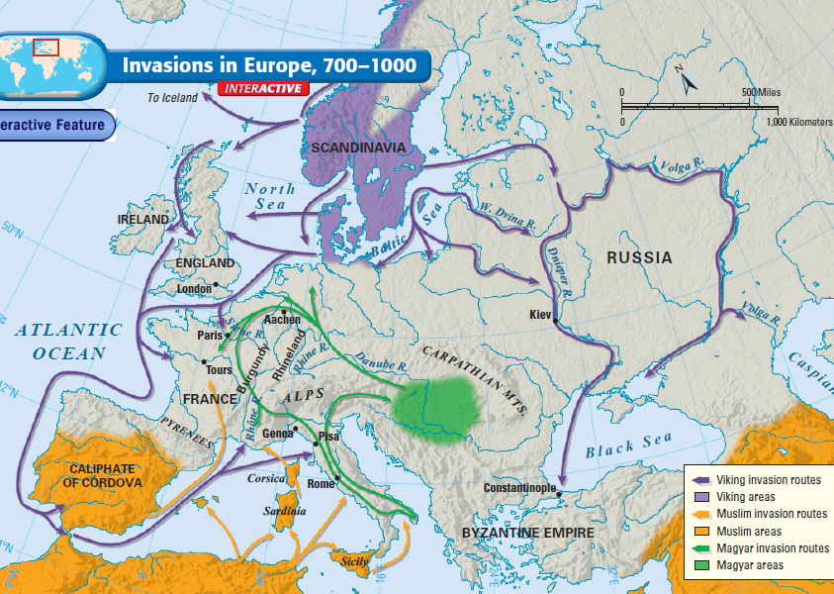
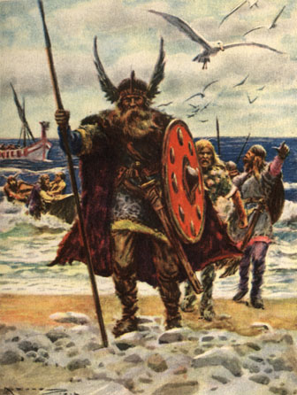
From 800 to 1000, a 2nd major wave of invasions struck Europe led by Vikings, Muslims &Magyars
Text
These invasions caused widespread fear & suffering
Kings could not defend against invasion
People stopped looking to kings for protection
Notes:
The invasions by Vikings, Magyars, and Muslims caused widespread disorder and suffering. Most western Europeans lived in constant danger. Kings could not effectively defend their lands from invasion. As a result, people no longer looked to a central ruler for security. Instead, many turned to local rulers who had their own armies. Any leader who could fight the invaders gained followers and political strength.

Slide 10
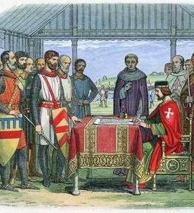
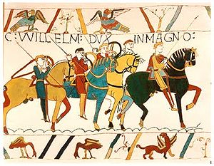
Feudalism
Feudalism began in Europe as a way to offer protection
Feudalism is based on land & loyalty
Land-owning lords offer land (called a fief) to knights in exchange for their loyalty & promise to protect the lord’s land
Feudalism came to England with Norman Invasion in 1066
Bayeaux Tapestry

Slide 11
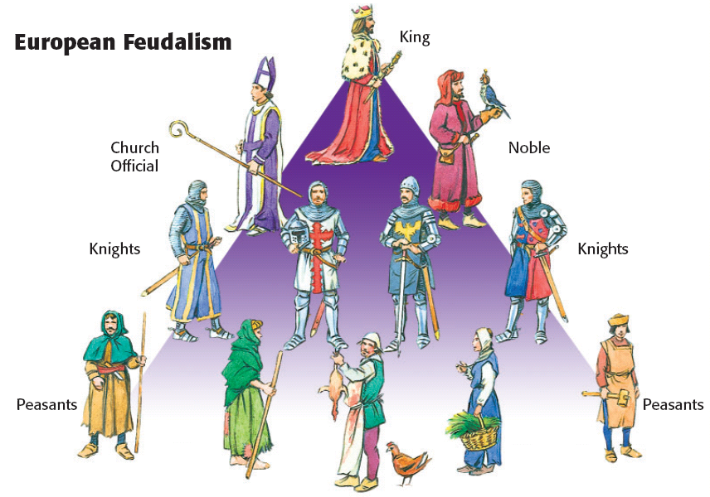
Feudal Structure
Knights were specially trained soldiers who protected the lords & peasants – vassals took an oath of fealty (loyalty)
Some peasants were serfs & could not leave the lord’s estate
Kings had land but very little power
Lords (also called Nobles) were the upper-class landowners; they had inherited titles (“Duke,” “Earl,” “Sir”)

Slide 12
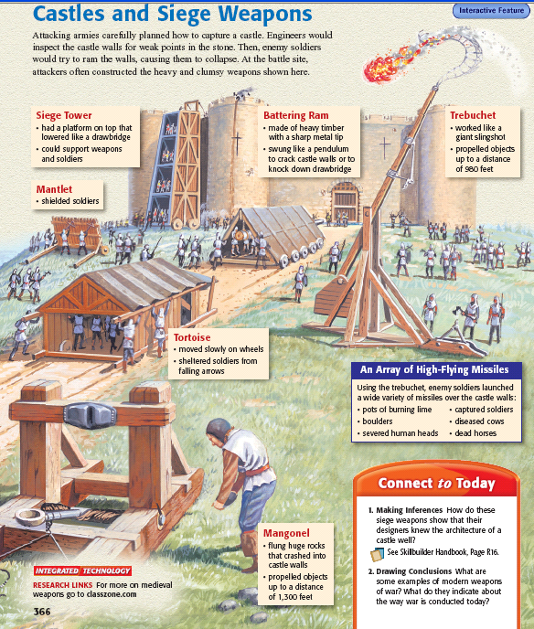
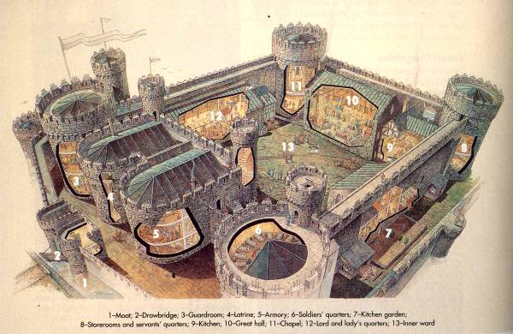
Lords built castles to protect their territory from outside invasions

Slide 13
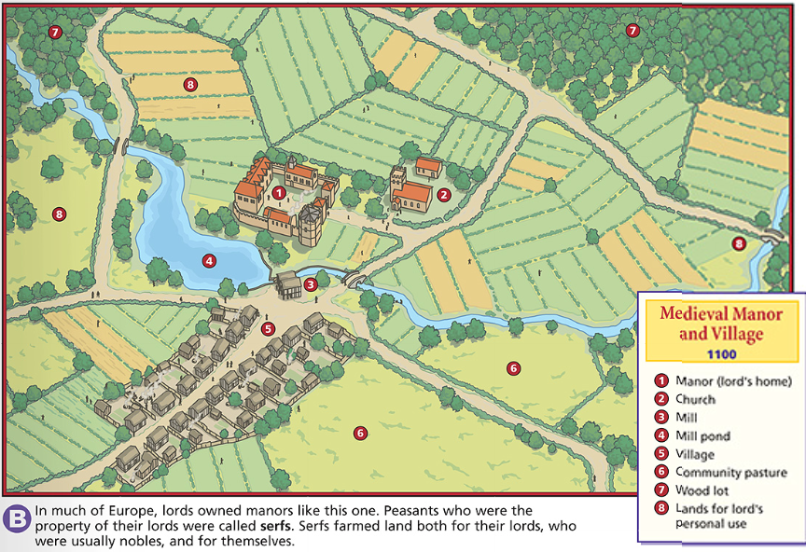
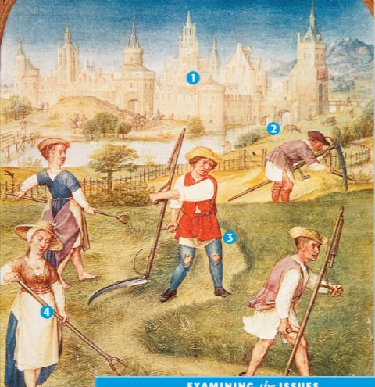
The Manorial System
During the Middle Ages, the manorial system was the way in which people survived
The lord’s land was called a manor
The lord provided peasants with housing, farmland, & protection
In exchange, peasants repaid the lord by working his land & providing a portion of the food they produced

Slide 14
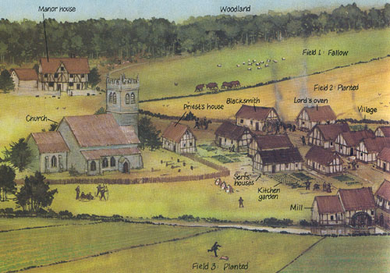
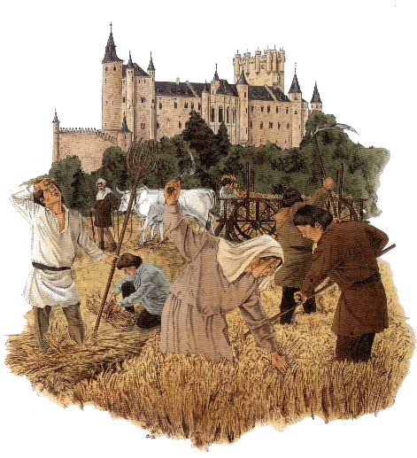
Peasant life was hard: They paid taxes to use the lord’s mill, had to get permission to get married, & life expectancy was about 35 years old
Manors were self-sufficient communities; Everything that was needed was produced on the manor

Slide 15
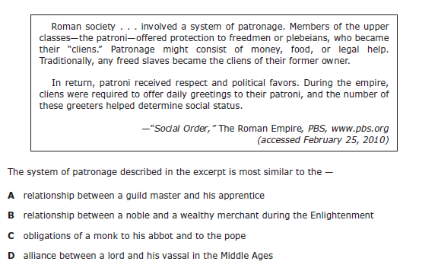

Slide 16
Homework: You must write a 1-2 page type-written, first-person account of daily life for a person living in the Middle Ages. You should make up a name, develop a voice, and describe your life as a king, noble, knight, or peasant. Feel free to give yourself a family and describe them as well. Grading will be based on creativity, organization, voice, word choice, evidence and elaboration. You must give evidence from the textbook and your notes. Most importantly, please have fun with this writing assignment! Due: Tuesday, October 25th

