Slide 1
Essential Question:
What were the main causes & effects of Latin American revolutions ?
Warm-Up Question:

Slide 2
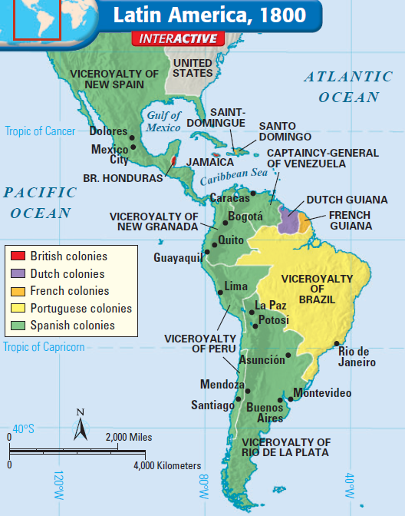
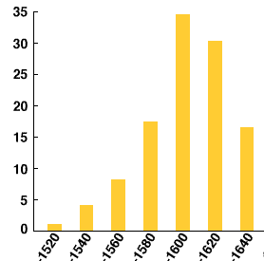
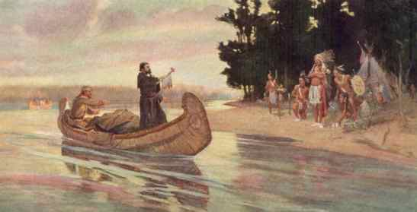
From 1500 to 1800, Latin America was colonized by Europe, especially Spain
European nations used mercantilism to gain wealth from their American colonies
Catholic missionaries from Spain & France converted Indians

Slide 3
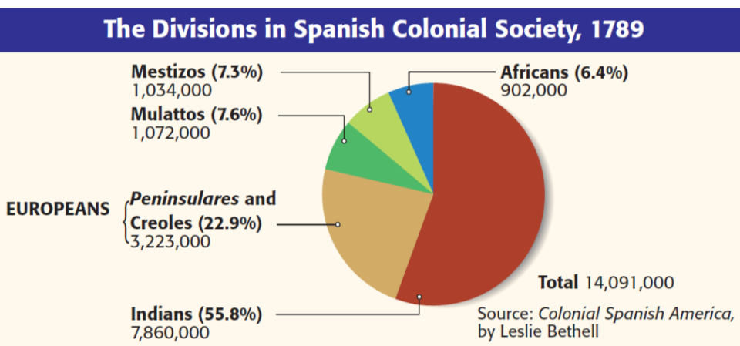
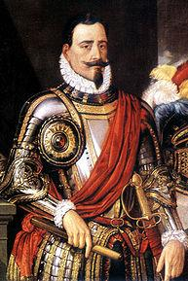
White Europeans were at the top of society
One major impact of European colonization was the unequal social hierarchy in Latin America
Text
Peninsulares were royal governors sent by the king to enforce mercantilism & maintain order in the colony

Slide 4
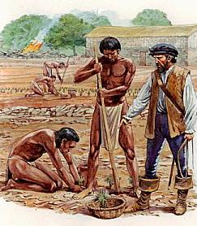
Title
White Europeans were at the top of society
One major impact of European colonization was the unequal social hierarchy in Latin America
Text
Spanish colonists living in America were called creoles; They had land & wealth but had no political power

Slide 5
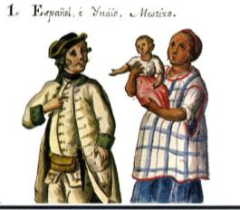
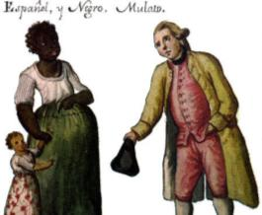
The lack of European women in America led to intermarriage & a large mixed-race population that made up the next level of the social hierarchy
Mestizos were the offspring of Europeans & Indians
Mulattos were the offspring of Europeans & Africans

Slide 6
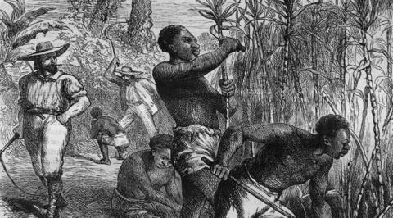
Indians & African slaves made up the bottom of the social hierarchy
Indians & slaves were used as workers for creoles plantations

Slide 7
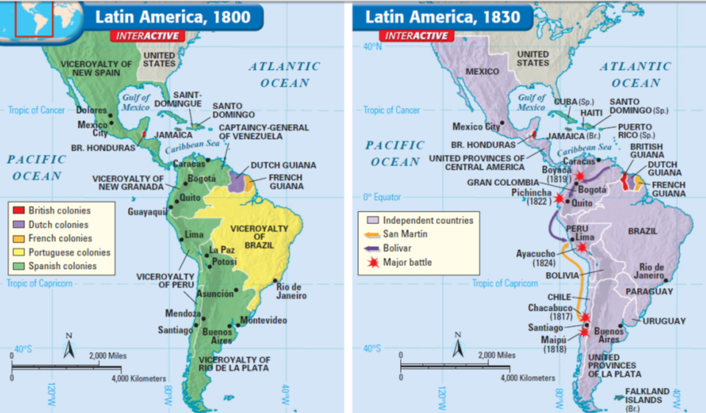
From 1800 to 1830, Latin American colonies began declaring independence from European nations & establishing democracies throughout the Americas

Slide 8
Quick Class Discussion:
Which social group will lead these Latin American Revolutions? Why?
Where did they get the idea to revolt & created democracies?
African slaves in Haiti
Creoles in South America
Indians in Mexico

Slide 9
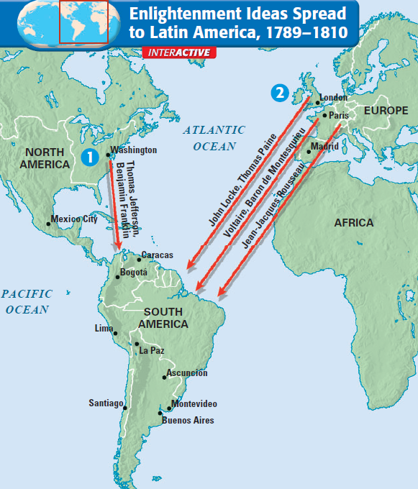
By the late 1700s, Latin Americans were inspired to gain independence because of the success of the American & French Revolutions
The ideas of the Enlightenment inspired independence especially among the well-educated creole class

Slide 10
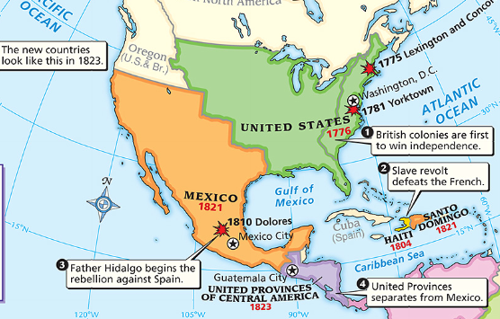
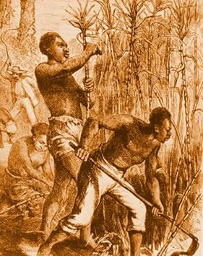
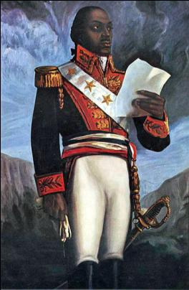
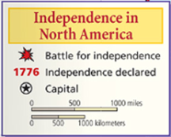
Haiti was a French colony with 500,000 African slaves working on sugar & coffee plantations
Plantation owners used brutal methods to control slaves
In 1791, Haitian slaves rose in revolt; Toussaint L’Ouverture became the leader of the slave uprising & helped free all the slaves by 1801
Haiti was the first Latin American colony to free itself from European rule
Notes:
Revolution in Haiti
The French colony called Saint Domingue was the first Latin American territory to free itself from European rule. The colony, now known as Haiti, occupied the western third of the island of Hispaniola in the Caribbean Sea. Nearly 500,000 enslaved Africans worked on French plantations, and they outnumbered their masters dramatically. White masters used brutal methods to terrorize them and keep them powerless. While the French Revolution was taking place, oppressed people in the French colony of Haiti rose up against their French masters. In August 1791, 100,000 enslaved Africans rose in revolt. A leader soon emerged, Toussaint L’Ouverture (too•SAN loo•vair•TOOR). Formerly enslaved, Toussaint was unfamiliar with military and diplomatic matters. Even so, he rose to become a skilled general and diplomat. By 1801, Toussaint had taken control of the entire island and freed all the enslaved Africans. In January 1802, 30,000 French troops landed in Saint Domingue to remove Toussaint from power. In May, Toussaint agreed to halt the revolution if the French would end slavery. Despite the agreement, the French soon accused him of planning another uprising. They seized him and sent him to a prison in the French Alps, where he died in April 1803.
Haiti’s Independence
Toussaint’s lieutenant, Jean-Jacques Dessalines (zhahn•ZHAHK day•sah•LEEN), took up the fight for freedom. On January 1, 1804, General Dessalines declared the colony an independent country. It was the first black colony to free itself from European control. Dessalines called the country Haiti, which in the language of the Arawak natives meant “mountainous land.”

Slide 11
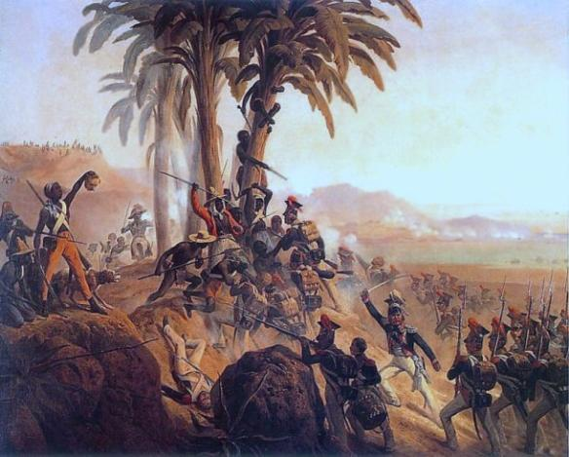
From 1802 to 1804, Haitians fought for their independence against Napoleon’s French army
In 1804, France granted Haiti its independence & created a republic
Notes:
Revolution in Haiti
The French colony called Saint Domingue was the first Latin American territory to free itself from European rule. The colony, now known as Haiti, occupied the western third of the island of Hispaniola in the Caribbean Sea. Nearly 500,000 enslaved Africans worked on French plantations, and they outnumbered their masters dramatically. White masters used brutal methods to terrorize them and keep them powerless. While the French Revolution was taking place, oppressed people in the French colony of Haiti rose up against their French masters. In August 1791, 100,000 enslaved Africans rose in revolt. A leader soon emerged, Toussaint L’Ouverture (too•SAN loo•vair•TOOR). Formerly enslaved, Toussaint was unfamiliar with military and diplomatic matters. Even so, he rose to become a skilled general and diplomat. By 1801, Toussaint had taken control of the entire island and freed all the enslaved Africans. In January 1802, 30,000 French troops landed in Saint Domingue to remove Toussaint from power. In May, Toussaint agreed to halt the revolution if the French would end slavery. Despite the agreement, the French soon accused him of planning another uprising. They seized him and sent him to a prison in the French Alps, where he died in April 1803.
Haiti’s Independence
Toussaint’s lieutenant, Jean-Jacques Dessalines (zhahn•ZHAHK day•sah•LEEN), took up the fight for freedom. On January 1, 1804, General Dessalines declared the colony an independent country. It was the first black colony to free itself from European control. Dessalines called the country Haiti, which in the language of the Arawak natives meant “mountainous land.”

Slide 12
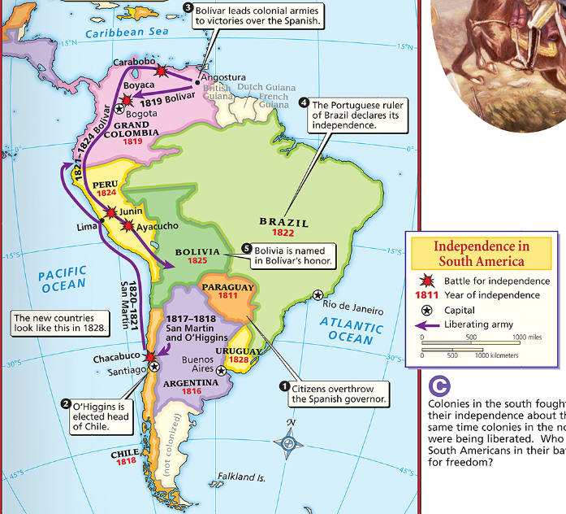
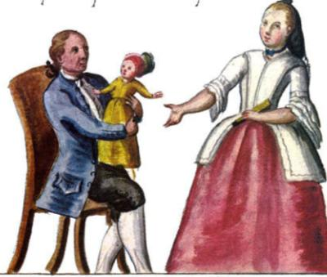
Throughout the Spanish colonies in South America, the creoles had wealth & education but could not participate in government
Creoles embraced Enlightenment ideas like natural rights & consent of the governed
Notes:
Even though they could not hold high public office, creoles were the least oppressed of those born in Latin America. They were also the best educated. In fact, many wealthy young creoles traveled to Europe for their education. In Europe, they read about and adopted Enlightenment ideas. When they returned to Latin America, they brought ideas of revolution with them. Napoleon’s conquest of Spain in 1808 triggered revolts in the Spanish colonies. Removing Spain’s King Ferdinand VII, Napoleon made his brother Joseph king of Spain. Many creoles might have supported a Spanish king. However, they felt no loyalty to a king imposed by the French. Creoles, recalling Locke’s idea of the consent of the governed, argued that when the real king was removed, power shifted to the people. In 1810, rebellion broke out in several parts of Latin America. The drive toward independence had begun.
The South American wars of independence rested on the achievements of two brilliant creole generals. One was Simón Bolívar, a wealthy Venezuelan creole. The other great liberator was José de San Martín, an Argentinian.
Bolívar’s Route to Victory
Simón Bolívar’s native Venezuela declared its independence from Spain in 1811. But the struggle for independence had only begun. Bolívar’s volunteer army of revolutionaries suffered numerous defeats. Twice Bolívar had to go into exile. A turning point came in August 1819. Bolívar led over 2,000 soldiers on a daring march through the Andes into what is now Colombia. (See the 1830 map on page 685.) Coming from this direction, he took the Spanish army in Bogotá completely by surprise and won a decisive victory. By 1821, Bolívar had won Venezuela’s independence. He then marched south into Ecuador. In Ecuador, Bolívar finally met José de San Martín. Together they would decide the future of the Latin American revolutionary movement.
San Martín Leads Southern Liberation Forces San Martín’s Argentina had declared its independence in 1816. However, Spanish forces in nearby Chile and Peru still posed a threat. In 1817, San Martín led an army on a grueling march across the Andes to Chile. He was joined there by forces led by Bernardo O’Higgins, son of a former viceroy of Peru. With O’Higgins’s help, San Martín finally freed Chile. In 1821, San Martín planned to drive the remaining Spanish forces out of Lima, Peru. But to do so, he needed a much larger force. San Martín and Bolívar discussed this problem when they met at Guayaquil, Ecuador, in 1822.
No one knows how the two men reached an agreement. But San Martín left his army for Bolívar to command. With unified revolutionary forces, Bolívar’s army went on to defeat the Spanish at the Battle of Ayacucho (Peru) on December 9, 1824. In this last major battle of the war for independence, the Spanish colonies in Latin America won their freedom. The future countries of Venezuela, Colombia, Panama, and Ecuador were united into a country called Gran Colombia.

Slide 13
In 1810, the demand by creoles for political rights led to revolutions throughout South America
South American nations gained their independence because of the leadership of two creole generals
Notes:
Even though they could not hold high public office, creoles were the least oppressed of those born in Latin America. They were also the best educated. In fact, many wealthy young creoles traveled to Europe for their education. In Europe, they read about and adopted Enlightenment ideas. When they returned to Latin America, they brought ideas of revolution with them. Napoleon’s conquest of Spain in 1808 triggered revolts in the Spanish colonies. Removing Spain’s King Ferdinand VII, Napoleon made his brother Joseph king of Spain. Many creoles might have supported a Spanish king. However, they felt no loyalty to a king imposed by the French. Creoles, recalling Locke’s idea of the consent of the governed, argued that when the real king was removed, power shifted to the people. In 1810, rebellion broke out in several parts of Latin America. The drive toward independence had begun.
The South American wars of independence rested on the achievements of two brilliant creole generals. One was Simón Bolívar, a wealthy Venezuelan creole. The other great liberator was José de San Martín, an Argentinian.
Bolívar’s Route to Victory
Simón Bolívar’s native Venezuela declared its independence from Spain in 1811. But the struggle for independence had only begun. Bolívar’s volunteer army of revolutionaries suffered numerous defeats. Twice Bolívar had to go into exile. A turning point came in August 1819. Bolívar led over 2,000 soldiers on a daring march through the Andes into what is now Colombia. (See the 1830 map on page 685.) Coming from this direction, he took the Spanish army in Bogotá completely by surprise and won a decisive victory. By 1821, Bolívar had won Venezuela’s independence. He then marched south into Ecuador. In Ecuador, Bolívar finally met José de San Martín. Together they would decide the future of the Latin American revolutionary movement.
San Martín Leads Southern Liberation Forces San Martín’s Argentina had declared its independence in 1816. However, Spanish forces in nearby Chile and Peru still posed a threat. In 1817, San Martín led an army on a grueling march across the Andes to Chile. He was joined there by forces led by Bernardo O’Higgins, son of a former viceroy of Peru. With O’Higgins’s help, San Martín finally freed Chile. In 1821, San Martín planned to drive the remaining Spanish forces out of Lima, Peru. But to do so, he needed a much larger force. San Martín and Bolívar discussed this problem when they met at Guayaquil, Ecuador, in 1822.
No one knows how the two men reached an agreement. But San Martín left his army for Bolívar to command. With unified revolutionary forces, Bolívar’s army went on to defeat the Spanish at the Battle of Ayacucho (Peru) on December 9, 1824. In this last major battle of the war for independence, the Spanish colonies in Latin America won their freedom. The future countries of Venezuela, Colombia, Panama, and Ecuador were united into a country called Gran Colombia.

Slide 14
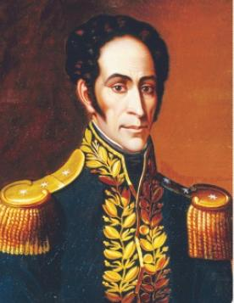
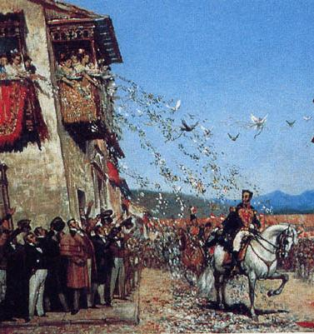
From 1811 to 1824, Venezuelan creole Simon Bolivar led an army of revolutionaries against Spain
Bolivar helped create new nations of Grand Colombia, Peru, Bolivia
Notes:
Bolívar’s Route to Victory
Simón Bolívar’s native Venezuela declared its independence from Spain in 1811. But the struggle for independence had only begun. Bolívar’s volunteer army of revolutionaries suffered numerous defeats. Twice Bolívar had to go into exile. A turning point came in August 1819. Bolívar led over 2,000 soldiers on a daring march through the Andes into what is now Colombia. (See the 1830 map on page 685.) Coming from this direction, he took the Spanish army in Bogotá completely by surprise and won a decisive victory. By 1821, Bolívar had won Venezuela’s independence. He then marched south into Ecuador. In Ecuador, Bolívar finally met José de San Martín. Together they would decide the future of the Latin American revolutionary movement.
San Martín Leads Southern Liberation Forces San Martín’s Argentina had declared its independence in 1816. However, Spanish forces in nearby Chile and Peru still posed a threat. In 1817, San Martín led an army on a grueling march across the Andes to Chile. He was joined there by forces led by Bernardo O’Higgins, son of a former viceroy of Peru. With O’Higgins’s help, San Martín finally freed Chile. In 1821, San Martín planned to drive the remaining Spanish forces out of Lima, Peru. But to do so, he needed a much larger force. San Martín and Bolívar discussed this problem when they met at Guayaquil, Ecuador, in 1822.
No one knows how the two men reached an agreement. But San Martín left his army for Bolívar to command. With unified revolutionary forces, Bolívar’s army went on to defeat the Spanish at the Battle of Ayacucho (Peru) on December 9, 1824. In this last major battle of the war for independence, the Spanish colonies in Latin America won their freedom. The future countries of Venezuela, Colombia, Panama, and Ecuador were united into a country called Gran Colombia.

Slide 16
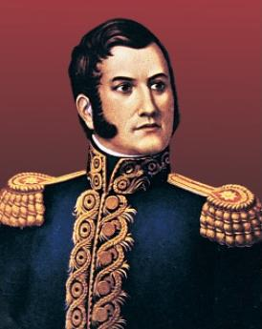
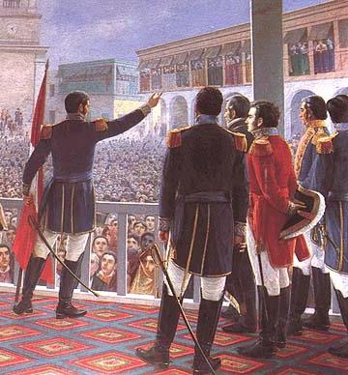
Argentinean creole San Martín led the independence movement in southern South America
San Martín helped create new nations of Argentina, Chile & Peru
Notes:
San Martín Leads Southern Liberation Forces San Martín’s Argentina had declared its independence in 1816. However, Spanish forces in nearby Chile and Peru still posed a threat. In 1817, San Martín led an army on a grueling march across the Andes to Chile. He was joined there by forces led by Bernardo O’Higgins, son of a former viceroy of Peru. With O’Higgins’s help, San Martín finally freed Chile. In 1821, San Martín planned to drive the remaining Spanish forces out of Lima, Peru. But to do so, he needed a much larger force. San Martín and Bolívar discussed this problem when they met at Guayaquil, Ecuador, in 1822.
No one knows how the two men reached an agreement. But San Martín left his army for Bolívar to command. With unified revolutionary forces, Bolívar’s army went on to defeat the Spanish at the Battle of Ayacucho (Peru) on December 9, 1824. In this last major battle of the war for independence, the Spanish colonies in Latin America won their freedom. The future countries of Venezuela, Colombia, Panama, and Ecuador were united into a country called Gran Colombia.

Slide 18
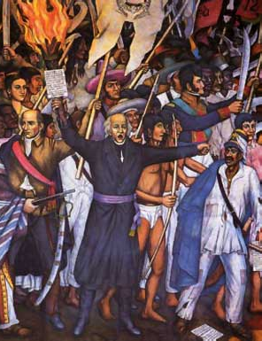
Unlike the South America creoles, in Mexico the Indians & mestizos played the leading role
In 1810, a poor but well educated Catholic priest named Miguel Hidalgo used Enlightenment ideals to call for a revolution against Spain
Hidalgo led an army of 80,000 Indian & mestizos revolutionaries against the Spanish military & creoles who feared losing their wealth

Slide 19
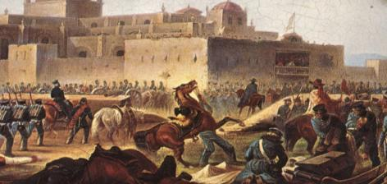
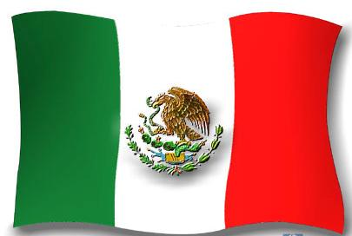
During the rebellion, Hidalgo was killed but Mexicans found new leaders to continue the fight another 10 years
The turning point in the war came in 1820 when the creoles switched sides & joined the revolt against Spain
In 1821, Spain granted Mexico its independence & a republic was formed

Slide 20
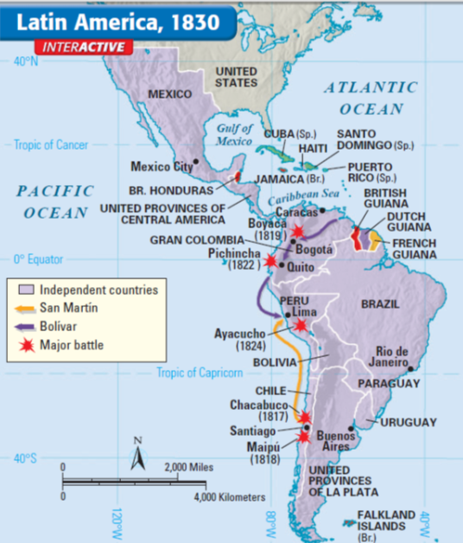
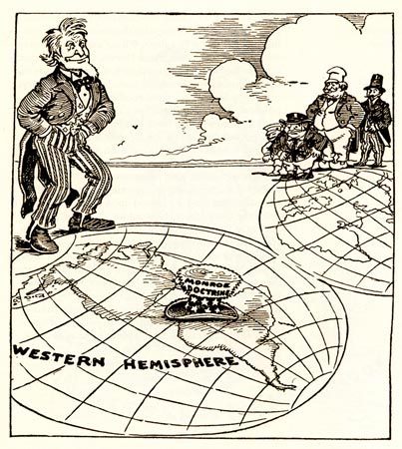
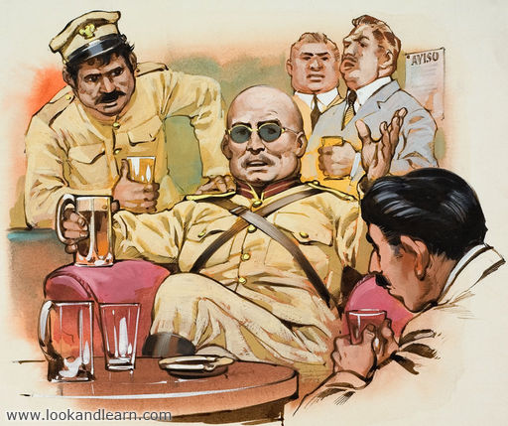
Throughout Latin America, new democratic republics were created
But, Latin Americans did not have a history of self-government & many of the new gov’ts were unstable
In many nations, military dictators called caudillos seized power & made few reforms for citizens
Latin America became dependent on the USA

Slide 21
Closure Activity
Creating an Enlightenment Encyclopedia:
Working with a partner, create an entry into Diderot’s Encyclopedia about one key idea or person of the Enlightenment
Use the template provided to provide a brief summary of the person/idea & create a brief sketch
When finished, hang it up in the room to create a classroom encyclopedia
Be prepared to present on your topic

Slide 22
title
summary
sketch
your names
Notes:
Encyclopedia template

Slide 23
Encyclopedia Entries
Colonial assemblies
Reasons for the American Revolution
“No Taxation without Representation”
Declaration of Independence
American Revolution
Constitution
Thomas Jefferson
Reasons for the French Revolution
Estates-General
National Assembly
Declaration of the Rights of Man and of the Citizen
National Convention
Louis XVI
Maximilien Robespierre
Reign of Terror
Napoleon Bonaparte
Latin American social classes
Toussaint L'Ouverture
Simon Bolivar
San Martín
Miguel Hidalgo

