Slide 1
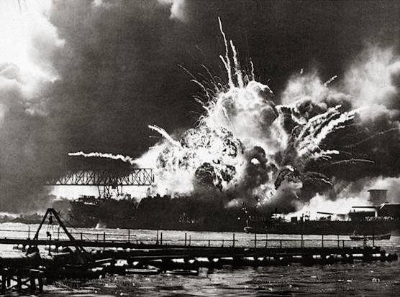
December 7, 1941
“A day that will live in infamy”
Notes:
The first Japanese immigrants came to the United States in 1843, almost 100 years before Pearl Harbor.
December 7, 1941 was the attack on Pearl Harbor.
Communicate to students the shock of the attack, and the U.S. entry into the World War II.
You might want to question students how they felt about September 11 or how they might feel if we were attacked. What emotions would they feel? How might they want to respond?

Slide 2
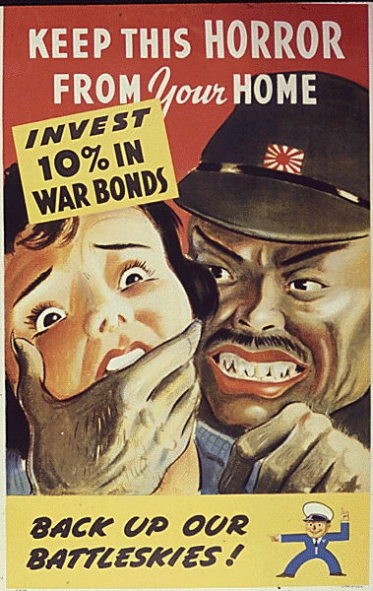
Consequences of the
Bombing of Pearl Harbor
U.S. enters WWII and prepares to fight a two-front war
Now that US is at war with Germany, Italy and Japan, how will it treat people from those countries?
Role of Race?
Notes:
Continuing from previous slide.
Now that we are in this war, how do we treat people of German, Italian or Japanese ancestry?
Do we make a distinction between the two? Are we more frightened of Japanese than Germans or Italians? Why?
You might want to bring up the topic of race/ethnicity here. The U.S. has a difficult history in how it both treated immigrants or people of color. Examples are plentiful here.
Thus, determine whether you want to discuss how we treat people whose ancestry came from the countries we are at war with or whether this is an issue of discrimination?

Slide 3
Executive Order 9066
Executive Order 9066 authorized the Secretary of War and U.S. armed forces commanders to declare areas of the United States as military zones "from which any or all persons may be excluded.”
Congress passed act enforcing exclusions
Notes:
Executive Order 9066 provided the legal authority for the forced removal of people from military areas.
Although the Order does not say “Japanese Ancestry,” this law was only applied to people of Japanese ancestry.
The law was primarily aimed at the three West Coast states, California, Oregon, and Washington. The law was not aimed at people of Japanese ancestry in Hawaii, who were a significant number of the population, nor people of Japanese ancestry in the interior of the country.
Define what we mean about people of Japanese Ancestry:
Issei: Japanese immigrants to the U.S. By law, Issei were not allowed to naturalize
Nisei: Japanese-Americans born here
Consider the difference between these two groups, in terms of attitude (for Nisei, this is the only country they ever knew) and in legal rights (Nisei had the protections of U.S. citizens offered by the Constitution.

Slide 4
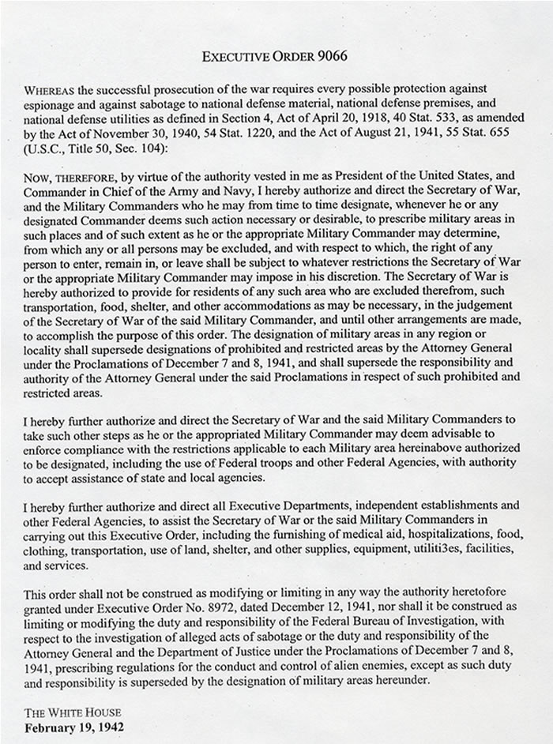

Slide 5
Series of Orders
Lt. Gen. DeWitt
Exclusion, then Evacuation, then Detention (initial plan was resettlement)
No accurate reports of disloyal Japanese

Slide 6
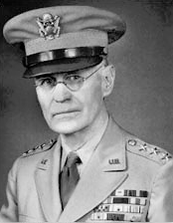

Slide 7
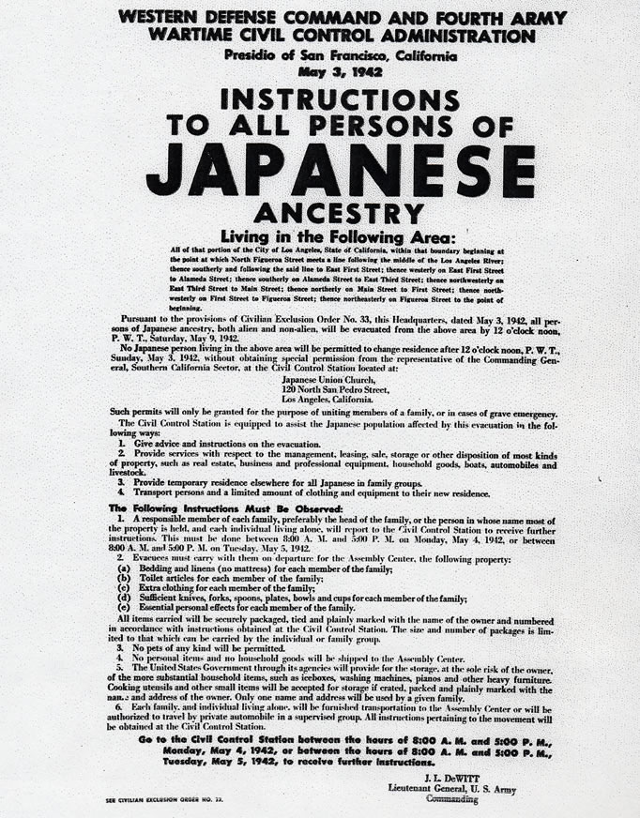

Slide 8
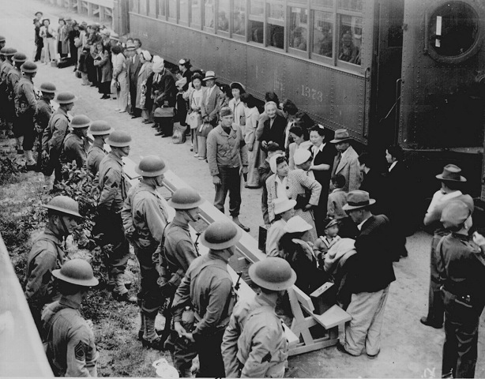

Slide 9
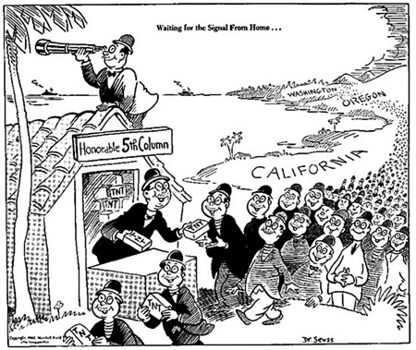
Theodore Geisel, Feb 13, 1942

Slide 10
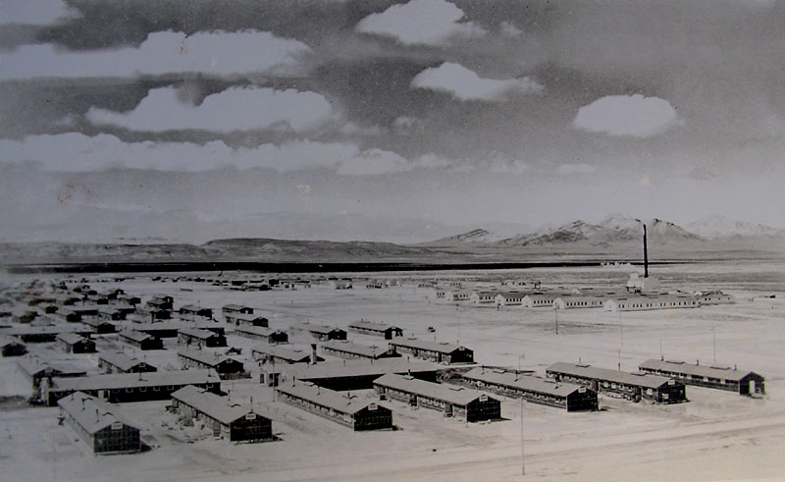

Slide 11
Notes:
In WWII, the U.S., via Executive Order 9066 incarcerated roughly 120,000 people of Japanese Ancestry into a set of relocation or concentration camps.
Approximately, 2/3s of the 120,000 people were American citizens, Nisei
People were first sent to temporary detention centers; often horse racing tracks which were converted for this purpose. In many cases, Japanese were given a mere 48 hours to sell their personal belongings, their businesses, their homes, their property.
Students, what strikes you about the location of many of these relocation areas? (The remoteness)
A few places of note:
--Manzanar, near Lone Pine, CA, was where many people from Southern California were sent
--Topaz, Utah was where many people from the Bay Area were sent
--Heart Mountain, Wyoming was the place of a serious resistance against the camps
--Tule Lake, CA, near the Oregon border was where most people who were thought to be disloyal were sent.
There is no evidence of any crime against the U.S. committed by a person of Japanese descent during WWII.

Slide 12
Persons of Japanese Ancestry in US
1940: approx 127,000. 63% Nisei (American born second generation)
120,000 removed and interned

Slide 13
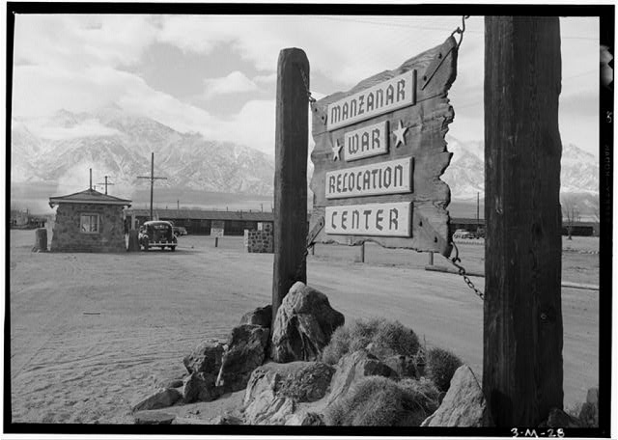
One of 10 Camps

Slide 14
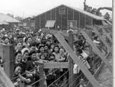

Slide 15
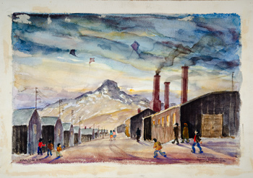
“Mess Hall, Bathroom, Barracks, Japanese Relocation Center, Heart Mt. Wyoming,” by Estelle Ishigo

Slide 16
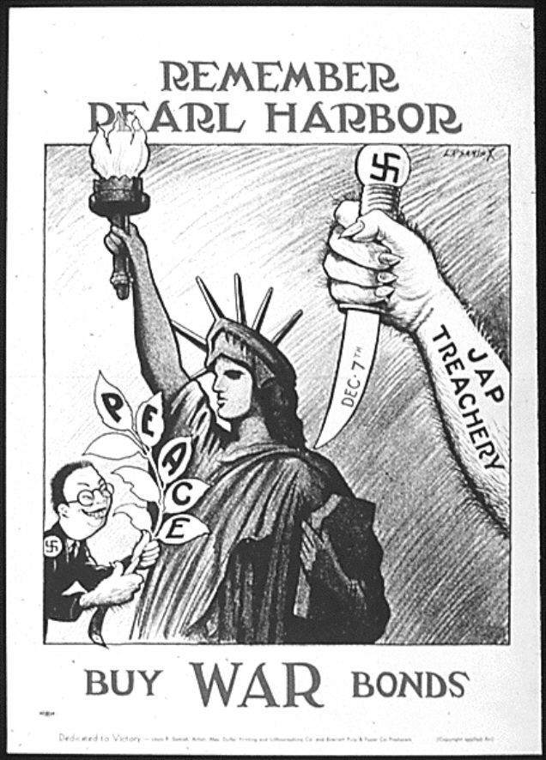

Slide 17
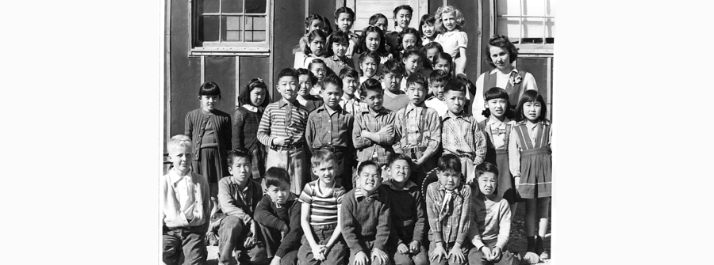
Schoolchildren at Heart Mountain

Slide 18
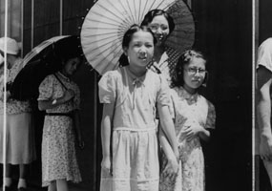

Slide 19
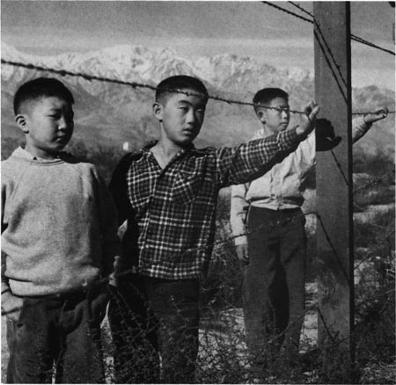
Notes:
Have the students comment on this picture.
Camps were surrounded by barbed wire. There were guard towers patrolled by the military.
Japanese Americans were told that the camps were to keep them safe. One internee noted, that “the guns were pointed in, not out.”
In the early days, the Americans tried to anticipate the Japanese American food interests.
Several families lived in each hut. Families put up sheets as divisions.
The shower facilities were communal. There are stories about modest people waiting until the middle of the night to shower.

Slide 20
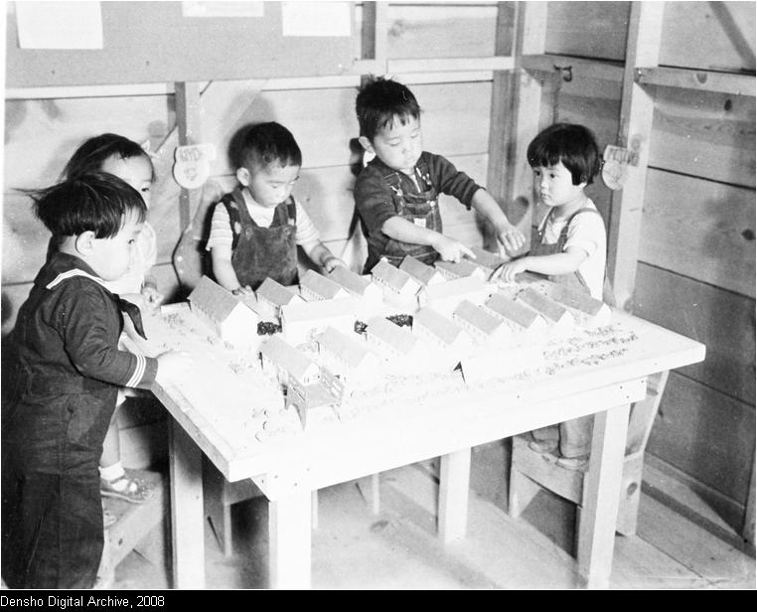
Notes:
Some of the people were able to leave in 1943 if they were able to find work in the interior of the country; any state other than the Pacific states (CA, OR, or WA).
When the government closed the camps, they gave internees a bus ticket to wherever they wanted to go, and $25.
By the end of the war, no person of Japanese ancestry was charged with any crime of sabotage or espionage.

Slide 21
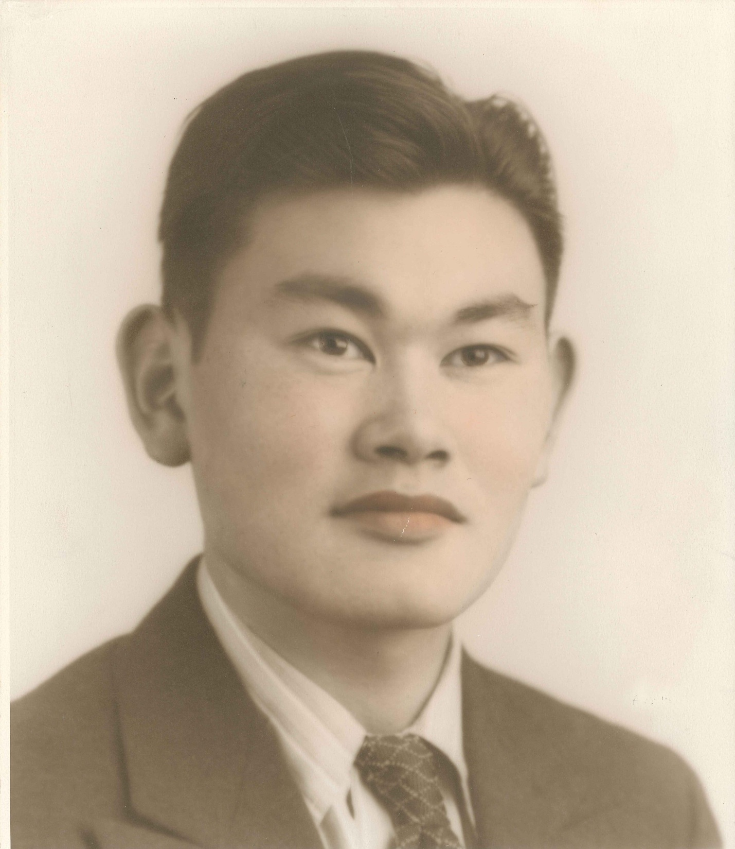
Photo Courtesy of Karen Korematsu and the Korematsu Institute
Notes:
14

Slide 22
Fred Korematsu
22 years old
American citizen (Nisei, second generation)
Korematsu changed his name and had cosmetic surgery to make himself appear less Japanese
He was charged with remaining in a military area barred to those of Japanese ancestry
Convicted

Slide 23
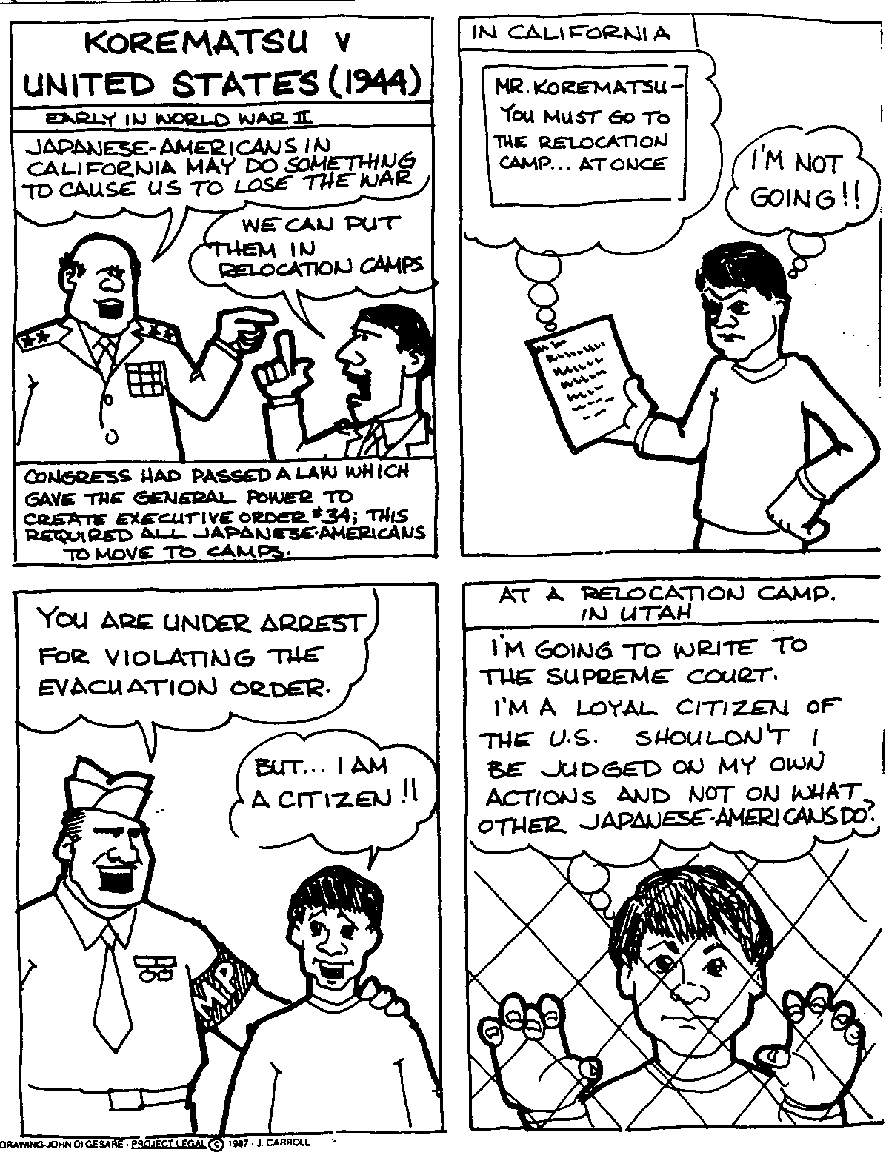

Slide 24
Following conviction, sent to Topaz, Utah internment camp
ACLU persuaded him to appeal his case
(while case pending, allowed to work as welder outside of CA. Went to Detroit.)

Slide 25
From DeWitt’s 1943 Report
Intelligence services records reflected the existence of hundreds of Japanese organizations in California, Washington, Oregon and Arizona which, prior to December 7, 1941, were actively engaged in advancing Japanese war aims. These records also disclosed that thousands of American-born Japanese had gone to Japan to receive their education and indoctrination there and had become rabidly pro-Japanese and then had returned to the United States. Emperor-worshipping ceremonies were commonly held and millions of dollars had flowed into the Japanese imperial war chest from the contributions freely made by Japanese here. The continued presence of a large, unassimilated, tightly knit and racial group, bound to an enemy nation by strong ties of race, culture, custom and religion along a frontier vulnerable to attack constituted a menace which had to be dealt with.

Slide 26
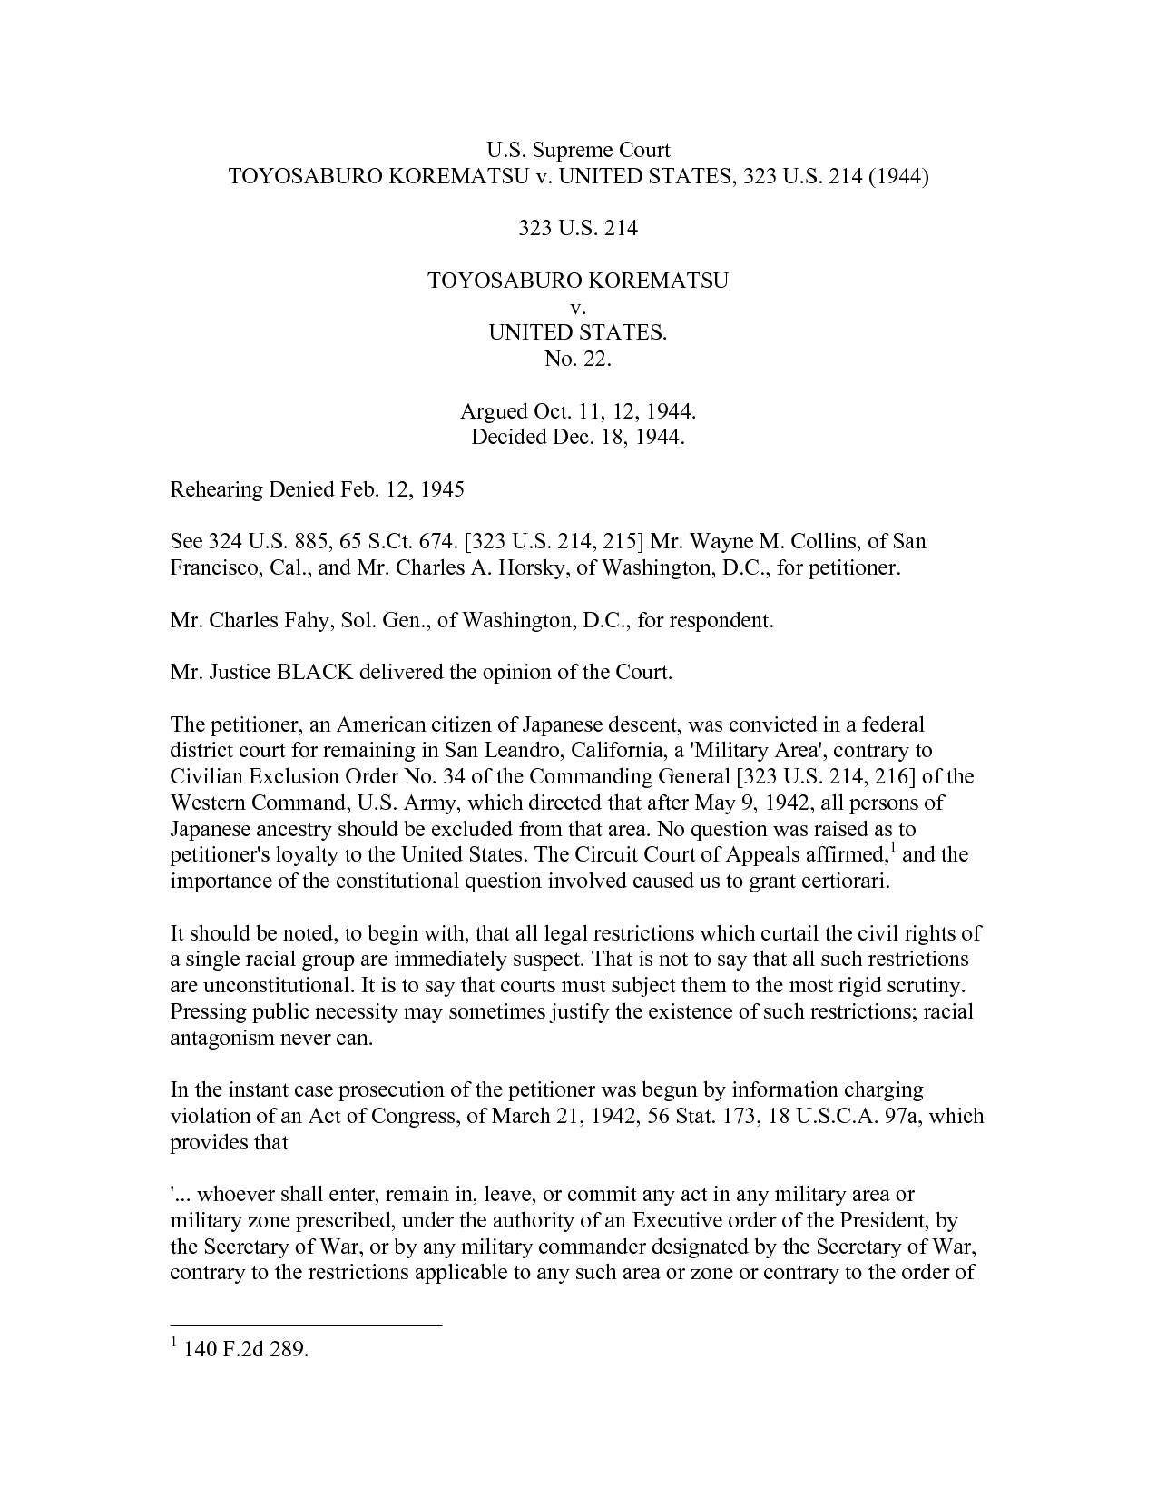

Slide 27
Justice Black
"Korematsu was not excluded from the Military Area because of hostility to him or his race. He was excluded because we are at war with the Japanese Empire, because the properly constituted military authorities feared an invasion of our West Coast and felt constrained to take proper security measures, because they decided that the military urgency of the situation demanded that all citizens of Japanese ancestry be segregated from the West Coast temporarily, and finally, because Congress, reposing its confidence in this time of war in our military leaders-as inevitably it must-determined that they should have the power to do just this. There was evidence of disloyalty on the part of some, the military authorities considered that the need for action was great, and time was short. We cannot-by availing ourselves of the calm perspective of hindsight-now say that at that time these actions were unjustified."

Slide 28
Three dissents
Joint dissent of Roberts, Murphy, Jackson: unconst as no evidence of disloyalty
Justice Murphy: falls into the ugly abyss of racism and violates procedural due process and equal protection of the law (see next slide)
Justice Jackson: our system depends on personal guilt, not inheritable guilt

Slide 29
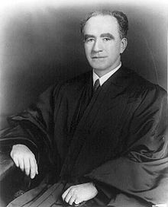
Justice Frank Murphy

Slide 30
Justice Frank Murphy
Justification for exclusion not based on any reliable evidence
Based on questionable racial and sociological grounds: a “large, unassimilated, tightly knit racial group bound to an enemy nation by strong ties of race, culture, custom and religion.”
I dissent from this legalization of racism. . . It is unattractive in any setting but it is utterly revolting among a free people who have embraced the principles set forth in the Constitution.

Slide 31
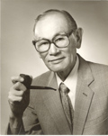

Slide 32
In 1980, President Jimmy Carter appointed a special commission to investigate the internment of Japanese-Americans during World War II. The commission concluded in 1983 that the decisions to remove those of Japanese ancestry to prison camps was ot based on military necessity but occurred because of "race prejudice, war hysteria, and a failure of political leadership".

Slide 33
Writ of coram nobis granted, 1984
Reverses conviction.
Remedy to restore erroneously convicted person to pre-conviction state
Peter Irons (legal historian) and others had discovered that govt lawyers tried to conceal DeWitt’s fabricated claims of Japanese-American disloyalty.

Slide 34
Civil Liberties Act of 1988
In 1988, Congress apologized and granted personal compensation of $20,000 to each surviving prisoner.
Letter from President George H. Bush: “[W]e can take a clear stand for justice and recognize that serious injustices were done to Japanese Americans during World War II.”

Slide 35
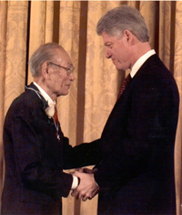
Presidential Medal of Freedom 1988

Slide 36
2003, amicus brief
On behalf of Fred Korematsu
Cases of Rasul, Hamdi, Odah involving SCOTUS review of prolonged detentions under Bush administration’s “war on terror”
Brief argues that “government’s position . . . is reminiscent of [past episodes] in which the US too quickly sacrificed civil liberties in the rush to accommodate overbroad claims of military necessity.

Slide 37
Boston Marathon Bombings
National security vs. Civil liberties
Tolerance vs. Terrorism
Ongoing debate

