Slide 1
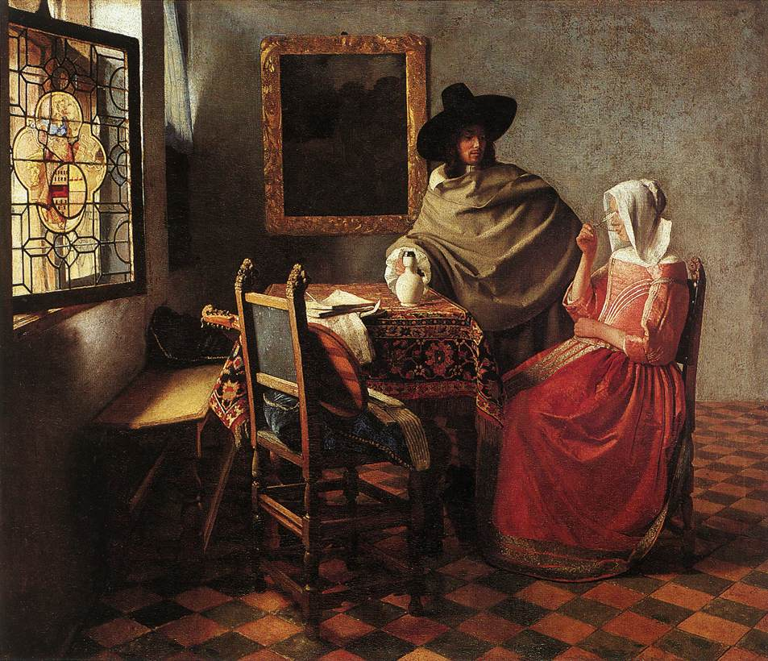
Vermeer Northern Renaissance
Notes:
Vermeer
Available at FTE Library
Vermeer’s Secret World, Etienne
Johannes Vermeer, Venezia
Chasing Vermeer, Balliett

Slide 2
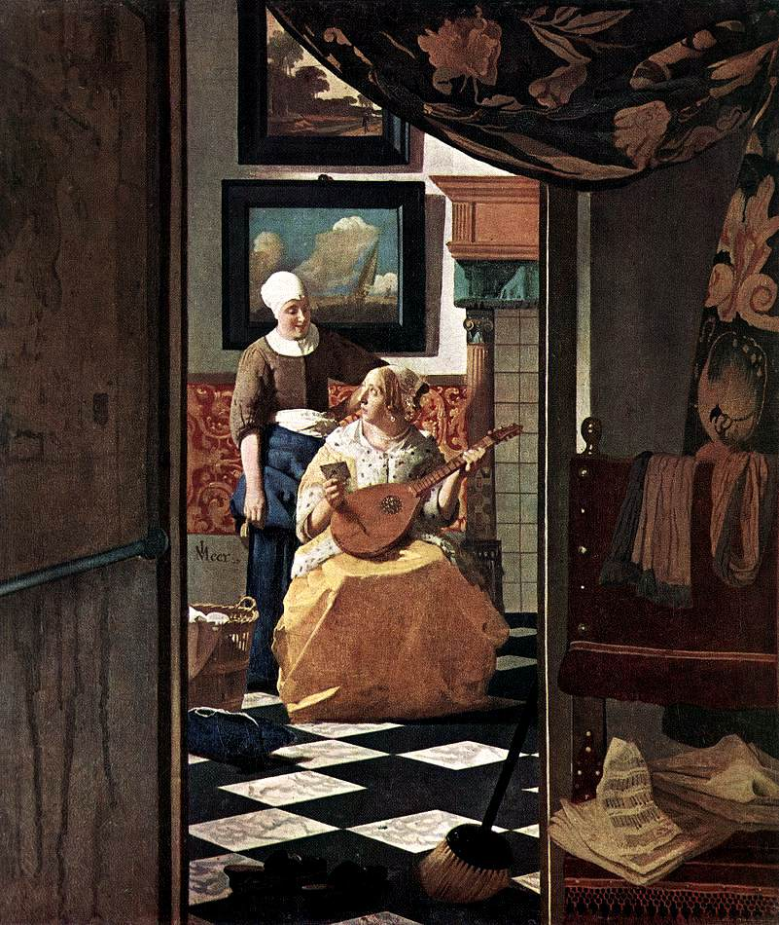
Northern Renaissance
The Renaissance began in Italy in the late 1400’s. The ideas and styles of art that started in Italy began moving into Northern Europe in the early 1500’s. The Northern Renaissance lasted until about 1615.
The art of the Northern Renaissance focused very much on daily life and nature rather than on religion.
The artists of this time worked hard to reflect very precise observation. The artist tried to paint exactly what he saw.
Artists also liked a lot of detail in their paintings – the more things that were in the painting, the happier they were.

Slide 3
What is this a painting of?
A woman receiving a letter.
What details do you notice in this painting?
Do you think it would be difficult to paint so many things in one picture?
Do you like this painting?

Slide 4
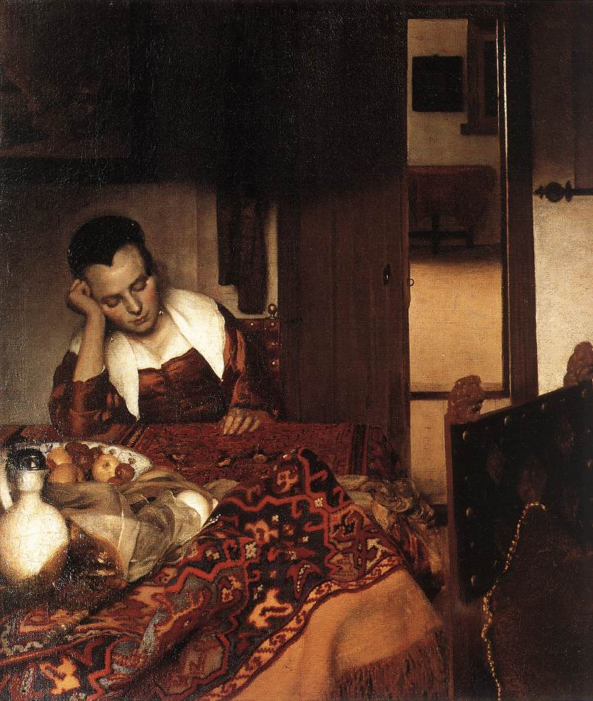
Vermeer
Girl Asleep at a Table
Johannas Vermeer was born in the Netherlands in 1632.
We do not know much about his life. He was not famous in his lifetime.
We do know that he was married and had 11 children!
He was not considered a great artist until someone wrote a paper about him in 1866 – more than 200 years after he died!
Because his work was not considered valuable in his lifetime, people didn’t save it. We only have about 35 works of art by Vermeer.

Slide 5
Girl Asleep at a Table
What is happening in this painting?
What colors are used in this painting?
What details do you notice in this painting?
Is there anything in this painting that looks especially real?
How does this painting make you feel?

Slide 6
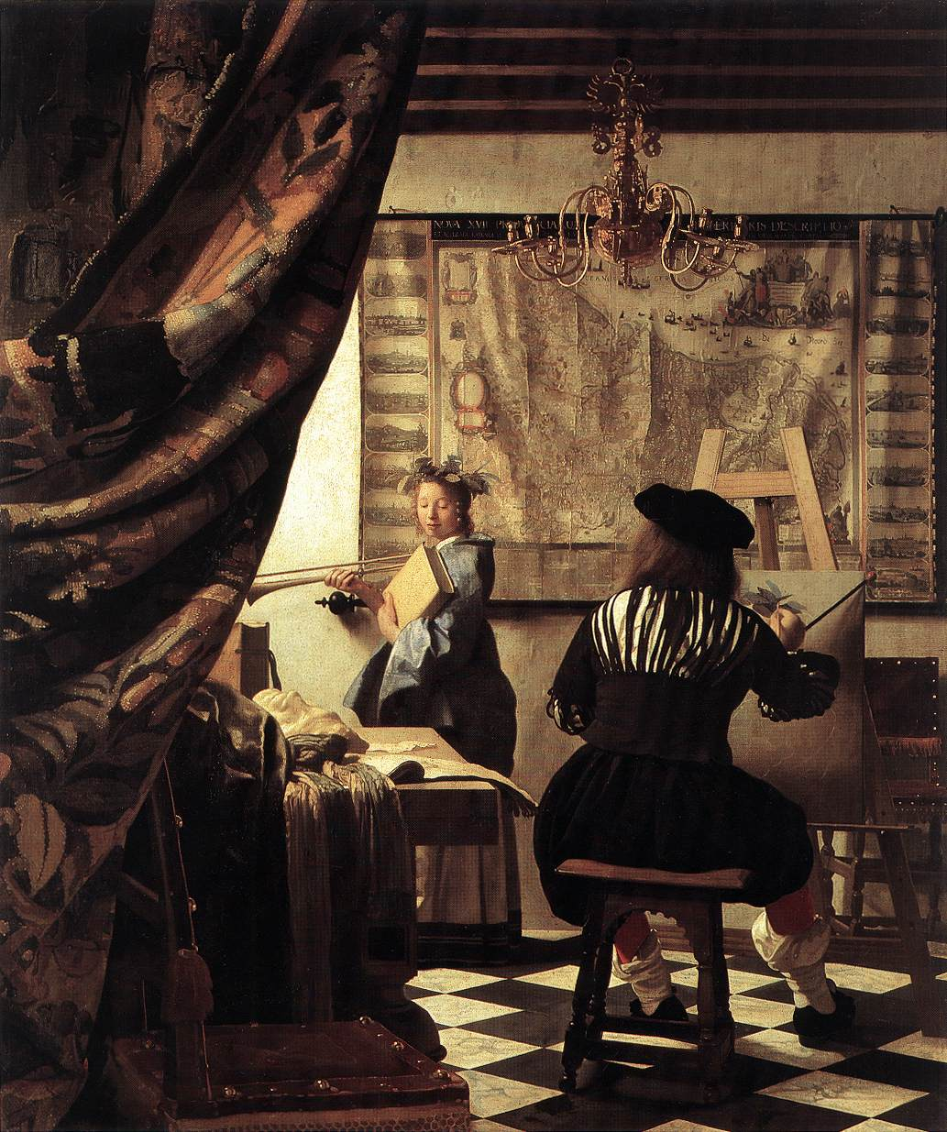
The Art of Painting
One thing that is so special about Vermeer’s work is the way that he paints light.
Notice the way that the light is coming through the window. Notice the light and shadow and the way that the light moves across the room.
What is happening in this painting?
What do you think of the colors in this painting?
What details do you notice in this painting?
Is there anything in this painting that looks especially real?

Slide 7
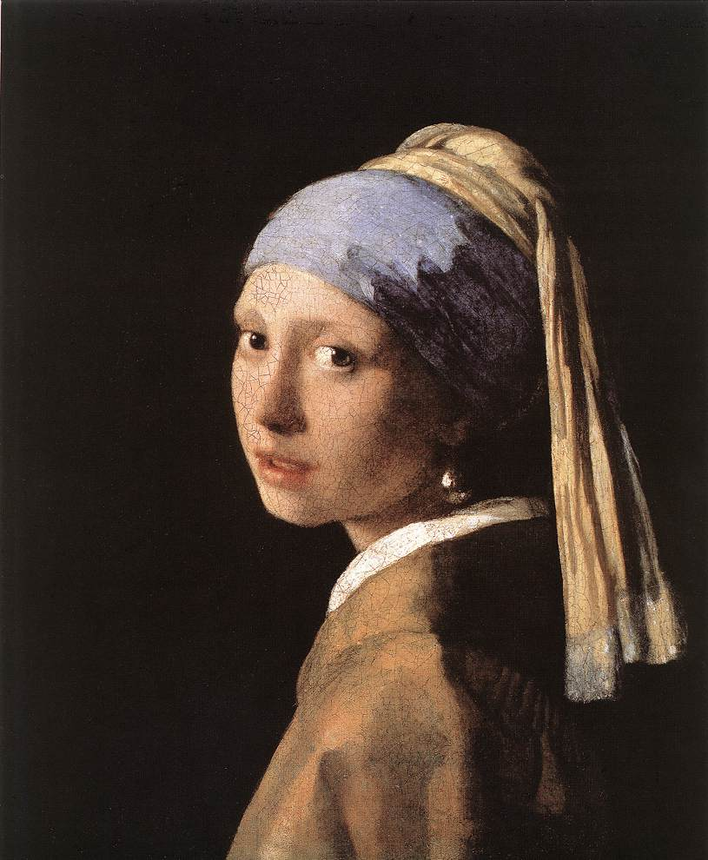
Girl With a Pearl Earring
Let’s think about light again while we look at this painting.
Where do you especially notice light in this painting?
Notice the light reflected in her eyes and on her earring.
In this painting, we don’t see where the light is coming from. Where do you think the light is coming from?
As we have seen, most of Vermeer’s paintings have a lot going on in them. This one seems much more simple. Why do you think he changed his style for this painting?

Slide 8
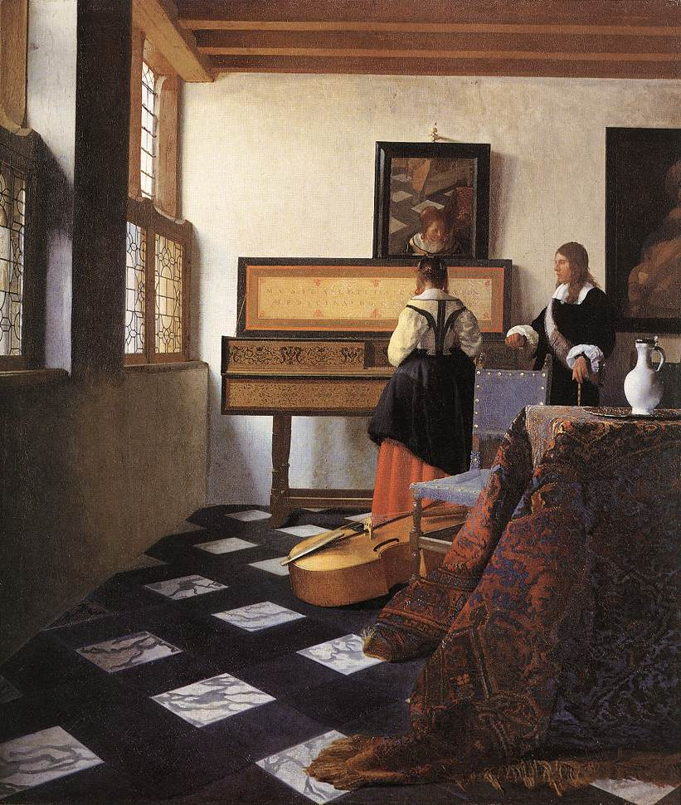
The Music Lesson
Vermeer painted hundreds of years before the invention of the camera.
What do you think is important in a painting?
Again, notice the light in this painting. It seems very real.
Vermeer used a camera obscura to achieve precise positioning in his compositions, asserting that this view is supported by certain light and perspective effects.
What details do you notice?
Note the mirror above the girl reflecting her face and the room.

Slide 9
The Geographer

Slide 10
The Astronomer

Slide 11
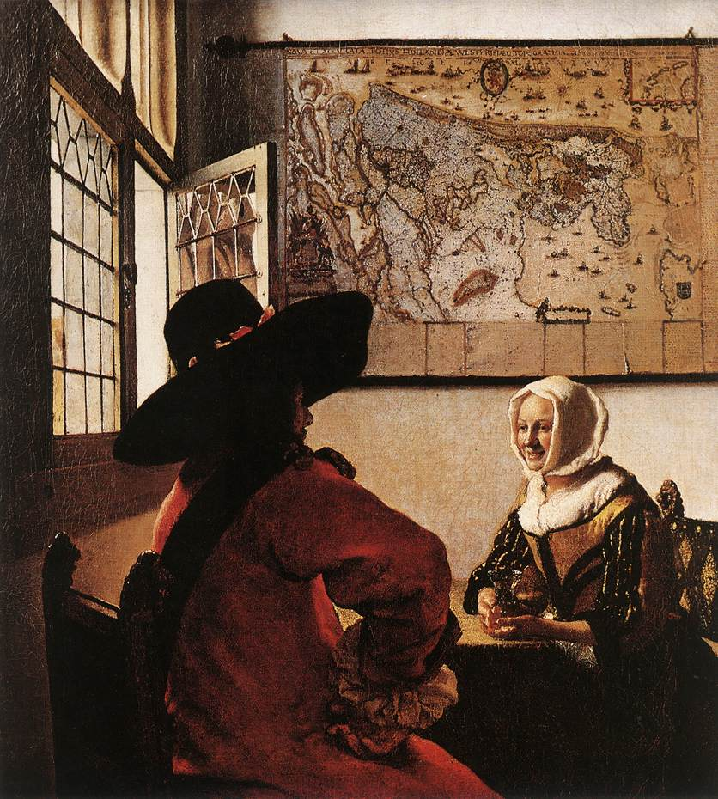
Art in Action!
Draw a picture of an ordinary part of your day – something that you do every day.
Try to add a lot of detail to your drawing. See how much you can get into one picture.
Suggested story to read to the class:
Vermeer’s Secret World by Vincent Etienne

