Slide 1
Essential Question:
What was the impact of the Enlightenment?
Warm-Up Question:
What were the Enlightenment ideas of John Locke, Montesquieu, & Rousseau?
Notes:
42c - identify the major ideas of the Enlightenment from the writings of Locke, Voltaire and Rousseau and their relationship to politics and society
43a - identify the causes and results of the revolutions in England (1689), United States (1776), France (1789), Haiti (1791), and Latin America (1808-1825)
43b - explain Napoleon's rise to power, defeat, and consequences for Europe

Slide 2
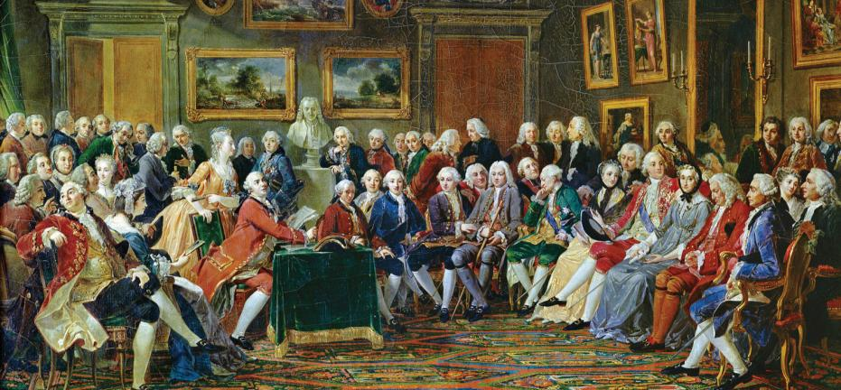
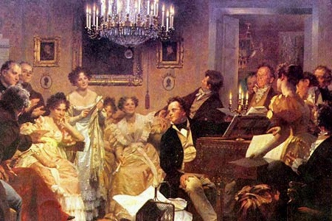
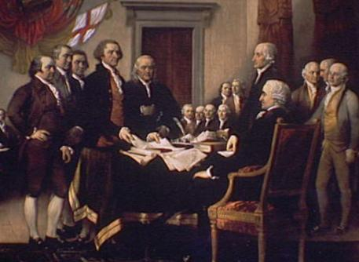
Impact of the Enlightenment
Enlightenment thinkers challenged the divine right of kings & argued for liberty & rights
Salons (discussion parties), high literacy rates & cheap printing helped spread new ideas across Europe
These theories inspired a variety of new ideas in art, music, gender, economics, & government
Notes:
Legacy of the Enlightenment Over a span of a few decades, Enlightenment writers challenged long-held ideas about society. They examined such principles as the divine right of monarchs, the union of church and state, and the existence of unequal social classes. They held these beliefs up to the light of reason and found them in need of reform. The philosophes mainly lived in the world of ideas. They formed and popularized new theories. Although they encouraged reform, they were not active revolutionaries. However, their theories eventually inspired the American and French revolutions and other revolutionary movements in the 1800s. Enlightenment thinking produced three other long-term effects that helped shape Western civilization.

Slide 3
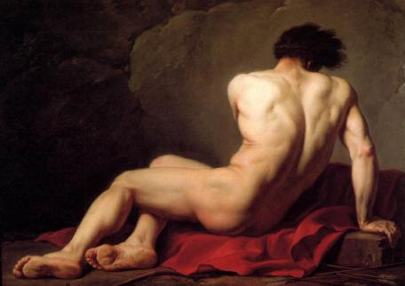
Impact of the Enlightenment: Culture
Enlightenment ideals of perfection & reason gave rise to neoclassical art
Art in the Enlightenment was simple, elegant, & focused on Greek styles
Jacques Louis David
Jean-Baptiste-Simeon Chardin
Notes:
New Artistic Styles
The Enlightenment ideals of order and reason were reflected in the arts—music, literature, painting, and architecture.
Neoclassical Style Emerges
European art of the 1600s and early 1700s had been dominated by the style called baroque, which was characterized by a grand, ornate design. Baroque styles could be seen in elaborate palaces such as Versailles (see page 600) and in numerous paintings. Under the influence of the Enlightenment, styles began to change. Artists and architects worked in a simple and elegant style that borrowed ideas and themes from classical Greece and Rome. The artistic style of the late 1700s is therefore called neoclassical (“new classical”).
Changes in Music and Literature
Music styles also changed to reflect Enlightenment ideals. The music scene in Europe had been dominated by such composers as Johann Sebastian Bach of Germany and George Friedrich Handel of England. These artists wrote dramatic organ and choral music. During the Enlightenment, a new, lighter, and more elegant style of music known as classical emerged. Three composers in Vienna, Austria, rank among the greatest figures of the classical period in music. They were Franz Joseph Haydn, Wolfgang Amadeus Mozart, and Ludwig van Beethoven. Writers in the 18th century also developed new styles and forms of literature. A number of European authors began writing novels, which are lengthy works of prose fiction. Their works had carefully crafted plots, used suspense, and explored characters’ thoughts and feelings. These books were popular with a wide middle-class audience, who liked the entertaining stories written in everyday language. Writers, including many women, turned out a flood of popular novels in the 1700s. Samuel Richardson’s Pamela is often considered the first true English novel. It tells the story of a young servant girl who refuses the advances of her master. Another English masterpiece, Tom Jones, by Henry Fielding, tells the story of an orphan who travels all over England to win the hand of his lady.

Slide 4
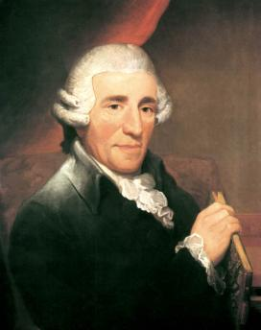
Impact of the Enlightenment: Culture
Music composers created new, elegant styles of music known as classical
Music became a popular art that people went to concerts to hear
Wolfgang Amadeus Mozart set a new standard for originality
Beethoven used emotion & range to move music beyond the classical style
Franz Joseph Haydn created the first symphony
Franz Joseph Haydn
Wolfgang Amadeus Mozart
Beethoven
Notes:
New Artistic Styles
The Enlightenment ideals of order and reason were reflected in the arts—music, literature, painting, and architecture.
Neoclassical Style Emerges
European art of the 1600s and early 1700s had been dominated by the style called baroque, which was characterized by a grand, ornate design. Baroque styles could be seen in elaborate palaces such as Versailles (see page 600) and in numerous paintings. Under the influence of the Enlightenment, styles began to change. Artists and architects worked in a simple and elegant style that borrowed ideas and themes from classical Greece and Rome. The artistic style of the late 1700s is therefore called neoclassical (“new classical”).
Changes in Music and Literature
Music styles also changed to reflect Enlightenment ideals. The music scene in Europe had been dominated by such composers as Johann Sebastian Bach of Germany and George Friedrich Handel of England. These artists wrote dramatic organ and choral music. During the Enlightenment, a new, lighter, and more elegant style of music known as classical emerged. Three composers in Vienna, Austria, rank among the greatest figures of the classical period in music. They were Franz Joseph Haydn, Wolfgang Amadeus Mozart, and Ludwig van Beethoven. Writers in the 18th century also developed new styles and forms of literature. A number of European authors began writing novels, which are lengthy works of prose fiction. Their works had carefully crafted plots, used suspense, and explored characters’ thoughts and feelings. These books were popular with a wide middle-class audience, who liked the entertaining stories written in everyday language. Writers, including many women, turned out a flood of popular novels in the 1700s. Samuel Richardson’s Pamela is often considered the first true English novel. It tells the story of a young servant girl who refuses the advances of her master. Another English masterpiece, Tom Jones, by Henry Fielding, tells the story of an orphan who travels all over England to win the hand of his lady.

Slide 5
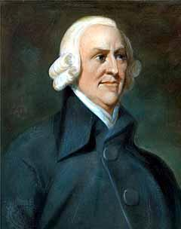
Impact of the Enlightenment: Economics
One of the most important Enlightenment ideas was the theory of capitalism & laissez-faire economics by Scottish professor Adam Smith
Capitalism is an economic model based on private ownership of property & desire to make profits
Laissez-faire is the idea that the economy thrives when the gov’t does not interfere with businesses & allows a free market to exist
According to Adam Smith, price is determined by supply & demand
Notes:
The term laissez faire refers to the economic policy of letting owners of industry and business set working conditions without interference. This policy favors a free market unregulated by the government. The term is French for “let do,” and by extension, “let people do as they please.”
Laissez-faire Economics
Laissez-faire economics stemmed from French economics. Philosophers of the Enlightenment criticized the idea that nations grow wealthy by placing heavy tariffs on foreign goods. In fact, they argued, government regulations only interfered with the production of wealth. These philosophers believed that if government allowed free trade—the flow of commerce in the world market without government regulation—the economy would prosper.
Adam Smith, a professor at the University of Glasgow, Scotland, defended the idea of a free economy, or free markets, in his 1776 book The Wealth of Nations. According to Smith, economic liberty guaranteed economic progress. As a result, government should not interfere. Smith’s arguments rested on what he called the three natural laws of economics:
• the law of self-interest—People work for their own good.
• the law of competition—Competition forces people to make a better product.
• the law of supply and demand—Enough goods would be produced at the lowest possible price to meet demand in a market economy.
The Economists of Capitalism
Smith’s basic ideas were supported by British economists Thomas Malthus and David Ricardo. Like Smith, they believed that natural laws governed economic life. Their important ideas were the foundation of laissez-faire capitalism. Capitalism is an economic system in which the factors of production are privately owned and money is invested in business ventures to make a profit.

Slide 6
Situation #1
The economy has taken a turn for the worse. The president believes the government should get the economy moving again. He wants to pass laws that require individuals and businesses to follow the government’s advice about what should be produced.
What Would Adam Smith Say? Why?

Slide 7
What Would Adam Smith Say about Situation #1
Smith would be on the side of relying on the market to improve the economy. He definitely would prefer the invisible hand of the market to the visible boot of the government. He would be afraid that government would favor some interests over others.

Slide 8
Situation #2
The Save Our jobs Coalition is working to pass a law that would penalize businesses that move jobs overseas. In addition, the law would require higher taxes to be placed on imported goods that are cheaper than those goods made in the USA.
What Would Adam Smith Say? Why?

Slide 9
What Would Adam Smith Say about Situation #2
Smith would favor free trade. He said the freer and more general the competition, the better off the public will be. Trade restrictions help certain groups at the expense of the general good. Smith was against mercantilism, just as the American colonies did. Smith supported the American position in his writings.

Slide 10
Situation #3
“Stop Government Now” is a group that believes there is no legitimate role for government except providing for police and fire protection. Members believe almost all governmental functions should be privatized and run by businesses.
What Would Adam Smith Say? Why?

Slide 11
What Would Adam Smith Say about Situation #3
Smith believed the government should provide more than police and fire protection. He supported public works and education. Most importantly, government should provide justice, without which there would be chaos. However, he would be shocked by the size of government today.

Slide 12
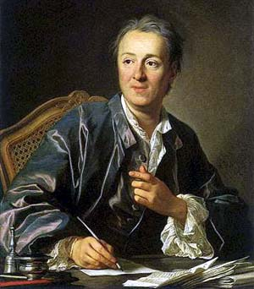
Impact of the Enlightenment: New Ideas
During the Enlightenment, people throughout Europe & America began to study, read, & philosophize about new ideas
To collect these new ideas & make them accessible, Denis Diderot created the first encyclopedia
Encyclopedia included essays & sketches on a wide variety of political, scientific, & cultural ideas
Encyclopedia spread the ideas of the Enlightenment & Scientific Revolution
Notes:
In the 1700s, Paris was the cultural and intellectual capital of Europe. Young people from around Europe—and also from the Americas—came to study, philosophize, and enjoy the culture of the bustling city. The brightest minds of the age gathered there. From their circles radiated the ideas of the Enlightenment. The buzz of Enlightenment ideas was most intense in the mansions of several wealthy women of Paris. There, in their large drawing rooms, these hostesses held regular social gatherings called salons. At these events, philosophers, writers, artists, scientists, and other great intellects met to discuss ideas.
Diderot’s Encyclopedia
The most influential of the salon hostesses in Voltaire’s time was Marie-Thérèse Geoffrin (zhuh•frehn). She helped finance the project of a leading philosophe named Denis Diderot. Diderot created a large set of books to which many leading scholars of Europe contributed articles and essays. He called it Encyclopedia and began publishing the first volumes in 1751. The Enlightenment views expressed in the articles soon angered both the French government and the Catholic Church. Their censors banned the work. They said it undermined royal authority, encouraged a spirit of revolt, and fostered “moral corruption, irreligion, and unbelief.” Nonetheless, Diderot continued publishing his Encyclopedia. The salons and the Encyclopedia helped spread Enlightenment ideas to educated people all over Europe. Enlightenment ideas also eventually spread through newspapers, pamphlets, and even political songs. Enlightenment ideas about government and equality attracted the attention of a growing literate middle class, which could afford to buy many books and support the work of artists.

Slide 13
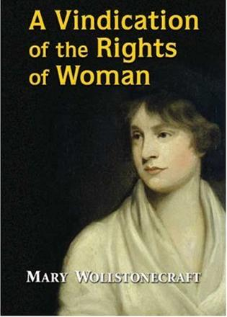
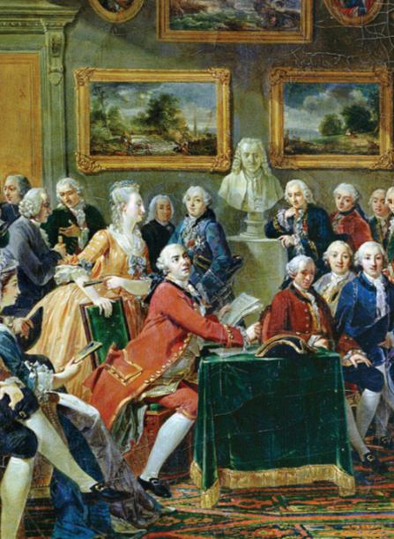
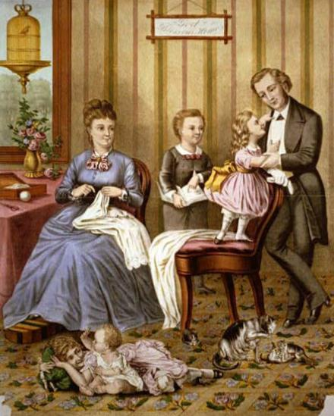
Impact of the Enlightenment: Women
Most Europeans had a traditional view of women as housewives, mothers, & not equals to men
But, new Enlightenment ideas inspired efforts to improve women’s status
Madame Geoffrin hosted salons & spoke her mind
Some women, like Mary Wollstonecraft, argued for more opportunities for education & professions
Notes:
The philosophes challenged many assumptions about government and society. But they often took a traditional view toward women. Rousseau, for example, developed many progressive ideas about education. However, he believed that a girl’s education should mainly teach her how to be a helpful wife and mother. Other male social critics scolded women for reading novels because they thought it encouraged idleness and wickedness. Still, some male writers argued for more education for women and for women’s equality in marriage. Women writers also tried to improve the status of women. In 1694, the English writer Mary Astell published A Serious Proposal to the Ladies. Her book addressed the lack of educational opportunities for women. In later writings, she used Enlightenment arguments about government to criticize the unequal relationship between men and women in marriage. She wrote, “If absolute sovereignty be not necessary in a state, how comes it to be so in a family? . . . If all men are born free, how is it that all women are born slaves?” During the 1700s, other women picked up these themes. Among the most persuasive was Mary Wollstonecraft, who published an essay called A Vindication of the Rights of Woman in 1792. In the essay, she disagreed with Rousseau that women’s education should be secondary to men’s. Rather, she argued that women, like men, need education to become virtuous and useful. Wollstonecraft also urged women to enter the male-dominated fields of medicine and politics. Women made important contributions to the Enlightenment in other ways. In Paris and other European cities, wealthy women helped spread Enlightenment ideas through social gatherings called salons, which you will read about later in this chapter. One woman fortunate enough to receive an education in the sciences was Emilie du Châtelet (shah•tlay). Du Châtelet was an aristocrat trained as a mathematician and physicist. By translating Newton’s work from Latin into French, she helped stimulate interest in science in France.

Slide 14
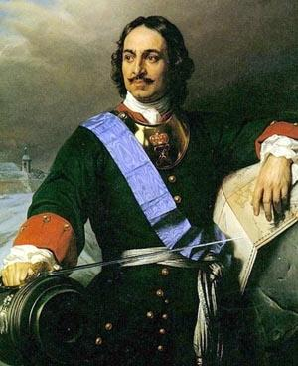
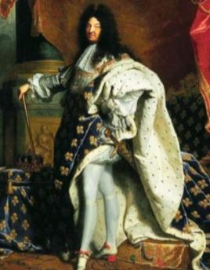
Impact of the Enlightenment: Kings
Enlightenment philosophes attacked absolute kings like Louis XIV & Peter the Great
Some powerful monarchs known as enlightened despots listened to new ideas & tried to improve the lives of their citizens
Most philosophes believed that the best form of gov’t was a limited monarchy that respected citizens’ rights
Notes:
Enlightenment and Monarchy
From the salons, artists’ studios, and concert halls of Europe, the Enlightenment spirit also swept through Europe’s royal courts. Many philosophes, including Voltaire, believed that the best form of government was a monarchy in which the ruler respected the people’s rights. The philosophes tried to convince monarchs to rule justly. Some monarchs embraced the new ideas and made reforms that reflected the Enlightenment spirit. They became known as enlightened despots. Despot means “absolute ruler.” The enlightened despots supported the philosophes’ ideas. But they also had no intention of giving up any power. The changes they made were motivated by two desires: they wanted to make their countries stronger and their own rule more effective. The foremost of Europe’s enlightened despots were Frederick II of Prussia, Holy Roman Emperor Joseph II of Austria, and Catherine the Great of Russia.
Frederick the Great
Frederick II, the king of Prussia from 1740 to 1786, committed himself to reforming Prussia. He granted many religious freedoms, reduced censorship, and improved education. He also reformed the justice system and abolished the use of torture. However, Frederick’s changes only went so far. For example, he believed that serfdom was wrong, but he did nothing to end it since he needed the support of wealthy landowners. As a result, he never tried to change the existing social order. Perhaps Frederick’s most important contribution was his attitude toward being king. He called himself “the first servant of the state.” From the beginning of his reign, he made it clear that his goal was to serve and strengthen his country. This attitude was clearly one that appealed to the philosophes.
Joseph II
The most radical royal reformer was Joseph II of Austria. The son and successor of Maria Theresa, Joseph II ruled Austria from 1780 to 1790. He introduced legal reforms and freedom of the press. He also supported freedom of worship, even for Protestants, Orthodox Christians, and Jews. In his most radical reform, Joseph abolished serfdom and ordered that peasants be paid for their labor with cash. Not surprisingly, the nobles firmly resisted this change. Like many of Joseph’s reforms, it was undone after his death.
Catherine the Great
The ruler most admired by the philosophes was Catherine II, known as Catherine the Great. She ruled Russia from 1762 to 1796. The well educated empress read the works of philosophes, and she exchanged many letters with Voltaire. She ruled with absolute authority but also sought to reform Russia. In 1767, Catherine formed a commission to review Russia’s laws. She presented it with a brilliant proposal for reforms based on the ideas of Montesquieu and Beccaria. Among other changes, she recommended allowing religious toleration and abolishing torture and capital punishment. Her commission, however, accomplished none of these lofty goals. Catherine eventually put in place limited reforms, but she did little to improve the life of the Russian peasants. Her views about enlightened ideas changed after a massive uprising of serfs in 1773. With great brutality, Catherine’s army crushed the rebellion. Catherine had previously favored an end to serfdom. However, the revolt convinced her that she needed the nobles’ support to keep her throne. Therefore, she gave the nobles absolute power over the serfs. As a result, Russian serfs lost their last traces of freedom.
Catherine Expands Russia
Peter the Great, who ruled Russia in the early 1700s, had fought for years to win a port on the Baltic Sea. Likewise, Catherine sought access to the Black Sea. In two wars with the Ottoman Turks, her armies finally won control of the northern shore of the Black Sea. Russia also gained the right to send ships through Ottoman controlled straits leading from the Black Sea to the Mediterranean Sea. Catherine also expanded her empire westward into Poland. In Poland, the king was relatively weak, and independent nobles held the most power. The three neighboring powers—Russia, Prussia, and Austria—each tried to assert their influence over the country. In 1772, these land-hungry neighbors each took a piece of Poland in what is called the First Partition of Poland. In further partitions in 1793 and 1795, they grabbed up the rest of Poland’s territory. With these partitions, Poland disappeared as an independent country for more than a century. By the end of her remarkable reign, Catherine had vastly enlarged the Russian empire. Meanwhile, as Russia was becoming an international power, another great power, Britain, faced a challenge from its North American colonies. Inspired by Enlightenment ideas, colonial leaders decided to do the unthinkable: break away from their ruling country and found an independent republic.

Slide 15
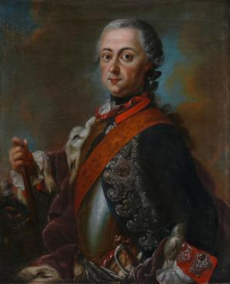
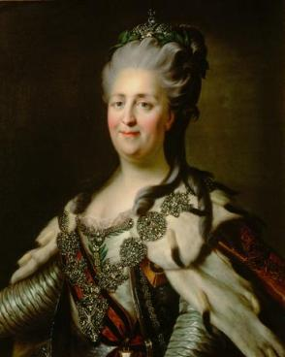
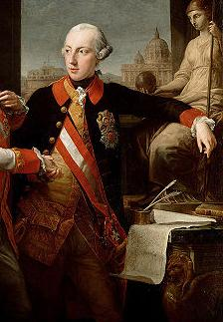
Enlightenment despots favored religious tolerance, tax reform, reduced gov’t spending, & legal rights
Frederick the Great of Prussia granted religious freedom, abolished torture, & improved education
Catherine the Great frequently wrote to Voltaire & considered protecting the rights of her citizens
Joseph II of Austria granted freedom of speech, press, religion & required peasants to be paid for their work
Notes:
Enlightenment and Monarchy
From the salons, artists’ studios, and concert halls of Europe, the Enlightenment spirit also swept through Europe’s royal courts. Many philosophes, including Voltaire, believed that the best form of government was a monarchy in which the ruler respected the people’s rights. The philosophes tried to convince monarchs to rule justly. Some monarchs embraced the new ideas and made reforms that reflected the Enlightenment spirit. They became known as enlightened despots. Despot means “absolute ruler.” The enlightened despots supported the philosophes’ ideas. But they also had no intention of giving up any power. The changes they made were motivated by two desires: they wanted to make their countries stronger and their own rule more effective. The foremost of Europe’s enlightened despots were Frederick II of Prussia, Holy Roman Emperor Joseph II of Austria, and Catherine the Great of Russia.
Frederick the Great
Frederick II, the king of Prussia from 1740 to 1786, committed himself to reforming Prussia. He granted many religious freedoms, reduced censorship, and improved education. He also reformed the justice system and abolished the use of torture. However, Frederick’s changes only went so far. For example, he believed that serfdom was wrong, but he did nothing to end it since he needed the support of wealthy landowners. As a result, he never tried to change the existing social order. Perhaps Frederick’s most important contribution was his attitude toward being king. He called himself “the first servant of the state.” From the beginning of his reign, he made it clear that his goal was to serve and strengthen his country. This attitude was clearly one that appealed to the philosophes.
Joseph II
The most radical royal reformer was Joseph II of Austria. The son and successor of Maria Theresa, Joseph II ruled Austria from 1780 to 1790. He introduced legal reforms and freedom of the press. He also supported freedom of worship, even for Protestants, Orthodox Christians, and Jews. In his most radical reform, Joseph abolished serfdom and ordered that peasants be paid for their labor with cash. Not surprisingly, the nobles firmly resisted this change. Like many of Joseph’s reforms, it was undone after his death.
Catherine the Great
The ruler most admired by the philosophes was Catherine II, known as Catherine the Great. She ruled Russia from 1762 to 1796. The well educated empress read the works of philosophes, and she exchanged many letters with Voltaire. She ruled with absolute authority but also sought to reform Russia. In 1767, Catherine formed a commission to review Russia’s laws. She presented it with a brilliant proposal for reforms based on the ideas of Montesquieu and Beccaria. Among other changes, she recommended allowing religious toleration and abolishing torture and capital punishment. Her commission, however, accomplished none of these lofty goals. Catherine eventually put in place limited reforms, but she did little to improve the life of the Russian peasants. Her views about enlightened ideas changed after a massive uprising of serfs in 1773. With great brutality, Catherine’s army crushed the rebellion. Catherine had previously favored an end to serfdom. However, the revolt convinced her that she needed the nobles’ support to keep her throne. Therefore, she gave the nobles absolute power over the serfs. As a result, Russian serfs lost their last traces of freedom.
Catherine Expands Russia
Peter the Great, who ruled Russia in the early 1700s, had fought for years to win a port on the Baltic Sea. Likewise, Catherine sought access to the Black Sea. In two wars with the Ottoman Turks, her armies finally won control of the northern shore of the Black Sea. Russia also gained the right to send ships through Ottoman controlled straits leading from the Black Sea to the Mediterranean Sea. Catherine also expanded her empire westward into Poland. In Poland, the king was relatively weak, and independent nobles held the most power. The three neighboring powers—Russia, Prussia, and Austria—each tried to assert their influence over the country. In 1772, these land-hungry neighbors each took a piece of Poland in what is called the First Partition of Poland. In further partitions in 1793 and 1795, they grabbed up the rest of Poland’s territory. With these partitions, Poland disappeared as an independent country for more than a century. By the end of her remarkable reign, Catherine had vastly enlarged the Russian empire. Meanwhile, as Russia was becoming an international power, another great power, Britain, faced a challenge from its North American colonies. Inspired by Enlightenment ideas, colonial leaders decided to do the unthinkable: break away from their ruling country and found an independent republic.

Slide 16
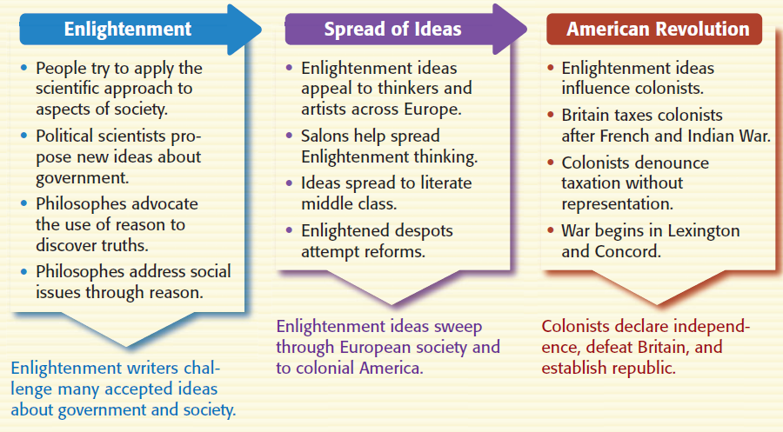
Impact of the Enlightenment: Revolutions
As the Enlightenment spread, citizens began questioning the authority of their kings…
…as a result, revolutionary wars broke out in America, France, & Latin America for independence and liberty
Notes:
Philosophes such as Voltaire considered England’s government the most progressive in Europe. The Glorious Revolution of 1688 had given England a constitutional monarchy. In essence, this meant that various laws limited the power of the English king. Despite the view of the philosophes, however, a growing number of England’s colonists in North America accused England of tyrannical rule. Emboldened by Enlightenment ideas, they would attempt to overthrow what was then the mightiest power on earth and create their own nation.

Slide 17
Closure Activity
Creating an Enlightenment Encyclopedia:
Working with a partner, create an entry into Diderot’s Encyclopedia about one key idea or person of the Enlightenment
Use the template provided to provide a brief summary of the person/idea & create a brief sketch
When finished, hang it up in the room to create a classroom encyclopedia
Be prepared to present on your topic

Slide 18
title
summary
sketch
your names
Notes:
Encyclopedia template

Slide 19
Encyclopedia Entries
Enlightenment (Age of Reason)
Reasons for the Enlightenment
Thomas Hobbes
John Locke
Baron de Montesquieu
Jean Jacques Rousseau
Voltaire
Cesare Beccaria
Salon
Neoclassical Art
Classical Music
Capitalism
Adam Smith
Mary Wollstonecraft
Denis Diderot
Enlightened Despots

