Slide 1
Essential Question:
What were the important characteristics of Humanism & Renaissance literature?
Warm-Up Question:
Find the chart on the back of Friday’s notes “Renaissance Artists”
For each image, guess whether it is Medieval or Renaissance art & why

Slide 2
Guess if the following pieces of art (A-J) are: Renaissance or Medieval

Slide 3
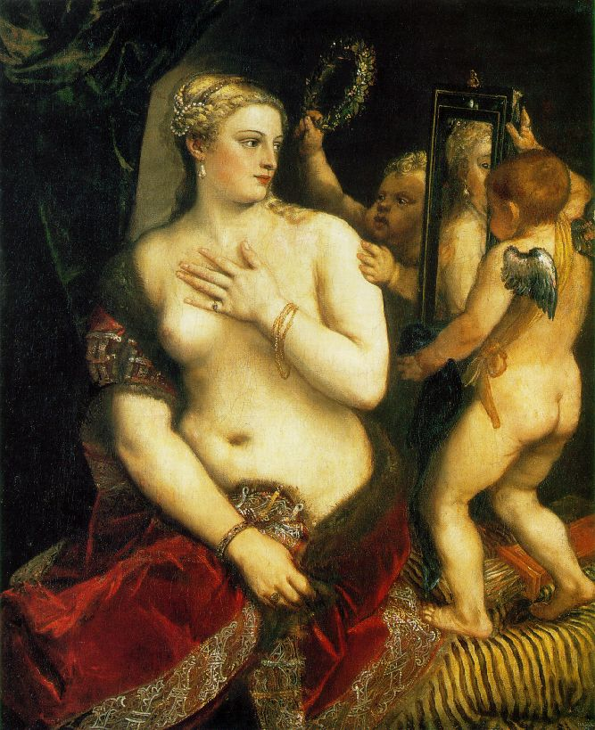
A

Slide 4
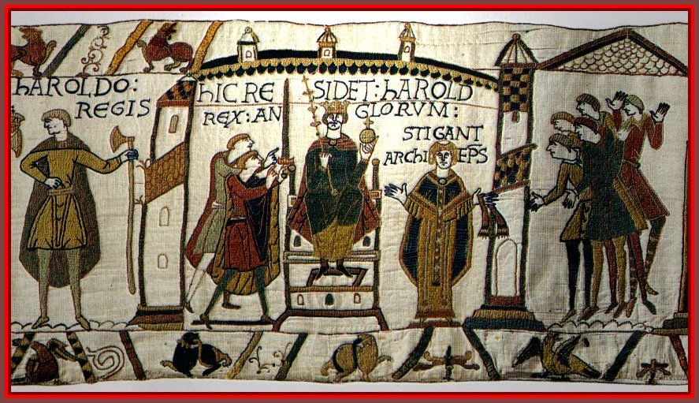
B
Notes:
Medeival

Slide 5
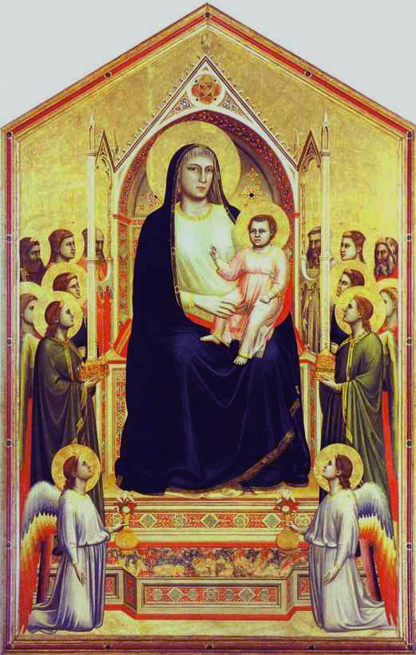
C
Notes:
Giotto-(Measta of Ognissanti)

Slide 6
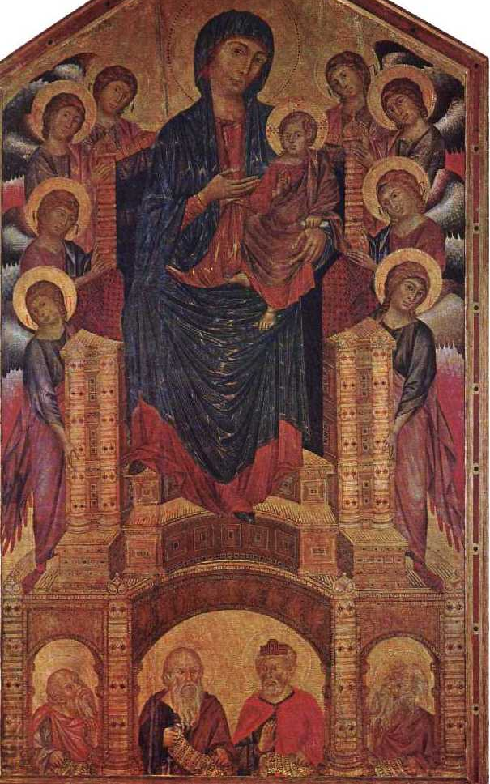
D
Notes:
Cimebue—(Maesta of St. Trinesta)

Slide 7
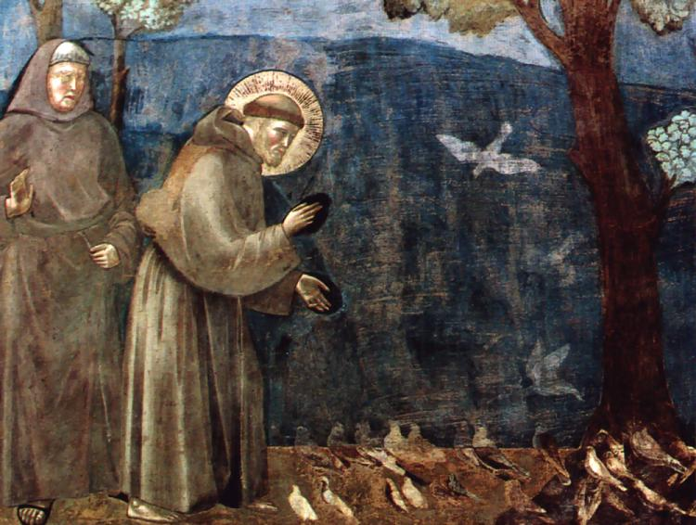
E
Notes:
Medieval

Slide 8
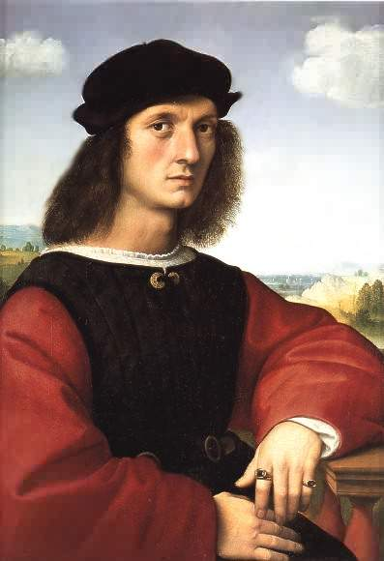
F
Notes:
Raphael—Agnolo Doni (1506)--Renaissance

Slide 9
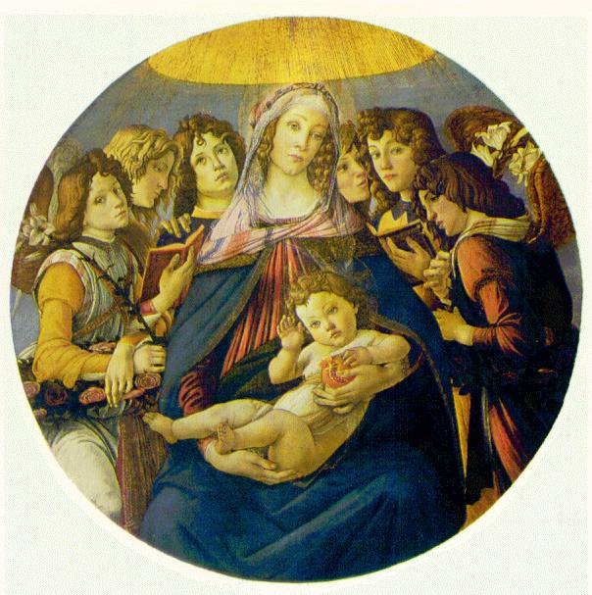
G
Notes:
Botticelli—Renaissance (Madonna of Melagrana)

Slide 10
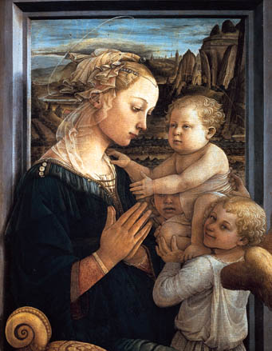
H
Notes:
Lippi—(Madonna with Child and Angels)--Renaissance

Slide 11
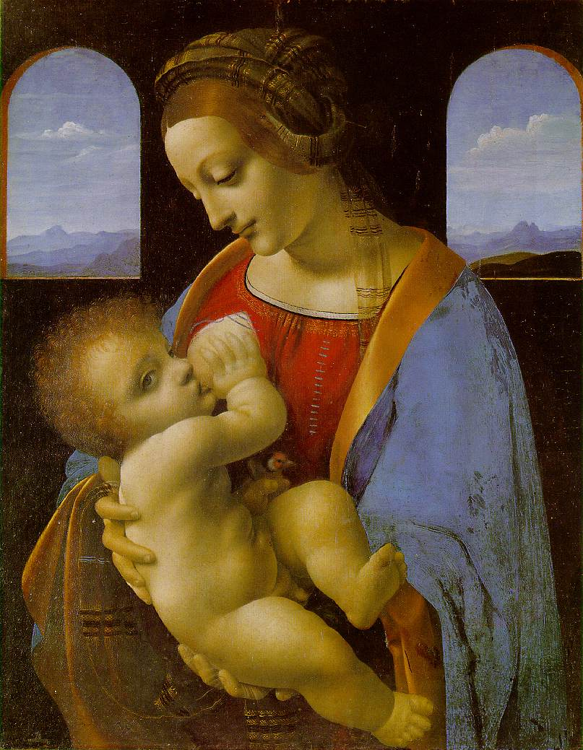
I
Notes:
madonna litta by leonardo da vinci

Slide 12
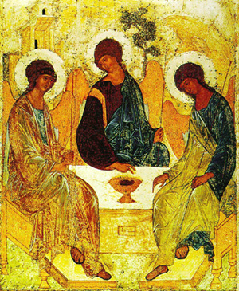
J
Notes:
The Old Testament Trinity Prefiguring the Incarnation" by Andrei Rublev, c.1410

Slide 13
Renaissance (Titian)
A

Slide 14
Medieval (tapestry)
B
Notes:
Medeival

Slide 15
(Early) Renaissance (Giotto)
C
Notes:
Giotto-(Measta of Ognissanti)

Slide 16
(late) Medieval (Cimebue)
D
Notes:
Cimebue—(Maesta of St. Trinesta)

Slide 17
(late) Medieval
E
Notes:
Medieval

Slide 18
Renaissance (Raphael)
F
Notes:
Raphael—Agnolo Doni (1506)--Renaissance

Slide 19
Renaissance (Botticelli)
G
Notes:
Botticelli—Renaissance (Madonna of Melagrana)

Slide 20
Renaissance (Lippi)
H
Notes:
Lippi—(Madonna with Child and Angels)--Renaissance

Slide 21
Renaissance (da Vinci)
I
Notes:
madonna litta by leonardo da vinci

Slide 22
(late) Medieval (Rublev)
J
Notes:
The Old Testament Trinity Prefiguring the Incarnation" by Andrei Rublev, c.1410

Slide 23
Essential Question:
What were the important characteristics of Humanism & Renaissance literature?
Warm-Up Question:
Identify the contributions of each of the following Renaissance artists: Donatello Michelangelo da Vinci Raphael Bruneschelli

Slide 24
Humanism & Renaissance Literature
What were the important characteristics of Humanism & Renaissance literature?
Working with your partner, examine the background information from the placard presented & answer the questions
When finished, bring your answers to the teacher & swap out for a new placard
When finished, be prepared for a brief class activity

Slide 25
Closure Assignment
Pick one of the Renaissance people we studied today & create a tombstone that commemorates their importance
For your person, write their name & a creative sentence that starts “Here lies…” that historians would have written to explain their importance
Include an image that best shows their importance

