Slide 1
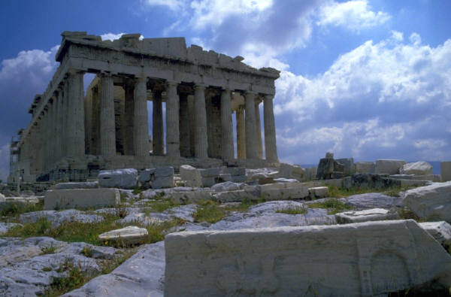
The Glory that was Greece
Driven by curiosity and a belief in reason, Greek thinkers, artists, and writers explore the nature of the universe and the place of people in it.

Slide 2
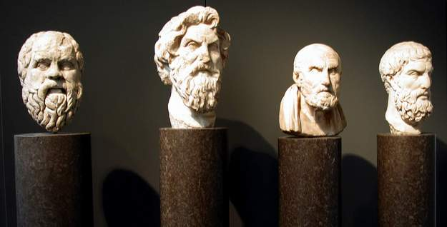
Greek Philosophers
Socrates
Plato
Aristotle
Pythagoras
Hippocrates
Herodotus
Thucydides
Aeschylus
Sophocles
Euripides
Aristophanes

Slide 3
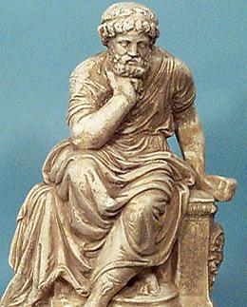
Socrates
Founder of the Socratic Method- he would pose a series of questions to his students and challenge them to examine the implications of their answers.
Seen as a threat to Greeks traditions and eventually put on trial. Was convicted of defying the gods and was sentenced to death by drinking Hemlock

Slide 4
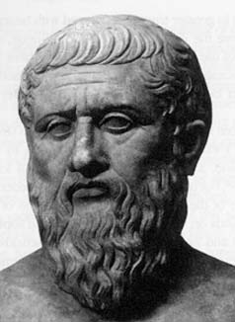
Plato
Set up the “Academy”
Taught the importance of reason
Wrote “the Republic”
In this book he describes the three levels of society
Workers
Soldiers
Philosophers

Slide 5
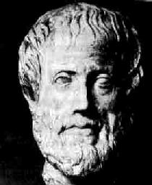
Aristotle
Plato’s most famous student
Supported a strong central ruler, because he was afraid of a strong and elite mob (citizenry)
Created the Lyceum a school for the study of all branches of knowledge

Slide 6
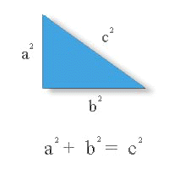
Mathematics, Medicine, and Science
Pythagoras and the Pythagorean theorem.
A squared + B squared equals C squared.
Hippocrates and the Hippocratic oath (founder of medical science)

Slide 7
History
Herodotus was considered to be the first historian and the greatest storyteller.
Thucydides stated that studying the past helped to understand human nature.

Slide 8
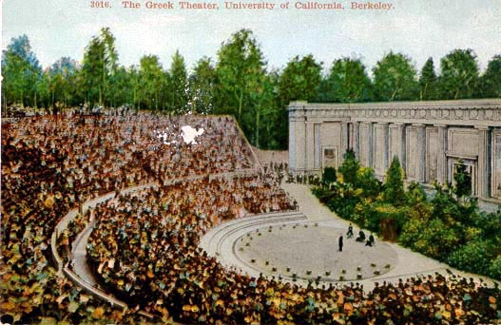
Greek Theater
Drama
Tragedies
Sophocles – Oedipus Rex
Euripides – The Trojan Women
Aeschylus wrote about religion
Dramas
Aristophanes

