Slide 1
Classical Greece
Chapter 5

Slide 2
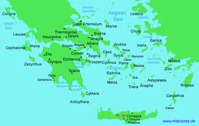
Greek City-States

Slide 3
Early Greece: Minoans
Crete, 3,000BCE, lasted over 2,000 years
Minoans sail the Aegean Sea as trading nation, settlement colonies (ships as images common)
Knossos: solid buildings with basic plumbing, artwork, private rooms
Women as priests, dangerous games
Writing but as yet not deciphered

Slide 4
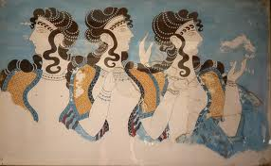
What happened?
Natural disaster? Volcano altered world climate patterns
Disruption of trade?
Internal collapse of society?
Conquered by Mycenaeans

Slide 5
Mycenaean States
Speak Greek language so considered original Greeks
Build fortress at Mycenae
From trading with Minoans, copied written language, which has been translated
Trading nation
Society dominated by competition, frequent warfare, powerful kings

Slide 6
Taxes on farming and trade to build palaces and public works
Trojan War-Mycenae v Troy (today Turkey)
War between states speeds up downfall, along with droughts and famines, war hurts trade
By 1100 BCE, ruins, dark age follows with hunger and invasions
300 years confusion

Slide 7
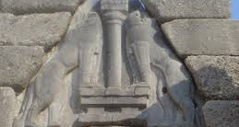

Slide 8
The City-States
Polis: the basic political unit of Greece, separate, communication between difficult, each develops independently
People are fiercely loyal, resident defines self not as national by citizen of the city-state
Acropolis: a high area that is fortified with temples to the gods and spaces for public ceremonies
Agora: below the acropolis, a marketplace-sell goods, discuss politics, surrounded by shops, additional temples
An area of town for public baths, gymnasium, training grounds
Walled with fields outside the city-state

Slide 9
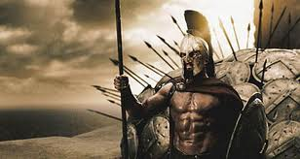
Develop independent political systems
Corinth: ruled by oligarchy-ruled by a few individuals
Athens: democracy
Sparta: monarchy

Slide 10
Sparta
Military society, expands territory and makes Messenians slaves (helots), they did physical labor so citizens were free to serve military
Keep control of helots as they outnumber citizens
Military lifestyle, strength primary virtue, weak left to die
Male children leave mother at age 7 for military training (Lycurgus), survive in wild test

Slide 11
At 20 become foot soldiers (hoplites)
Serve 10 years
Women role in society increases with men away at war, physical training to bear strong children, own property
Two kings, also military leaders with aid of council of elders

Slide 12
Mythology: Gods & Heroes
Stories told to explain natural phenomena or events in the distant past
Polytheistic, each governs one aspect of nature or life
12, the Olympians particularly influential, flawed, unpredictable
Each polis claims a patron as special protector
Sacred places like Delphi-oracle, Olympia-games

Slide 13
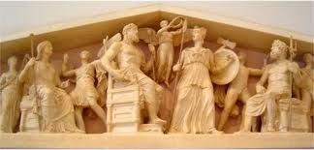

Slide 14
Hero stories used to teach Greeks where they came from and what sort of people they should try to be
Hercules-son Zeus, strength, Theseus-kills Minotaur of Crete
Inspiration, talk with gods, kill monsters, achieve great things like saving cities, BUT
Beware HUBRIS-great pride-come to a tragic end
Odyssey, by Homer, tale of Odysseus traveling home from Trojan War

Slide 15
The Classical Age
478-431 BCE, democracy: a form of government run by the people.
Monarchy at first, later Draco severe laws
594 BCE Solon redesigns laws allowing for all men to take part in assembly and be on juries,541 Peisistratus seizes power as tyrant,508 BCE Cleisthenes reforms democracy setting up Council of 500, 430 BCE Pericles leader at height

Slide 16
Democracy
Only free, adult males over age 20 who had completed military training- no women, immigrants—about 10% population
FULL involvement: vote, serve if elected, serve on juries, serve in military time of war
Assembly (all voting members) makes laws and important decisions, DIRECT DEMOCRACY
Council of 500-writes laws for Assembly vote
Courts

Slide 17
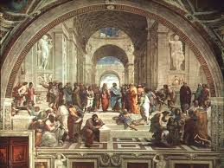
Special roles: generals who lead cities in war
Archon: chief of state, head of both Assembly & Council of 500, elected annually

Slide 18
Persian Wars
Causes: Ionia, present day Turkey, unhappy with Persian rule in 500s BCE, revolt and failure leads to Darius angry, seeks revenge v. allies
490 BCE huge fleet sets sail, came ashore at Marathon, not far from Athens (26 miles)
Athenians catch unaware, PHALANX (formation of soldiers with spears), drive Persians into retreat

Slide 19
Darius plans a second invasion, dies, 10 years later son Xerxes sets sail again
Athenians ask other Greek city-states for help, Sparta joins heads armies of Greece
To slow down advance, Spartans gather at Thermopylae, pass holds several days, local resident aids enemy
March to Athens but it had been evacuated, burn it

Slide 20
Need supplies, lured into Strait of Salamis, boats too large to maneuver, defeated
Persian army is stuck in Greece, no supplies, demoralized, defeated again at Plataea, go home

Slide 21
Golden Age of Athens
Athens becomes the leading city-state, Delian League formed for common defense, Athens largest controls, couldn’t quit
Athens needs rebuilding-use Delian League funds=resentment
Acropolis first, grand temples-Parthenon grandest dedicated to Athena
Roads, port, high walls around city

Slide 22
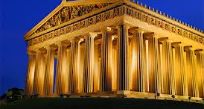
Parthenon

Slide 23
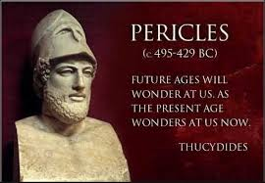
Age of Pericles
Powerful family, gifted speaker, rises to power
Encourages greater participation, introduction of democracy into other areas
Commissions buildings,artists

Slide 24
Peloponnesian War
Spartans resent Athenian dominance, own Peloponnesian League, declare war 431 BCE
Sparta dominates land battles, Athens dominates naval
Plague hits Athens 430-429 BCE, Pericles dies, fighting continues
Truce 421 BCE

Slide 25
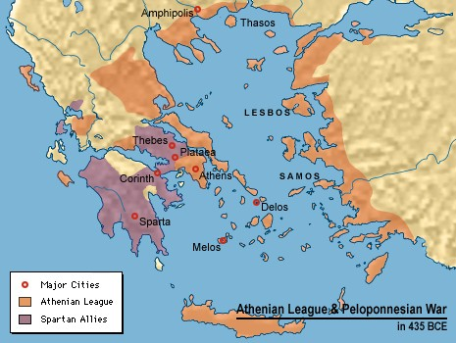

Slide 26
6 years later, war breaks out again when Athens attacks one of Sparta’s allies, destroy Athenian fleet, surrender 404 BCE
Both cities devastated
Sparta can’t fulfill leadership role, defeated by Thebes but also fail
340 BCE northern Macedonian sweeps in and takes control

Slide 27
Achievements: Philosophy
Socrates-mid 400s BCE, know about from writings of students
Sought TRUTH about broad concepts like virtue
Thought people learn best by asking questions
Believe philosophers study human behavior to learn how to improve society as a whole

Slide 28
Plato- one of Socrates’s students (428-348 BCE)
Thought philosophers were best suited to govern other people, the REPUBLIC-his most famous work on government
Not a fan of democracy
Founded The Academy a school for philosophers
Believed every material object in the world was only a reflection of a perfect ideal

Slide 29
Aristotle- studied at The Academy (384-322BCE)
Pioneered the use of reason and logic to study the natural world
Believed the greatest good people could perform was the practice of rational thought
Contributed to sciences, particularly biology

Slide 30
Literature
Homer-epic poetry
The Iliad- tells the story of the last year of the Trojan War, story of 2 heroes: Achilles of Greece and Hector a Prince of Troy, engage in single combat
The Odyssey- tells the story of Odysseus who angers the gods and wanders for 10 years before return home, meeting monsters and trials
Hesiod- descriptive poetry
Sappho-lyrical poetry on daily life, Pindar public events

Slide 31
Drama
A form of writing for entertainment
Earliest as parts of religious festivals
A chorus tells the story
Comedy and tragedy
Aeschylus-events from Athenian history
Sophocles-suffering people bring on themselves
Euripides-irrational behavior brings tragedy
Aristophanes-comedy picking on Athenian society

Slide 32
Art & Architecture
Want to celebrate city
Parthenon begun by Pericles in 447BCE, amazing for proportion, columns and statue of Athena
Sculpture celebrate human form, look lifelike and active, portrayed with beauty and grace rather than flawed reality
Painting-on vessels remain, but tales of public murals also

Slide 33
History
Herodotus-first to write and record history, lived during wars with Persia, THE HISTORIES record
Thucydides-lived during Peloponnesian War, included primary sources
Xenophon-descriptions of famous men

Slide 34
Alexander the Great
Philip II, throne in 359BCE of Macedonia
Reorganizes army, phalanx but longer spears, cavalry and archers also
Conquers all of Greece except Sparta before assassinated in 336BCE
Alexander, son at 20 inherits throne, educated by Aristotle, faces revolts, totally crushes opposition

Slide 35
Builds an Empire
Persia… Phoenicia, Egypt welcomed as liberator from Persian rule
Final defeat of Darius III, burns capital to the ground
Marches into India, before troops force return home
Dies 323 BCE in Babylon of natural causes at 33-no heir named, empire divided between 3 generals who name themselves kings

Slide 36
Achievements
Hellenistic culture reflects a blending of empire influences
Alexandria greatest example-trade, Library
Women able to own property, be educated
City-state no longer the basic political unit

Slide 37
Philosophy
Philosophy spreads throughout empire
New schools: Cynics- reject pleasure and society
Epicureans-should seek out pleasure
Stoicism-emphasis on reason, self-discipline, know your role

Slide 38
Art & Literature
Women become more common in art
Convey emotion in art, first love stories
Focus on daily lives of population rather than past heroes or gods

Slide 39
Science & Technology
Euclid- geometry
Eratosthenes- astronomy and measures the world
Archimedes- inventor, compound pulley, levers, water raising device

