Slide 1
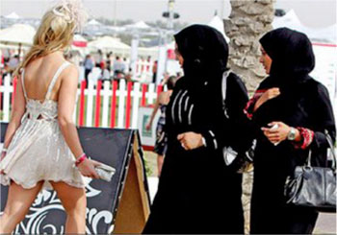
Globalization and Modernization
Amelia Bryan, Belva Barringer, Cooper Parsons, Ivan Hernandez, Jex Williams

Slide 2
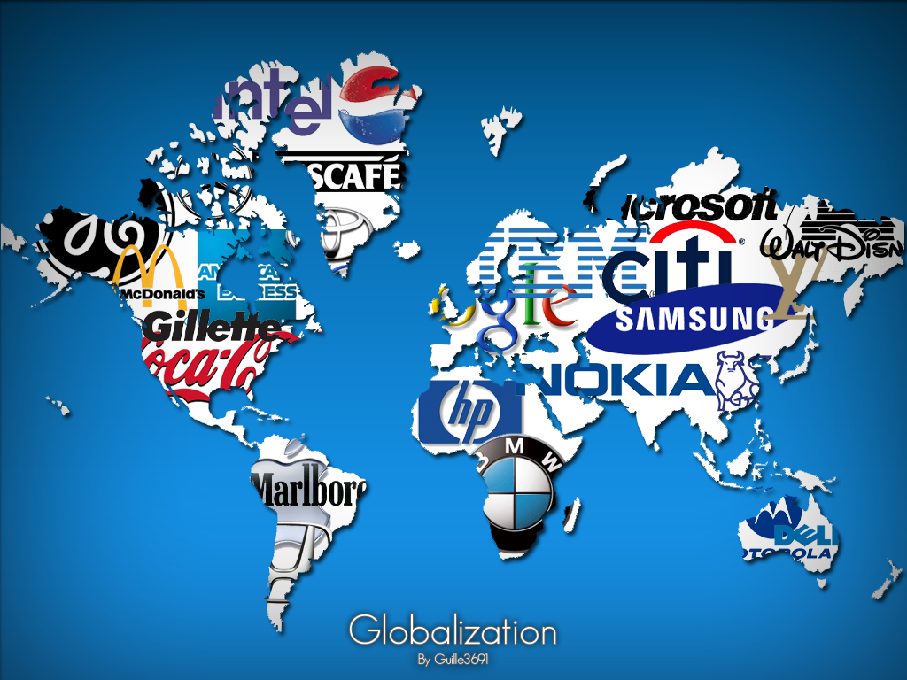
Globalization
Definition: growth to a global or worldwide scale

Slide 3
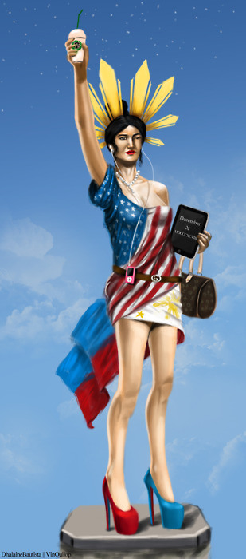
Modernization
Definition: to accept or adopt modern ways, ideas, or style.

