Slide 1
Essential Question:
What is the impact of globalization on the modern world?
Warm Up Questions:

Slide 2
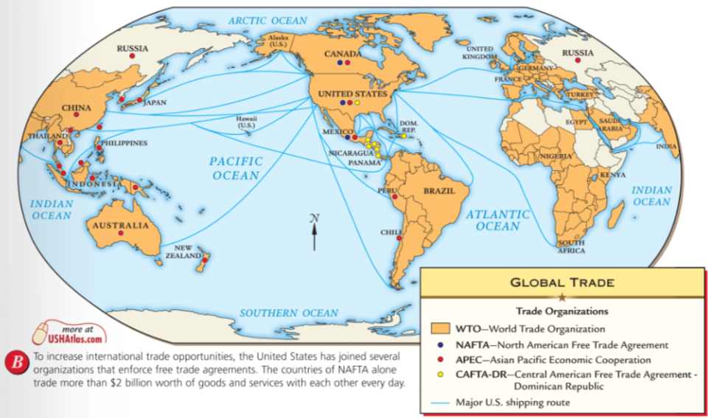
One of the biggest changes of the mid-20th century was the rapid increase in globalization
What is “globalization”?

Slide 3
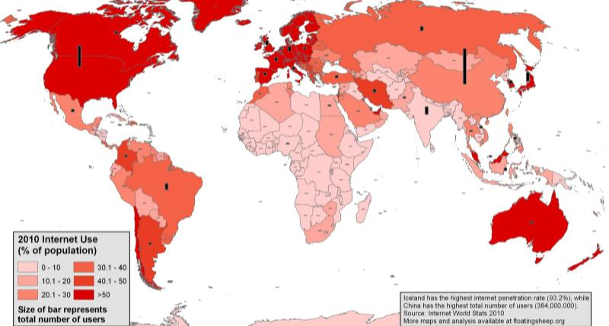
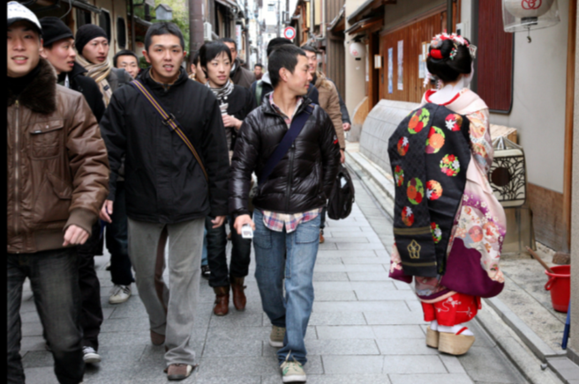
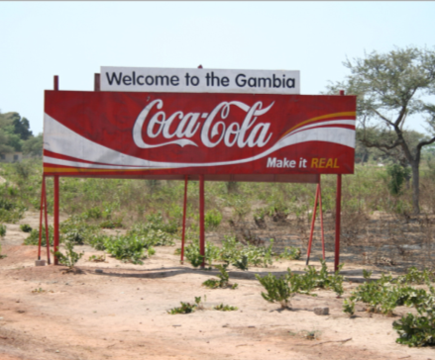
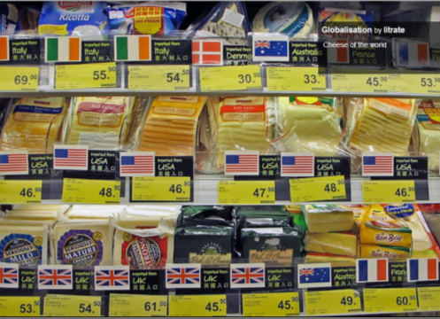
Globalization is the increased flow of trade, people, technology, culture, & ideas among countries
Today, globalization is
most associated with international trade & multinational corporations…
…advances in technology & communication…
…& increase in cultural diffusion

Slide 4
How new is globalization? What previous examples can you remember?

Slide 5
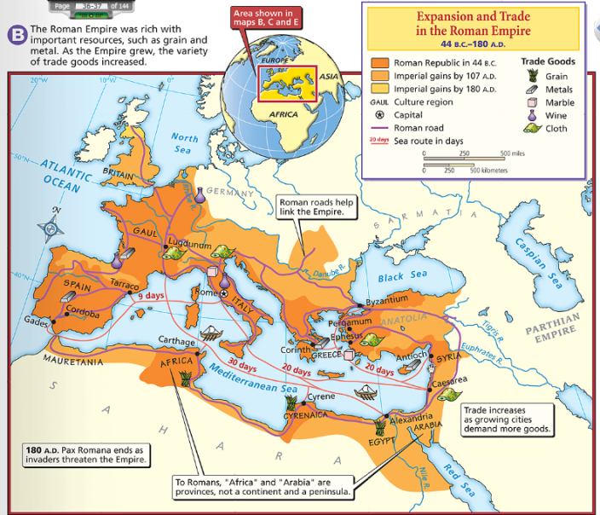
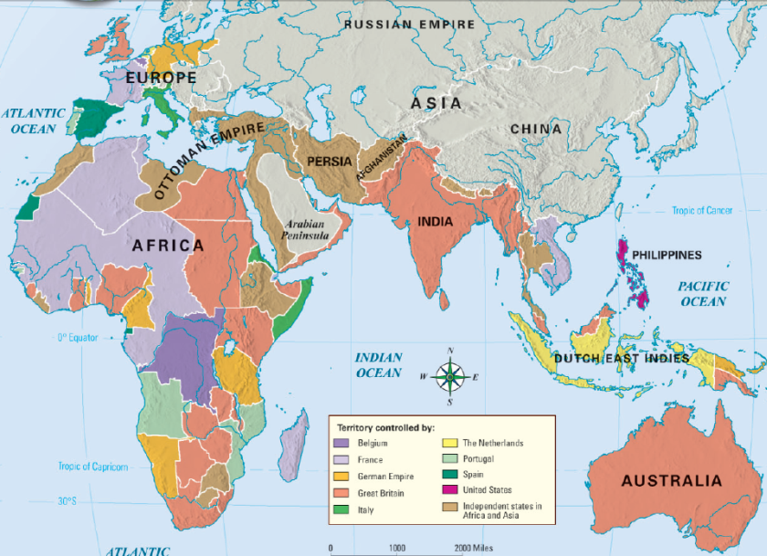
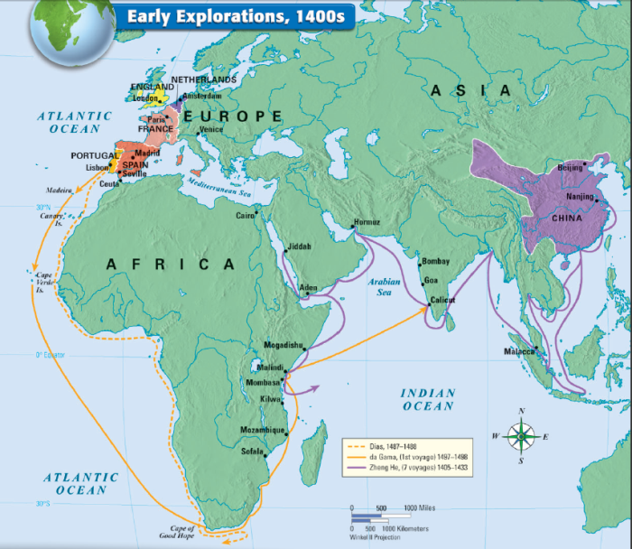
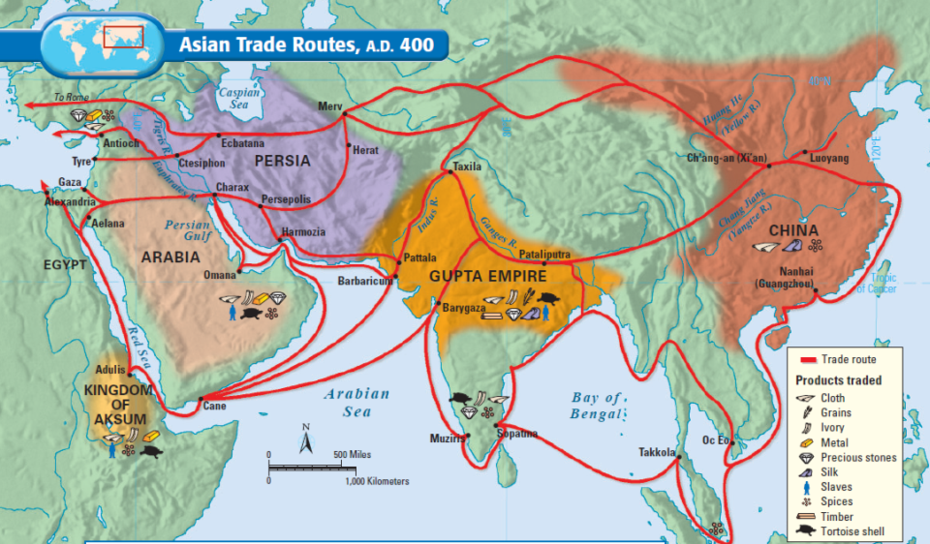
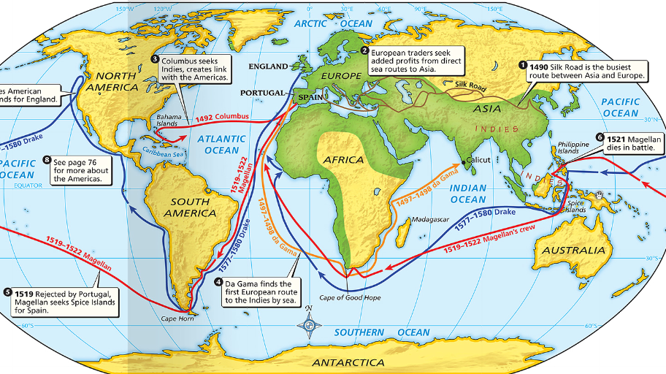
Globalization has been around for centuries but has been rapidly increasing since 1990

Slide 6
What has led to increased globalization?

Slide 7
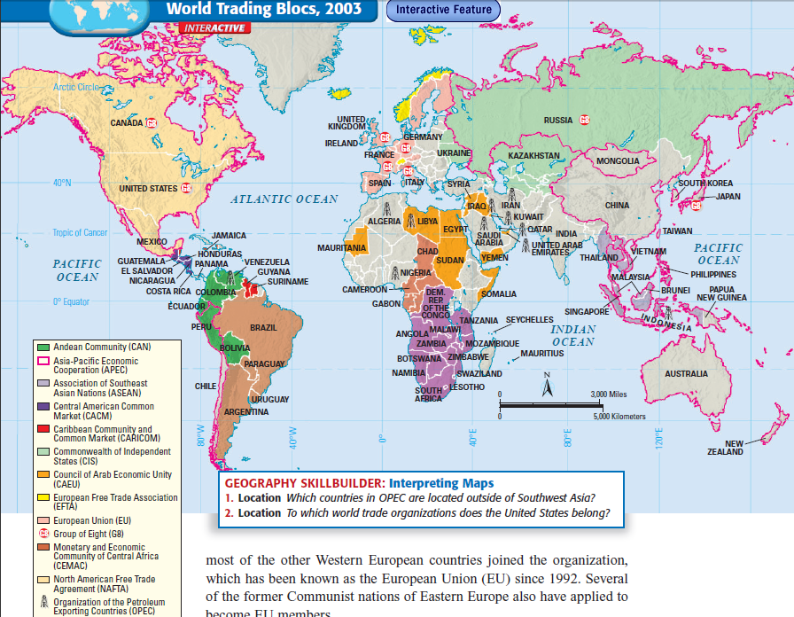
The World Trade Organization (WTO) promotes free trade
The United Nations settles trade disputes among member nations
OPEC is a cartel of oil producing nations
Globalization has increased due to lowered trade barriers, new trade organizations, & increased communication

Slide 8
What are some positive effects of globalization?

Slide 9
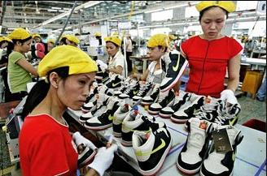
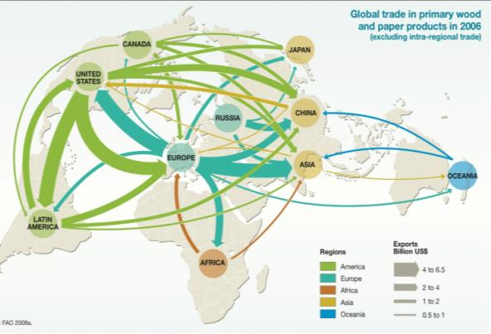
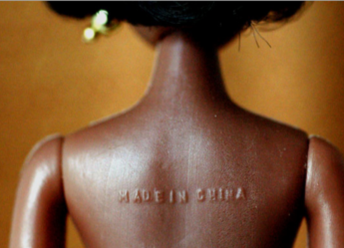
Increased trade gives people more goods & services
Companies lower costs & prices by buying materials & hiring workers from other countries
Creates jobs & raises standard of living
Globalization increases access to medicine & technology

Slide 10
What are some negative effects of globalization?

Slide 11
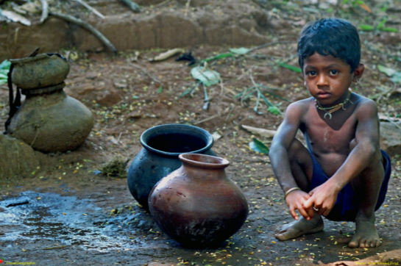
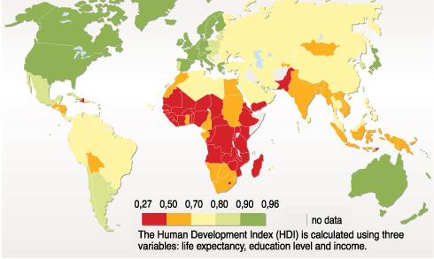
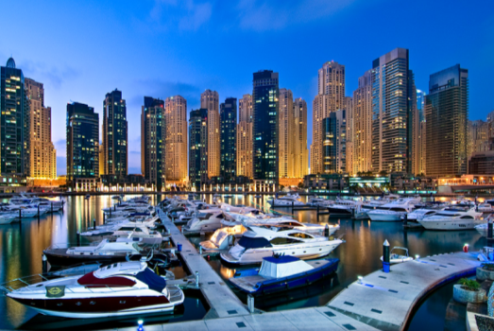
Globalization increases the gap between the developed nations & developing nations
Outsourcing leads to low-paying jobs in developing nations

Slide 12
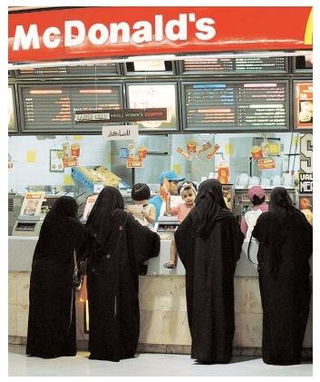
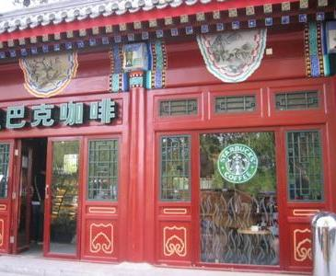
Globalization increases spread of Western culture & resentment among non-Western nations

Slide 13
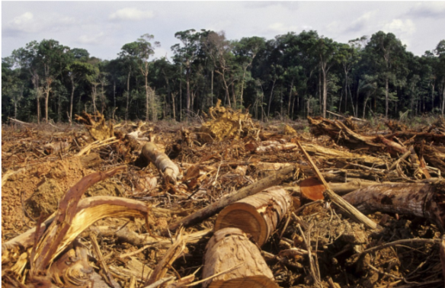
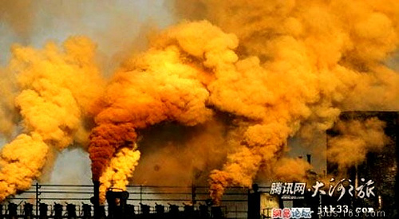
Globalization increases environmental pollution & the depletion of natural resources

Slide 14
What are some effects of multinational businesses?

Slide 15
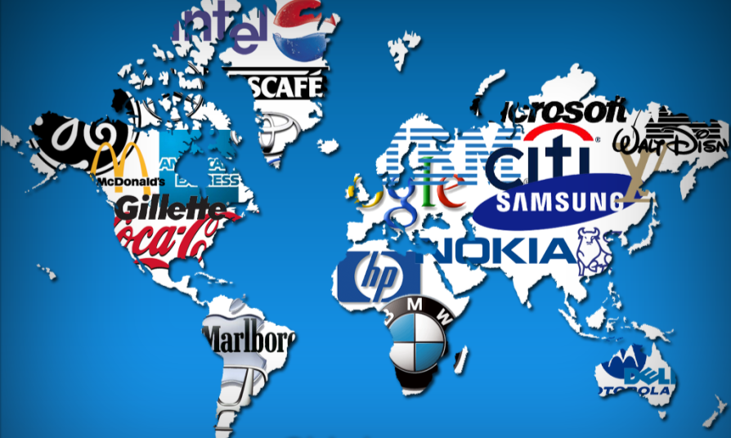
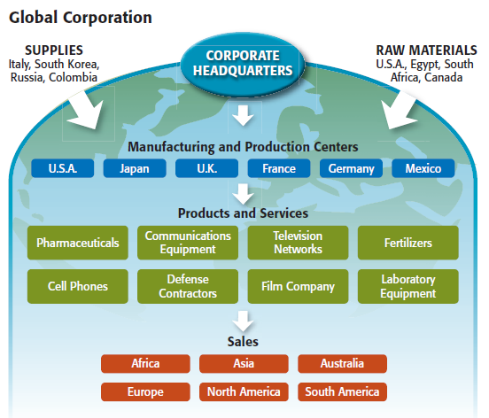
Multinational corporations (MNCs) operate in multiple countries in order to gain raw materials, assemble products, & sell throughout the world
Can you name 1 of the top 10 multinational corporations in the world? (Hint: only 1 is shown in this image)
Notes:
All of these companies have established manufacturing
plants, offices, or stores in many countries. For their manufacturing
plants, they select spots where the raw materials or
labor are cheapest. This enables them to produce components
of their products on different continents. They ship the
various components to another location to be assembled.
This level of economic integration allows such companies to
view the whole world as the market for their goods. Goods
or services are distributed throughout the world as if there
were no national boundaries.

Slide 16
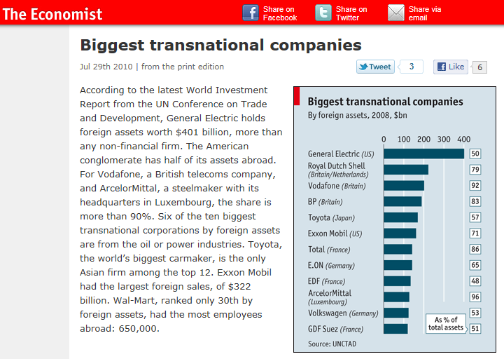

Slide 17
What is the future of globalization?

Slide 18
The future is going to change rapidly… To be successful in the future, we need to be ready to adapt
Did You Know? 3.0
Notes:
http://www.youtube.com/watch?v=Gv8pmIr3a7k&feature=related

