Slide 1
Essential Question:
What were the major events following WWII and their impact?
Warm Up Question:

Slide 2
Analyzing the Impact of World War II
How did WWII impact the world globally?
Examine each of the following images & readings. Take notes on the information provided.
Be prepared to share your answers.

Slide 3
EUROPE

Slide 4
EUROPE
After six years of war, Europe lay in ruins. 40 million Europeans were dead, two-thirds were civilians.
Many cities suffered terrible destruction. London was little more than blackened ruins. Warsaw in Poland was almost completely destroyed. Allied bombings had demolished 95 percent of Berlin in Germany. Close to 50 million Europeans were homeless. Some lived in partially destroyed homes or apartments. Others huddled in cellars or caves made from rubble. They had no water, no electricity, and very little food.
Many Europeans blamed their leaders for the war and its aftermath. After the war, the Communist Party promised change, and millions were ready to listen. Throughout Europe, people made difficult decisions between communism or democracy. The United States was worried about the spread of communism in Europe in the post-war era known as the Cold War.

Slide 5
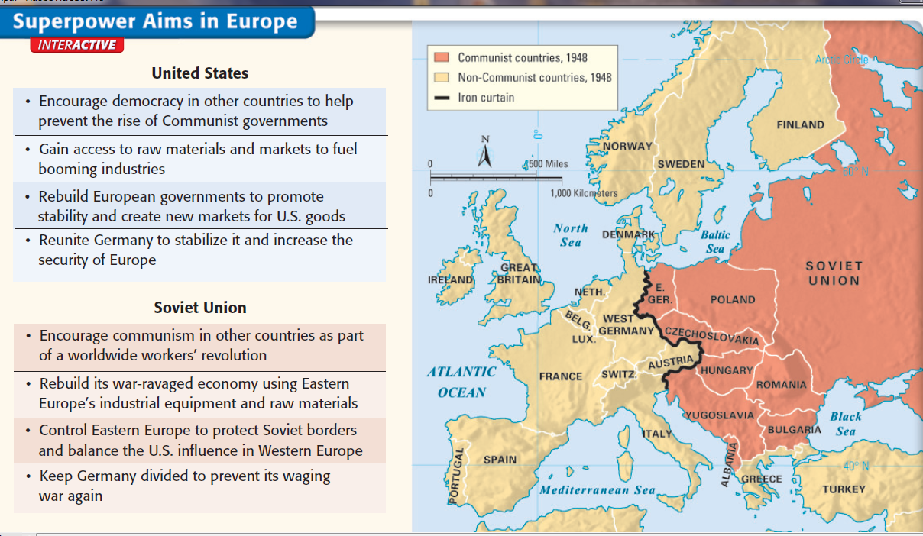
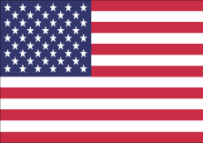
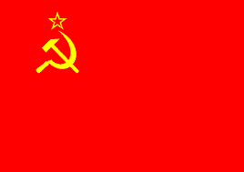
SOVIET UNION

Slide 6
SOVIET UNION
The United States and the Soviet Union split sharply after the war. The USA, the world’s richest and most powerful country, suffered 400,000 deaths, but its cities and factories remained intact. The USSR had at least 50 times as many fatalities and many Soviet cities were demolished. Despite the destruction, the USSR was a superpower in the decades after World War II.
At the end of WWII, Soviet troops removed the Nazis from Eastern Europe. Stalin saw these countries as a buffer from the democracies of Western Europe. Stalin ignored his promise at the Yalta Conference to allow self-determination in Europe and created Communist governments in Albania, Bulgaria, Czechoslovakia, Romania, Hungary, Poland, Yugoslavia.
In the post-war years known as the Cold War, Europe became divided between democracy in Western Europe and communism in Eastern Europe.

Slide 7
CHINA

Slide 8
CHINA
In the early 1900s, China was humiliated as a result of foreign imperialists who controlled Chinese trade and resources. In 1911 nationalist leader Sun Yat-sen ended the dynastic system and created a democracy to modernize China. When he died in 1925, a new leader named Chiang Kai-shek took over. But, Chaing became corrupt and offered few democratic elections.
Meanwhile, the communism was growing in China under Mao Zedong. Mao hoped to bring equality to the masses of poor Chinese peasants. From 1927 to 1949, a civil war broke out between Mao’s Communists and Chiang Kai-shek’s Nationalists. Communists used guerilla warfare and a peasant army to win the war.
Beginning in 1949, the new Communist government under Mao Zedong took land from the rich, restricted personal freedoms, introduced collective farms, and began a series of Five Year Plans to increase industry.

Slide 9
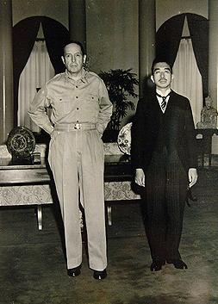
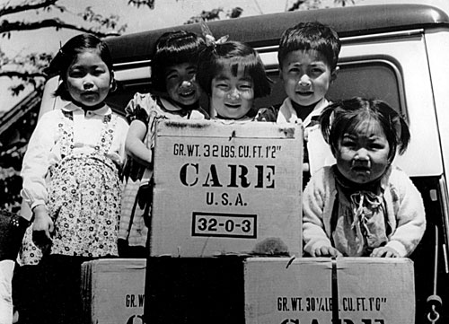
JAPAN
American-made products arrive in Japan after WWII
U.S. General Douglas MacArthur and Japanese Emperor Hirohito pose for a photograph at the end of World War II

Slide 10
JAPAN
Japan’s defeat in World War II left the country in ruins. Two million people died. Major cities were destroyed by bombing raids. The atomic bomb destroyed Hiroshima and Nagasaki. In addition, the Allies stripped Japan of its colonial empire in the Pacific.
After the war, the United States occupied Japan in order to help the country rebuild. U.S. General Douglas MacArthur took charge of the U.S. occupation. MacArthur demilitarized Japan’s army and brought Japanese war criminals to trial (many Japanese officers were executed including Hideki Tojo).
MacArthur ended Japan’s military dictatorship by introducing democracy and a constitutional monarchy. He encouraged workers, farmers, and women to vote. The occupation allowed Japan to focus on rebuilding its economy, not its military. By the 1980s, Japan was able to become a leading world economic power.

Slide 11
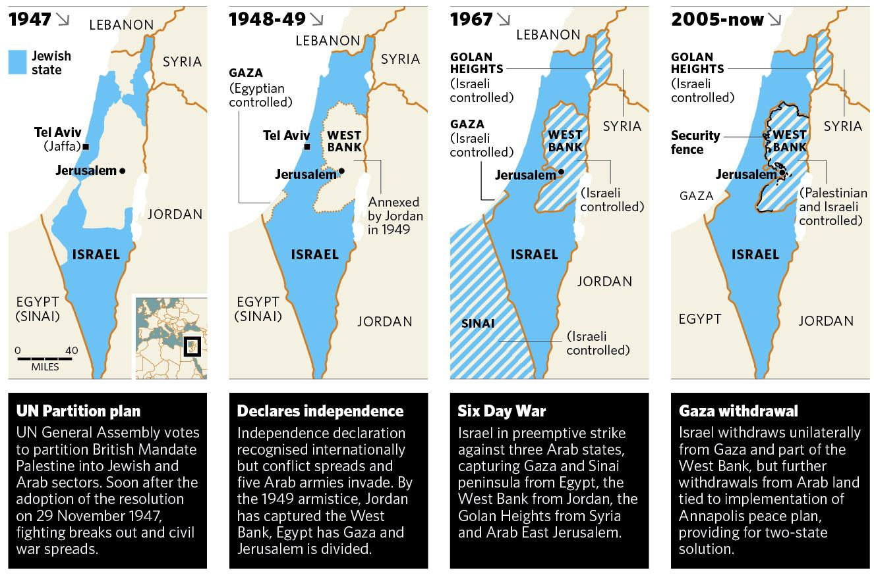
ISRAEL

Slide 12
ISRAEL
The land called Palestine in the Middle East now consists of Israel, the West Bank, and the Gaza Strip. To Jews, their claim to the land dates back 3,000 years, when Jewish kings ruled Jerusalem. But, Palestinians (both Muslim and Christian) and Arabs claimed ownership of the area after Jews left in 135 A.D.
In the 1900s, Jews known as Zionists began returning to Palestine and demanded the creation of a Jewish nation. After World War II, the United Nations voted for a partition (division) of Palestine into a Palestinian state and a Jewish state called Israel.
In 1948, Jews declared the formation of an independent Israel. The next day, six Islamic nations (Egypt, Iraq, Jordan, Lebanon, Saudi Arabia, Syria) invaded Israel. Israel won this first Arab-Israeli War. But, wars broke out again in 1956, 1967, and 1973. Fighting continues today between Israelis and Palestinians over control of the region.

Slide 13
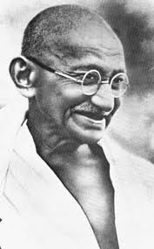
DECOLONIZATION

Slide 14
DECOLONIZATION
After World War II, dramatic changes swept across the world. After the fight against dictatorship, many leaders argued that no country should control another nation. People of colonized regions started to gain independence as Asia and Africa became decolonized.
The first colonized nation to gain its independence was India. Britain had ruled India for almost 200 years, but Britain’s weakness after WWII created opportunities for Indian freedom. Mohandas Gandhi used nonviolence and boycotts to help India become independent in 1947. Other Asian nations such as Vietnam, the Philippines, Indonesia, and Burma gained independence soon after.
Beginning in in 1957, Kwame Nkrumah helped Ghana gain independence. Over the next 30 years, most African nations struggled to gain freedom. Many African nations experienced instability, violence, and weak economies after gaining independence.

Slide 15
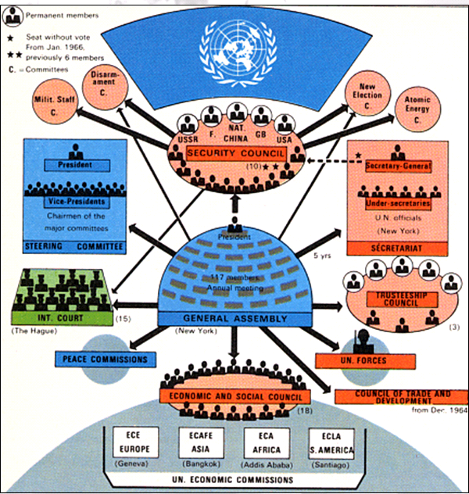
UNITED NATIONS

Slide 16
UNITED NATIONS
The outbreak of World War II revealed the weakness of the League of Nations to keep peace in the world. In 1945, 48 nations including the USA and USSR formed the United Nations (UN), whose headquarters are in New York City. The UN serves to protect international peace and equal rights.
The UN has a General Assembly where each member nation can cast its vote on a broad range of issues. But the real power is in the Security Council led by five permanent members: Britain, China, France, the United States, and Soviet Union. Each could veto any Security Council action.
The United Nations has a military force made up of member nation soldiers as well as an international court similar to the one used to try Nazi war criminals after WWII. During the Nuremburg Trials, Nazi leaders were tried for their war crimes, including the murder of 6 million Jews during the Final Solution.

Slide 17
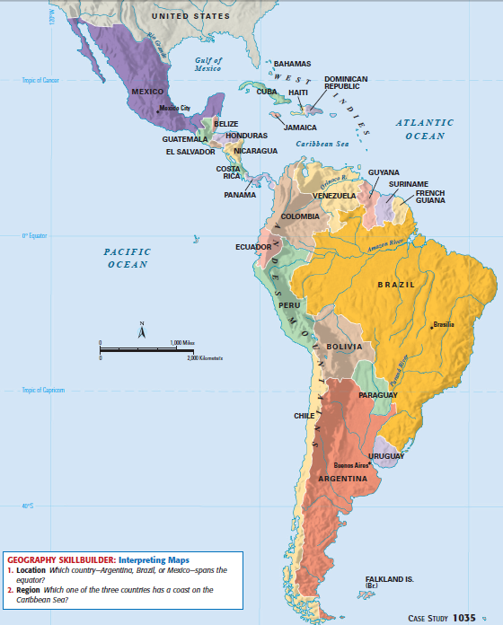
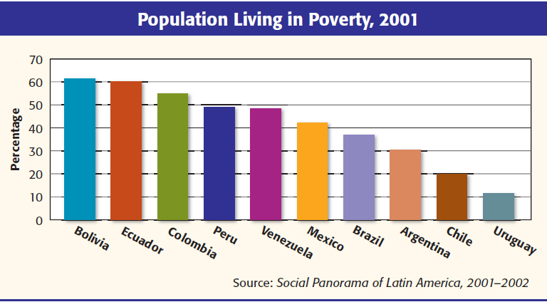
LATIN AMERICA

Slide 18
LATIN AMERICA
Many Latin American nations won their independence in the early 1800s. However, 300 years of colonial rule left many problems: Latin American nations were often ruled by military dictators, had economies that were too dependent on a single crop, and had large gaps between rich and poor.
Throughout the 20th century, many Latin American nations failed to create successful democracies. Rather than having elected presidents, dictators called caudillos came to power in Brazil, Argentina, Nicaragua, Chile, and Mexico. Today, Venezuela’s Hugo Chavez is a modern dictator.
Many Latin American nations grew dependent upon the United States for their economic development. Many nations sold raw materials (like fruits, sugar, coffee) but bought expensive manufactured goods from the USA. This trade imbalance led to high unemployment and large poor populations.

Slide 19
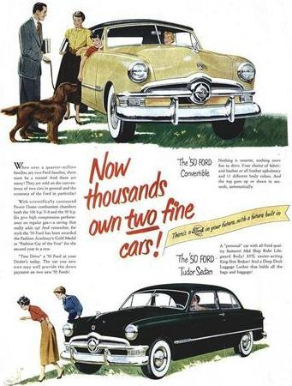
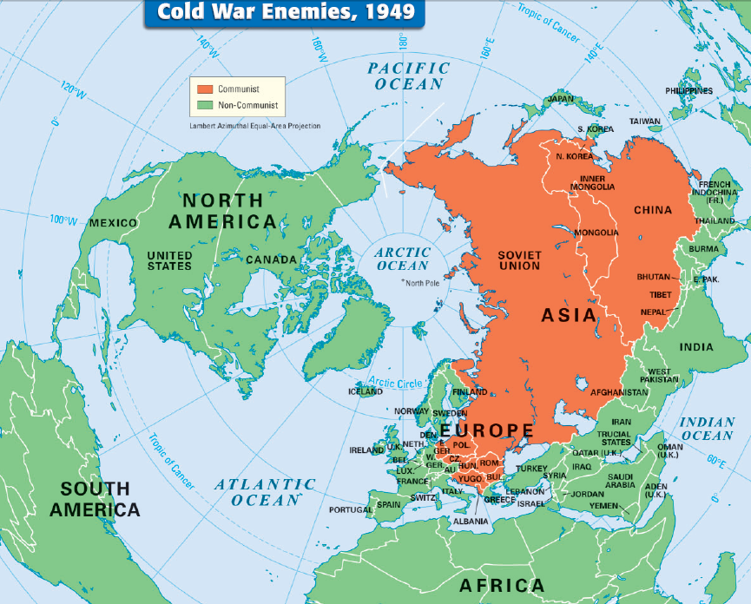
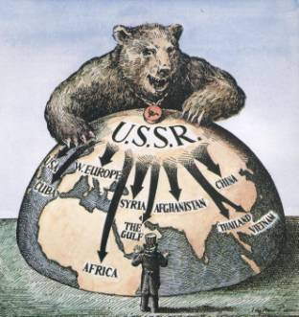
UNITED STATES

Slide 20
UNITED STATES
When World War II came to an end, the United States and Soviet Union were the world’s two superpowers. The USA was the world’s richest and most powerful country and was ready to accept a leadership role in world affairs especially stopping the spread of communism during the Cold War against the USSR.
After WWII, the U.S. economy boomed, incomes rose, and Americans began buying new homes and consumer goods. The USA became a major exporter of consumer goods, especially cars and electrical appliances. Americans, especially those in suburbs, enjoyed the highest standard of living in the world.
In world affairs, U.S. leaders feared the expansion of communism by the Soviet Union and began a policy to “contain” communism in Eastern Europe. The USA formed alliances, gave economic and military aid to democratic nations, and developed new atomic and space technologies to try to win the Cold War.

