Slide 1
Japan

Slide 2
Japan’s Geography
Japan is a series of islands—the group consists of over 3000 islands of which 600 are inhabited.
The four main islands, Honshu, Kyushu, Shikoku, and Hokkaido dominate Japanese history, however.
The largest island is Honshu, but the overall geographical area of the inhabited islands is less than California.

Slide 3
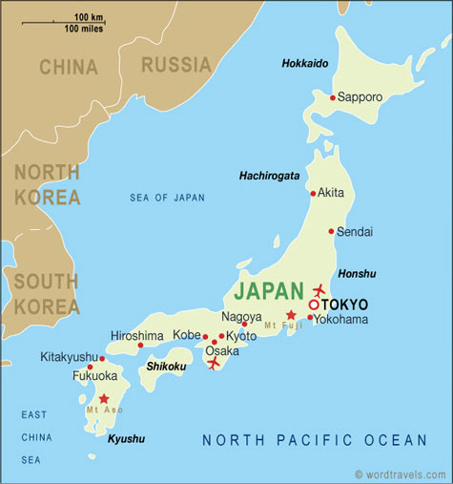

Slide 4
Japan’s Geography
The climate is pleasantly moderate, for the islands lie in the path of the Black Current which flows north from the tropics.
All the islands are mountainous and subject to a variety of natural disasters, especially earthquakes and tsunamis.

Slide 5
Japan’s Geography
All the islands are mountainous and subject to a variety of natural disasters, especially earthquakes and tsunamis.
The mountainous terrain leaves its mark on Japanese culture; since the mountains provide natural and difficult barriers, political life in Japan centered around regional rather than national governments.

Slide 6
Japan’s Geography
This island status has also protected Japan from foreign invasions.
Only twice in Japanese history has the island been successfully overrun by foreigners: in the third century BC by the wave of immigrations from the Korean peninsula, and in 1945 by the United States.

Slide 7
Japan’s Geography
Despite the late arrival of Japan into written history, the beginnings go back ten thousand years to a mysterious people which would eventually produce a unique and vital culture, the Jomon.

Slide 8
Japan’s Early Development
Japan does not appear in history until 57 AD when it is first mentioned in Chinese histories, where it is referred to as Wa.
The Chinese historians tell us of a land divided into a hundred or so separate tribal communities.
The Japanese do not start writing their histories until around 600 AD.

Slide 9
Japan’s Early Development
In order to get a handle on ancient Japanese history, it helps to consider that it is driven by outside influences.
The first involved the settlement of Japan by a group of peoples from the Korean peninsula in the third century BC.
Overnight they transformed the stone-age culture of Japan into an agricultural and metal-working culture.
These early immigrants are ultimately the origin of Japanese language and culture.

Slide 10
Japan’s Early Development
The second great push in Japanese history was contact with China from 200 AD onwards.
From the Chinese, who demanded that Japan be a tribute state to China, the Japanese adopted forms of government, Buddhism, and writing.
The bulk of Japanese culture is forged from the Chinese

Slide 11
Clan Life in Japan
The people of Japan lived in clans, which were held together by their common descent from a single ancestor.
These clans were ruled by a powerful chief, who was also the religious priest of the group.

Slide 12
Clan Life in Japan
Members of each clan practiced a form of ancestor worship known as Shinto.
Clan members believed that the spirit of the common ancestor from whom they all descended still inhabited their village, and that it protected them, and worked to help better their lives.
They worshiped this ancestor and prayed to it for help and guidance.

Slide 13
Clan Life in Japan
The clan chief also acted as the military leader, and directed the efforts of the clan to protect themselves against outsiders, and against other neighboring clans.

Slide 14
Yamata Clan
By the late A.D. 300s one clan in particular began to stand out among all the rest in political power and influence.
This clan was known as the Yamato Clan.
The Yamato Clan was known for their bravery in battle, and their superior fighting techniques.
As a result, all other clans within Japan became subject to them. The chief of the Yamato Clan became the first emperor of Japan.

Slide 15
Yamata Clan
As a result, all other clans within Japan became subject to them. The chief of the Yamato Clan became the first emperor of Japan.
Local clans still ruled their own lands, but they owed their loyalty to the emperor, who by A.D. 400 had become very powerful.

Slide 16
Feudal
Japan

Slide 17
Feudal
Japan
Feudalism:
A political, economic, and social system based on loyalty, the holding of land, and military service.

Slide 18
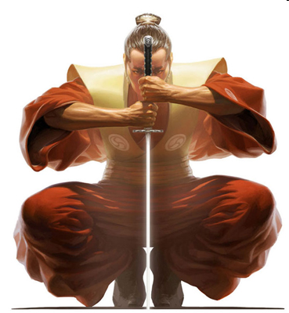
Feudal
Japan
Japan fell into a feudal system similar to that of Europe. Landowning warriors known as samurai pledged their allegiance to lords known as daimyos, and fought to protect their lands.

Slide 19
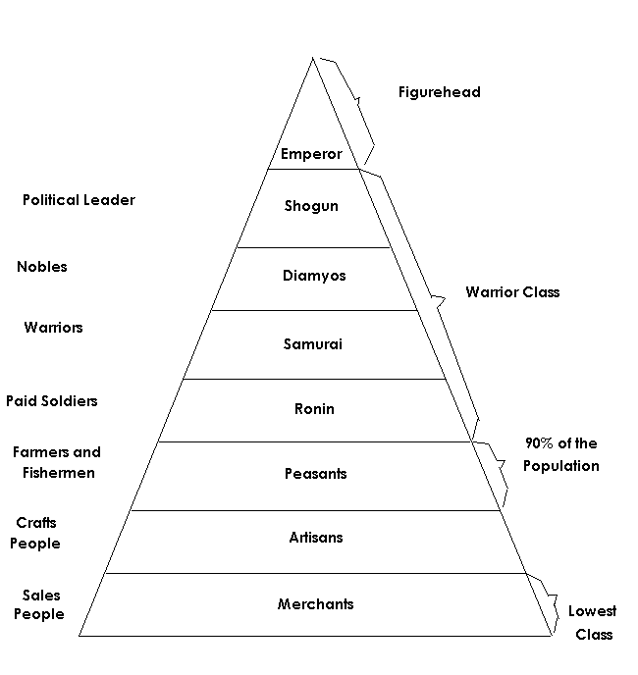
The emperor reigned, but did not always rule!
Feudal Society

Slide 20
Samurai
The samurai (or bushi) were the members of the military class, the Japanese warriors.
Samurai employed a range of weapons such as bows and arrows, spears and guns; but their most famous weapon and their symbol was the sword.
After a defeat, some samurai chose to commit ritual suicide (seppuku) by cutting their abdomen rather than being captured or dying a dishonorable death.

Slide 21
Samurai
Samurai were supposed to lead their lives according to the ethic code of bushido (the way of the warrior).
Strongly Confucian in nature, Bushido stressed concepts such as loyalty to one's master, self discipline and respectful, ethical behavior.

Slide 22
Code of Bushido
Fidelity
Politeness
Virility
Simplicity

Slide 23
Samurai
After a defeat, some samurai chose to commit ritual suicide (seppuku) by cutting their abdomen rather than being captured or dying a dishonorable death.

Slide 24
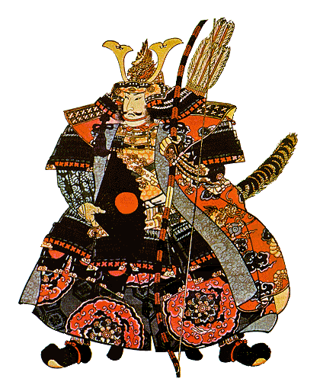
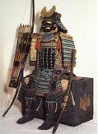
Full Samurai Attire

Slide 25
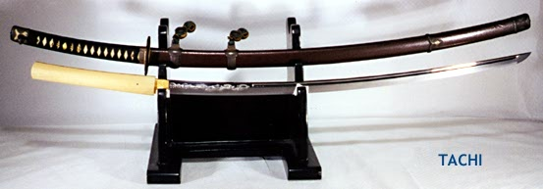
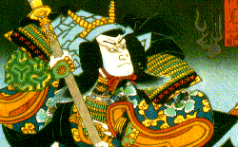
Samurai Sword

Slide 26
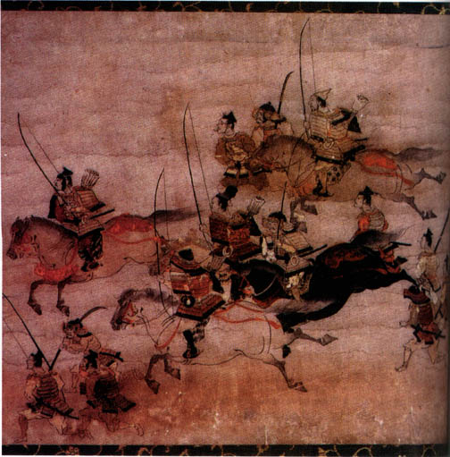
Early Mounted Samurai Warriors

Slide 27
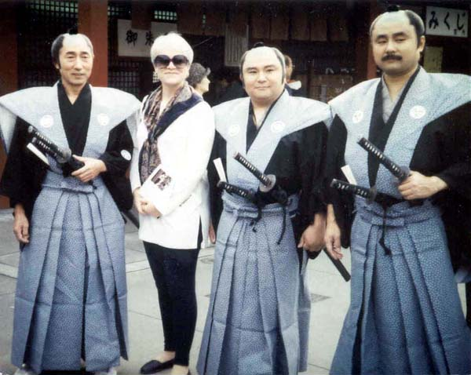
Modern-Day “Samurai Warriors”

Slide 28
Code of Chivalry
Justice
Loyalty
Defense
Courage
Faith
Humility
Nobility

Slide 29
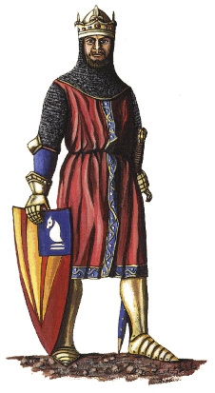
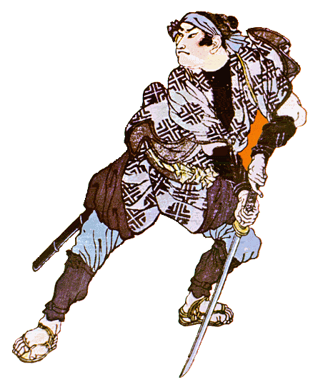
Medieval Warriors
vs.
European knight
Samurai Warrior

Slide 30
Medieval Warriors
vs.
Knight’s Armor
Samurai Armor

