Slide 1
Exploration and Expansion
Voyages and Discovery

Slide 2
1. Foundations of Exploration
The Drive to Explore
Age of Exploration was driven by the search for wealth
Many explorers hoped to find faster routes to Asia
Some set out to find glory and fame
Others to spread faith in new lands
Simple curiosity

Slide 3
b. Advances in Technology
The compass and astrolabe
Allowed sailors to plot courses even when they were out of sight of land
Advances in shipbuilding
Deep-draft ships
Were capable of withstanding heavier waves than earlier ships could
The Carvel ship
Light and fast
Two features
Steered with a rudder at the rear of the ship
Lateen sails (triangular)
Could be moved to catch the wind from any direction
Could be armed with weapons

Slide 4
2. Explorers from Portugal and Spain
The Portuguese
1st country to launch large-scale voyages of exploration
Henry the Navigator
Son of King John I of Portugal
Not an explorer, but a Patron and supporter of those who wished to explore
Established a small court of sailors, mapmakers, astronomers, and others interested in navigation
Sent expeditions to islands in the Atlantic and western coast of Africa

Slide 5
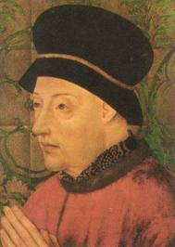
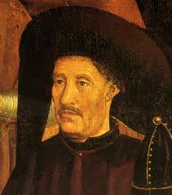
King John I of Portugal
Henry the Navigator

Slide 6
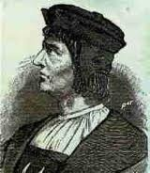
iii. Bartolomeu Dias
1488 1st European to attempt to sail around the southern tip of Africa (Cape of Good Hope)
Had to turn back due to violent storms

Slide 7
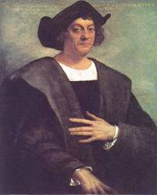
b. The Spanish
Christopher Columbus
Voyage was financed by Queen Isabella and King Ferdinand in 1492
Wanted to sail to the Indies, but reached the Caribbean after two months
Returned to Spain in 1493 with parrots, jewels, gold and plants unknown in Europe
Made 3 more voyages still believing he had reached Asia

Slide 8
ii. Amerigo Vespucci
In 1502, he concluded that the land that Columbus found was not Asia but a new land

Slide 9
iii. Vasco Nunez de Balboa
Crossed the Isthmus of Panama in 1513
1st European to see the Pacific Ocean

Slide 10
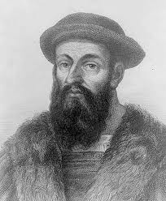
iv. Ferdinand Magellan
Sailed west around the world
He left Spain in 1519 with 5 ships and 250 men
He was killed in the Philippines but his men sailed on
In 1522, 18 survivors of the original fleet arrive back in Spain
First people ever to circumnavigate (sail) around the world completely

Slide 11
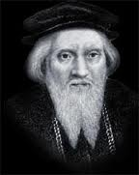
3. Explorers from the Rest of Europe
The English
John Cabot
In 1497, sailed from England to Canada

Slide 12
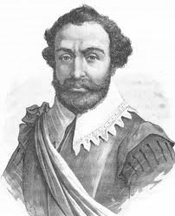
ii. Sir Francis Drake
Sent to explore the Western coast of the Americas
He wanted to find a way back to the Atlantic by sailing north but was unable to due to weather
Became the 2nd man to circumnavigate the globe

Slide 13
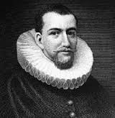
iii. Henry Hudson
Set out in 1607, to find a northeast passage around Europe
Sailed in 1609, for the Dutch, and found the Hudson River and Hudson Bay in the Americas

Slide 14
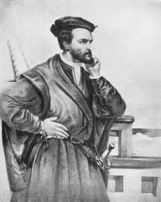
b. The French
Jacques Cartier
Left France in 1534
Sent to find a Northwest passage around North America
Sailed to New Foundland and up the St. Lawrence River in Canada
Claimed all land on either side of the river for France and called it New France

Slide 15
Conquest and Colonies

Slide 16
1. Spain builds an Empire
Spain in the Caribbean
Settled islands in the Caribbean, such as Hispaniola and Cuba
Hoped to find gold but didn’t
Introduced the encomienda system
Colonist were given an amount of land and certain number of Native Americans to work the land
In return colonist were required to teach natives about Christianity
System was disastrous for Native Americas
Overworked and mistreated
Disease spread i.e. smallpox
No resistance to the illness, million die ( went from a pop. of 50 million down to a pop. of 4 million)

Slide 17
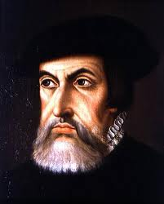
b. Conquest of Mexico
Hernan Cortez
Led expedition to Mexico
Was a Conquistador (conqueror)
Applied to Spanish military leaders who fought against native peoples in America

Slide 18
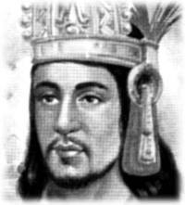
3. Conquered Aztecs
Moctezuma
Leader of the Aztecs
Unpopular with those he conquered
Conquered the Aztecs with the help of their enemies
4. Advantages
Had translator
Metal weapons, heavy armor and guns
Also had horses
5. November 8, 1519 Cortez and army entered Tenochtitlan

Slide 19
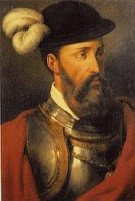
c. The Conquest of Peru
Francisco Pizarro
Led expedition to Peru
Met Inca leader Atahualpa in 1532
Pizarro demanded that Atahualpa accept Christianity and had over his empire to Spain
Took Atahualpa prisoner and eventually killed him
Received a huge fortune in gold and silver

Slide 20
d. Life in the Spanish Empire
To govern American holdings the Spanish king chose officials called viceroys
Each ruled a large area in the kings
Colonial economy was based on the mining of gold and silver
Farming was also common
Native Americans were used for labor
Effects
Disease and mistreatment dropped the population by 90%

Slide 21
v. Bartolome de Las Casas
Was a priest
Was appalled at the mistreatment of the Native Americans
Wanted to protect those that remained
Recommended replacing them as labors with imported African slaves

Slide 22
2. The Portuguese in Brazil
Treaty of Tordesillas
Signed in 1494
Drew imaginary line through the Atlantic
Everything west was given to Spain, everything east to Portugal
Only Brazil remained under the control of Portugal

Slide 23
b. Brazil
Slow to develop
Established huge farming states
Labor
First was Native Americans
Then African Slaves

Slide 24
3. French, Dutch and English Colonies in the Americas
New France
Resources
Fish
Furs (fox, lynx, otter, etc.)
Did not send large number of colonist
Did not enslave Native Americans
Main source for furs

Slide 25
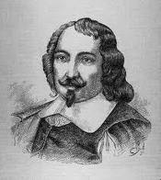
iv. Samuel de Champlain
Founded the city of Quebec in 1608

Slide 26
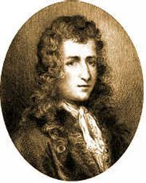
v. Rene-Robert LaSalle
Canoed down the entire Mississippi River
Claimed enormous Mississippi region and its tributaries for France
Named region Louisiana after King Louis XIV

Slide 27
b. The Dutch of New Netherland
Dutch colonist mostly interested in trade
New Netherland was located in the Hudson River Valley
1626, governor of New Netherland bought island of Manhattan from the natives and founded the city of New Amsterdam
Reasons for lack of growth
Focused on developing colonies in other parts of the world
The colonies were more profitable

Slide 28
c. The English Colonies
1st colony in America ,established in 1607, was Jamestown
1620, Pilgrims sailed from England
Established the colony of Plymouth, Massachusettes
Viewed Native Americans with distrust and even anger

Slide 29
d. British-French Conflict
Mid 1700s British colonist began attempting to settle in French territory in the upper Ohio River Valley
War broke out in 1754
British vs. French and Indians
War went badly for the British at first
Turning point was when the British took Quebec
French eventually surrendered
Yielded Canada and all French territory east of the Mississippi

