Slide 1
Essential Question:
In what ways has Europe in the post- Cold War era (1991-present)?
Warm Up Questions:

Slide 2
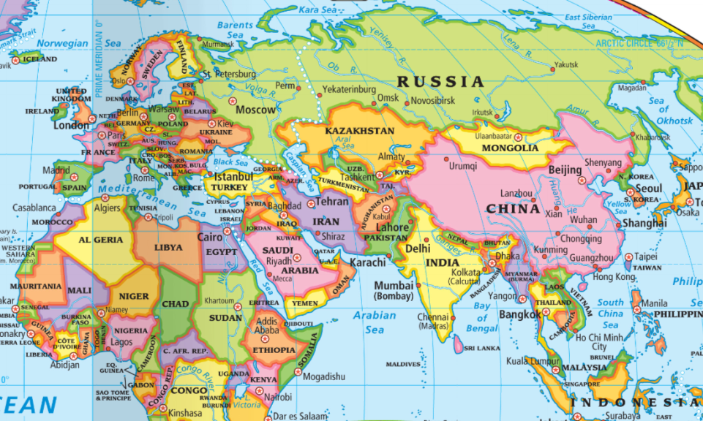
In the 20 years after the Cold War ended, Europe experienced important changes

Slide 3
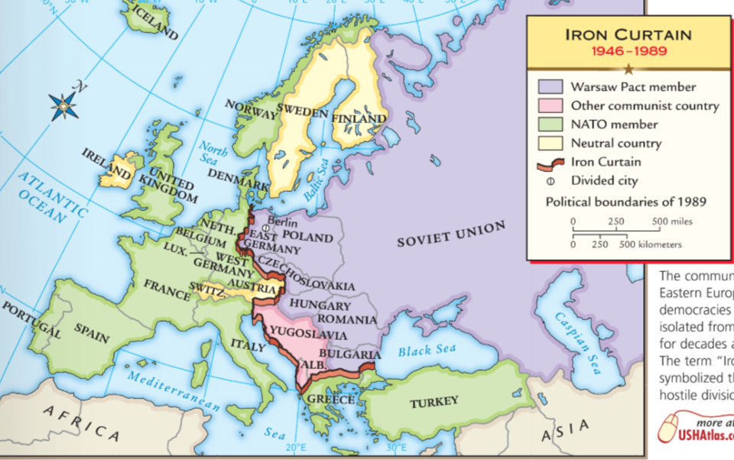
During the Cold War, nations in Western Europe were democracies
Eastern European nations were communist satellites

Slide 4
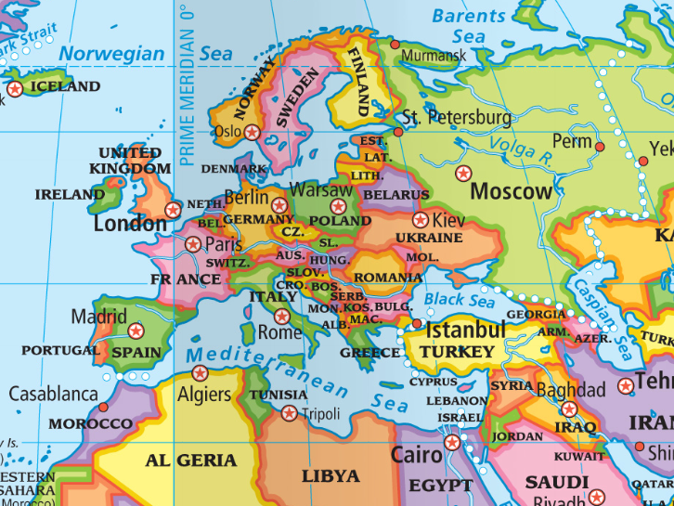
As communism fell in Eastern Europe & USSR from 1989 to 1991, nations created democratic governments & capitalist economies
In 1990, East & West Germany reunified
Former Soviet states like Ukraine & Kazakhstan became nations

Slide 5
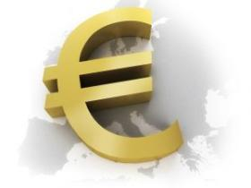
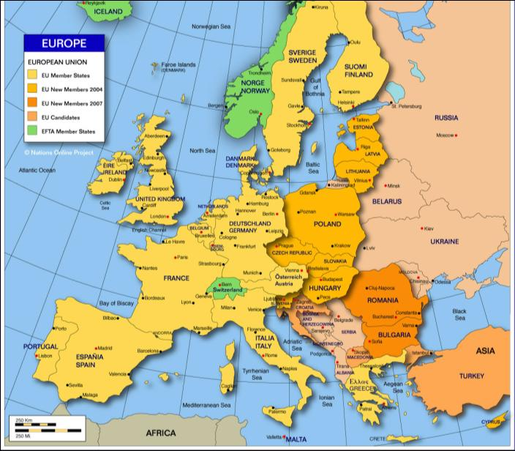
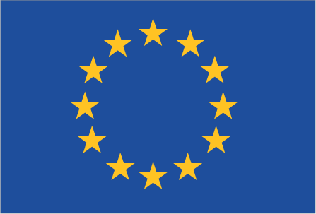
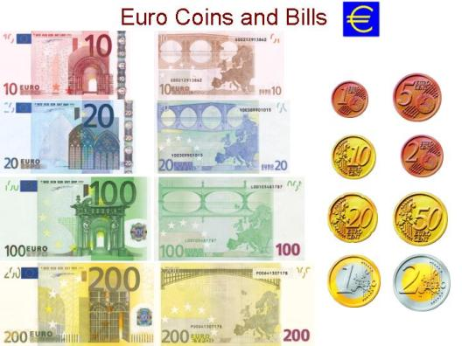
Since the 1950s, Western European nations encouraged trade through a “European Economic Community”
In 1992, this organization became known as the European Union (EU)
The EU Parliament regulates trade among 27 nations
In 1999, the EU created a common currency called the “Euro” that is used by most member nations
Today, the Euro is the 2nd most traded currency in the world
The EU has effectively created a common European economy

Slide 6
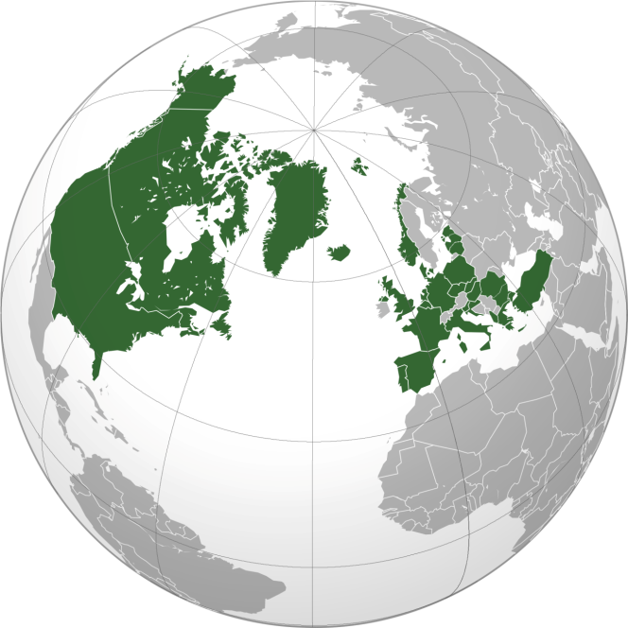
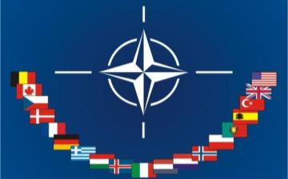
During the Cold War, the Western democracies formed the NATO military alliance to defend against aggression by the Soviet Union
When the Cold War ended in 1991, Eastern European nations joined NATO

Slide 7
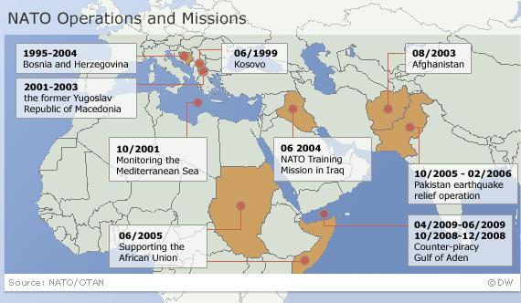
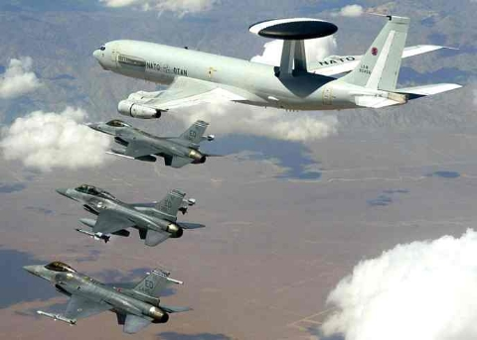
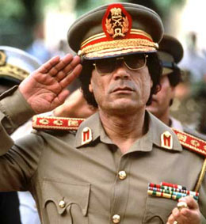
Today, NATO serves an important role in international peacekeeping & fighting terrorism
Libya, 2011

Slide 8
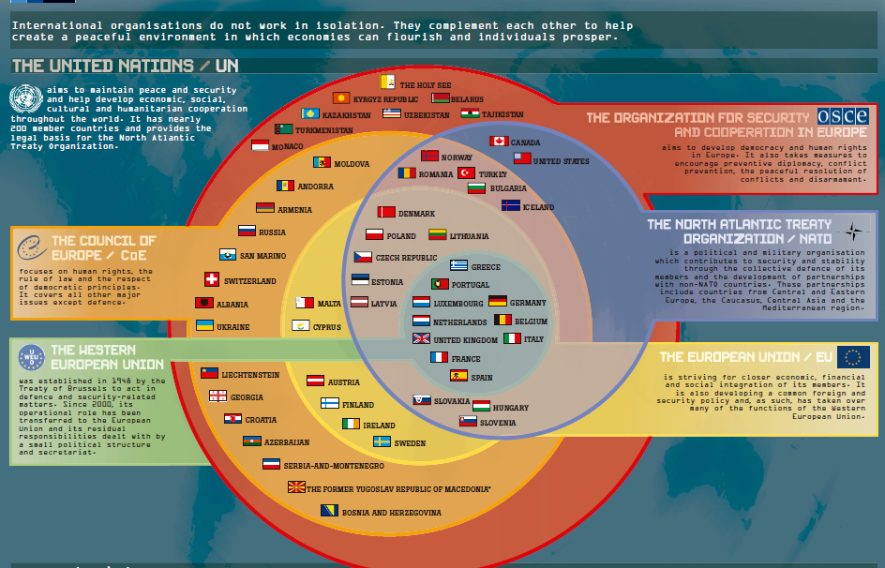
Together, NATO & the EU serve major roles in protecting peace & security in Europe

Slide 9
Despite the successes of the EU & NATO, Europe’s most tragic failure was not stopping genocide after the break-up of Yugoslavia in the 1990s

Slide 10
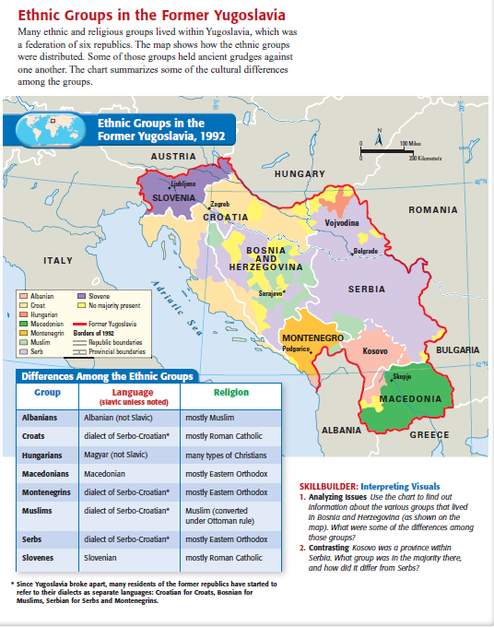
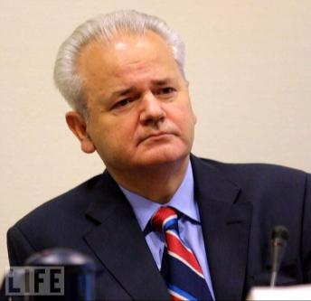
When the Cold War ended, ethnic nationalism increased in the Balkans which led to the break-up of Yugoslavia in 1991
Croatia & Slovenia declared independence
Bosnia-Herzegovina broke away in 1992
Muslims & Croats in Bosnia supported independence, but Serbs were against it
In 1992, the Serbian leader Slobodan Milosevic declared war & used the military to “ethnically cleans” Bosnia of its Muslims

Slide 11
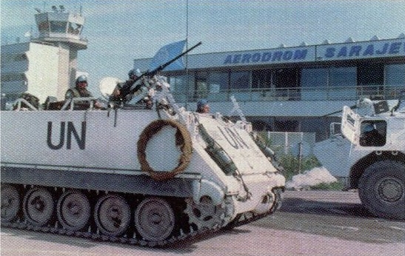
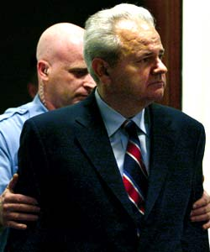
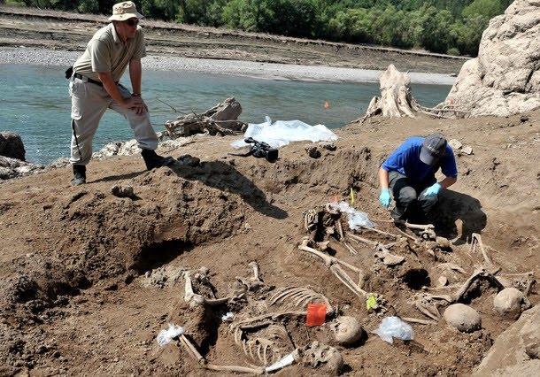
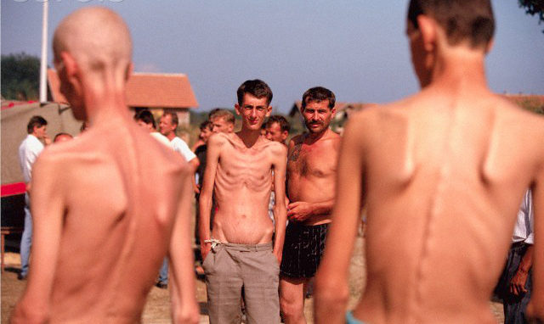
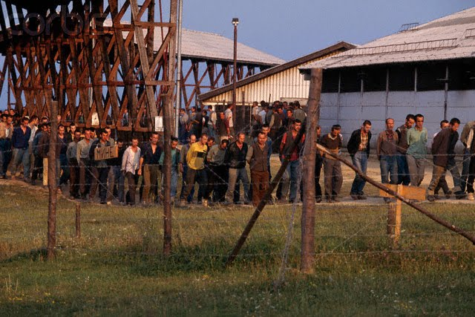
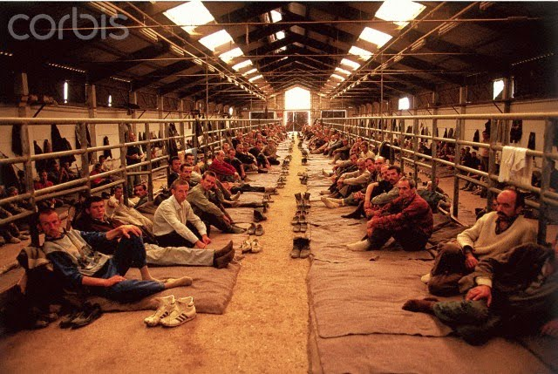
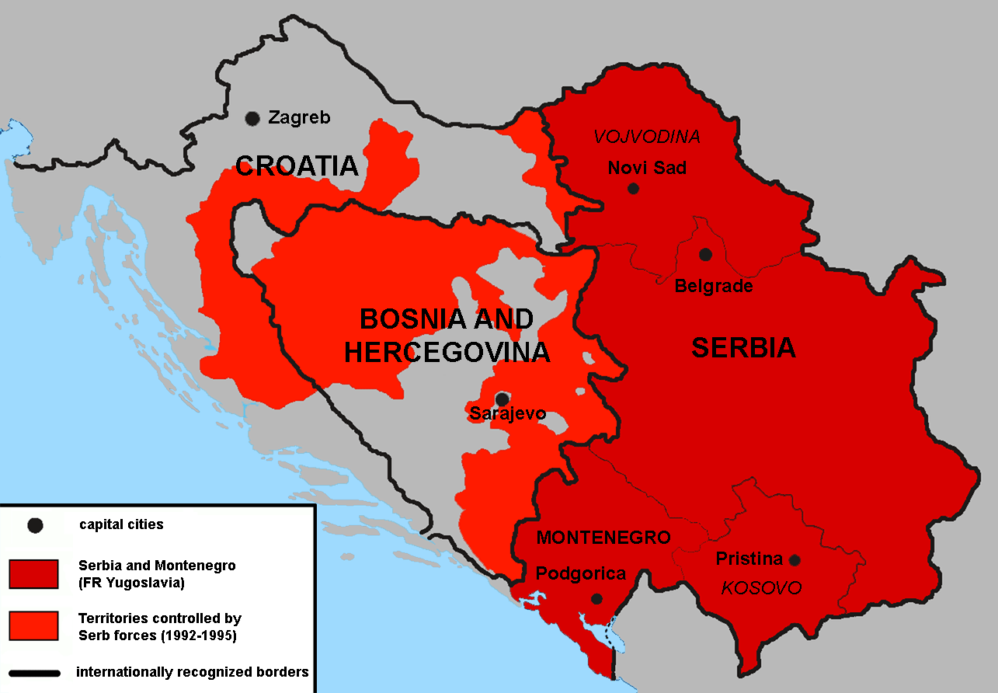
From 1992 to 1995, Serbians fought & murdered 100,000 Bosnian Croats & Muslims
By 1995, United Nations peacekeepers brought an end to the Bosnian War
In 2002, Milosevic’s trial began for war crimes & he died in jail in 2006
Concentration camp

Slide 12
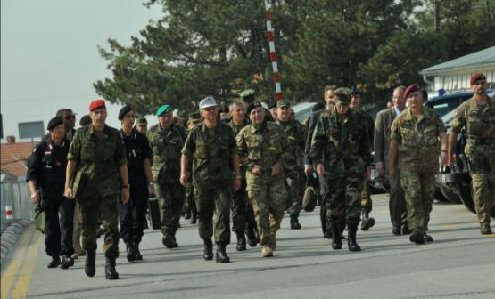
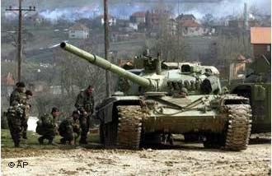
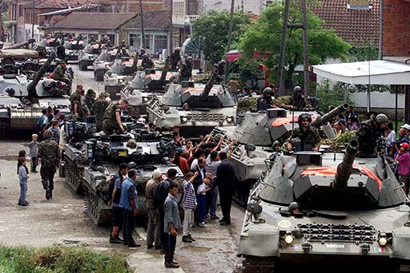
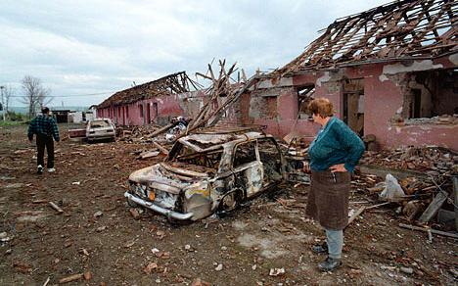
Violence broke out again in the Balkans when war began in Kosovo in 1998
Ethnic Albanians in Serbia declared independence
The Serbian military used force to end the Kosovo rebellion
The conflict ended in 1999 when NATO began bombing the Serbian military

Slide 13
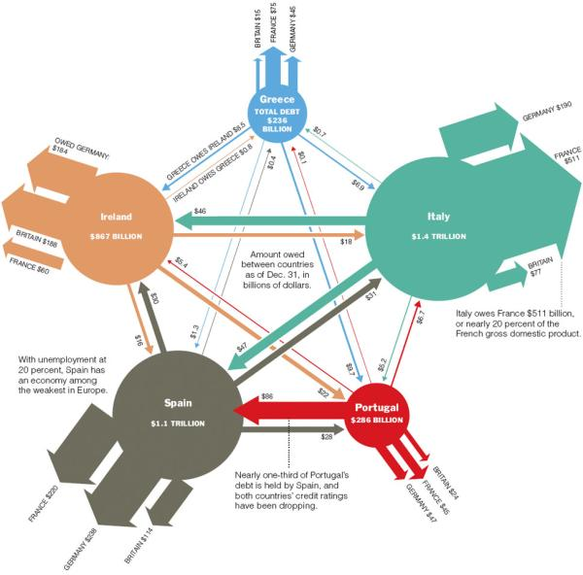
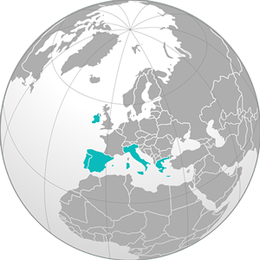
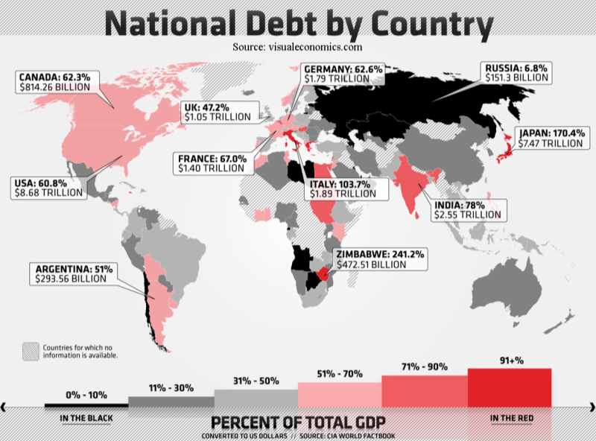
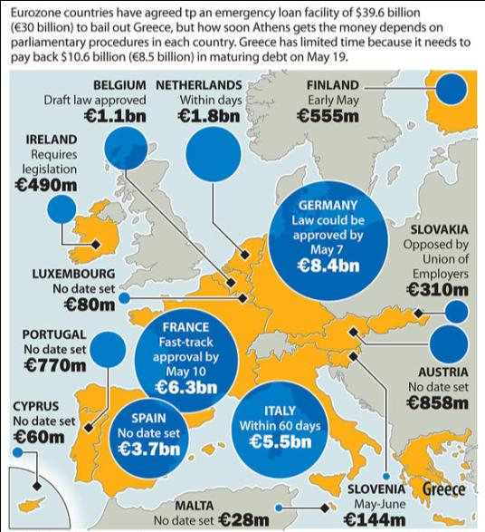
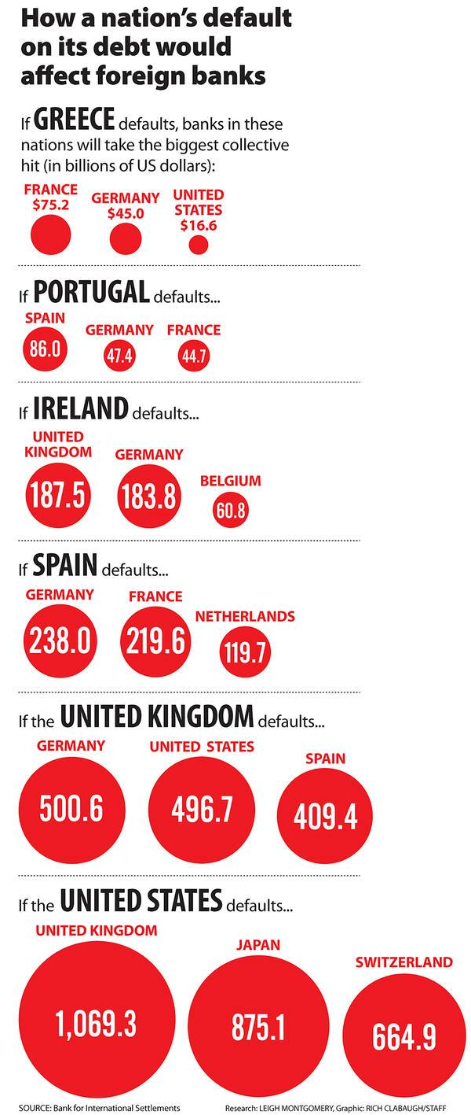
Currently, the largest problem in Europe is the debt crisis
A growing number of European nations are unable to pay their debts
Since 2010, Greece, Italy, Ireland, Spain, & Portugal received bailouts from European gov'ts

Slide 14
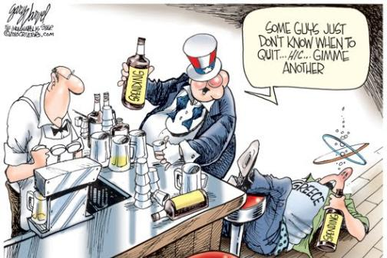

Slide 15
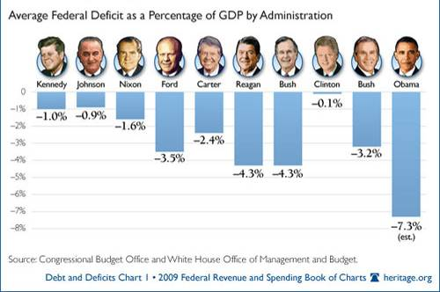
As of 2011, the National Debt is $13 trillion

Slide 16
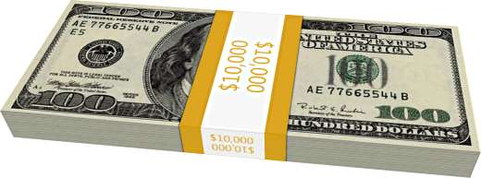
What is a trillion dollars?
A packet of one hundred $100 bills is less than 1/2″ thick and contains $10,000. Fits in your pocket easily and is more than enough for week or two of shamefully decadent fun.

Slide 17
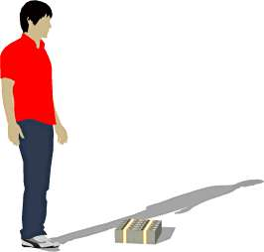
Believe it or not, this next little pile is $1 million dollars (100 packets of $10,000). You could stuff that into a grocery bag and walk around with it.

Slide 18
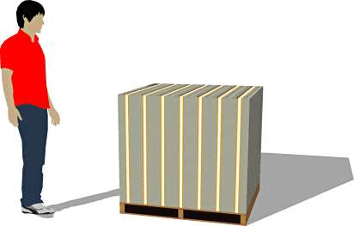
While a measly $1 million looked a little unimpressive, $100 million is a little more respectable. It fits neatly on a standard pallet…

Slide 19
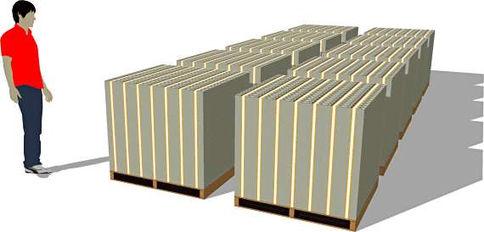
And $1 BILLION dollars… now we’re really getting somewhere…

Slide 20
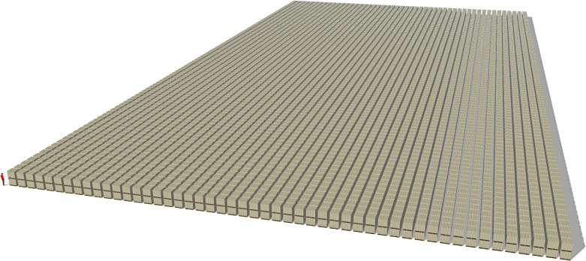
Next we’ll look at one trillion dollars. This is that number we’ve been hearing so much about. What is a trillion dollars? It’s a million million. It’s a thousand billion. It’s a one followed by 12 zeros.

Slide 21
American Debt Videos
U.S. Debt Ceiling In Focus: What happens if we default? (2.48) http://abcnews.go.com/GMA/video/us-debt-ceiling-in-focus-13346143
American Debt: How much is $13 trillion? (2.07) http://abcnews.go.com/WNT/video/13-trillion-counting-10791961
Notes:
Hitting the Ceiling (3.57) http://abcnews.go.com/WNT/video/hitting-ceiling-budget-debt-trillion-money-finance-obama-president-us-13343836

