Slide 1
Ethics & History
20th century conflict day one

Slide 2
The Trolley Car…

Slide 3
Ethics Calculations
What is right/moral depends on the consequences which result from the action
UTILITARIANISM or CONSEQUENTIALIST MORAL REASONING locates morality in the results
What is right/moral results from the intrinsic quality of the act itself
CATEGORICAL MORAL REASONING locates morality in absolutes

Slide 4
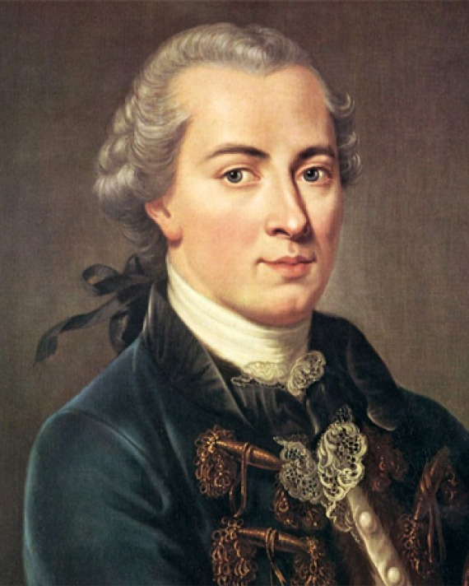
The Deontologists
Immanuel Kant: Kant is known for his theory that there is a single moral obligation, which he called the "Categorical Imperative", and is derived from the concept of duty.
Categorical imperatives are principles that are intrinsically valid; they are good in and of themselves; they must be obeyed by everyone in all situations and circumstances, if our behavior is to observe the moral law.

Slide 5
Don’t push that Fat man!
Politically, Kant was one of the earliest exponents of the idea that perpetual peace could be secured through universal democracy and international cooperation.
Critique of Pure Reason: ENDS NEVER JUSTIFY THE MEANS

Slide 6
The Deontology Critique
1. Are moral ‘laws’ absolute? Don’t lie but Anne Frank example
2. Are these laws universal or vary by culture
3. Are they the same for individuals and governments? Is it the job of government to avoid harm?

Slide 7
The Utilitarians
Utilitarianism is an ethical theory which states that the best action is the one that maximizes utility. "Utility" is defined in various ways, usually in terms of the well-being of sentient entities.
The basic premise is that the greatest good for the greatest number is the ethical choice. Change tracks opinion!

Slide 8
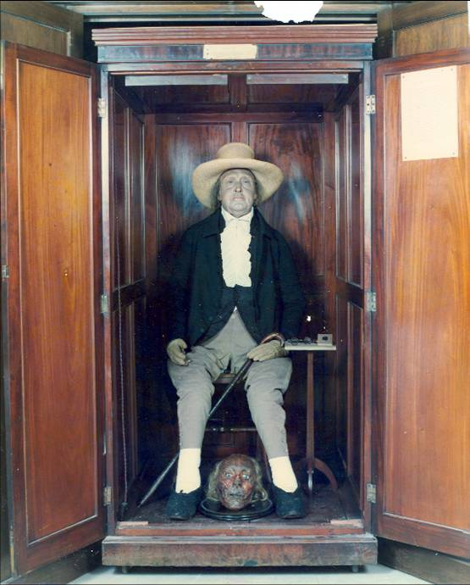
The Utilitarians
Jeremy Bentham: Bentham introduces a method of calculating the value of pleasures and pains, which has come to be known as the hedonic calculus. Bentham says that the value of a pleasure or pain, considered by itself, can be measured according to its intensity, duration, certainty/uncertainty and propinquity/remoteness

Slide 9
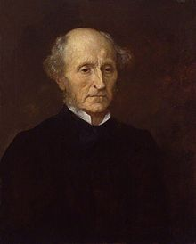
The Utilitarians
John Stuart Mill: Utilitarianism, is that people really do desire happiness, and since each individual desires their own happiness, it must follow that all of us desire the happiness of everyone, contributing to a larger social utility. Thus, an action that results in the greatest pleasure for the utility of society is the best action.

Slide 10
Critiques of Utilitarianism
1. What about JUSTICE?
2. Is happiness something you can quantify? Can it be aggregated?
3. Does happiness differ by individual?
4. Do individual ethics differ from government ethics?

Slide 11
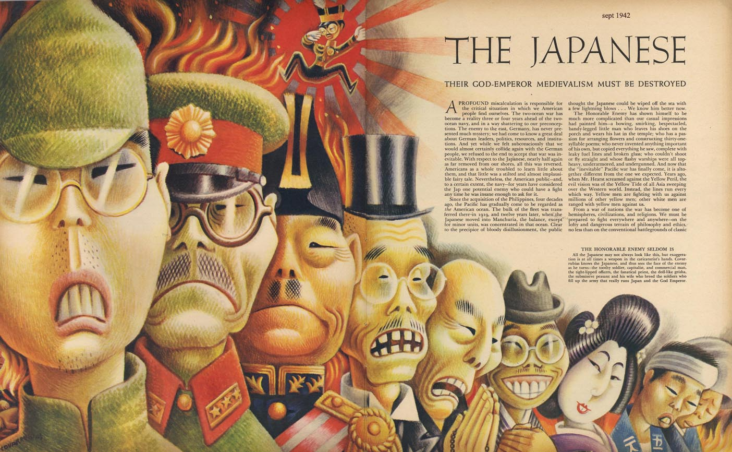
Propaganda

Slide 12
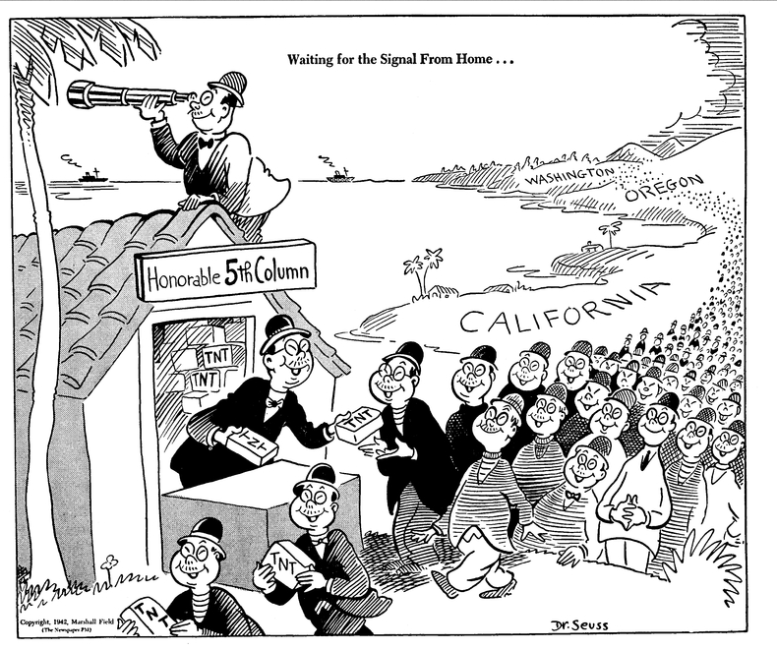

Slide 13
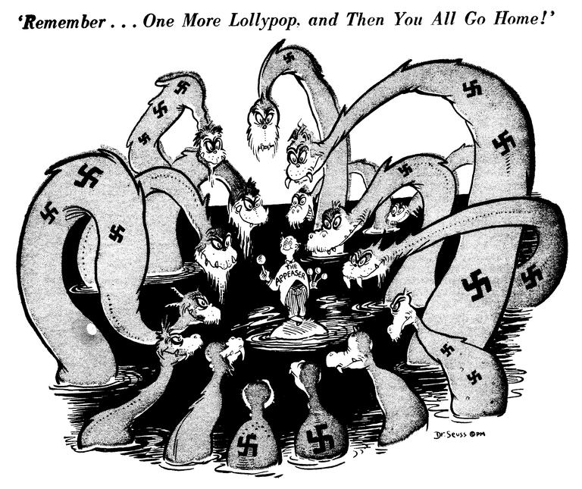
Dr. Seuss & WW II

Slide 17
Critiques of Deontologists

