Slide 1
Essential Question:
What were the key ideas of the Enlightenment?
Warm-Up Question:
What do you not like about East View High?
What suggestions do you have to make this school better?
Notes:
42c - identify the major ideas of the Enlightenment from the writings of Locke, Voltaire and Rousseau and their relationship to politics and society
43a - identify the causes and results of the revolutions in England (1689), United States (1776), France (1789), Haiti (1791), and Latin America (1808-1825)
43b - explain Napoleon's rise to power, defeat, and consequences for Europe
What is the Enlightenment? (HA! book 35.2)
Connect to Sci Rev, Renaissance, Prot Ref
Conflict with old ideas, esp. kings & church
Enlightenment Thinkers
Hobbes, Locke, Rousseau, Montesquieu, Voltaire, (Beccaria??) Use ISN pg 242-3 (notes then questions to answer??)
Matching Enlightenment thinkers w/ quotes (HA! 35 activity pg 823-825)
Impact of Enlightenment (HA! book 35.8-9)
Enlightened Despots, women, music, economics, foreshadow political revolutions
Activity

Slide 2
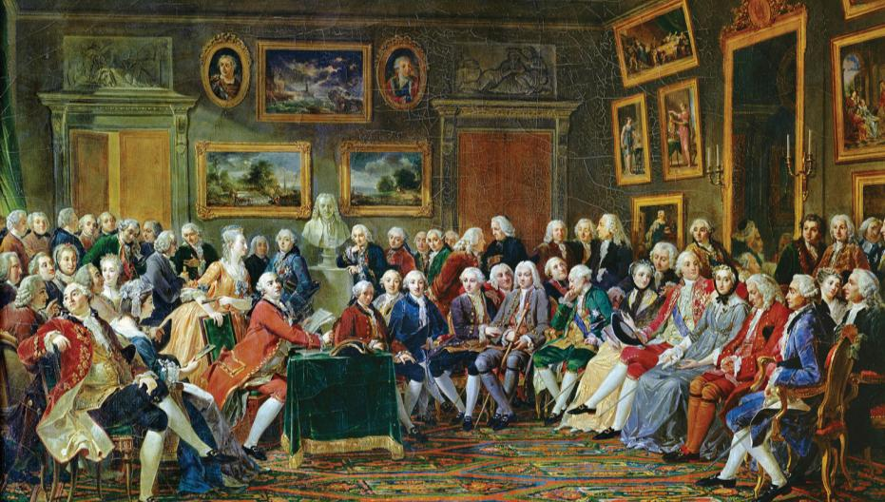
From 1650 to 1800, European philosophers began rethinking old ideas about gov’t, religion, economics which led to an era known as the Enlightenment (also called the Age of Reason)
Notes:
In the wake of the Scientific Revolution, and the new ways of thinking it prompted, scholars and philosophers began to reevaluate old notions about other aspects of society. They sought new insight into the underlying beliefs regarding government, religion, economics, and education. Their
efforts spurred the Enlightenment, a new intellectual movement that stressed reason and thought and the power of individuals to solve problems. Known also as the Age of Reason, the movement reached its height in the mid-1700s and brought great change to many aspects of Western civilization.

Slide 3
The Enlightenment
The intellectuals of the Enlightenment were called philosophes & they shared some basic beliefs
New truths could be discovered by using logic & reason
Everything could be explained by observing universal truths known as natural laws
A belief in progress, that the world can be improved, & that life should be enjoyed
People are born with natural rights (personal freedoms that protect liberty)
Notes:
The Philosophes Advocate Reason
The Enlightenment reached its height in France in the mid-1700s. Paris became the meeting place for people who wanted to discuss politics and ideas. The social critics of this period in France were known as philosophes (FIHL•uh•SAHFS), the French word for philosophers. The philosophes believed that people could apply reason to all aspects of life, just as Isaac Newton had applied reason to
science. Five concepts formed the core of their beliefs:
Reason
Enlightened thinkers believed truth could be discovered through reason or logical thinking.
2. Nature
The philosophes believed that what was natural was also good and reasonable.
3. Happiness
The philosophes rejected the medieval notion that people should find joy in the hereafter and urged people to seek well-being on earth.
4. Progress
The philosophes stressed that society and humankind could improve.
5. Liberty
The philosophes called for the liberties that the English people had won in their Glorious Revolution and Bill of Rights.

Slide 4
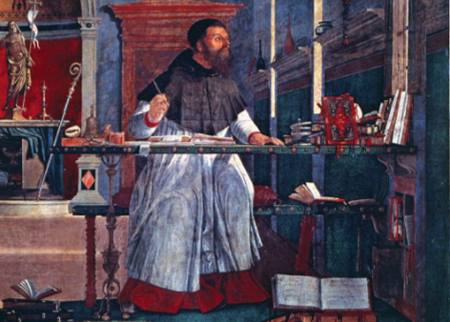
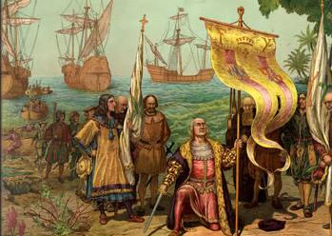
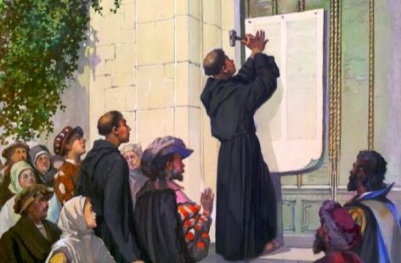
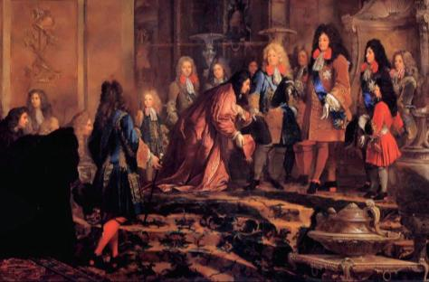
Why did the Enlightenment begin?
During the Renaissance, people began to question medieval ideas, emphasize individual potential (humanism), & encourage education
During the Age of Exploration, the discovery of new lands & trade routes led Europeans to search for other “new” things
During the Protestant Reformation, people began to question church teachings, freely explore new ideas, & tolerate other religions
During the Age of Absolute Monarchs, powerful kings spent lavishly, fought expensive wars, & ruled without regard to their nation’s people
Notes:
The Philosophes Advocate Reason
The Enlightenment reached its height in France in the mid-1700s. Paris became the meeting place for people who wanted to discuss politics and ideas. The social critics of this period in France were known as philosophes (FIHL•uh•SAHFS), the French word for philosophers. The philosophes believed that people could apply reason to all aspects of life, just as Isaac Newton had applied reason to
science. Five concepts formed the core of their beliefs:
Reason
Enlightened thinkers believed truth could be discovered through reason or logical thinking.
2. Nature
The philosophes believed that what was natural was also good and reasonable.
3. Happiness
The philosophes rejected the medieval notion that people should find joy in the hereafter and urged people to seek well-being on earth.
4. Progress
The philosophes stressed that society and humankind could improve.
5. Liberty
The philosophes called for the liberties that the English people had won in their Glorious Revolution and Bill of Rights.

Slide 5
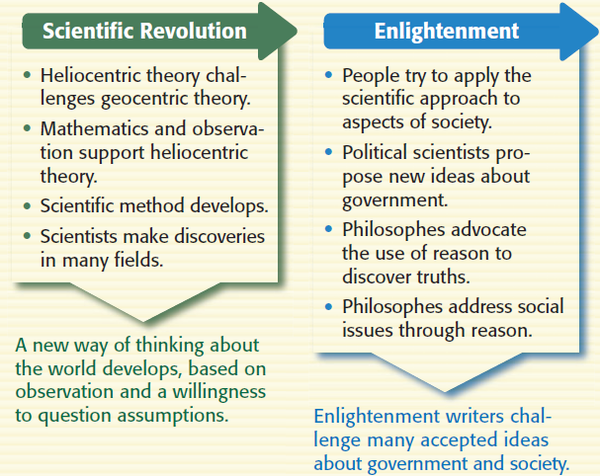
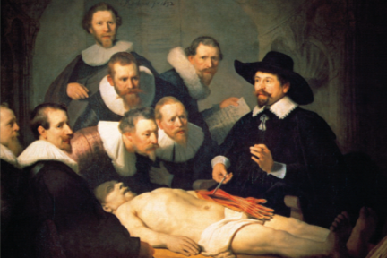
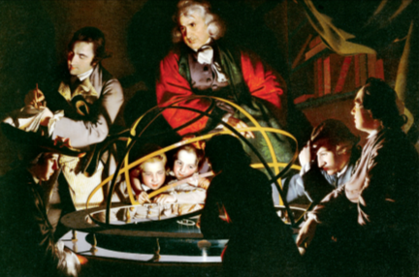
During the Scientific Revolution, scholars applied logic, perfected the scientific method, & made new discoveries that shattered old ideas…
…This gave Enlightenment philosophes a model to follow to make new theories about society
The most important Enlightenment ideas were those that challenged rule by absolute monarchs & presented new theories about government

Slide 6
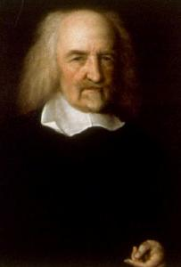
Political Ideas of the Enlightenment
One of the first political thinkers of the Enlightenment was Thomas Hobbes
Hobbes was bothered by the English Civil War & chaos that plagued England after the beheading of King Charles I
Hobbes believed that humans are naturally cruel, selfish, & hungry for power; Hobbes argued that people need to be protected from themselves
What kind of government do you think Hobbes supported?

Slide 7
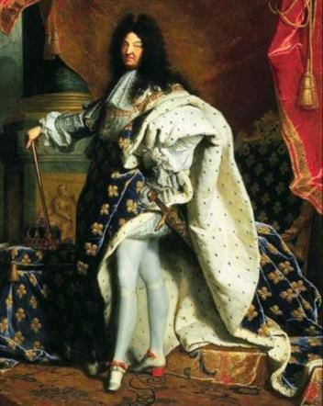
Political Ideas of the Enlightenment
Hobbes supported rule b y absolute monarchs; He used scientific reasoning to argue that only kings with absolute power could maintain order in society
Hobbes believed in an idea called the social contract: people give up power & rights to a king who provides law & order

Slide 8
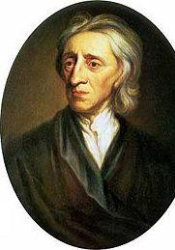
Political Ideas of the Enlightenment
English philosophe John Locke disagreed with the ideas of Thomas Hobbes
He was influenced by the Glorious Revolution when the Bill of Rights was created to protect citizens’ rights
Locke believed that people are born with natural rights, including life, liberty, property; Locke argued that kings could be overthrown if they violated peoples’ rights
What kind of government do you think Locke supported?

Slide 9
Political Ideas of the Enlightenment
Locke supported limited or constitutional monarchies
The English Bill of Rights (1689)
The king cannot tax or overturn Parliament’s laws
Protected freedom of speech
The army cannot be used as a police force
No excessive bail
Locke believed that gov’t power came from the consent of the governed (approval of the people) & that kings should protect the rights of the people

Slide 10
Quick Writing Prompt: Who’s ideas are right: Hobbes or Locke?
Hobbes
People are naturally selfish & act out of self-interest
Without gov’t control, society would be chaotic
People are like children & need a strong “father” to keep them in line
Locke
People are reasonable & able to make decisions
Freedom & liberty are more important than order & safety
People should be able to overthrow kings who abuse their power

Slide 11
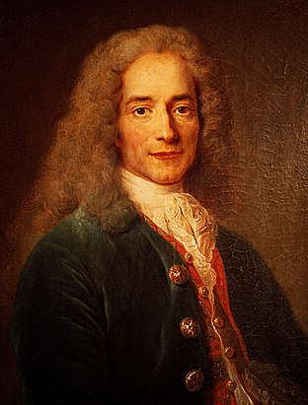
Political Ideas of the Enlightenment
The French philosophe Voltaire was one of the most famous writers of the Enlightenment
Voltaire argued for the rights of freedom of speech & religion; He criticized intolerance, prejudice, & oppression
Voltaire was jailed twice in France for criticizing the gov’t but his letters to European monarchs helped introduce new reforms & freedoms

Slide 12
Quick Writing Prompt: Do you agree with Voltaire?
Voltaire once said: “I may disapprove of what you say, but I will defend to the death your right to say it.”
When, if ever, should freedom of speech be restricted?
Consider schools, TV, radio, wartime, etc.

Slide 13
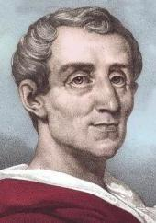
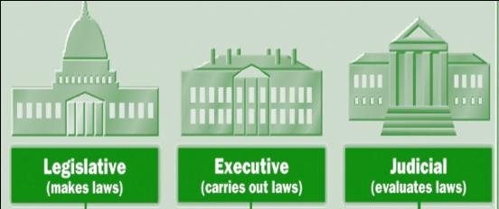
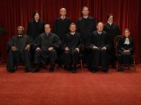
Political Ideas of the Enlightenment
Baron de Montesquieu agreed with John Locke that government should protect individual liberties & that too much power led to tyranny
Montesquieu believed in separation of powers: divide power among 3 branches of government

Slide 14
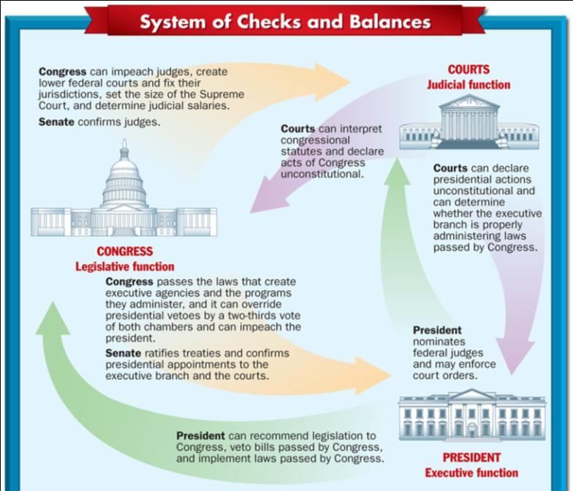
Montesquieu’s model of gov’t also included a system of checks & balances in which each branch of gov’t could limit the power of the other branches

Slide 15
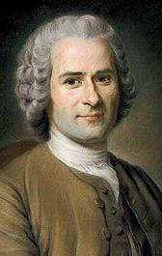
Political Ideas of the Enlightenment
The Swiss philosophe Jean-Jacques Rousseau believed in individual freedom
Rousseau believed that people are naturally good, but power corrupts them; Free people form a social contract & gov’t based on the common good
Rousseau argued for a direct democracy that is guided by the general will of the majority of citizens
What kind of gov’t do you think Rousseau supported?

Slide 16
Quick Writing Prompt: Which form of gov’t is better: Separation of powers or direct democracy?
Montesquieu
Take power from one king & divide it among 3 branches of gov’t that each can limit other branches
Rousseau
Let the people make all decisions directly to ensure what the majority wants, the majority gets

Slide 17
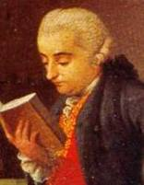
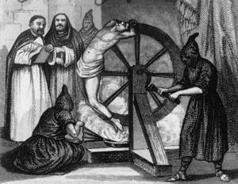
Political Ideas of the Enlightenment
Italian philosophe Cesare Beccaria criticized abuses in the justice system
Beccaria was upset with the use of torture, corrupt judges, secret trials, & severe punishments for crimes
Beccaria argued that people accused of crimes should be given a fair & speedy trial and that capital punishment & torture should be abolished
Notes:
An Italian philosophe named Cesare Bonesana Beccaria (BAYK•uh•REE•ah) turned his thoughts to the justice system. He believed that laws existed to preserve social order, not to avenge crimes. Beccaria regularly criticized common abuses of justice. They included torturing of witnesses and suspects, irregular proceedings in trials, and punishments that were arbitrary or cruel. He argued that a person accused of a crime should receive a speedy trial, and that torture should never be used. Moreover, he said, the degree of punishment should be based on the seriousness of the crime. He also believed that capital punishment should be abolished. Beccaria based his ideas about justice on the principle that governments should seek the greatest good for the greatest number of people. His ideas influenced criminal law reformers in Europe and North America.

Slide 18
Quick Writing Prompt: Do you agree with Beccaria?
Is capital punishment an acceptable form of punishment for crimes?

Slide 19
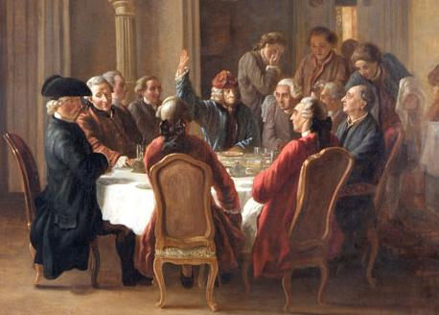
Closure Activity
Which Enlightenment philosophe?
Working in teams, analyze excerpts from famous documents & match them to the correct Enlightenment thinker
The group with the most correct answers wins & receives bonus points

Slide 20
John Locke
We hold these truths to be self-evident, that all men are created equal, that they are endowed by their Creator with certain
unalienable Rights, that among these are Life, Liberty and the pursuit of Happiness.
—Declaration of Independence, 1776

Slide 21
Cesare Beccaria
In all criminal prosecutions, the accused shall enjoy the right to a speedy and public trial, by an impartial jury of the State and district wherein the crime shall have been committed.
—U. S. Bill of Rights

Slide 22
Voltaire
The free communication of ideas and opinions is one of the most precious of the rights of man. Every citizen may thus speak, write, and print with freedom, but shall be responsible for such abuses of this freedom as shall be defined by law.
—Declaration of the Rights of Man and Citizen, 1789

Slide 23
Montesquieu
All legislative Powers herein granted shall be vested in a Congress of the United States, which shall consist of a Senate and House of Representatives.
The executive Power shall be vested in a President of the United States of America.
The judicial Power shall be vested in one supreme Court, and in such inferior Courts as the Congress may ordain and establish.
—U.S. Constitution

Slide 24
Jean-Jacques Rousseau
In 2003, the communities of Freetown and Lakeville, Massachusetts held their annual town meetings and voted on the budget for the school district. Freetown voters approved a budget that reduced their contribution by $100,000 from what the School Committee asked for.

Slide 25
Voltaire
Congress shall make no law respecting an establishment of religion, or prohibiting the free exercise thereof.
—U.S. Bill of Rights, 1791

Slide 26
Cesare Beccaria
As all persons are held innocent until they have been declared guilty, if arrest is considered essential, all harshness not necessary for the securing of the person shall be severely repressed by law.
—Declaration of the Rights of Man and Citizen, 1789

Slide 27
John Locke
Governments are instituted among Men, deriving their just powers from the consent of the governed...whenever any Form of Government becomes destructive of these ends, it is the Right of the People to alter or to abolish it, and to institute new Government.
—Declaration of Independence, 1776

Slide 28
Montesquieu
Every Bill which shall have passed the House of Representatives and the Senate, shall, before it become a Law, be presented to the President of the United States; if he approve he shall sign it, but if not he shall return it, with his Objections to that House in which it shall have originated, who shall…proceed to reconsider it.
—U.S. Constitution

