Slide 1
Essential Question:
What were the important Cold War events of the 1960s & 1970s?
Warm Up Question:

Slide 2
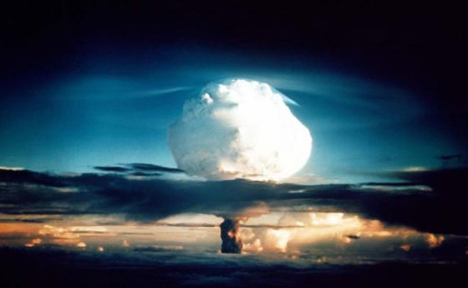
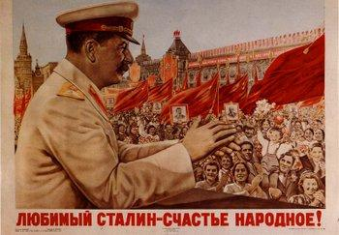
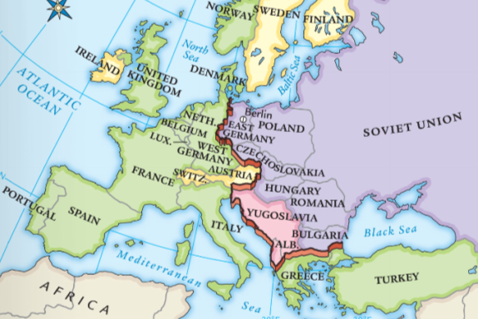
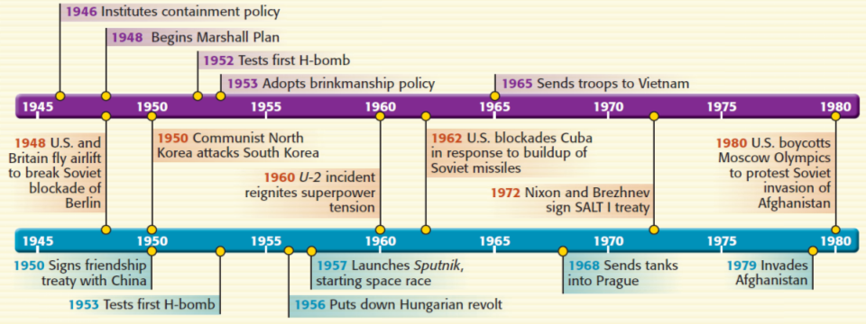
Joseph Stalin led the Soviet Union from 1927 to 1953
Stalin escalated the Cold War by creating the Berlin Blockade in 1948
When the Cold War began, Stalin spread communism into the satellites in Eastern Europe
Under Stalin, the USSR tested the atomic bomb in 1949 & hydrogen bomb in 1953

Slide 3
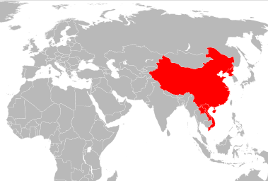
Stalin signed a “treaty of friendship” with Mao Zedong after the Chinese Revolution
Stalin sent weapons to communists in North Korea during the Korean War

Slide 4
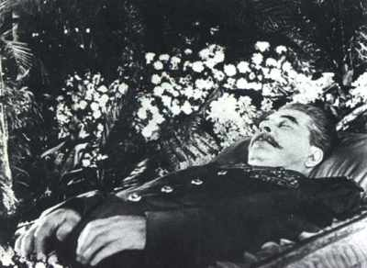
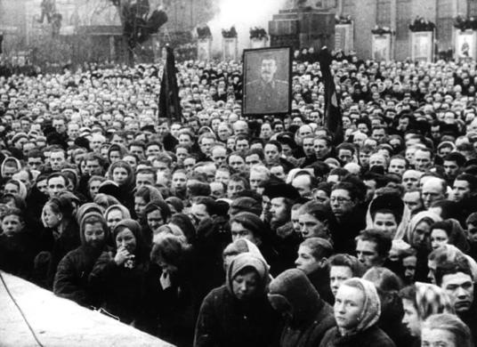
Joseph Stalin’s death in 1953 changed the Soviet Union & how it approached the Cold War against the United States

Slide 5
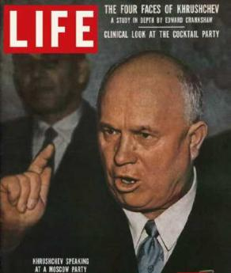
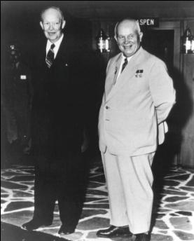
New USSR leader Nikita Khrushchev began a series of reforms known as de-Stalinization, which included releasing political prisoners & relaxing censorship
Khrushchev seemed willing to work with the USA to ease Cold War tensions…

Slide 6
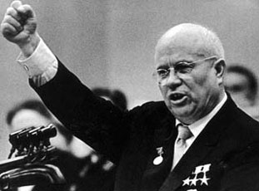
…But, tensions between the USA & USSR escalated throughout the 1950s & 1960s

Slide 7
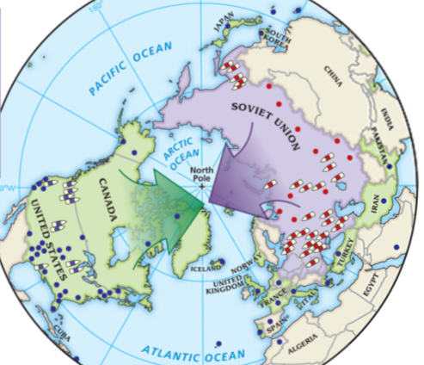
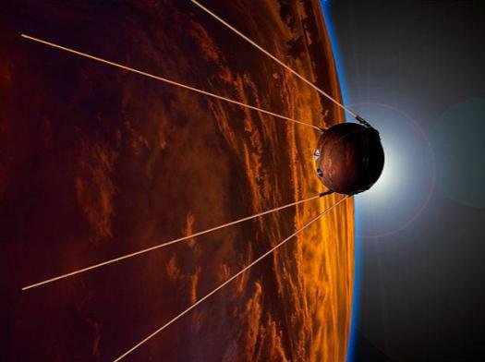
Under Khrushchev, the Soviet Union launched Sputnik & the space race began
The creation of ICBMs led to the stockpiling of nuclear weapons during the arms race

Slide 8
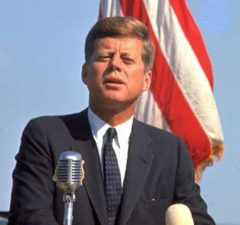
In 1961, John F Kennedy became U.S. president
Kennedy & Khrushchev faced two important crises that heightened Cold War tensions: Building of the Berlin Wall & the Cuban Missile Crisis

Slide 9
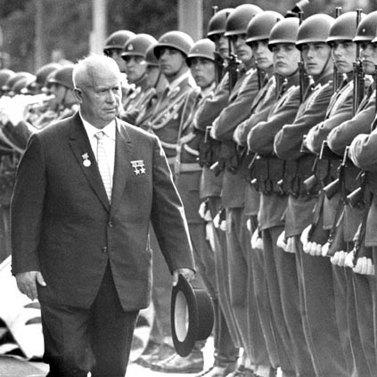
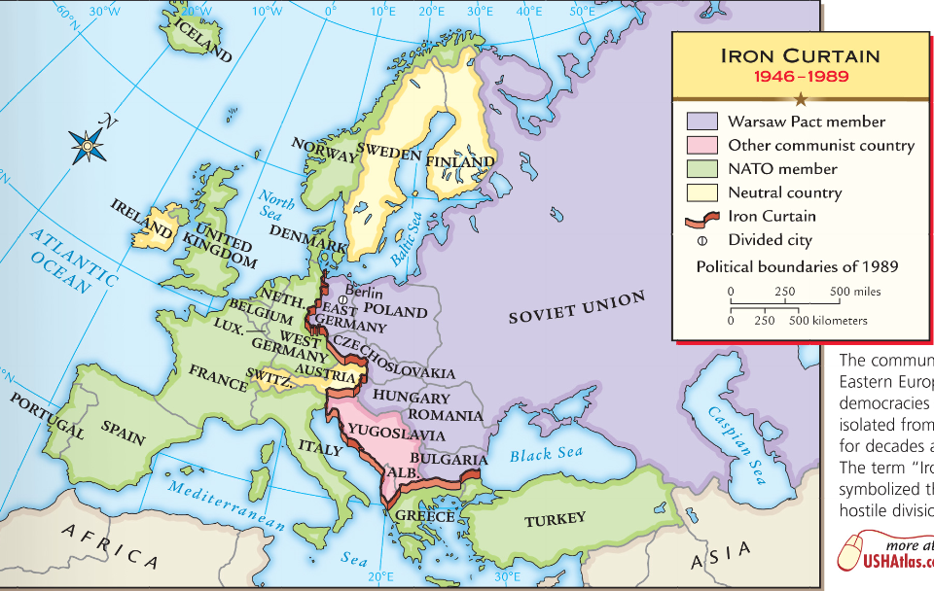
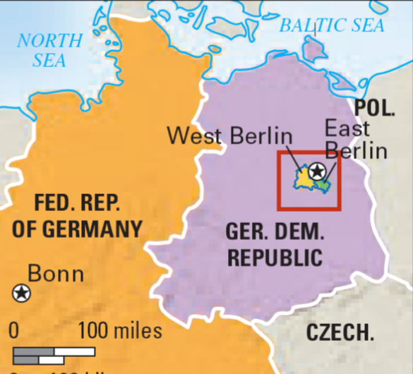
The Berlin Crisis, 1961
Khrushchev was upset with the increasing number of communist East Germans who moved to democratic West Berlin
In 1961, Khrushchev threatened to cut off access to West Berlin like Stalin’s blockade in 1948
President Kennedy promised to protect West Berlin
Notes:
to never give up access to West Berlin

Slide 10
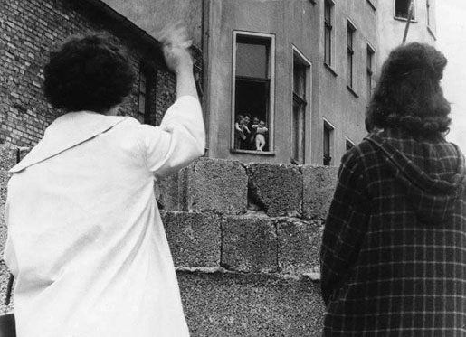
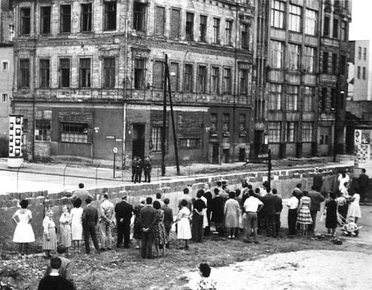
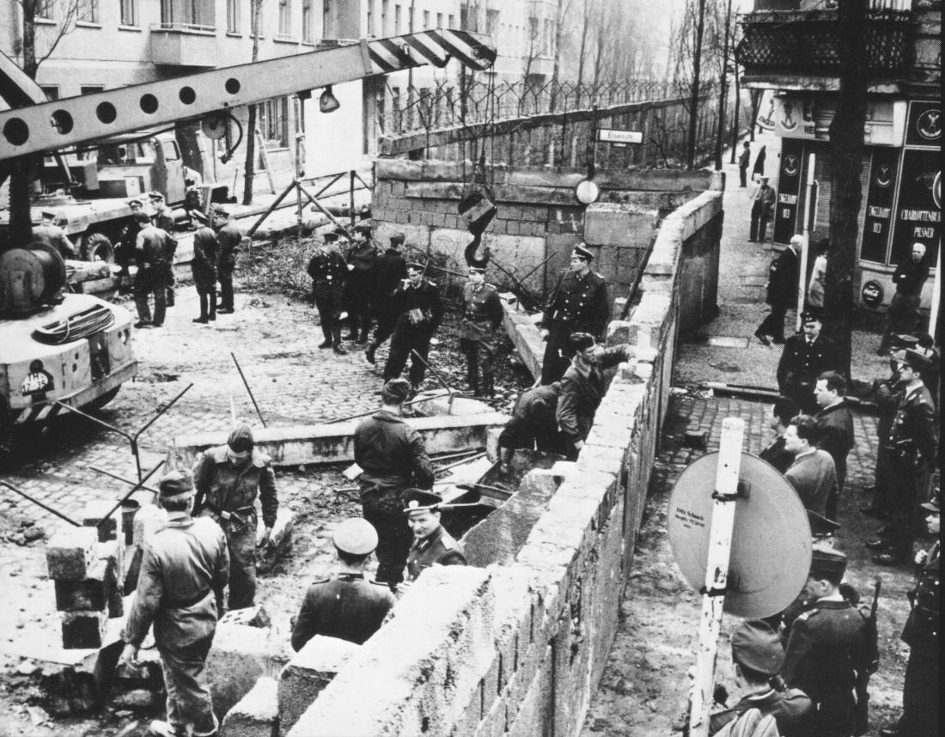
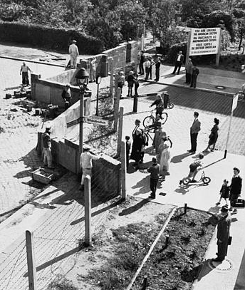
Rather than blockade the city, Communist leaders built the Berlin Wall to keep East Germans out of West Berlin

Slide 11
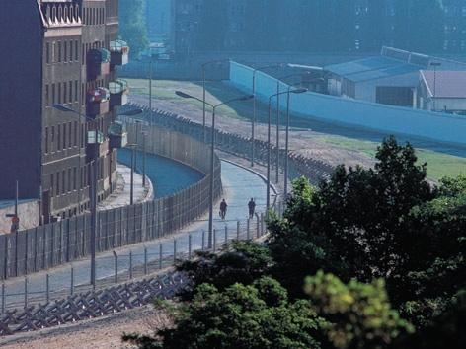
The Berlin Wall became the iconic image of the Cold War
Walls and other barriers 10–15 feet high surrounded West Berlin. The length of the barriers around the city totaled about 110 miles
The “death strip” stretched like a barren moat around West Berlin, with patrols, floodlights, electric fences, and vehicle traps between the inner and outer walls

Slide 12
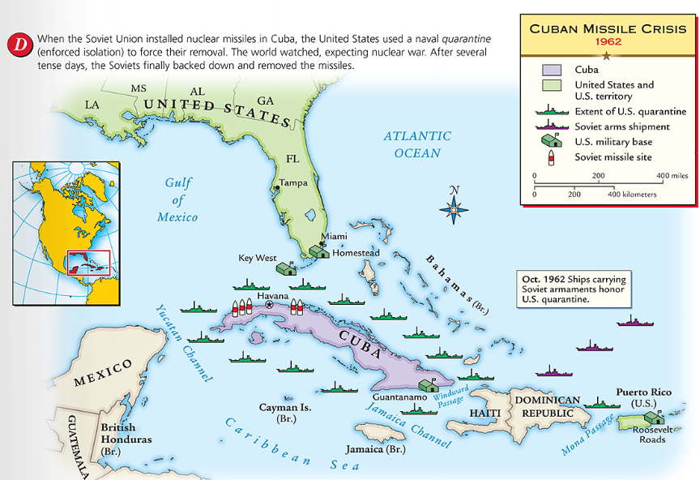
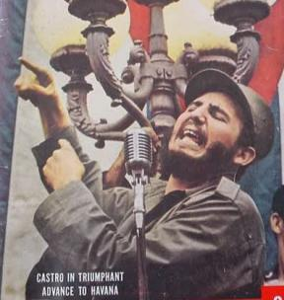
When Fidel Castro seized power in Cuba in 1959, the USA feared the spread of communism so close to America

Slide 13
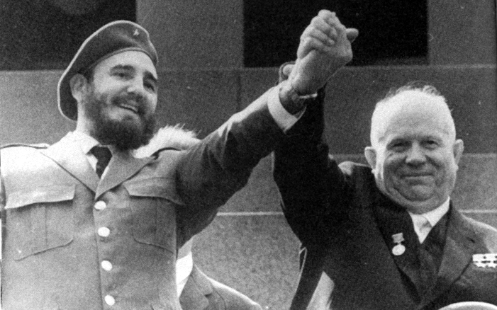
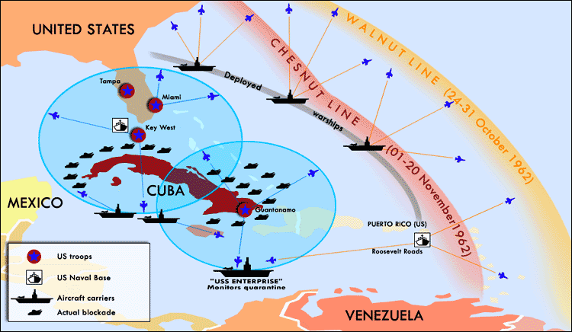
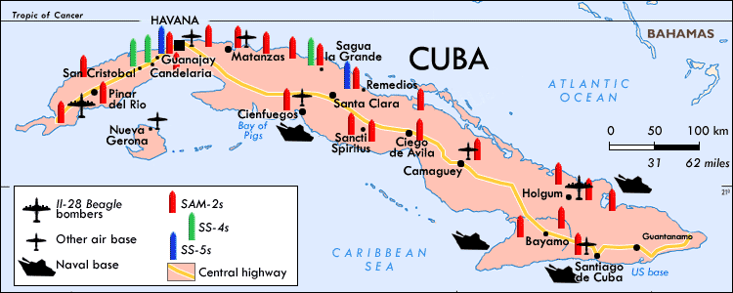
After a failed attempt to overthrow Castro, Khrushchev secretly sent nuclear missiles to Cuba
The U.S. successfully blockaded Cuba & Khrushchev removed the ICBMs in exchange for the removal of American ICBMs in Europe
The Cuban Missile Crisis was the closest the USA & USSR came to nuclear war

Slide 14
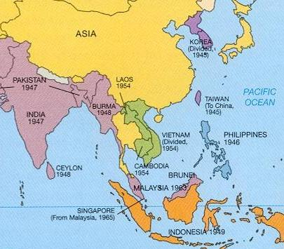
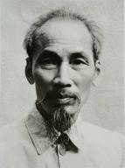
From 1965 to 1973, the USA became involved in the Vietnam War
When communist leader Ho Chi Minh gained independence for Vietnam, the USA feared communism in SE Asia

Slide 15
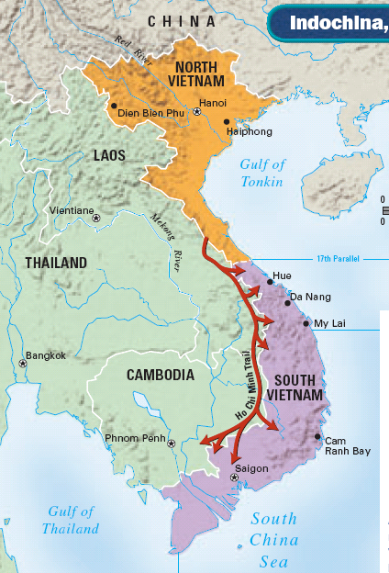
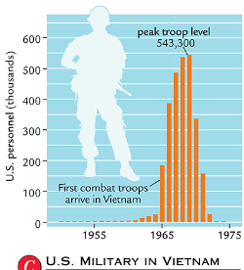
Vietnam was divided into a communist North & a democratic South
In South Vietnam, communists known as the Vietcong worked to unify North & South Vietnam
To contain communism, the USA sent troops to Vietnam starting in 1965

Slide 16
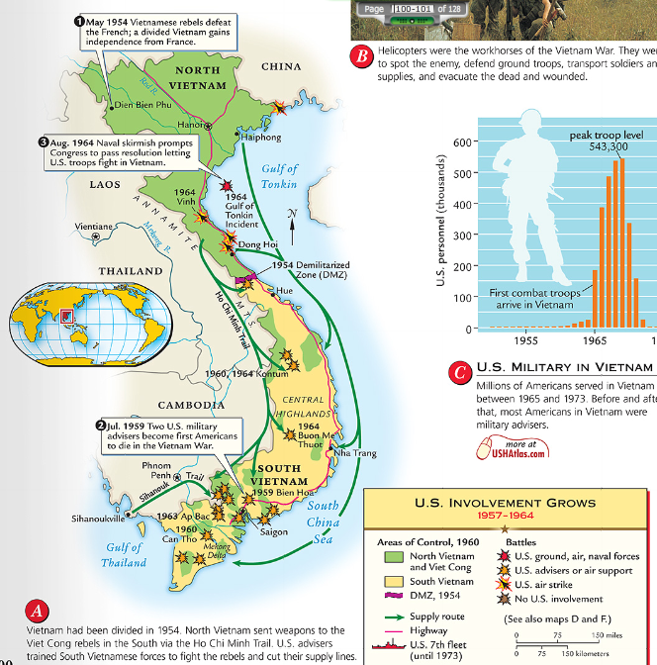
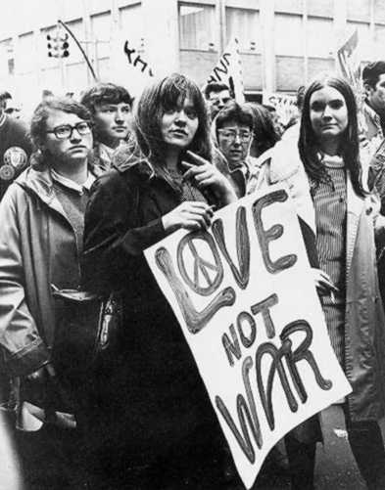
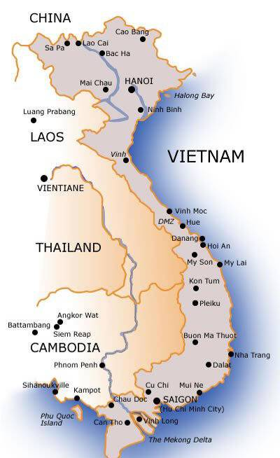
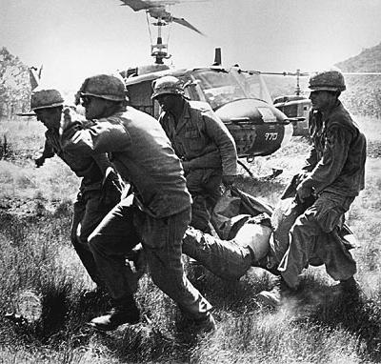
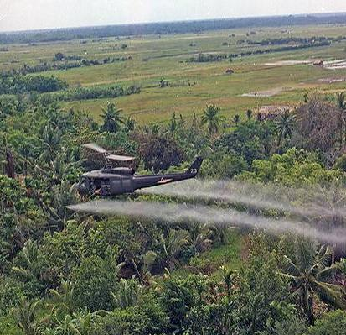
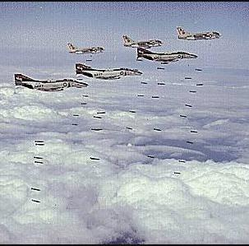
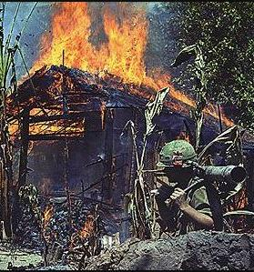
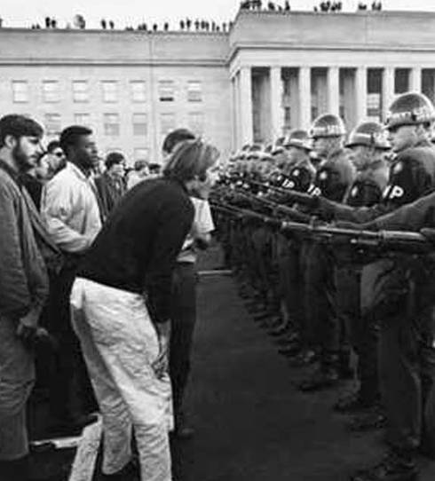
The American military used bombing raids, pesticides, & search-and-destroy missions to fight the communists
Despite these efforts, the U.S. was unable to defeat the communist enemy
The Vietnam War was expensive, hurt the U.S. economy, & became unpopular with anti-war protestors in the USA.
In 1973, the USA withdrew from Vietnam & 2 years later communists unified Vietnam

Slide 17
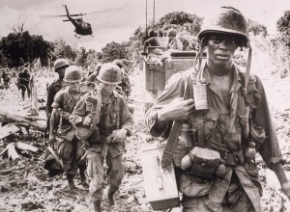
America’s failure in Vietnam led to a change in Cold War policies
The USA abandoned its containment policy & began looking for ways to improve relations with Cold War enemies

Slide 18
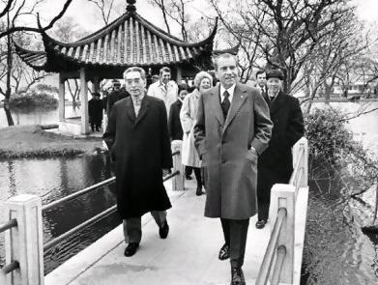
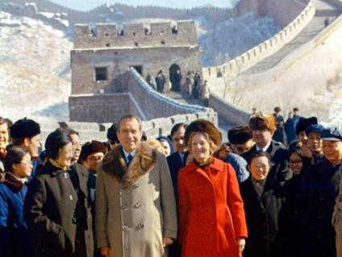
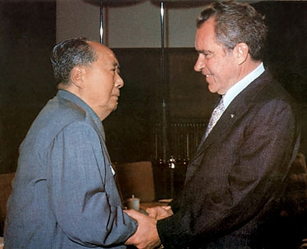
In the 1970s, Richard Nixon’s policy of détente (easing Cold War tensions) replaced brinkmanship
In 1972, Nixon became the first U.S. president to visit & recognize communist China
Nixon’s visit to China put pressure on the Soviet Union to negotiate with the USA

Slide 19
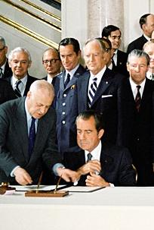
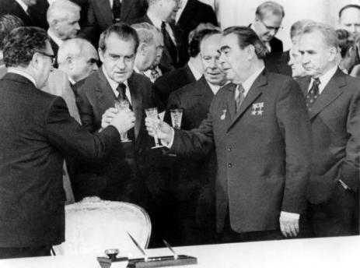
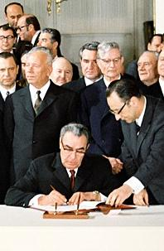
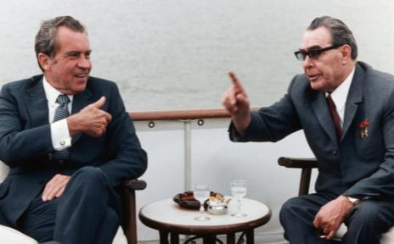
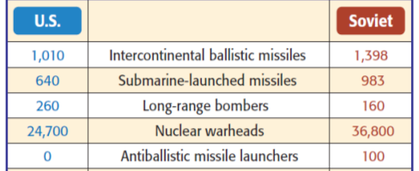
In 1972, Nixon met with Soviet leader Brezhnev to discuss arms reduction
The USA & USSR signed the Strategic Arms Limitation Talks (SALT) which limited the number of ICBMs each nation could have
By the 1970s, the USA & USSR seemed willing to peacefully coexist

Slide 20
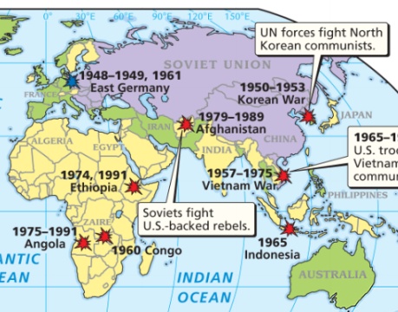
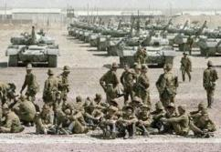
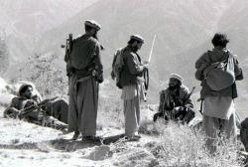
But, détente ended in 1979 when the USSR invaded Afghanistan to put down an anti-communist uprising

Slide 21
The U.S. viewed the attack as an attempt to spread communism into South Asia & the Middle East
The United States cut off all trade with the USSR & sent military & economic aid to Afghan rebels

Slide 22
The USSR fought in Afghanistan from 1979 to 1989, but was unable to defeat the Afghan resistance
The war exhausted Soviet economy & proved as unwinnable as Vietnam was for the United States
The war renewed tensions between the USA & USSR

Slide 23
In the 1980s, new U.S. President Ronald Reagan helped win with Cold War against the Soviet Union
President Reagan’s strong anti-communist policies & the collapse of communist economies brought the Cold War to an end by 1991

Slide 24
Cold War Discussion Questions
??

