Slide 1
Essential Question:
How did the arms race & space race escalate the Cold War between the United States & the Soviet Union?
Warm Up Question:

Slide 2
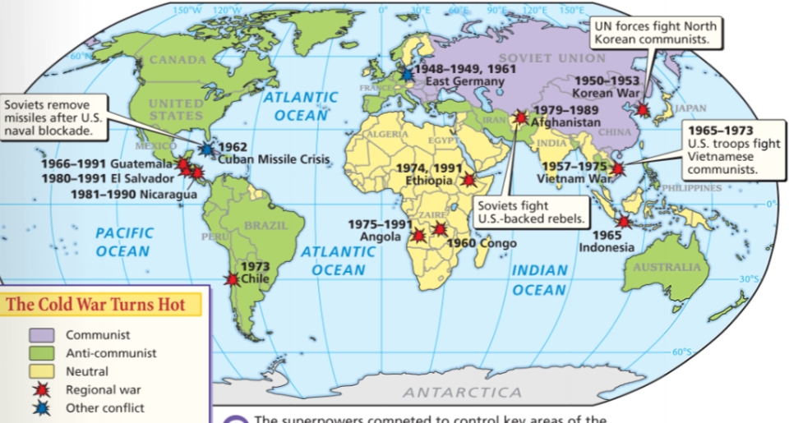
From 1945 to 1991, the USA & USSR used a variety of strategies to win the Cold War

Slide 3
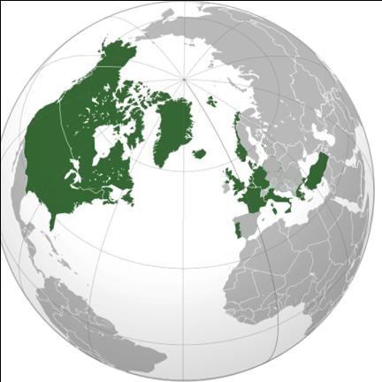
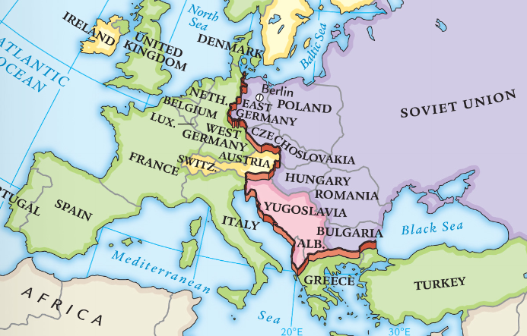
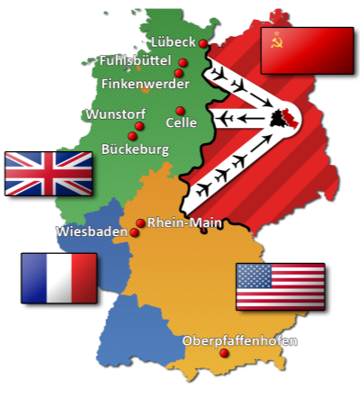
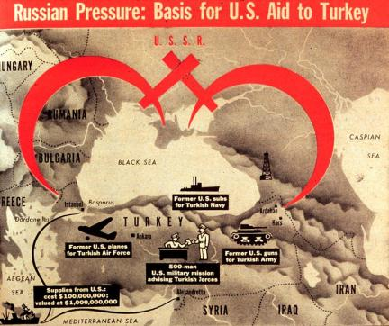
In the early years of the Cold War (1945-1949), the USA used a containment policy to successfully stop the spread of communism in Europe
Marshall Plan
NATO
Berlin Airlift
Truman Doctrine

Slide 4
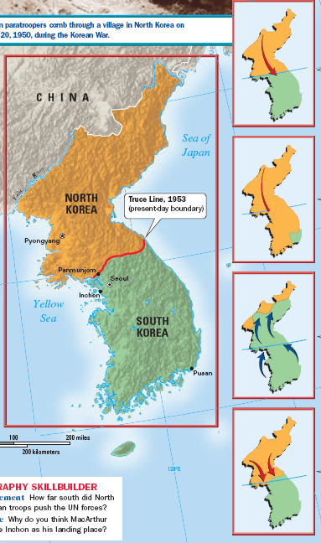
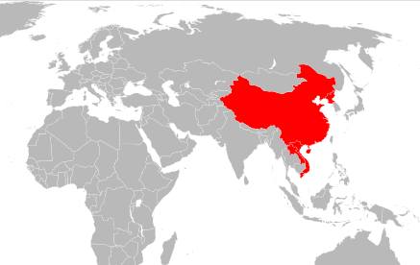
When communism spread to China in 1949, the USA feared the “domino theory” & became more aggressive in its efforts to stop communism
The USA went to war in Korea to defend South Korea from communism
The Soviet Union supplied weapons to the communists in North Korea during the war
The type of indirect fight between the USA & USSR is called a “proxy war”

Slide 5
From 1949 to 1970, the Cold War escalated as a result of a nuclear arms race, space race, & espionage

Slide 6
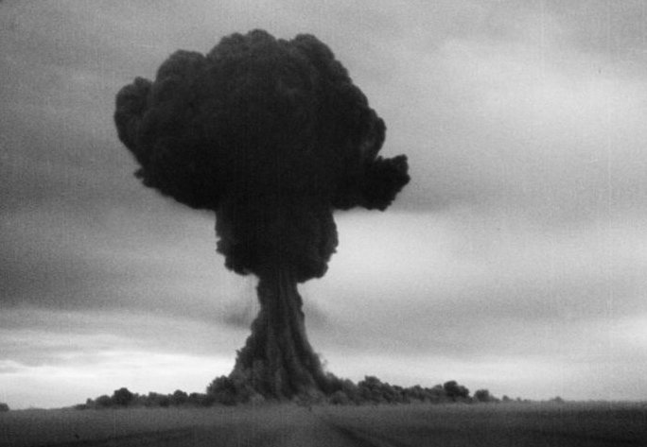
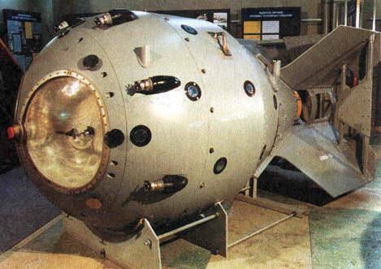
The U.S. monopoly on nuclear weapons ended in 1949 when the USSR successfully tested an atomic bomb
The Soviet development of the atomic bomb led to a nuclear arms race between the USA & USSR

Slide 7
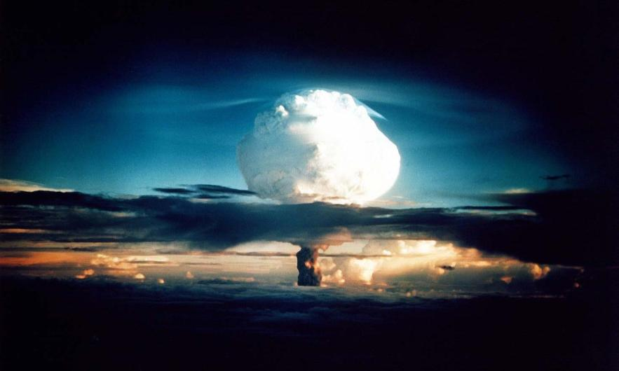
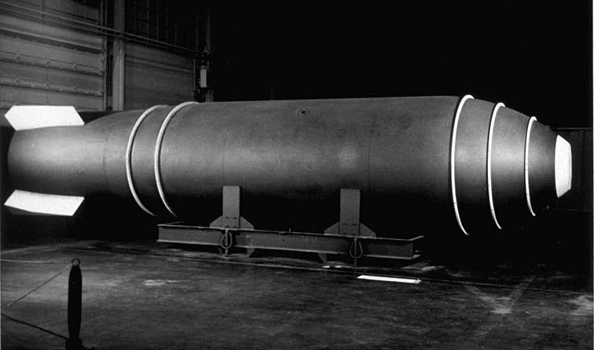
In 1952, the USA tested the first hydrogen bomb which is 1,000 times more powerful than the atomic bomb
The Soviet Union responded by detonating its own hydrogen bomb in 1953

Slide 8
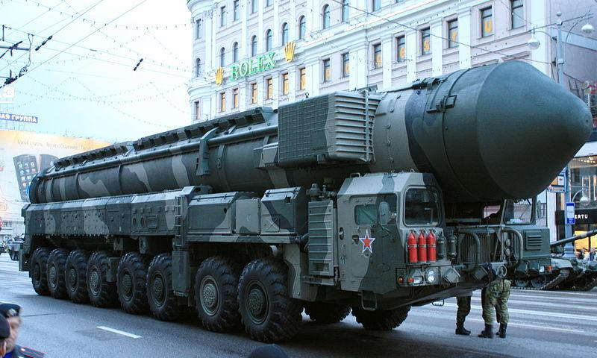
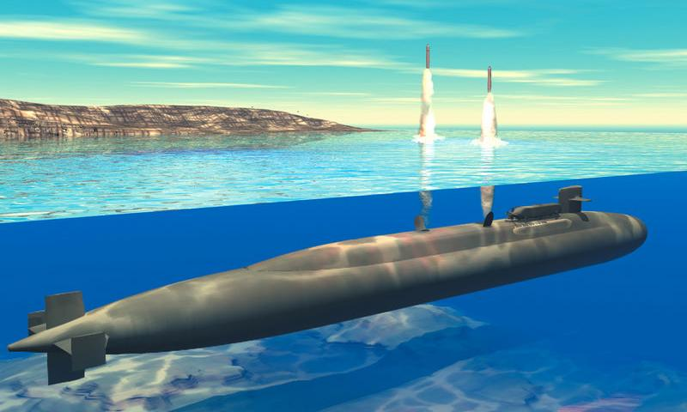
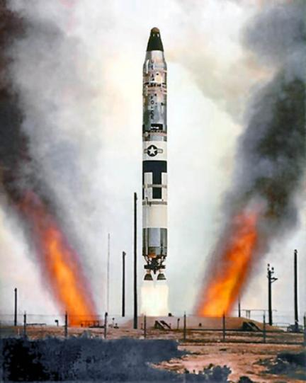
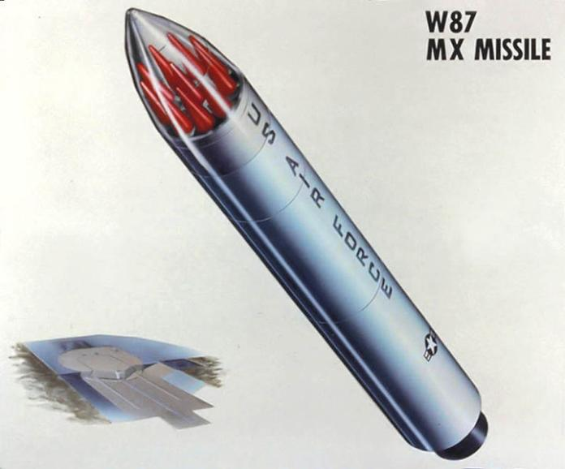
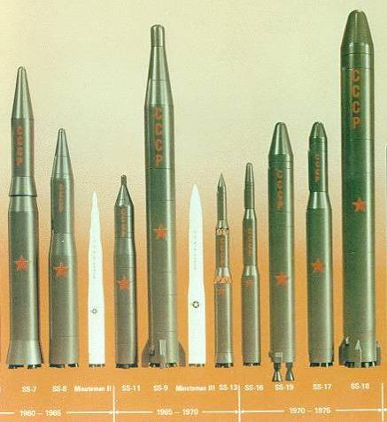
By 1959, both the USA & USSR developed rockets called intercontinental ballistic missiles (ICBMs) that could deliver nuclear warheads to distant targets
U.S. Polaris Submarine
Soviet Transporter Erector Launcher (TEL)
U.S. Titan ICMB from the 1960s
Soviet ICMBs from 1960-1975

Slide 9
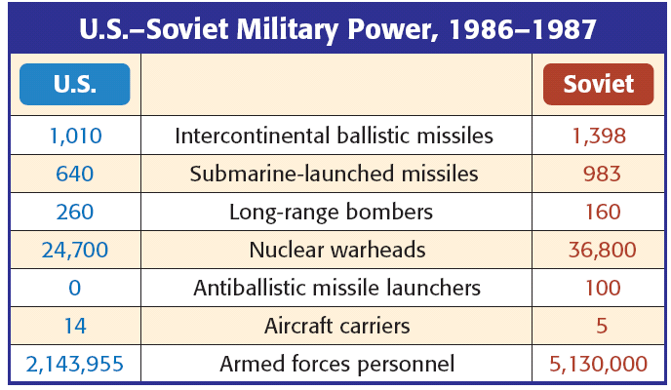
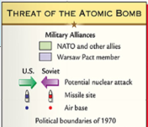
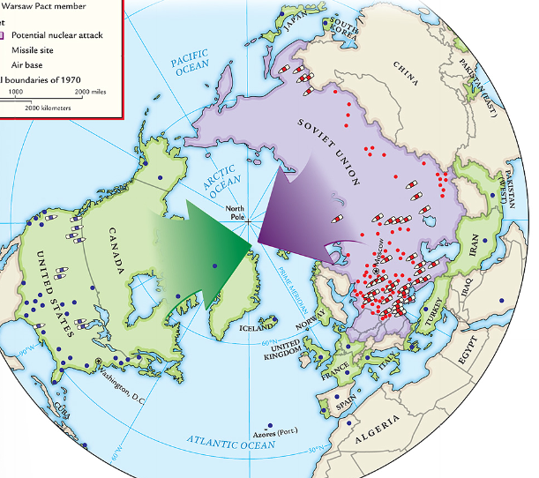
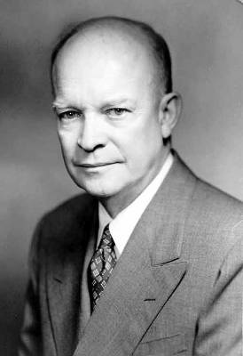
In the 1950s, U.S. President Eisenhower escalated the Cold War by using brinkmanship: threatening to use nuclear weapons & willingness to go to the brink of war
If the USSR attacked a NATO member, the U.S. would use massive retaliation: attack every major Soviet city & military target
As a result, the USA & USSR began stockpiling nuclear weapons & building up their militaries
Notes:
The Threat of Nuclear War As these alliances were forming, the Cold War threatened to heat up enough to destroy the world. The United States already had atomic bombs. In 1949, the Soviet Union exploded its own atomic weapon. President Truman was determined to develop a more deadly weapon before the Soviets did. He authorized work on a thermonuclear weapon in 1950.The hydrogen or H-bomb would be thousands of times more powerful than the A-bomb. Its power came from the fusion, or joining together, of atoms, rather than the splitting of atoms, as in the A-bomb. In 1952, the United States tested the first H-bomb. The Soviets exploded their own in 1953. Dwight D. Eisenhower became the U.S. president in 1953. He appointed the firmly anti-Communist John Foster Dulles as his secretary of state. If the Soviet Union or its supporters attacked U.S. interests, Dulles threatened, the United States would “retaliate instantly, by means and at places of our own choosing.” This willingness to go to the brink, or edge, of war became known as brinkmanship. Brinkmanship required a reliable source of nuclear weapons and airplanes to deliver them. So, the United States strengthened its air force and began producing stockpiles of nuclear weapons. The Soviet Union responded with its own military buildup, beginning an arms race that would go on for four decades.

Slide 10
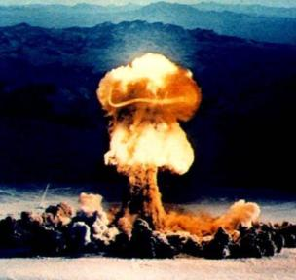
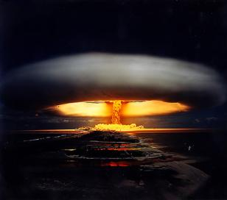
With the USA & USSR in possession of large nuclear stockpiles, each side could destroy each other: this was known as Mutually Assured Destruction (MAD)
Throughout the Cold War, the USA & USSR looked for ways to gain first strike capability
Notes:
Mutual Assured Destruction
When the Soviet Union achieved nuclear parity with the United States, the Cold War had entered a new phase. The cold war became a conflict more dangerous and unmanageable than anything Americans had faced before. In the old cold war Americans had enjoyed superior nuclear force, an unchallenged economy, strong alliances, and a trusted Imperial President to direct his incredible power against the Soviets. In the new cold war, however, Russian forces achieved nuclear equality. Each side could destroy the other many times. This fact was officially accepted in a military doctrine known as Mutual Assured Destruction, a.k.a. MAD. Mutual Assured Destruction began to emerge at the end of the Kennedy administration. MAD reflects the idea that one's population could best be protected by leaving it vulnerable so long as the other side faced comparable vulnerabilities. In short: Whoever shoots first, dies second.

Slide 11
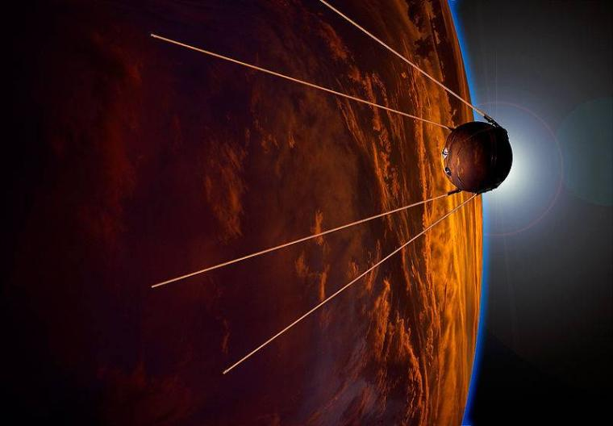
In 1957, the USSR used its first ICBM to launch Sputnik, the first satellite into space
Sputnik shocked Americans who feared the U.S. had fallen behind the USSR in science & technology
As a result of Sputnik, the Cold War escalated into a space race to show American & Soviet dominance
Notes:
Space Race: Sputnik, NASA, race to moon
The Cold War in the Skies The Cold War also affected the science and education programs of the two countries. In August 1957, the Soviets announced the development of a rocket that could travel great distances—an intercontinental ballistic missile, or ICBM. On October 4, the Soviets used an ICBM to push Sputnik, the first unmanned satellite, above the earth’s atmosphere. Americans felt they had fallen behind in science and technology, and the government poured money into science education. In 1958, the United States launched its own satellite. In 1960, the skies again provided the arena for a superpower conflict. Five years earlier, Eisenhower had proposed that the United States and the Soviet Union be able to fly over each other’s territory to guard against surprise nuclear attacks. The Soviet Union said no. In response, the U.S. Central Intelligence Agency (CIA) started secret high-altitude spy flights over Soviet territory in planes called U-2s. In May 1960, the Soviets shot down a U-2 plane, and its pilot, Francis Gary Powers, was captured. This U-2 incident heightened Cold War tensions..

Slide 12
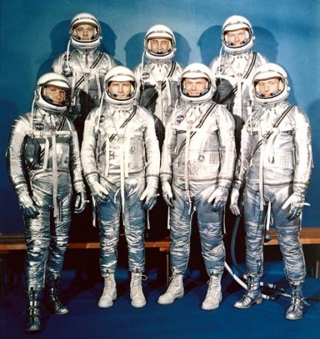
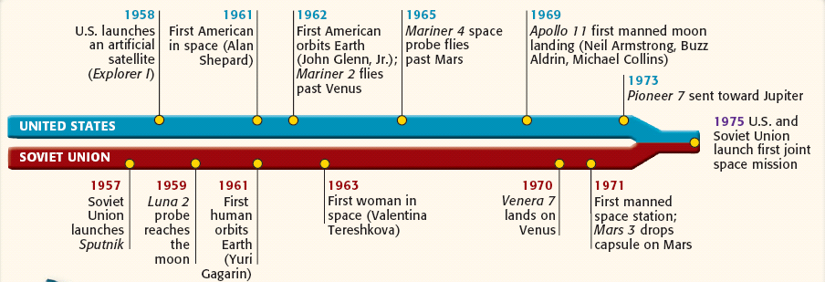
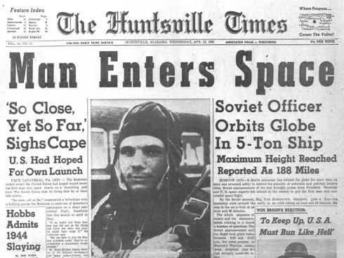
In 1958, the USA created National Aeronautics & Space Administration (NASA) to catch up to the USSR…
The USSR repeatedly beat the USA in space by launching the first man into orbit & orbiting the moon
…U.S. schools promoted math, science, & technology
NASA’s original seven NASA Mercury astronauts

Slide 13
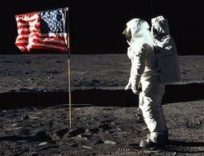
In 1962, President John Kennedy committed the USA to beating the Soviet Union in the race to the moon
In 1969, Apollo 11 landed U.S. astronauts on the moon

Slide 14
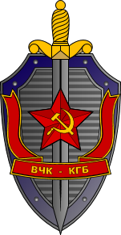
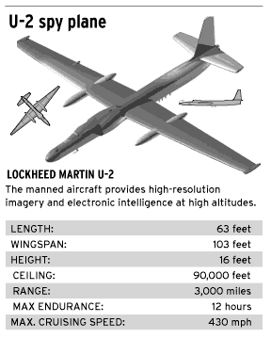
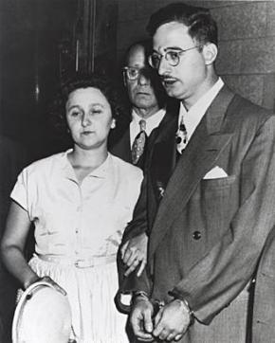
During the Cold War, the USA & USSR created intelligence agencies, the CIA and KGB, in order to spy and carry out covert operations
The USA & USSR used spies to gather intelligence
U.S. & Soviet spy planes gathered information also
Convicted spies Julius & Ethel Rosenberg
Notes:
Espionage: CIA, KGB, covert military ops
Cold War Strategies The United States, the Soviet Union, and, in some cases, China, used a variety of techniques to gain influence in the Third World. (See feature on next page.) They backed wars of revolution, liberation, or counterrevolution. The U.S. and Soviet intelligence agencies—the CIA and the KGB—engaged in various covert, or secret, activities, ranging from spying to assassination attempts. The United States also gave military aid, built schools, set up programs to combat poverty, and sent volunteer workers to many developing nations. The Soviets offered military and technical assistance, mainly to India and Egypt.

Slide 15
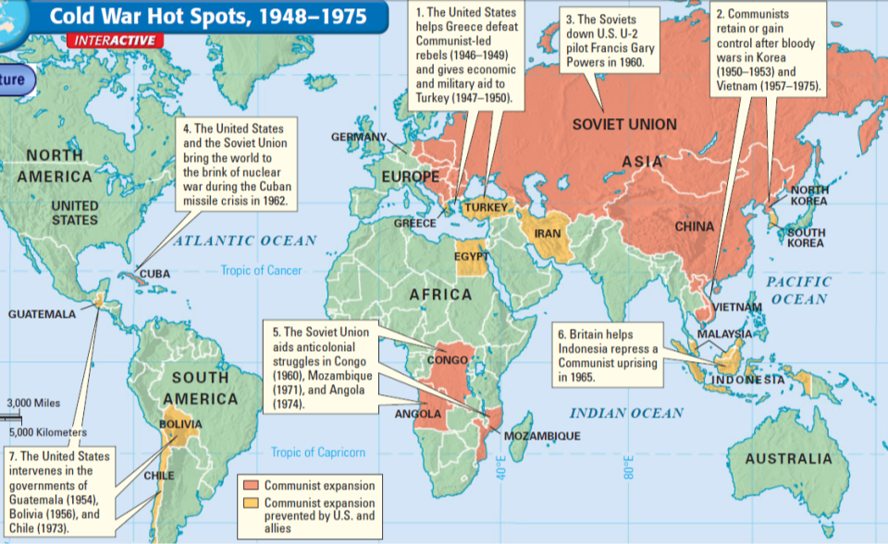
The CIA overthrew the governments of Iran & Guatemala and intervened in Egypt, Bolivia, Chile, & Cuba to stop communism
The Cold War escalated as the threat of communism spread into the Middle East, Africa, & Latin America

Slide 16
Essential Question:
Why did the Cuban Missile Crisis result in near nuclear war in 1962?
CPWH Agenda for Unit 13.3:
Clicker Review Questions
“Cuban Missile Crisis” activity
Today’s HW: 33.5
Unit 13 Test: Tuesday, May 3

Slide 17
The Cuban Missile Crisis brought the United States & Soviet Union to a near nuclear war in 1962
Cuban Missile Crisis Decision-Making Activity:
In groups, examine the information presented & make an informed decision from the perspective of the U.S. government
Write your answers in the space provided on the decision-making guide

Slide 18
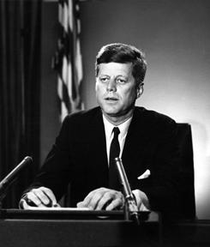
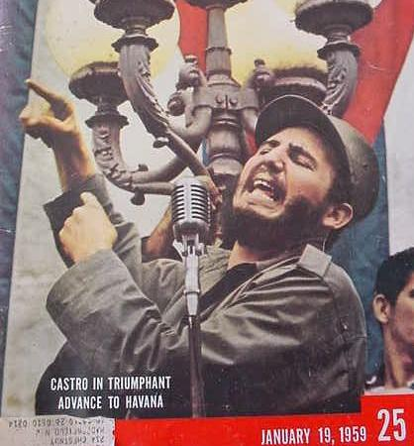
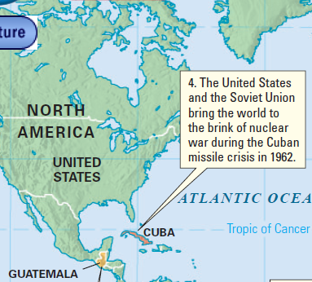
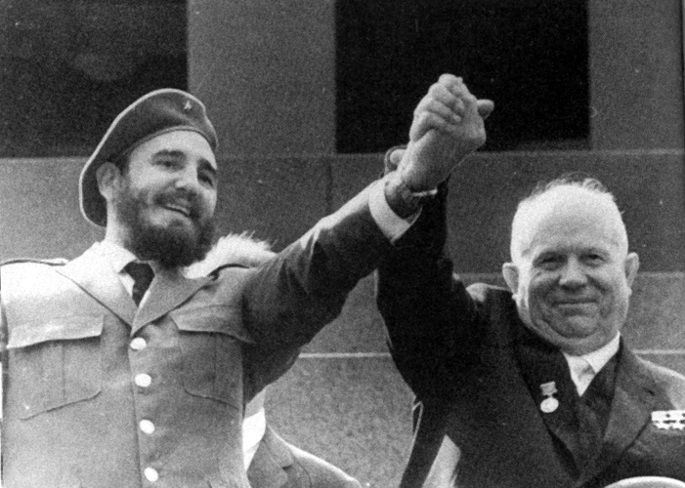
Overview of Kennedy, the Cold War & Cuba

Slide 19
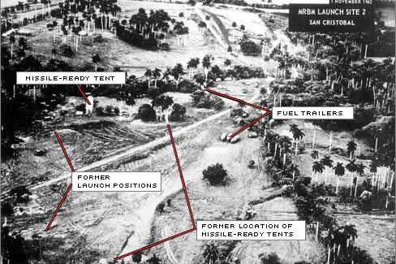
Critical Thinking Question A

Slide 20
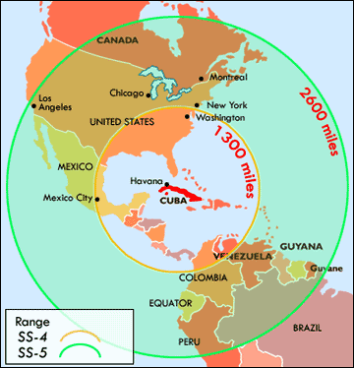
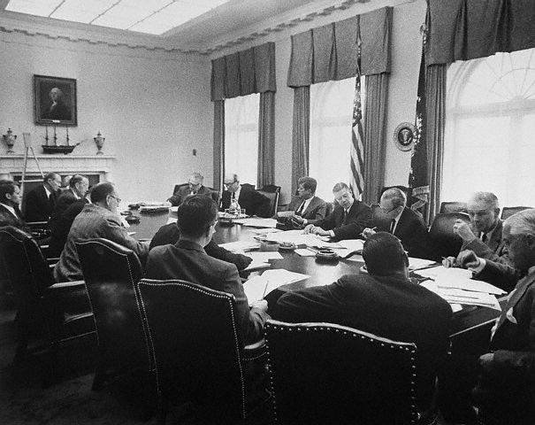
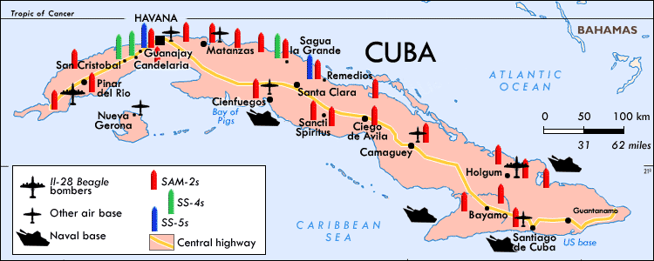
Critical Thinking Question B

Slide 21
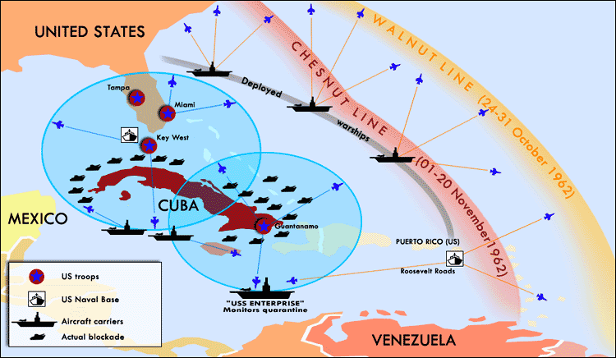
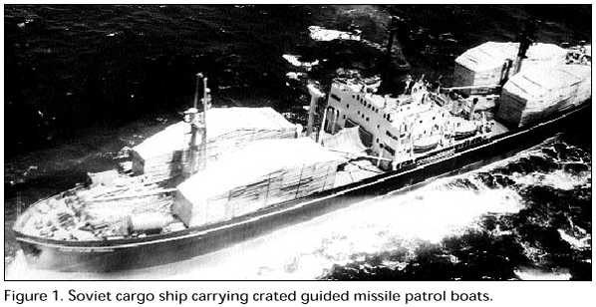
Critical Thinking Question C

