Slide 1
Essential Question:
What is the significance of the Byzantine Empire?

Slide 2
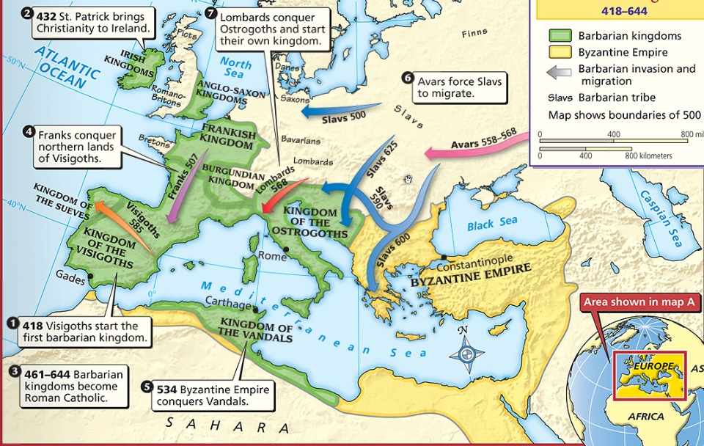
What happened to the Roman Empire by 500 A.D.?

Slide 3
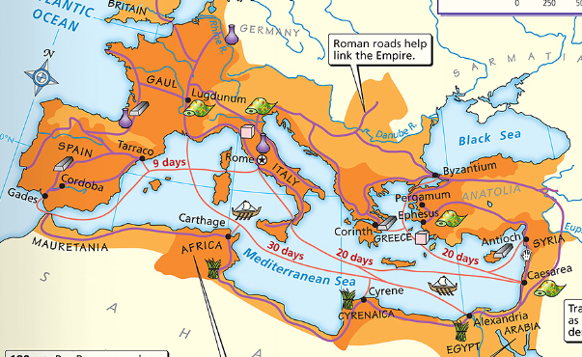
The Fall of the Roman Empire
After the Pax Romana, the Roman Empire entered an era of decline
The Roman Empire had a series of weak emperors
Romans had a large trade imbalance (they bought more than they produced)
As Rome grew more in debt, the military became weak & began using foreign mercenary soldiers

Slide 4
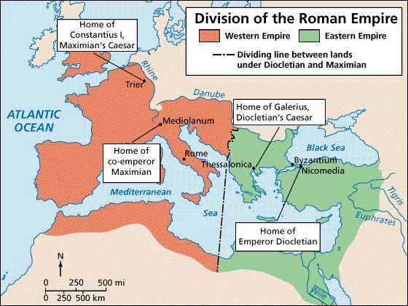
The Western Roman Empire continued to grow weak
Emperor Constantine moved the Roman capital to Constantinople in the Eastern Roman Empire
Text
Emperor Diocletian tried to save Rome by dividing the empire

Slide 5
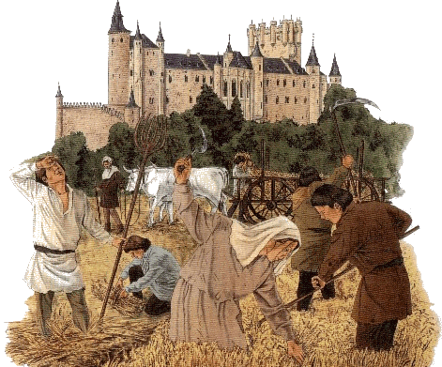
The Fall of the Roman Empire
By 476, barbarians conquered the Western Roman Empire
The Western Roman Empire fell into the Middle Ages (“Dark Ages”) from 500 to 1300 A.D.

Slide 6
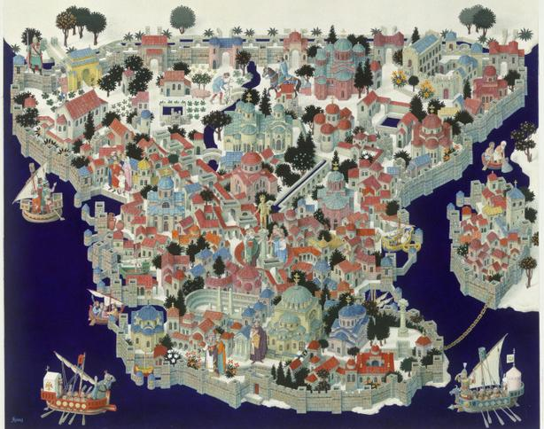
What happened in the Eastern Roman Empire?

Slide 7
The Fall of the Roman Empire
While the Western Roman Empire was in decline…
…the Eastern Roman Empire remained strong
The Eastern Roman Empire became known as the Byzantine Empire

Slide 8
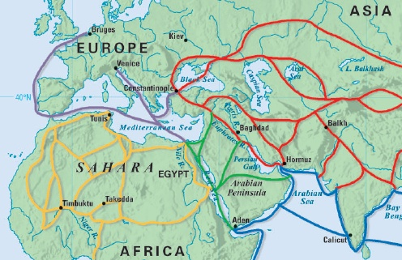
How did physical geography impact the Byzantine capital of Constantinople?
Text

Slide 9
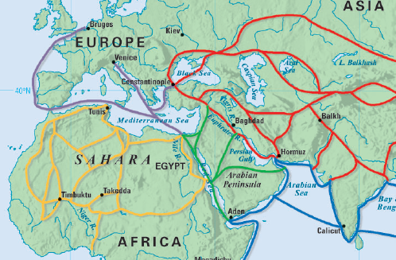
The Byzantine capital was Constantinople
Constantinople was a wealthy trade city located between the Mediterranean & Black Seas

Slide 10
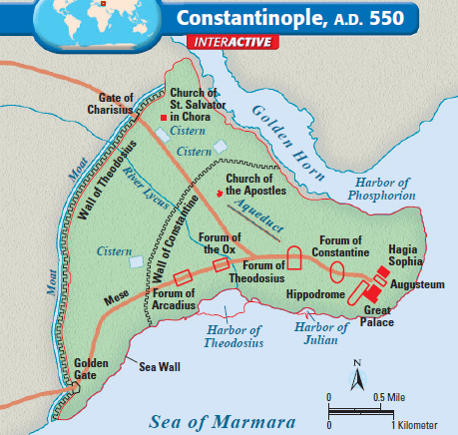
Byzantine Capital of Constantinople

Slide 11
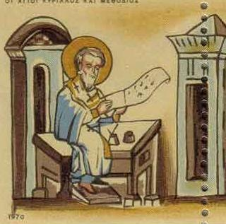
The Byzantine Empire
Citizens in the Byzantine Empire thought of themselves as Romans & they shared some similarities with the Roman Empire:
The Byzantine Empire kept alive Greco-Roman culture
Constantinople was a center for learning where schools taught philosophy, medicine, Greek and Latin grammar, geometry

Slide 12
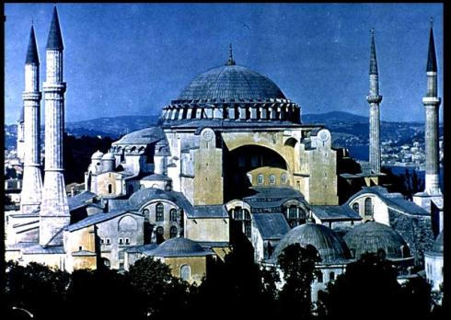
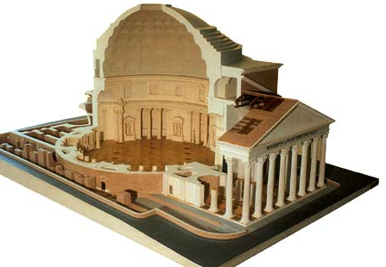
The Byzantine Empire
Citizens in the Byzantine Empire thought of themselves as Romans & they shared some similarities with the Roman Empire:
Byzantine Hagia Sophia
Roman Pantheon
How was architecture similar?

Slide 13
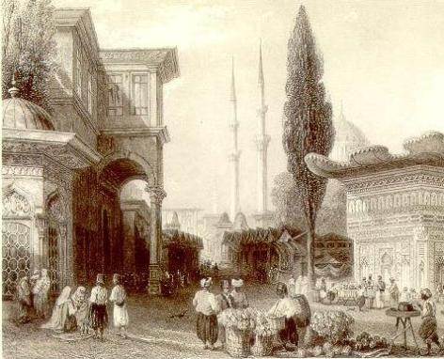
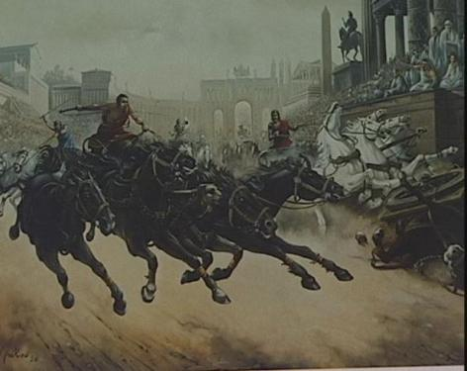
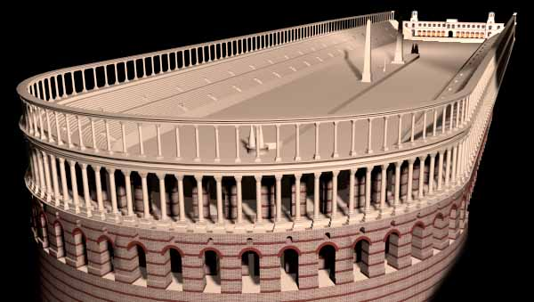
The Byzantine Empire
Citizens in the Byzantine Empire thought of themselves as Romans & they shared some similarities with the Roman Empire:
Constantinople used Roman-style architecture such as arches & domes
Byzantine cities had forums for trade & arenas to entertain citizens

Slide 14
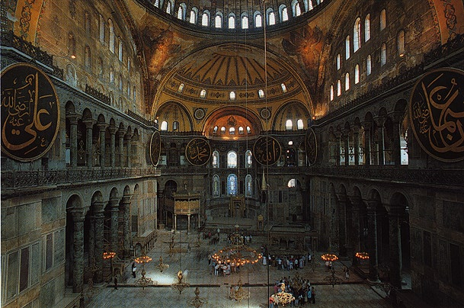
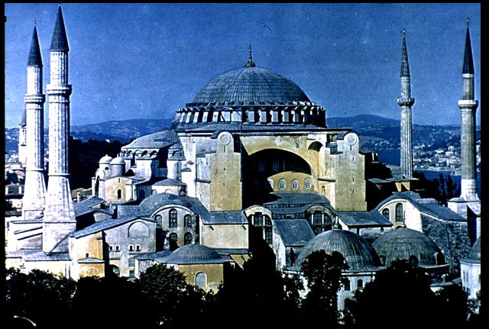
One of the most impressive architectural buildings in the Byzantine Empire was a Christian cathedral called the Hagia Sophia

Slide 15
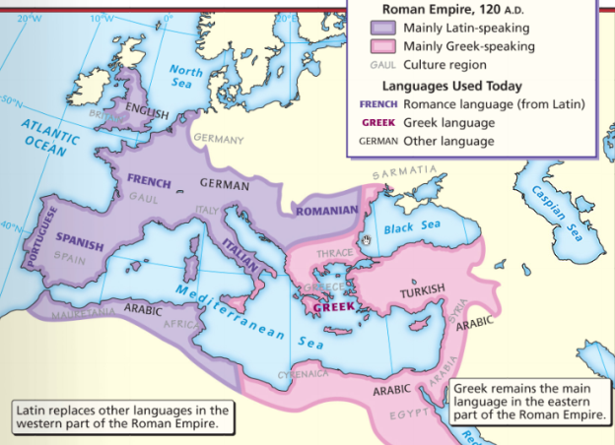
The Byzantine Empire
Citizens in the Byzantine Empire thought of themselves as Romans & they shared some similarities with the Roman Empire:
The official language was Latin, but most Byzantines spoke Greek

Slide 16
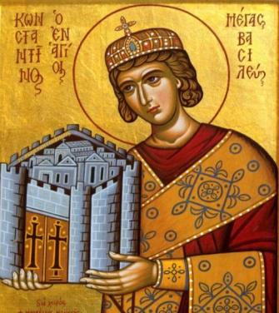
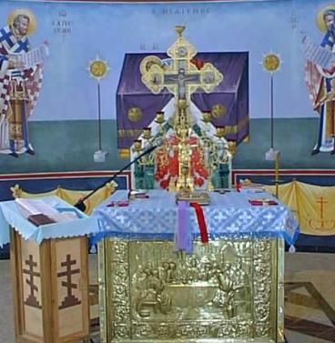
The Byzantine Empire
Citizens in the Byzantine Empire thought of themselves as Romans & they shared some similarities with the Roman Empire:
Religion in the late Roman Empire
Religion in the Byzantine Empire
How was religion similar?

Slide 17
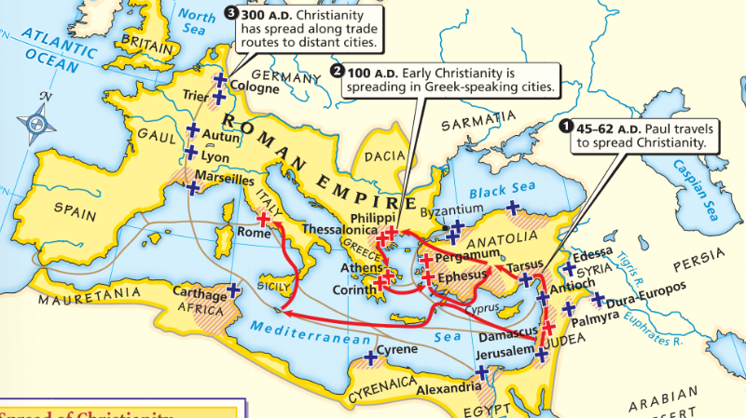
Because of its location close to Judea, most Byzantines had converted to Christianity before those in the Western Roman Empire

Slide 18
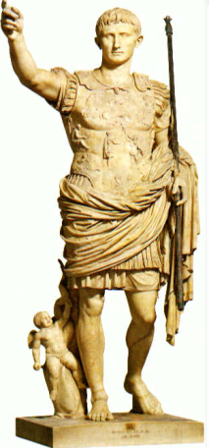
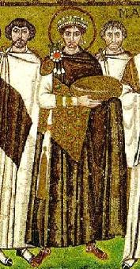
The Byzantine Empire
Citizens in the Byzantine Empire thought of themselves as Romans & they shared some similarities with the Roman Empire:
Both the Roman & Byzantine Empires were ruled by emperors who had absolute power over the empire
Justinian was the most famous Byzantine Emperor
Roman government
Byzantine government
How was government similar?

Slide 19
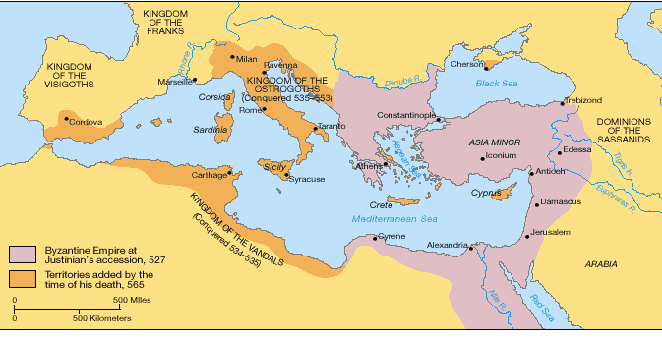
About 50 years after the fall of Rome, Byzantine Emperor Justinian came to power & began reconquering Roman territories

Slide 20
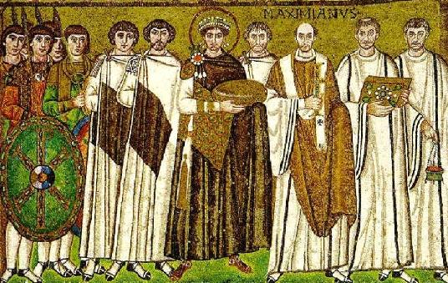
In addition to empire building, what else did Emperor Justinian value?

Slide 21
The Justinian Code
To oversee his new empire, Justinian ordered legal experts to consolidate old Roman laws into a single law code
The Justinian Code served as the legal basis for criminal justice, marriage, property, slavery, & women’s rights
The law code became one of the most important legacies of the Byzantine Empire & served as the basis for laws for the next 900 years

Slide 22
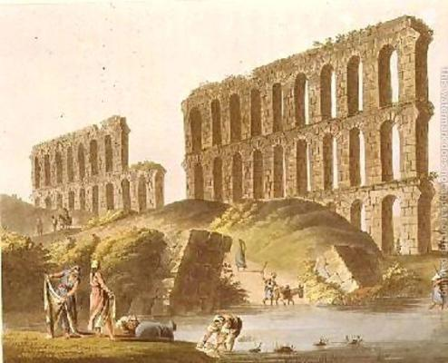
Justinian
In addition to expanding the empire & creating a uniform set of laws, Emperor Justinian also began large building projects
He ordered the construction of the Hagia Sophia to show the importance of the church
He built hospitals, aqueducts, public baths, schools, & courts

Slide 23
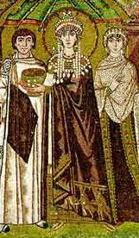
Empress Theodora
Justinian’s wife Theodora had a lot of power & influence in the Byzantine Empire:
She met with & wrote to foreign leaders
She advised Justinian & helped him pass laws
She encouraged building of Christian cathedrals

Slide 24
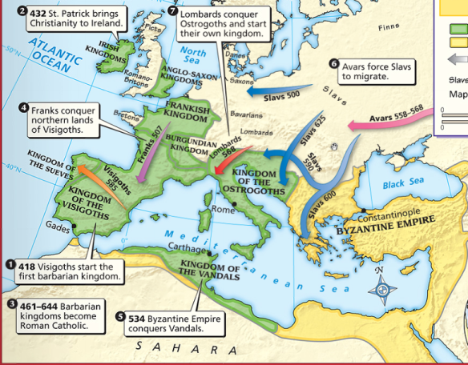
The Division of Christianity
Because of the distance & lack of contact between Byzantine Empire & Western Europe, Christianity developed differently
All Christians based their faith on Jesus & the Bible
But they had different practices to show their faith

Slide 25
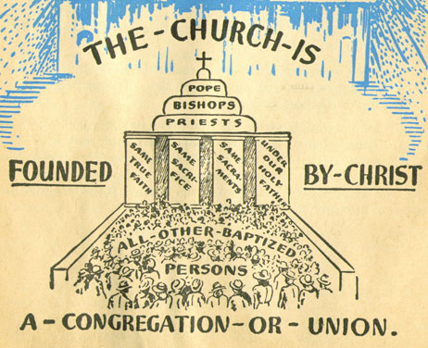
The Division of Christianity
Christians were organized the same way:
Archbishops & bishops oversaw regions where Christianity was practiced
Priests led individual churches
But, Christians in the East & West disagreed over leadership of the Church

Slide 26
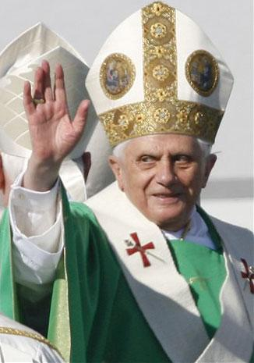
The Division of Christianity
Christians in Western Europe:
Believed that there should be a Pope to oversee bishops & give authority to all Christians
Christians in Western Europe accepted the authority of the Pope

Slide 27
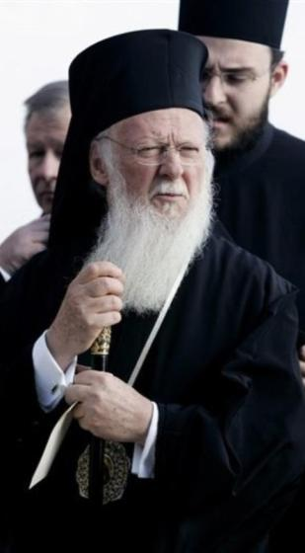
The Division of Christianity
Christians in Eastern Europe:
Believed that the Byzantine Emperor had authority over issues involving Christianity
Byzantine emperors relied on a Patriarch to oversee the church, but the emperor had final authority
Christians in the Byzantine Empire did not accept the authority of the Pope

Slide 29
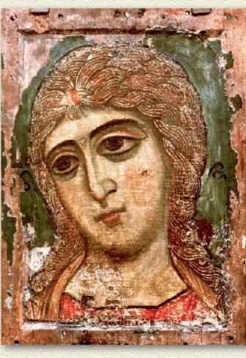
The Division of Christianity
One of the biggest controversies among Christians was the use of icons:
Icons were religious images to help Christians in their prayers & worship
Some Christians thought this was “idol worship”
In 730, the Byzantine Emperor banned icons & many Christians rioted

Slide 30
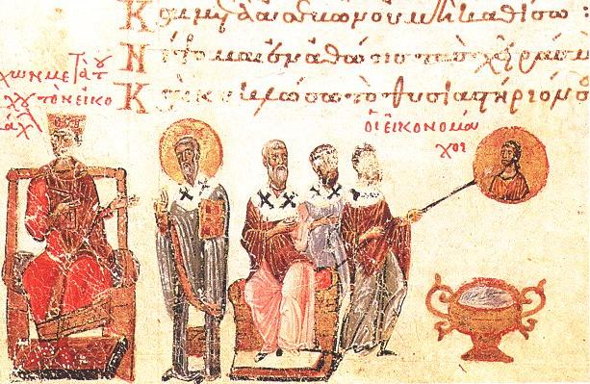
Emperor Leo III ordered the destruction of icons in the Byzantine Empire
Riots broke out between people who wanted icons & iconoclasts (those who wanted to ban icons)
The Pope excommunicated the emperor (kicked him out of the church)
The Pope in Western Europe supported the use of icons & called the Byzantine Emperor a heretic (a believer of false ideas)

Slide 31
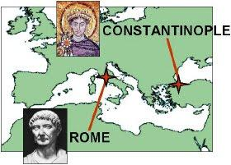
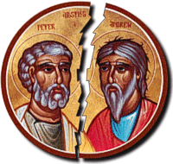
The Division of Christianity
These disagreements led to deep divisions among Christians & the Great Schism (split) occurred in 1054:

Slide 32
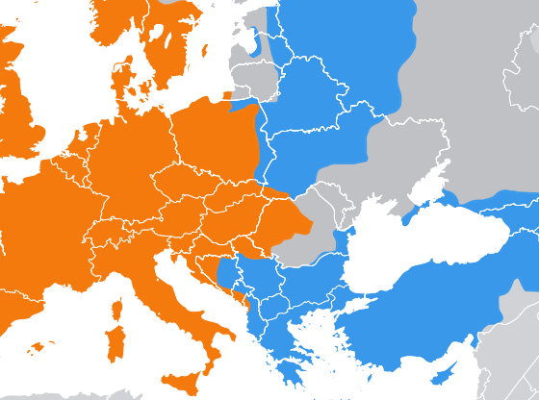
The Division of Christianity
Christians in Western Europe became the Roman Catholic Church
Christians in Eastern Europe became the Eastern Orthodox Church

Slide 33
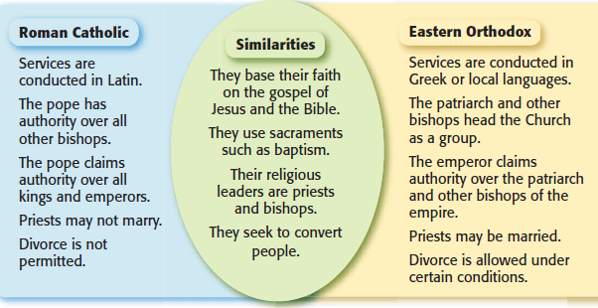
The Division of Christianity
Roman Catholics & Eastern Orthodox Christians practice their regions differently:

Slide 34
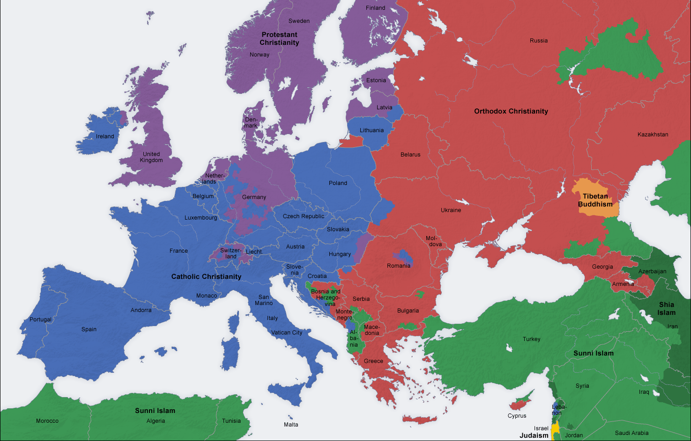
Religion in Europe Today

Slide 35
Closure Activity
You are a Roman citizen who was caught in an avalanche and frozen during the Pax Romana. You were found 250 years later during Justinian’s reign & defrosted in the city of Constantinople. You awoke to find yourself in a new city that you have never seen before. Some things are different, some are familiar.
Write a paragraph journal entry from the perspective of a frozen Roman that compares your home in Rome with this new city of Constantinople. (Think about gov’t, location, entertainment, religion, language)
Include at least 4 facts in your journal entry

