Slide 1
Essential Question:
What were the important themes in world history from 1919 to 1939?
Warm Up Question:
Notes:
31.1, 31.2

Slide 2
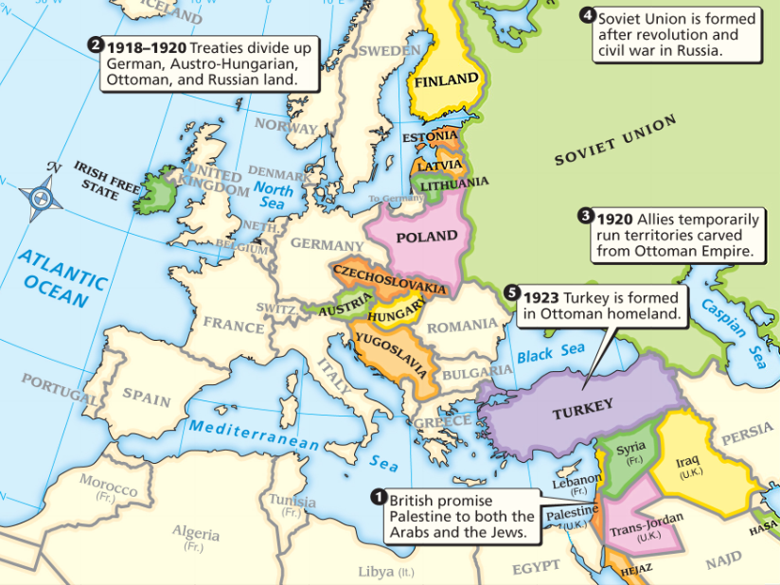
Title
Text
Important changes took place in the 20 years between the two world wars (1919-1939)

Slide 3
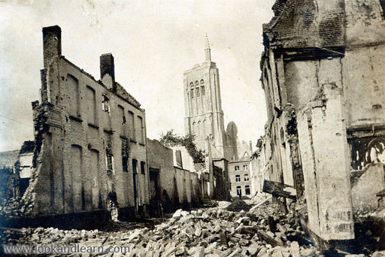
What was Europe like after World War I ?

Slide 4
Title
Russia was destroyed after WWI & a three-year civil war that led to communism & the formation of the Soviet Union
Many European nations were destroyed & bankrupted by years of fighting along the Western Front
Text
Italians were angry when they did not receive land along the Adriatic Coast
Important changes took place in the 20 years between the two world wars (1919-1939)
The harshness of the Treaty of Versailles created bitterness in Germany who were unable to pay reparations
In Europe, the war led to a sense of bitterness & pessimism among nations

Slide 5
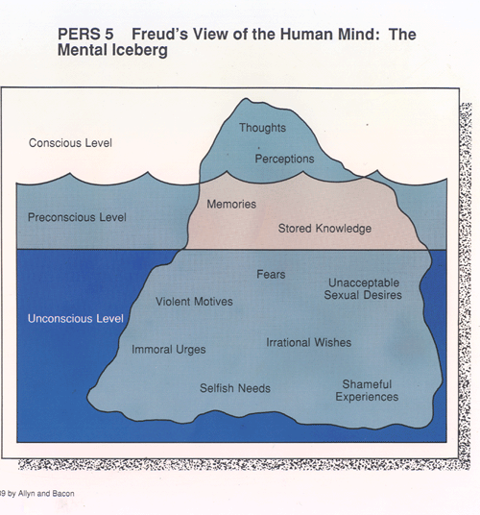
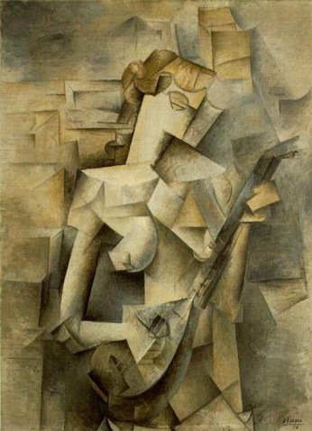
What were some new ideas in the post-war era?
The horrors of World War I changed people’s attitudes about progress
After the war, people started questioning traditional beliefs
Notes:
The horrors of World War I shattered the Enlightenment
belief that progress would continue and reason would prevail. In the postwar period, people began questioning traditional beliefs

Slide 6
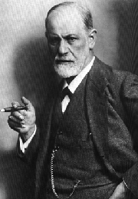
Austrian-born Sigmund Freud revolutionized psychology; He believed the mind has conscious & subconscious thoughts that affect peoples’ behavior

Slide 7
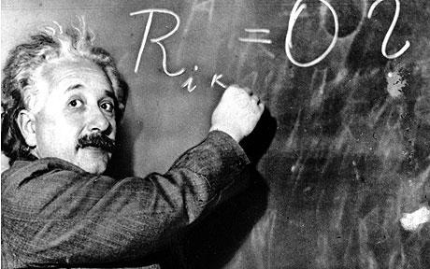
German-born Albert Einstein revolutionized physics; His theories on light, relativity, & energy disproved many of Isaac Newton’s discoveries from the 1600s

Slide 8
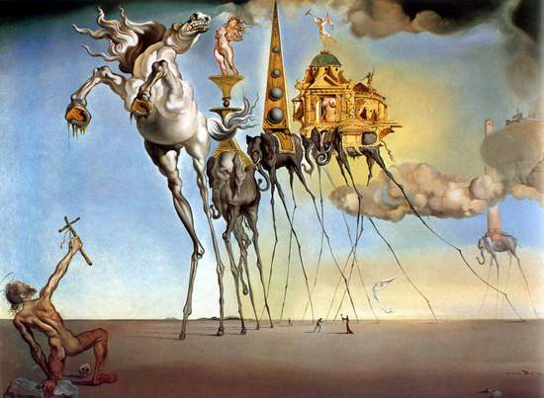
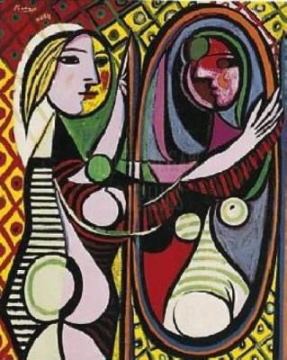
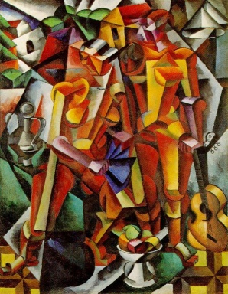
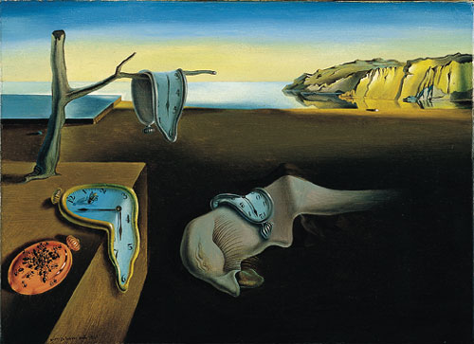
New abstract art like Pablo Picasso’s cubism (using geometric shapes) & Salvador Dali’s surrealism (dream-like art) reacted against tradition art forms

Slide 9
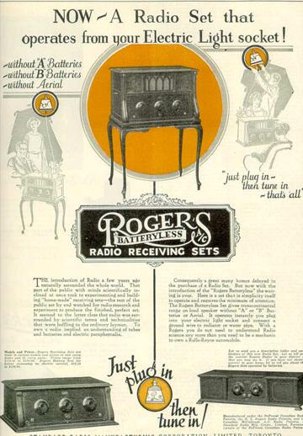
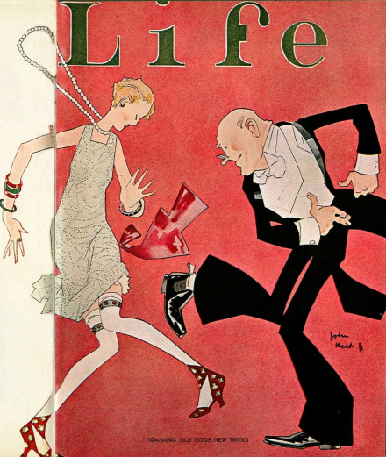
What was America like after World War I ?

Slide 10
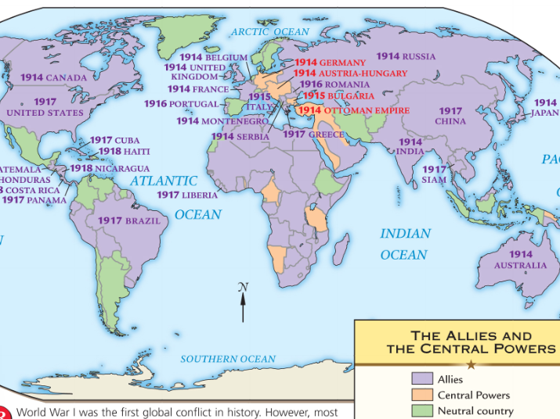
The USA was the wealthiest nation in the world & a major world power that created (but never joined) the League of Nations
Japan gained wealth by selling supplies to the Allies & increased its position as the strongest nation in Asia
While European nations struggled to rebuild & pay for the war, some world nations benefited from WWI

Slide 11
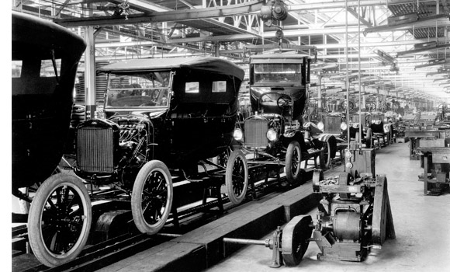
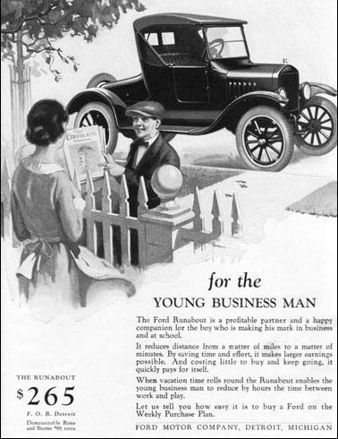
After WWI, the United States entered the Roaring Twenties
Mass production in factories led to new consumer goods & high wages for workers
Automobiles became inexpensive & popular…

Slide 12
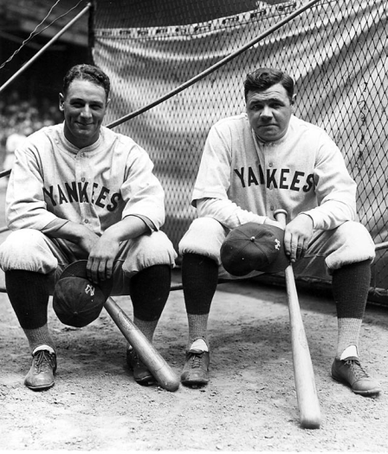
…Americans enjoyed themselves at movies, sporting events, & jazz clubs
Electric appliances & radios were popular…

Slide 13
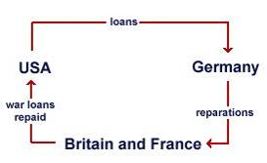
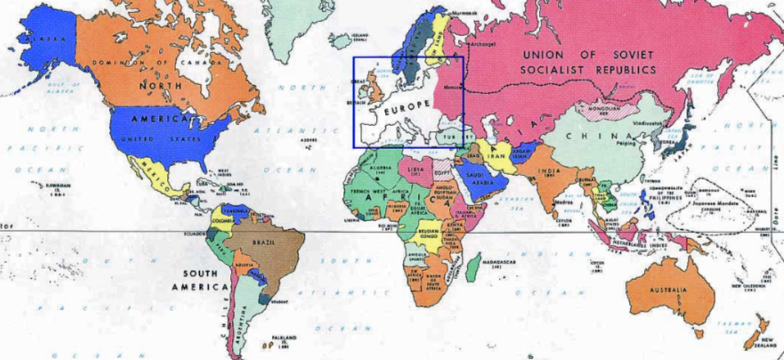
The USA used its wealth to help European nations repay their debts & rebuild after the war

Slide 14
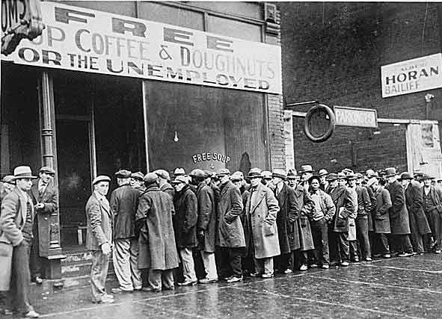
What changed in America in the 1930s?

Slide 15
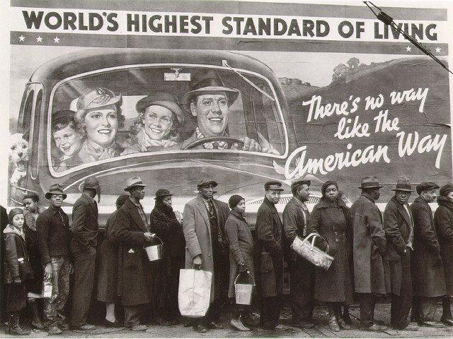
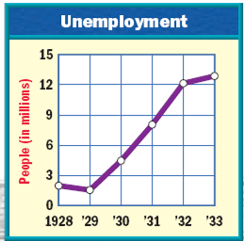
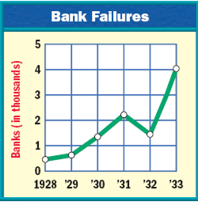
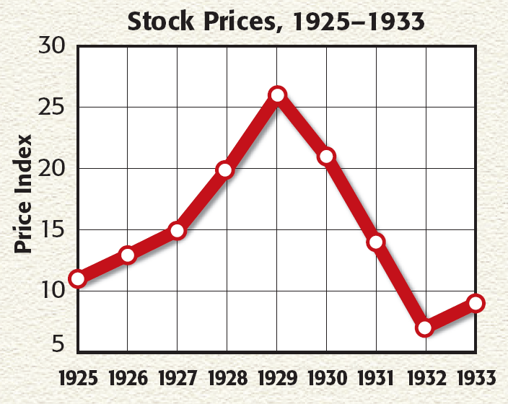
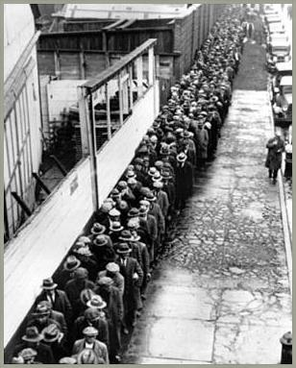
The Roaring Twenties came to an end in 1929 when the stock market crash, bank failures, & high unemployment led to a Great Depression

Slide 16
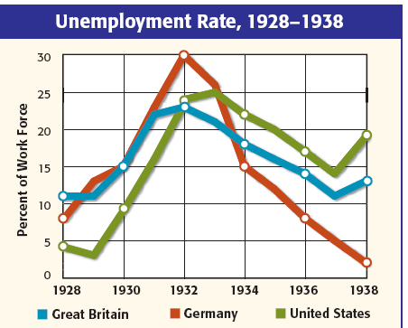
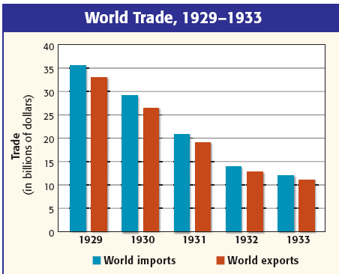
The depression in America triggered a world-wide depression in the 1930s when international trade declined & U.S. investment in Europe ended
The depression led to a sharp rise in unemployment in Europe

Slide 17
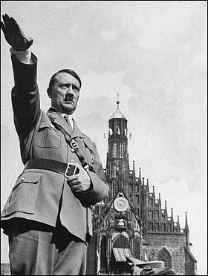
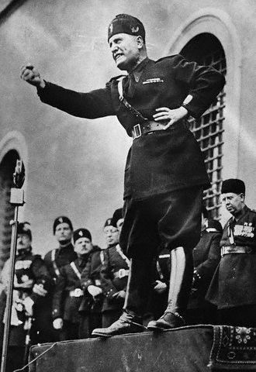
Why did powerful dictators come to power in Europe in the 1920s & 1930s?

Slide 18
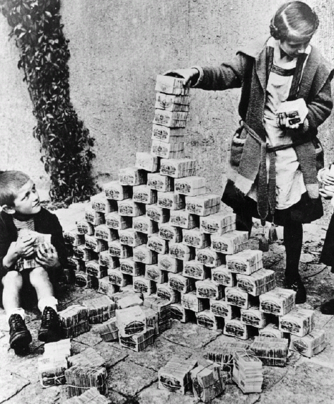
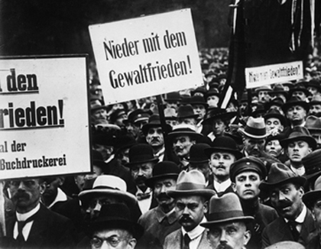
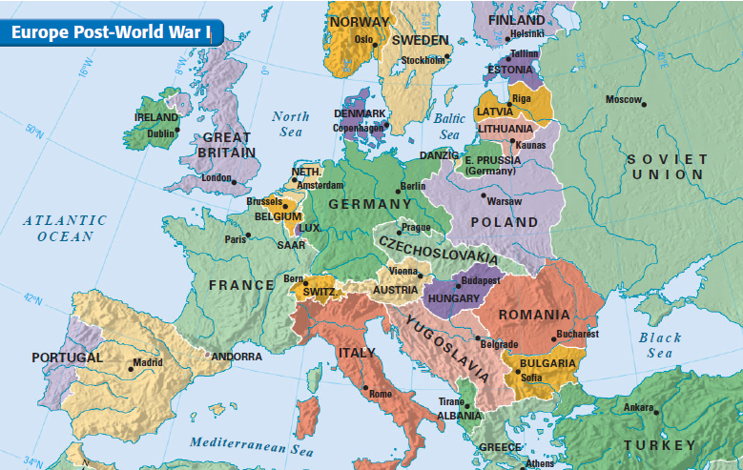
In Germany, the situation grew desperate by the 1930s & the Weimar gov’t became more unpopular
The Weimar republic was already unpopular because gov’t leaders signed the Treaty of Versailles
Like Germany, Italians felt betrayed by the treaty, had a suffering economy, & saw its unemployment rise
Unemployment in Germany reached 30%
To pay war reparations & rebuild the country, the gov’t printed money which led to hyper-inflation

Slide 19
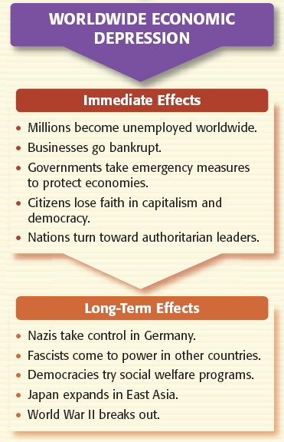
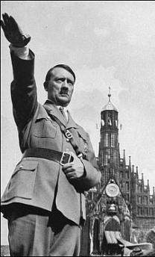
Due to the economic depression, bitterness, & desperation, powerful dictators will seize power in Germany & Italy
These dictators played an important role in causing World War II

