Slide 1
Essential Question:
What were the major causes & effects of the American Revolution?
Warm-Up Question:

Slide 2
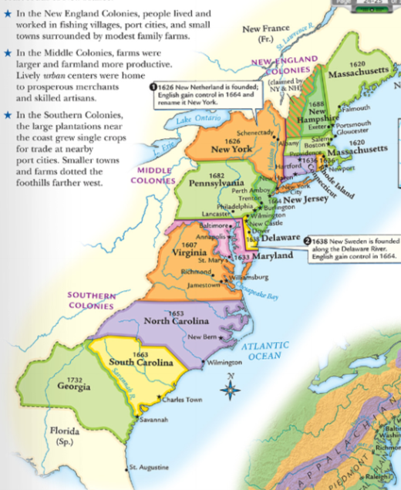
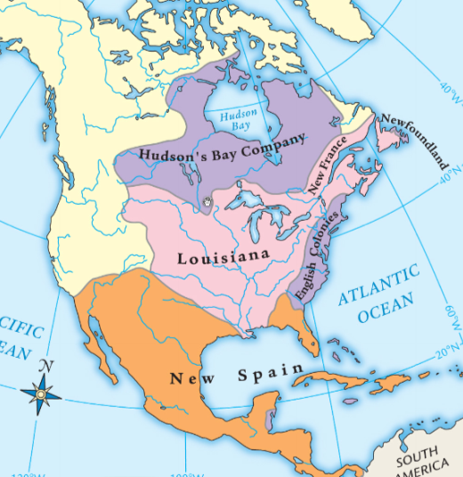
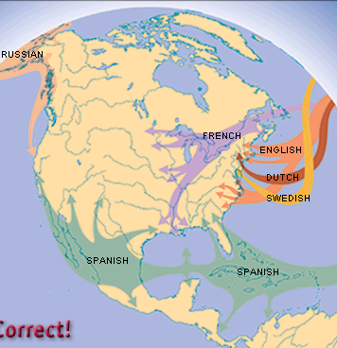
The Settlement of America
During the Age of Exploration, Europeans began colonizing in North America
England granted joint-stock charters to colonists who were searching for wealth or religious freedom
From 1607 to 1733, England established 13 colonies in America; The colonies were very different & lacked unity

Slide 3
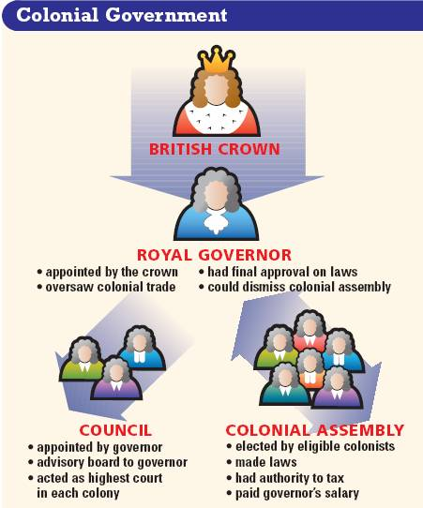
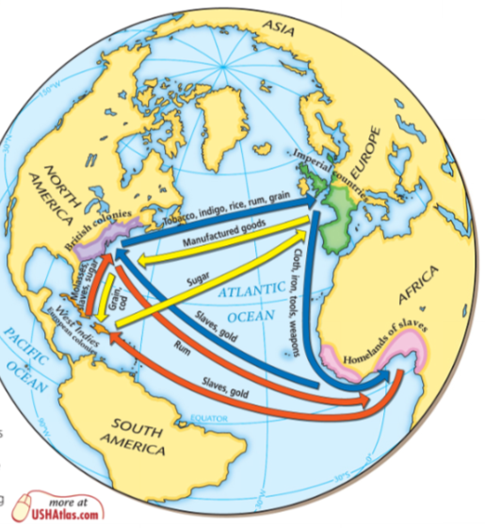
Economics & Government in America
England used mercantilism to control colonial trade & increase their profits
Text
Despite these trade restrictions, the colonists made money trading with England
England used a policy called salutary neglect which allowed colonists freedom to make their own laws & taxes
Americans created their own colonial assemblies & enjoyed self government

Slide 4
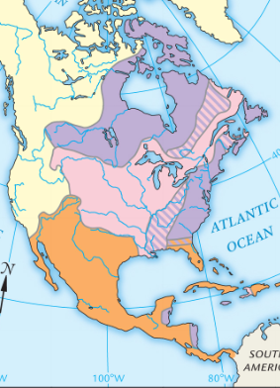
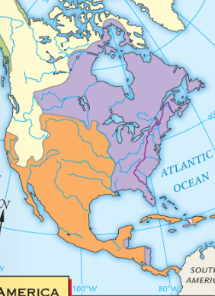
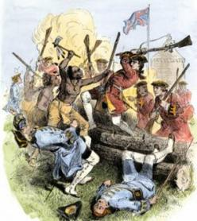
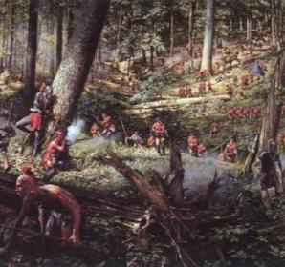
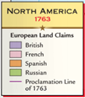
The French & Indian War (1754-1763)
For 150 years, colonists were happy with this relationship with England
But, everything changed after the French & Indian War
In 1754, England & France went to war for seven years over territory in America
In 1763, England won the war & the Treaty of Paris gave England all French lands east of the Mississippi River...
…But the war left England with massive debts

Slide 5
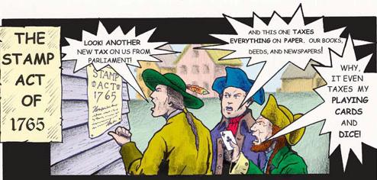
To pay off war debts, Britain created a series of new taxes on the American colonists
The colonists were upset that Parliament in England would pass laws without the colonists approval
Their slogan became: “No taxation without representation”

Slide 6
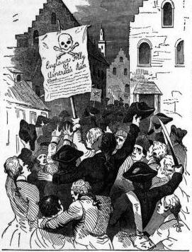
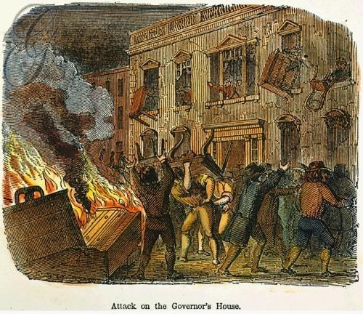
Colonists responded to new taxes with boycotts (refusing to buy British goods that were taxed)
Boycotts were effective, but the king & Parliament believed the Americans should obey British laws & took power away from the colonial assemblies

Slide 7
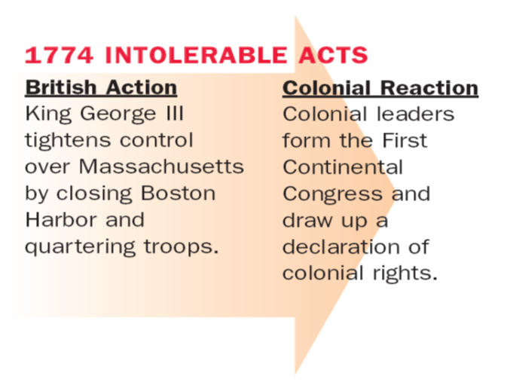
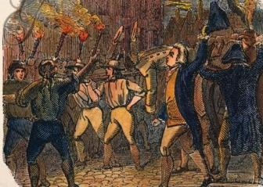
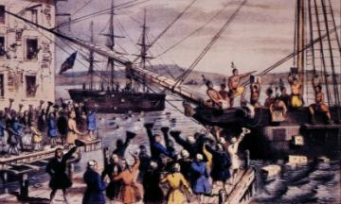
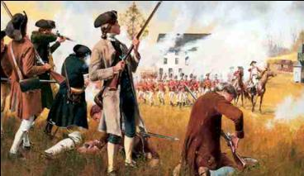
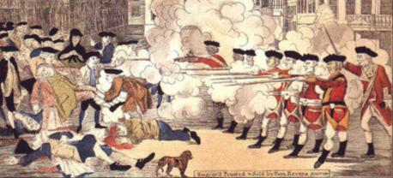
From 1763 to 1776, tensions between the English government & the American colonists increased

Slide 8
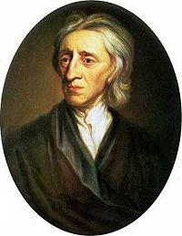
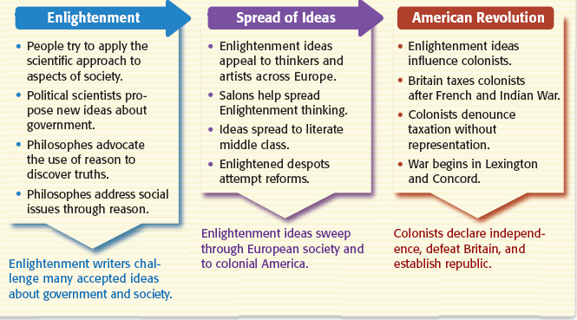
Americans were literate & read books by leading Enlightenment thinkers, especially John Locke, & used these ideas to justify their protest
“People are born with natural rights, including life, liberty, property”
“Kings can be overthrown if they violate peoples’ natural rights”
“Government power comes from the consent of the governed”

Slide 9
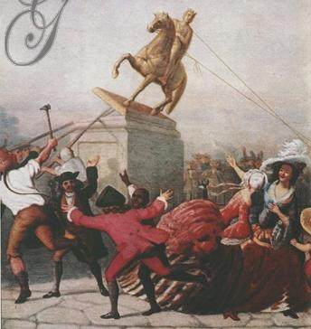
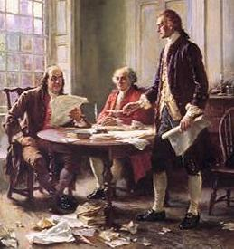
British abuses & Enlightenment ideas inspired Americans to declare independence
Ben Franklin, John Adams, & Thomas Jefferson served on the committee to draft the Declaration of Independence

Slide 10
Title

Slide 11
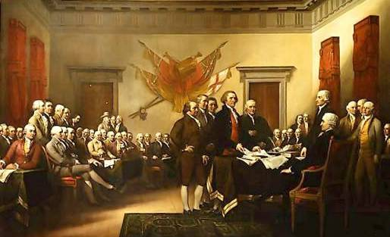
On July 4, 1776 Americans sent King George III the Declaration of Independence

Slide 12
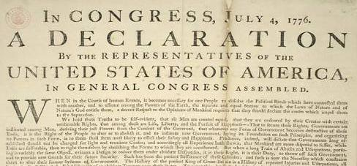
The Declaration of Independence Analysis
What did the Declaration of Independence say & why was it such a revolutionary document?
Examine the excerpts of the Declaration of Independence & match the quotes with the appropriate summary sentence
ANSWERS:
1. E 2. B 3. H 4. F
5. A 6. D 7. G 8. C

Slide 13
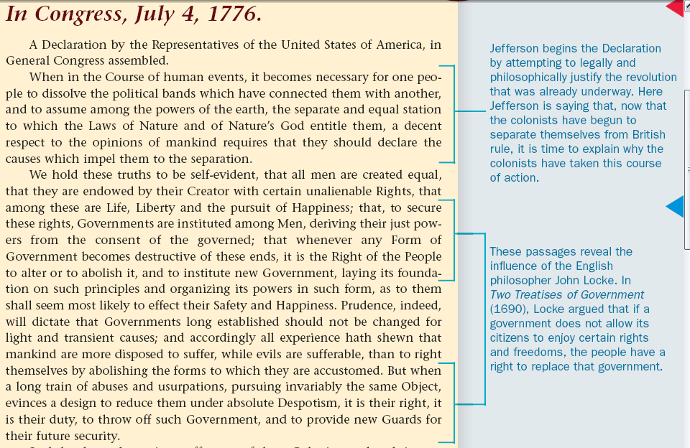
The Declaration of Independence & Influences from the Enlightenment
The Declaration of Independence used ideas from the Enlightenment (especially John Locke) to explain why Americans were declaring independence
Notes:
33a - explain the language, organization, and intellectual sources of the Declaration of Independence including the writings of John Locke and Montesquieu, and the role of Thomas Jefferson

Slide 14
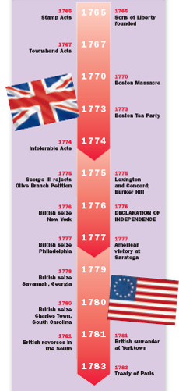
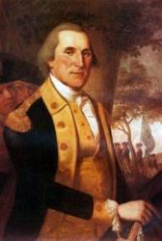
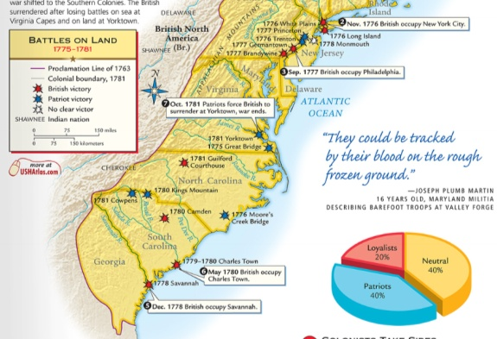
Brief summary of American Revolution Treaty of Paris, 1783
The American Revolution lasted from 1775 to 1783
After 6 years of fighting, the Americans defeated the British at the Battle of Yorktown

Slide 15
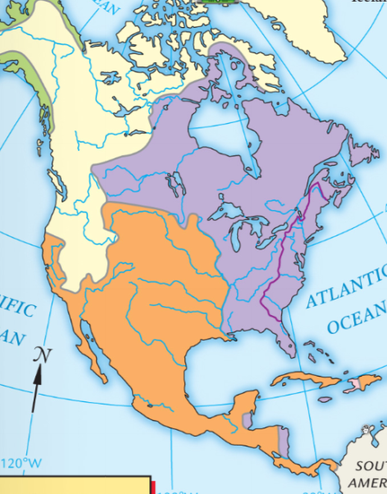
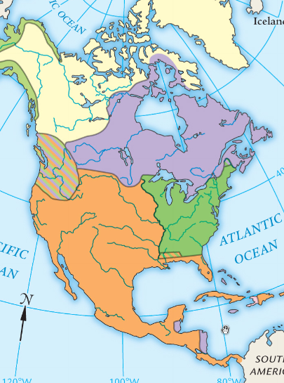
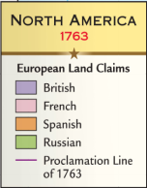
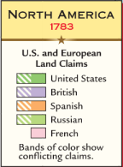
The Treaty of Paris, 1783 granted the United States independence from Britain & all lands east of the Mississippi River
With independence, the United States needed a national government to unite the new nation

Slide 16
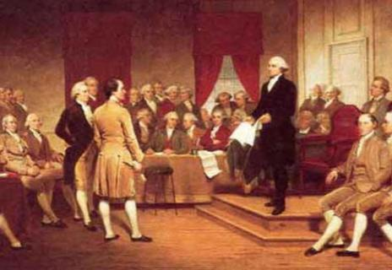
The founding fathers created a “federal” system that created a national gov’t but allowed the 13 states to keep power & make their own laws
Government Structure
Many of the ideas of the Enlightenment served as inspiration for the new national government of the United States

Slide 17
Analyzing the Constitution
How did the Enlightenment influence the structure & power of the national gov’t under the U.S. Constitution?
Examine each of the following images & guess what it reveals about the structure or power of the U.S. government
Match each idea to the Enlightenment philosophe who supported it
John Locke Voltaire Montesqueiu
Jean-Jacques Rousseau Cesare Beccaria

Slide 18
Constitution Concept #1

Slide 19
Popular Sovereignty
The framers of the Constitution created a democratic republic, a form of government where the people elect their leaders
The U.S. Constitution was inspired by John Locke’s idea that gov’t power comes from the “consent of the governed”
The Constitution also used Rousseau’s idea of a direct democracy because Congressmen & the president are elected directly by the people (majority rule)

Slide 20
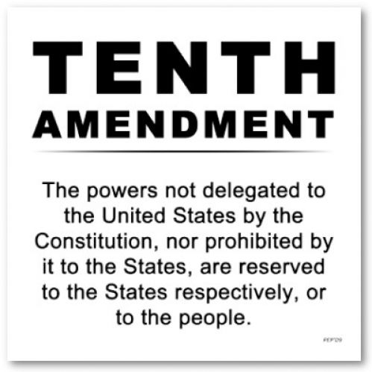
Constitution Concept #2

Slide 21
Limited Government
The founding fathers were afraid of giving the national gov’t too much power so they stated exactly which powers the gov’t had & all other powers were left to the state gov’ts or to the people
Both Locke & Montesquieu shared the idea of limiting gov’t power
Locke believed that a limited gov’t was the only way to protect individual liberty

Slide 22
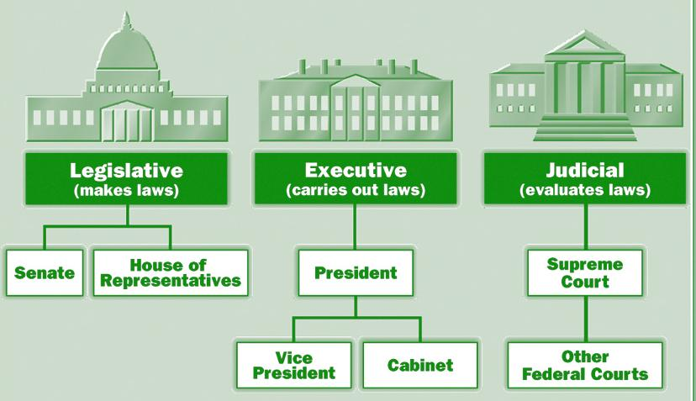
Constitution Concept #3

Slide 23
Separation of Powers
The Constitution uses separation of powers to divide the powers among three branches
The legislative branch consists of a Congress that makes laws & taxes
The executive branch consists of the president, vice president, & bureaucracy that enforces laws passed by Congress
The judicial branch is the Supreme Court & other federal courts that interpret laws, settle disputes, & decide guilt
This idea was inspired by Montesquieu

Slide 24
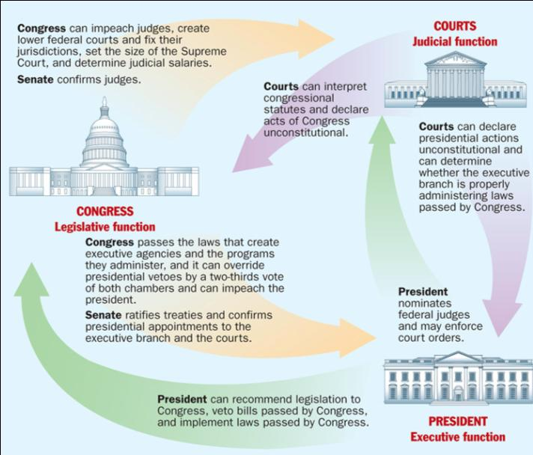
Constitution Concept #4

Slide 25
Checks & Balances
To keep one branch from seizing all power, the framers of the Constitution used a system of checks and balances
Each branch of gov’t holds powers over the other two branches as a means to limit their power
This idea was inspired by Montesquieu

Slide 26
Constitution Concept #5

Slide 27
Individual Liberty
The founding fathers added a Bill of Rights to the Constitution in order to guarantee that the gov’t could not violate liberty
Among these liberties are the freedoms of speech, press, and religion
The framers of the Constitution were inspired by the ideas of Voltaire

Slide 28
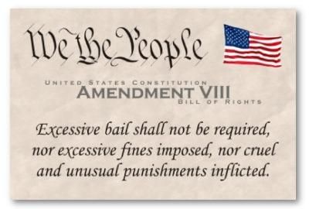
Constitution Concept #6

Slide 29
Individual Liberty
The Bill of Rights includes a number of protections of the rights of accused people
The Bill of Rights guarantees Americans freedom from self-incrimination, right to a speedy trial, & protection from cruel and unusual punishment
These protections of accused people were supported by Cesare Beccaria

Slide 30
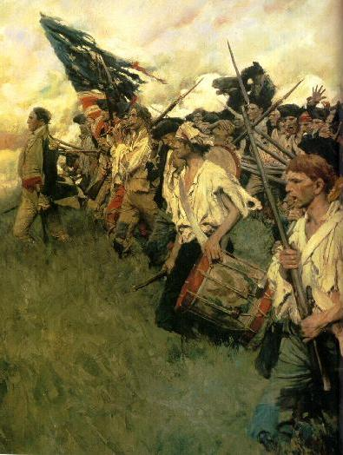
The American Revolution was an important event in world history
It was the first time a colony overthrew its mother country
It was the first time a gov’t was created using Enlightenment ideas of limited gov’t & individual liberty
The success in America inspired revolutions in Europe & Latin America

