Slide 1
The
Northern
Renaissance
Where are we talking about…Northern?

Slide 2
Renaissance Art in Northern Europe
Should not be considered an appendage to Italian art…it was distinctly different
But, Italian influence was strong.
Painting in OIL, developed in Flanders, was widely adopted in Italy…where is Flanders?
The differences between the two cultures:
Italy → change was inspired by humanism with its emphasis on the revival of the values of classical antiquity…what is Humanism?
Northern Europe → change was driven by religious reform of the church, the return to values in the scriptures, and the revolt against the authority of the Church.
More princes & kings were patrons of artists…what is patronage?

Slide 3
Characteristics of Northern Renaissance Art
The continuation of late medieval attention to details.
Tendency toward realism & naturalism [less emphasis on the “classical ideal”].
Interest in landscapes.
More emphasis on middle-class and peasant life.
Details of domestic interiors.
Great skill in portraiture.

Slide 4
Flemish
Realism

Slide 5
Jan van Eyck (1395 – 1441)
More courtly and aristocratic work.
Court painter to the Duke of Burgundy, Philip the Good.
←The Virgin and Chancellor Rolin, 1435.

Slide 6
Van Eyck -Adoration of the Lamb, Ghent Altarpiece, 1432

Slide 7
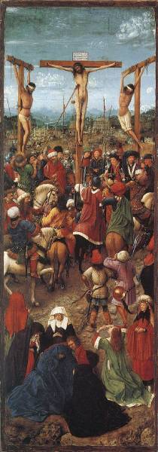
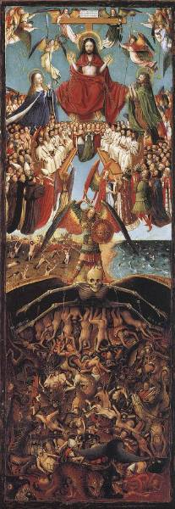
Van Eyck: ← The Crucifixion & The Last Judgment → 1420-1425

Slide 8
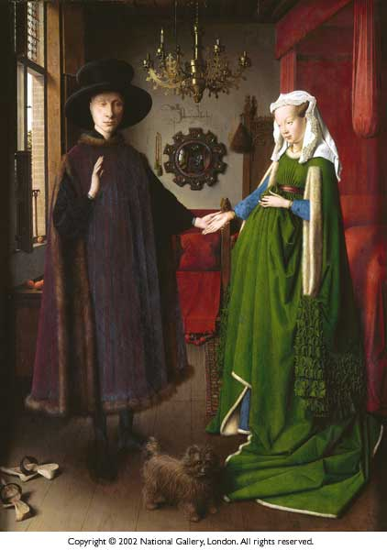
Giovanni Arnolfini and His Wife (Wedding Portrait) Jan Van Eyck 1434
This painting is full of symbolism Checkout the…
Dog, the clogs, the chandelier, the mirror, the medallions in the mirror frame, the oranges, the tiny statue, the colors green and red

Slide 9
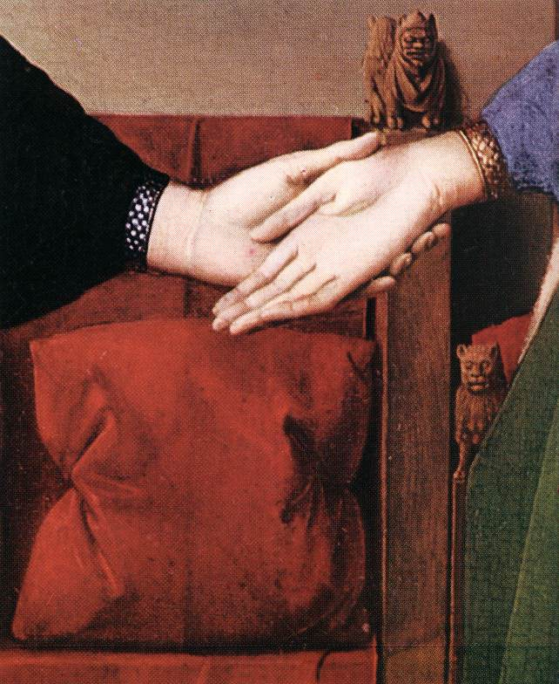
Jan van Eyck – Giovanni Arnolfini and his Wife
'joining of hands' and an open left hand…what does it symbolize?

Slide 10
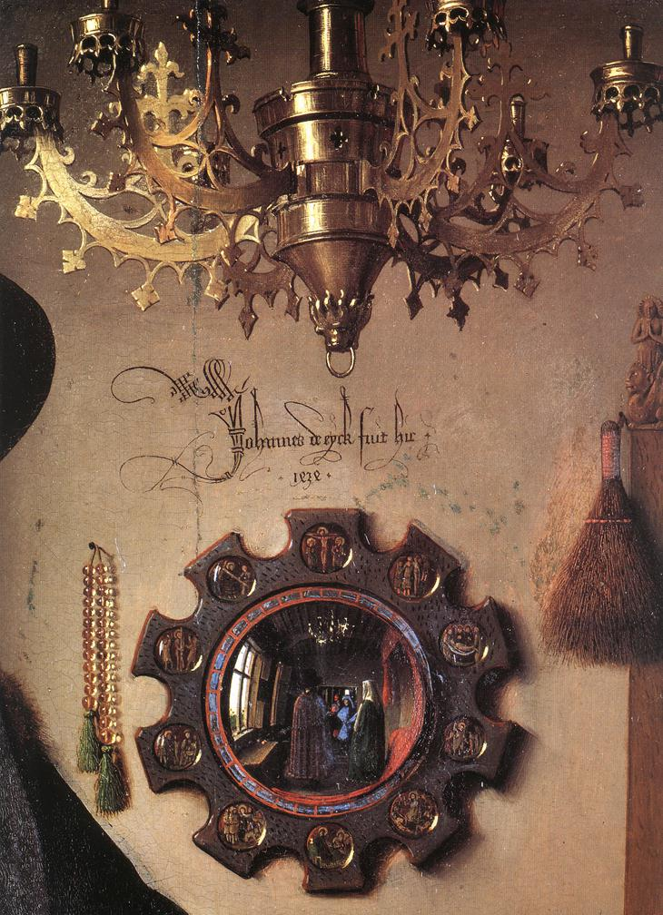
The mirror is the focal point of the whole composition. It has often been noted that two tiny figures can be seen reflected in it, their image captured as they cross the threshold of the room.
They are the painter himself and a young man, perhaps arriving to act as witnesses to the marriage.

Slide 11
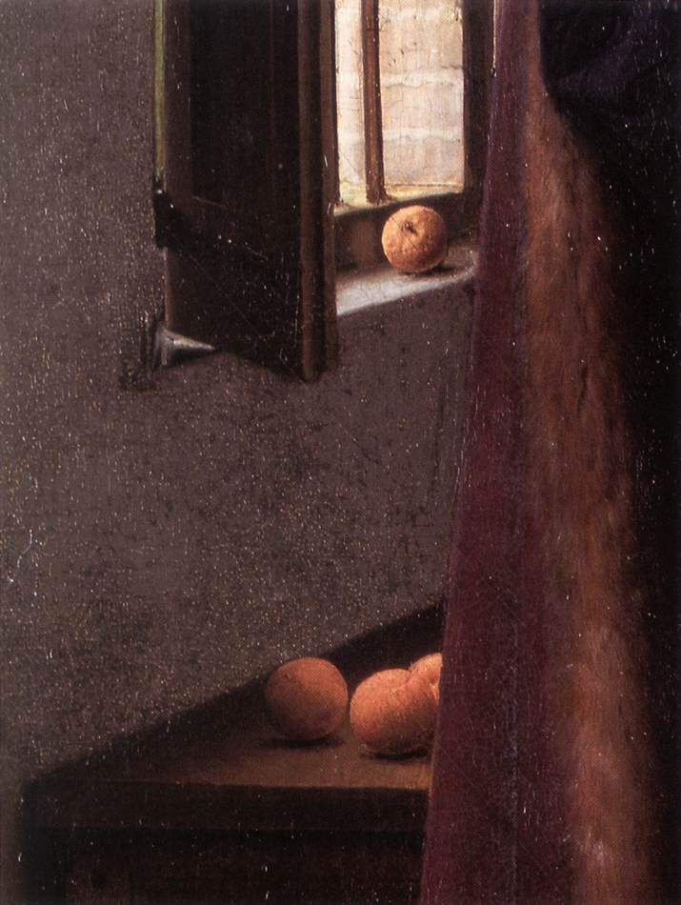
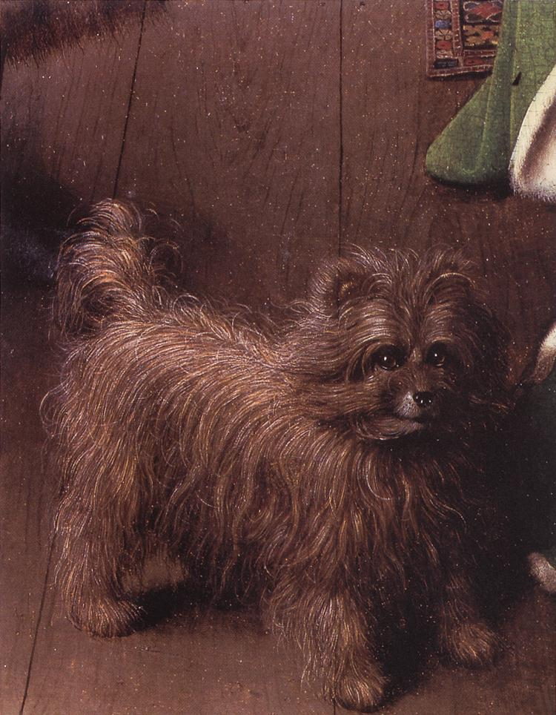
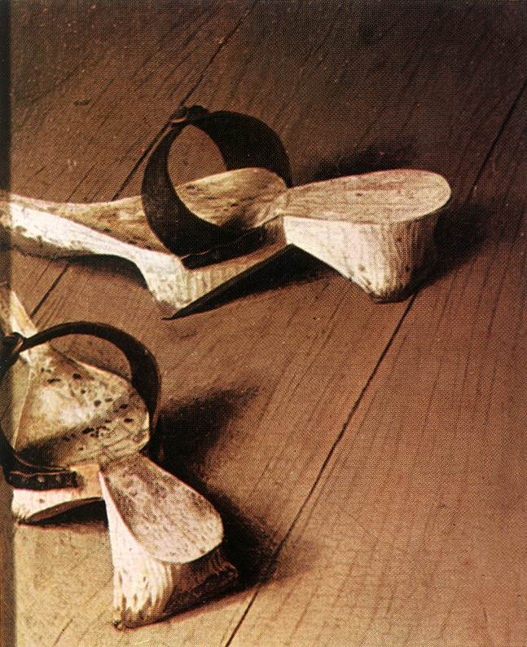
The oranges placed on the low table and the windowsill are a reminder of an original innocence, of an age before sin. Unless, that is, they are not in fact oranges but apples (it is difficult to be certain), in which case they would represent the temptation of knowledge and the Fall…Garden of Eden
The small dog in the foreground is an emblem of fidelity and love.
The clogs and outdoor sandals which the couple have removed might be typical wedding presents, or represent the taking of shoes in a sacred precincts.

Slide 12
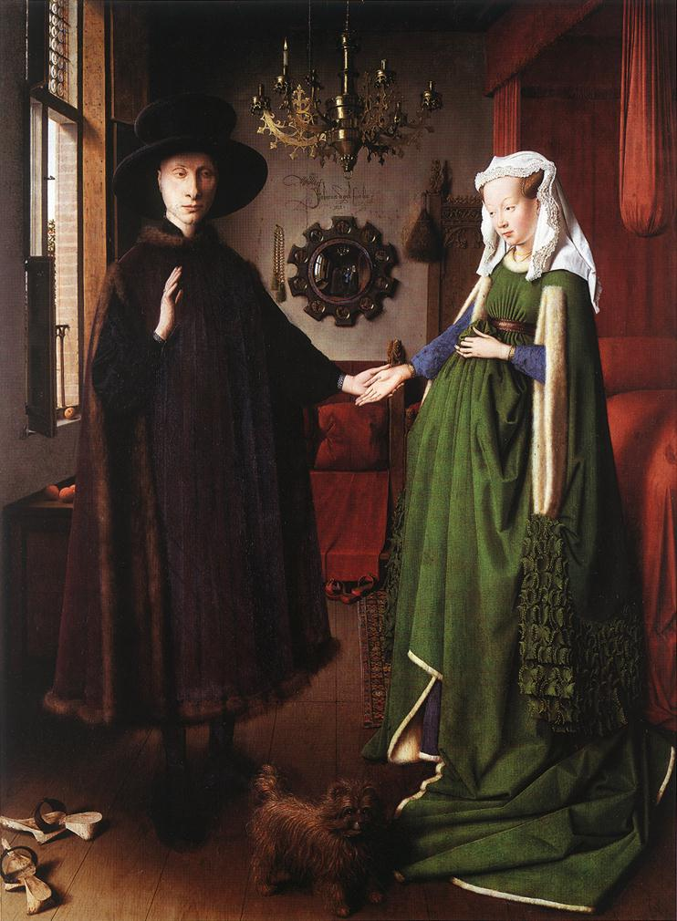
Above the couple's heads, the candle that has been left burning in broad daylight on one of the branches of an ornate copper chandelier can be interpreted as the nuptial flame. Meanwhile, the marriage bed with its bright red curtains evokes the physical act of love which, according to tradition and culture, is an essential part of the perfect union of man and wife.
The single candle can also represent the eye of God.

Slide 13
Rogier van der Weyden (1399-1464)
The Deposition
1435

Slide 14
van der Weyden’s Deposition (details)

Slide 15
Quentin Massys (1465-1530)
Belonged to the humanist circle in Antwerp that included Erasmus.
Influenced by da Vinci.
Thomas More called him “the renovator of the old art.”
The Ugly Dutchess, 1525-1530 →

Slide 16
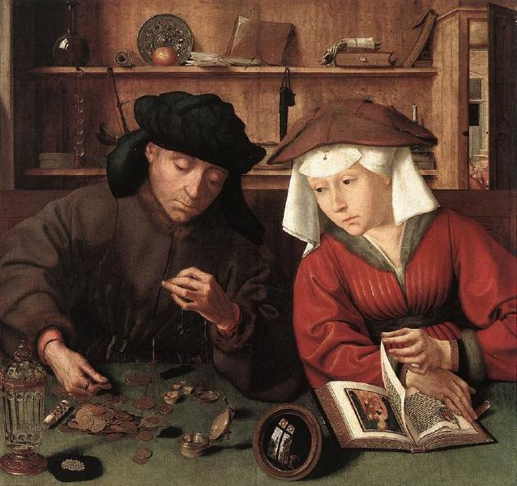
Massys’ The Moneylender & His Wife, 1514

Slide 19
France

Slide 20
Renaissance Art in France
A new phase of Italian influence in France began with the French invasions of the Italian peninsula that began in 1494.
The most important royal patron was Francis I.
Actively encouraged humanistic learning.
Invited da Vinci and Andrea del Sarto to France.
He collected paintings by the great Italian masters like Titian, Raphael, and Michelangelo.

Slide 21
Jean Clouet – Portrait of Francis I, 1525

Slide 22
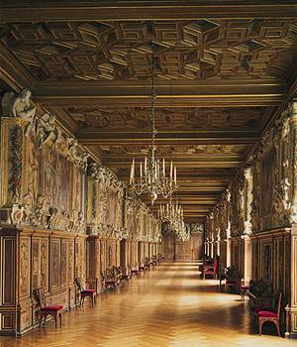
The School of Fontainebleau Artists
Gallery [right] by Rosso Fiorentino & Francesco Primaticcio
1528-1537

Slide 23
Germany

Slide 24
Lucas Cranach the Elder (1472-1553)
Court painter at Wittenberg from 1505-1553.
His best portraits were of Martin Luther (to the left).

Slide 25
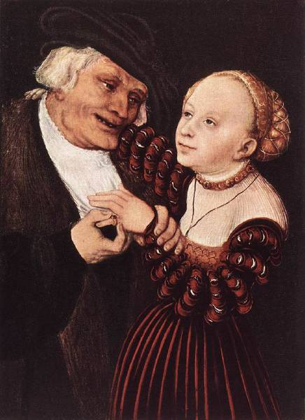
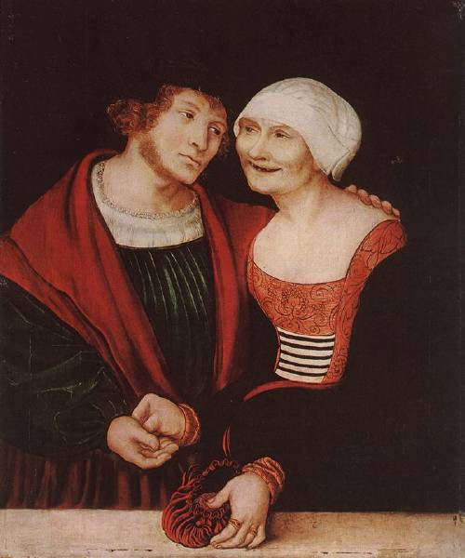
Lucas Cranach the Elder
Old Man with a Young Woman
Amorous Old Woman with a Young Man

Slide 26
Albrecht Dürer (1471-1528)
The greatest of German artists.
A scholar as well as an artist.
His patron was the Emperor Maximilian I.
Also a scientist
Wrote books on geometry, fortifications, and human proportions.
Self-conscious individualism of the Renaissance is seen in his portraits.
← Self-Portrait at 26, 1498.

Slide 27
Dürer – Self-Portrait in Fur-Collared Robe, 1500

Slide 28
Dürer The Last Supper woodcut, 1510

Slide 29
Dürer Four Horsemen of the Apocalypse woodcut, 1498

Slide 30
England

Slide 31
Hans Holbein, the Younger (1497-1543)
One of the great German artists who did most of his work in England.
While in Basel, he befriended Erasmus.
Erasmus Writing, 1523 →
Henry VIII was his patron
A great portraitist noted for:
Objectivity & detachment.
Doesn’t conceal the weaknesses of his subjects.

Slide 32
Holbein…Artist to the Tudors
Henry VIII (left), in 1540 and the future Edward VI (above), 1543.

Slide 33
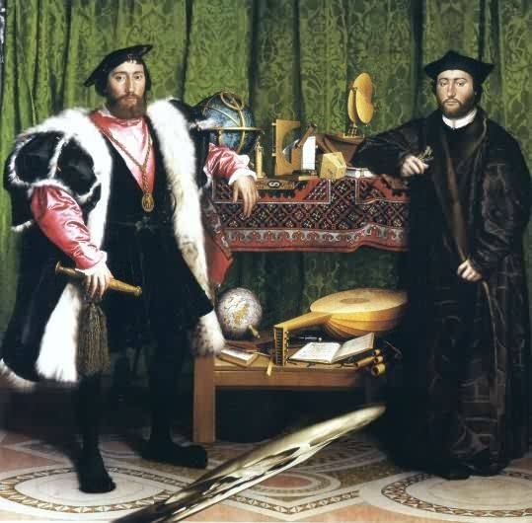
Holbein’s, The Ambassadors, 1533
A Skull

Slide 34
Multiple Perspectives

Slide 35
The English Were More Interested in Architecture than Painting
Hardwick Hall, designed by Robert Smythson in the 1590s, for the Duchess of Shrewsbury [more medieval in style].

Slide 36
Burghley House for William Cecil
The largest & grandest house of the early Elizabethan era.

Slide 37
The
Low
Countries

Slide 38
Hieronymus Bosch (1450-1516)
A pessimistic view of human nature.
Had a wild and lurid imagination.
Fanciful monsters & apparitions.
His figures are flat.
Perspective is ignored.
More a landscape painter than a portraitist.
Philip II of Spain was an admirer of his work.

Slide 39
Hieronymus Bosch The Garden of Earthy Delights 1500

Slide 40
Hieronymus Bosch The Garden of Earthy Delights (details) 1500

Slide 41
Hieronymus Bosch The Cure of Folly 1478-1480

Slide 42
Pieter Brueghel the Elder (1525-1569)
One of the greatest artistic geniuses of his age.
Worked in Antwerp and then moved to Brussels.
In touch with a circle of Erasmian humanists.
Was deeply concerned with human vice and follies.
A master of landscapes; not a portraitist.
People in his works often have round, blank, heavy faces.
They are expressionless, mindless, and sometimes malicious.
They are types, rather than individuals.
Their purpose is to convey a message.

Slide 43
Brueghel's, Tower of Babel, 1563

Slide 44
Breughel's, Mad Meg, 1562

Slide 45
Breughel's, The Beggars, 1568

Slide 46
Brueghel's, Parable of the Blind Leading the Blind, 1568

Slide 47
Breughel's, Niederlandisch Proverbs, 1559

Slide 48
Brueghel's, The Triumph of Death, 1562

Slide 49
Bruegel’s, Hunters in the Snow, 1565

Slide 50
Bruegel’s, Winter Scene, 1565

Slide 51
Spain

Slide 52
Domenikos Theotokopoulos (El Greco)
The most important Spanish artist of this period was Greek.
He deliberately distorts & elongates his figures, and seats them in a lurid, unearthly atmosphere.
He uses an agitated, flickering light.
He ignores the rules of perspective, and heightens the effect by areas of brilliant color.
His works were a fitting expression of the Spanish Counter-Reformation.

Slide 53
El Greco Christ in Agony on the Cross 1600s

Slide 54
El Greco Portrait of a Cardinal 1600

Slide 55
El Greco’s, The Burial of Count Orgaz, 1586-1588

Slide 56
El Greco’s, The Burial of Count Orgaz, 1586-1588 (details)

Slide 57
El Greco’s, The Burial of Count Orgaz,

Slide 58
El Greco The View of Toledo 1597-1599

Slide 59
Conclusions:
The artistic production of Northern Europe in the 16th century was vast, rich, and complex.
The Northern Renaissance ended with a Mannerist phase, which lasted a generation longer in the North than it did in Italy, where it was outmoded by 1600.

